Slide 1
A Diffusing Mechanism for Online Advertisements over Social Media
Yung-Ming Li Ya-Lin Shiu
Institute of Information Management
National Chiao Tung University, TAIWAN

Slide 2
Agenda
Background
System Architecture
Experimental Study
Conclusion

Slide 3
Background and Motivation (1/3)
Social media has been flourished and raised high popularity and attention
Online advertising revenue is growing year over year
A number of marketers have used social media to market their businesses
Notes:
Social media marketing
Micro-blogging information diffusion speed
Social advertising in social media
Facebook twitter social marketing
Find a high propagation nodes to implement social advertising.

Slide 4
Background and Motivation (2/3)
Approaches of Online advertising
 | Targeted advertising | Social advertising
Concept | Distribute appropriate advertisements to users | Distribute appropriate advertisements between users
Approaches | Content-based (Albadvi and Shahbazi,2009) Collaborative-based (Yang and Dia,2008) | Social network analysis (Li and Lien,2009)
Notes:
Social relations and influences are meaningful and important for selling products or services Wen et al.,2009

Slide 5
Background and Motivation (3/3)
Social relation and influence are important for selling products or services (Wen et al.,2009)
Social advertising has become an important advertising model
  Marketers should advertise between people and increase the resonance to keep the advertisement alive
  E.g. The Promoted Tweets emphasizes “resonance” - the interactions between users and advertisements
Notes:
Micro-blogging has emerged as a paradigm of information diffusion.
eMarketer reports that 90% of consumers rely on recommendations from people they trust. In the meantime,
IDG Amplify indicated that the efficiency of social advertising is greater than traditional advertising.

Slide 6
Research Problem and Objectives
Marketers
  How to choose the right people to deliver the information
  How to improve the efficiency and the resonances of advertisements
Users
  How to reduce the risk of excessive sharing
  How to avoid being a social spam
Approach
  Take the advantage of social media to design a diffusing mechanism to improve the efficiency and resonances, reduce the risk of social spam
Notes:
How to choose the right people to deliver the information, how to take the advantage of the social media, and how to design an ads diffusion mechanism to widen the spreading coverage are crucial issues in the online advertising campaign.
How could users select interesting and suitable social applications form tons of them?
How to help developers enhance social app’s visibility?

Slide 7
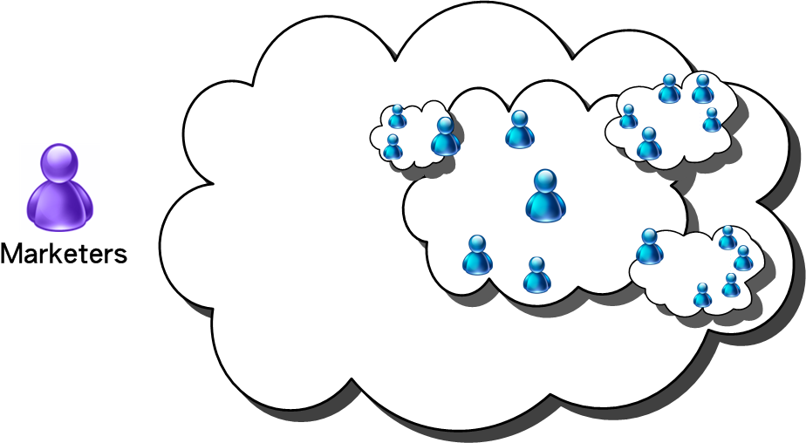


Social Diffusing Mechanism
Social Diffusing Mechanism
(2b) Endorser discovery engine sends a
recommended list of friends for each researched endorser.
(1) Endorser discovery engine identifies influential endorsers
(2) Deliver the relevant ads and recommended lists.
(2a) Social endorsers deliver the ads to their friends.

Slide 8
Influential Factors for Information Diffusion
8
Marketers can maximize the expected spreading result by measuring influential factors and realizing the process of information diffusion (Iribarren and Moro,2007)
Different users’ characteristics - preference, relation, and action, lead to various information infection probability (Xia et al.,2009)
We apply these factors to evaluate the diffusion capabilities of users in social media
Notes:
夏
不同的使用者特性會影響使用者的資訊接受
行銷者藉由了解這些資訊影響因子以及資訊遞過程可以最大化預期的傳播。
Diffusion 根據每個人的特性 因此對於資訊感興趣的程度不同 因此 藉由分析每個人特性可以diffusion的成效
我們的design來自於 combine information diffusion and network routing. Network routing
藉由提供
In this paper, we include static and dynamic factors dimensions to evaluate the propagation ability of nodes in social network.
8

Slide 9
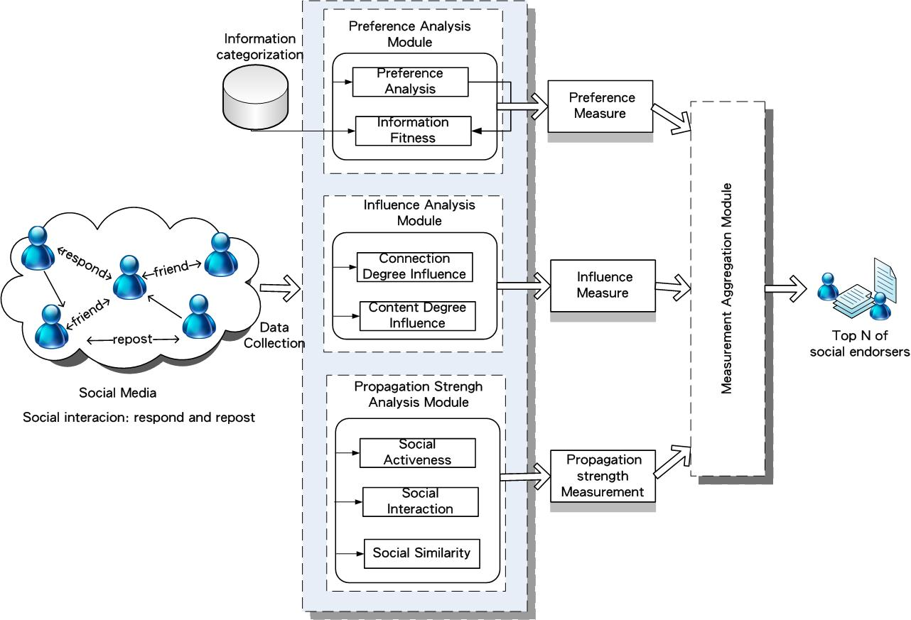
Social Endorsers Discovery Engine

Slide 10
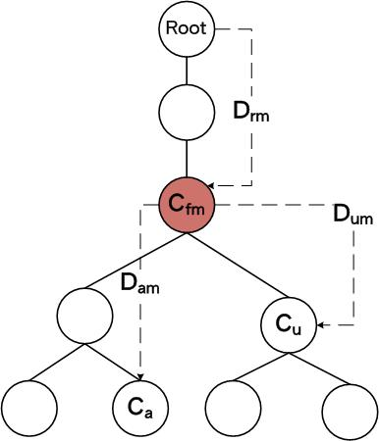
Preference Module
Preference tree (PT) establishment
  Based on category tree
Advertisement classification based on product category) (J. W. Kima et al, 2006)
Ads fitness estimation by computing the relevancy of the category of Ads and PT
Notes:
(Advertisement classification based on product category) describe a new personalized advertisement selection technique based on customer’s preference scores for product categories. They used category tree to define user preference and presented the preference tree algorithm to select personalized advertisements. Preference tree can reflect affinity levels among preference categories.
Product recommendation. (S.T. Yuan,2004)

Slide 11
Discovery Engine of Social Endorsers

Slide 12
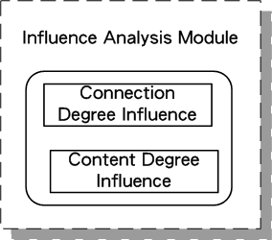
Influence Module
Connection Degree
  Evaluate the popularity of users
    E_{ij} is 1 if an edge from node i to j and from node j to i exists
Content Degree
  Evaluate the popularity of content
    as the total number the set of elements

Slide 13
Discovery Engine of Social Endorsers

Slide 14
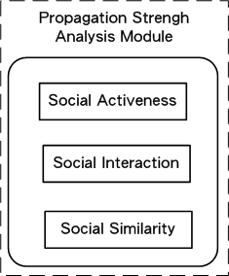
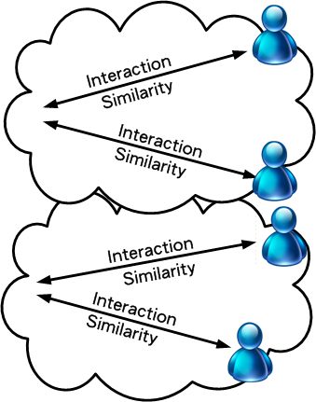
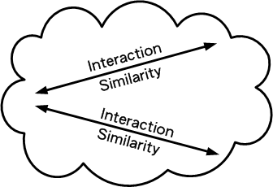



Propagation Strength Module
Social Propagation (Sp)

Slide 15
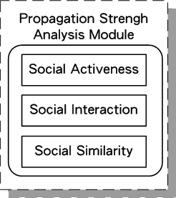


Propagation Strength Module (cont.)
Social activeness (Sa)
Social propagation (Sp)
  Social interaction (Si)
  Social Similarity (Ss)
User i
Friend j

Slide 16

Propagation Strength mModule (cont.)
Friend-in-common (Abraham and Rajesh,2008)
Content-in-common
F(i): Friend of i
N: # of posts
n_{i} : # of posts including term i
Notes:
higher connection
discover potential preference of users.

Slide 17
Discovery Engine of Social Endorsers

Slide 18
Measurement aggregation module
Common approaches deal with uncertain weighting problems (Kuo et al.,2002)
  Black box : Artificial neural network (ANN)
  White box: Analytic hierarchy process (AHP)
AHP is applied in many research fields.
  Social network analysis (Liebowitz,2005)
  Recommendation systems (Huang and Bian,2009)
We apply AHP to deal with uncertain weighting problems
Notes:
discover the practical weights for dealing with the u
ncertain weighting problem of parameter combination.
由於ANN模型的建立需要 training data, output and input

Slide 19
Experiments- Data Description
Platform: Plurk
  One of the most popular microblog services
  In Taiwan, the usage of Plurk is more than Twitter
Target users : 107 active users
  55% male, 45% female
  Aging between 20-50
Collect data to 3rd layers
  121,837 users
  971,014 plurks
Experiment time
  3 months

Slide 20
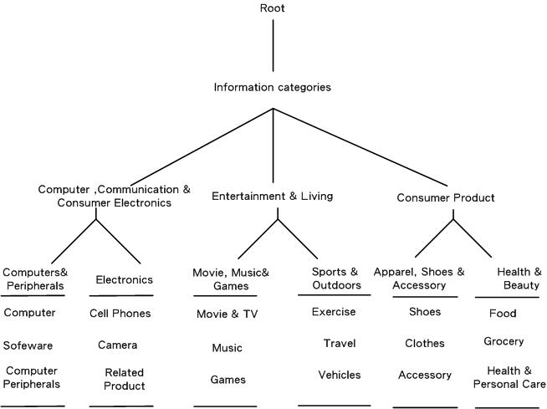
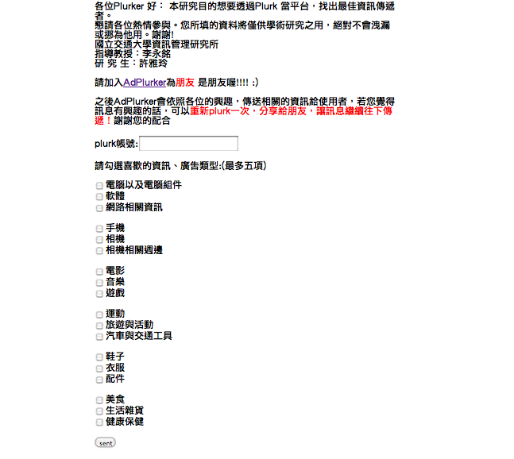


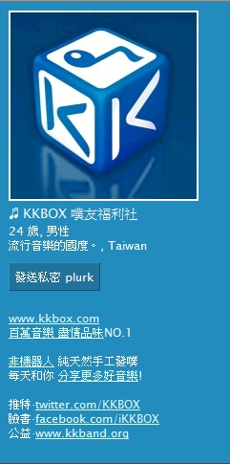
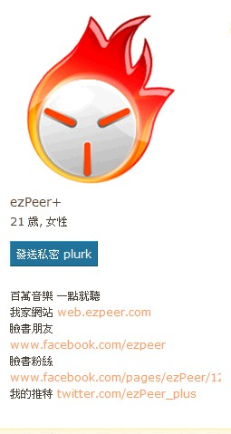
Preference Module Computing
Preference analysis module
  Establish category tree with Yahoo and PChome
  Explicit preferences by questionnaires
  Implicit preferences from the fan pages

Slide 21
Other Module Computing
Influence analysis module
  Friends/Content links
Propagation strength analysis module
  Social activeness during the recent one month
AHP measure aggregation
  Professional lecturers and active users in social media
Measure | Preference | Influence | Propagation strength
Weight | 0.340075768 | 0.325100803 | 0.33482343
1
3
2

Slide 22
Benchmark Selection
In-degree
  the number of fans or followers
  Twiiterholic.com and Wefollow.com
Ratio-degree
  The ratio between the number of a user’s followers and the number of other people that the user follow
  Proposed by Web Ecology Project
Topic-influence
  Consider preference and influence measures
  Without considering propagation strength
Social diffusion- our approach
18 categories * 3ads * 4 approaches= 216 different ads
Notes:
12*18=216Social diffusion
18 categories* 3 ads * 4 approaches = 216 different advertisements.

Slide 23
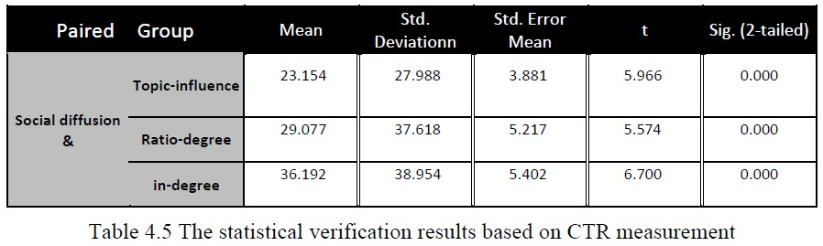
Results and Evaluations
Click-through Rate

Slide 24
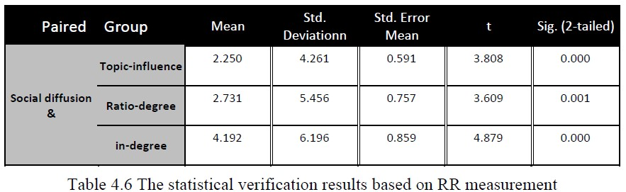
Results and Evaluations (cont.)
Repost Rate (RR)

Slide 25
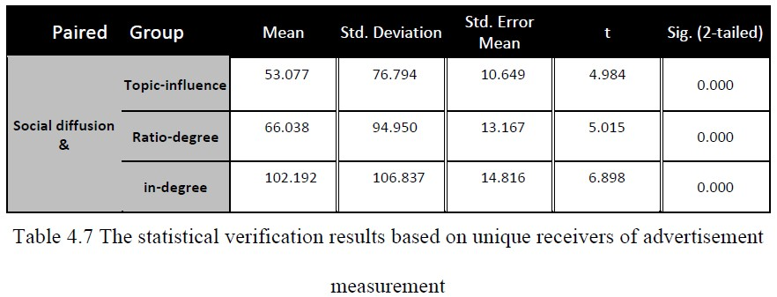
Results and Evaluations (cont.)
Exposure Rate (ER)

Slide 26
Conclusion
We propose one of the pioneering mechanism for diffusing online ads over social media
Our system significantly increases the CTR, repost rate , and exposure rate of online advertisements
The mechanism support users to effectively share the information and reduce the risk of social spam

Slide 27
Future works
Continuously improve the performance of the modules included in the endorser discovery engine.
  Generalization of the framework
  Include other important factors
Design a monitor/feedback mechanism to adjust the recommended list or variation of users’ preferences
Develop appropriate incentive mechanisms to induce higher diffusing effort
Interface design and service quality improvement

Slide 28
Thank you!

