Slide 1
Social Commerce Engineering
Yung-Ming Li Ph.D.
Professor, Institute of Information Management
National Chiao Tung University, Taiwan

Slide 2
Agenda
Social Commerce Background
Social Commerce Engines
Social Commerce Applications
Social Commerce Open Issues

Slide 3
Social Commerce Background

Slide 4

Social Commerce
E-Commerce
Social Computing
Social Commerce

Slide 5
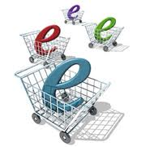

From E-Commerce to S-Commerce
E-Commerce
Efficiency
Improvement
Expedite the process of buying, selling, or exchanging products, services, or information via Internet

Slide 6

Shift
Social Media

Slide 7

From E-Commerce to S-Commerce
S-Commerce
Value
Creation
Create new business transactions through customer participation and social relations

Slide 8
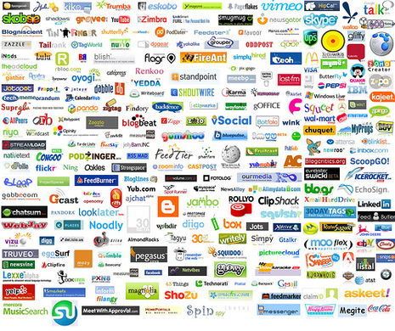
Social Media
Online service, platform, technological tools that allow users sharing and discuss information

Slide 9
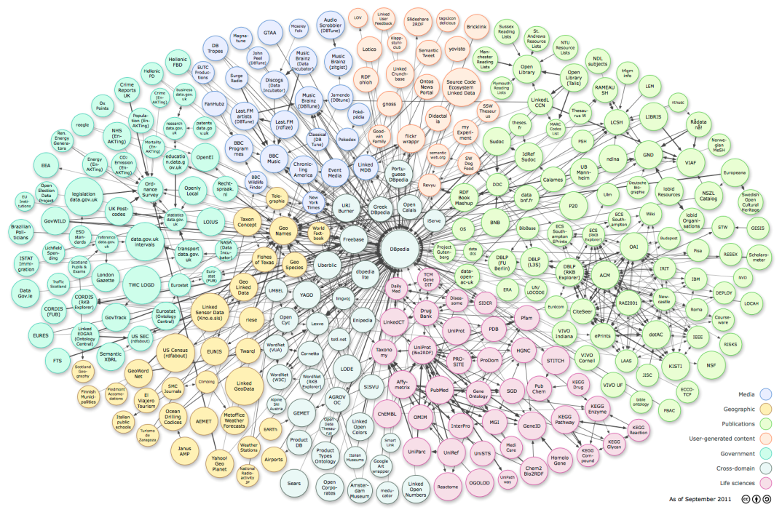
The Era of Big Data
Social Data
Machine Data
Transactional Data
Notes:
According to IBM, we create 2.5 quintillion bytes of data every day.
90% of the data we have has been created in the past two years and the amount of data is expected to increase exponentially.
This social computing sources come through interactive.

Slide 10
Social Computing: Life Cycle
Social Media
Big Data
Analyzing
(Discovering)
Social Elements & Dynamics
Designing
(Engineering)
Trust mechanism
Diffusion mech.
Decision mech.
Behavior
Click
Feedback
Link
PageRank
Relationship
Influence
Interaction
Similarity

Slide 11
Social Elements and Dynamics
Interactions
Relations/ ties
Homophily
Similarity
Influence
Information Cascade
Diffusion
The Elements of Social Dynamics

Slide 12
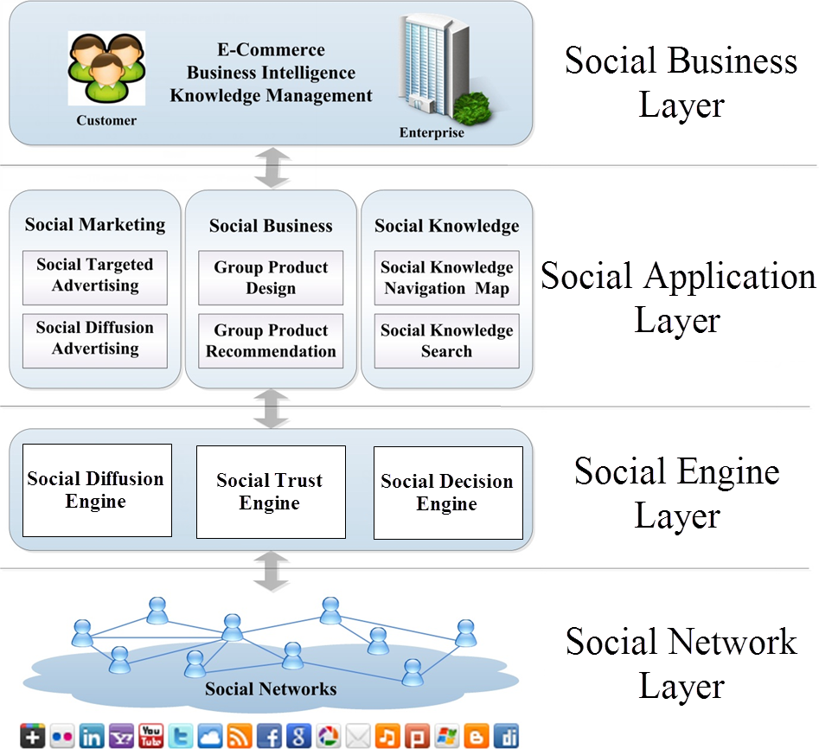
Social Commerce Engineering Architecture

Slide 13
Social Commerce Engines
Diffusion
Decision
Trust

Slide 14
Social Commerce Engine
Diffusion
Decision
Trust
Social Diffusion Engine
Used to disseminate the right information to the right users and spreading it widely
Social Decision Engine
Used to facilitate the integration of diverse views into a growing knowledge base
Social Trust Engine
Used to provides a basis dealing with uncertain, complex, and threatening images of the future

Slide 15
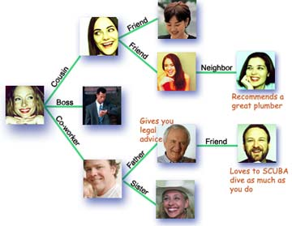
Social Diffusion Engine
Business Applications
  Information/Knowledge Sharing
  Innovation Propagation (new product, idea)
  Viral (Word-of-Mouth)
  Marketing/Advertising

Slide 16

Research Issues – endorser discovery
Social Diffusion Engine
Seed Endorser
Seed Endorser

Slide 17
Research Issues
Social Diffusion Engine
Maximizing the number of the ultimately influenced nodes and the expected lift in profit (value creation)
Minimizing the set size of the seed endorsers that can guarantee the complete diffusion coverage and the expected time to complete diffusion (cost reduction)

Slide 18
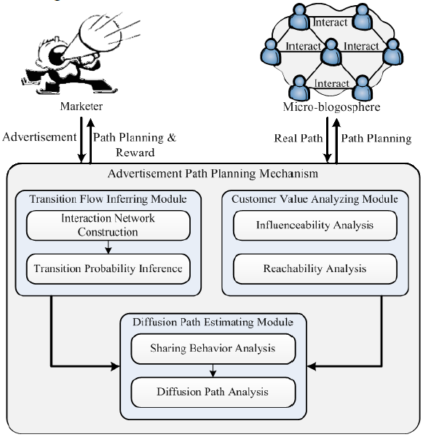
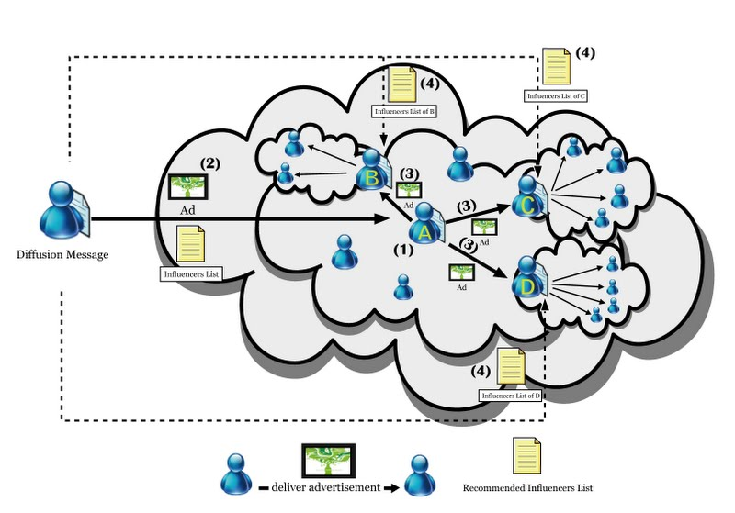
Diffusing Path Planning

Slide 19

Social Decision Engine
50% of 16-64 year olds users admit to using social media to assist with shopping decisions (IBM, 2011).
81% of consumers receive advice from friends (Gartner, 2012)

Slide 20
Social Decision Engine
Business Applications
  Wisdom of Crowd/Collective Intelligence
  Market Prediction
  Product Creation
  Social Recommendation/Appraisal

Slide 21
Social Decision Engine
Social Decision Process
Social decision group recruiting: finding important and influential decision supporters from social networks
Alternatives proposing & ranking: resolving conflicts and ranking alternatives by inducing consensus

Slide 22
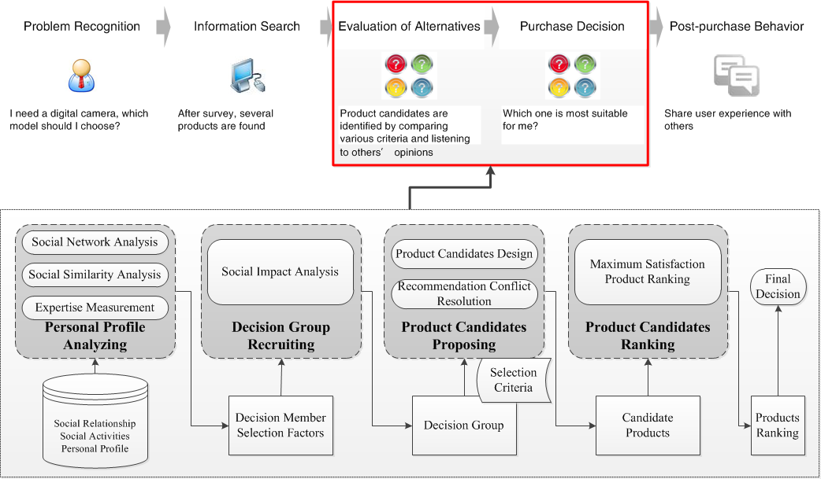
Social Decision Engine
Social Decision Process

Slide 23
Social Trust Engine
Internet involves more uncertainty and risk
Social trust engine can
  Mitigate Risks
  Reduce Uncertainties
  Conveying Cooperation
  Improve Service discovery

Slide 24
Social Trust Engine
Business Applications
  Information quality assessment (request and provision)
  Computing resource reliability assessment
  Buyer/seller credibility assessment

Slide 25
Social Trust Engine
Social Trust Process
Similarity belief
Familiarity
Target Selection
Reputation
(trust score)
Importance
Past experience
Business situation,
Strategic valuations
Direct trust
  Propagation
Witness reputation
Risk
Tolerance
comparison
Neighborhood reputation
Aggregation
System reputation
Indirect trust
Trust inference
trust decision
Trust formation
(trust discovery)
Trust computation
(trust calculator)
Trust evaluation
(trust credibility)

Slide 26
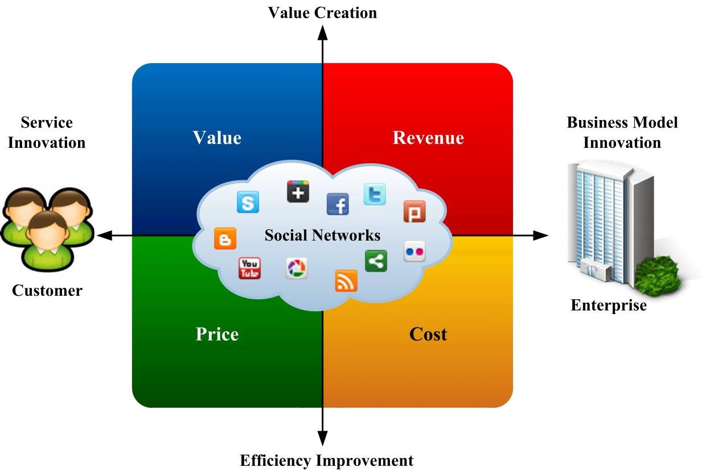
Social Commerce Applications

Slide 27
Social Commerce Applications
Social Marketing
and Advertising
Market Intelligence and Product Creation
Social Recommendation
and Appraisal
Social Context
Application
Advertising Strategy
Social advertising
Target advertising
Production Strategy
Market trend monitoring
Product creation
Purchasing Strategy
Recommendation
Appraisal
SoLoMo Commerce
Store Shopping
Advertising
Crowd Marketing

Slide 28
Social Marketing and Advertising
How to cost down (disturbance avoiding) advertising?
  How to value up (loveliness increasing) advertising?
Target advertising mechanism
Social advertising mechanism
Notes:
How to value up advertising?
How to cost saving advertising?

Slide 29
Social Marketing and Advertising
Social Context Enhanced Ads
Problem of banner advertising
  CTR of Facebook ads (Webtrends, 2011)
    2009: 0.063%, 2010: 0.051% (significantly lower than Google ads)
Solution: Enhance the adornment of Ads by adding social context

Slide 30

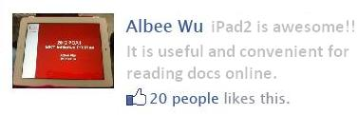
Social Marketing and Advertising
Social Context Enhanced Ads
Discover and leverage the social context from the social sharing behavior to amplify the effect of advertising
Official product info
Social context info

Slide 31
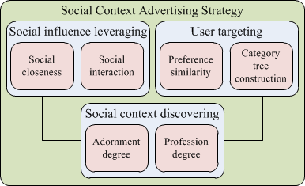
Close to user evaluation means it can more reflect the reality

Slide 32
Social Marketing and Advertising
Social Endorser Advertising
Target-reaching social advertising strategy focuses on
(1) identifying the right receivers of the ads
(2) discovering the influencers of the receivers to deliver the ads

Slide 33
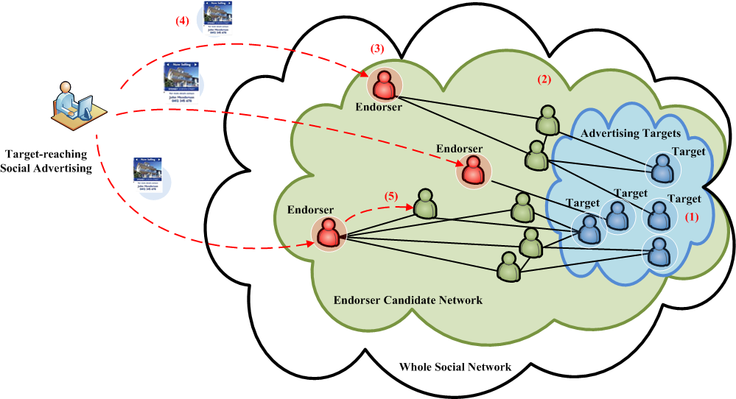
Social Marketing and Advertising
Target-Reaching Social Advertising Strategy

Slide 34
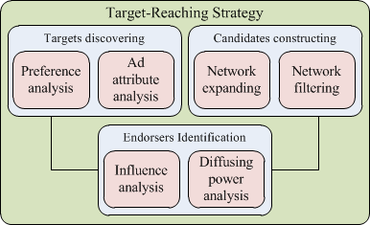
Close to user evaluation means it can more reflect the reality

Slide 35
Market Intelligence and Product Creation
What do people talk about brands on social media ?
How to design products satisfying user expectation ?
Market trends monitoring mechanism
New products creating mechanism

Slide 36
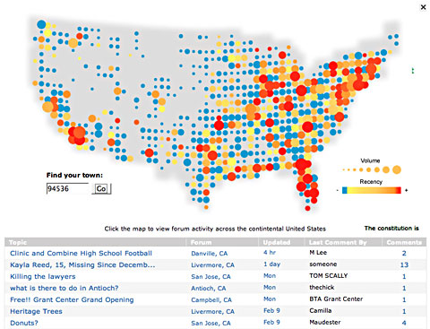
Market Intelligence and Product Creation
Monitoring Market Trends
Word-of-mouth could make business better or worse rapidly
We can identifying opportunities and threats of the market from social media
How to numerically summarize opinions?

Slide 37
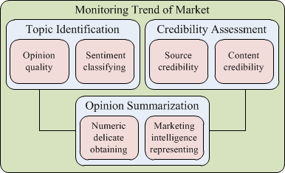
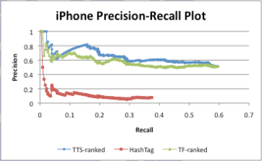
Market trends monitoring

Slide 38
Market Intelligence and Product Creation
Product Creation via Market Intelligence
Enterprises might construct focus group and organize feedback within the company to understand customer needs
Social media make businesses get closer to customers and directly know their perceptions of products

Slide 39
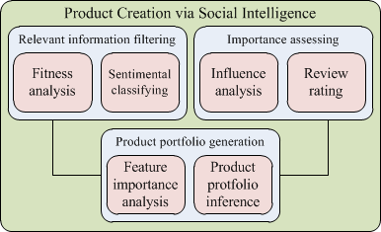
Product Creation via Market Intelligence
Category | Range
Screen Size | 3.7 ~ 4.3 inches
Processor | 1 ~1.2 Ghz
Camera | 5 ~ 8 megapixels
Build-in Memory | 512 MB ~1GB
Battery | 6 ~ 8 hours
Users’ opinions on product portfolio can more reflect the reality

Slide 40
Social Recommendation and Appraisal
How to increase the willingness-to-buy of online shopper?
How to support customer to make purchasing decision via social networking of friends?
Social recommendation mechanism
Social appraisal mechanism
Notes:
How to value up advertising?
How to cost saving advertising?

Slide 41
Social Recommendation and Appraisal
Group-Coupon Recommendation
Group-coupons: Products are sold using the form of ticket package which needs a suitable (minimum) number of consumer companions.
Practical and Research Issues
  How to develop personalized and value-added services for the group-coupon customers?
  How to utilize the power of social influence to increase the revenue of group-coupon platform?

Slide 42
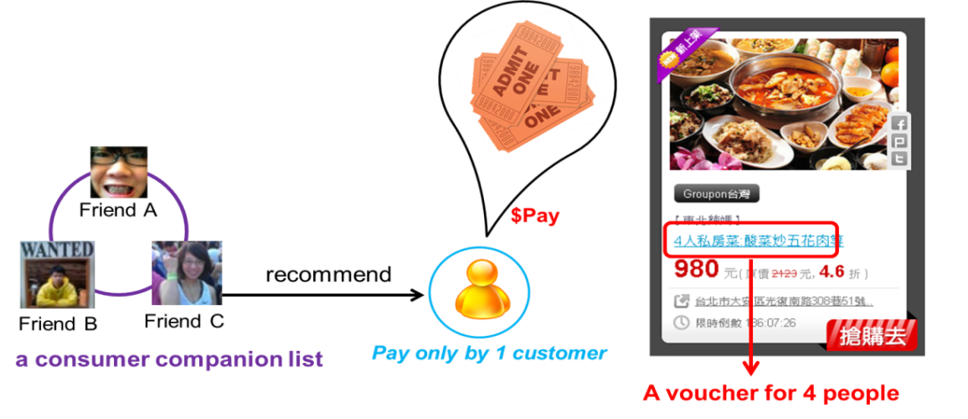
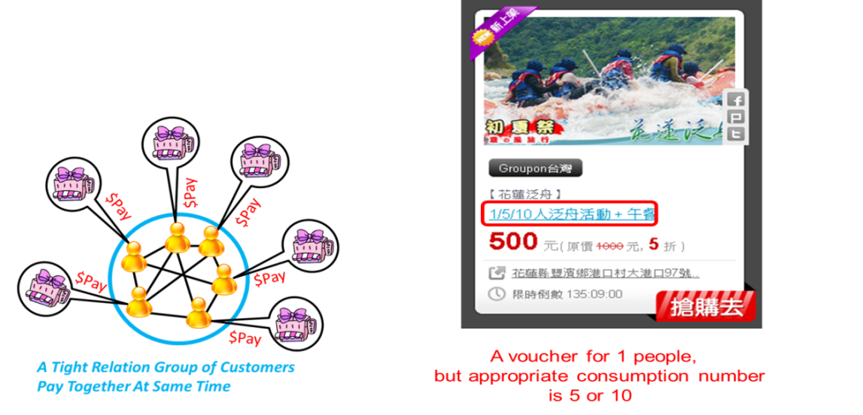
Social Recommendation and Appraisal
Group-Coupon Recommendation
The types of group coupons to promote
Package coupon
Group-formed coupon

Slide 43
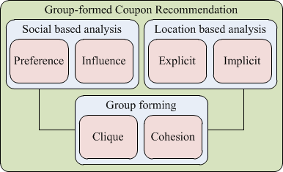
Group-Coupon Recommendation

Slide 44
Social Recommendation and Appraisal
Social Appraisal for Purchase Decision
People usually ask for some others’ support for decision making
Soliciting friends’ suggestions is time consuming

Slide 45
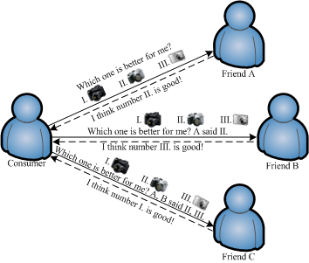
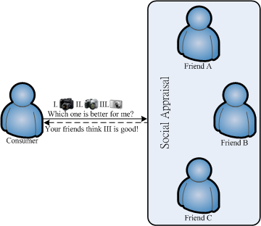
Social Recommendation and Appraisal
Social Appraisal for Purchase Decision
A social network could be seen as a large group of experts supporting decisions of consumers
Traditional Way
Social Appraisal

Slide 46
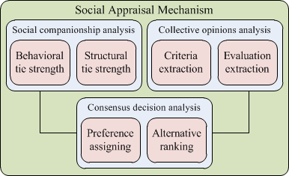

Slide 47
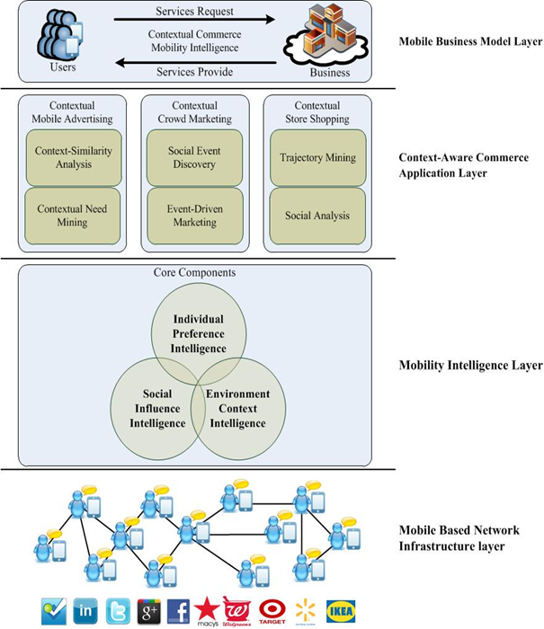
Contextual Commerce Architecture
Social Contextual commerce

Slide 48
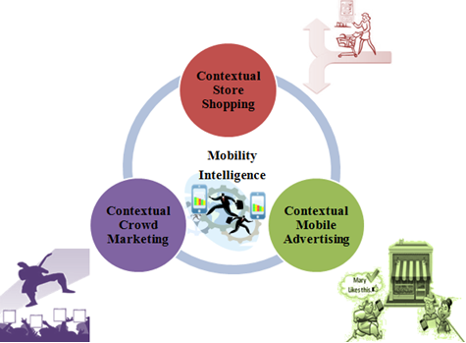
Contextual Commerce Applications
Social Contextual commerce

Slide 49
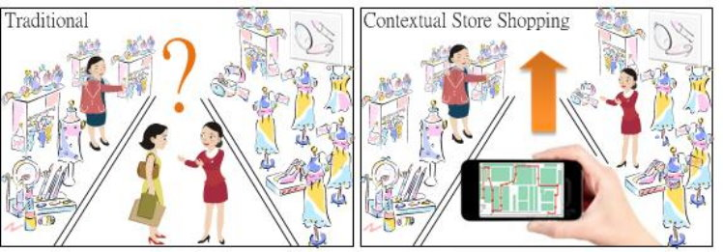
Social Contextual commerce
Contextual Store Shopping Mechanism
  Help customers get the better shopping experience with the shopping support tool .

Slide 50
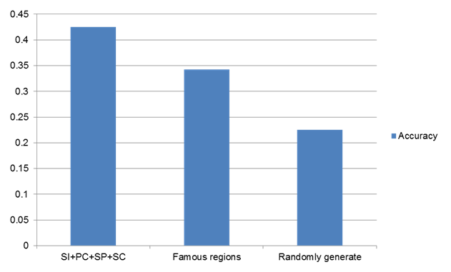
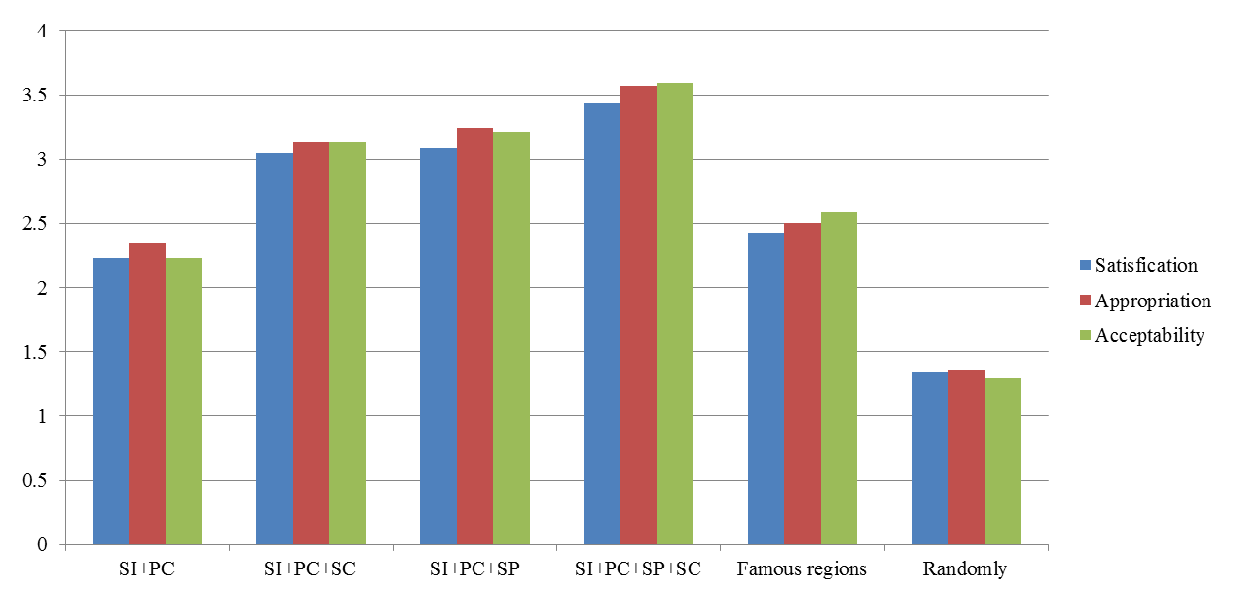
Recommendation Performance
Customer’s Rating

Slide 51
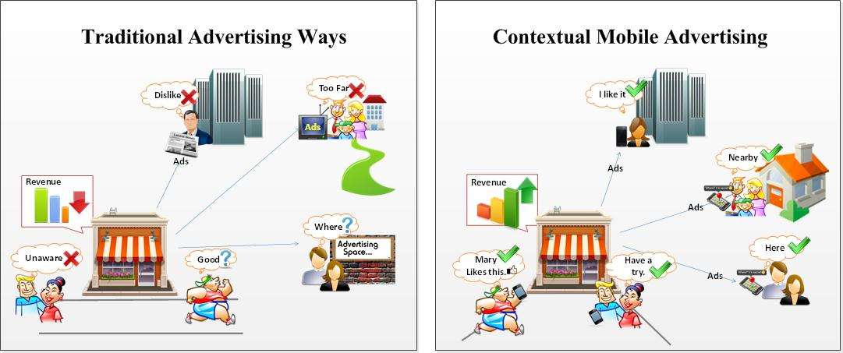
Social Contextual commerce
Contextual Mobile Adverting
  Promote products on mobile device with an intellective and persuasive way.

Slide 52
Have a better performance in predicting users’ basic need.
Close to user evaluation means it can more reflect the reality

Slide 53
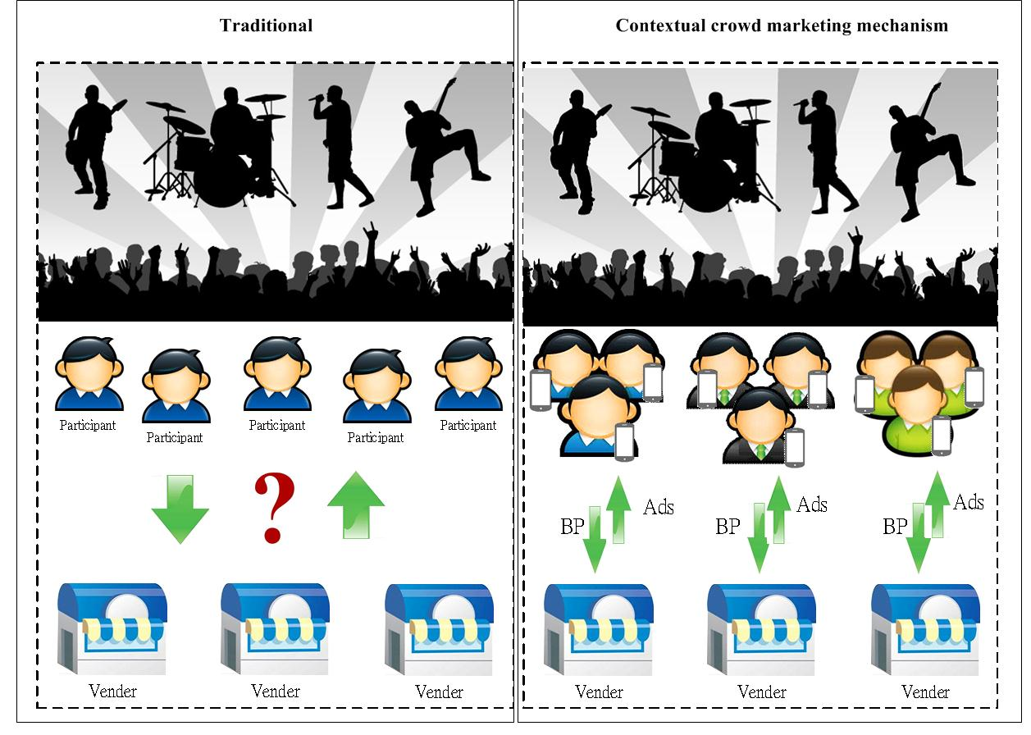
Social Contextual commerce
Contextual Crowd Marketing
  Maximize the participants and the economic value of a social event

Slide 54
Recommendation Performance
Close to user evaluation means it can more reflect the reality

Slide 55
Social Commerce: Conclusion and Open Issues

Slide 56
Open issues and Extended Studies
Social media
  Consolidate big data of
  social interactions
Social Engines
  Efficiency-improved
  computing algorithm
Social Applications
  Value-created service
  innovation
Social Business Models
  Monetizing and pricing
  scheme (game theory)

Slide 57
資管精神: 眼高手黑

Slide 58
資管方法: 歸納x演繹
(資料實證與工程設計)

Slide 59
資管範疇: 微觀x宏觀
http://iebi.nctu.edu.tw/AutomobileTheory.pdf

Slide 60
資管實務: 改變 Change
服務創新x價值創造

Slide 61
資管趨勢:
Social x Mobile x Cloud

Slide 62
IS Current Trends
value
Finance
investment
Contribution (Web 2.0)
Relations (Social networks)
Social resource
Marketing
Pricing
Operations
Social Computing
Scheduling
Service
Mobile Computing
Cloud computing
Applications
Technology
Personalization
Location
Instant
Computing Resource
Economic
De-location
skill

Slide 63
資管職涯: Engineer x Manager
(IT-solutions x Strategy-insights)

