Slide 1

Management Information Systems: Managing the Digital Firm
Seventeenth Edition, Global Edition
Chapter 3
Information Systems, Organizations, and Strategy
Copyright © 2022, 2020, 2018 Pearson Education, Ltd. All Rights Reserved
Notes:
If this PowerPoint presentation contains mathematical equations, you may need to check that your computer has the following installed:
1) MathType Plugin
2) Math Player (free versions available)
3) NVDA Reader (free versions available)

Slide 2
Learning Objectives
3.1 Which features of organizations do managers need to know about to build and use information systems successfully?
3.2 What is the impact of information systems on organizations?
3.3 How do Porter’s competitive forces model, the value chain model, synergies, core competencies, and network economics help companies develop competitive strategies using information systems?
3.4 What are the challenges posed by strategic information systems, and how should they be addressed?
3.5 How will MIS help my career?
Notes:
You could ask students to recall some concepts from the previous chapters that might help managers build and use information systems successfully. Answers could include what business processes the company performs, the size of the company, or the organization of the information systems function.

Slide 3
Video Cases
Case 1: GE Becomes a Digital Firm: The Emerging Industrial Internet
Case 2: National Basketball Association: Competing on Global Delivery with Akamai O S Streaming

Slide 4
N26: A Bank Without Branches
Problem
  Improving operational efficiency
  Improve customer experience
Solutions
  Online customer-centric processes
  Improved cash-based operations
  Security systems
Illustrates use of IT to differentiate services and improve customer experience

Slide 5
The Relationship Between Organizations and Information Technology
Information technology and organizations influence each other
  Relationship influenced by organization’s
    Structure
    Business processes
    Politics
    Culture
    Environment
    Management decisions
Notes:
This concept was briefly discussed in Chapter 1. Figures 1.2 and 1.3 as well as the figure on the next slide, 3.1, display this interdependent relationship graphically.

Slide 6
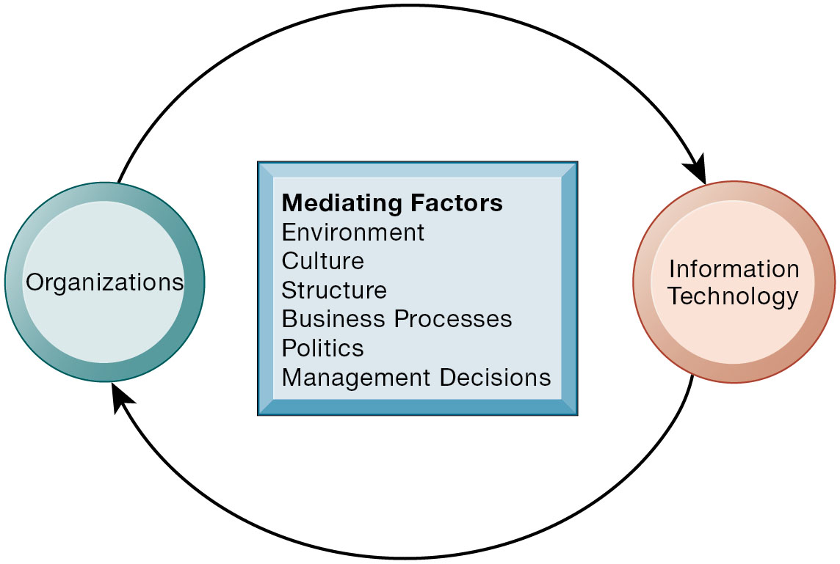
Figure 3.1 The Two-Way Relationship Between Organizations and Information Technology
Notes:
Figure 3.1, Page 80.
This complex two-way relationship is mediated by many factors, not the least of which are the decisions made—or not made—by managers. Other factors mediating the relationship include the organizational culture, structure, politics, business processes, and environment.
Ask students to explain how each factor might affect the relationship between organizations and information technology. Emphasize to students that the relationship between these two and its effects on the future of a business are difficult to predict. For example, very few people could have predicted the prominence of e-mail, texting, or social media in business communication 15 years ago.
Alt Text
Long description: A flow diagram explains the mediating factors and shows the interconnectedness between organizations and information technology. In the diagram, the organizations and information technology are connected via a two-way arrow. The mediating factors shown between them include:
Environment
Culture
Structure
Business Processes
Politics
Management Decisions

Slide 7
What Is an Organization?
Technical definition
  Formal social structure that processes resources from environment to produce outputs
  A formal legal entity with internal rules and procedures, as well as a social structure
Behavioral definition
  A collection of rights, privileges, obligations, and responsibilities that is delicately balanced over a period of time through conflict and conflict resolution
Notes:
Which of the two definitions do students find more accurate and why? It is important to consider both definitions rather than exclusively use one at the expense of the other. The two definitions are complementary.

Slide 8
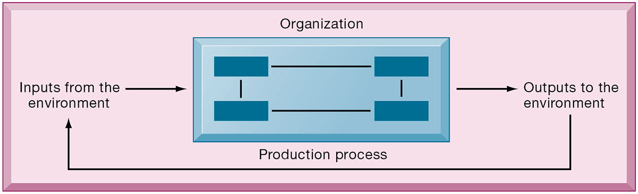
Figure 3.2 The Technical Microeconomic Definition of the Organization
Notes:
Figure 3.2, Page 80.
In the microeconomic definition of organizations, capital and labor (the primary production factors provided by the environment) are transformed by the firm through the production process into products and services (outputs to the environment). The products and services are consumed by the environment, which supplies additional capital and labor as inputs in the feedback loop.
Ask students what are the inputs from the environment. What do organizations output (goods and services)? In this view, the organization or business firm is rather easily changed, and malleable. The organization is a collection of parts, like a machine, that can be rearranged as needed. There are no humans in this model, or if there are, they are assumed to be relatively simple.

Slide 9
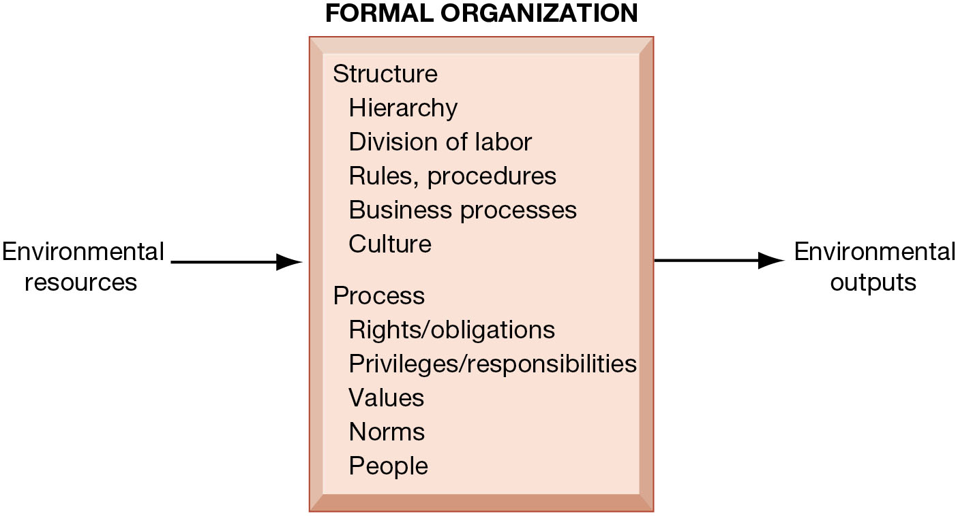
Figure 3.3 The Behavioral View of Organizations
Notes:
Figure 3.3, Page 81.
The behavioral view of organizations emphasizes group relationships, values, and structures.
In this view, the business firm is a little more difficult to change rapidly or on-command because it is a very complex machine populated with human beings. Firms operate with an existing hierarchy, job definitions, business rules, legal contracts, procedures, and processes. Efficient organizations become very good at these elements of business. Changing these elements takes more time.
Alt Text
Long description: A diagram explains the behavioral view of organizations, which focuses on structure and process. The sequence is as follows: Environmental resources, formal organization, and environmental outputs. Under the formal organization are structure and process.
Structure includes the following elements:
Hierarchy
Division of labor
Rules, procedures
Business processes
Culture.
Process includes the following:
Rights and obligations
Privileges and responsibilities
Values
Norms
People.

Slide 10
Features of Organizations
Use of hierarchical structure
Accountability, authority in system of impartial decision making
Adherence to principle of efficiency
Routines and business processes
Organizational politics, culture, environments, and structures
Notes:
You could ask students to envision what would happen to an organization that did not use a hierarchical structure (would anything get done?), did not adhere to the principle of efficiency (would they provide any good or service worth using at an affordable price?), and so on.

Slide 11
Routines and Business Processes
Routines (standard operating procedures)
  Precise rules, procedures, and practices developed to cope with virtually all expected situations
Business processes: Collections of routines
Business firm: Collection of business processes
Notes:
You could ask students to describe examples of situations where a business they have interacted with has had a well-understood set of routines. One such example is at the doctor’s office, where the receptionist, nurses, and doctors all have a defined set of routines. Ask students to think about and describe routines they performed on their jobs.

Slide 12
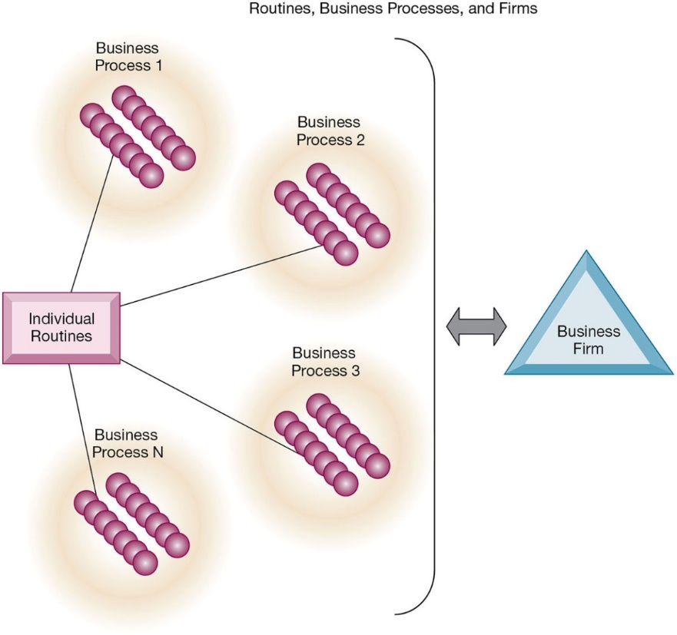
Figure 3.4 Routines, Business Processes, and Firms
Notes:
Figure 3.4, Page 83.
All organizations are composed of individual routines and behaviors, a collection of which make up a business process. A collection of business processes make up the business firm. New information system applications require that individual routines and business processes change to achieve high levels of organizational performance.
Explain to students that the spheres are individual routines, which together constitute a business process. A firm can be seen as a collection of these processes.

Slide 13
Organizational Politics
Divergent viewpoints lead to political struggle, competition, and conflict
Political resistance greatly hampers organizational change
Notes:
You could ask students to describe examples where organizational politics might hamper a firm’s ability to succeed, or examples where effectively managed organizational politics helps a company to undergo a smoother transition or make more intelligent decisions. Ask students to describe their personal experiences with “organizational politics.”

Slide 14
Organizational Culture
Encompasses set of assumptions that define goal and product
  What products the organization should produce
  How and where it should be produced
  For whom the products should be produced
May be powerful unifying force as well as restraint on change
Notes:
Culture may seem like a pretty abstract idea to many students. On the other hand, students with work experiences will easily be able to describe the cultures of firms where they have worked. Ask students to describe organizational cultures they have experienced while on the job, or other areas of their lives. What kind of organizational culture do students prefer and why? Ask students to describe different kinds of cultures and what types of firms are more likely to have them.

Slide 15
Organizational Environments
Organizations and environments have a reciprocal relationship
Organizations are open to, and dependent on, the social and physical environment
Organizations can influence their environments
Environments generally change faster than organizations
Information systems can be instrument of environmental scanning, act as a lens
Notes:
Explain that environmental scanning involves searching for and determining external changes that may require an organizational response. The current economic climate represents an example of external change that requires sweeping organizational responses to ensure survival.

Slide 16
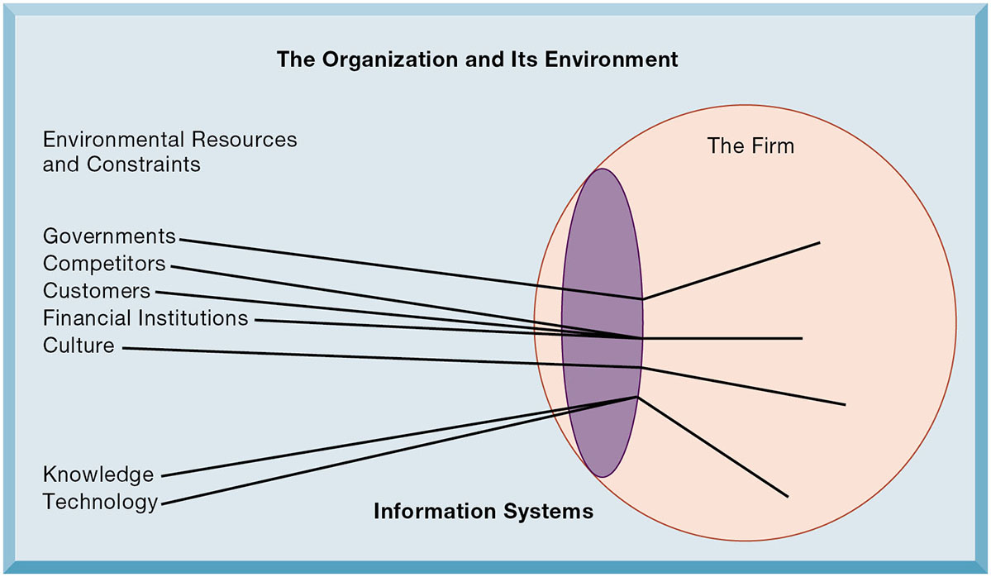
Figure 3.5 Environments and Organizations Have a Reciprocal Relationship
Notes:
Figure 3.5, Page 84.
Environments shape what organizations can do, but organizations can influence their environments and decide to change environments altogether. Information technology plays a critical role in helping organizations perceive environmental change and in helping organizations act on their environment.
This graphic further establishes information systems as the “lens” of the firm, observing external factors and filtering information back into the firm. To some extent, organizations “see” only what their systems will let them see. If systems are poorly built, they may blind managers to difficulties and problems.
Alt Text
Long description: A refractive image of an eye illustrates the role of information systems in aiding an organization to perceive changes in the environment. The diagram depicts an elliptical opening at the left side of a circle, which gives an impression of an eye. The circle is labeled: The firm. Various lines representing the elements of environmental resources and constraints are seen entering the circle through the elliptical lens.
Few of the elements are sloping toward the circumference of the circle.
Governments is sloping upward.
Competitors and customers seem to be in the center.
Financial institutions appear straight.
Culture is sloping downward.
Knowledge and technology are sloping downward.

Slide 17
Disruptive Technologies
Substitute products that perform as well as or better than existing product
Technology that brings sweeping change to businesses, industries, markets
Examples: personal computers, smartphones, Big Data, artificial intelligence, the Internet
First movers and fast followers
  First movers—inventors of disruptive technologies
  Fast followers—firms with the size and resources to capitalize on that technology
Notes:
Ask students if they can give examples of any first movers that invented a disruptive technology yet failed to last (examples might include the MITS Altair personal computer, the Netscape Navigator Internet browser, etc.).

Slide 18
Organizational Structure
Five basic kinds of organizational structure (Mintzberg)
  Entrepreneurial
  Machine bureaucracy
  Divisionalized bureaucracy
  Professional bureaucracy
  Adhocracy
Information system often reflects organizational structure
Notes:
Do students agree with the classification of these types of organizational structure? Can they come up with examples for each type of organization?

Slide 19
Other Organizational Features
Goals
  Coercive, utilitarian, normative, and so on
Constituencies
Leadership styles
Types of tasks
Different environments
Notes:
Ask students to give some examples of each organizational feature listed above. For example, different organizations (prisons, businesses, colleges) have different types of goals (coercive, utilitarian, normative, respectively).

Slide 20
Economic Impacts
I T changes relative costs of capital and the costs of information
Information systems technology is a factor of production, like capital and labor
I T affects the cost and quality of information and changes economics of information
  Information technology helps firms contract in size because it can reduce transaction costs (the cost of participating in markets)
    Outsourcing
Notes:
IT figures to replace the function of more middle managers as time passes, as well as reduce the need for other forms of capital (buildings, machinery). Ensure that students understand what is meant by “economics of information” and why outsourcing is a possibility due to IT.

Slide 21
Transaction Cost Theory
Firms seek to economize on transaction costs (the costs of participating in markets)
  Vertical integration, hiring more employees, buying suppliers and distributors
I T lowers market transaction costs, making it worthwhile for firms to transact with other firms rather than grow the number of employees
Notes:
Explain that using the market can be expensive. If you depend on the market, rather than hiring employees, you will need to search for talent, research the quality of providers and workers, write contracts for work to be performed, monitor the work, and so forth. When participation in markets is expensive, firms would rather hire employees to accomplish their work. But the Internet makes it less expensive to use the marketplace. With the Internet, firms find it more cost effective to use the marketplace and contract for work in a market, rather than hire employees. Ask your students why the Internet can make participating in markets less expensive than before.

Slide 22
Agency Theory
Firm is nexus of contracts among self-interested parties requiring supervision
Firms experience agency costs (the cost of managing and supervising) which rise as firm grows
I T can reduce agency costs, making it possible for firms to grow without adding to the costs of supervising, and without adding employees
Notes:
By characterizing employees as independent agents requiring constant supervision, agency theory underscores a key reason that costs increase as firms grow in size and scope—the need to expend more effort managing their employees.

Slide 23
Organizational and Behavioral Impacts
I T flattens organizations
  Decision making is pushed to lower levels
  Fewer managers are needed (I T enables faster decision making and increases span of control)
Postindustrial organizations
  Organizations flatten because in postindustrial societies, authority increasingly relies on knowledge and competence rather than formal positions
Notes:
Ask students to explain what is meant by authority relying on knowledge and competence rather than formal positions. Why might this “flatten” the organization? The idea here is that with sufficient IT, competent workers will be able to accomplish more on their own than they would under a more hierarchical arrangement.

Slide 24
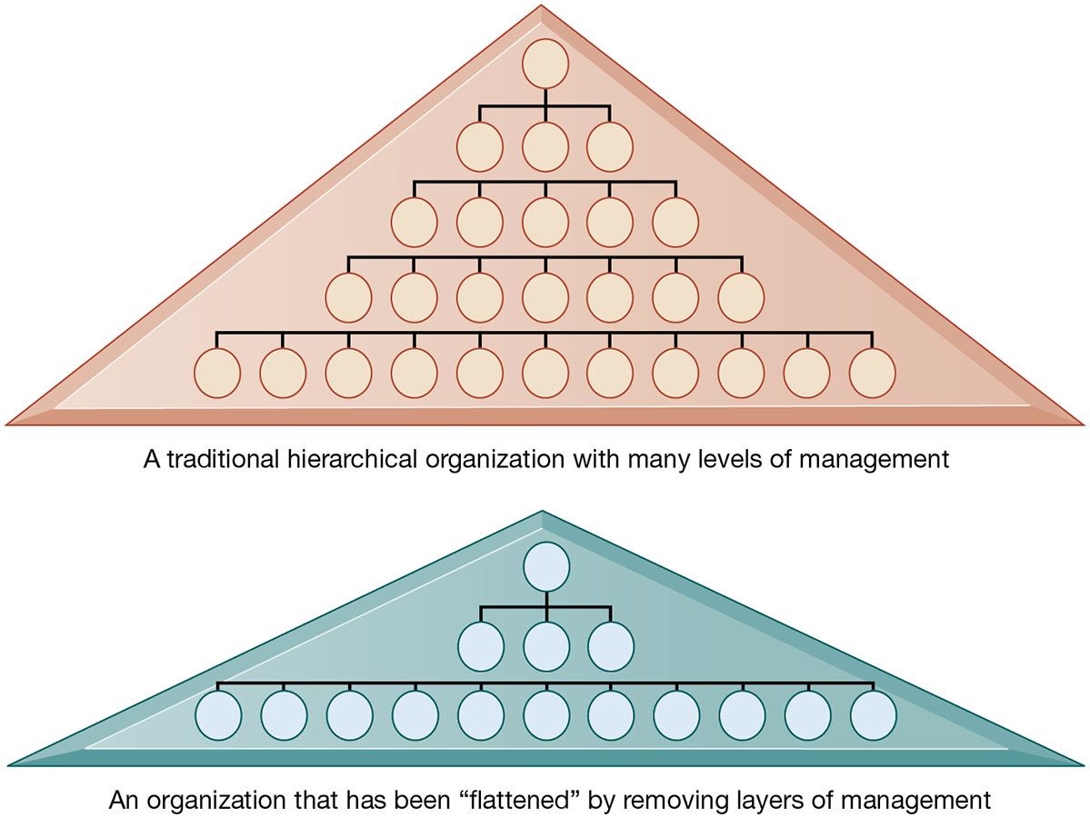
Figure 3.6 Flattening Organizations
Notes:
Figure 3.6, Page 88.
Information systems can reduce the number of levels in an organization by providing managers with information to supervise larger numbers of workers and by giving lower-level employees more decision-making authority.
Ask students to explain some of the benefits of the flattened organization as opposed to the more complicated hierarchy in the top of the diagram. Information travels through fewer levels to its intended recipients; there are fewer managers, so agency costs are smaller, and firms can act faster (less decision delay).
Alt Text
Long description: Two organizational charts compare the role of information systems. Details are as follows:
The first chart has five levels and the text below reads: A traditional hierarchical organization with many levels of management.
The second chart has only three levels and the text below reads: An organization that has been “flattened” by removing layers of management.

Slide 25
Understanding Organizational Resistance to Change
Information systems become bound up in organizational politics because they influence access to a key resource—information
Information systems potentially change an organization’s structure, culture, politics, and work
Four factors
  Nature of the innovation
  Structure of organization
  Culture of organization
  Tasks affected by innovation
Notes:
Explain what is meant by changes in culture and politics of the firm. For example, workers may resist changes that disrupt their routines. Also explain to students that as important as technical understanding of information systems may be for potential managers, it is equally important to understand the people and organizational structures and customs affected by information systems.

Slide 26
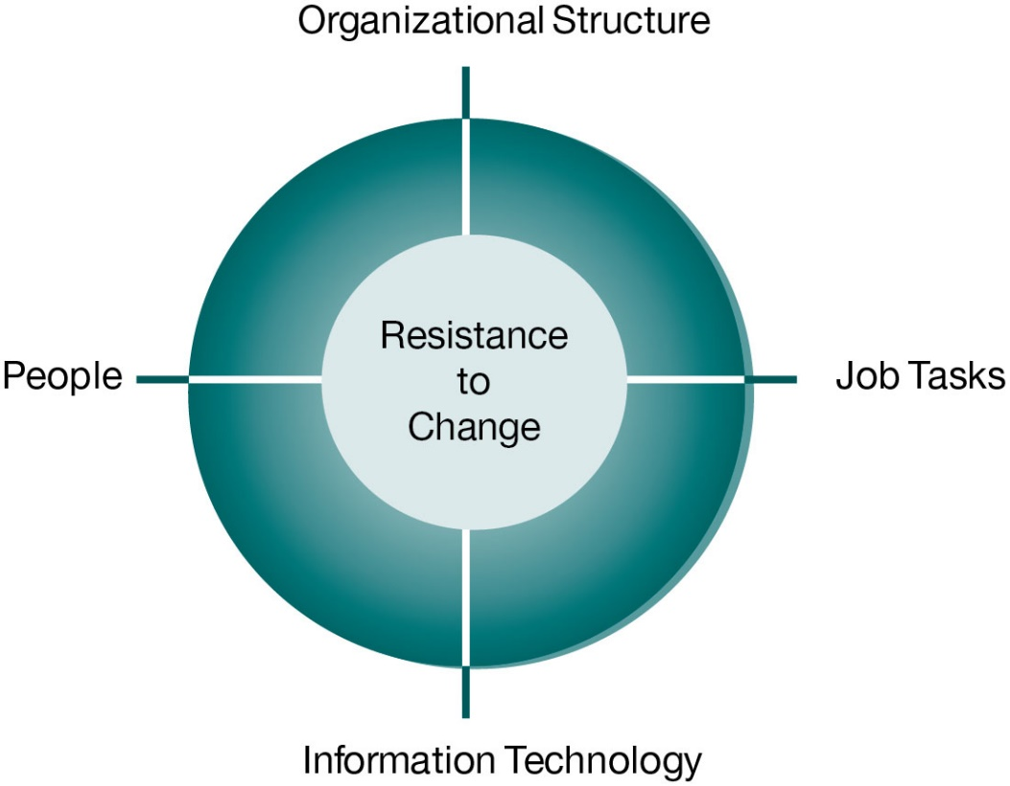
Figure 3.7 Organizational Resistance to Information System Innovations
Notes:
Figure 3.7, Page 90.
Implementing information systems has consequences for task arrangements, structures, and people. According to this model, to implement change, all four components must be changed simultaneously.
The circle shape in the figure represents the mutual relationship among the concepts shown.

Slide 27
The Internet and Organizations
The Internet increases the accessibility, storage, and distribution of information and knowledge for organizations
The Internet can greatly lower transaction and agency costs
  Example: Large firm delivers internal manuals to employees via a corporate website, saving millions of dollars in distribution costs
Notes:
The Internet should also have a flattening effect on many organizations. Can students describe any businesses that have become more efficient and flatter thanks to successful incorporation of the Internet in their operations? Some older students may remember the “bad old days” when seven or more levels of management needed to decide even simple issues in a typical firm. Many Fortune 1000 firms are still like this.

Slide 28
Implications for the Design and Understanding of Information Systems
Organizational factors in planning a new system:
  Environment
  Structure
    Hierarchy, specialization, routines, business processes
  Culture and politics
  Type of organization and style of leadership
  Main interest groups affected by system; attitudes of end users
  Tasks, decisions, and business processes the system will assist
Notes:
Ask students to consider the results of an information system implemented without properly considering each of the above factors. For example, an information system designed without an understanding of the company’s culture and politics is likely to be unpopular, perhaps forcing employees to drastically deviate from their previous routines.

Slide 29
Porter’s Competitive Forces Model (1 of 3)
Why do some firms become leaders in their industry?
Michael Porter’s competitive forces model
  Provides general view of firm, its competitors, and environment
Five competitive forces shape fate of firm:
  Traditional competitors
  New market entrants
  Substitute products and services
  Customers
  Suppliers
Notes:
Porter’s competitive forces model is intended to explain why some firms do better than others. Do students believe that this model captures this idea effectively? Which factor is most important to a firm’s success? You can make a list of five well-known firms and ask students, for each firm, which do they think are the most important competitive forces.

Slide 30
Porter’s Competitive Forces Model (2 of 3)
Traditional competitors
  All firms share market space with competitors who are continuously devising new products, services, efficiencies, and switching costs
New market entrants
  Some industries have high barriers to entry, for example, computer chip business
  New companies have new equipment, younger workers, but little brand recognition
Notes:
Ask students to name different industries and describe the benefits and drawbacks of being a new market entrant in each industry.

Slide 31
Porter’s Competitive Forces Model (3 of 3)
Substitute products and services
  Substitutes customers might use if your prices become too high, for example, i Tunes substitutes for C D s
Customers
  Can customers easily switch to competitor's products? Can they force businesses to compete on price alone in transparent marketplace?
Suppliers
  Market power of suppliers when firm cannot raise prices as fast as suppliers
Notes:
Ask students to name different businesses and describe whether or not customers have great control over the business or vice versa, or whether substitute products are a large or insignificant threat to the success of the business.

Slide 32
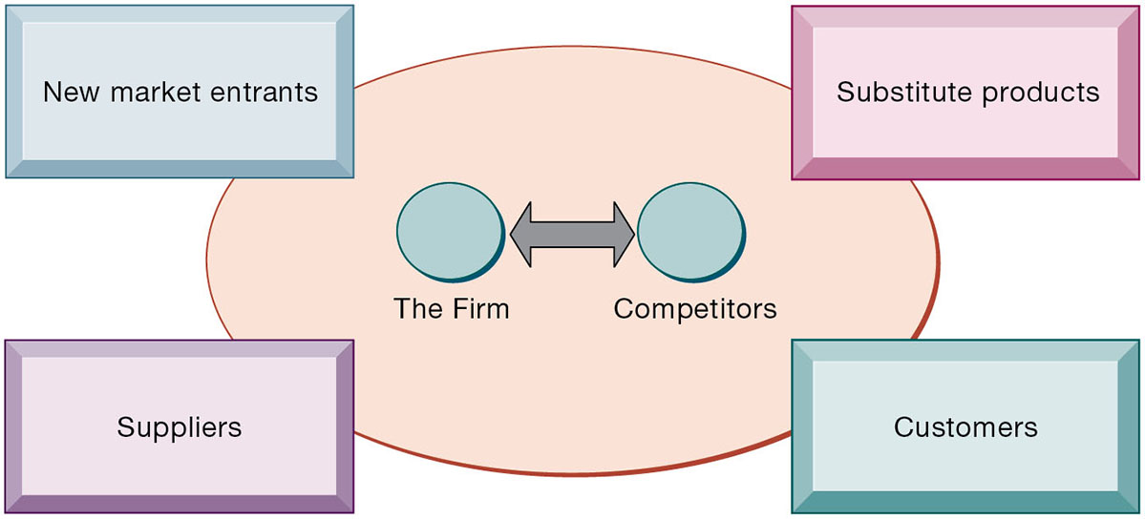
Figure 3.8 Porter’s Competitive Forces Model
Notes:
Figure 3.8, Page 92.
In Porter’s competitive forces model, the strategic position of the firm and its strategies are determined not only by competition with its traditional direct competitors but also by four other forces in the industry’s environment: new market entrants, substitute products, customers, and suppliers.
Notice that in the graphic, competitors are represented differently than the other four competitive forces influencing a firm. Why do students think this is the case? One answer might be that competitors are firms in the same industry and are under similar pressures as other firms in the industry.
Alt Text
Long description: A diagram illustrates how Porter’s framework analyzes the competition of a business. In the diagram, an interconnectedness is depicted between the firm and the competitors through a two-way arrow. The forces such as: New market entrants, substitute products, customers, and suppliers, that affect and shape the competition are listed.

Slide 33
Information System Strategies for Dealing with Competitive Forces (1 of 3)
Four generic strategies for dealing with competitive forces, enabled by using I T:
  Low-cost leadership
  Product differentiation
  Focus on market niche
  Strengthen customer and supplier intimacy
Notes:
Here you can make a list of five well-known firms and then analyze with students the major thrust of their strategy. Walmart is a good example to start with because of its emphasis on low-cost leadership.

Slide 34
Information System Strategies for Dealing with Competitive Forces (2 of 3)
Low-cost leadership
  Produce products and services at a lower price than competitors
  Example: Walmart’s efficient customer response system
Product differentiation
  Enable new products or services, greatly change customer convenience and experience
  Example: Google Nike
  Mass customization; customer experience management
Notes:
Do students believe it is possible both to design information systems that focus both on low-cost leadership and product differentiation? Some may say it is, with sufficient planning and innovation; perhaps a new product is even cheaper to produce than older ones. Some may say that the investment in innovation required for product differentiation precludes that firm from maintaining low-cost leadership.

Slide 35
Interactive Session: Organizations: Shipping Wars
Class discussion
  Why is shipping so important for e-commerce? Explain your answer.
  Compare the shipping strategies of Amazon, FedEx, and UPS. How are they related to each company’s business model?
  Will FedEx succeed in its push into ground shipping. Why or why not?

Slide 36
Interactive Session: Technology: Singapore as a Smart Nation
Class Discussion
  What are the factors driving the Smart Nation initiative?
  What are the possible downsides of the Smart Nation projects?
  Describe the smart city initiatives of an urban center in your country or region.

Slide 37
Information System Strategies for Dealing with Competitive Forces (3 of 3)
Focus on market niche
  Use information systems to enable a focused strategy on a single market niche; specialize
  Example: Hilton Hotels’ O n Q system
Strengthen customer and supplier intimacy
  Use information systems to develop strong ties and loyalty with customers and suppliers
  Increase switching costs
  Examples: Toyota, Amazon
Notes:
You could ask students to provide other examples from their own experience of companies that exemplify strong focus on market niche as well as excellent customer and supplier intimacy.

Slide 38
The Internet’s Impact on Competitive Advantage
Transformation or threat to some industries
  Examples: travel agency, printed encyclopedia, media
Competitive forces still at work, but rivalry more intense
Universal standards allow new rivals, entrants to market
New opportunities for building brands and loyal customer bases
Notes:
Do students believe it is easier or harder to gain a competitive advantage via the Internet as opposed to more traditional means? Table 3.5 describes the impact of the Internet on various competitive forces.

Slide 39
Smart Products and the Internet of Things
Internet of Things (I o T)
  Growing use of Internet-connected sensors in products
Smart products
  Fitness equipment, health trackers
Expand product differentiation opportunities
  Increasing rivalry between competitors
Raise switching costs
Inhibit new entrants
May decrease power of suppliers
Notes:
Ask students about how they are using IoT devices from fitness trackers to smart home products, including smart assistants like Alexa and Siri. Or, smart assistants in their cars. Do they find these products “smart”?

Slide 40
The Business Value Chain Model
Firm as series of activities that add value to products or services
Highlights activities where competitive strategies can best be applied
  Primary activities vs. support activities
At each stage, determine how information systems can improve operational efficiency and improve customer and supplier intimacy
Utilize benchmarking, industry best practices
Notes:
How does the value chain model differ from the Porter model? (It offers more specific detail about what exactly to do to achieve competitive advantages.) How do primary activities differ from support activities?

Slide 41
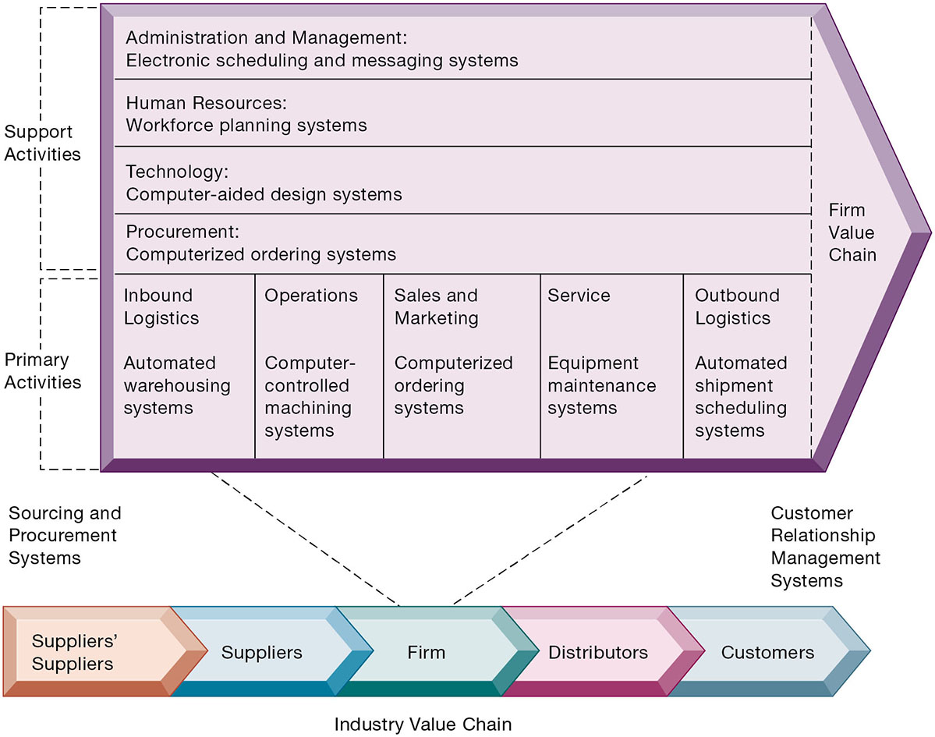
Figure 3.9 The Value Chain Model
Notes:
Figure 3.9, Page 100.
This figure provides examples of systems for both primary and support activities of a firm and of its value partners that can add a margin of value to a firm’s products or services.
Emphasize the relationship between the primary and support activities of this firm and explain how information systems are critical to the success of each activity
Alt Text
Long description: A schematic shows a step-by-step set of activities that a firm performs to increase its efficiency. The schematic is divided into two parts. The first part lists the support activities as listed below:
Administration and Management: Electronic scheduling and messaging systems
Human Resources: Workforce planning systems
Procurement: Computerized ordering systems
Technology: Computer-aided design systems.
The second part lists the primary activities as listed below:
Inbound logistics: Automated warehousing systems
Operations: Computer controlled machining systems
Sales and marketing: Computerized ordering systems
Service: Equipment maintenance systems
Outbound logistics: Automated shipment scheduling systems.
Sourcing and procurement systems and customer relationship management systems lie outside the schematic before it is connected to the industry value chain.
Both of these are connected to the industry value chain. The chain lists the sequence of the players in the value chain as follows: Suppliers’ Suppliers; Suppliers; Firm; Distributors; Customers.

Slide 42
Extending the Value Chain: The Value Web
Firm’s value chain is linked to value chains of suppliers, distributors, customers
Industry value chain
Value web
  Collection of independent firms using highly synchronized I T to coordinate value chains to produce product or service collectively
  More customer driven, less linear operation than traditional value chain
Notes:
Explain that a value web extends beyond the boundaries of an individual firm and represents the coordination of value chains across multiple independent firms. A value web is flexible and adapts to changes in supply and demand and changing market conditions.

Slide 43
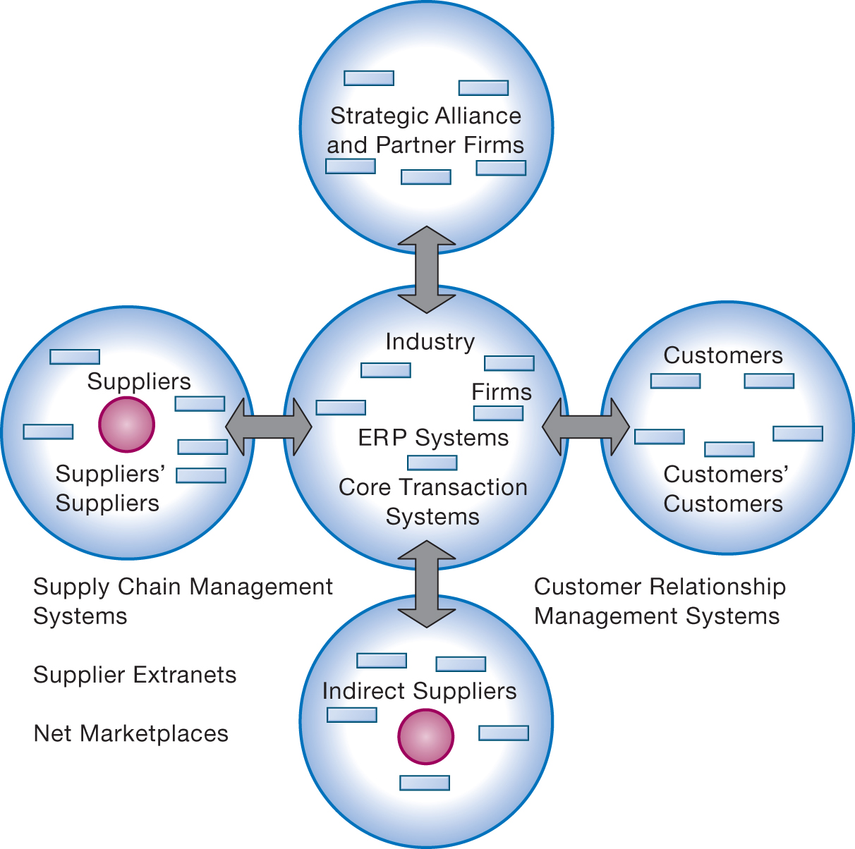
Figure 3.10 The Value Web
Notes:
Figure 3.10, Page 102.
The value web is a networked system that can synchronize the value chains of business partners within an industry to respond rapidly to changes in supply and demand.
Ask students why a model like the one displayed in the figure might be more likely to adapt quickly to changes in supply and demand. Also emphasize the networking among the different segments of the value web.
Alt Text
Long description: A radial diagram explains how a firm’s value chain is interconnected to the value chain of its indirect suppliers, partner firms, and customers. In the center of this radial diagram is the industry which consists of: Firms, ERP systems, and core transaction systems.
The industry is linked to value chains of its suppliers, indirect suppliers, strategic alliance partner firms, and customers via two-way arrows.
The customers include customers’ customers as well, while the suppliers include suppliers’ suppliers.
Between the suppliers and indirect suppliers outside the diagram are the following:
Supply chain management systems
Supplier extranets
Net marketplaces.
Similarly, between customers and indirect suppliers outside the diagram is the customer relationship management system.

Slide 44
Synergies
When output of some units are used as inputs to others, or organizations pool markets and expertise
Example: Merger of Bank of N Y and J P Morgan Chase
Purchase of YouTube by Google
Notes:
Explain that information technology’s role in promoting synergy is often tying together operations of disparate business units so that they can act as a whole. Why might this lead to reduced costs and increased efficiency?

Slide 45
Core Competencies
Activity for which firm is world-class leader
Relies on knowledge, experience, and sharing this across business units
Example: Procter & Gamble’s intranet and directory of subject matter experts
Notes:
Can students name any other notable examples of core competencies among firms? (Google: search, Microsoft: office productivity software; Intel processors, and so on)

Slide 46
Network-Based Strategies
Take advantage of firm’s abilities to network with one another
Include use of:
  Network economics
  Virtual company model
  Business ecosystems
Notes:
Facebook and eBay, which are based on networks of millions of users, are examples of firms that use this type of strategy to achieve an advantage. These companies have used the web and Internet communication tools to build communities. The more people who join these communities, the more benefit members receive. Many other companies are following suit in using a network-based strategy—can students name any others?

Slide 47
Network Economics
Marginal cost of adding new participant almost zero, with much greater marginal gain
Value of community grows with size
Value of software grows as installed customer base grows
Compare to traditional economics and law of diminishing returns
Notes:
Explain the difference between network economics and traditional economics and the law of diminishing returns. What aspect of network economics allows value to continue to increase with the size of the community?

Slide 48
Virtual Company Model
Virtual company
  Uses networks to ally with other companies
  Creates and distributes products without being limited by traditional organizational boundaries or physical locations
Example: Li & Fung
  Manages production, shipment of garments for major fashion companies
  Outsources all work to thousands of suppliers
Notes:
Explain to students that companies like this are “virtual” because they do not actually own any factories, machines, or other similar infrastructure. Instead, they offer a series of services, aided by information systems and uninhibited by geographical boundaries.

Slide 49
Business Ecosystems and Platforms
Industry sets of firms providing related services and products
Platforms
  Microsoft, Facebook
Keystone firms
Niche firms
Individual firms can consider how I T will help them become profitable niche players in larger ecosystems
Notes:
Can students see the similarities between business ecosystems and industry value chains and value webs? Can they appreciate the key difference (that business ecosystems extend across industries as opposed to primarily firms within the same industry)?

Slide 50
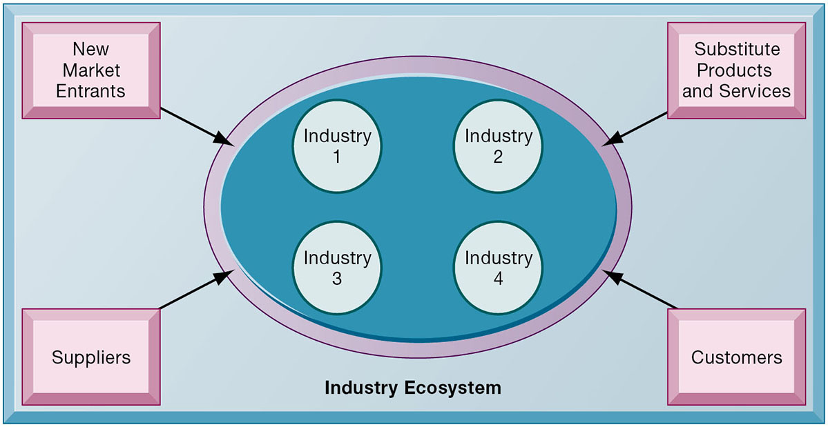
Figure 3.11 An Ecosystem Strategic Model
Notes:
Figure 3.11, Page 105.
The digital firm era requires a more dynamic view of the boundaries among industries, firms, customers, and suppliers, with competition occurring among industry sets in a business ecosystem. In the ecosystem model, multiple industries work together to deliver value to the customer. IT plays an important role in enabling a dense network of interactions among the participating firms.
Emphasize how important IT is in bringing disparate industries together to deliver value to the customer. What are the challenges of coordinating the flow of information across, for example, four different industries, as shown in the figure.

Slide 51
Challenges Posed by Strategic Information Systems
Sustaining competitive advantage
  Competitors can retaliate and copy strategic systems
  Systems may become tools for survival
Aligning I T with business objectives
  Performing strategic systems analysis
    Structure of industry
    Firm value chains
Notes:
Emphasize the importance and difficulty of aligning information technology with the business. What does this phrase mean? It seems pretty simple. Why do so many companies fail at this critical task? Can students think of any other important questions that management should ask about their company before designing their IT systems? What is a solution for the fact that many competitive advantages can be copied? This fact highlights the importance of continuous innovation in order to stay ahead.

Slide 52
How Will MIS Help My Career?
The Company: Superior Data Quality
Position Description: Entry-level business development representative
Job Requirements
Interview Questions
Author Tips
Notes:
A good opportunity for a class discussion on how MIS will help students with their current or future careers. Would any in the class be interested in a job like this? What do they think are the most important skills the employer is looking for? How would they answer the interviewer questions?

Slide 53

Copyright
This work is protected by United States copyright laws and is provided solely for the use of instructors in teaching their courses and assessing student learning. Dissemination or sale of any part of this work (including on the World Wide Web) will destroy the integrity of the work and is not permitted. The work and materials from it should never be made available to students except by instructors using the accompanying text in their classes. All recipients of this work are expected to abide by these restrictions and to honor the intended pedagogical purposes and the needs of other instructors who rely on these materials.

