Slide 1
Contracting Models in P2P Economy
Yung-Ming Li
Institute of Information Management
National Chiao Tung University

Slide 2
P2P economy
`
`
Digital economy
Platform economy
Sharing economy
P2P economy

Slide 3
P2P economy models
P2P Digital content distribution (Digital economy)
P2P Physical resource sharing (Sharing economy)
P2P Finance (Fintech)

Slide 4
Contracting Models for P2P Content Distribution
Hossein Ghasemkhani, Krannert School of Management, Purdue University
Yung-Ming Li, College of Management, National Chiao Tung University
Kamran Moinzadeh, Michael G. Foster School of Business, University of Washington
Yong Tan, Michael G. Foster School of Business, University of Washington

Slide 5
P2P network
A peer-to-peer or P2P network is a social network for pooling resources, such as computing cycle, hard disk storage, network bandwidth, content, resource at numerous edge nodes.
Netflix is currently responsible for over 30% of all downstream traffic might be considering using P2P technology for content delivery (Hastings 2014).
Free-riding occurs as many users take advantage of the content provided through the network, but do not contribute by sharing the content with others.
For a sustainable commercial P2P network, the most fundamental question is how to stimulate peers’ incentives to cooperate or contribute resources

Slide 6
Commercial P2P networks
Due to the decentralized nature of P2P networks and the stochastic characteristics of their operating environments, e.g., uncertain routing and traffic in public network domain
It is difficult to observe and measure the effort exerted by peer nodes, resulting in information asymmetry
By utilizing the principal-agent model from incentive theory (Gibbons 1992, Green and Stokey 1983, Lazear and Rosen 1981), we formulate and solve a multilateral contracting problem for a monopolistic P2P provider.

Slide 7
P2P contracting model
  We develop contracts implemented between the P2P provider, as the principal, and the peer nodes, as agents, to support content distribution.
  The proposed reward scheme
    The provider compensates peers for agreeing to become provision nodes by making content available for download. Moreover, an additional upload reward is paid to peers who execute the file upload.
    Customers (content request nodes) must be charged a download fee.

Slide 8
Advantage of the contracting model
It eliminates piracy, incentivizes peers to participate in the upload of less popular content, and eliminates free riding.
It effectively deals with moral hazard and monitoring issues.
The two part reward scheme is better than a one-part flat (such as subscription model in Netflex) reward in which peers who contribute receive a flat reward regardless of content and environmental characteristics.

Slide 9
Related works
Previous literature on P2P content distribution has mainly studied the problems from the perspective of cooperative distribution channels, without considering the competition and information asymmetry issues among the players in the digital supply chain
  Maille and Toka 2008, Ganesh et al. 2007, MacKie-Mason and Varian 1995, Afeche and Mendelson 2004
This principal-agent problem has been widely used as a representation of various standard economic relations such as in the theory of
  insurance under moral hazard (Arrow 1970, Spence and Zeckhauser 1971)
  in efficiency wage theory (Shapiro and Stiglitz 1984),
  in teams with sequential hidden actions (Holmstrom 1982, Strausz 1996)

Slide 10
Contribution to the literature
It analyzes a rank order based compensation scheme in order to address the hidden action problem of upload bandwidth provision.
The proposed contract scheme is suited to the popular P2P technological protocol which allow simultaneous download from multiple provision nodes.
The contest literature in the P2P context which possesses some unique characteristics
  For example, the uncertainty due to propagation delay always affects the overall content transfer performance and there exists significant positive network externalities on the propagation delay, whereas in traditional contest models, the uncertainty (noise) plays a negligible role

Slide 11
P2P Dynamics and Operating Policies
The operations of a typical P2P file sharing network can be summarized as having three main procedures:
  (1) A peer node initiates a content request.
  (2) after searching the profiles of peer nodes, the P2P provider recommends a list of provision nodes that have the desired file and are “close”to the request node (determined by the expected file transfer latency between these two nodes).
  (3) Once this information is passed on to the requesting and provision nodes, download occurs directly between the peers.

Slide 12
Quality ranking and recommendation
Transfer delay (Q_{i})=provision delay (D_{i}) +propagation delay (T_{i})
  the value of variable T_{i} is assumed to be uniformly distributed on [0, τ], where parameter τ is the upper bound of propagation delay per byte.
Provision policy:
  The optimal set of provision nodes suggested by the P2P provider is described as:
is the set of transfer delays of all available peer nodes

Slide 13
Multilateral Contracting Model

Slide 14
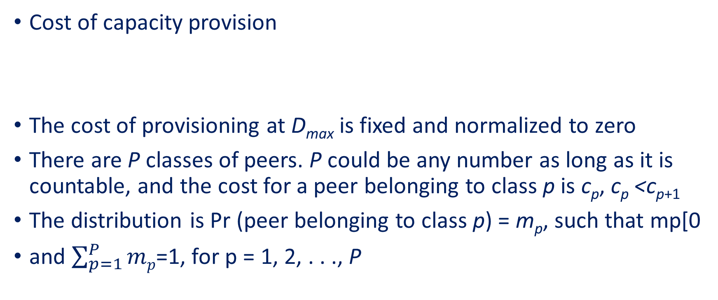
General Model - Cost of capacity provision
Cost of capacity provision
The cost of provisioning at D_{max} is fixed and normalized to zero
There are P classes of peers. P could be any number as long as it is countable, and the cost for a peer belonging to class p is c_{p}, c_{p} <c_{p+1}
The distribution is Pr (peer belonging to class p) = m_{p}, such that mp[0
and $\sum_{p=1}^{P}{mp}$=1, for p = 1, 2, . . ., P

Slide 15
Reward for uploading service

Slide 16
Optimal upload capacity

Slide 17
PROPOSITION 1. If propagation delay T_{j} is uniformly distributed=in [0, s], the optimal delay selection D_{j} , ∀_{j} satisfies:

Slide 18
Symmetric Model with Homogeneous Peers
is the expected number of nodes selected to jointly upload the file
is the expected number of peers who have the content available

Slide 19
Optimal reward

Slide 20
PROPOSITION 2. The optimal reward scheme (availability compensation and upload compensation), and delay aregiven by the following:

Slide 21
Impact of System Parameters on Reward Scheme

Slide 22
Heterogeneous Peers
Two separable classes (D₂-D₁≥τ
are class 1 peers
.
η = the probability at least selected nodes
η₁ = the probability at least selected nodes are class 1 peers

Slide 23
Payoff functions – two classes
κ:expected number of peers selected
κ₁ Class 1 , κ₂ class 2

Slide 24
Rewards under two classes

Slide 25
Impact of System Parameters on Reward Scheme (two classes)

Slide 26
Conclusion
Utilizing the principal-agent model, this study presents a contracting scheme for P2P file-sharing networks
A more generalized contest model with network externality on uncertainty (propagation delay)and dynamic contesters (content availability )
The contract scheme complies with P2P technological protocols which allow file swarming—simultaneous download from various provision nodes ranked by to transfer delay performance
The mechanisms can eliminates behaviors of piracy and free-riding and incentivize contribution(uploading)

Slide 27



P2P & Crowd Business model
P2P
Crowd
Social network
Person to Person ，
disitermediary
Long tail market ,
micro customer aggregation
Mutual interest, trust, reciprocal，resource sharing

Slide 28












P2P
Social network
Openness, low entry barrier
Mass market
Trend prediction (Crowd wisdom)
Transparency
User generation
(Crowdsourcing)
Recognition
Efficiency
Trustiness
Low cost
Endorsing
Crowd
High variety
Collaborative sharing

Slide 29
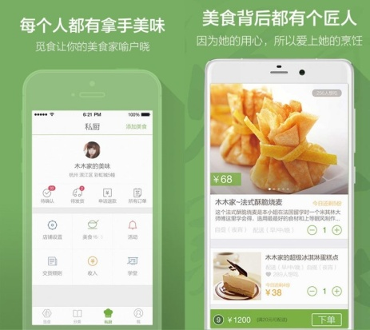



Sharing economy is changing our life
覓食、領廚
Air Closet
Air bnb
Uber

Slide 30
P2P Sharing economy
P2P Community to P2P Market – incentive to avoid free riding
  Fee and reward scheme
P2P market to B2P market – deployment to reduce provision uncertainty
  Mixing of peer provision and business provision

Slide 31


Social Finance Applications
Social Finance
Third party Payment
P2P Lending
Crowdfunding
Virtual Currency
Social Insurance
Social Marketing
and Advertising
Social Recommendation
Social Context
Application

Slide 32





P2P Lending operations
Lender
Borrower
3.Agreement
2. Risk evaluation & Matching
1. Credit evaluation & interest rate
P2P Platform
4. Fund
5. Agreement of return : fund +interest
Guarantee Agency
Notes:
圖解 P72

Slide 33
P2P Lending
Research issues
  Pricing: risk and interest, commission
  Product: debt transfer
  Platform roles: information(accreditation) & matching, cash flow, guarantee, insurance
  Operating models: O2O, social network
  Competition (with incumbent)

Slide 34

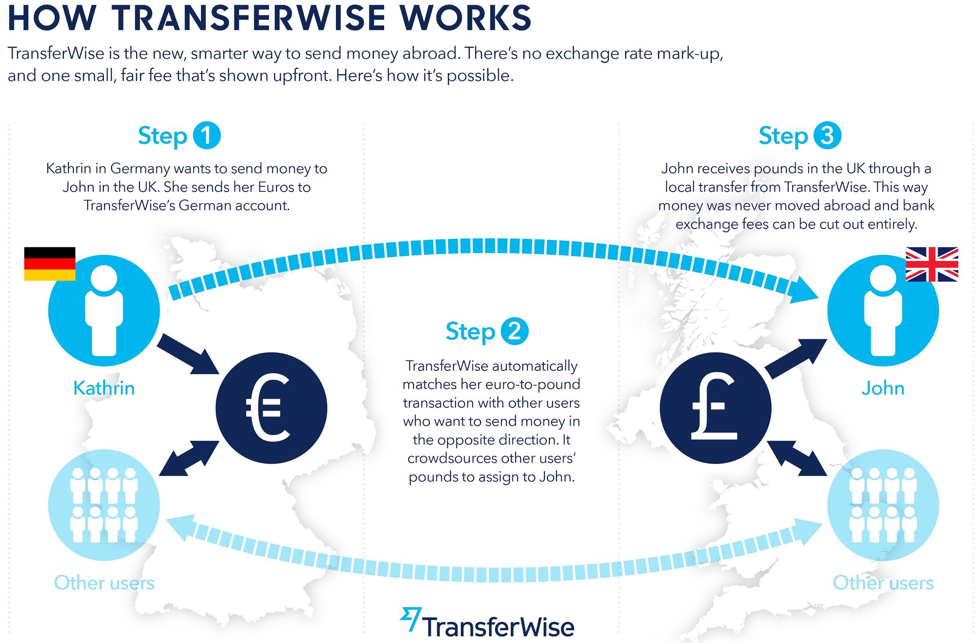
P2P Transfer & currency exchange
Opposite transfer direction matching
Opposite currency matching

Slide 35
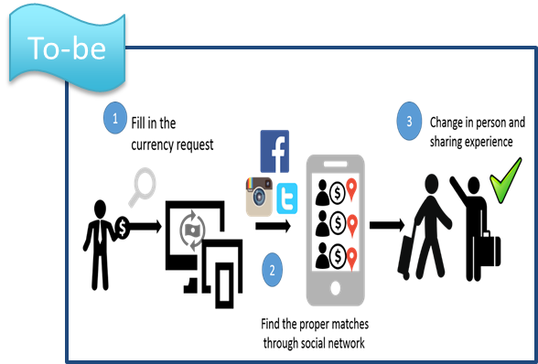
P2P Transfer & Currency Exchange
Research issues
  Matching optimization
  Location, trust, capacity
  Commission contract scheme
  Competition (with incumbent)

Slide 36



P2P Insurance
Problem
High fraud risk
High sale cost
Risk-sharing Network
Mutual Trust
Reinsure
Solution
40
100
FRIENDSURANCE
P2P Insurance Platform
60
Insurance pool ，reduce risk of fraud outcome
claims-free bonus

Slide 37
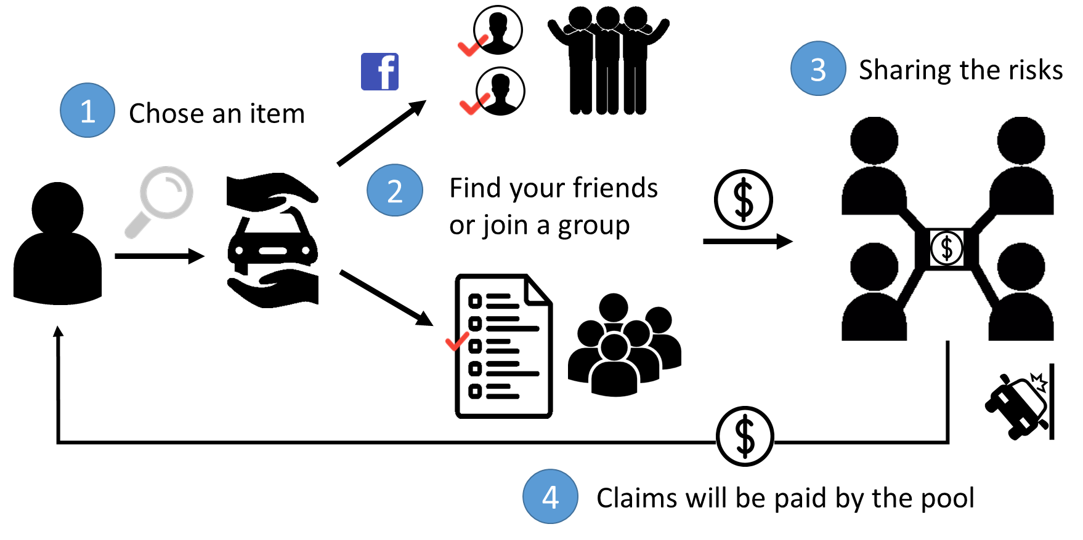
P2P Insurance
Research issues
  Insurer grouping
  Insurance portfolio allocation
  Competition (with incumbent)

Slide 38
Q&A

