Slide 1
Social Commerce Research:
Social Marketing & Social Finance
Yung-Ming Li Ph.D. 李永銘 博士
Professor, Institute of Information Management
National Chiao Tung University, Taiwan

Slide 2
Agenda
Social Commerce Background
Social Commerce Architecture
Social Commerce Applications
Social Commerce Open Issues

Slide 3
Social Commerce Background

Slide 4

Social Commerce
E-Commerce
(Marketing, Finance)
Social Computing
Social Commerce
(Social Marketing, social Finance)

Slide 5


From E-Commerce to S-Commerce
E-Commerce
Efficiency
Improvement
Expedite the process of buying, selling, or exchanging products, services, or information via Internet

Slide 6




Shift
Social Market
Social Media

Slide 7

From E-Commerce to S-Commerce
S-Commerce
Value
Creation
Create new business transactions through customer participation and social relations

Slide 8
Social Computing: Life Cycle
Social Media
Sharing Economy Platform
Big Data
Analyzing
(Discovering)
Social Elements & Dynamics
Designing
(Engineering)
Trust mechanism
Diffusion mech.
Decision mech.
Behavior
Click
Feedback
Link
PageRank
Relationship
Influence
Interaction
Similarity

Slide 9
Social Elements and Dynamics
Interactions
Relations/ ties
Homophily
Similarity
Influence
Information Cascade
Diffusion
The Elements of Social Dynamics

Slide 10
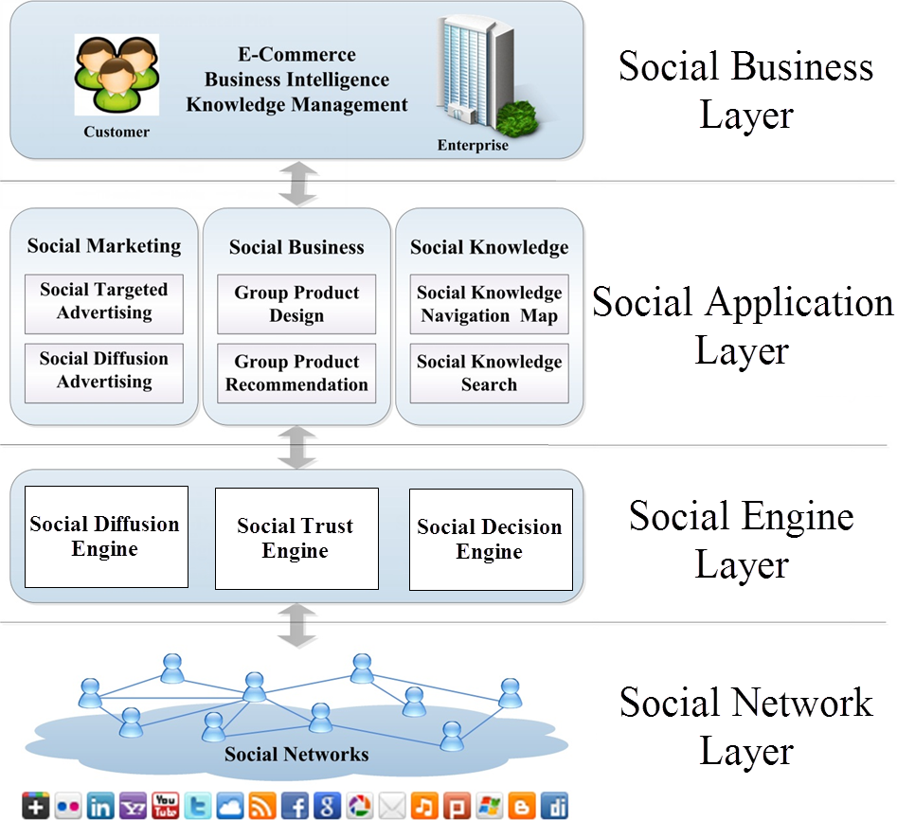
Social Commerce Engineering Architecture

Slide 11
Social Commerce Engine
Diffusion
Decision
Trust
Social Diffusion Engine
Used to disseminate the right information to the right users and spreading it widely
Social Decision Engine
Used to facilitate the integration of diverse views into a growing knowledge base
Social Trust Engine
Used to provides a basis dealing with uncertain, complex, and threatening images of the future

Slide 12
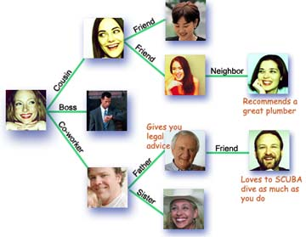
Social Diffusion Engine
Business Applications
  Information/Knowledge Sharing
  Innovation Propagation (new product, idea)
  Viral (Word-of-Mouth)
  Marketing/Advertising

Slide 13

Research Issues – endorser discovery
Social Diffusion Engine
Seed Endorser
Seed Endorser

Slide 14
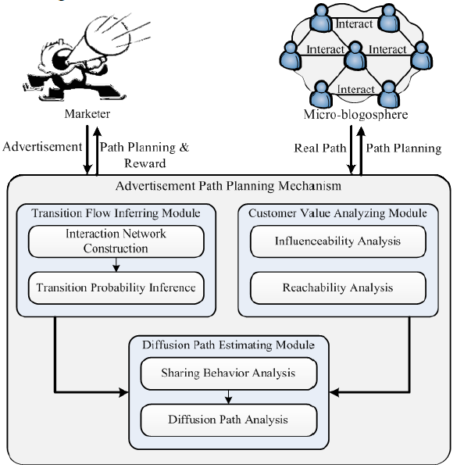
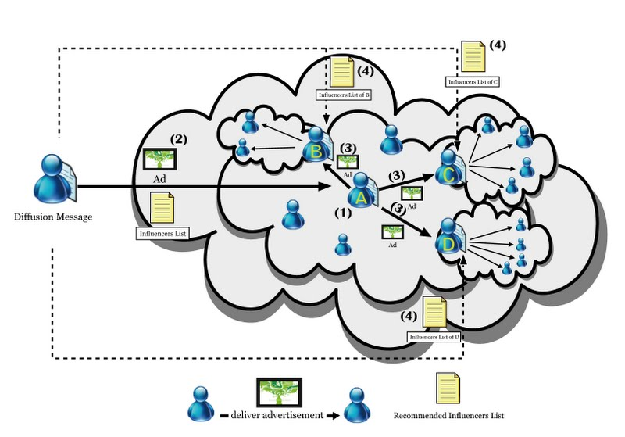
Diffusing Path Planning
“A Diffusion Path Planning Mechanism for Social Marketing,” with C.-Y., Lai and L.-F. Lin, Information & Management, 2017(SSCI). Forthcoming

Slide 15
Social Decision Engine
Business Applications
  Wisdom of Crowd/Collective Intelligence
  Market Prediction
  Product Creation
  Social Recommendation/Appraisal

Slide 16
Social Decision Engine
Social Decision Process
Social decision group recruiting: finding important and influential decision supporters from social networks
Alternatives proposing & ranking: resolving conflicts and ranking alternatives by inducing consensus

Slide 17
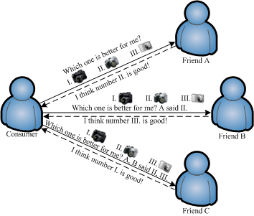
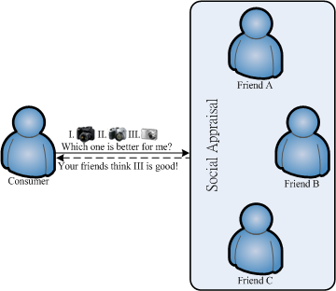
Social Appraisal
Social Appraisal for Purchase Decision
A social network could be seen as a large group of experts supporting decisions of consumers
Traditional Way
Social Appraisal

Slide 18
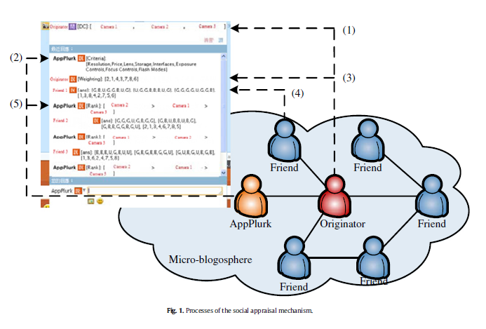
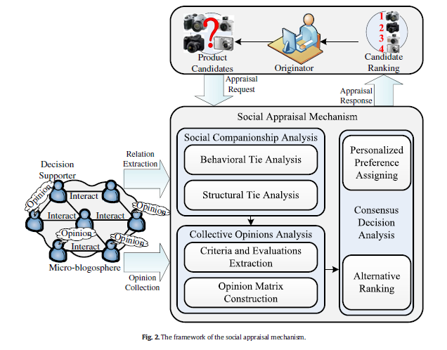
Social Appraisal
“A Social Appraisal Mechanism for Online Purchase Decision Support in the MicroBlogosphere” with C.-Y., Lai, Decision Support Systems, Vol. 59, pp 190–205, 2014 (SCI)

Slide 19
Social Trust Engine
Internet involves more uncertainty and risk
Social trust engine can
  Mitigate Risks
  Reduce Uncertainties
  Conveying Cooperation
  Improve Service discovery

Slide 20
Social Trust Engine
Business Applications
  Information quality assessment (request and provision)
  Computing resource reliability assessment
  Buyer/seller credibility assessment
  Finance Credibility evaluation

Slide 21
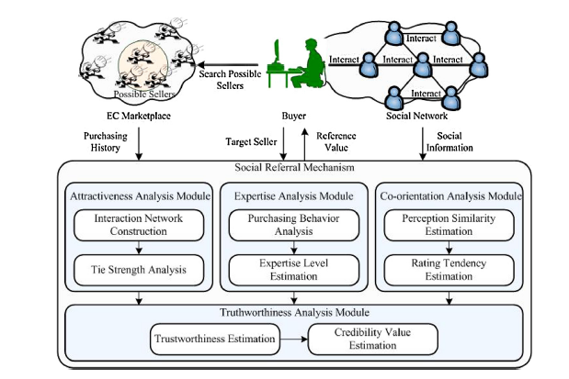
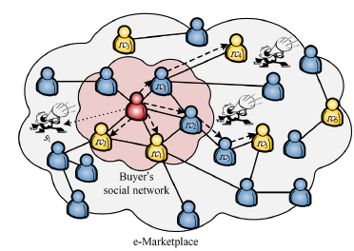
Social Reputation
“A Social Referral Appraising Mechanism for the e-Marketplace,” with C.-Y., Lai and L.-F. Lin, Information & Management, 2017 (SSCI). Forthcoming

Slide 22
Social Commerce Applications
Market Intelligence and Product Creation
Social Marketing
and Advertising
Social Recommendation
and Appraisal
Journal publications:
IJEC, DSS,I&M,INS,ECRA
Social Context
Application

Slide 23

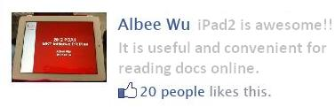
Social Marketing and Advertising
Social Context Enhanced Ads
“Enhancing Targeted Advertising with Social Context Endorsement” with L-F Lin and S-W Chiu, International Journal of Electronic Commerce, Vol. 19 (1), pp 99-128, 2014 (SSCI)
Discover and leverage the social context from the social sharing behavior to amplify the effect of advertising
Official product info
Social context info

Slide 24
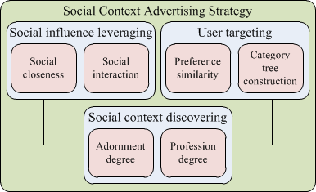
Close to user evaluation means it can more reflect the reality

Slide 25
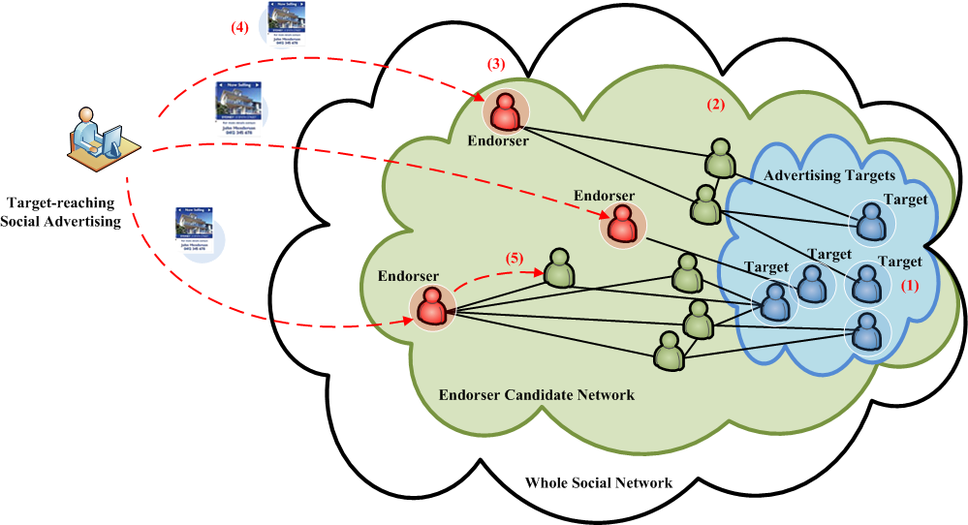
Social Marketing and Advertising
Target-Reaching Social Advertising Strategy
“A Social Endorsing Mechanism for Target Advertisement Diffusion,” with L.F. Lin and W.-H. Wu, , Information & Management, forthcoming, 2015 (SSCI)

Slide 26
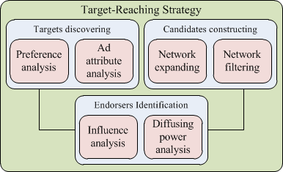
Close to user evaluation means it can more reflect the reality

Slide 27
Market Intelligence and Product Creation
Product Creation via Market Intelligence
. “Creating Social Intelligence for Product Portfolio Design,” with H.-M Chen, J.-H. Liou, L.-F. Lin, Decision Support Systems, Vol. 66, pp 123-134, 2014 (SCI)
Enterprises might construct focus group and organize feedback within the company to understand customer needs
Social media make businesses get closer to customers and directly know their perceptions of products

Slide 28
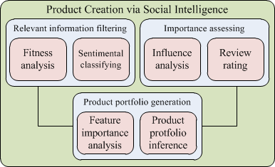
Product Creation via Market Intelligence
Category | Range
Screen Size | 3.7 ~ 4.3 inches
Processor | 1 ~1.2 Ghz
Camera | 5 ~ 8 megapixels
Build-in Memory | 512 MB ~1GB
Battery | 6 ~ 8 hours
Users’ opinions on product portfolio can more reflect the reality

Slide 29
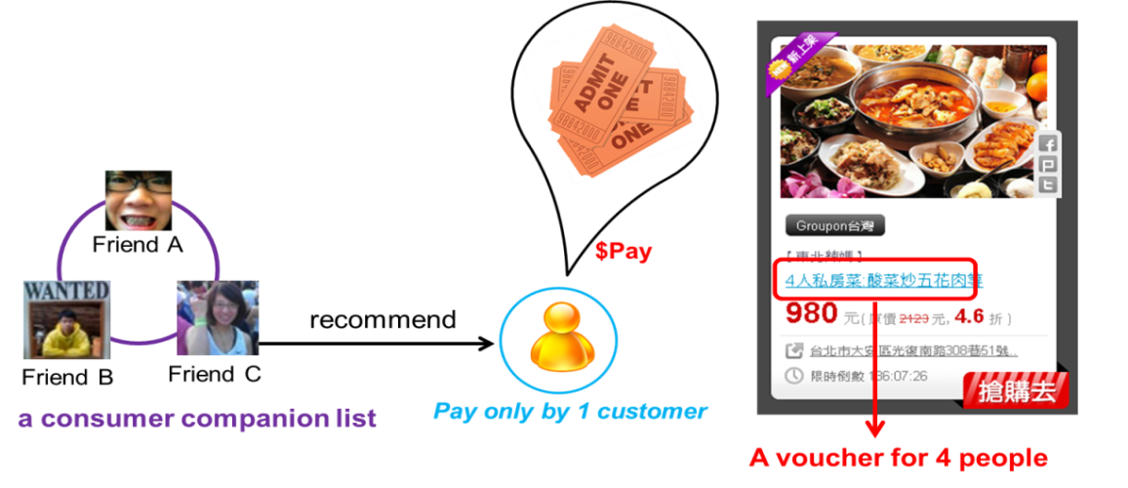
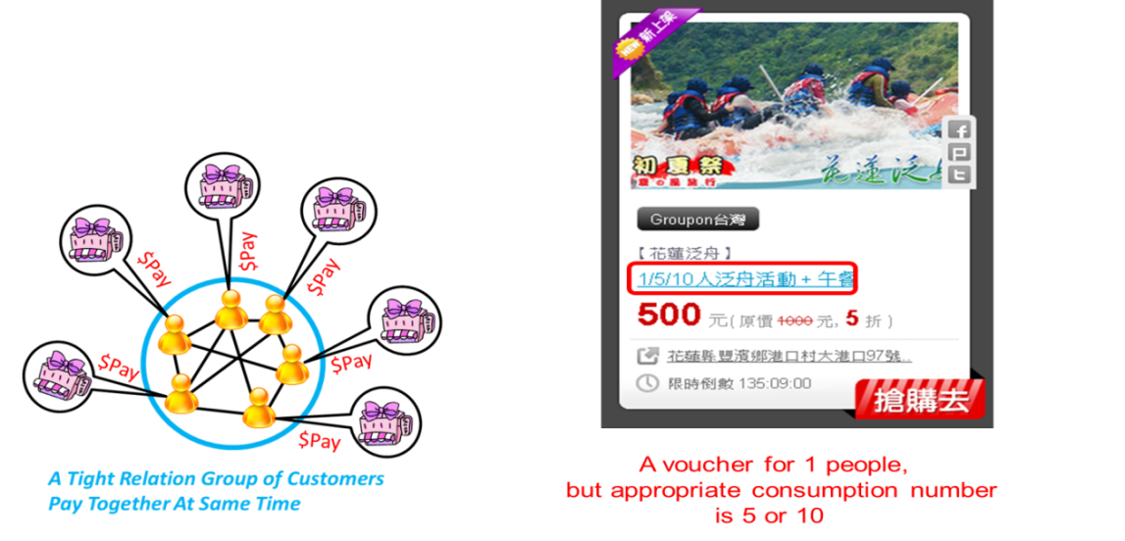
Social Recommendation
Group-Coupon Recommendation
“A Social Recommender Mechanism for Location-Based Group Commerce”, with C.-L. Chou. and L.-F. Lin, Information Sciences, Vol. 274, pp 125-142, 2014 (SCI)
The types of group coupons to promote
Package coupon
Group-formed coupon

Slide 30
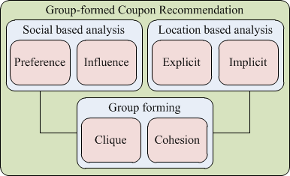
Group-Coupon Recommendation

Slide 31
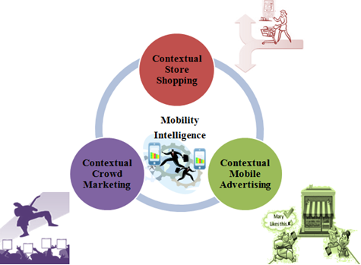
Contextual Commerce Applications
Social Contextual commerce
Help customers get the better shopping experience with the shopping support tool

Slide 32
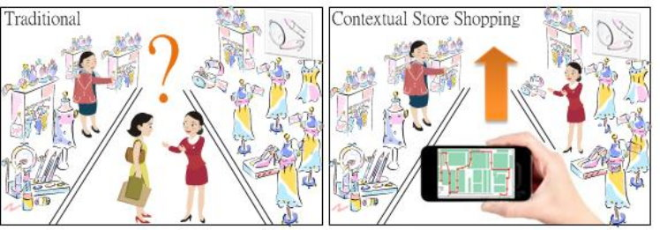
Social Contextual commerce
Contextual Store Shopping Mechanism
“A Contextual Route Recommendation Mechanism for Store Shopping,” with L.F. Lin and C.C. Hou, Decision Support Systems, 2017 (SCI). Forthcoming

Slide 33
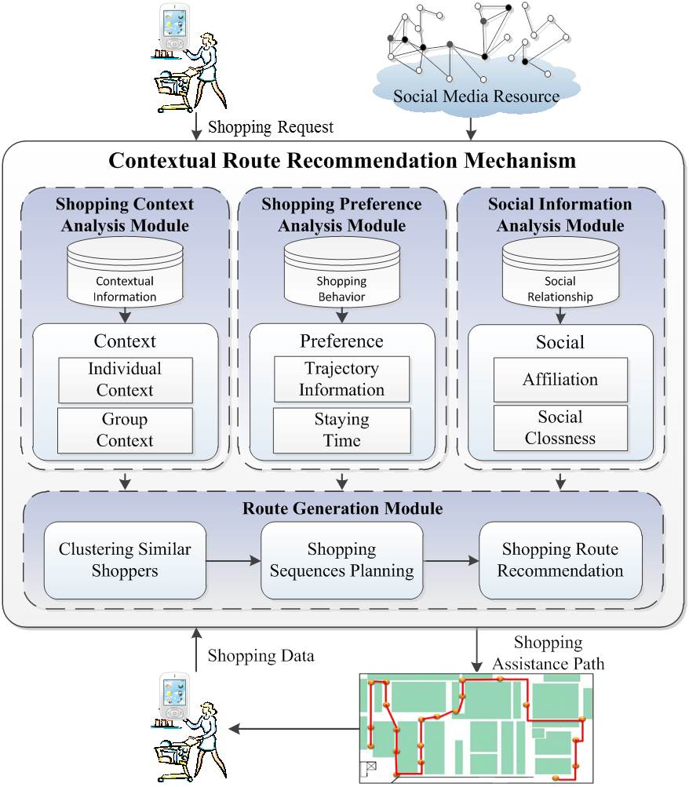
Contextual Route Recommendation Mechanism

Slide 34
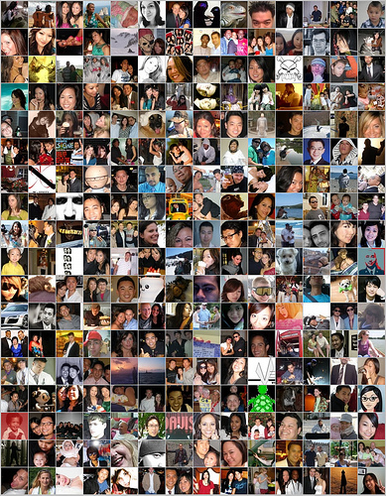

Social Finance Applications
Social Finance
Third party Payment
P2P Lending
Crowdfunding
Virtual Currency
Social Insurance
Social Marketing
and Advertising
Social Recommendation
Social Context
Application

Slide 35
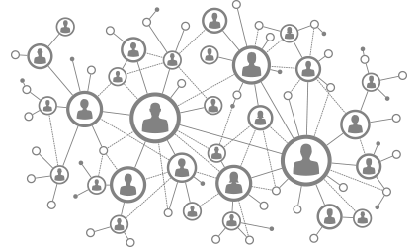


P2P & Crowd - Finance
P2P
Insurance
P2P Currency
P2P Lending
Crowd
Investing
Crowd
Finding
Crowd
Financing
Credit
Risk
Value
P2P & Crowd

Slide 36
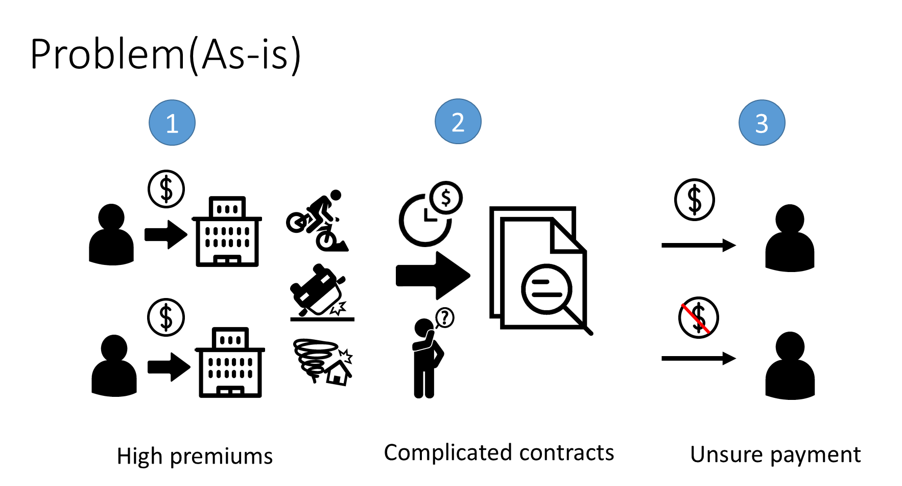
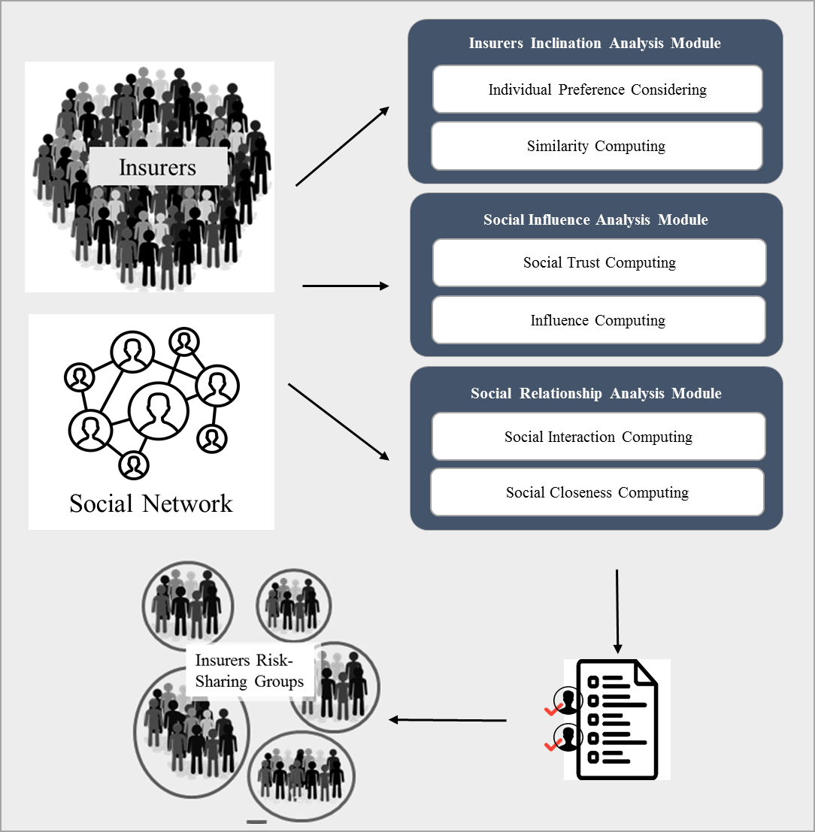
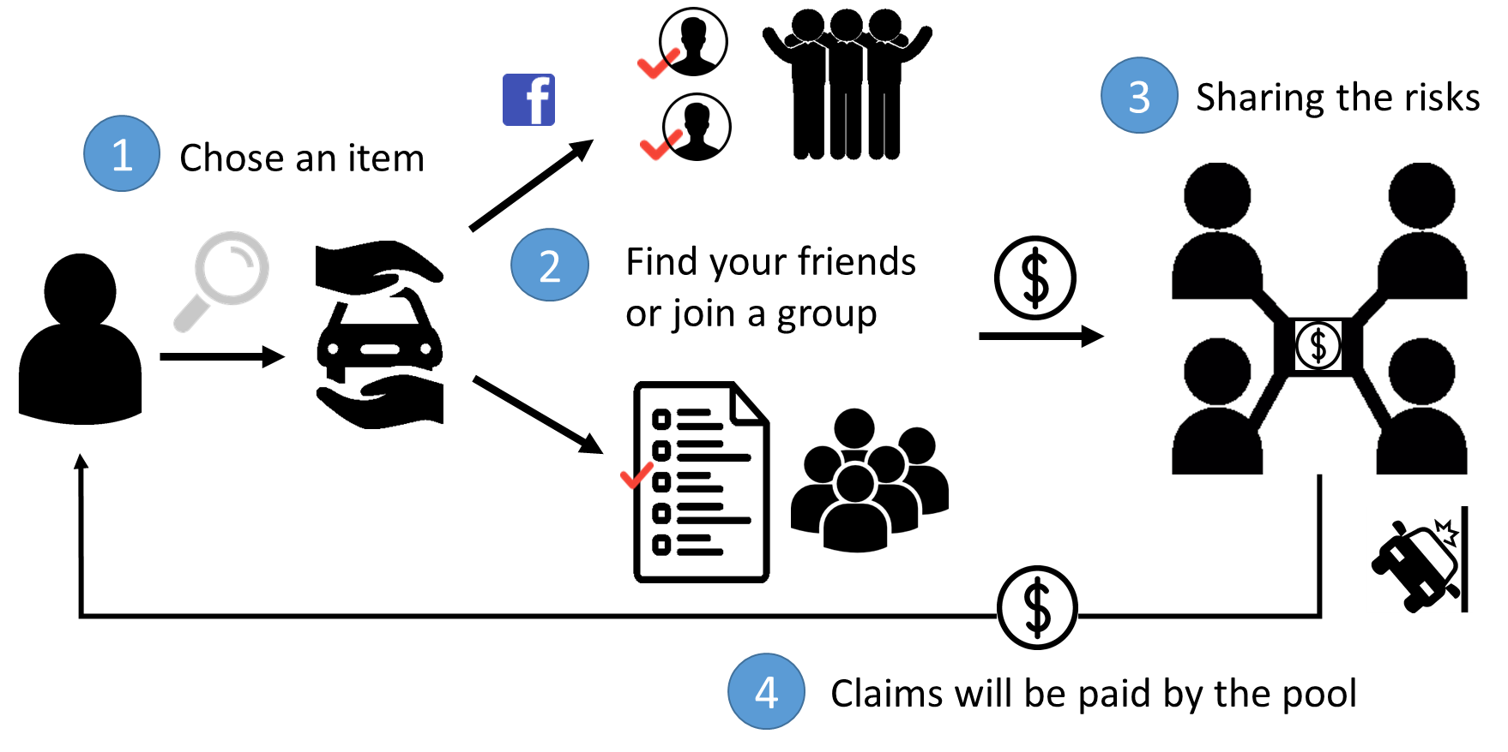
P2P Insurance
Develop a social-based co-insurers recommendation mechanism that can give insurers a more reliable combination with other insurers.
As-is
Architecture
To-be

Slide 37
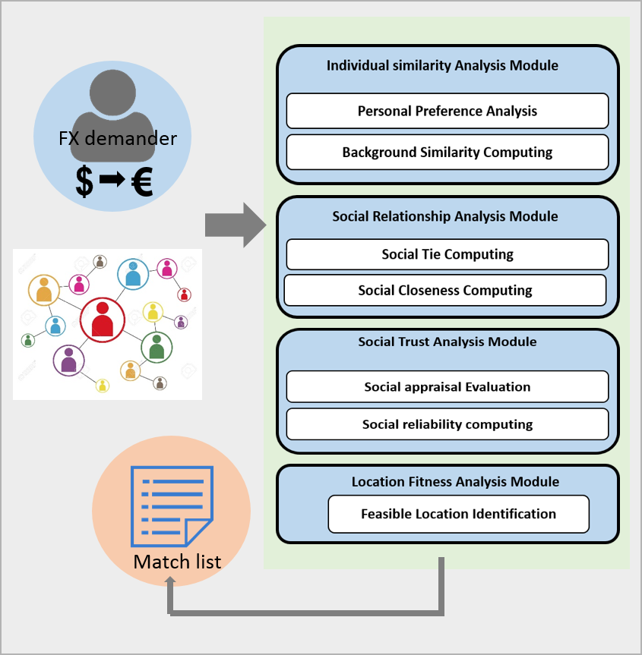
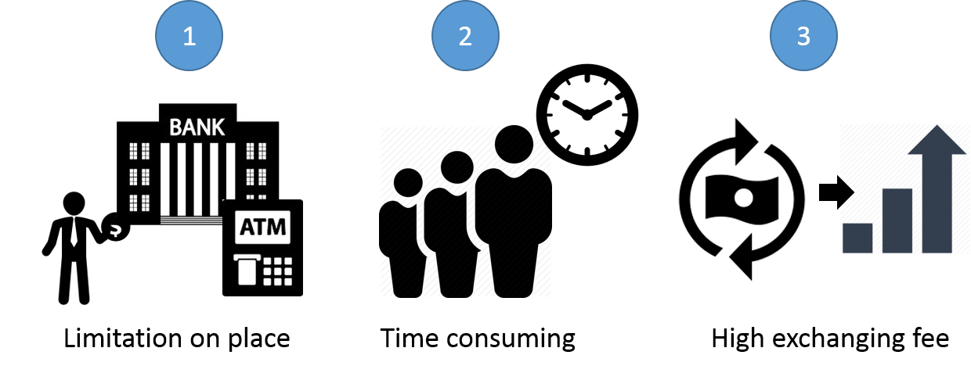
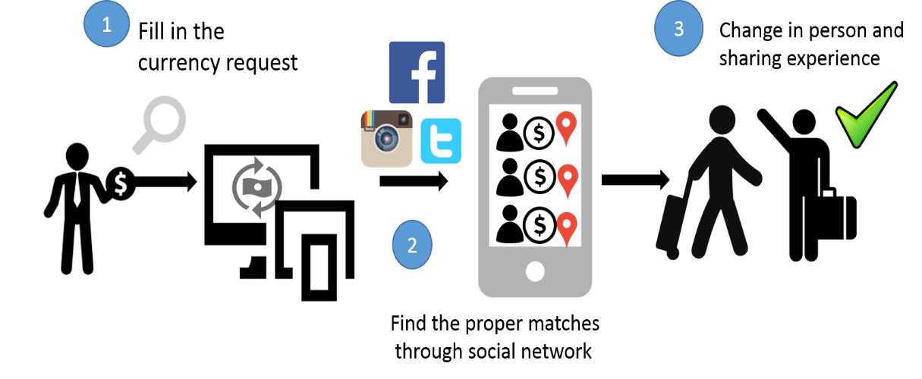
P2P Currency Exchange
Develop a social based referral mechanism by providing users with match list which is improved by higher trustiness and willingness.
As-is
Architecture
To-be

Slide 38
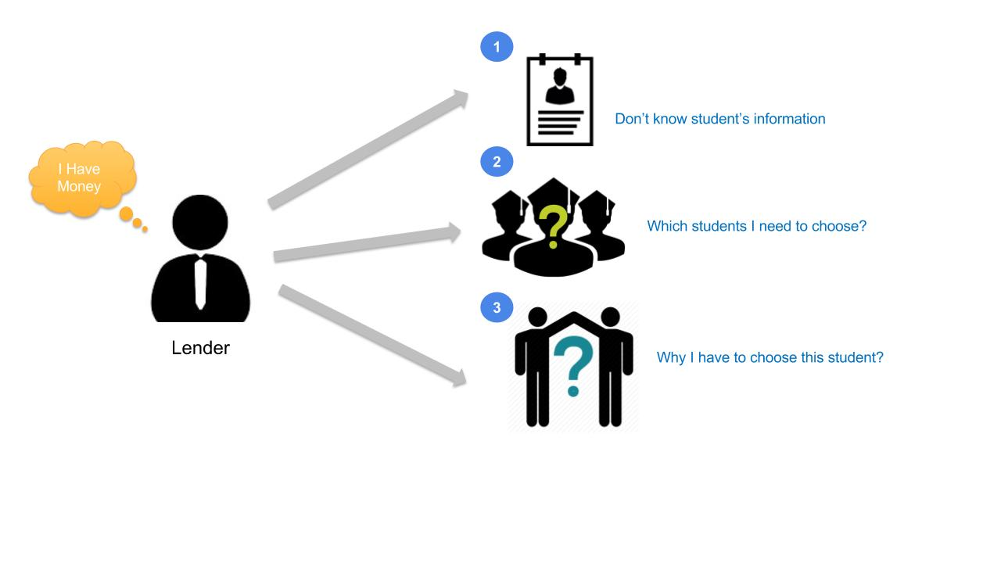
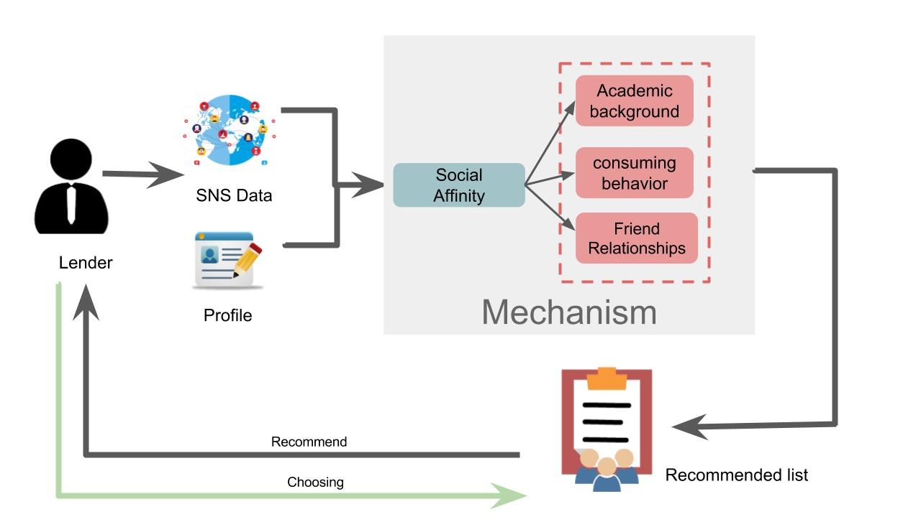
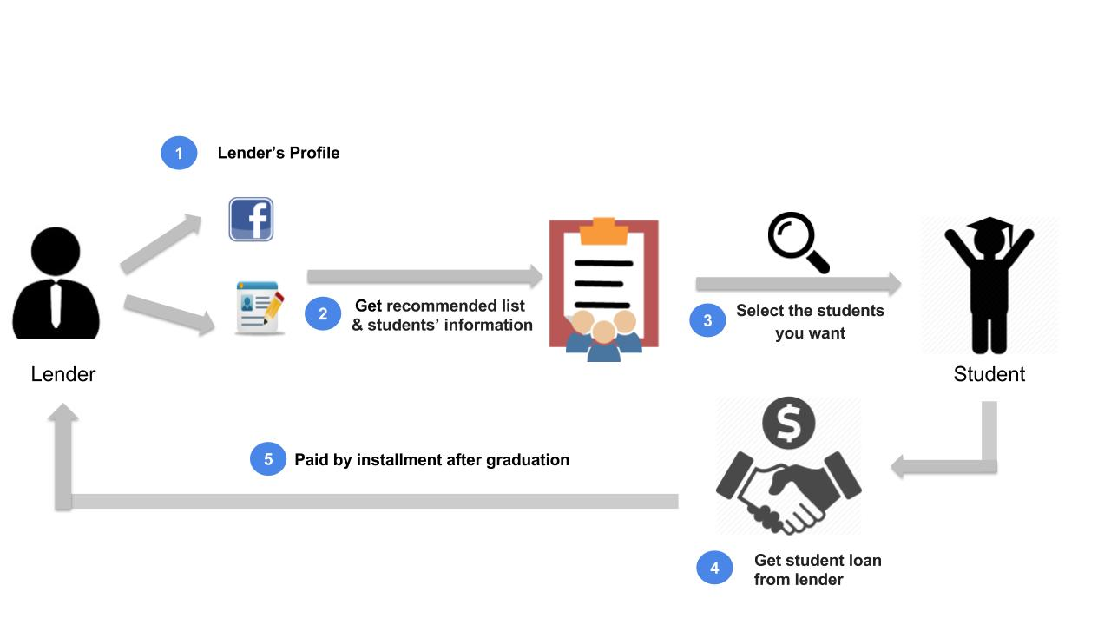
P2P Lending
Solve the situation of information asymmetry, using recommendation mechanism to reduce the gap between two sides. It can reduce default rates and provide assistance among students.
As-is
Architecture
To-be

Slide 39
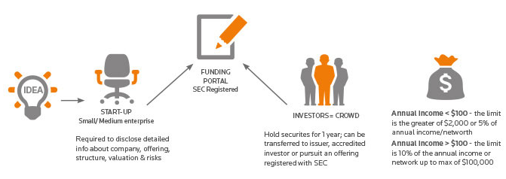
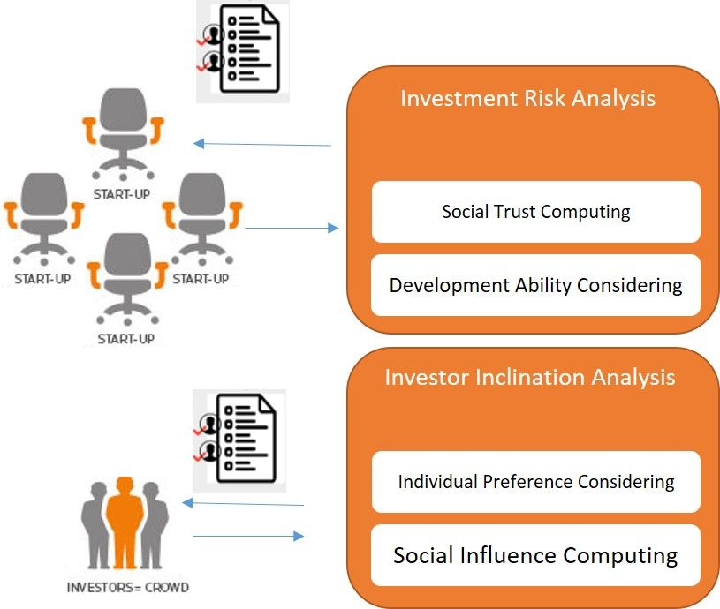
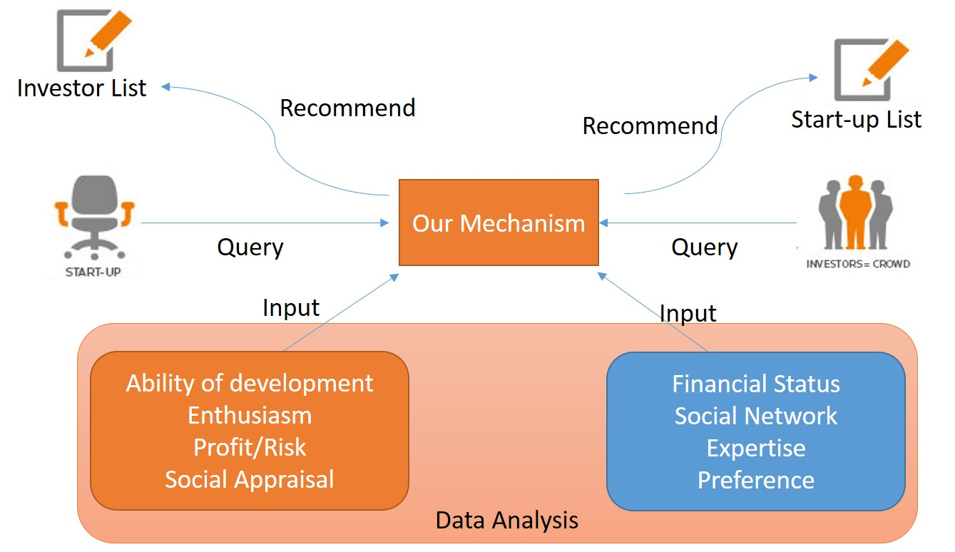
Crowd Funding
Provide the social analysis about the investor, recommending suitable lead investor to the start-ups and strengthening the links between crowd investors and start-ups.
As-is
Architecture
To-be

Slide 40
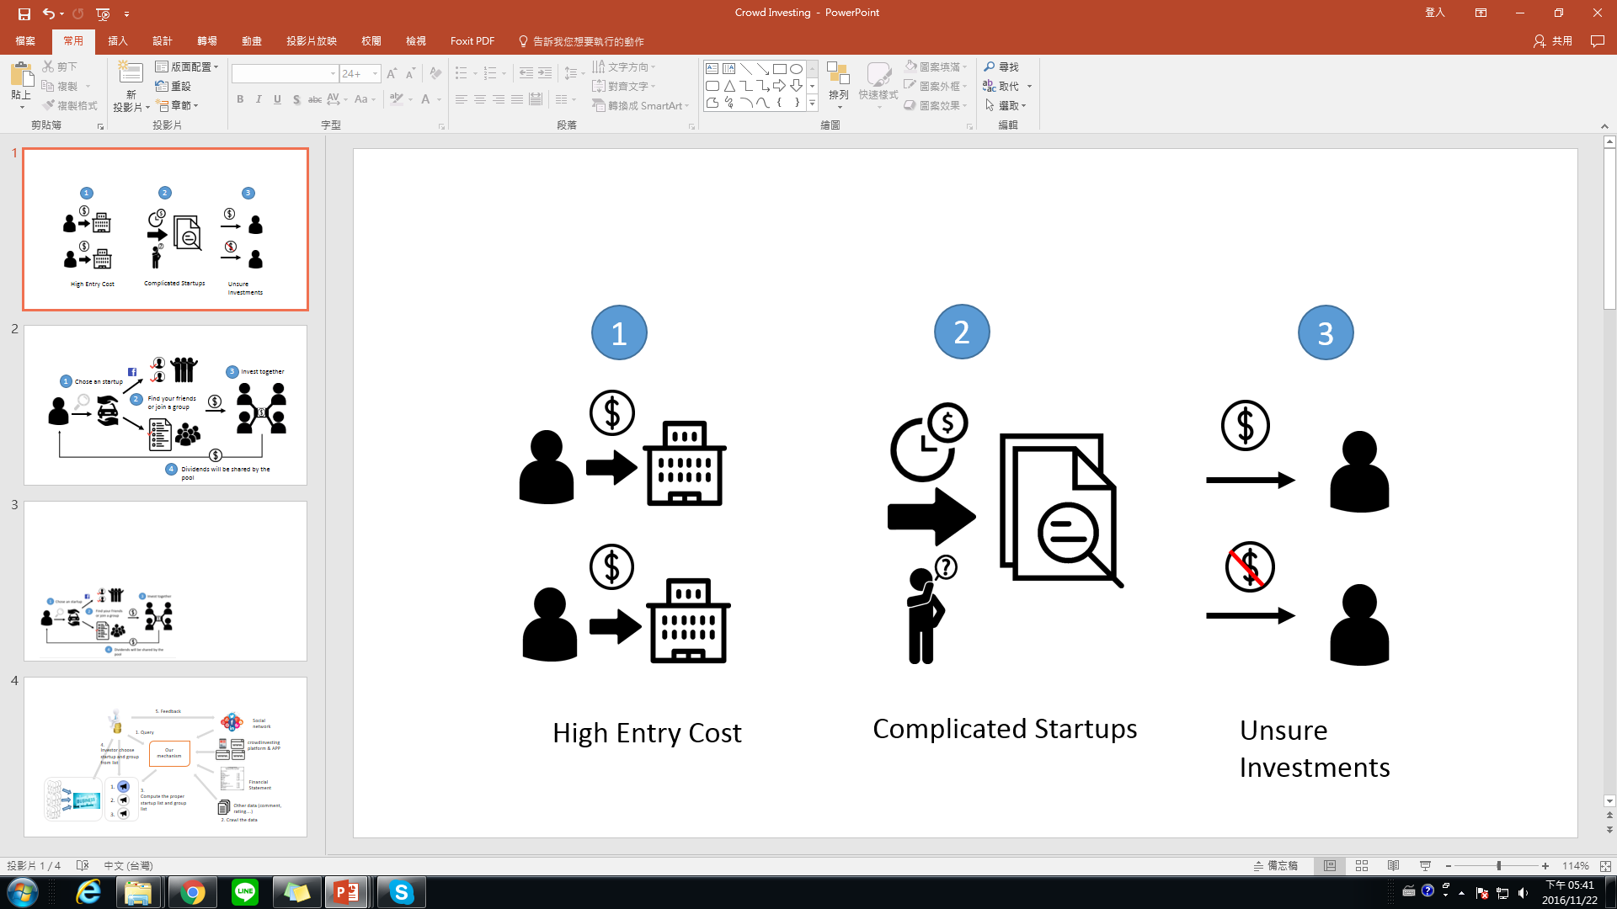
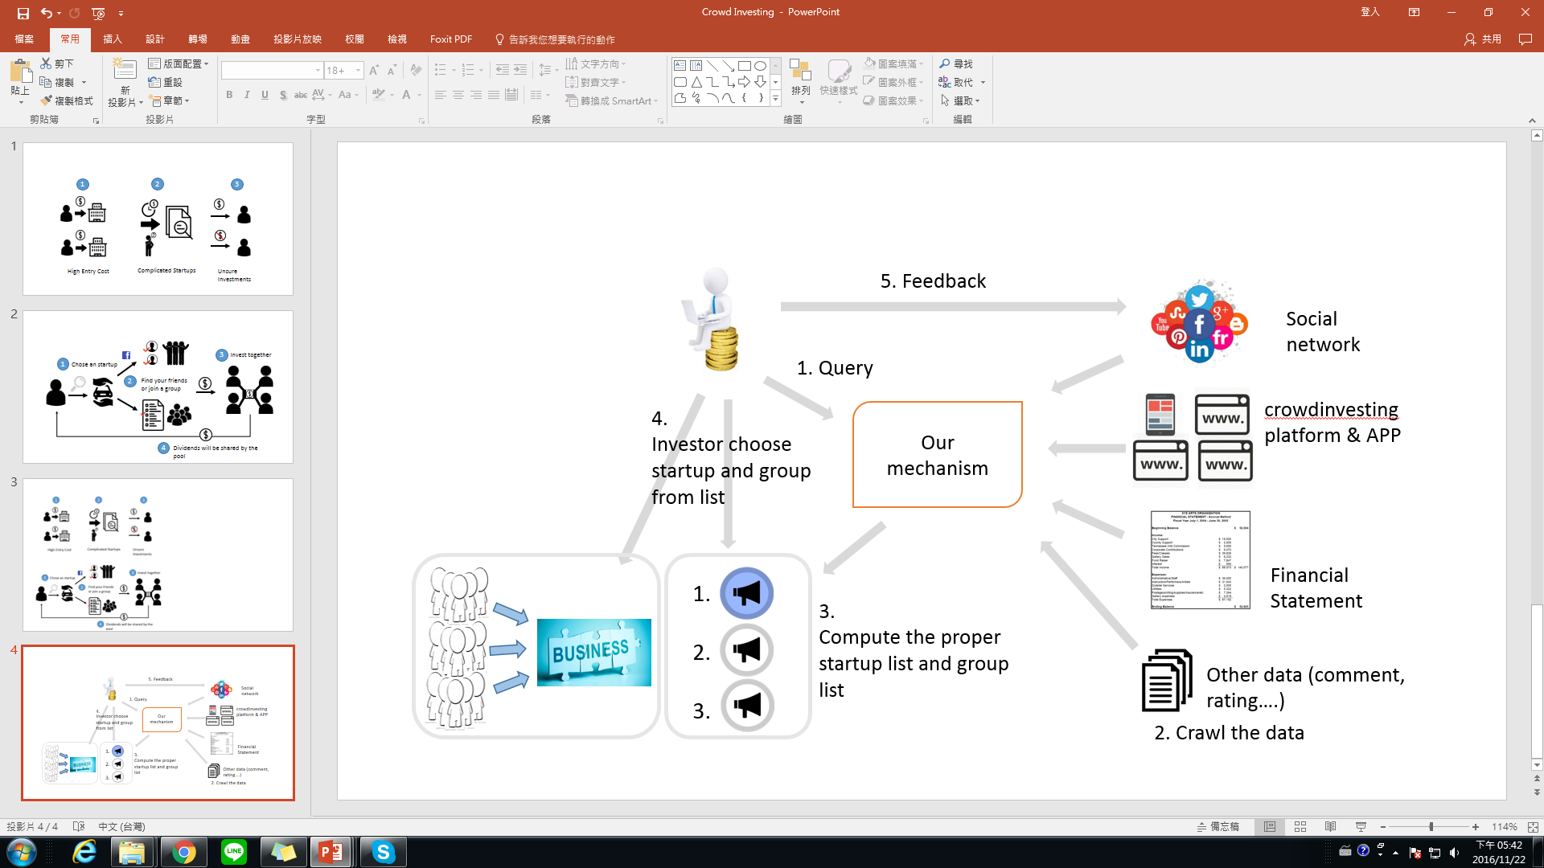
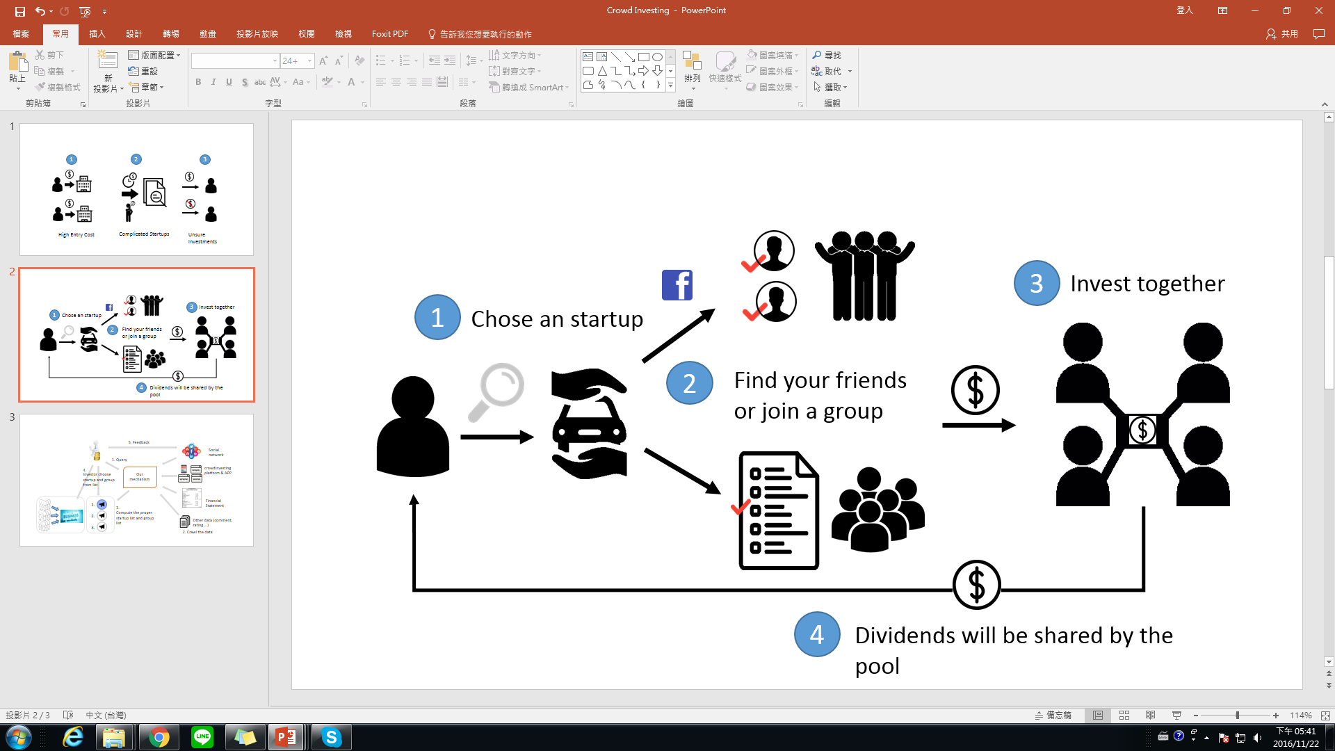
Crowd Investing
Depicts another source of financing for young start-up companies. Focus on monetary return from the investor’s point of view.
As-is
Architecture
Mechanism
To-be

Slide 41
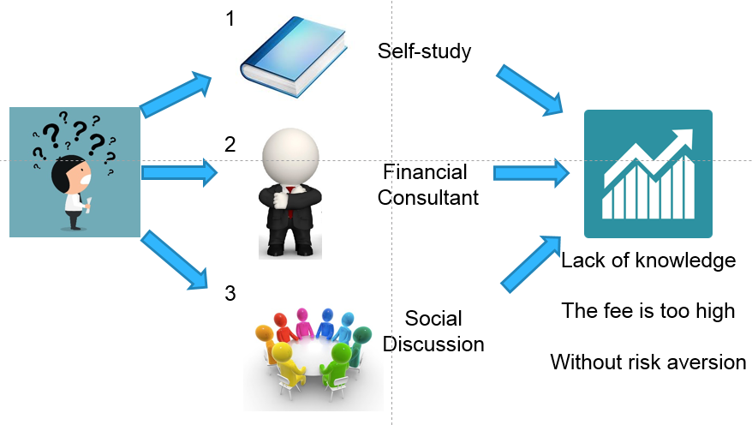

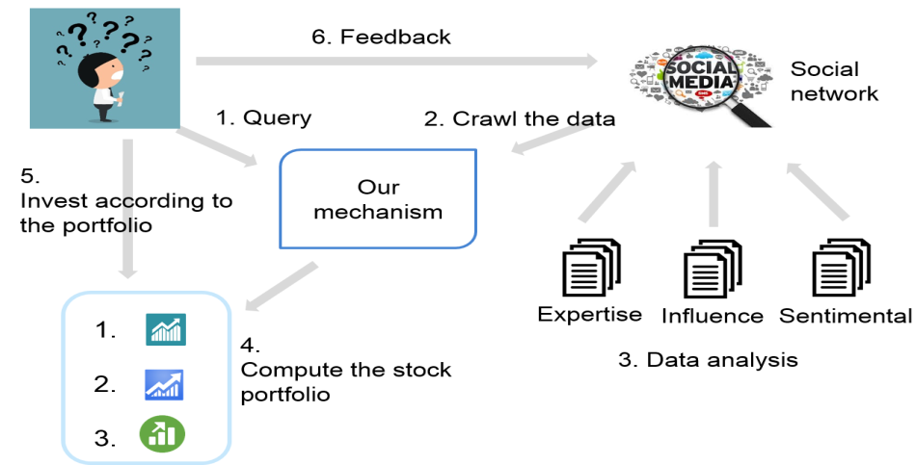

Crowd Financing
Recommend stock portfolio by using crowd intelligence approach on social network.
Architecture
As-is
Knowledge Analysis
Fitness Score
Expertise Score
Authority Analysis
Influence Score
Review Rating
To-be
Sentimental Analysis
Evaluation Extraction
Sentimental Classification
Recommend
Stock portfolio

Slide 42
Thank you !

