Slide 1
Social Finance Computing
社群金融計算
Yung-Ming Li, Ph.D.
Institute of Information Management
National Chiao Tung University

Slide 2




Traditional Financial Industry
Through financial institute (intermediary) , transferring funds from supplier to demander or investing in the stock market
  Direct financial market (stock, bond)
  Indirect financial market (fund, insurance)
loan
interest
fund
Investment
return
Return
Fund provider
Financial institution
Stock
Bonus

Slide 3
Internet Financial Model
Accommodation of funds and financing through Internet platform

Slide 4
The Internet Finance
Third party payment
P2P
lending
Crowd
funding
Virtual
Currency
Insurance
Tech
Smart
Investment
Online
Credit
Digital
Bank
EC
Finance
Mobile
payment
Third party Payment
Mobile Payment
P2P lending
Crowdfunding
Crypt Currency
Insurance Tech
Smart Investment
Online Credit
Digital bank
EC Finance
Internet
Finance

Slide 5
FinTech DNAs
Mobile Fin
Online (Cloud & IoT) finance
Mobile finance
Social finance
Smart (AI & big data) finance
Crypt (blockchain) finance
Online Fin
Social Fin
FinTech
DNAs
Crypt Fin
Smart Fin
5

Slide 6



Five characteristics of digital finance
Online operating platform
AI & data driven analysis
Financial sector
Social business model
Customers
De-bundled financial service
Micro-financial market

Slide 7






Characteristics of digital finance (1): Online operating platform
Real time & personalized services
Cloud computing platform (low cost for mass market)
Digital Finance
Face-face service, limited market scalability
Limited temporal & space (huge cost)
Traditional Finance

Slide 8










Characteristics of digital finance (2):AI-Data driven analysis
Precise prediction & matching
Risk management
Personal recommendation
Digital Finance
Data + AI
Product A B C
Traditional Finance
理財專員

Slide 9







Characteristics of digital finance (3): Social business model
Returns
Unconnected
Loan
Ｘ
Loans
credit barrier
Fund Provider
Fund Requstor
Information and power
Intransparency
Financial product
Fund demand
Saving
P2P & crowd platform
Information sharing and market matching

Slide 10


Characteristics of digital finance (4):Service Un-bundling
Traditional finance
Digital Finance
Third party payment
P2P
landing
Crowd
fundung
Virtual Currency
Insurance
Tech
Smart
Investment
Online Credit
Mobile payment
Digital Finance
Saving
Loan
Payment
Exchange
All financial service
in one bank
  Financial Service un-bunding

Slide 11
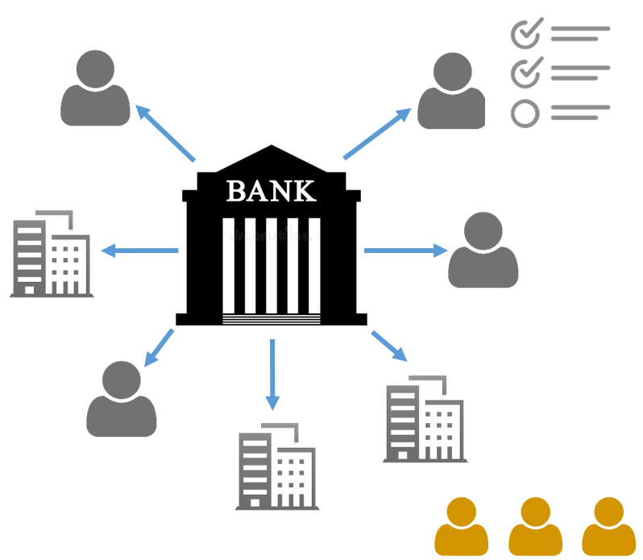
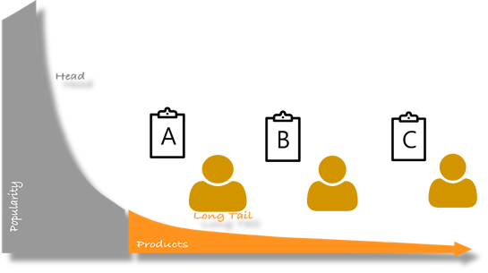
Characteristics of digital finance (5):Micro-financial market
Traditional finance services focus on secured customers, big, reputational customers or companies
New Finance services focus on small business or customers without credit
Long tail market: “Micro” & “Mass” market
Micro-customers

Slide 12


Social business model: P2P, Crowd, Social Networking
P2P
Crowd
Social network
Person to Person,
disintermediary
Long tail market ,
micro customer aggregation
Mutual interest, trust, reciprocal resource sharing

Slide 13












P2P
Crowd
Social network
Openness, low entry barrier
Mass market
Trend prediction (Crowd wisdom)
Transparency
User generation
(Crowdsourcing)
Recognition
Efficiency
Trustiness
Low cost
Endorsing
High variety
Collaborative sharing

Slide 14
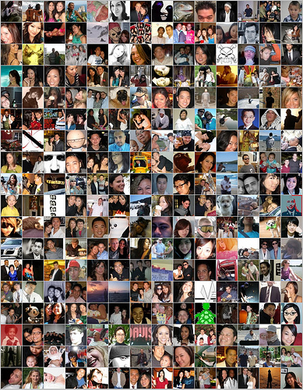

Social Finance
Crowdfunding
Crowdinvesting
Virtual Currency
Social Insurance
P2P Lending
Notes:
社群金融

Slide 15
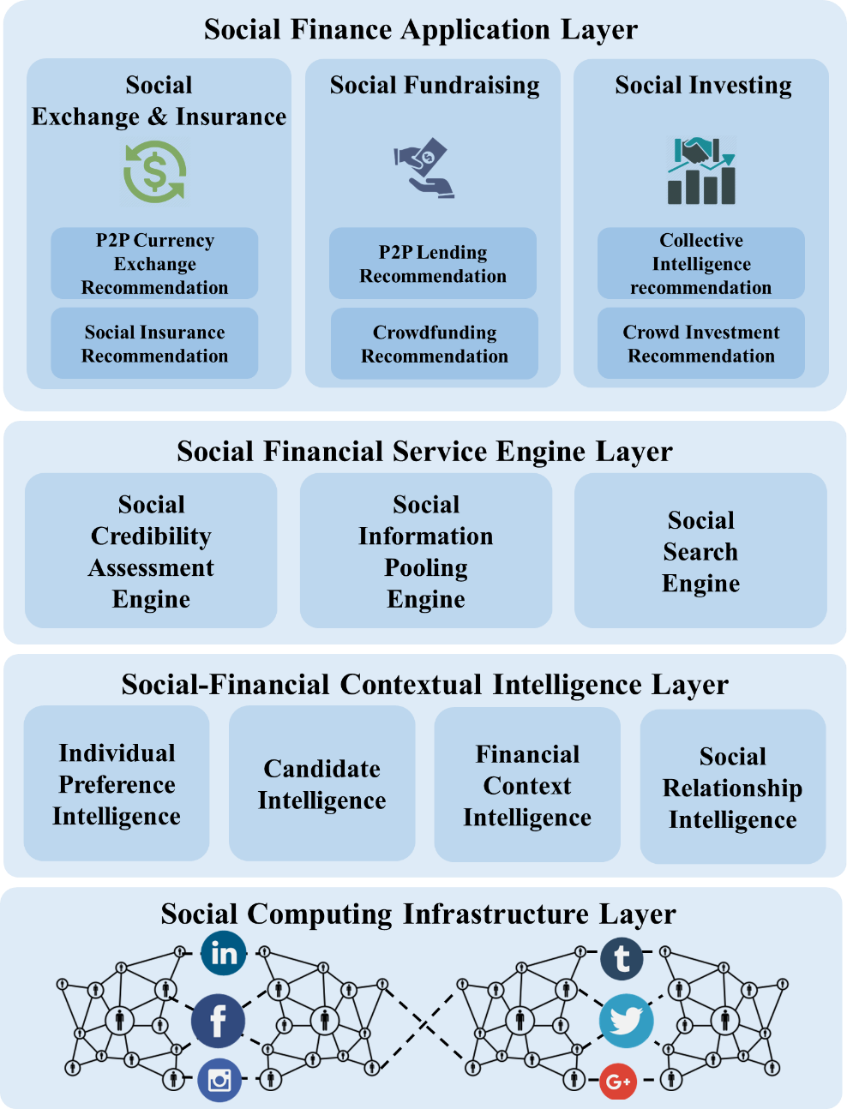
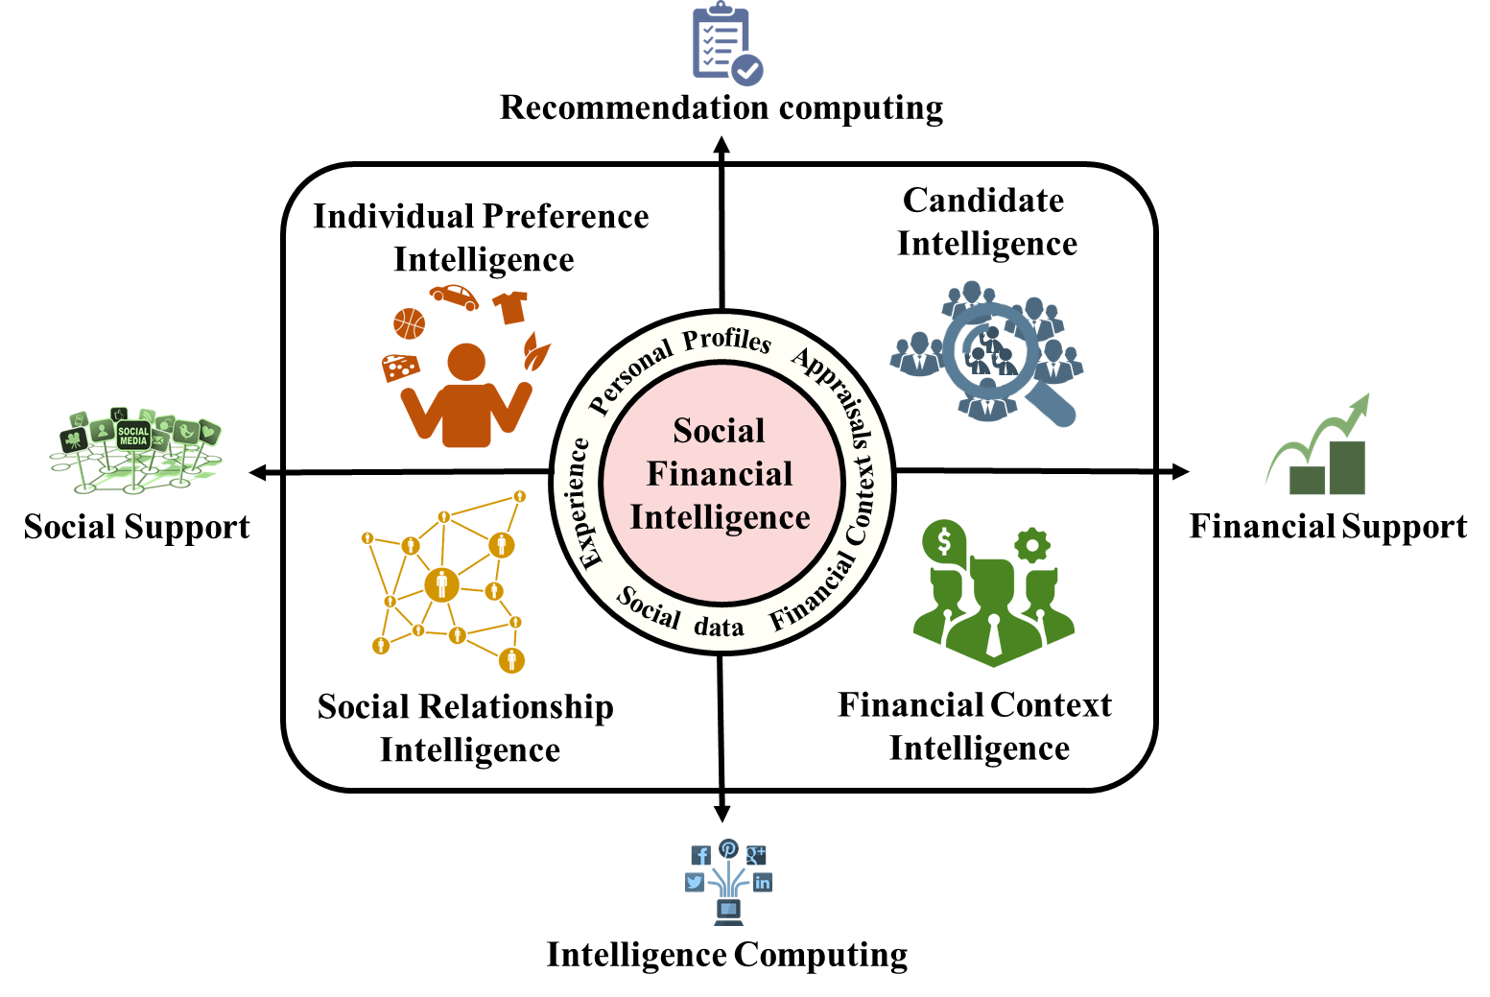
Social Finance Computing

Slide 16
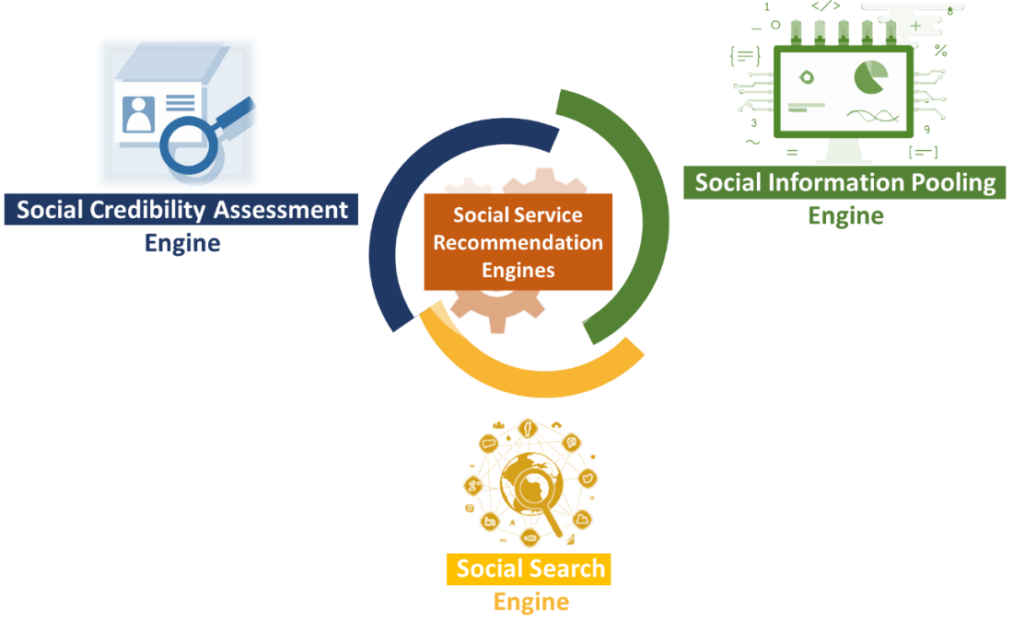
Social Finance Computing

Slide 17
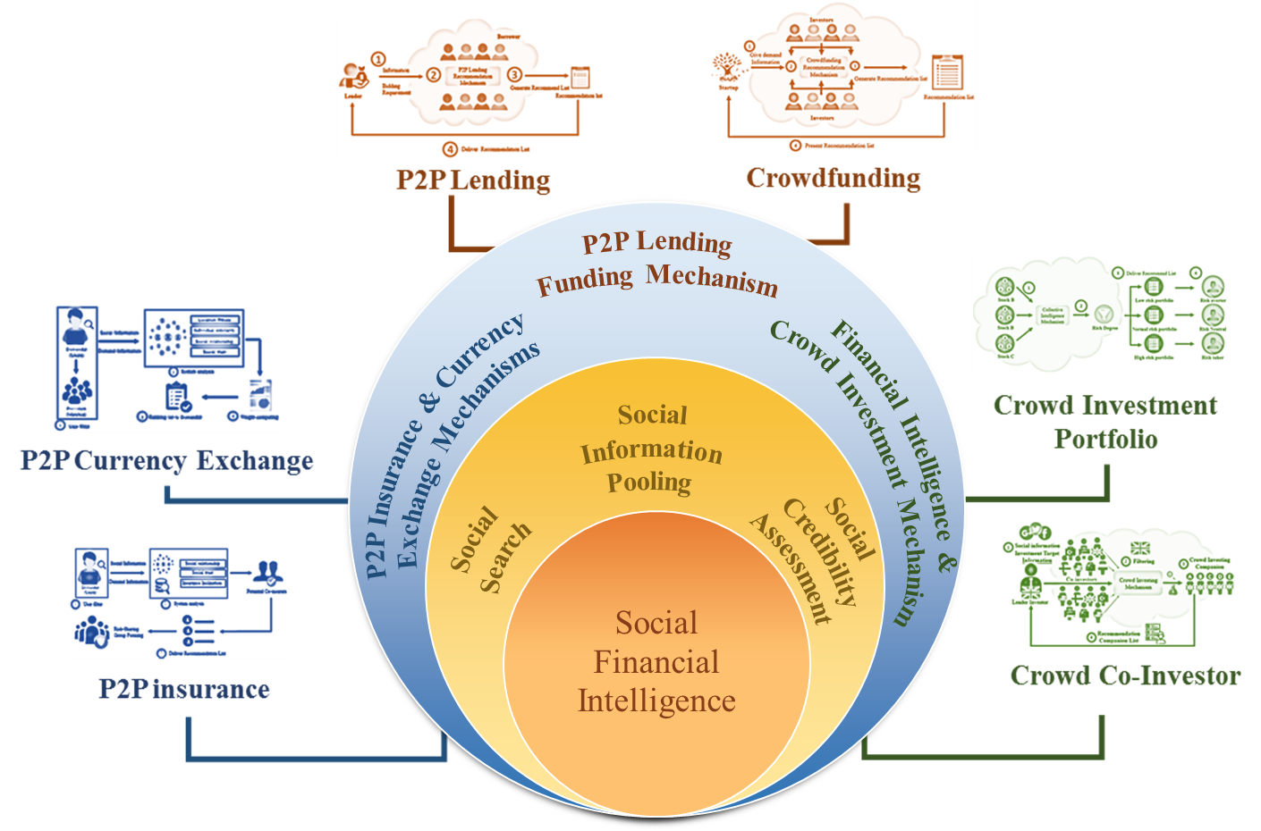
Social Finance Computing

Slide 18







Evolution: From E-Commerce to Digital Finance
Social Networking
Crowd Sourcing
P2P Computing

Slide 19

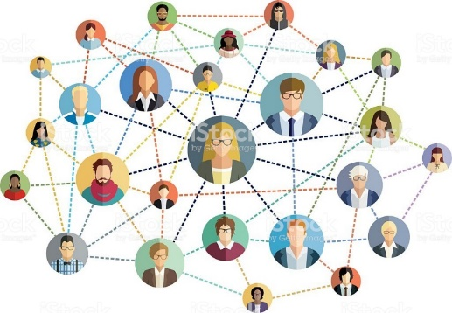
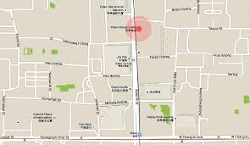
Social Coupon Endorsing
Diffusion by social endorser
Factors:
  Preference
  Location
  Proneness
  Influence

Slide 20
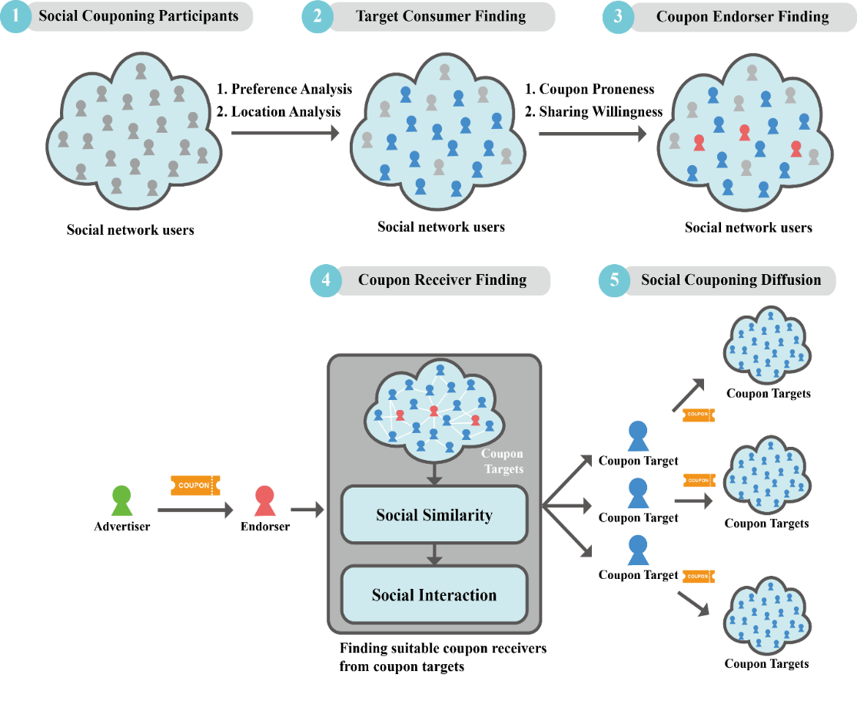
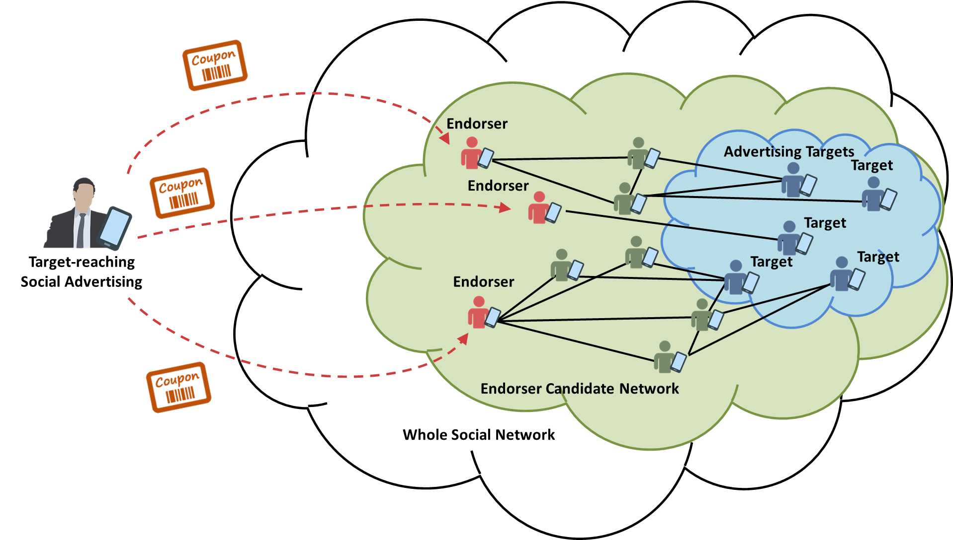
Social Coupon Endorsing : Processes
Notes:
一個人拿手機，有折價券

Slide 21
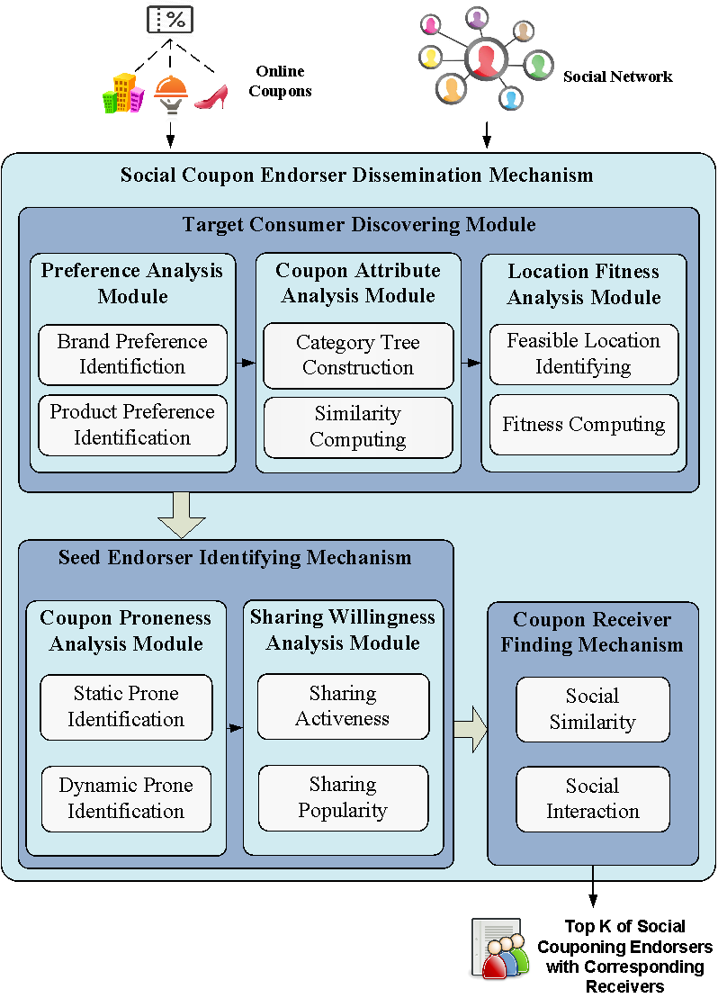
Social Coupon Endorsing: Results

Slide 22

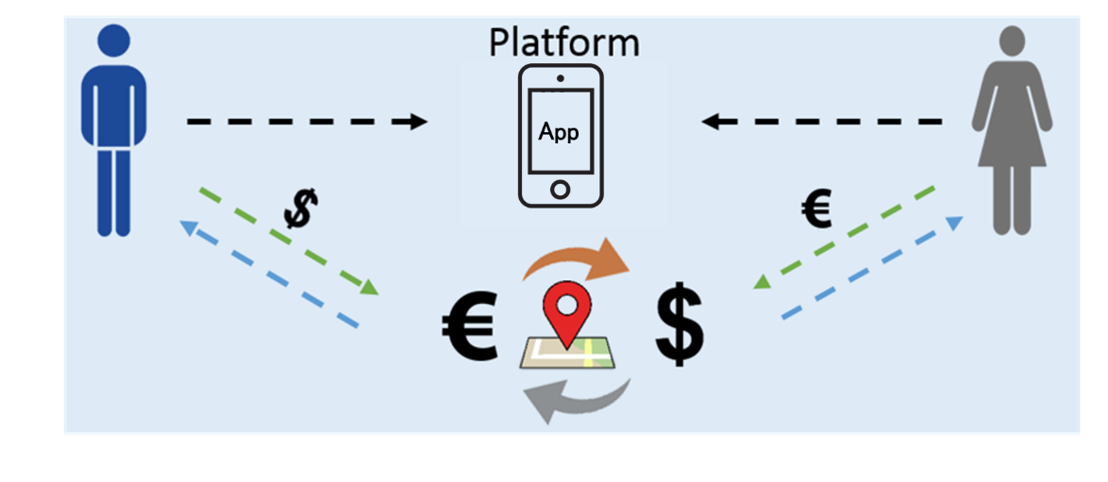
P2P Currency Exchange
Concepts:
  Location based P2P support & economy
  Currency exchange cutting out the middleman, banks, and brokers
  Two parties or individual to exchange directly
Techniques:
  Online to offline exchange model
  Matching based location and social intelligence

Slide 23


P2P Currency Exchange
Notes:
首先是系統的流程
1. 蒐集兩部分的資料集分別為
社群股票討論區的資訊 以及歷史股價
2. 然後透過我們提出的混合式推薦系統
3. 依據風險大小將股票分別匹配到不同的風險組合 產生三種類型的投資組合
4. 最後再依照投資俱樂部偏好推薦他們最適合的投資組合

Slide 24
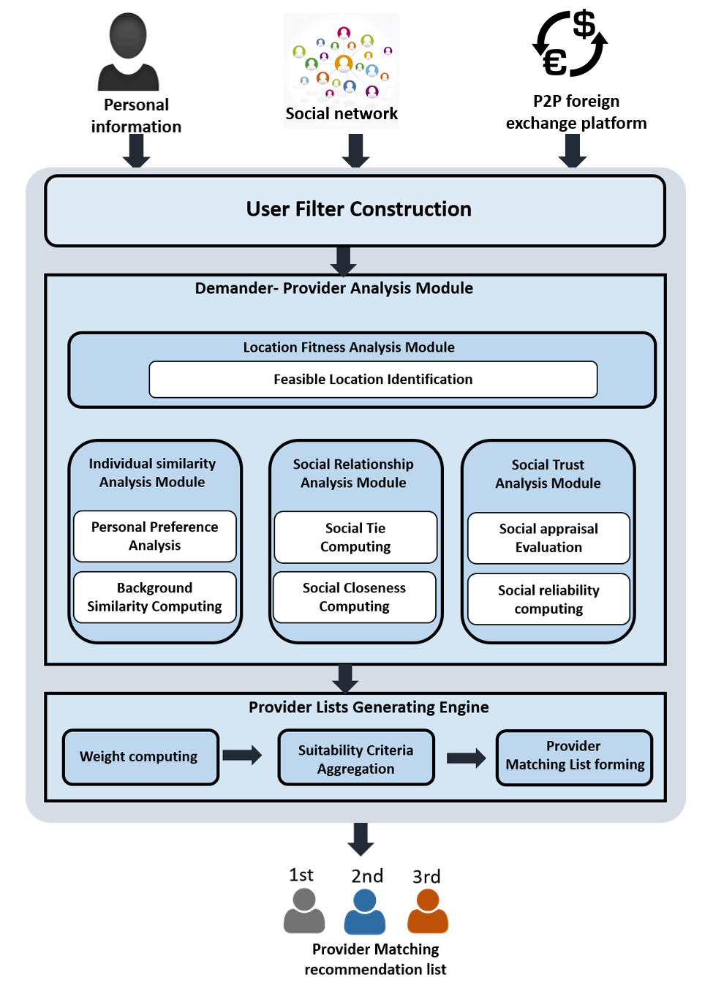
Recommendation Accuracy
Recommendation feedback
Notes:
接著是股票趨勢分析

Slide 25
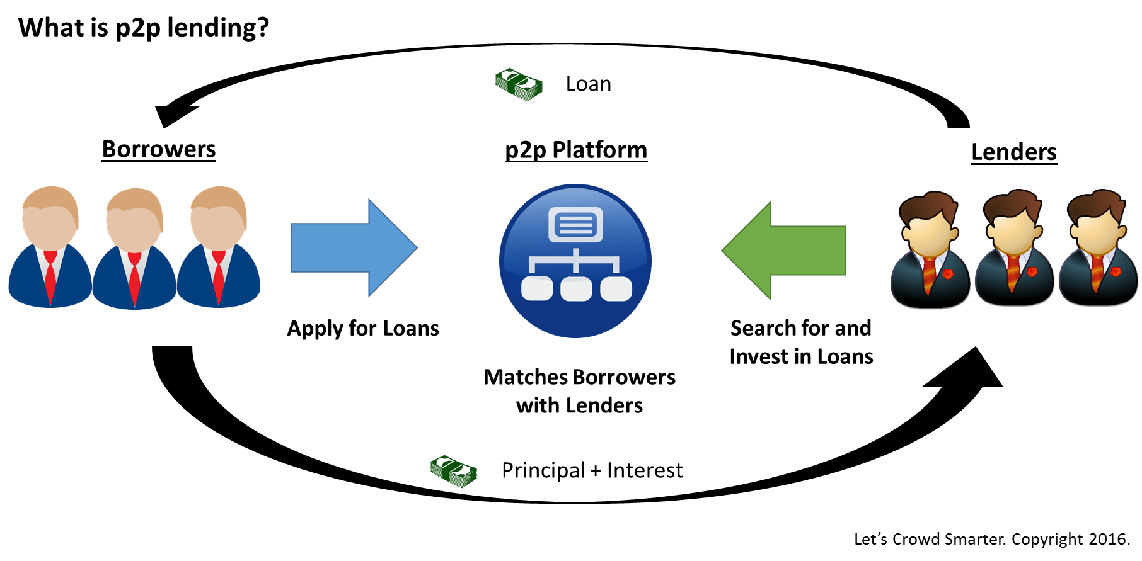
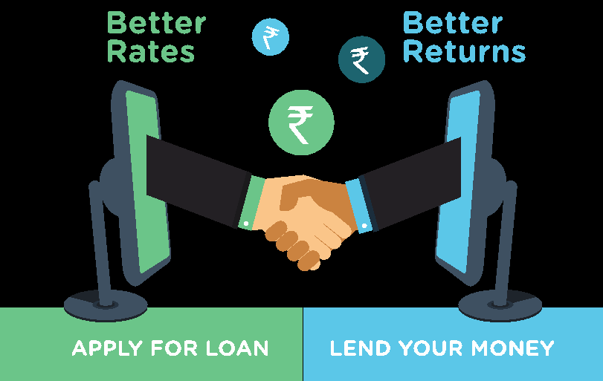
P2P Lending
  Concepts:
    Soliciting loan from peers (strangers) instead of institutes (banks).
    Higher return (lenders) , lower rate (borrowers)
Business problem: Successful matching between borrowers and lenders
Lending factors: loan, interest rate, risk, preference

Slide 26
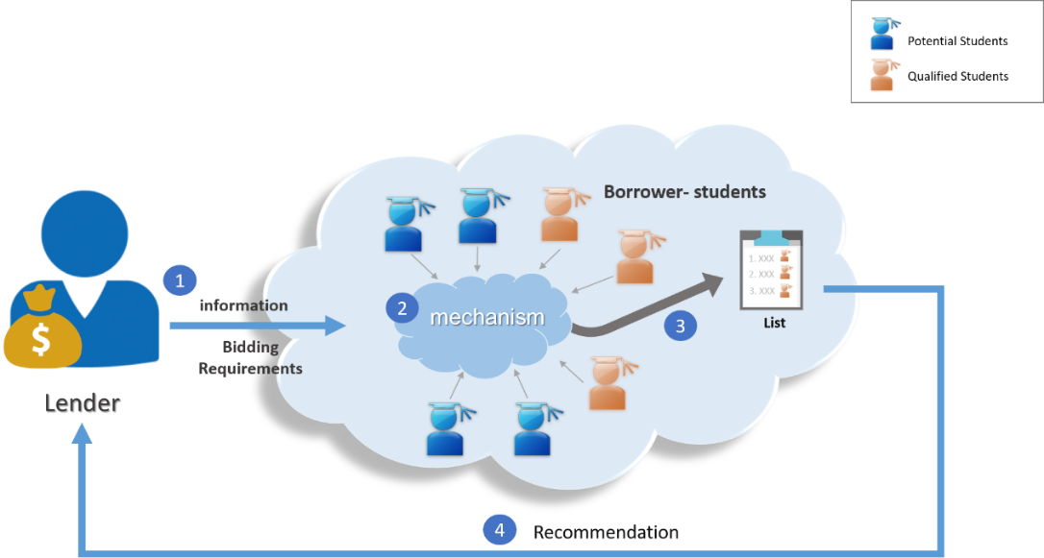
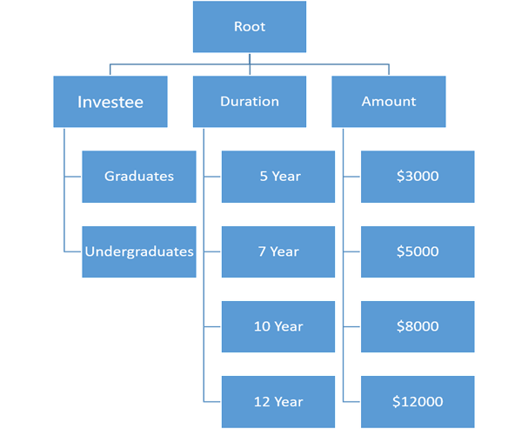
P2P Student Lending
Processes

Slide 27
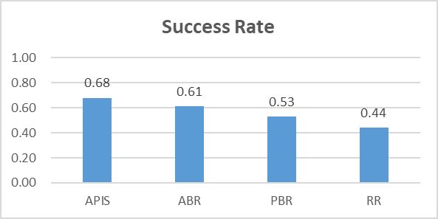
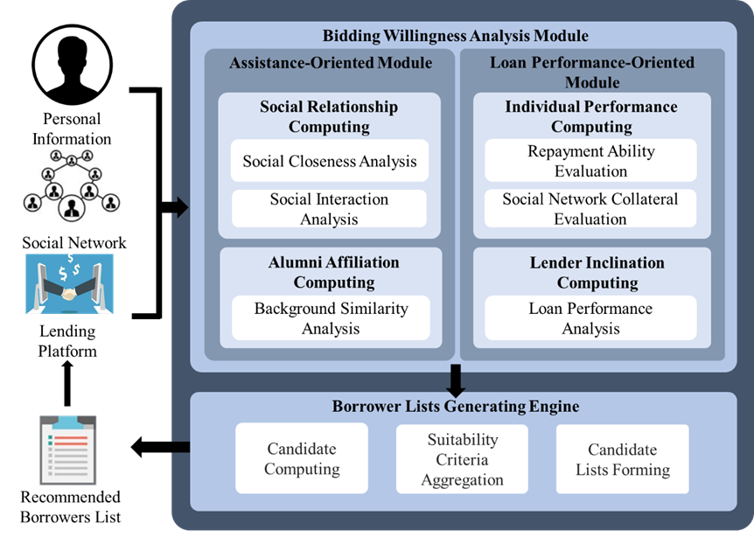
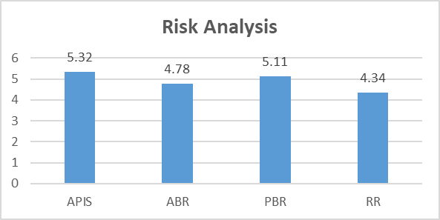
P2P Lending

Slide 28
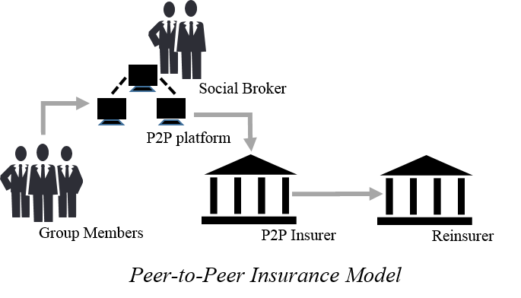
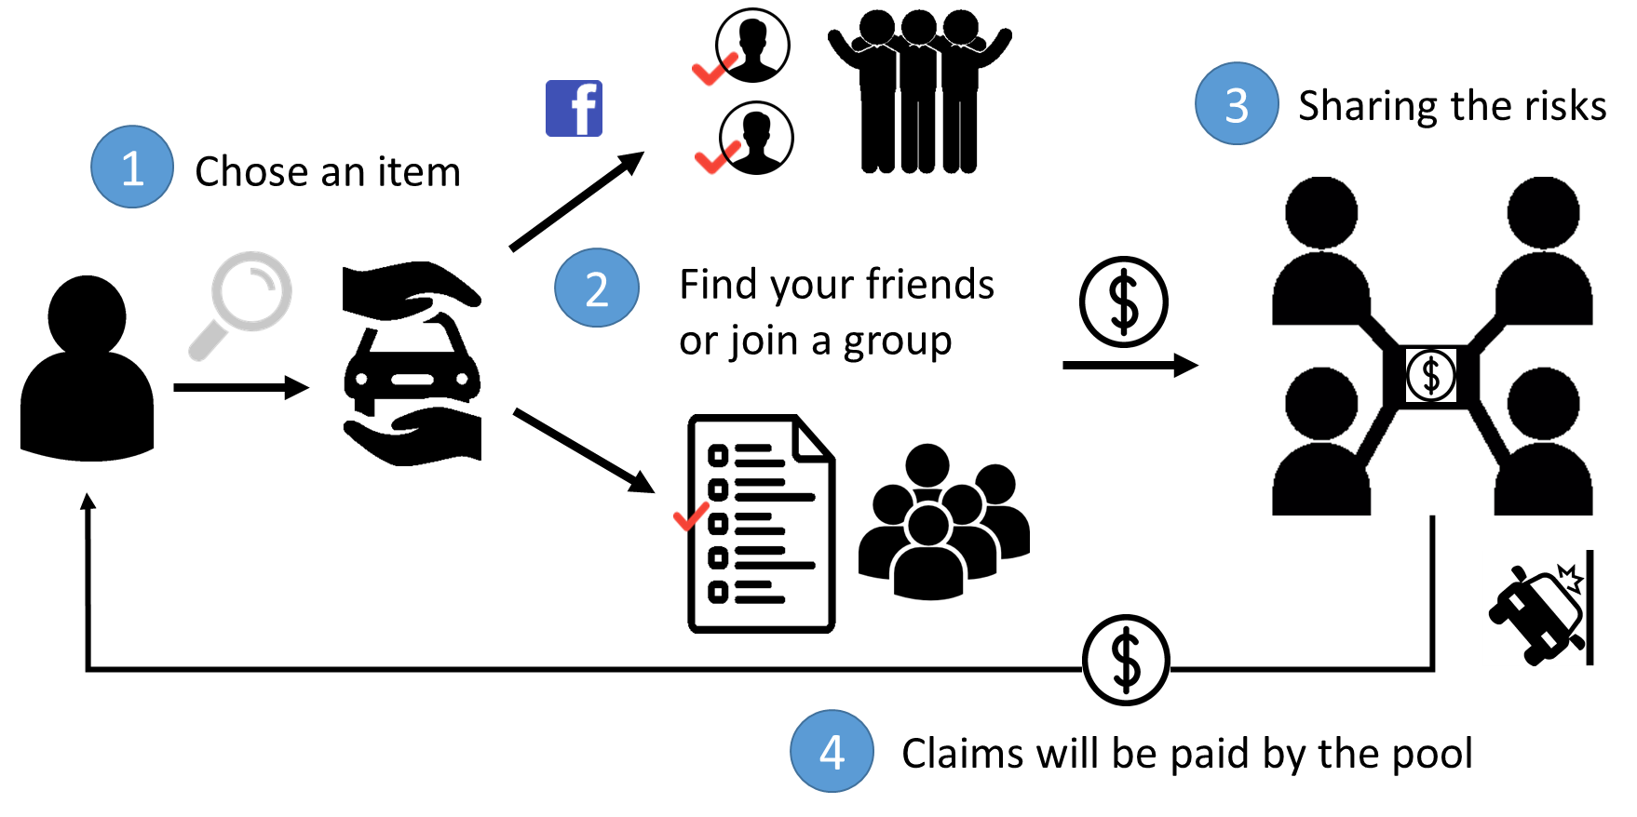
Social Insurance Formation
Concept:
  A group o people who share similar risk profiles forms an risk protection agreement of mutual assistance
  Group reinsurance
Success factor: inclination, similarity, trustiness

Slide 29
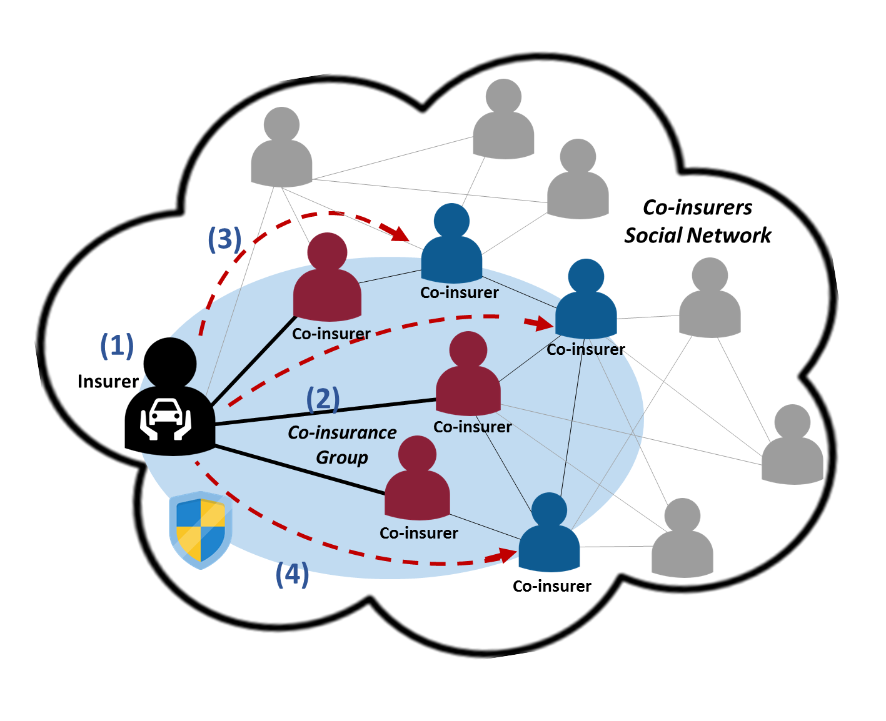
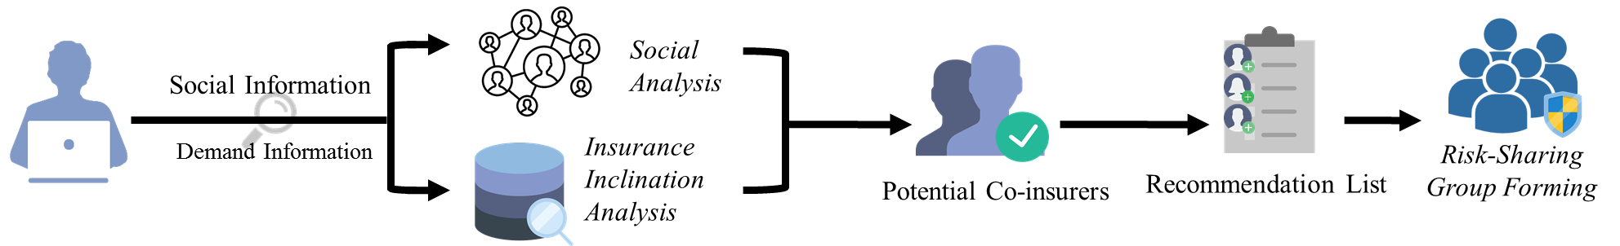
P2P Insurance Formation Process
(1)
(2)
(3)
(4)

Slide 30
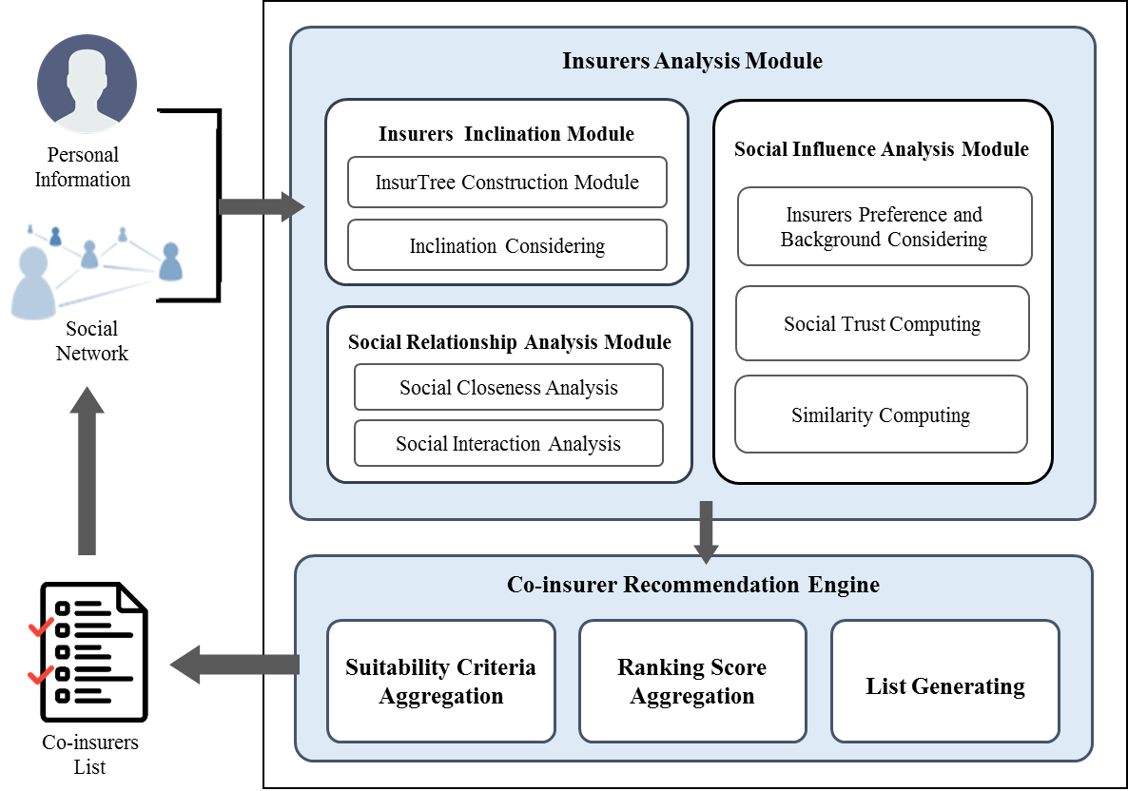

Slide 31
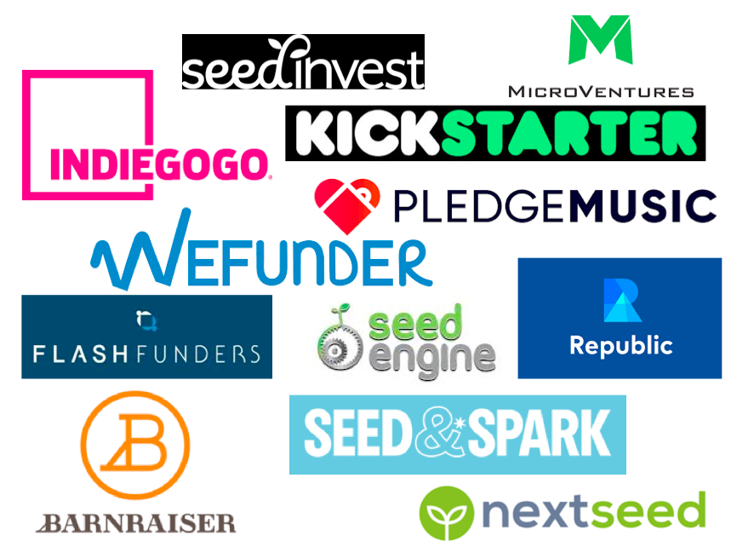

Crowdfunding Campaigns
Business problem: Success rate of projects has never exceeded 50%
Success factor: relationship, network, preference
Life cycle: Early, middle, late phases
Investors: family, friend, the crowd

Slide 32
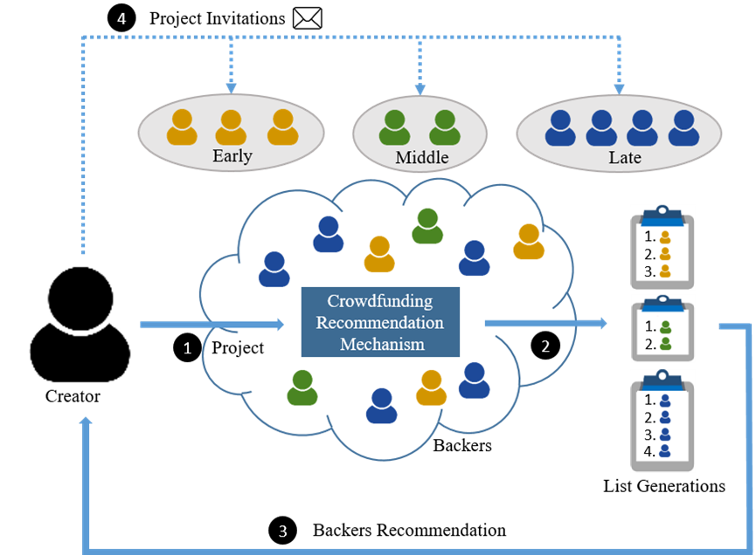
Phase-based Crowdfunding recommendation
Process

Slide 33
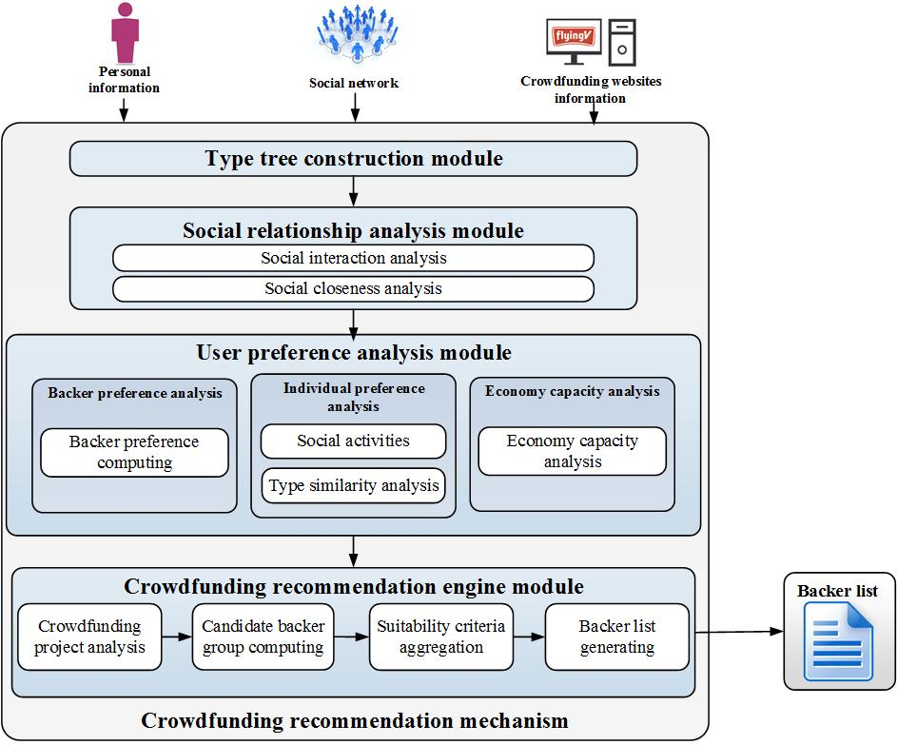
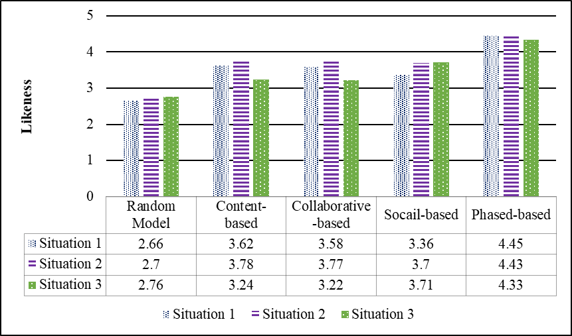

Slide 34

Smart Portfolios for Investment Clubs
Concepts: Power of crowd- Aggregation of information and funds
Techniques: Collective intelligence (Social computing) PLUS Deep learning (LSTM algorithm)

Slide 35
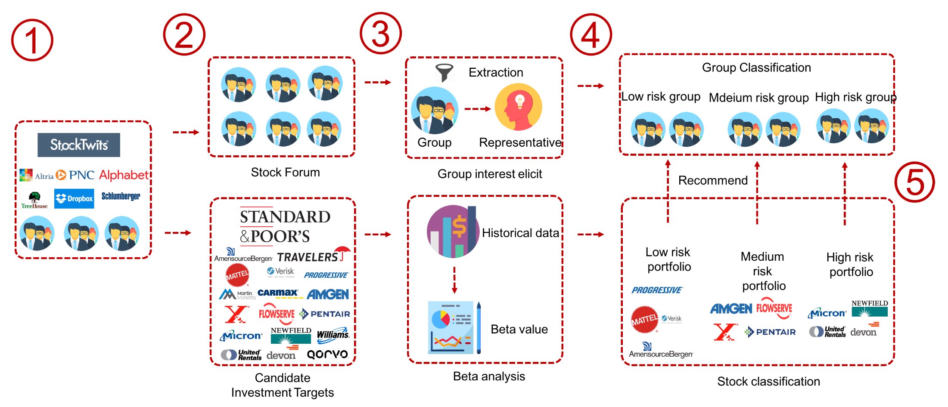
Smart Portfolios for Investment Clubs
Club Preference Analysis (risk type)
Stock Performance Analysis (risk type)
Notes:
首先是系統的流程
1. 蒐集兩部分的資料集分別為
社群股票討論區的資訊 以及歷史股價
2. 然後透過我們提出的混合式推薦系統
3. 依據風險大小將股票分別匹配到不同的風險組合 產生三種類型的投資組合
4. 最後再依照投資俱樂部偏好推薦他們最適合的投資組合

Slide 36
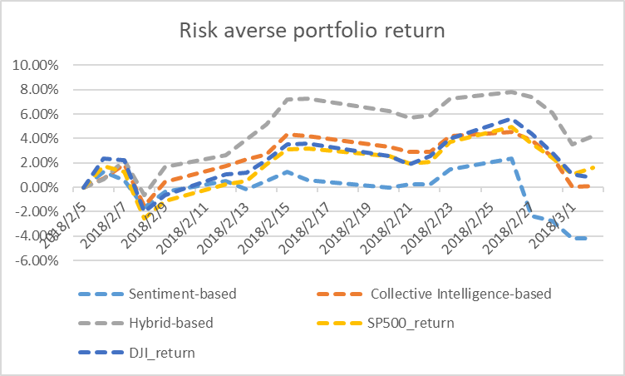
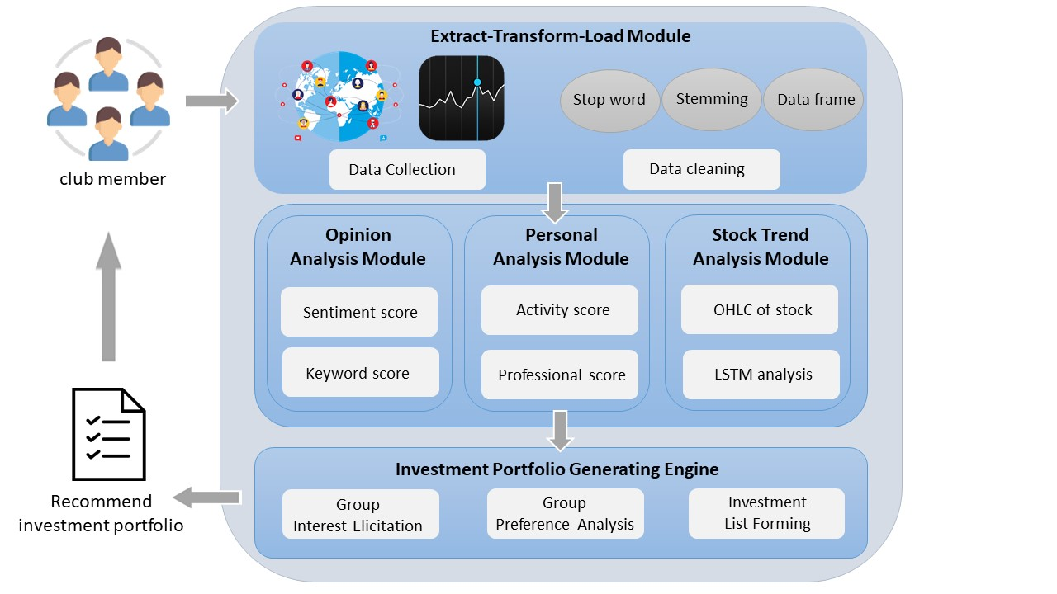
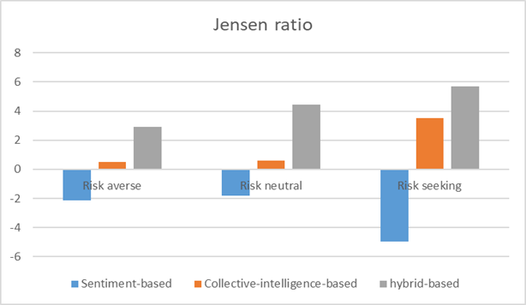
Notes:
接著是股票趨勢分析

Slide 37
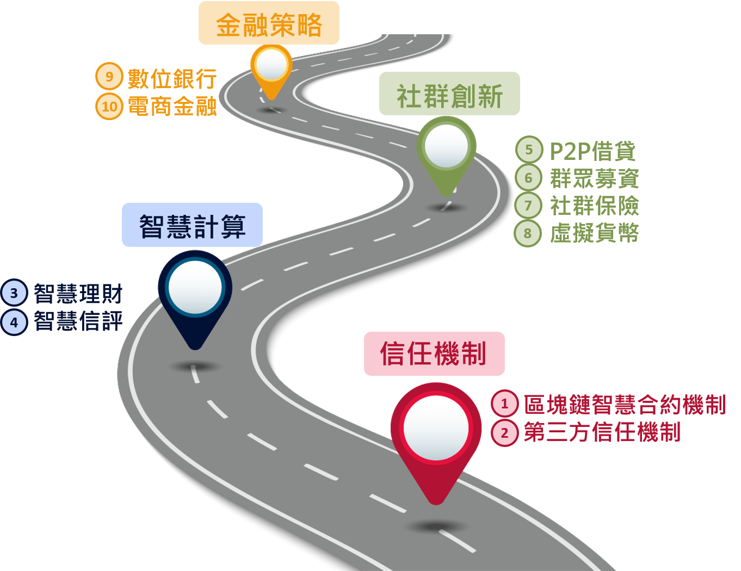
NEXT: Research road map

Slide 38
Thank you ! Q&A

