Slide 1
Social Finance Computing Research
Yung-Ming Li, Ph.D.
Institute of Information Management
National Chiao Tung University

Slide 2



Five Ingredients of digital finance
Online operating platform
AI & data driven analysis
Financial sector
Social business model
Customers
De-bundled financial service
Micro-financial market

Slide 3
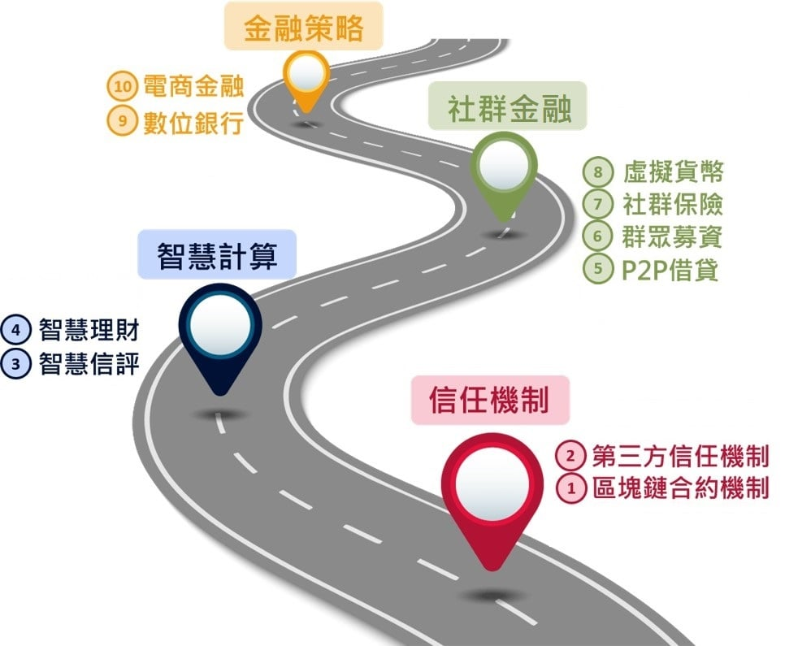

Slide 4
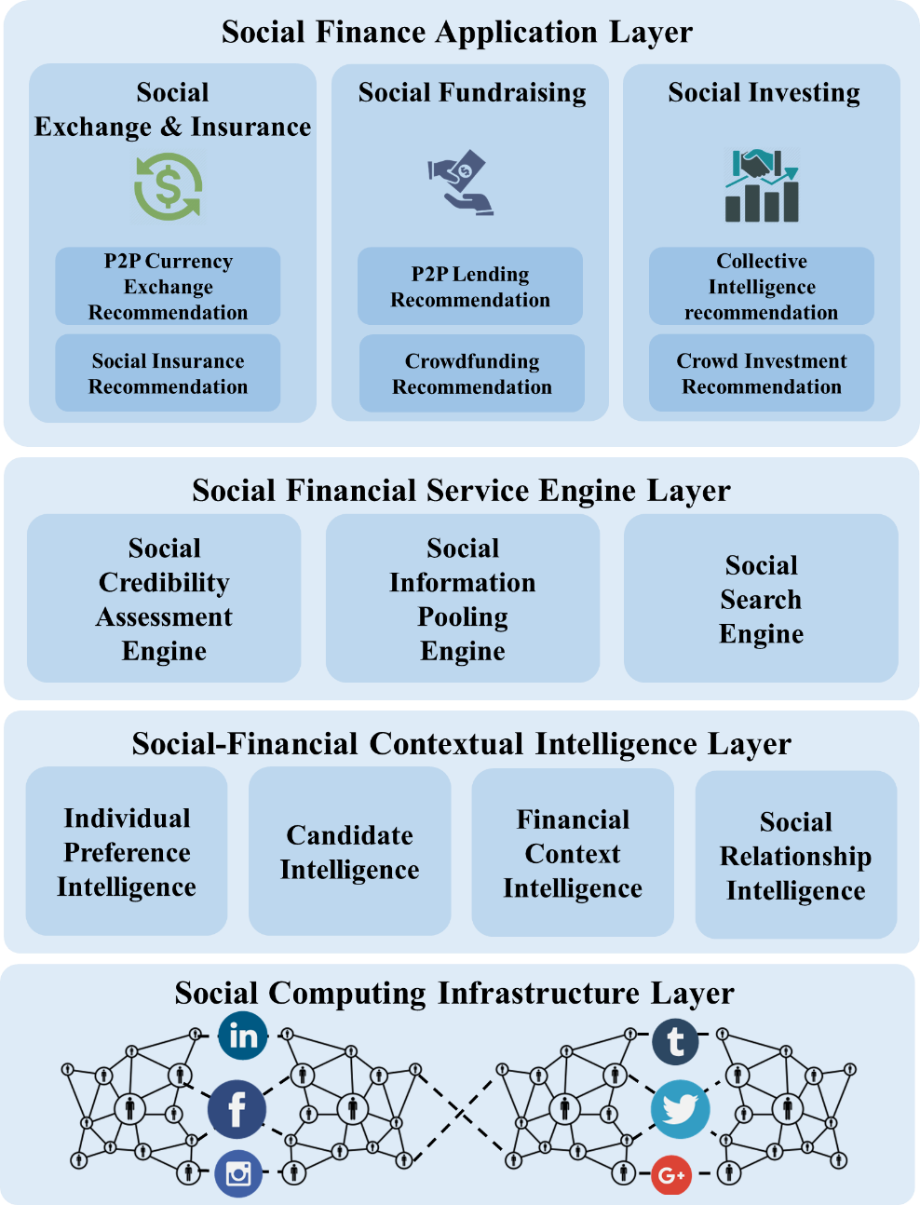
Social Finance Computing Infrastructure
Applications
Engines
Intelligence
Data

Slide 5



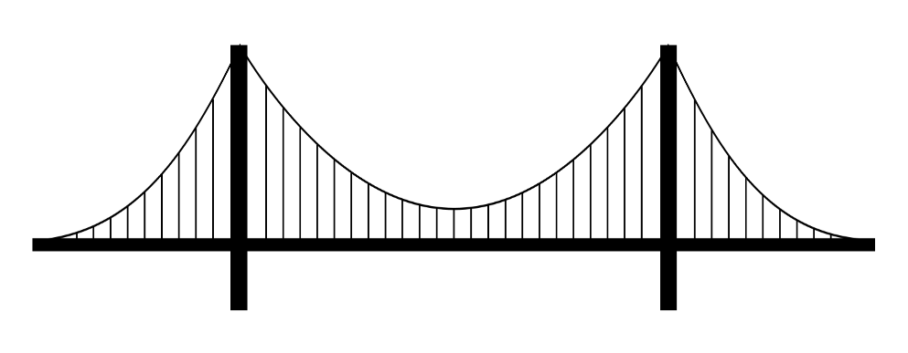



Social Finance: Funding, Lending, Investing
Crowd Funding
P2P Lending
Social Investing
Funding
Investing
Crowd computing
P2P computing
Social computing
RNN
LSTM
BERT

Slide 6
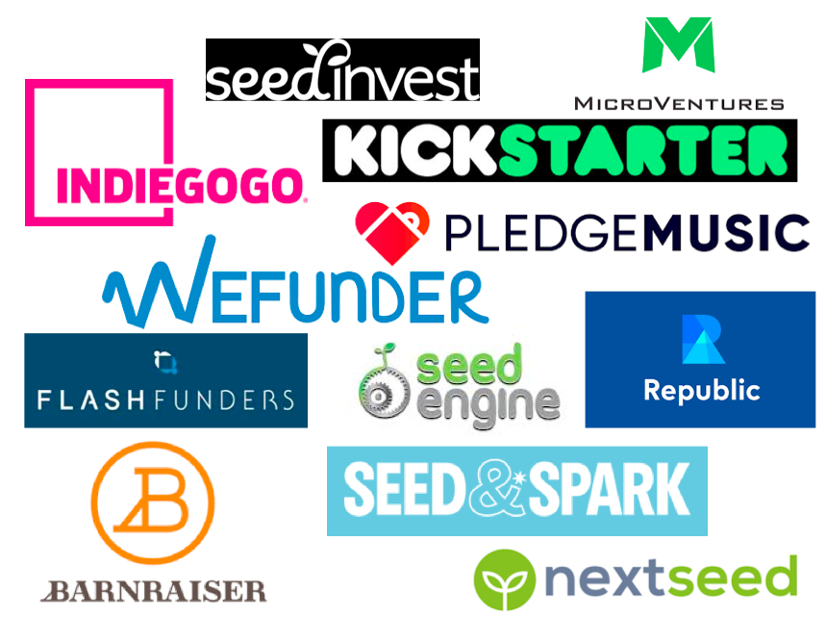

Crowdfunding (1): Reward based Campaigns
All-or-nothing
Business problem: Success rate of projects has never exceeded 50%
Success factor: relationship, network, preference
Life cycle: Early, middle, late phases
Investors: family, friend, the crowd

Slide 7
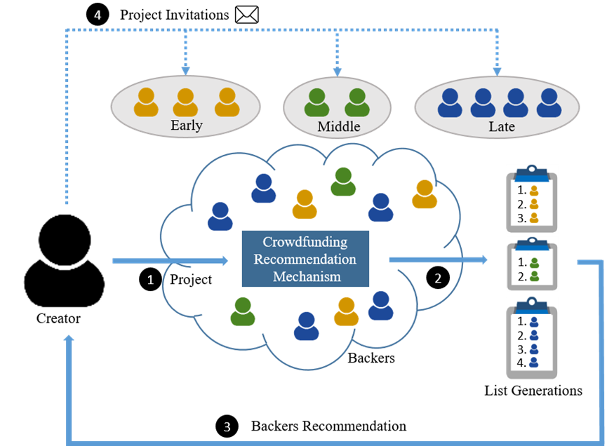
Phased-based crowdfunding recommendation
Process

Slide 8
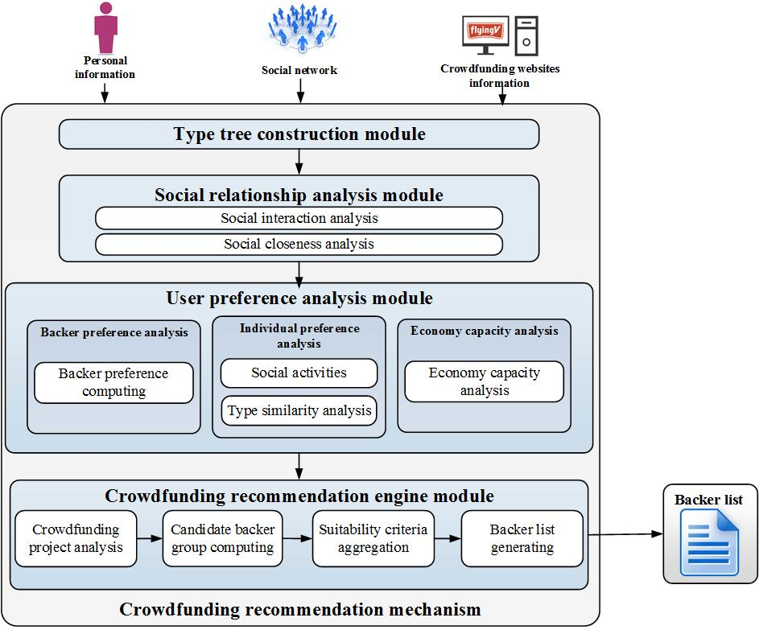
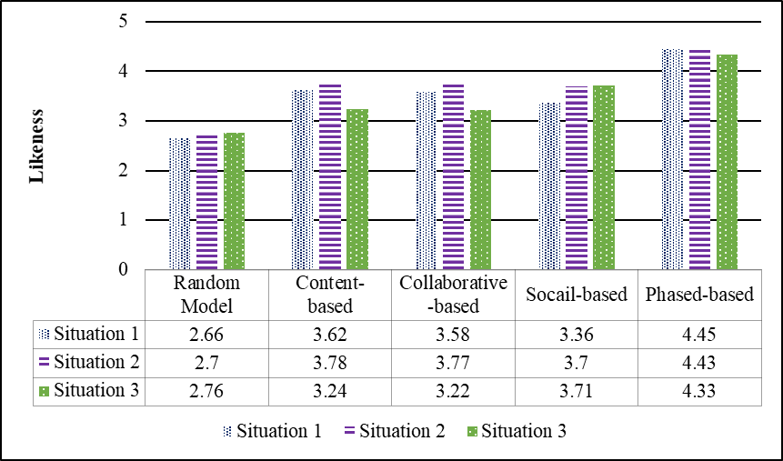

Slide 9

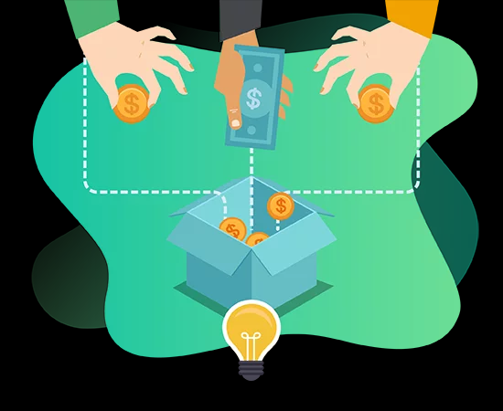


Crowdfunding (2): Donation-based Campaigns
Keep-in-all
Non-profit crowdfunding
The trust in the charity campaign
The willingness to donate
Social influence (direct and indirect influence )

Slide 10
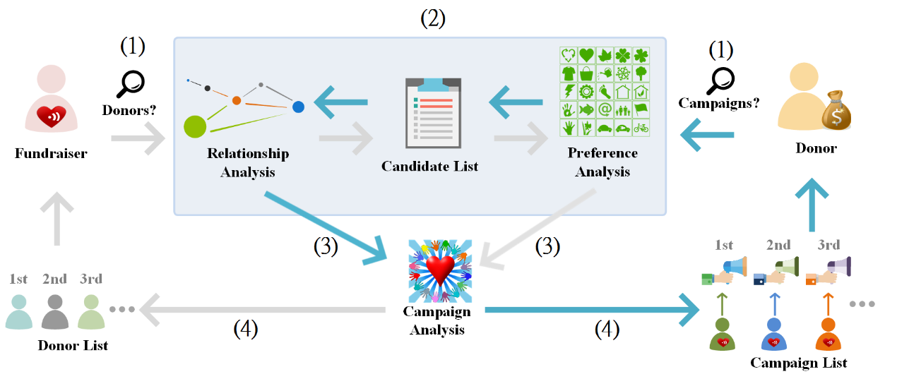
Social fundraising recommendation
Process

Slide 11
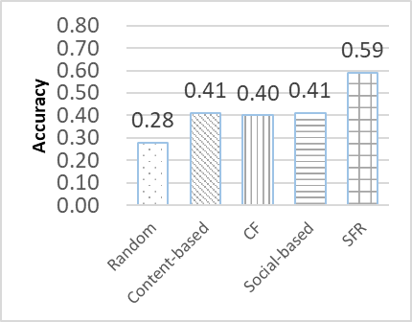
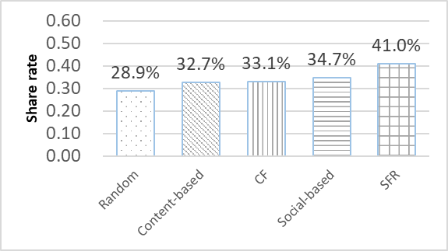

Slide 12




Social Investing (1): Personalized Portfolio
Concepts: Aggregation of crowd intelligence and market information
Techniques: Collective intelligence (Social computing) PLUS Deep learning (LSTM algorithm) PLUS GA (Optimization algorithm)

Slide 13
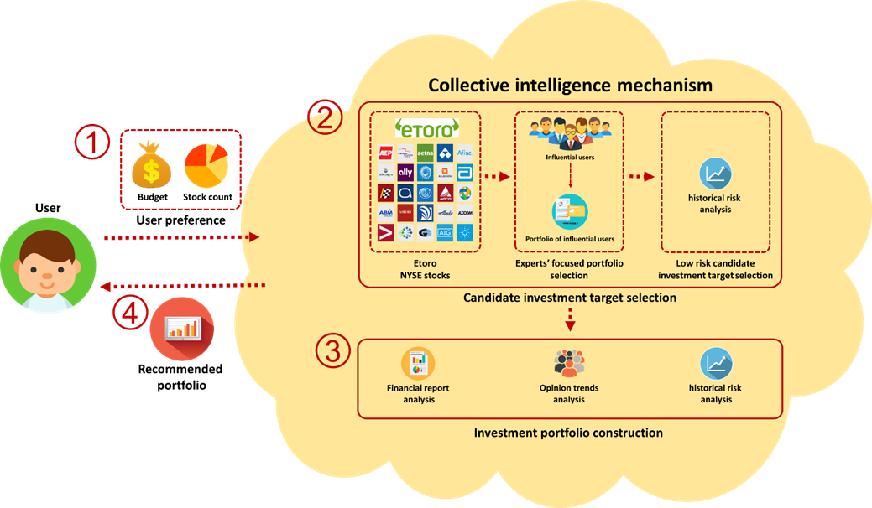
Social Investing for Personalized Portfolio
Notes:
首先是系統的流程
1. 蒐集兩部分的資料集分別為
社群股票討論區的資訊 以及歷史股價
2. 然後透過我們提出的混合式推薦系統
3. 依據風險大小將股票分別匹配到不同的風險組合 產生三種類型的投資組合
4. 最後再依照投資俱樂部偏好推薦他們最適合的投資組合

Slide 14
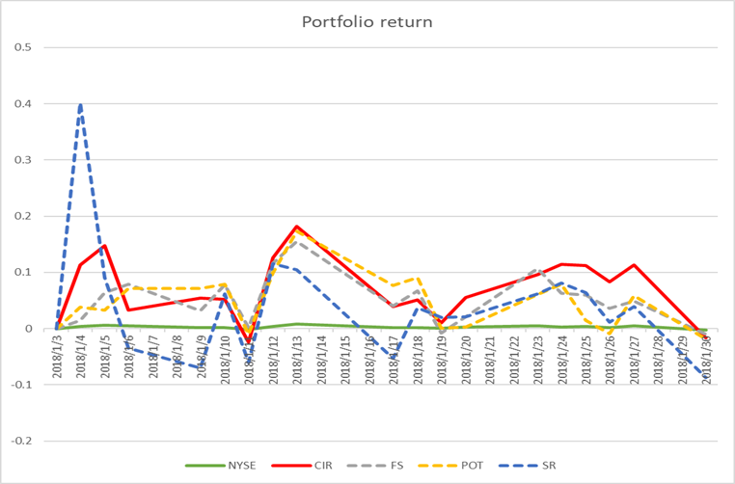
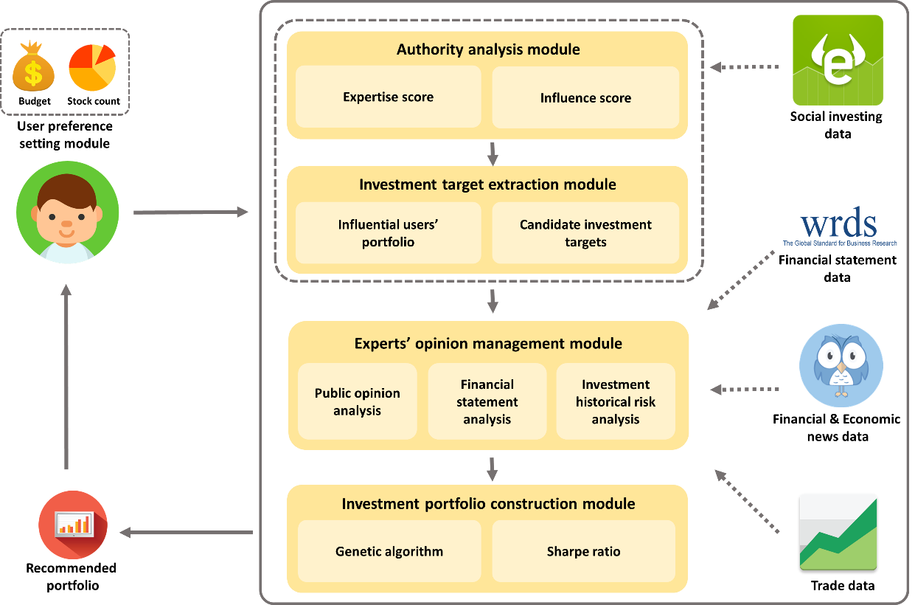
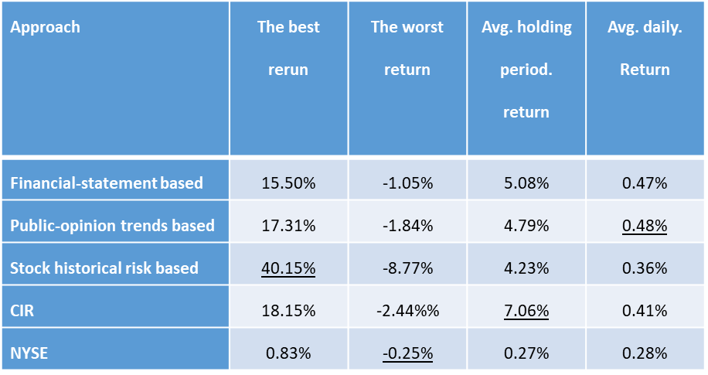
Notes:
接著是股票趨勢分析

Slide 15


Social Investing (2): Group Portfolio
Concepts: Power of crowd- Aggregation of information and funds
Techniques: Collective intelligence (Social computing) PLUS Deep learning (LSTM algorithm)

Slide 16
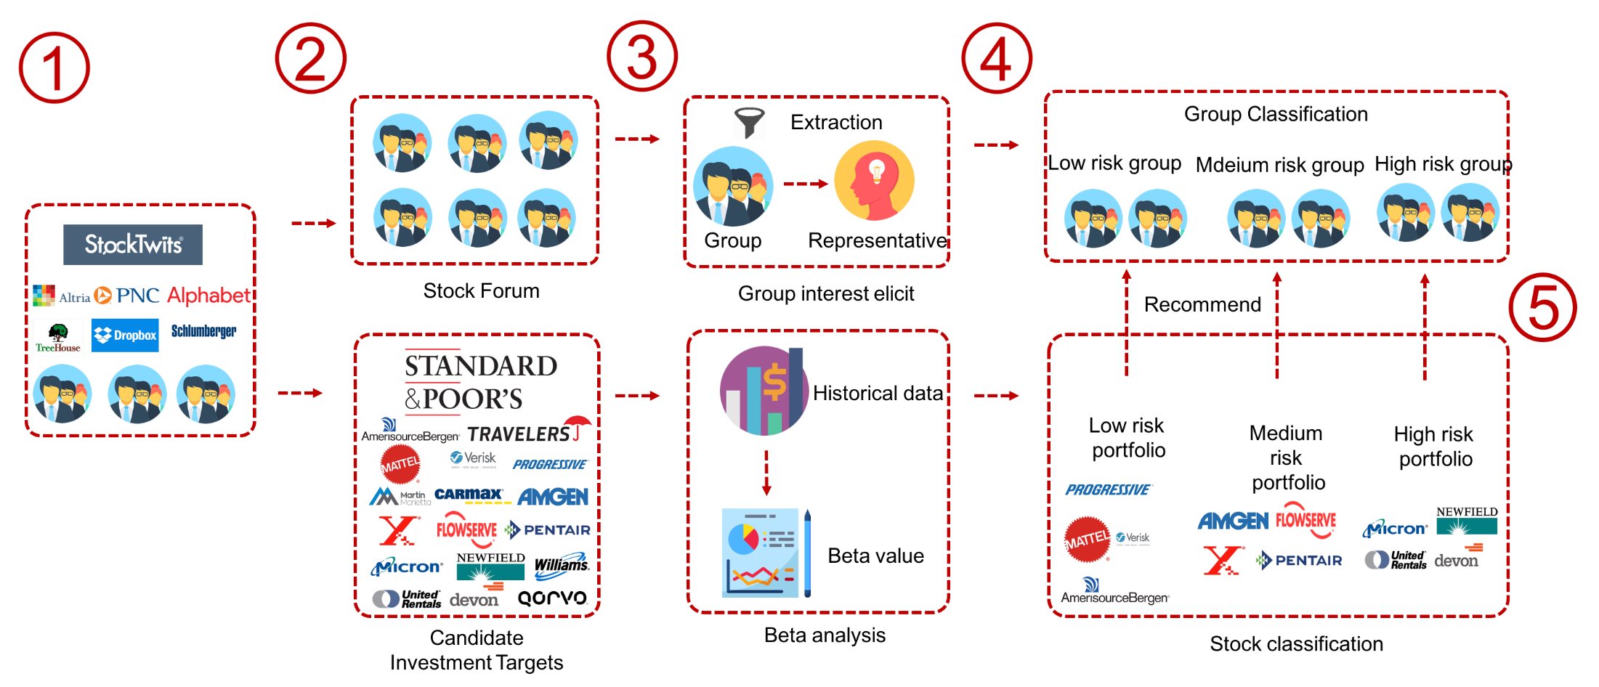
Social Investing for Group Portfolio
Club Preference Analysis (risk type)
Stock Performance Analysis (risk type)
Notes:
首先是系統的流程
1. 蒐集兩部分的資料集分別為
社群股票討論區的資訊 以及歷史股價
2. 然後透過我們提出的混合式推薦系統
3. 依據風險大小將股票分別匹配到不同的風險組合 產生三種類型的投資組合
4. 最後再依照投資俱樂部偏好推薦他們最適合的投資組合

Slide 17
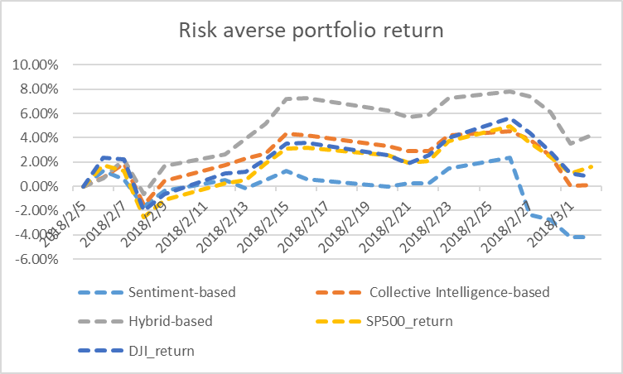
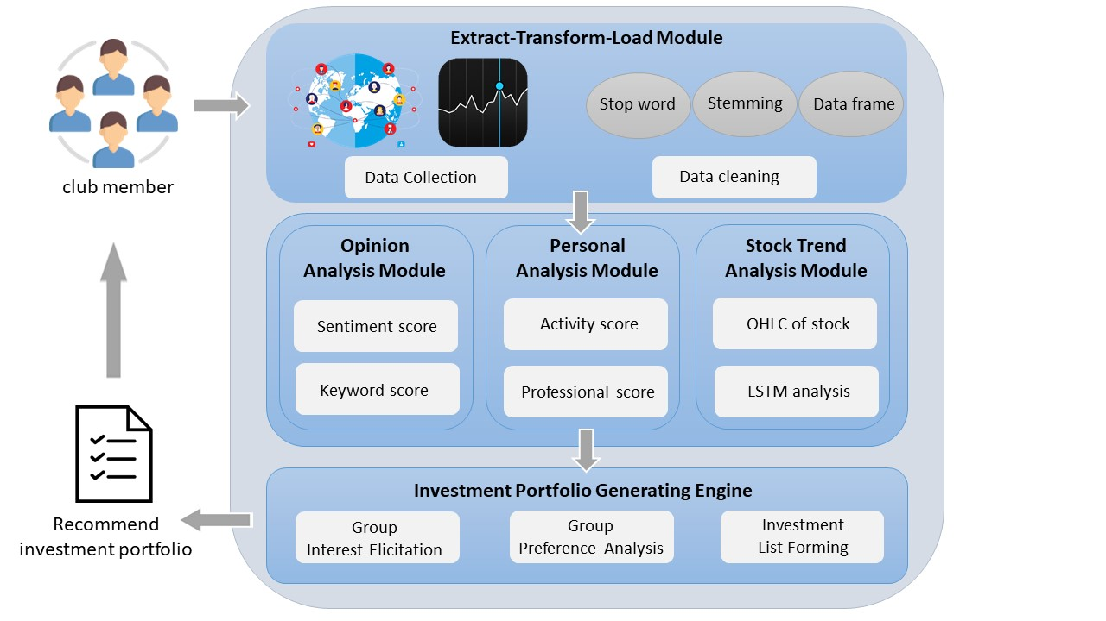
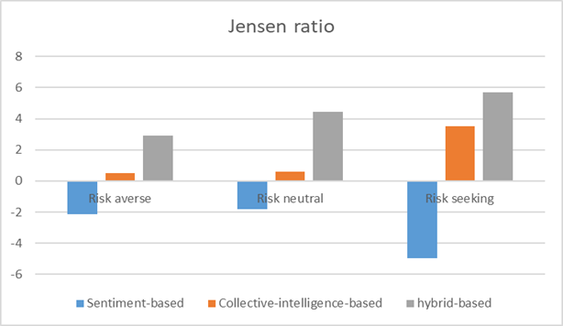
Notes:
接著是股票趨勢分析

Slide 18
Thank you ! Q&A

