Slide 1
Publication in Journals
Yung-Ming Li Ph.D.
Institute of Information Management
National Yung-Ming Chiao Tung University, TAIWAN

Slide 2
Journal publication
Signal of quality research
Graduation (Ph.D. degree requirement)
Job market (Competition advantage )
Promotion (ranks, salary)
Exchange (University)
Collaboration (Interdisciplinary cooperation, friendship)

Slide 3
UT Dallas Journals: Top Business School Research Ranking (24 topJournals)
The Accounting Review | Journal of Accounting and Economics | Journal of Accounting Research | Journal of Finance | Journal of Financial Economics | The Review of Financial Studies
Information Systems Research | Journal on Computing | MIS Quarterly | Journal of Consumer Research | Journal of Marketing | Journal of Marketing Research
Marketing Science | Management Science | Operations Research | Journal of Operations Management | Manufacturing and Service Operations Management | Production and Operations Management
Academy of Management Journal | Academy of Management Review | Administrative Science Quarterly | Organization Science | Journal of International Business Studies | Strategic Management Journal

Slide 4
Financial Times Top 50 Journal
Academy of Management Journal | Academy of Management Review | Accounting, Organizations & Society | Administrative Science Quarterly | American Economic Review
Contemporary Accounting Research | Econometrica | Entrepreneurship Theory and Practice | Harvard Business Review | Human Relations
Human Resource Management | Information Systems Research | Journal of Accounting and Economics | Journal of Accounting Research | Journal of Applied Psychology
Journal of Business Ethics | Journal of Business Venturing | Journal of Consumer Psychology | Journal of Consumer Research | Journal of Finance
Journal of Financial and Quantitative Analysis | Journal of Financial Economics | Journal of International Business Studies | Journal of Management | Journal of Management Information Systems
Journal of Management Studies | Journal of Marketing | Journal of Marketing Research | Journal of Operations Management | Journal of Political Economy
Journal of the Academy of Marketing Science | Management Science | Manufacturing and Service Operations Management | Marketing Science | MIS Quarterly
Operations Research | Organization Science | Organization Studies | Organizational Behavior and Human Decision Processes | Production and Operations Management
Quarterly Journal of Economics | Research Policy | Review of Accounting Studies | Review of Economic Studies | Review of Finance
Review of Financial Studies | Sloan Management Review | Strategic Entrepreneurship Journal | Strategic Management Journal | The Accounting Review

Slide 5
MIS Journal ranking
http://www1.chapman.edu/~bdehning/MIS%20Journal%20Rankings.htm

Slide 6
Top MIS journals
MIS Quarterly
Information Systems Research (ISR)
Journal of Management Information Systems (JMIS)

Slide 7
IS/IT journals (Scope, AE served)
Information & Management (SSCI, Elsevier)
Electronic Commerce Research and Applications (SSCI, Elsevier)
Information Technology & Management (SCI, Springer)
Journal of E-Business (TSSCI, Area Editor)
Journal of Management & Systems (TSSCI, Area Editor)
Sun Yat-Sen Management Review (TSSCI, Area Editor)

Slide 8

Information & Management
Serves researchers in the information systems field and managers, professionals, administrators and senior executives of organizations which design, implement and manage Information Systems Applications.
Impact factor: 10.328

Slide 9

Electronic Commerce Research and Applications
  Aim to create and disseminate enduring knowledge for the fast-changing e-commerce environment. A major dilemma in e-commerce research is how to achieve a balance between the currency and the life span of knowledge.
Impact factor: 5.662
5.622

Slide 10

Information Technology & Management
  Explores the many different technologies inherent in the field of information technology and their impact on information systems design, functionality, operations, and management.
  Impact factor: 2.310

Slide 11
Relevance and Rigidness (R&R)
Relevance
  Industry/market relevance (newness, interesting, importance)
  Literature/Theory relevance
  Introduction(Position, Motivation, Research gaps, Problems)
  Discussion (Findings, implications, limitations, extensions)
Rigidness
  Methodology (math model, hypothesis model, algorithm model)
  Validation (theorem/proposition proof, data analysis/statistic validation , benchmark comparisons)
  Data representativeness: quantity (big data perspective) and quality (small data perspective)
  Benchmark comparisons: state of art algorithm, new theory constructs, new measurements, data sources

Slide 12
Structure of a Journal Paper
1. Introduction
2. Related Literature/theory foundation
3. Research Framework: Model/ System Framework/Hypothesis development
4. Methodology: Analytical model/Statistics model/Algorithm Design
5. Experiments/Empirical Study
6. Results : Evaluations/Comparisons, Findings/Implications
7. Discussions: Summary, Contributions, Limitations, Future works

Slide 13
Why not acceptable ?
While your results are of potential interest, the topic of your manuscript falls outside of the scope of this journal.
Although your manuscript falls within the aim and scope of this journal, it is being declined due to lack of sufficient novelty.
In its current state, the level of English throughout your manuscript does not meet the journal’s required standard.
Your manuscript shows an unacceptable level of overlap with prior publications. In the present form, the originality of the study cannot be assessed.
Although the problems being addressed are potentially of interest to our readership, your manuscript does not meet the required quality standards to be considered for publication.
The research results reported are too premature for publication. More work is needed to substantiate the conclusions in your manuscript.
We regret to tell you we were not able to find the required number of reviewers to evaluate your manuscript; we don’t want to delay the process for you any longer.

Slide 14
Milestones in Publications
International conference proceeding
  Short paper, short review period, new idea and concept – ongoing study
  ICIS, PACIS, ECIS, AMCIS,…..
  3-9 months (one run of review and revision)
Journals
    Complete paper, longer review period, solid theory and validation – completeness: relevance and rigidness
    1-2 years (several runs of reviews and revisions)

Slide 15
IS/IT Journal (My submission experience)
Europe Journal of Operational Research (Math/Data Modeling)
Information & Management (Managerial Insights, Information Systems)
Decision Support Systems (Information Systems, Math/Data Modeling, Managerial Insights)
Information Sciences (Algorithms, Information Systems)

Slide 16
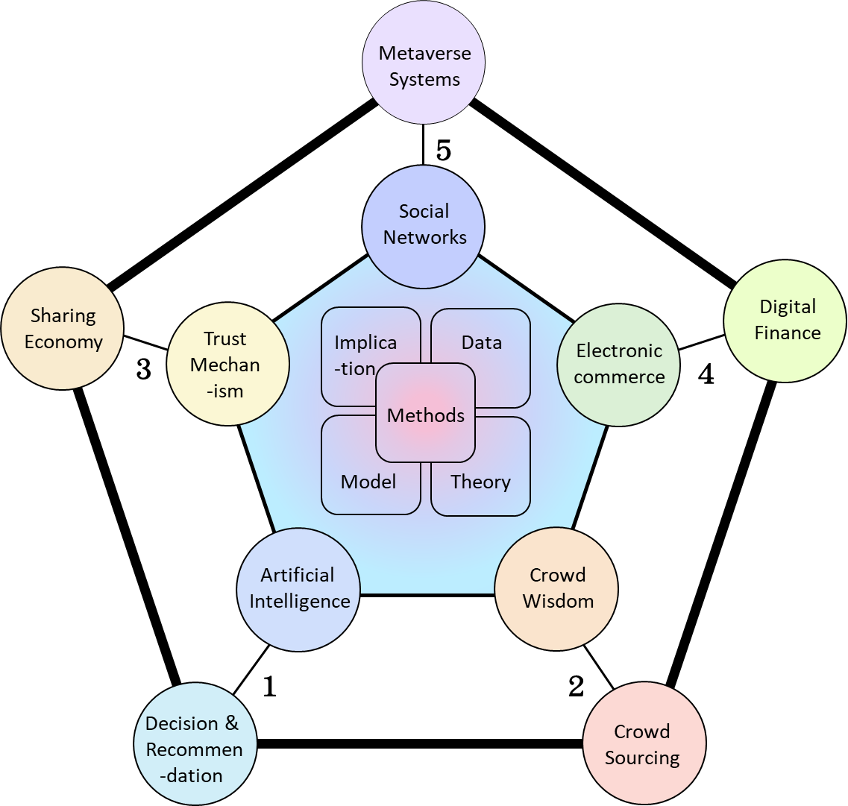
Research Topics in Digital Economy
(1A) Artificial Intelligence
(1B) Decision & Recommendation
(2A) Crowd Wisdom
(2B) Crowd Sourcing
(3A) Trust Mechanism
(3B) Sharing Economy
(4A) Electronic commerce
(4B) Digital Finance
(5A) Social Networks
(5B) Metaverse Systems
Notes:
Methods
implication

Slide 17
Research Framework
Platform
Data
Hypothesis
Discovery
Theory
Recommendation Prediction
Design Science
Social Science
Optimization
(Observations from data)
(Artifacts for platform )

Slide 18
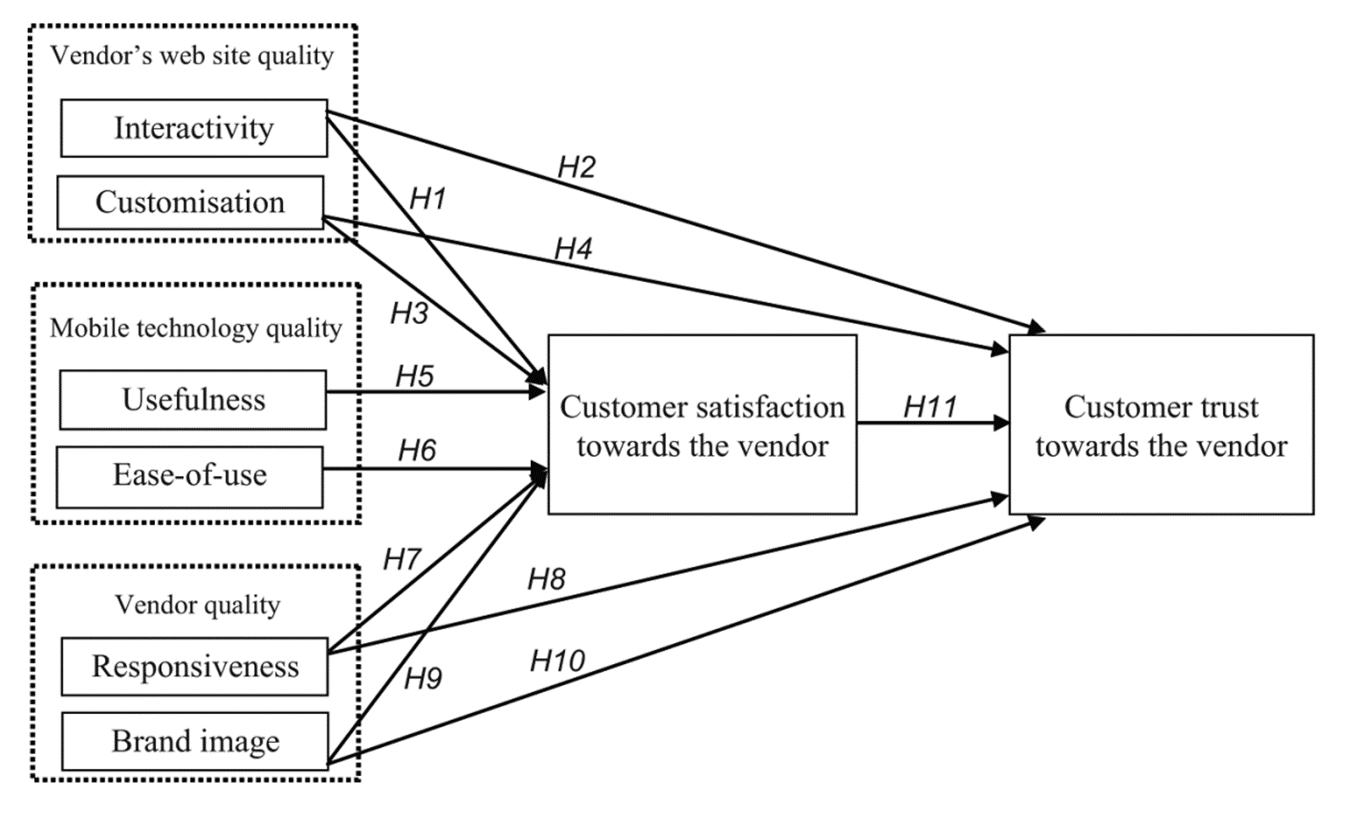
Research Frameworks – Hypothesis
Hypothesis, Discovery, Prediction, Recommendation (Optimization)
H1. Interactivity as m‐quality directly and positively
affects satisfaction.
H2. Interactivity as m‐quality directly and positively
affects trust.
H3. Customisation as m‐quality directly and
positively affects satisfaction.
H4. Customisation as m‐quality directly and
positively affects trust.
.
.
.
H11. Satisfaction directly and positively affects trust.
Yeh, Yung Shao, and Yung‐Ming Li. "Building trust in m‐commerce: contributions from quality and satisfaction." Online Information Review (2009).

Slide 19
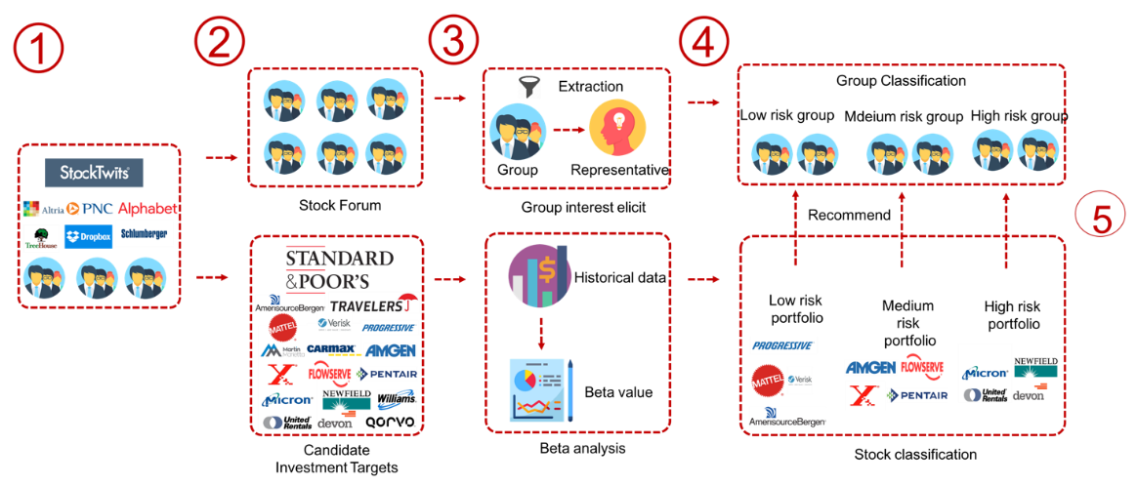
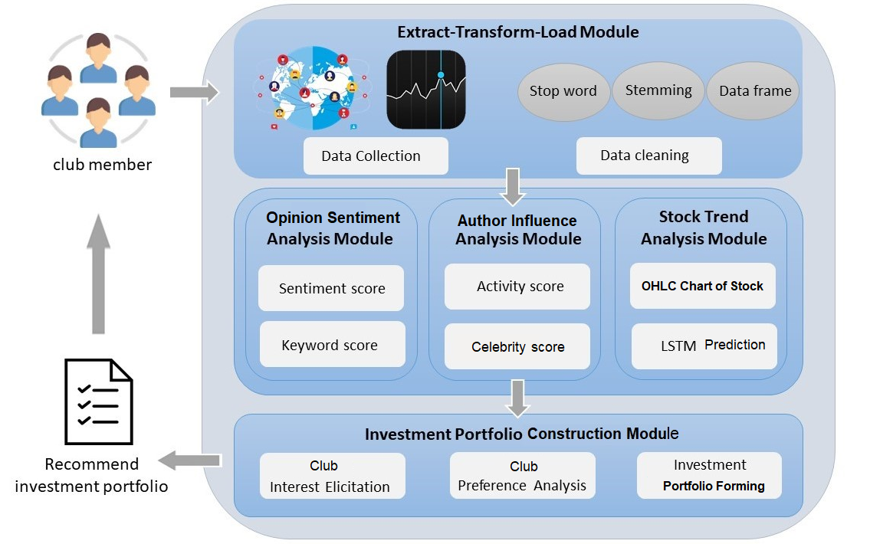
Research Frameworks- Discovery
Hypothesis, Discovery, Prediction, Recommendation, Optimization
A Collective Portfolio Recommendation Approach for Investment Clubs

Slide 20
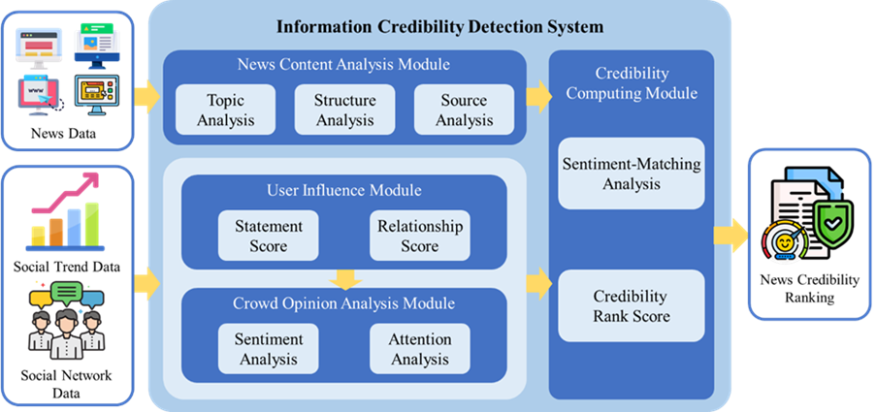
Research Frameworks- Prediction
Hypothesis, Discovery, Prediction, Recommendation, Optimization
Item 1
Factor 1
Item 5
Item 6
Item 2
Factor 2
Y
Item 4
Item 3
Factor 3
Item 7
Appraising the Information Credibility of Online News with Collective Intelligence
Prediction

Slide 21
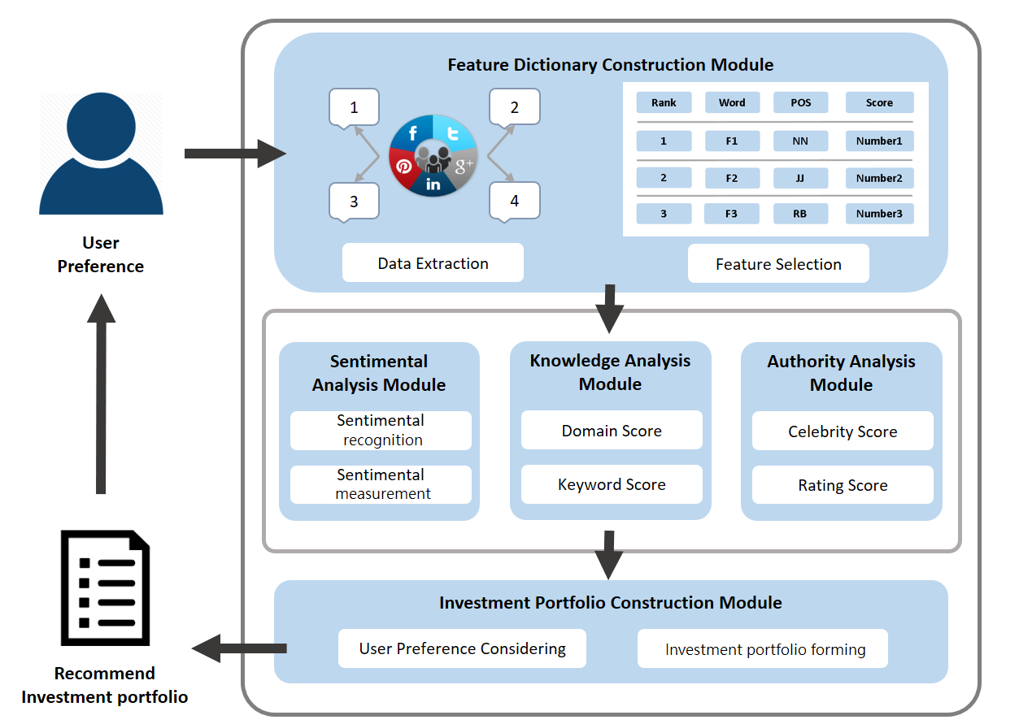
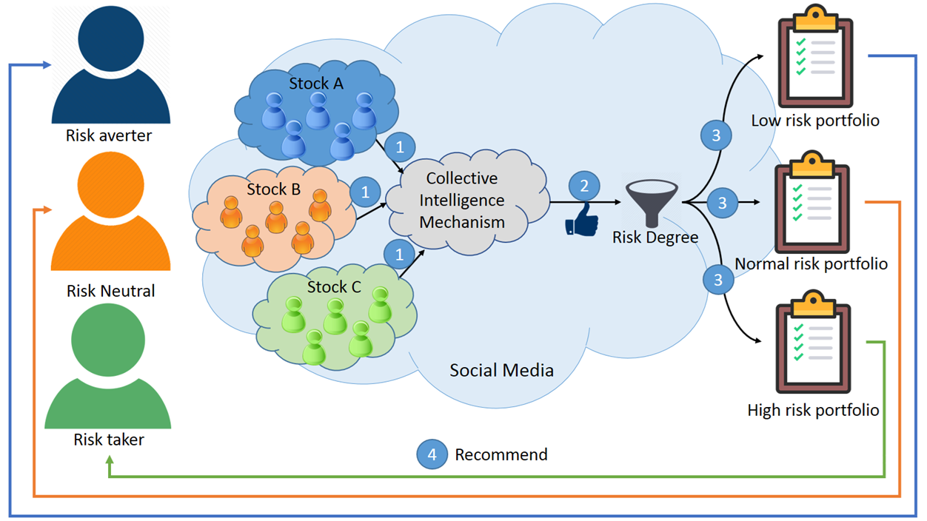
Research Frameworks – Recommendation
Hypothesis, Discovery, Prediction, Recommendation, Optimization
Li, Yung-Ming, et al. "A social investing approach for portfolio recommendation." Information & Management 58.8 (2021): 103536.

Slide 22
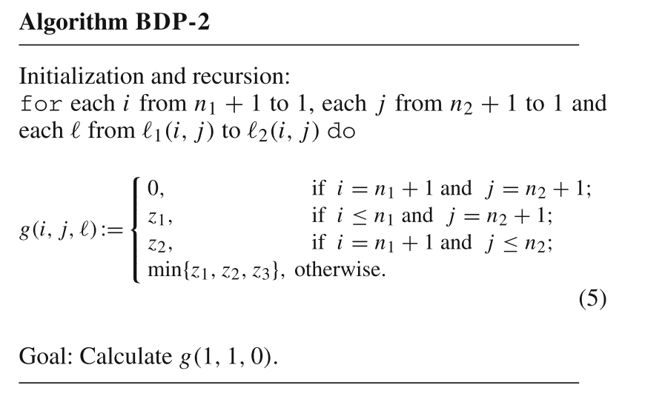
Research Frameworks – Optimization
Hypothesis, Discovery, Prediction, Recommendation, Optimization
This is a kind of a relocation scheduling problem. In the resource-constrained contextualization, how to allocate the jobs (or tasks) to two parallel dedicated machines.
Study Aims
Proposing a backward dynamic programming for the objective function to minimization of makespan, total weighted completion time or maximum lateness.
Objective Function
Note : makespan, total weighted completion time, maximum lateness, total weighted tardiness, weighted number of tardy jobs, and number of tardy jobs
Lin, Bertrand MT, F. J. Hwang, and Alexander V. Kononov. "Relocation scheduling subject to fixed processing sequences." Journal of Scheduling 19.2 (2016): 153-163.
Notes:
This study addresses a relocation scheduling problem that corresponds to resource-constrained scheduling on two parallel dedicated machines where the processing sequences of jobs assigned to the machines are given and ﬁxed. Subject to the resource constraints, the problem is to determine the starting times of all jobs for each of the six considered regular performance measures, namely, the makespan, total weighted completion time, maximum lateness, total weighted tardiness, weighted number of tardy jobs, and number of tardy jobs. By virtue of the proposed dynamic programming framework, the studied problem for the minimization of makespan, total weighted completion time, or maximum lateness can be solved in O ( n1n2 ( n1 + n2 )) time, where n1 and n2 are the numbers of jobs on the two machines.
轉成integer programming (轉成數學的方法)

Slide 23
Q&A

