Slide 1
社群金融計算研究分享
Social Finance Computing
Yung-Ming Li, Ph.D.
Institute of Information Management
National Chiao Tung University

Slide 2
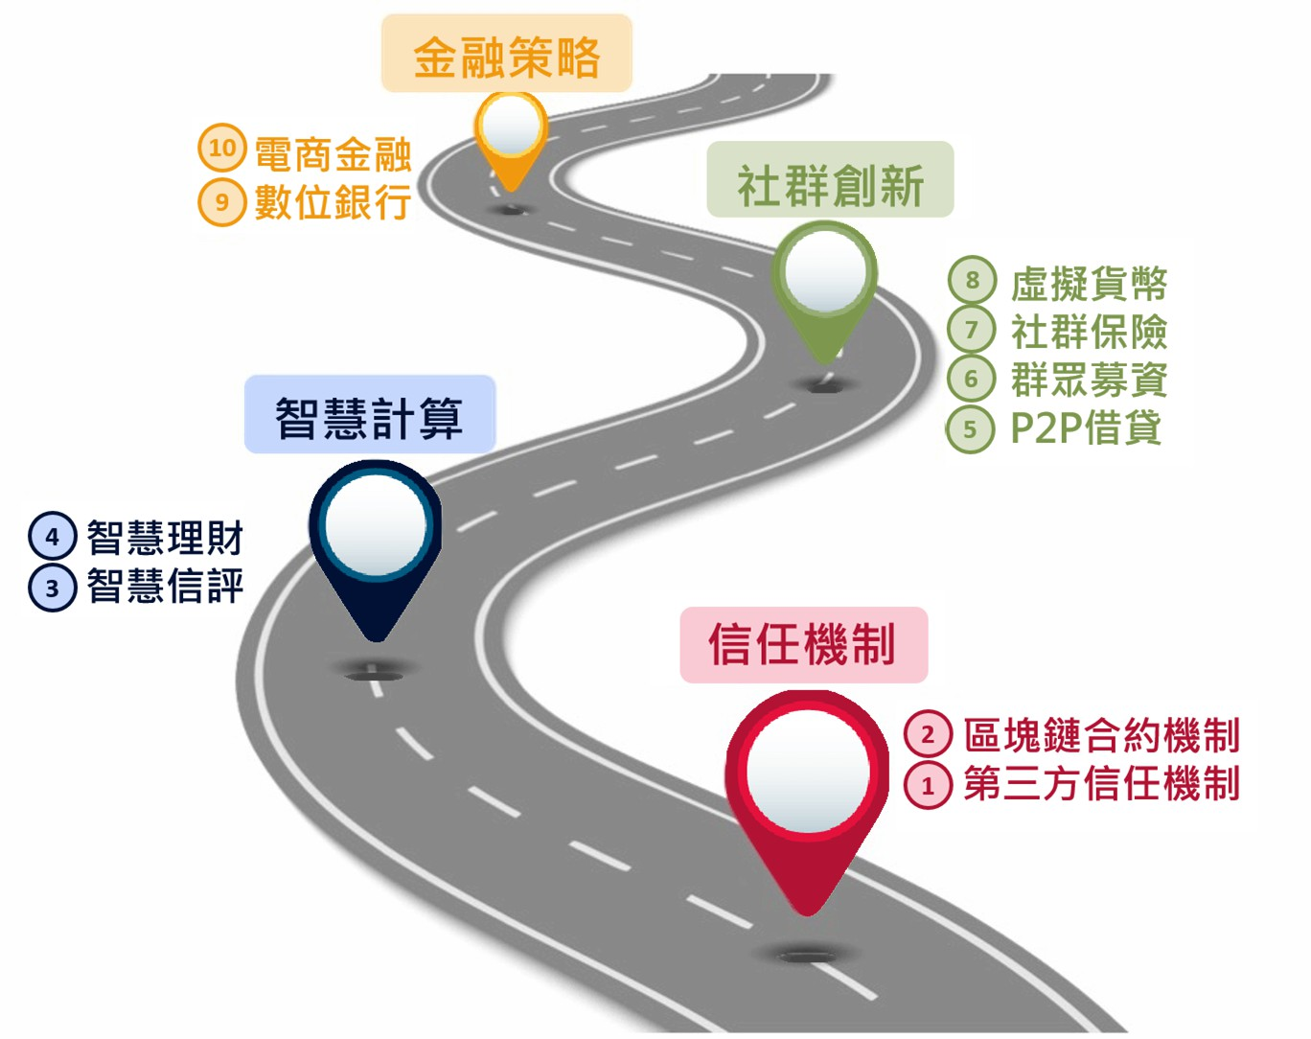
數位金融之道

Slide 3



Five characteristics of digital finance
Online operating platform
AI & data driven analysis
Financial sector
Social business model
Customers
De-bundled financial service
Micro-financial market

Slide 4




互聯網金融運作平台組合
AI +大數據：大量數據收集、整理及智 慧分析
雲端運算基礎建設：將不同位置的計算資源透過互網網整合起來
行動互聯網：透過行動通訊和互聯網結合，使人們能更方便地運用手機使用金融服務

Slide 5










數位金融平台組合:效率提升+價值創造
顧客產品分析
資料收集
行動交易
行動支付
行動理財
智慧建模預測
數據共享
提升效能、降低成本
業務拓展

Slide 6


Social business model: P2P, Crowd, Social Networking
P2P
Crowd
Social network
Person to Person,
disintermediary
Long tail market ,
Micro customer aggregation
Mutual interest, trust, reciprocal resource sharing

Slide 7












P2P
Crowd
Social network
Openness, low entry barrier
Mass market
Trend prediction (Crowd wisdom)
Transparency
User generation
(Crowdsourcing)
Recognition
Efficiency
Trustiness
Low cost
Endorsing
High variety
Collaborative sharing

Slide 8


Social Finance
Crowdfunding
Crowdinvesting
Virtual Currency
Social Insurance
P2P Lending
Notes:
社群金融

Slide 9
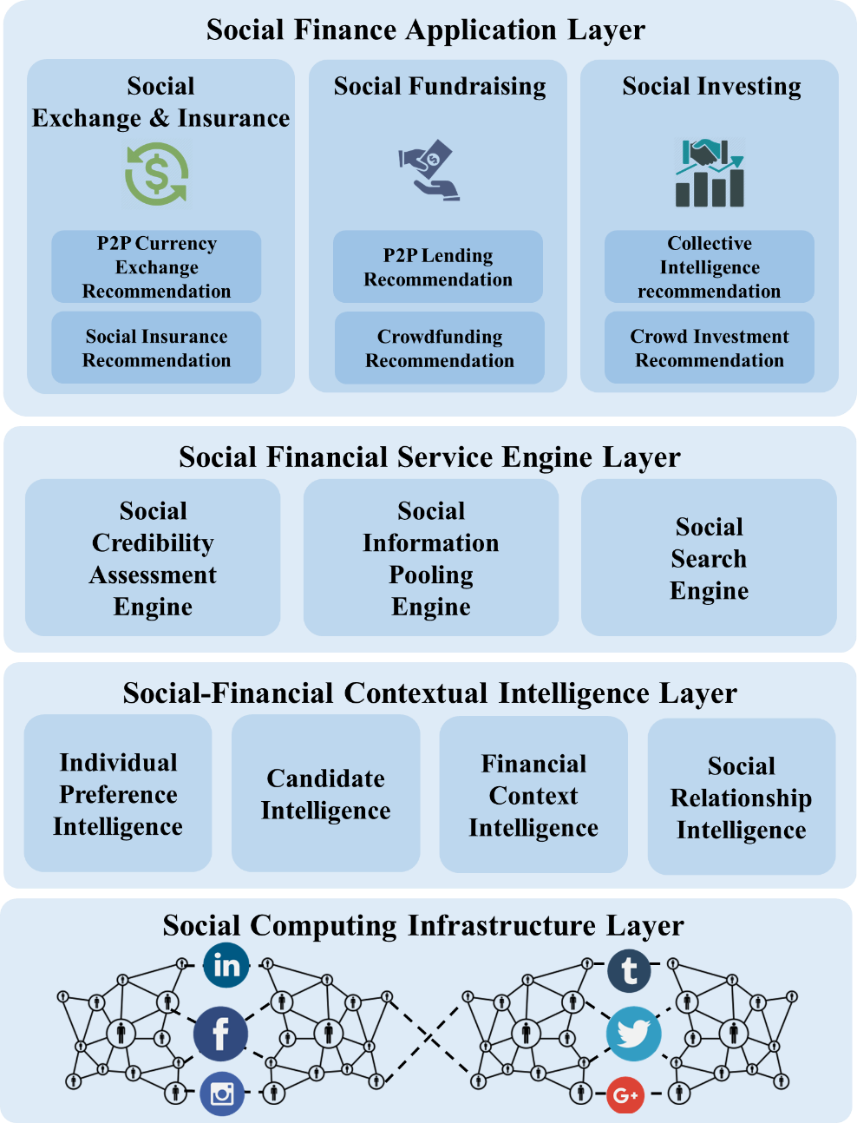
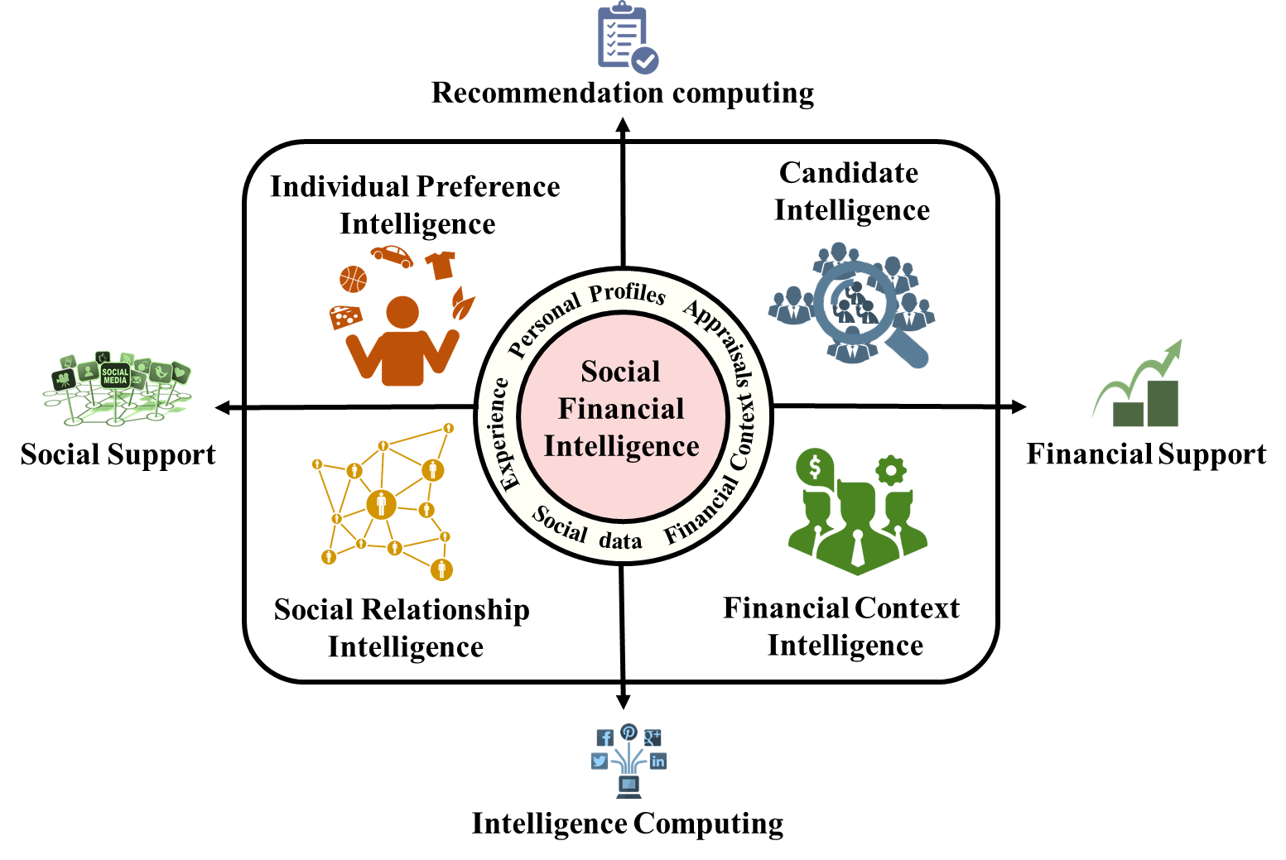
Social Finance Computing

Slide 10
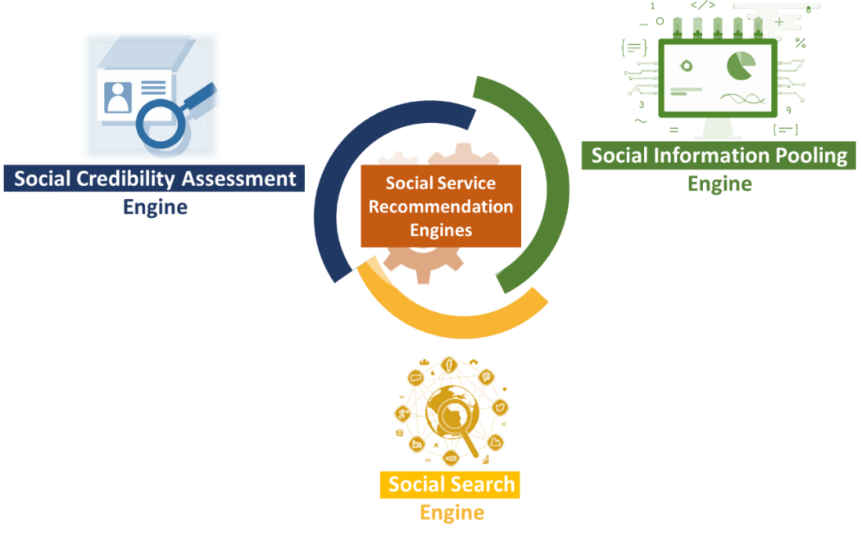
Social Finance Computing

Slide 11
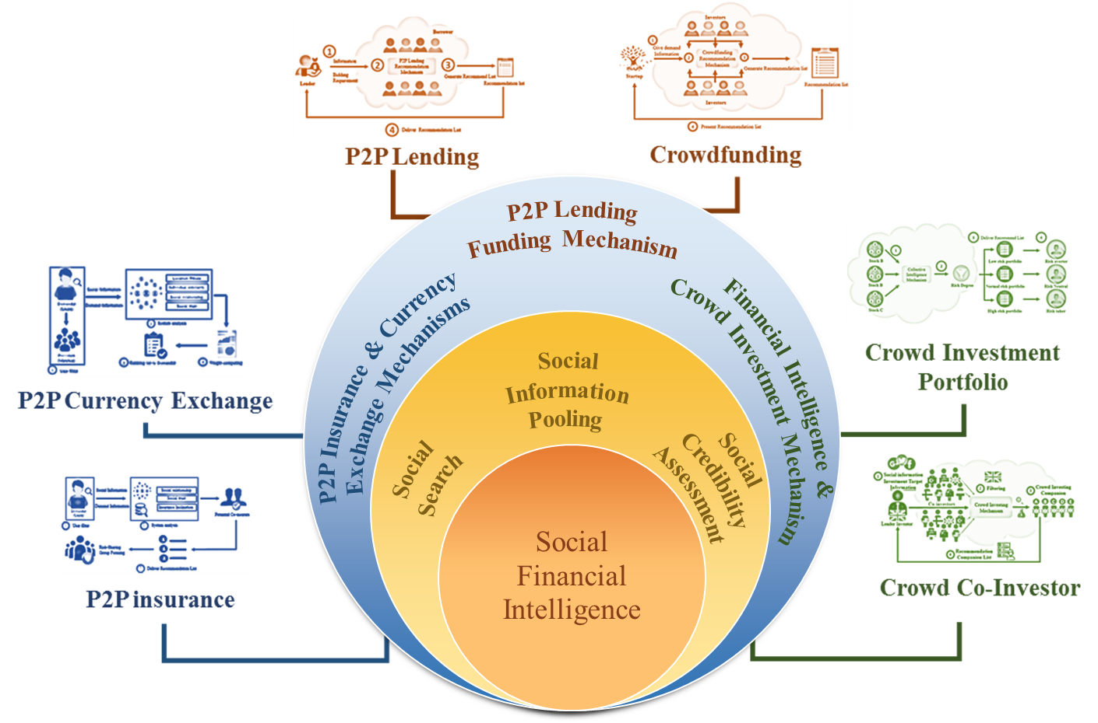
Social Finance Computing

Slide 12







Evolution: From E-Commerce to Digital Finance
Social Networking
Crowd Sourcing
P2P Computing

Slide 13


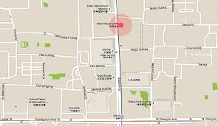
Social Coupon Endorsing
Diffusion by social endorser
Factors:
  Preference
  Location
  Proneness
  Influence

Slide 14
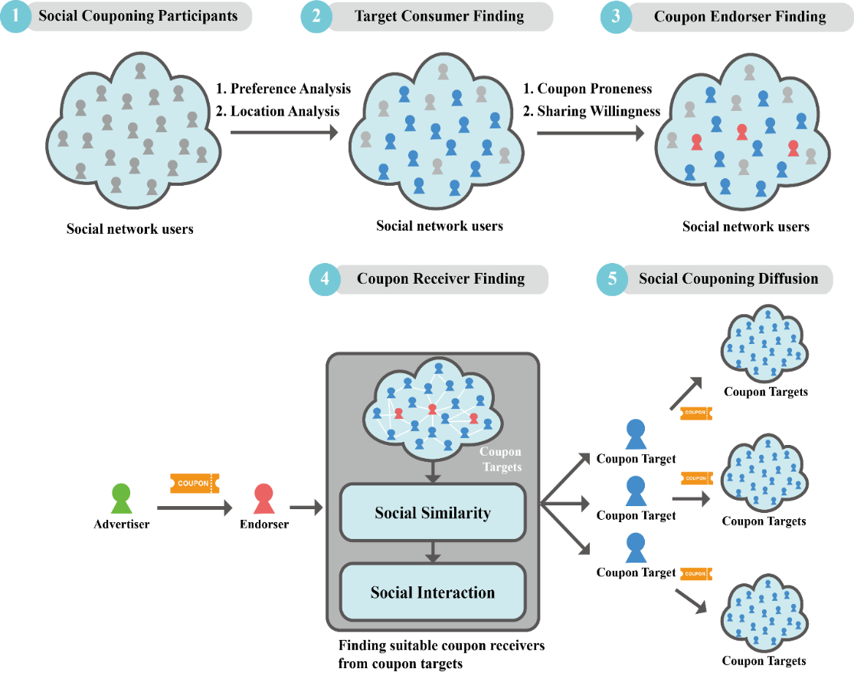
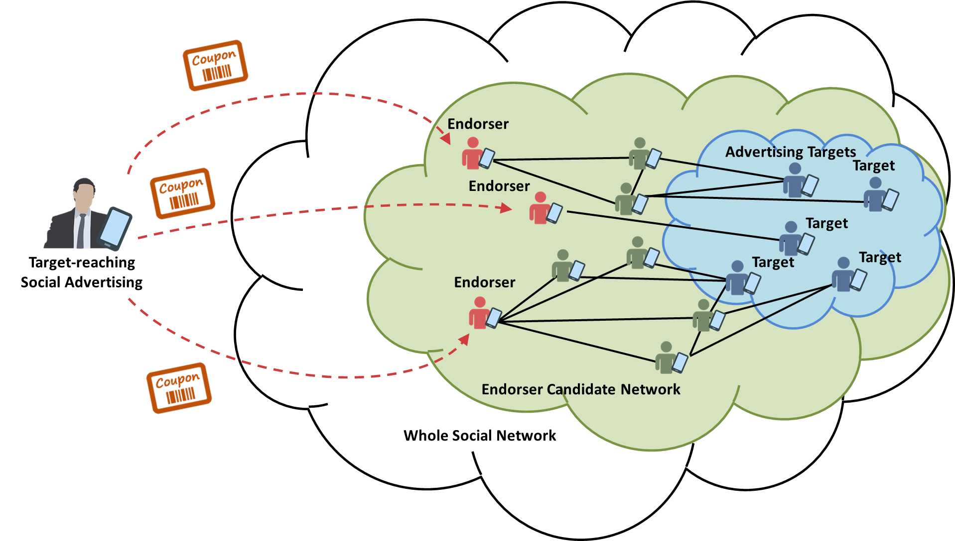
Social Coupon Endorsing : Processes
Notes:
一個人拿手機，有折價券

Slide 15
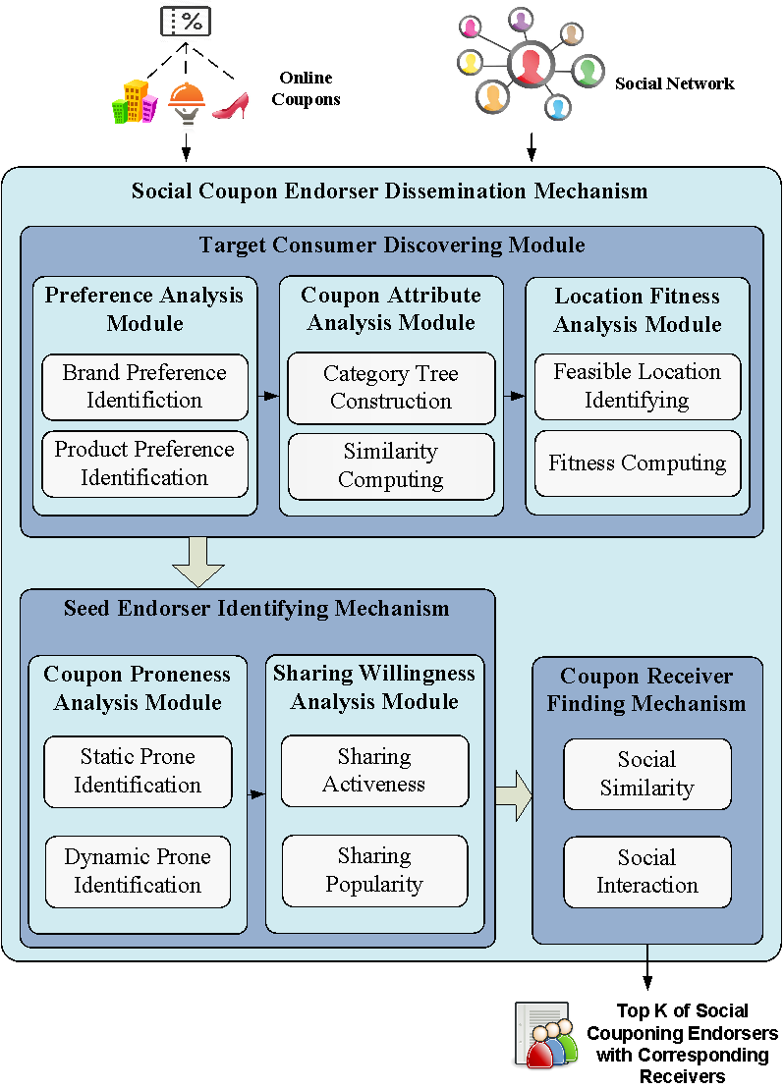
Social Coupon Endorsing: Results

Slide 16

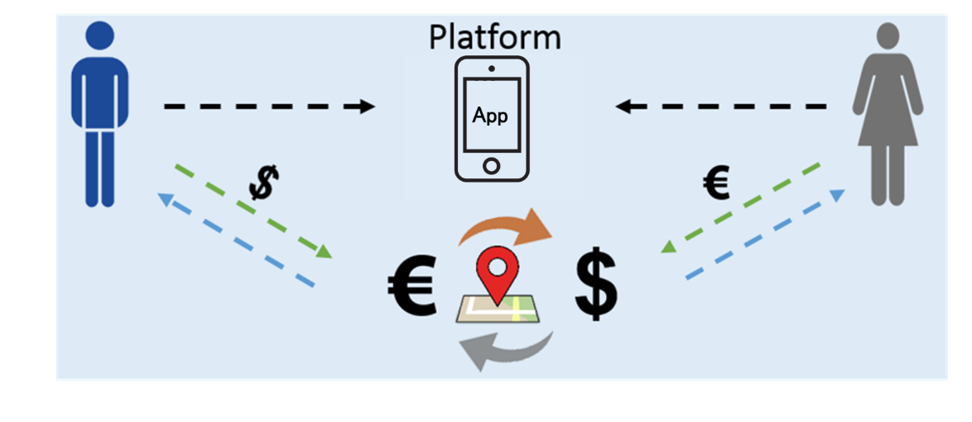
P2P Currency Exchange
Concepts:
  Location based P2P support & economy
  Currency exchange cutting out the middleman, banks, and brokers
  Two parties or individual to exchange directly
Techniques:
  Online to offline exchange model
  Matching based location and social intelligence

Slide 17


P2P Currency Exchange
Notes:
首先是系統的流程
1. 蒐集兩部分的資料集分別為
社群股票討論區的資訊 以及歷史股價
2. 然後透過我們提出的混合式推薦系統
3. 依據風險大小將股票分別匹配到不同的風險組合 產生三種類型的投資組合
4. 最後再依照投資俱樂部偏好推薦他們最適合的投資組合

Slide 18
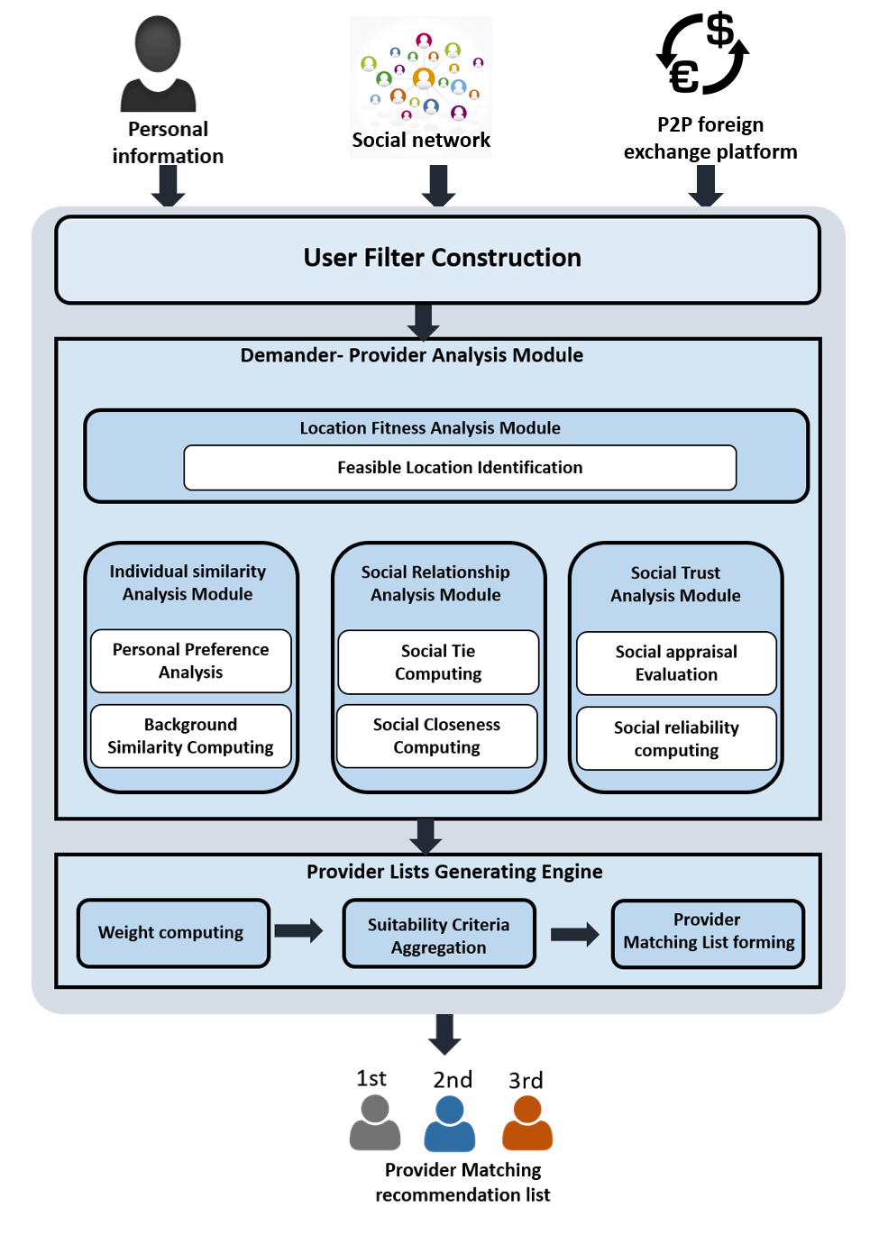
Recommendation Accuracy
Recommendation feedback
Notes:
接著是股票趨勢分析

Slide 19
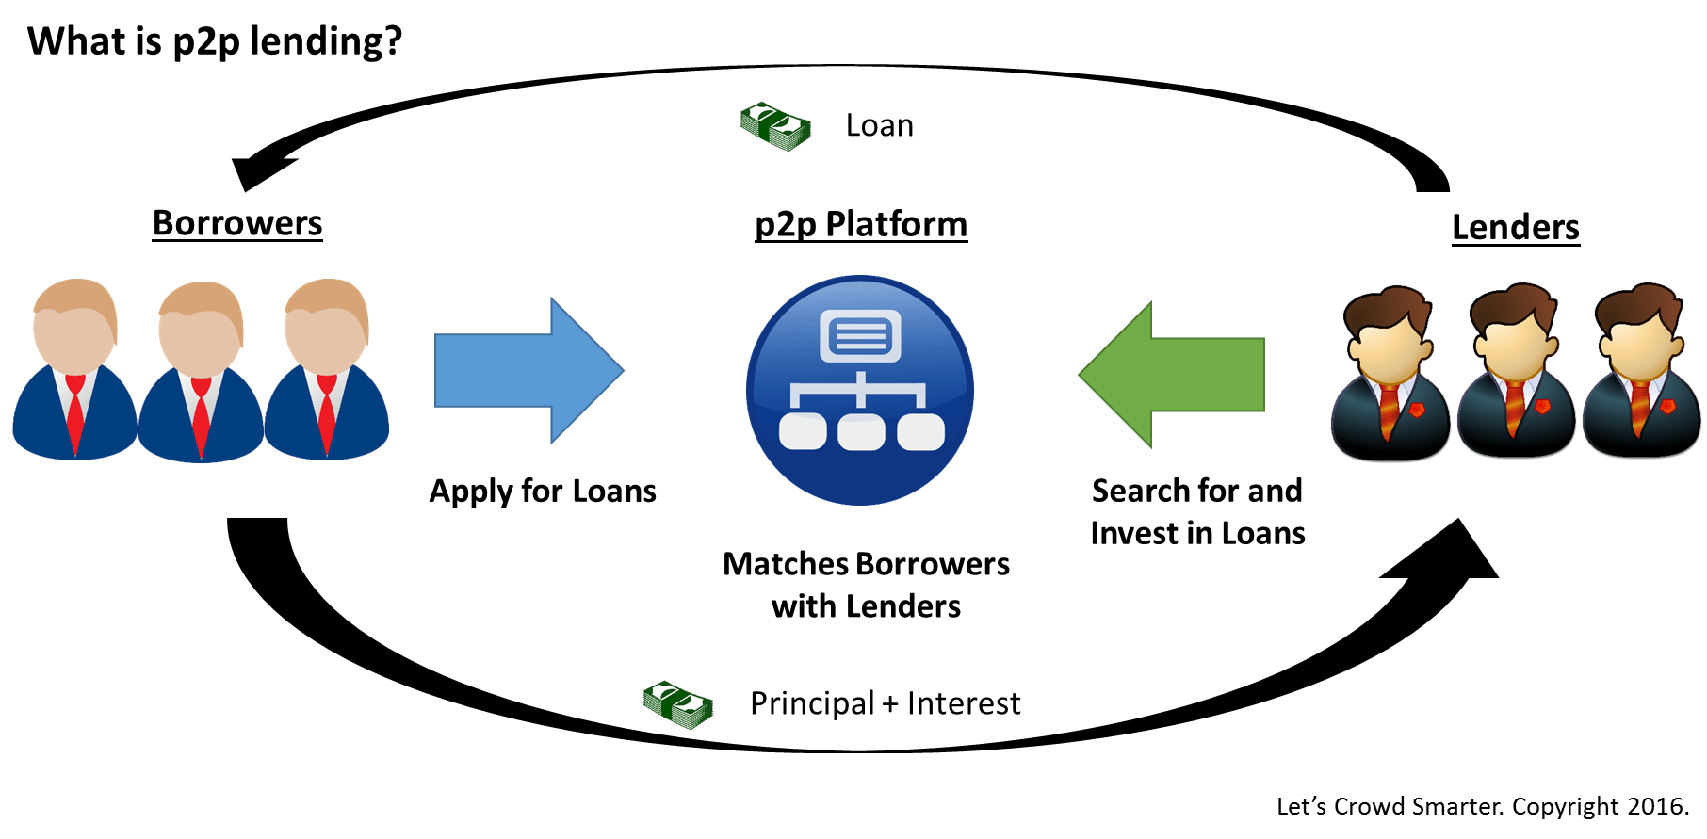
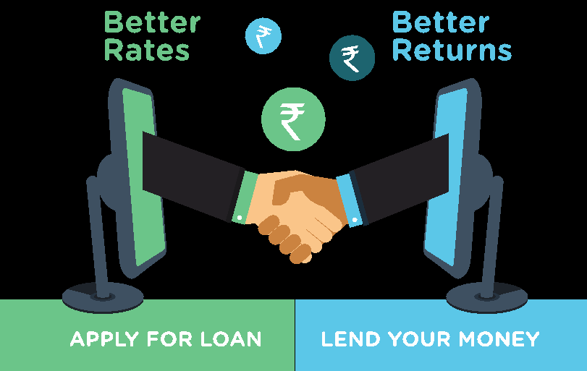
P2P Lending
  Concepts:
    Soliciting loan from peers (strangers) instead of institutes (banks).
    Higher return (lenders) , lower rate (borrowers)
Business problem: Successful matching between borrowers and lenders
Lending factors: loan, interest rate, risk, preference

Slide 20
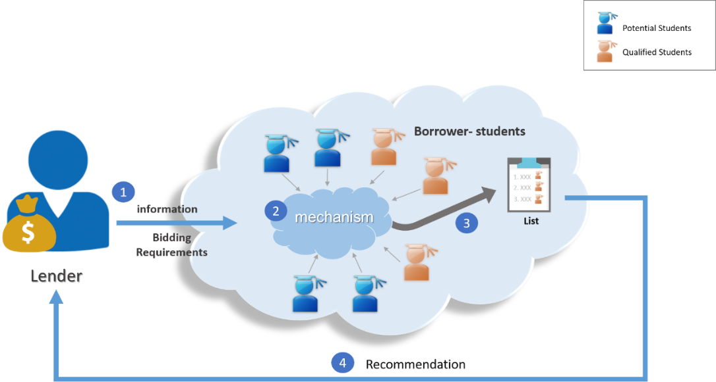
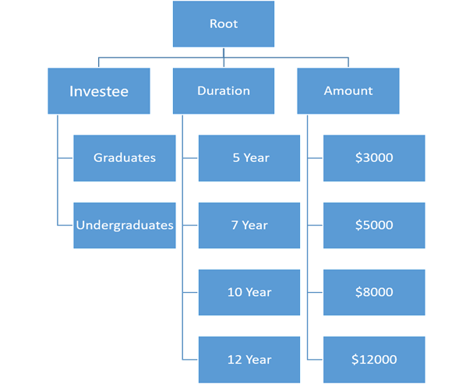
P2P Student Lending
Processes

Slide 21
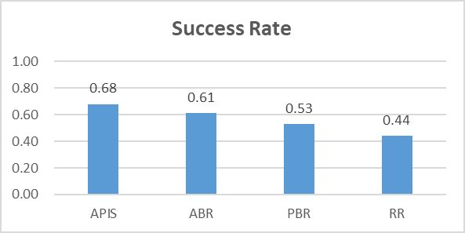
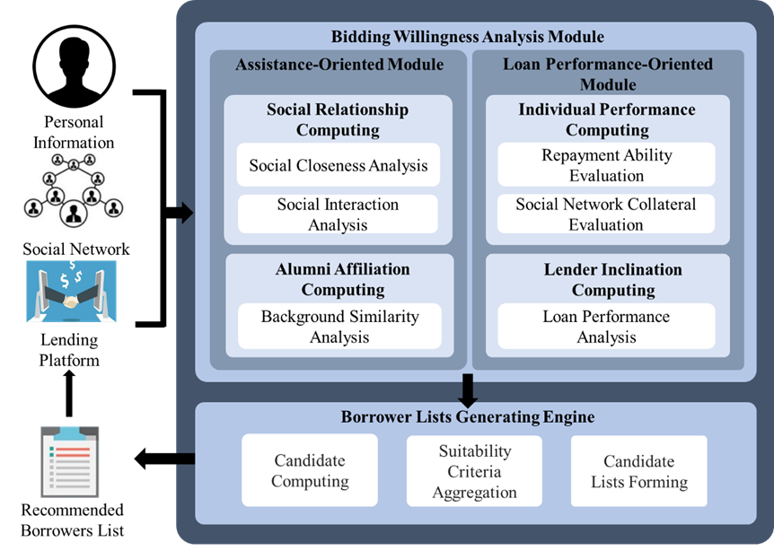
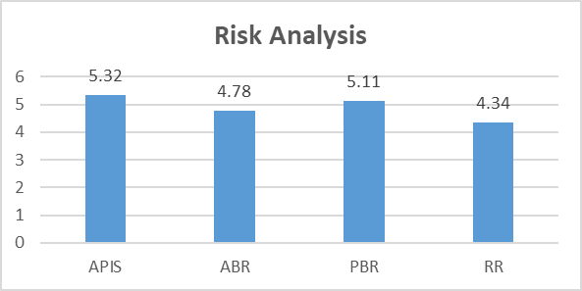
P2P Lending

Slide 22
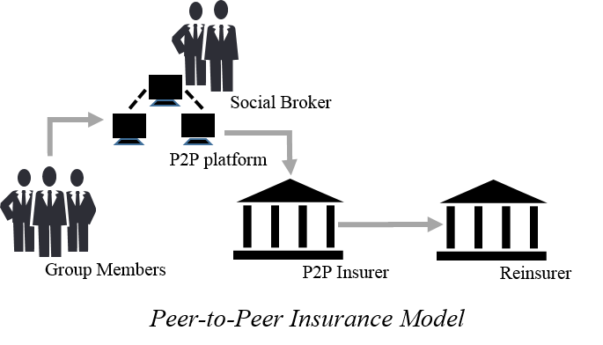
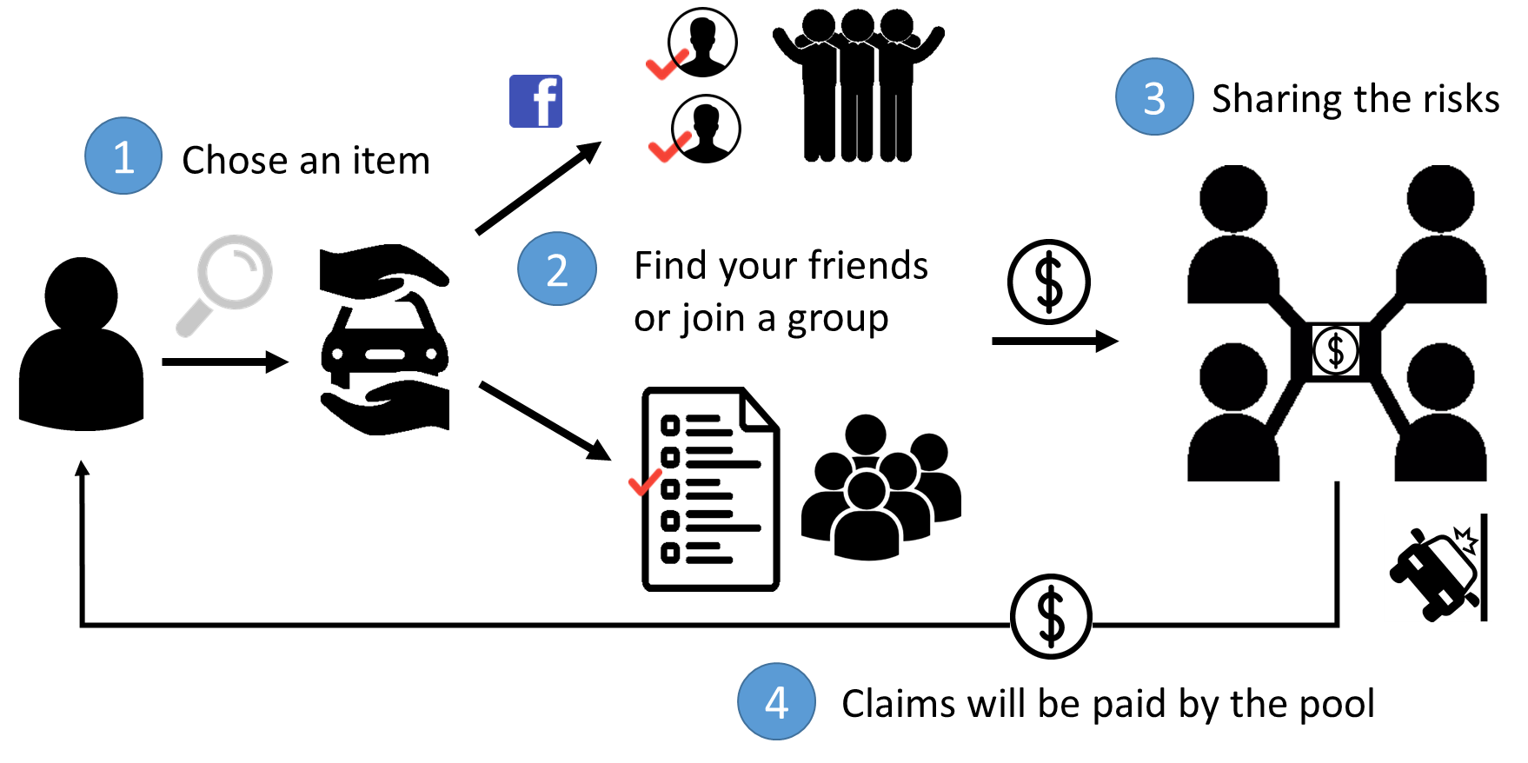
Social Insurance Formation
Concept:
  A group o people who share similar risk profiles forms an risk protection agreement of mutual assistance
  Group reinsurance
Success factor: inclination, similarity, trustiness

Slide 23
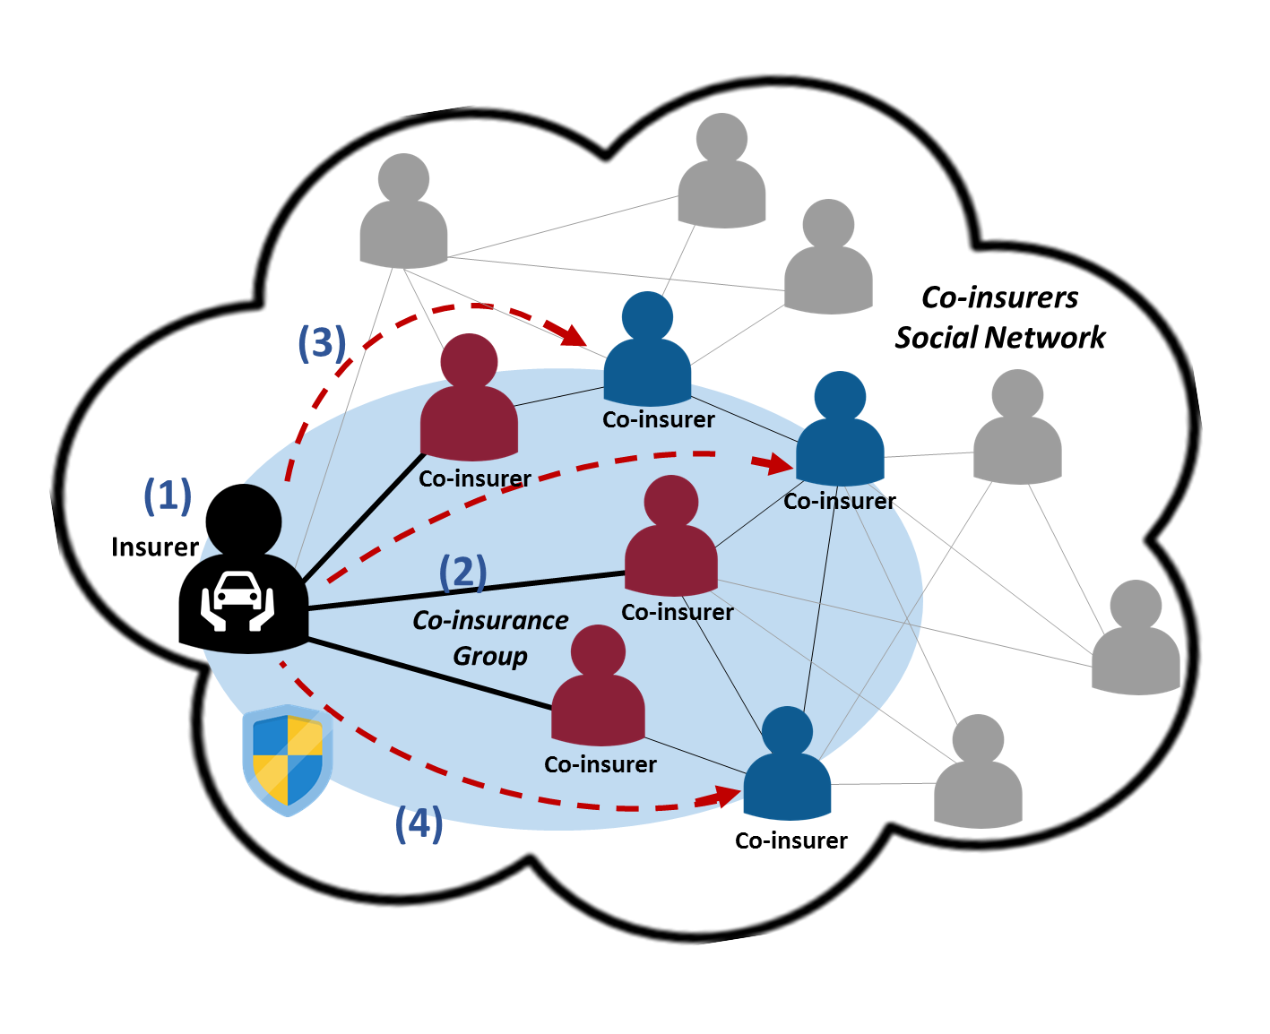
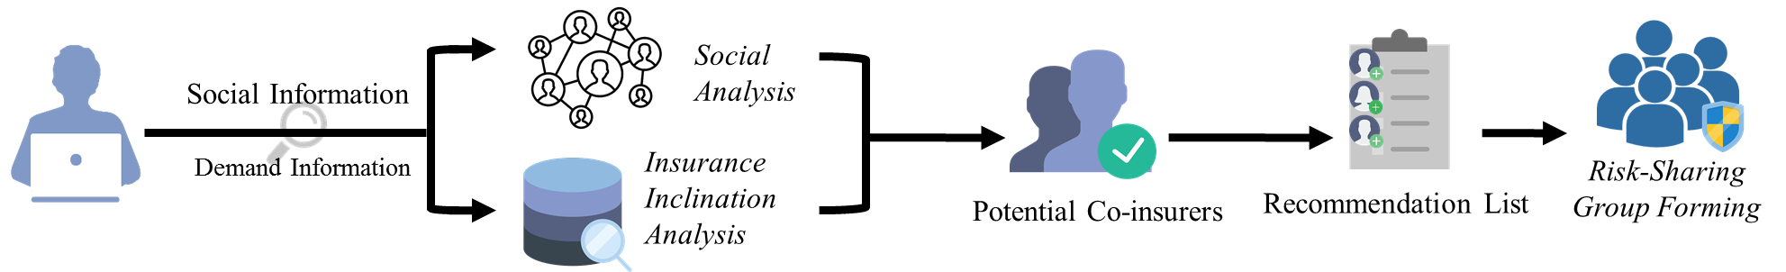
P2P Insurance Formation Process
(1)
(2)
(3)
(4)

Slide 24
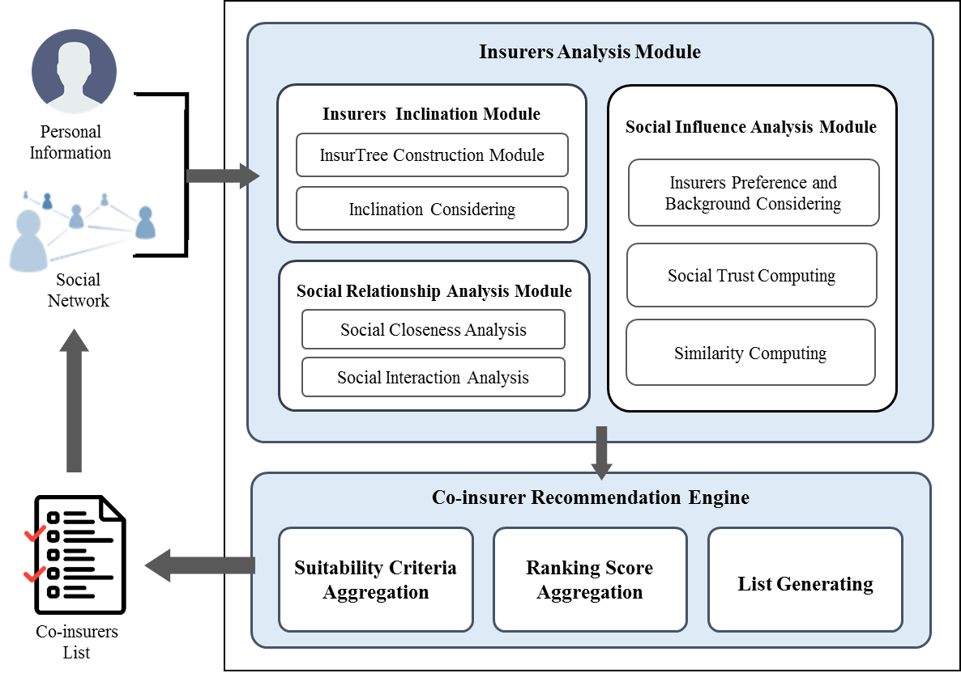

Slide 25


Crowdfunding (1): Reward based Campaigns
All-or-nothing
Business problem: Success rate of projects has never exceeded 50%
Success factor: relationship, network, preference
Life cycle: Early, middle, late phases
Investors: family, friend, the crowd

Slide 26
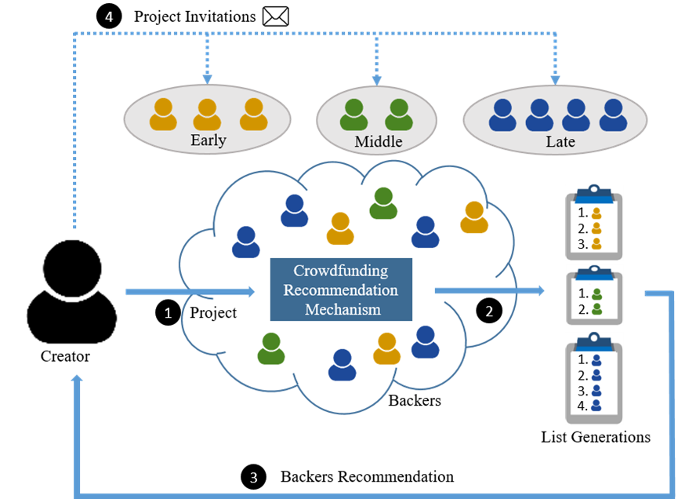
Phased-based crowdfunding recommendation
Process

Slide 27
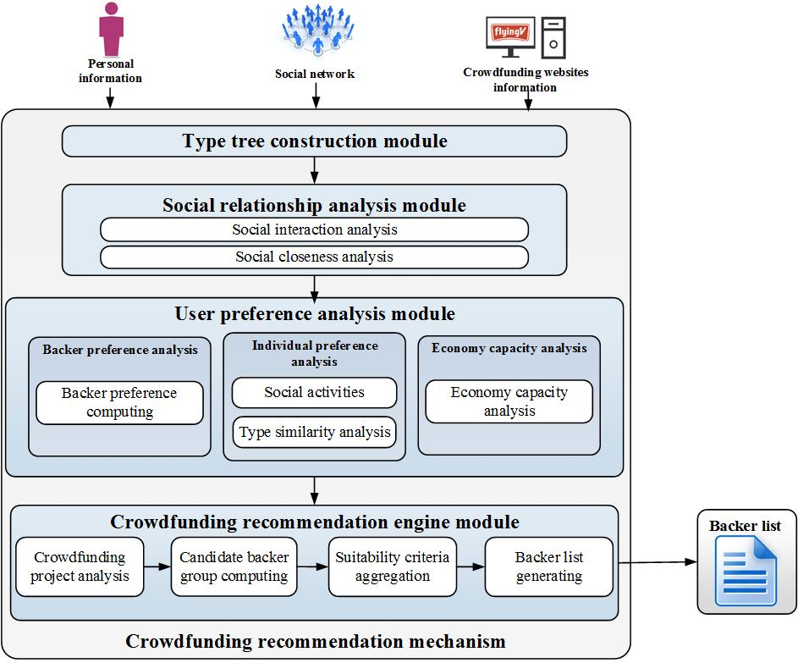
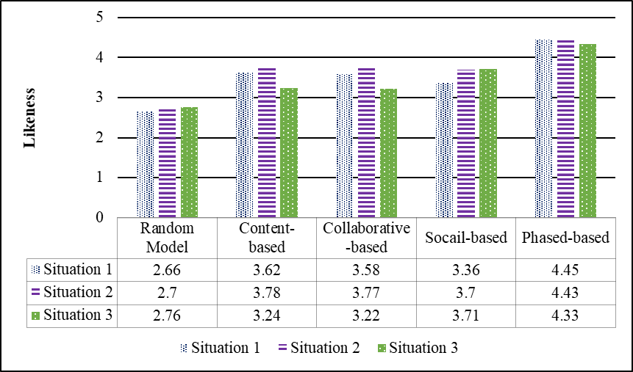

Slide 28




Crowdfunding (2): Donation-based Campaigns
Keep-in-all
Non-profit crowdfunding
The trust in the charity campaign
The willingness to donate
Social influence (direct and indirect influence )

Slide 29
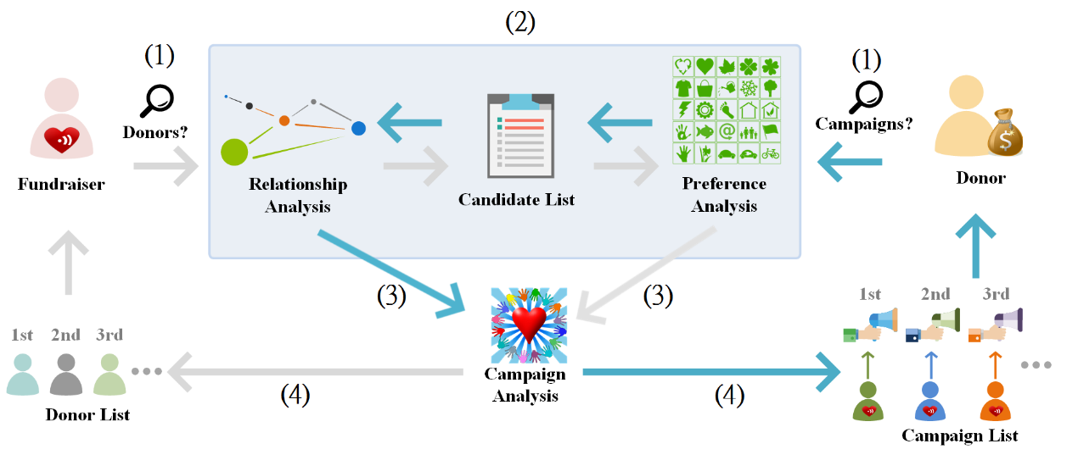
Social fundraising recommendation
Process

Slide 30
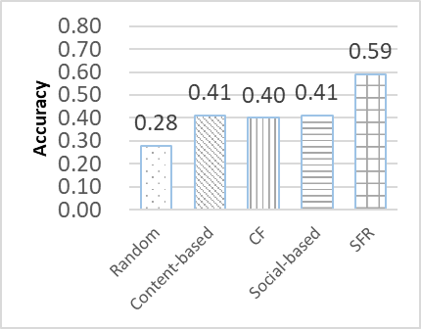
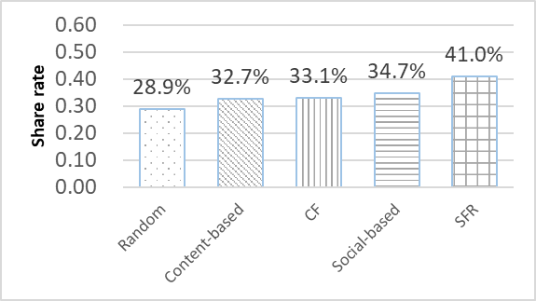

Slide 31




Smart Portfolios (1): Personalized Investment
Concepts: Aggregation of crowd intelligence and market information
Techniques: Collective intelligence (Social computing) PLUS Deep learning (LSTM algorithm) PLUS GA (Optimization algorithm)

Slide 32
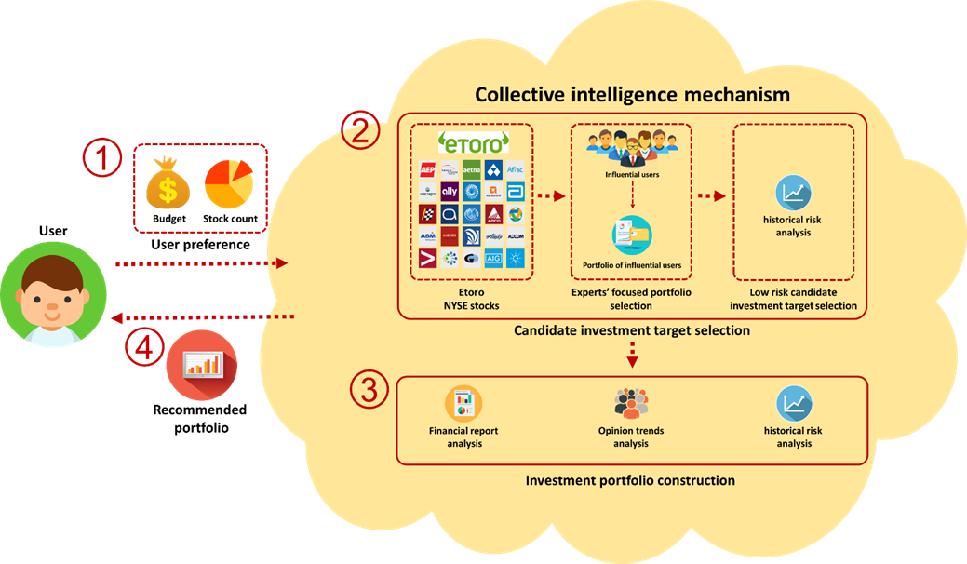
Smart Portfolios for Personalized Investment
Notes:
首先是系統的流程
1. 蒐集兩部分的資料集分別為
社群股票討論區的資訊 以及歷史股價
2. 然後透過我們提出的混合式推薦系統
3. 依據風險大小將股票分別匹配到不同的風險組合 產生三種類型的投資組合
4. 最後再依照投資俱樂部偏好推薦他們最適合的投資組合

Slide 33
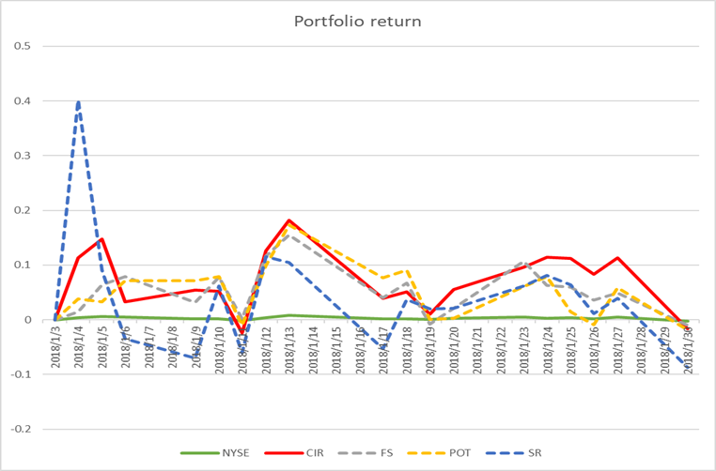
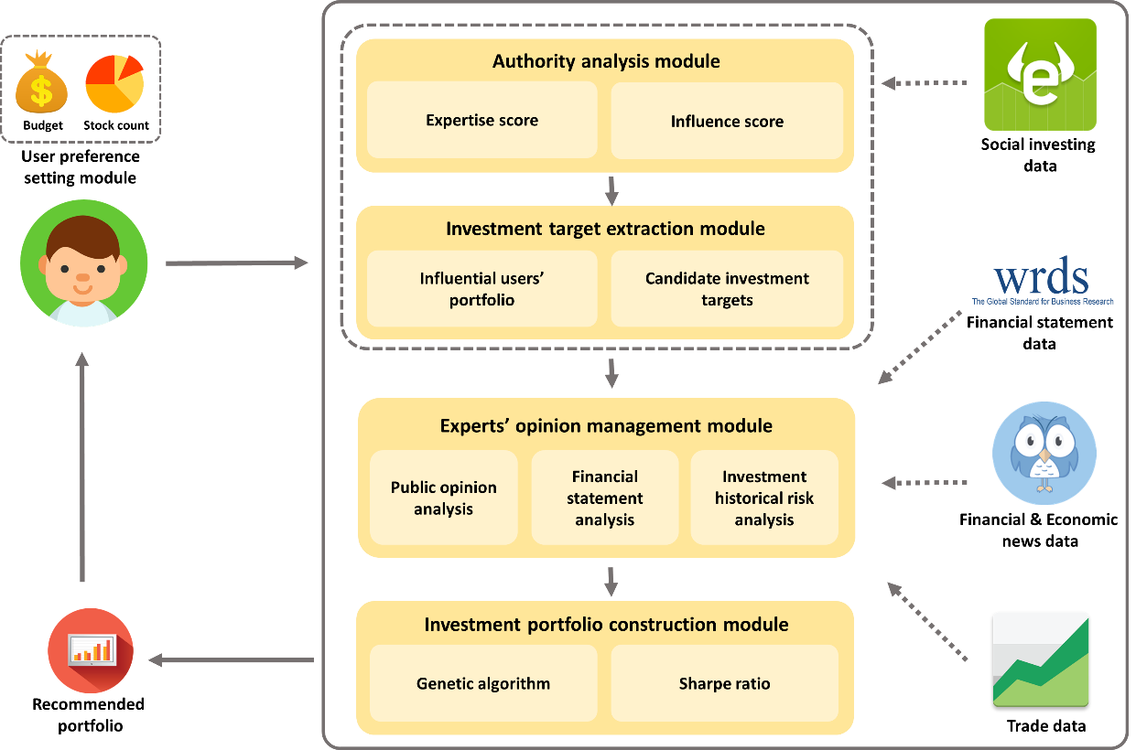
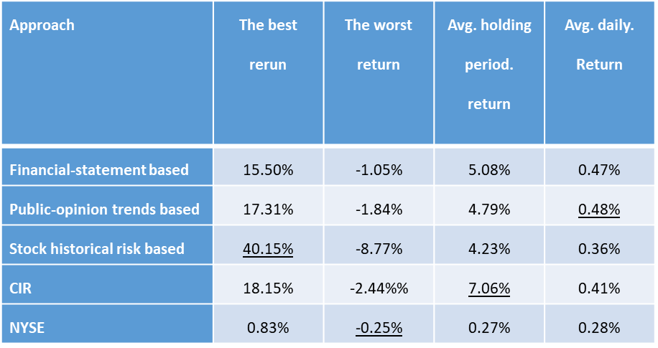
Notes:
接著是股票趨勢分析

Slide 34

Smart Portfolios (2): Investment Clubs
Concepts: Power of crowd- Aggregation of information and funds
Techniques: Collective intelligence (Social computing) PLUS Deep learning (LSTM algorithm)

Slide 35
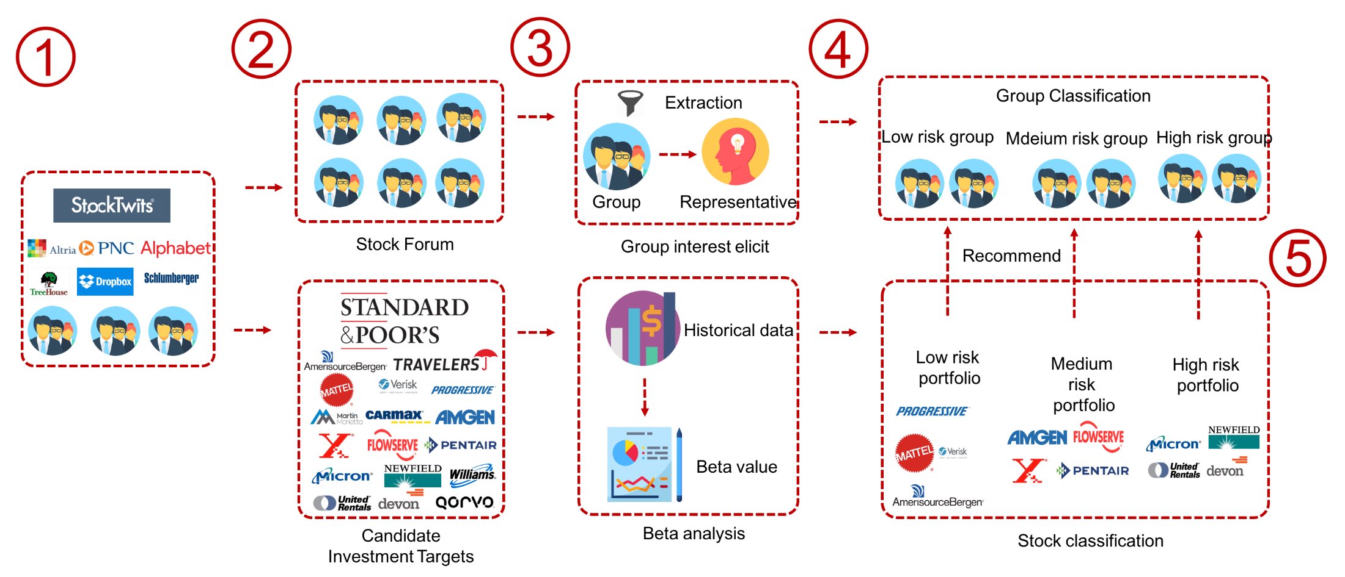
Smart Portfolios for Investment Clubs
Club Preference Analysis (risk type)
Stock Performance Analysis (risk type)
Notes:
首先是系統的流程
1. 蒐集兩部分的資料集分別為
社群股票討論區的資訊 以及歷史股價
2. 然後透過我們提出的混合式推薦系統
3. 依據風險大小將股票分別匹配到不同的風險組合 產生三種類型的投資組合
4. 最後再依照投資俱樂部偏好推薦他們最適合的投資組合

Slide 36
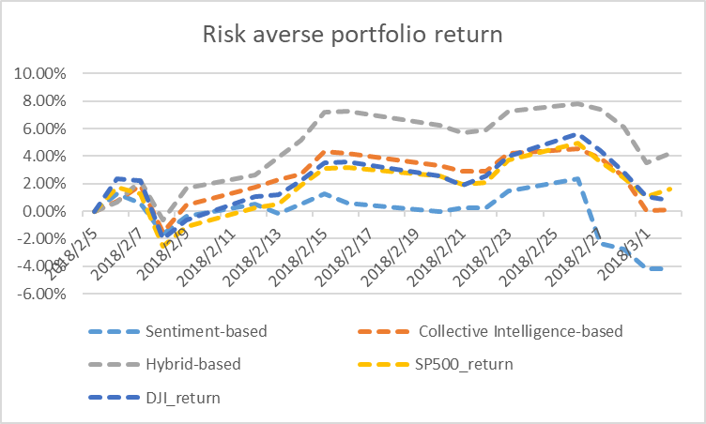
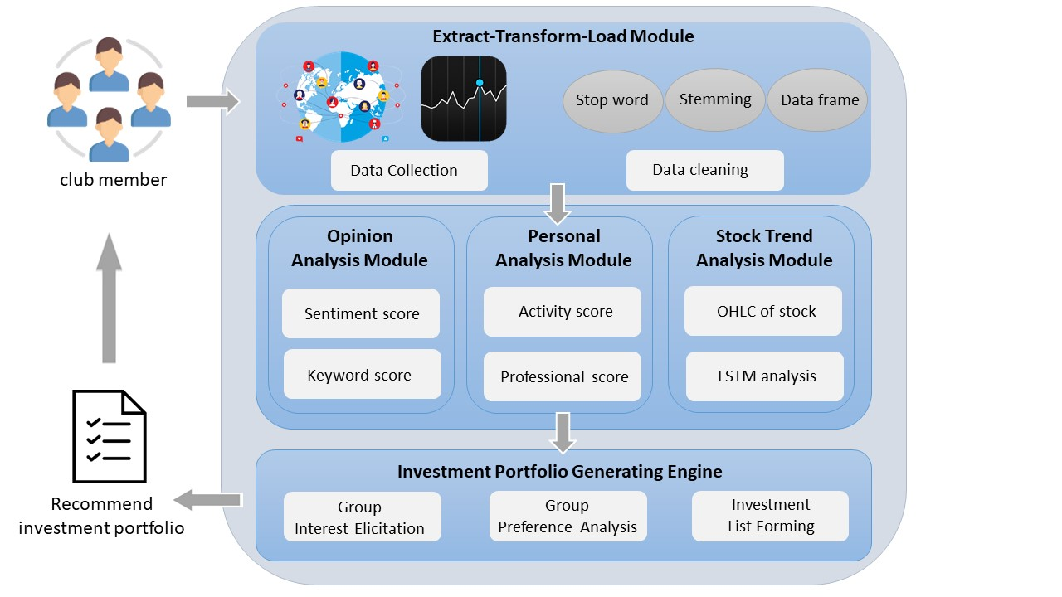
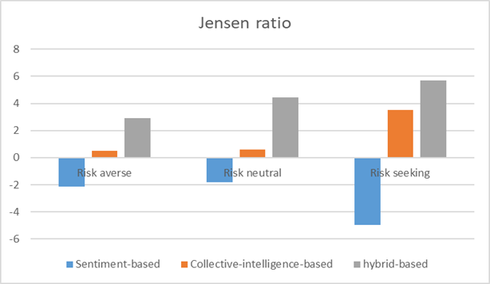
Notes:
接著是股票趨勢分析

Slide 37
Thank you ! Q&A

