Slide 1
Creative Industries survive in the digital era
Adapting to Change: The Evolution of Work in the Era of AI and Emerging Technologies
Yung-Ming Li Ph.D.
Institute of Information Management
National Yang Ming Chiao Tung University
Notes:
MBA主題: Creative Industries survive in the digital era
演講時長1.5小時, 預計30-45頁投影片
演講講題方向: 探討AI等新IT影響的產業服務、職業工作型態、競爭力挑戰與機會
簡報編輯小組成員(碩一): 預計1~2位
博班:德全

Slide 2
Agenda
Creative Industry (CI)
Emerging IT Technologies
Transformation of Work Patterns
Applications of AI and Emerging IT
Competitive Challenges and Opportunities

Slide 3


Creative Industry (CI)

Slide 4

Creative Economy
Human creativity
Ideas
Intellectual property
Knowledge
Technology
Creative Economy Programme (UNCTAD, United Nations Conference on Trade and Development 2022 )
Notes:
Creative Economy Programme (UNCTAD, United Nations Conference on Trade and Development 2022 )
https://unctad.org/topic/trade-analysis/creative-economy-programme
The creative economy has no single definition. It is an evolving concept which builds on the interplay between human creativity and ideas and intellectual property, knowledge and technology. Essentially it is the knowledge-based economic activities upon which the ‘creative industries’ are based.

Slide 5

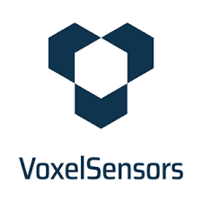

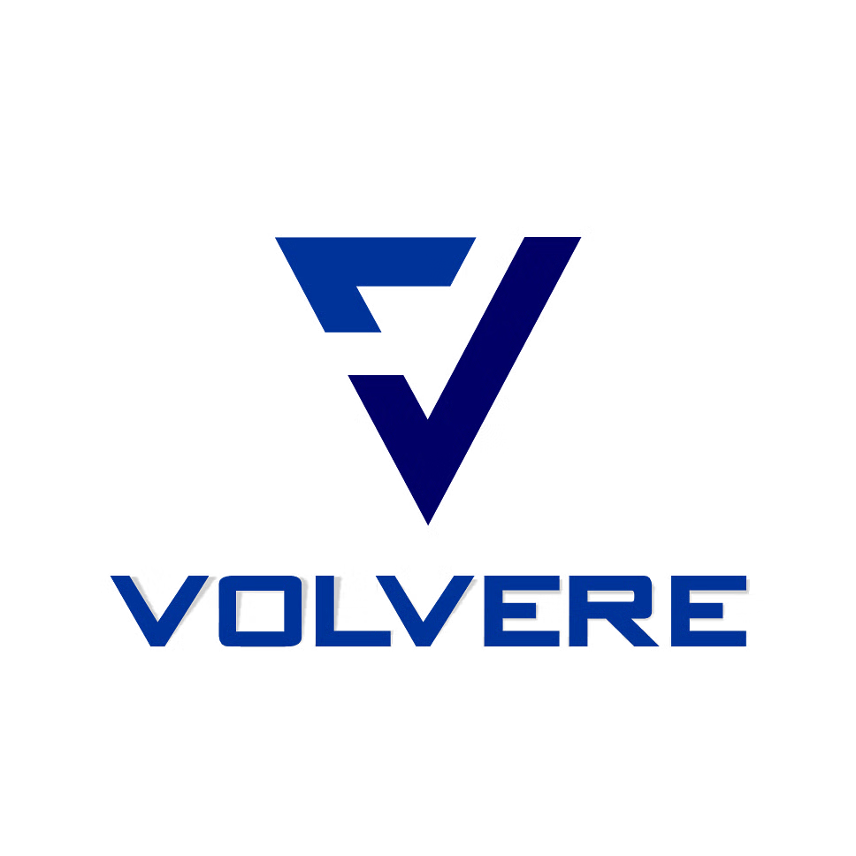
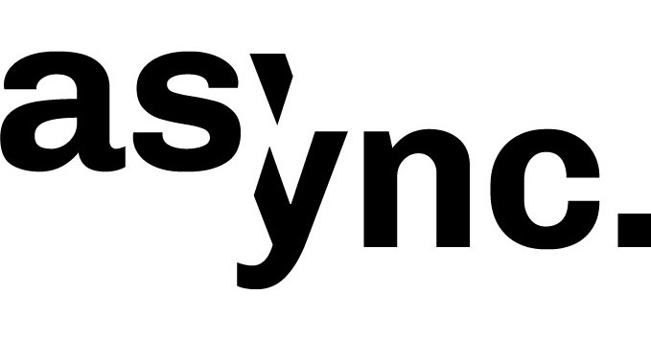








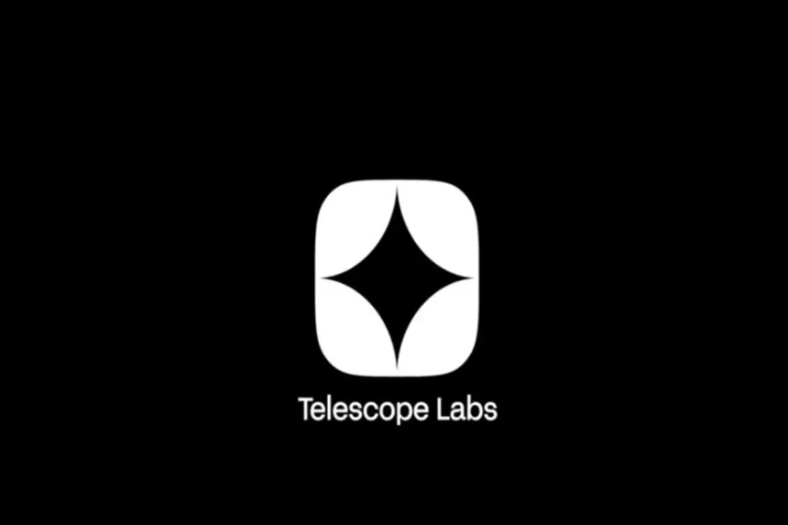
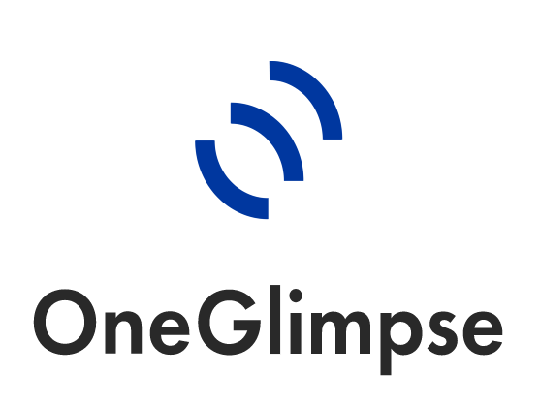




Creative industry 4.0
Creative Industry 4.0 is expected to benefit from the opportunities brought by new technologies.
Top 10 Creative Economy Trends in 2023
NFT Technology
Interactive Sensors
Algorithmic Creativity
High-speed
5G Networks
Extended Reality
Collaboration Platforms
Data Analytics
AdTech
3D Printing
Digital Rights Management
Creative Economy Programme (UNCTAD, United Nations Conference on Trade and Development 2022 )
Notes:
Creative industry 4.0: Towards a new globalized creative economy (UNCTAD 2022)
https://unctad.org/system/files/official-document/ditctncd2021d3_en.pdf
Creative Industry 4.0 is expected to benefit from the opportunities brought by new technologies. On
the design and production side, the study has identified four types of opportunity: enhanced efficiency,
unrestricted creativity, greater interactivity; and flexibility that facilitates cost-effective customisation. The
potential of knowledge-based creative products is not limited to the digital creative industry; It is also
relevant for more traditional art and craft activities.
[圖片來源] Discover the Top 10 Creative Economy Trends in 2023
https://www.startus-insights.com/innovators-guide/creative-economy-trends/

Slide 6
Emerging IT Technologies
Notes:
社群平台（決策）
LLMs（決策）
演算法（最佳化）
高品質資料集（基礎設施）
算力（基礎設施）

Slide 7
Emerging IT Technologies
AI
Blockchain
Social network
VR & AR

Slide 8
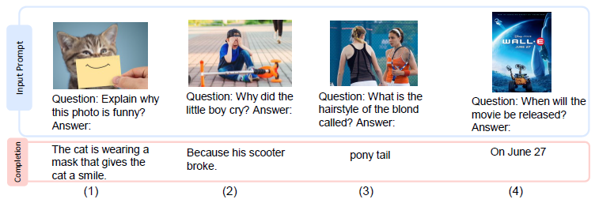
AI
Language Is Not All You Need: Aligning Perception with Language Models, Shaohan Huang, et al., (Microsoft 2023)
Notes:
Language Is Not All You Need: Aligning Perception with Language Models, Shaohan Huang, et al., (Microsoft 2023)
https://arxiv.org/abs/2302.14045
A Survey of Large Language Models, Wayne Xin Zhao, et al., (2023)
https://arxiv.org/abs/2303.18223
https://a16z.com/for-b2b-generative-ai-apps-is-less-more/

Slide 9
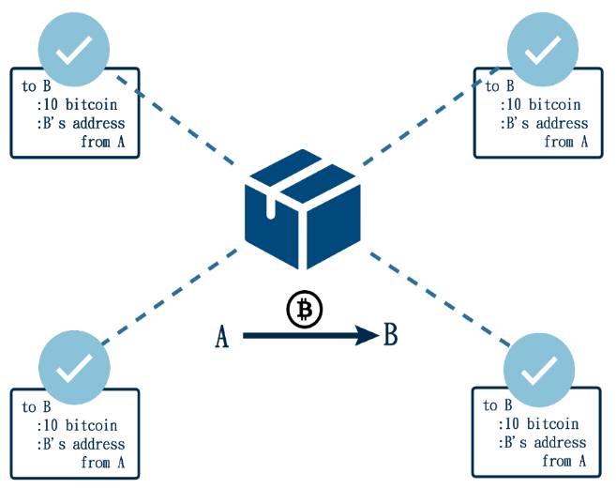
Blockchain & NFT Technology

Slide 10
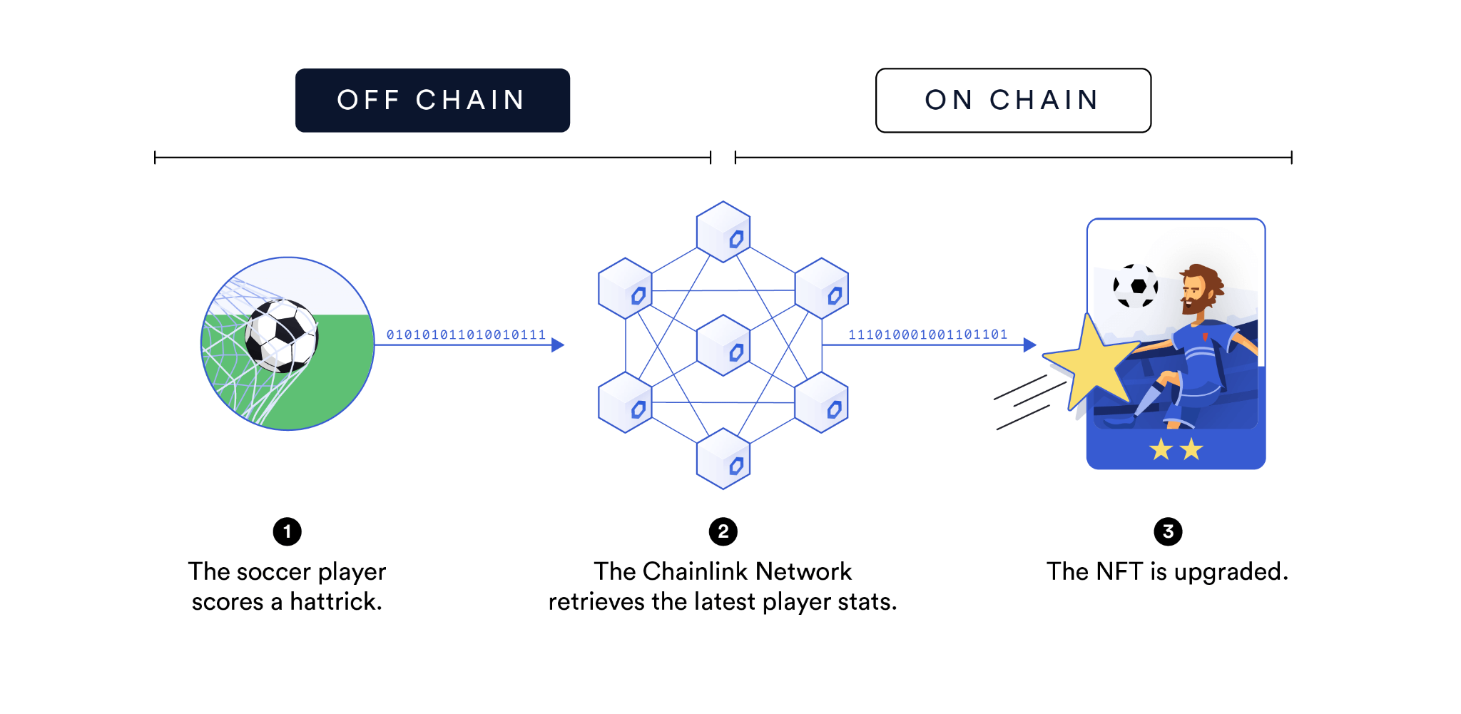
Blockchain & NFT Technology
https://chain.link/education-hub/dynamic-nft-use-cases

Slide 11

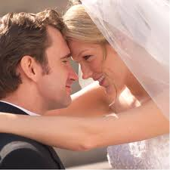


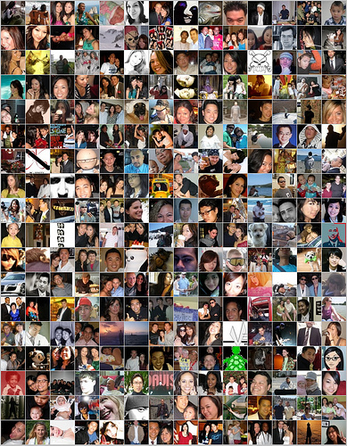

Social network: The power of people and network
Career
Marriage
Finance
Health

Slide 12
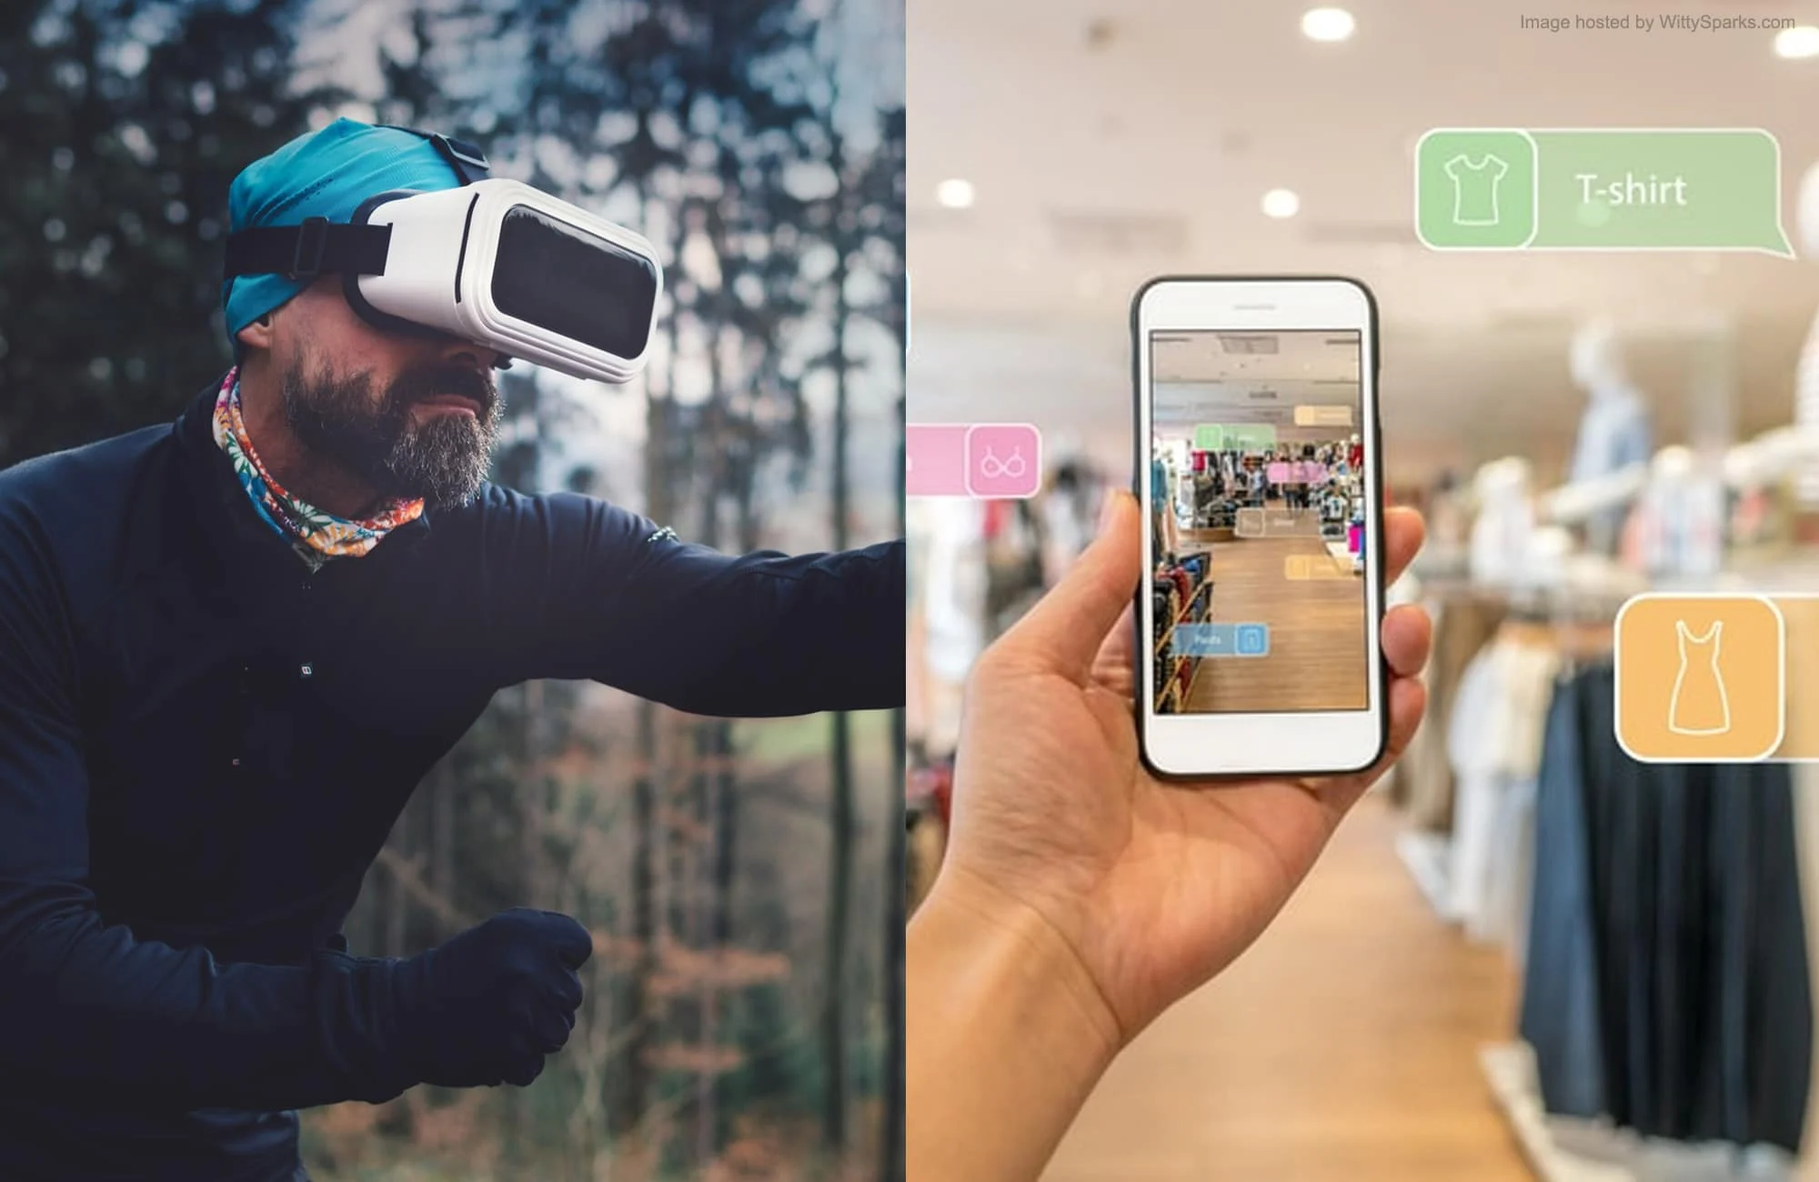
VR & AR
The AR/VR Revolution: 6 Applications You Need to Know About (wittysparks.com)

Slide 13
Transformation of Work Patterns
Notes:
無縫人機協作
虛實整合（規劃，模擬，決策）
Agents （多工協作）

Slide 14
Optimizing processes using AI
Existing processes
Optimizing
Demand
Demand
AI
Expert
Optimizing
normal
Output
Expert
Output
Output

Slide 15
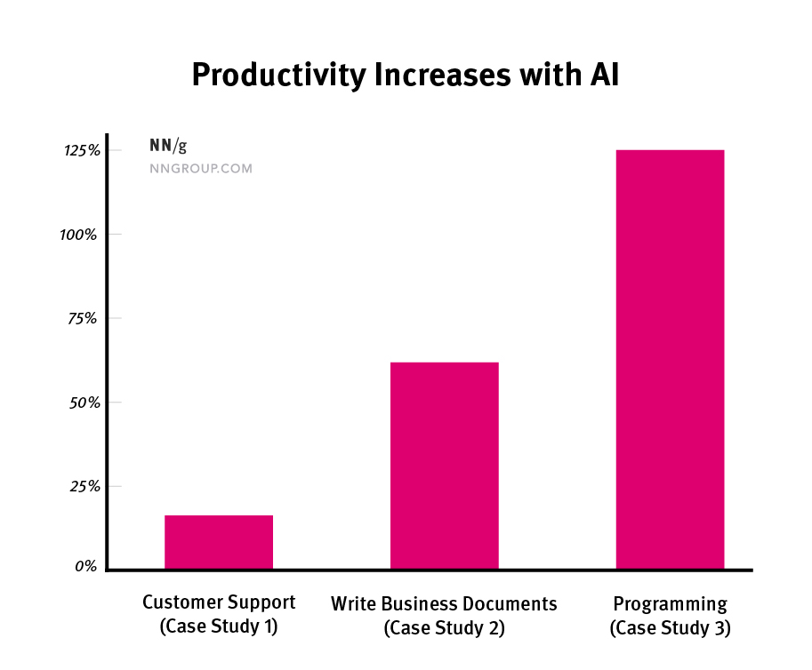
AI Improves Employee Productivity by 66%
Using generative AI (like ChatGPT) in business improves users’ performance by 66%, averaged across 3 case studies. More complex tasks have bigger gains, and less-skilled workers benefit the most from AI use.
AI Improves Employee Productivity by 66% - By Jakob Nielsen on July 16, 2023

Slide 16
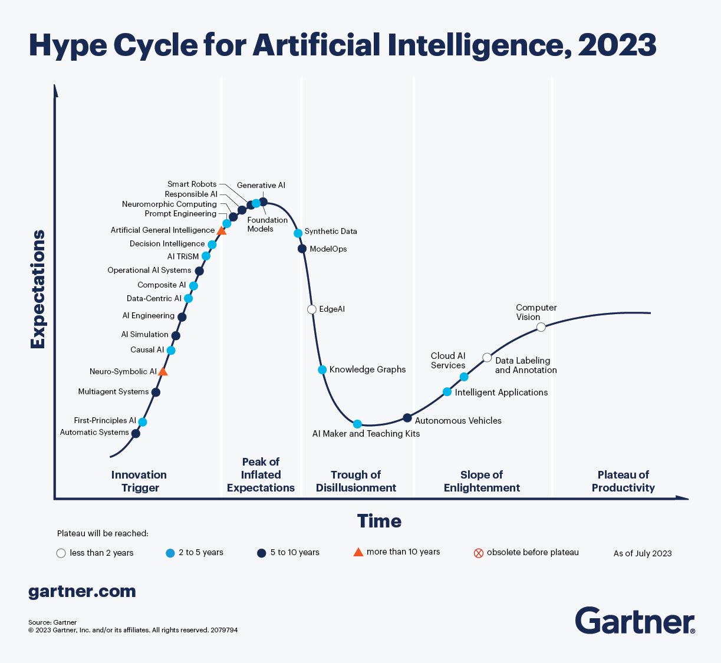
How Generative AI Is Changing Creative Work
Automated content generation
Improved content quality
Increased content variety
Personalized content
by Thomas H. Davenport and Nitin Mittal (HBR 2022)

Slide 17
Applications of AI and Emerging IT
Notes:
作曲
ChatGPT
Co-Pilot
Midjurney
虛擬主播/歌手
電競

Slide 18
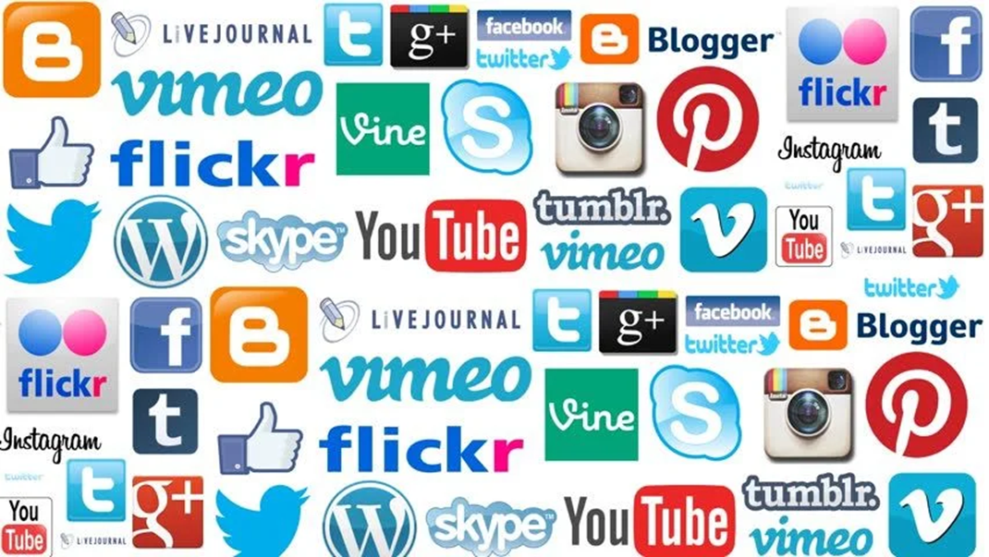
Collaboration Platforms: Applications & Infrastructure

Slide 19
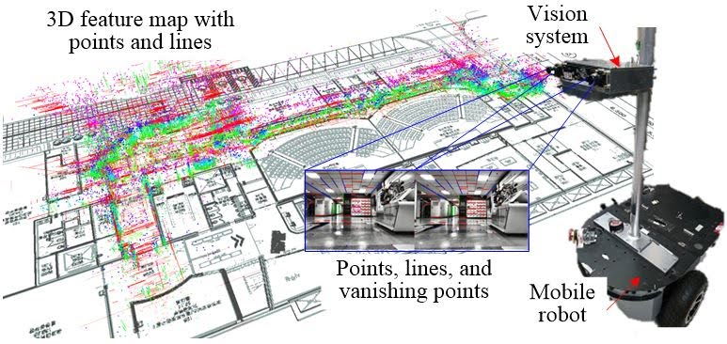
VR & AR: Visual SLAM
Visual SLAM - Intelligent Robotics Laboratory (korea.ac.kr)

Slide 20
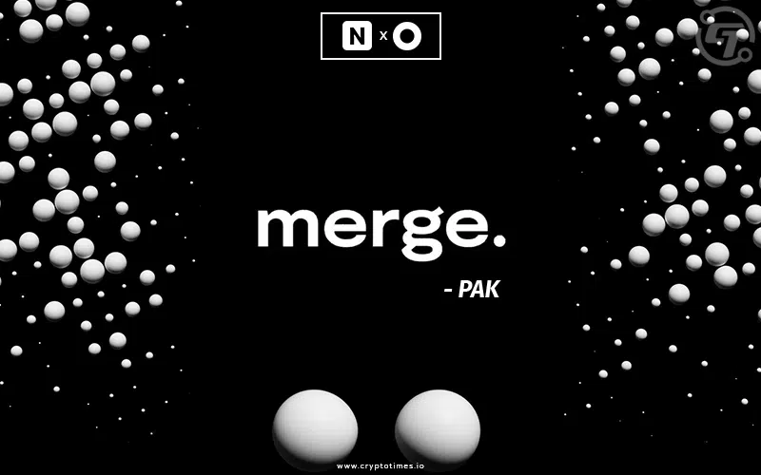
PAK’s NFT Artwork - The Merge
https://www.cryptotimes.io/paks-merge-nfts-are-about-to-reach-100-million-milestone/
Notes:
Digital artist Pak’s newest creation, The Merge, has fetched US$91.8 million on Nifty Gateway, with 28,983 collectors snapping up 312,686 total units of mass, or otherwise known as a nonfungible token (NFT).
The price was a record for an artwork sold publicly by a living artist, according to Nifty Gateway, a leading NFT marketplace.
https://www.barrons.com/articles/paks-nft-artwork-the-merge-sells-for-91-8-million-01638918205
https://hypebeast.com/hk/2021/12/pak-merge-nifty-gateway-nft
https://abmedia.io/20211203-pak-project-merge-on-nifty-gateway#%E5%AF%8C%E8%80%85%E6%9B%B4%E5%AF%8C%E7%9A%84%E7%8D%8E%E5%8B%B5%E6%A9%9F%E5%88%B6

Slide 21
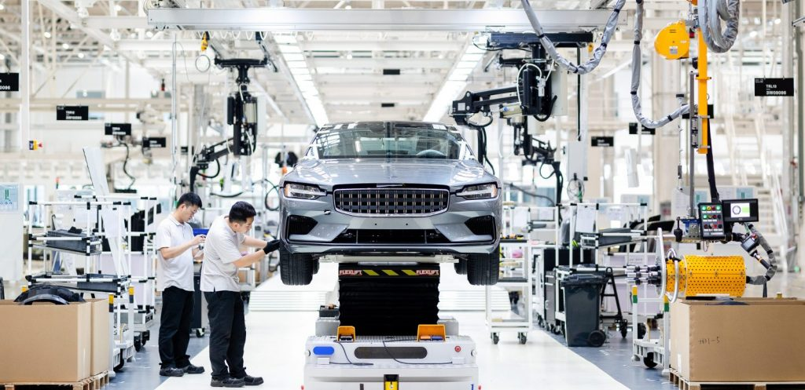
3D Printing
How is 3D Printing Transforming the Automotive Industry?
Notes:
https://amfg.ai/2018/06/13/3d-printing-transforming-automotive-industry/
https://builtin.com/3d-printing/3d-printed-car

Slide 22

MadTech
AdTech and MarTech Converge, creating MadTech (talkcmo.com)

Slide 23
Competitive Challenges and Opportunities
Notes:
效率提升
異質整合（價值）
對話溝通（無國界，語言的限制）

Slide 24
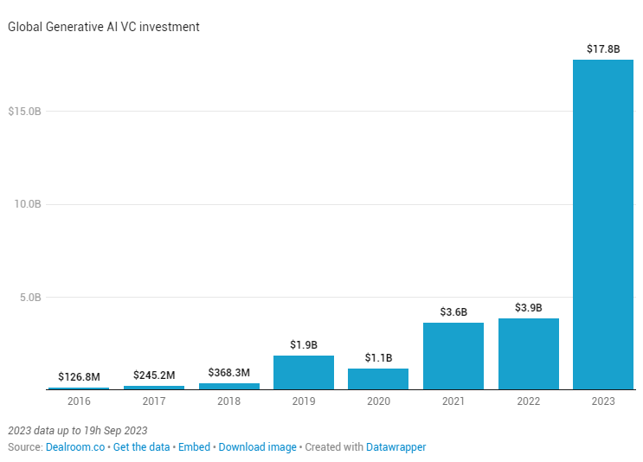
2023 sees a massive acceleration in GenAI funding
Named after a textbook genre of artificial intelligence, GenAI companies are attracting mountains of capital.
OpenAI is generating revenue at a pace of $1.3 billion a year, CEO Sam Altman.(2023.10)
For 2022, the company's revenue was just $28 million.
Notes:
Source: https://www.datawrapper.de/_/5Q5fp/

Slide 25


Can Open-Source LLMs Solve AI’s Democratization Problem?
Large Language Models(LLMs)
Open-source models
Open-source datasets
The open vs. closed source debate continues..
Open source LLMs level the playing field for research and enterprises but come with higher risk of proliferation and misuse by bad actors. Closed source APIs offers more security and control but less transparency.
stateof.ai 2023
Notes:
Can Open-Source LLMs Solve AI’s Democratization Problem? - By Sally Ward-Foxton 05.02.2023
https://www.eetimes.com/can-open-source-llms-solve-ais-democratization-problem/
關於開源的大型語言模型，是否可以解決人工智慧的民主化問題
就是是否可以被人們社會普遍使用
目前開源及閉源模型都有一定的優缺點
開源模型可以為社會提供了公平的競爭環境，但也帶來了更高的擴散和被不良行為者濫用的風險。
而閉源 API 提供了更高的安全性和控制力，但透明度較低，可能會阻礙發展。
Differentiation
Deployment

Slide 26

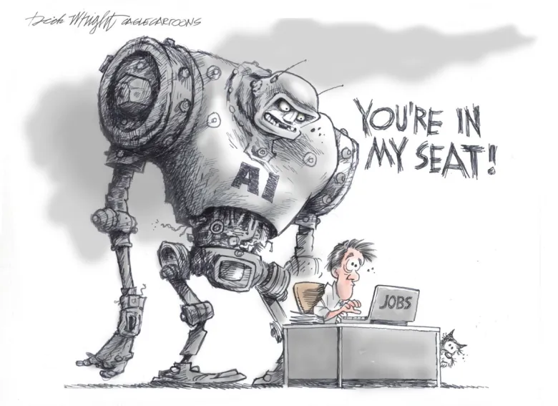
Five Key Principles and Potential Threats of AI Governance
When AI development exceeds human control…
CEO of DoNotPay, attempted to develop AI lawyers to assist individuals with traffic fines
But the American Bar Association responded with threats and retaliation in an attempt to obstruct AI applications
Notes:
哈佛法學教授雷席格：我們正處於AI的「奧本海默時刻」，好壞永遠並存【完整全文】
https://futurecity.cw.com.tw/article/3183
勞倫斯・萊斯格在書中提出「Pathetic Dot Theory」，解釋個人生活如何受到法律、社會規範、市場與科技基礎設施等四種面向調節。

Slide 27
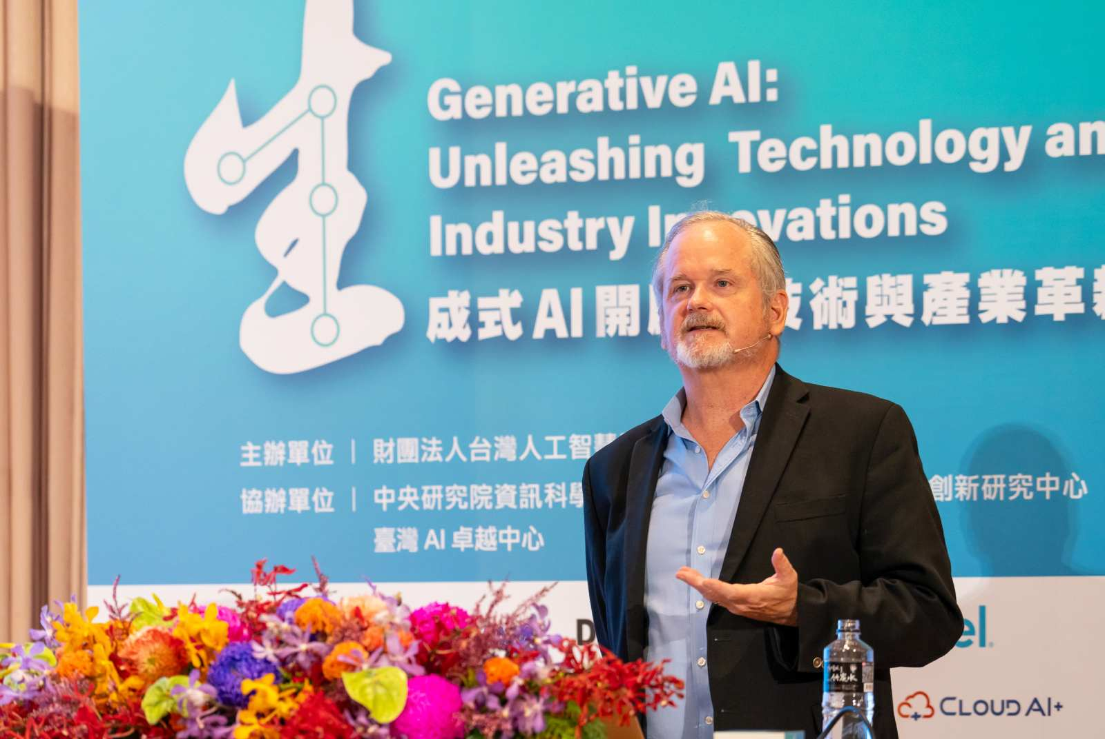
Pathetic Dot Theory
LAW
NORMS
MARKET
AI
CODES
AI and the Law, Prof. Lawrence Lessig
(https://aiacademy.tw/conf2023-ai-law/)
Notes:
哈佛法學教授雷席格：我們正處於AI的「奧本海默時刻」，好壞永遠並存【完整全文】
https://futurecity.cw.com.tw/article/3183
勞倫斯・萊斯格在書中提出「Pathetic Dot Theory」，解釋個人生活如何受到法律、社會規範、市場與科技基礎設施等四種面向調節。
轉向AI:
Pathetic Dot Theory，是一種社會經濟調節理論，AI受到了受到四種力量(code 市場、社會倫理、法律)的調節及制約，
以此來說明人類與AI可以並存

Slide 28

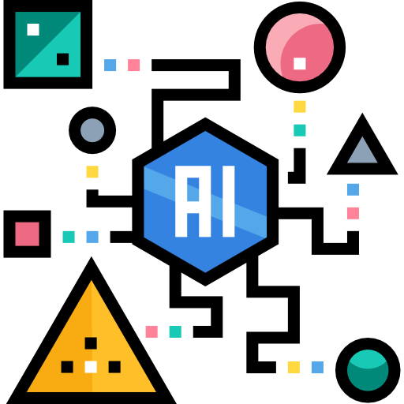
Research Trends-AIOT
deploy Generative AI in edge device
AIoT
Notes:
将AI模型安装在邊緣設備，使設備能夠進行自主的生成性任務
智能家電、工業自動化、監控系統、物流管理、自動駕駛、GIS...

Slide 29
Thank you ! Q&A

