Slide 1
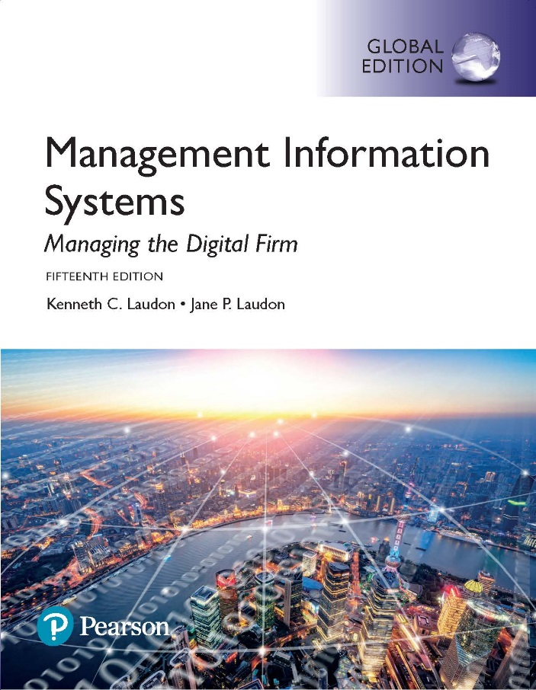
Management Information Systems: Managing the Digital Firm
Fifteenth edition
Chapter 15
Managing Global Systems

Slide 2
Learning Objectives
15-1 What major factors are driving the internationalization of business?
15-2 What are the alternative strategies for developing global businesses?
15-3 What are the challenges posed by global information systems and management solutions for these challenges?
15-4 What are the issues and technical alternatives to be considered when developing international information systems?
Notes:
This chapter discusses the use and influence of information technology in developing a global business strategy. You could ask students to give an example of a global company and describe what it is that makes that company global. What are the advantages that a global firm has over an equivalent national firm?

Slide 3
Video Cases
Case 1: Daum Runs Oracle Apps on Linux
Case 2: Lean Manufacturing and Global ERP: Humanetics and Global Shop

Slide 4
The Bel Group: Laughing All the Way to Success (1 of 2)
Problem
  Potential expansion
  Untouched market potential globally
Solutions
  Design global strategy and business model
  Redesign business processes
  Deploy Salesforce’s Sales Cloud software

Slide 5
The Bel Group: Laughing All the Way to Success (2 of 2)
Dunlop uses Salesforce’s Sales Cloud to create a global CRM, to coordinate sales and marketing teams from different business locations around the globe
Demonstrates IT’s role in helping organizations pursue a global growth strategy
Illustrates the ability of IT systems to support scalability

Slide 6
What Major Factors Are Driving the
Internationalization of Business?
Global economic system and global world order driven by advanced networks and information systems
The growth of international trade has radically altered domestic economies around the globe
For example, production of many high-end electronic products parceled out to multiple countries
  For example: Apple iPhone’s global supply chain
Notes:
This slide emphasizes the role of advanced networks and information systems in enabling the growth of global economic systems and global world order. Ask students why networks and IT advances make globalization more feasible. The text uses the example of HP’s path to market to illustrate what globalization means for an international firm, illustrated in the next slide.

Slide 7
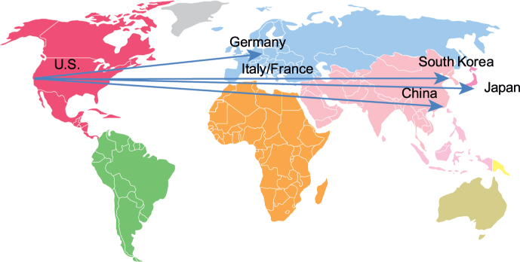
Figure 15.1: Apple iPhone’s Global Supply Chain
Notes:
Figure 15.1, Page 563.
Apple designs the iPhone in the United States and relies on suppliers in the United States, Germany, Italy, France, Japan, and South Korea for other parts. Final assembly occurs in China.

Slide 8
Developing an International Information
Systems Architecture
Understand global environment
  Business drivers for global competition
  Inhibitors creating management challenges
Develop corporate strategy for global competition
Develop organizational structure and division of labor
Consider management issues
  Design of business procedures, reengineering, managing change
Consider technology platform
Notes:
This slide discusses the strategy a firm should take in order to make a successful move toward globalization. Why would understanding the business drivers be the top consideration? Why is considering the technology platform the last consideration?

Slide 9
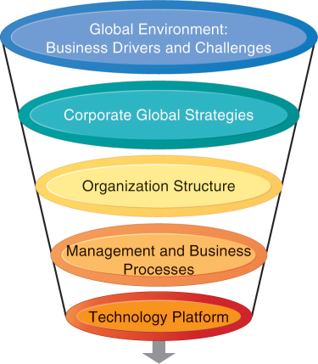
Figure 15.2: International Information Systems Architecture
Notes:
Figure 15.2, Page 564.
The major dimensions for developing an international information systems architecture are the global environment, the corporate global strategies, the structure of the organization, the management and business processes, and the technology platform.
This graphic illustrates the strategy for developing an international system. There are a variety of choices when determining a corporate global strategy. For example, you could sell to the globe from a domestic base, or organize production and distribution around the world. Determining a global strategy means deciding what portions of the business are located globally. What would be the biggest factors in making this decision?

Slide 10
The Global Environment: Business Drivers and Challenges
General cultural challenges
  Cultural particularism
  Social expectations
  Political laws
Specific challenges
  Standards
  Reliability
  Speed
  Personnel
Notes:
This slide continues the discussion of the environmental factors driving a business or industry to globalization. There are both general, cultural challenges in internationalization as well as specific challenges; this slide looks at the general challenges. Ask students to define particularism and to provide an example of it. How would particularism, regionalism, nationalism, affect the success of a business trying to globalize? What is transborder data flow? With the use of the Internet, how is transborder data flow an issue?
This slide continues the discussion of the challenges to internationalization and looks at specific challenges that firms face. One challenge discussed in the text is different accounting standards. How can accounting standards be different from country to country? Ask students how an accounting standard can pose difficulties to developing a global information system. Ask students to define EDI (discussed in an earlier chapter).

Slide 11
Table 15.1 The Global Environment: Business Drivers and Challenges
GENERAL CULTURAL FACTORS | SPECIFIC BUSINESS FACTORS
Global communication and transportation technologies | Global markets
Development of global culture | Global production and operations
Emergence of global social norms | Global coordination
Political stability | Global workforce
Global knowledge base | Global economies of scale
Notes:
The first strategic consideration in building an international system is to examine the global environment in terms of business drivers and challenges. This slide and the next two examine business drivers and challenges that lead industries toward global markets and competition. Ask students what global culture is and how this influences internationalization. Ask students to explain what the global knowledge base is, and how this has changed over the past half-century. Can all industries benefit equally from globalization? Why or why not?

Slide 12
Table 15.2 Challenges and Obstacles to Global Business Systems
GLOBAL | SPECIFIC
Cultural particularism: Regionalism, nationalism, language differences | Standards: Different Electronic Data Interchange (EDI), e-mail, telecommunications standards
Social expectations: Brand-name expectations, work hours | Reliability: Phone networks not uniformly reliable
Political laws: Transborder data and privacy laws, commercial regulations | Speed: Different data transfer speeds, many slower than United States
- | Personnel: Shortages of skilled consultants

Slide 13
State of the Art
Most companies have inherited a patchwork international system using traditional batch-oriented reporting, manual data entry, legacy systems, and little online control.
Significant difficulties in building appropriate international architectures
  Planning a system appropriate to firm’s global strategy
  Structuring organization of systems and business units
  Solving implementation issues
  Choosing right technical platform
Notes:
This slide describes the reality of global information systems in use in typical businesses today. Few businesses that have begun to internationalize have top-of-the-line systems and face powerful competition from those companies that do have truly international systems.

Slide 14
Global Strategies and Business Organization
Three main kinds of organizational structure
  Centralized: In the home country
  Decentralized/dispersed: To local foreign units
  Coordinated: All units participate as equals
Four main global strategies
  Domestic exporter
  Multinational
  Franchisers
  Transnational
Notes:
This slide discusses the general ways business activities can be organized and the four main business strategies used by global companies. Ask students to describe each of the strategies (domestic exporter, multinational, franchiser, transnational) and to provide an example.

Slide 15
Table 15.3 Global Business Strategy and Structure
BUSINESS FUNCTION | DOMESTIC EXPORTER | MULTINATIONAL | FRANCHISER | TRANSNATIONAL
Production | Centralized | Dispersed | Coordinated | Coordinated
Finance/ accounting | Centralized | Centralized | Centralized | Coordinated
Sales/ marketing | Mixed | Dispersed | Coordinated | Coordinated
Human resources | Centralized | Centralized | Coordinated | Coordinated
Strategic management | Centralized | Centralized | Centralized | Coordinated

Slide 16
Global Systems to Fit the Strategy
Configuration, management, and development of systems tend to follow global strategy chosen
Four main types of systems configuration
  Centralized: Systems development and operation occur totally at domestic home base
  Duplicated: Development occurs at home base but operations are handed over to autonomous units in foreign locations
  Decentralized: Each foreign unit designs own solutions and systems
  Networked: Development and operations occur in coordinated fashion across all units

Slide 17
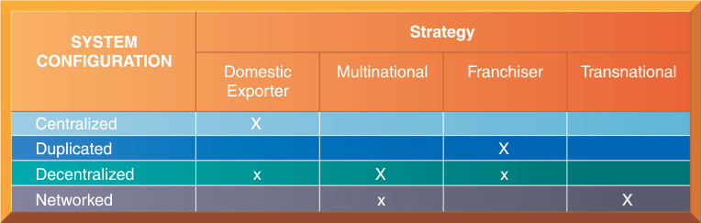
Figure 15.3: Global Strategy and Systems Configurations
Notes:
Figure 15.3, Page 570.
The large Xs show the dominant patterns, and the small Xs show the emerging patterns. For instance, domestic exporters rely predominantly on centralized systems, but there is continual pressure and some development of decentralized systems in local marketing regions.
This table shows which system configurations are typically used when a firm employs one of the four global strategies. The large Xs show the dominant patterns whereas the small Xs show the emerging pattern. The transnational has the most ambitious form of systems development, using a singular global environment. This structure is most visible in financial services companies, where the homogeneity of the product (money, money instruments) seems to overcome cultural barriers.

Slide 18
Reorganizing the Business
To develop a global company and information systems support structure:
  Organize value-adding activities along lines of comparative advantage
    For example: Locate functions where they can best be performed, for least cost and maximum impact.
  Develop and operate systems units at each level of corporate activity—regional, national, and international
  Establish at world headquarters:
    Single office responsible for development of international systems
    Global CIO position
Notes:
This slide discusses how a firm should organize itself for doing business on an international scale and offers three main principles to follow when developing a global company and information systems support structure. Ask students to explain the second principal. (For local needs, there should be host country systems units; regional systems units should handle systems development across national boundaries but within major geographic regions; transnational systems should create linkages across and between regional systems.) What types of systems would serve local over regional needs?

Slide 19
A Typical Scenario: Disorganization on a Global Scale
Traditional multinational consumer-goods company based in United States and operating in Europe would like to expand into Asia
World headquarters and strategic management in United States
Separate regional, national production and marketing centers
Foreign divisions have separate IT systems
E-mail systems are incompatible
Each production facility uses different ERP system, different hardware and database platforms, and so on
Notes:
This slide describes a common scenario of a multinational company and the challenges it faces in trying to develop a transnational information system as it expands into Asian markets. What types of implementation problems can the company expect when it begins development? Can resistance be expected even from the IT departments in different countries? The text describes some likely reactions (the foreign divisions will resist efforts to agree on common user requirements, U.S. systems groups will not easily accept guidance from anyone recommending a transnational strategy, etc.).

Slide 20
Global Systems Strategy (1 of 2)
Share only core systems
  Core systems support functionality critical to firm
Partially coordinate systems that share some key elements
  Do not have to be totally common across national boundaries
  Local variation desirable
Peripheral systems
  Need to suit local requirements only
Notes:
This slide looks at the basic framework of a solution to implementing a transnational information system. Ask students what types of systems might be considered “core systems.” What types of systems might fall into the partially coordinated category? The peripheral systems category?

Slide 21
Global Systems Strategy (2 of 2)
Define core business processes
Identify core systems to coordinate centrally
Choose an approach
  Piecemeal and grand design approaches tend to fail
Make benefits clear
  Global flexibility
  Gains in efficiency
  Global markets and larger customer base unleash new economies of scale at production facilities
  Optimizing corporate funds over much larger capital base
Notes:
This slide outlines the steps in creating a successful global systems solution appropriate to the firm’s goals and strategies. Ask students how a firm would determine its core business processes? (Conduct business process analysis.) Emphasize that the second step is to define the core systems identified as the transnational systems, and these should be kept to a minimum. Emphasize that it is crucial for senior managers at headquarters and in foreign divisions to understand the benefits. Ask students how a larger customer base unleashes economies of scale. What does optimizing funds over a larger capital base mean?

Slide 22
The Management Solution: Implementation (1 of 2)
Agreeing on common user requirements
  Short list of core business processes
  Develop common language, understanding of common elements and unique local qualities
Introducing changes in business processes
  Success depends on legitimacy, authority, ability to involve users in change design process
Coordinating applications development
  Coordinate change through incremental steps
  Reduce set of transnational systems to bare minimum
Notes:
What is meant by “developing a common language to discuss the business” and why is this important? Ask students to define legitimacy. Emphasize that, at the global level, there is far too much complexity to implement full-scale, worldwide application changes.

Slide 23
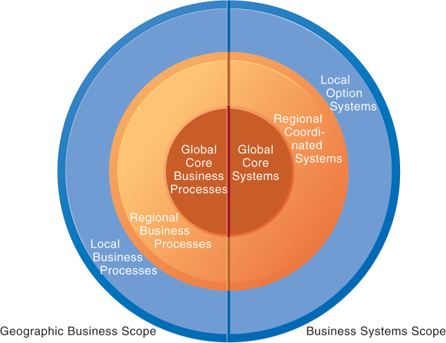
Figure 15.4: Local, Regional, and Global Systems
Notes:
Figure 15.4, Page 573.
Agency and other coordination costs increase as the firm moves from local option systems toward regional and global systems. However, transaction costs of participating in global markets probably decrease as firms develop global systems. A sensible strategy is to reduce agency costs by developing only a few core global systems that are vital for global operations, leaving other systems in the hands of regional and local units. Source: From Managing Information Technology in Multinational Corporations by Edward M. Roche, © 1993. Adapted by permission of Prentice Hall, Inc., Upper Saddle River, NJ.
This graphic illustrates the scope of the three different categories of system (global, regional, local). Give the student an example industry, say, sports apparel manufacturing, and ask students to describe what local, regional, and global business processes might be. Use Nike as an example—a U.S. firm for design, marketing, sales and distribution where all the products are made in offshore factories.

Slide 24
The Management Solution: Implementation (2 of 2)
Coordinating software releases
  Institute procedures to ensure all operating units update at same time
Encouraging local users to support global systems
  Cooptation: Bringing the opposition into design and implementation process without giving up control over direction and nature of the change
    Permit each country unit to develop one transnational application
    Develop new transnational centers of excellence
Notes:
This slide continues the discussion of solutions to the management challenges. What types of difficulties might there be in having all units update software at the same time? Why does the text suggest that, as much as possible, raw power—commanding people—should be avoided, when dealing with user resistance?

Slide 25
Issues and Technical Alternatives When Developing International Information Systems (1 of 2)
Computing platforms and systems integration
  How new core systems will fit in with existing suite of applications developed around globe by different divisions
  Standardization: Data standards, interfaces, software, and so on
Connectivity
  Internet does not guarantee any level of service
  Many firms use private networks and VPNs
  Low penetration of PCs, outdated infrastructures in developing countries
Notes:
This slide and the next emphasize the types of technological, rather than organizational, challenges faced when building a global system. It is important to note that all units having the same hardware and operating software does not guarantee integration, data standardization must also be enforced. For example, technical accounting terms such as the beginning and end of the fiscal year must be standardized.

Slide 26
Issues and Technical Alternatives When Developing International Information Systems (2 of 2)
Software
  Integrating new systems with old
  Human interface design issues, languages
Software localization
  Converting software to operate in second language
Most important software applications:
  TPS and MIS
  SCM, EDI, and enterprise systems
  Collaboration tools, e-mail, videoconferencing
Notes:
This slide continues the discussion of technology challenges in building global systems. Ask students why MIS and TPS are typically the most important applications.

Slide 27
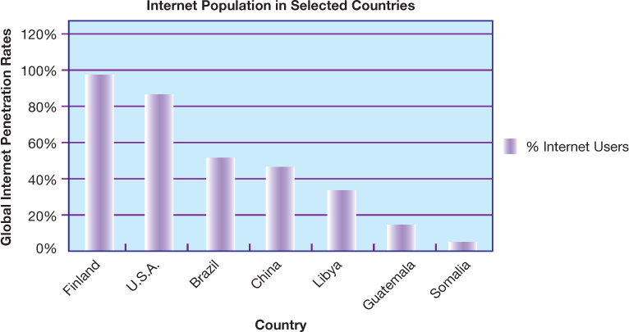
Figure 15.5: Internet Population in Selected Countries
Notes:
Figure 15.5, Page 578.
The percentage of the total population using the Internet in developing countries is much smaller than in the United States and Europe, but it is growing rapidly. Source: Based on data from Internerworldstats.com, 2015; Pew Global Attitudes Project, 2015; and authors.
This graph shows the percentage of population using the Internet, by region. It illustrates the lower penetration of Internet usage in developing countries.

Slide 28
Interactive Session: Organizations: Indian E-commerce: Obstacles to Opportunity
Class discussion
  Describe the technical, cultural, and organizational obstacles to e-commerce growth in India.
  How do these factors hamper companies from doing business in India or setting up Indian e-commerce sites?
  Will non-Indian companies like Amazon.com and eBay flourish in India? Explain.

Slide 29
Interactive Session: Management: Steelcase Designs Goes for Global Talent Management
Class discussion
  Why are human resources and talent management so important at Steelcase?
  Identify the problem described in this case. What management, organization and technology factors contributed to this problem? What role did globalization play?
  Describe the capabilities of the SAP ERP HCM and SuccessFactors systems that were helpful to Steelcase. How did these systems improve global operations and decision making?

