Slide 1
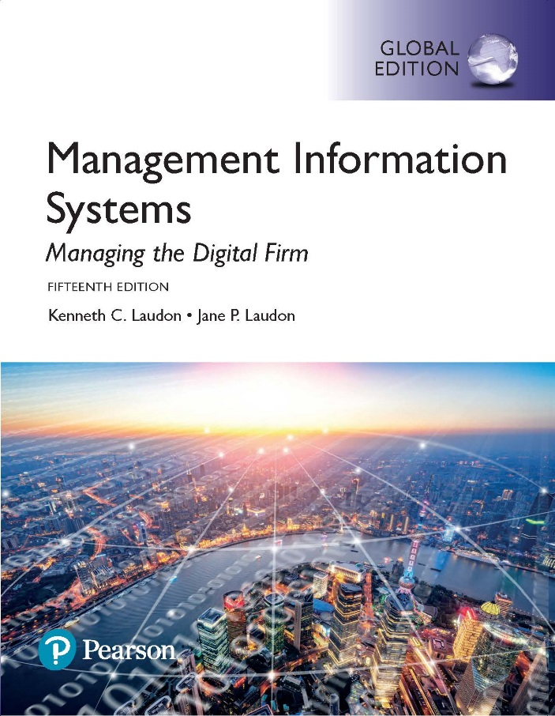
Management Information Systems: Managing the Digital Firm
Fifteenth edition
Chapter 7
Telecommunications, the
Internet, and Wireless
Technology

Slide 2
Learning Objectives
7-1 What are the principal components of telecommunications networks and key networking technologies?
7-2 What are the different types of networks?
7-3 How do the Internet and Internet technology work, and how do they support communication and e-business?
7-4 What are the principal technologies and standards for wireless networking, communication, and Internet access?
Notes:
This chapter discusses the principle technologies used in networking and the Internet. Ask students what the difference is between a network and the Internet. Why is networking so important to modern organizations? How many students have wireless networks at home? How many have a smartphone that uses a 3G or 4G network? What's the difference between a 4G network and Wi-Fi? How many students have seen an RFID tag?

Slide 3
Video Cases
Case 1: Telepresence Moves out of the Boardroom and into the Field
Case 2: Virtual Collaboration with IBM Sametime

Slide 4
Wireless Technology Makes Dundee Precious Metals Good as Gold (1 of 2)
Problem
  Making mining operations more efficient
  Challenges communicating and coordinating work underground
Solutions
  Underground wireless Wi-Fi network
  Technology adapted to difficult conditions
  Wi-Fi RFID tags to track and transmit data
  Mobile View interface provides reports and rules-based alerts

Slide 5
Wireless Technology Makes Dundee Precious Metals Good as Gold (2 of 2)
Dundee uses Cisco Systems’ Wi-Fi and AeroScout RFID technology to make its mining operations more efficient.
Demonstrates IT’s role in helping organizations increase efficiency and lower costs
Illustrates the ability of IT systems to track equipment and workers and use resources more efficiently

Slide 6
Networking and Communication Trends
Convergence
  Telephone networks and computer networks converging into single digital network using Internet standards
Broadband
  More than 74 percent U.S. Internet users have broadband access
Broadband wireless
  Voice, data communication are increasingly taking place over broadband wireless platforms
Notes:
This slide discusses recent developments in networking technologies. Ask students to give an example of convergence. How fast is broadband today? How many of your students have broadband? Note that in 2000, typical Internet access speeds were 56 kbps over a telephone line, costing 25 cents per kilobit, whereas today broadband speeds are 1 to 5 mbps, costing 1 cent per kilobit (or 10 cents per gigabit). Are students aware of how fast their Internet connections are at home, school, or work? Ask students if they know the speed of their cell phone’s Internet connection. The point here is to try and raise awareness of telecommunications systems among students.

Slide 7
What Is a Computer Network?
Two or more connected computers
Major components in simple network
  Client and server computers
  Network interfaces (NICs)
  Connection medium
  Network operating system (NOS)
  Hubs, switches, routers
Software-defined networking (SDN)
  Functions of switches and routers managed by central program
Notes:
This slide describes what a network is along with the components that you will find in a simple network (illustrated on the next slide.) Ask students to describe the function of an NIC. What is a connection medium? Ask students to describe the purpose of a hub, switch, and router.

Slide 8
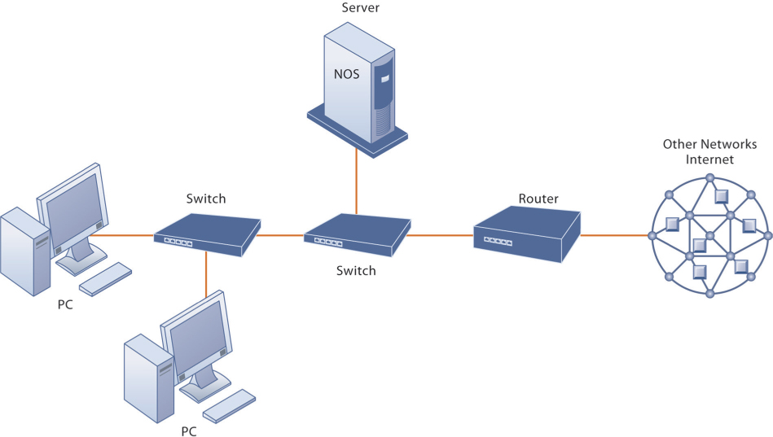
Figure 7.1: Components of a Simple Computer Network
Notes:
Figure 7.1, Page 252.
Illustrated here is a simple computer network consisting of computers, a network operating system (NOS) residing on a dedicated server computer, cable (wiring) connecting the devices, switches, and a router.
Although the NOS is shown as part of the server, note that, depending on the type of software, an NOS may also be designed to reside on client computers (these are called peer-to-peer networks). Do some students have a home computer network? Ask them to describe the elements of the network.

Slide 9
Networks in Large Companies
Hundreds of local area networks (LANs) linked to firm-wide corporate network
Various powerful servers
  Website, corporate intranet, extranet
  Backend systems
Mobile wireless LANs (Wi-Fi networks)
Videoconferencing system
Telephone network, wireless cell phones
Notes:
This slide looks at the additional components one might expect to find in the network of a large company that has many locations and thousands of employees (illustrated on the next slide). Ask students what is meant by “backend systems.” Note that many firms are dispensing with traditional landline telephone networks and using Internet telephones that run on existing internal data networks and the Internet.

Slide 10
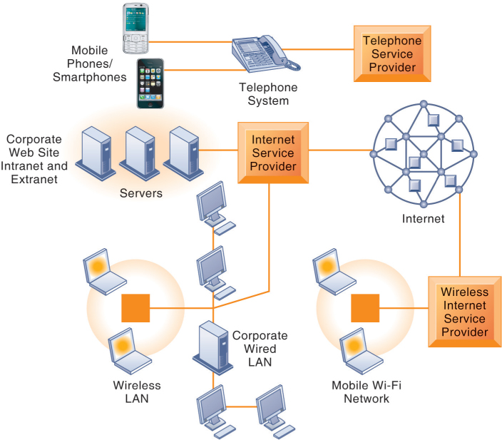
Figure 7.2: Corporate Network Infrastructure
Notes:
Figure 7.2, Page 254.
Today’s corporate network infrastructure is a collection of many networks from the public switched telephone network, to the Internet, to corporate local area networks linking workgroups, departments, or office floors.
This graphic illustrates the components of a large company’s network. Note the difference between the wireless LAN, which allows wireless access within the office, and the mobile Wi-Fi network, which allows Internet access to employees outside of offices. The advantage of telephone-based wireless systems is that they do not require a Wi-Fi hotspot to work, and in fact can connect users to the entire globe through their telephone networks. Cable networks—major competitors of telephone company Internet providers—have recently developed a mobile option. Optimum Cable (Comcast) has installed neighborhood Wi-Fi hot spots, allowing cable subscribers wireless access to the Internet.

Slide 11
Key Digital Networking Technologies (1 of 3)
Client/server computing
  Distributed computing model
  Clients linked through network controlled by network server computer
  Server sets rules of communication for network and provides every client with an address so others can find it on the network
  Has largely replaced centralized mainframe computing
  The Internet: largest implementation of client/server computing
Notes:
This slide and the following two look at the main technologies in use today for networks: client/server computing, packet switching, and TCP/IP. Ask students what advantages client/server computing has over centralized mainframe computing.

Slide 12
Key Digital Networking Technologies (2 of 3)
Packet switching
  Method of slicing digital messages into parcels (packets), sending packets along different communication paths as they become available, and then reassembling packets at destination
  Previous circuit-switched networks required assembly of complete point-to-point circuit
  Packet switching more efficient use of network’s communications capacity
Notes:
This slide continues the discussion of the three main networking technologies today, looking at the second, packet switching. Note that circuit-switched networks were expensive and wasted available communications capacity—the circuit had to be maintained whether data was being sent or not. It is also important to note that packet switching enables packets to follow many different paths. What is the advantage of this capability? If one path is blocked due to an accident or power failure, the data will automatically be shifted by routers to open paths. However, in truly massive outages like the September 11, 2011 attack on the World Trade Center, nearby metropolitan servers were knocked out, and for a period of several days, Internet access was limited in the New York Metropolitan area. The notion that packet switching networks would survive a nuclear attack is highly unlikely.

Slide 13
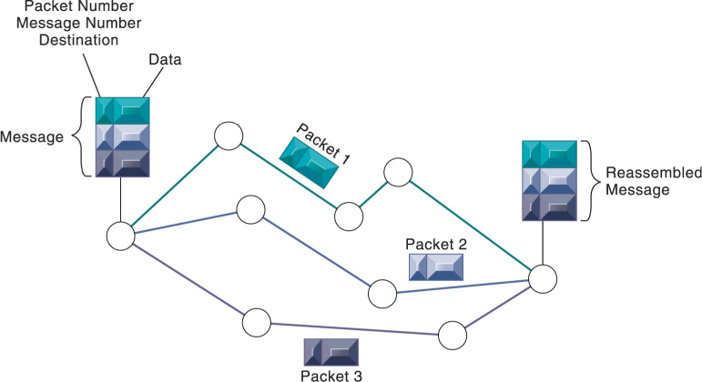
Figure 7.3: Packet-Switched Networks and Packet Communications
Notes:
Figure 7.3, Page 255.
Data are grouped into small packets, which are transmitted independently over various communications channels and reassembled at their final destination.
This graphic illustrates how packet switching works, showing a message being split into three packets, sent along different routes, and then reassembled at the destination. Note that each packet contains a packet number, message number, and destination.

Slide 14
Key Digital Networking Technologies (3 of 3)
TCP/IP and connectivity
  Protocols: rules that govern transmission of information between two points
  Transmission Control Protocol/Internet Protocol (TCP/IP)
    Common worldwide standard that is basis for the Internet
  Department of Defense reference model for TCP/IP
    Four layers
      Application layer
      Transport layer
      Internet layer
      Network interface layer
Notes:
This slide continues the discussion of the three main networking technologies in use today, and looks at the third TCP/IP. Note that in a network, there are typically many different types of hardware and software components that need to work together to transmit and receive information. Different components in a network communicate with one another only by adhering to a common set of rules called protocols. In the past, many diverse proprietary and incompatible protocols often forced business firms to purchase computing and communications equipment from a single vendor. But today, corporate networks are increasingly using a single, common, worldwide standard called Transmission Control Protocol/ Internet Protocol (TCP/IP). TCP/IP actually is a suite of protocols, the main ones of which are TCP and IP. Ask students what these two main protocols are responsible for.

Slide 15
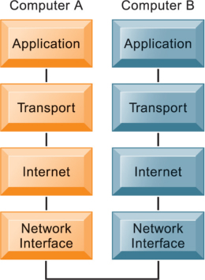
Figure 7.4: The Transmission Control Protocol/Internet Protocol (TCP/IP) Reference Model
Notes:
Figure 7.4, Page 256.
This graphic illustrates the four layers of the DOD reference model for TCP/IP. Note that what happens, when computer A sends a message to computer B, is that the data that computer A creates is transferred within that computer from the application layer to subsequent layers in sequence. In this process it is split into packets, and information is added at each stage, ultimately translating the packets into a form that can be transferred over the network interface. After traveling over the network interface, the packets are reassembled at the recipient computer, from the network interface layer up, ultimately for use by the application layer.

Slide 16
Types of Networks
Signals: Digital versus analog
  Modem: translates digital signals into analog form (and vice versa)
Types of networks
  Local area networks (LANs)
    Ethernet
    Client/server vs. peer-to-peer
  Wide area networks (WANs)
  Metropolitan area networks (MANs)
  Campus area networks (CANs)
Notes:
This slide looks at the types of networks that organizations use. Ask students what the differences are between digital and analog signals. Ask students to describe and distinguish between LANs, CANs, WANs, and MANs, and also to talk about their different range of operation. Note that a network can be defined by the way the clients interact (client/server versus peer-to-peer), the type of physical medium to carry signals (Ethernet, Fast Ethernet, etc.), and the way in which computers are connected and send signals to each other (topology).

Slide 17
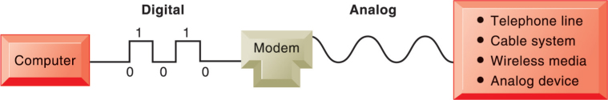
Figure 7.5: Functions of the Modem
Notes:
Figure 7.5, Page 257.
A modem is a device that translates digital signals into analog form (and vice versa) so that computers can transmit data over analog networks such as telephone and cable networks.
This graphic illustrates the differences between digital and analog signals, and shows how digital signals can be sent to other computers over analog cables such as telephone and cable lines which are analog. Note that digital signals are representations of the two binary digits, 0 and 1, and are represented logically as on and off electrical pulses (in reality as different voltages). Ask students what MODEM stands for.

Slide 18
Transmission Media and Transmission Speed
Physical transmission media
  Twisted pair wire (CAT5)
  Coaxial cable
  Fiber optics cable
  Wireless transmission media and devices
    Satellites
    Cellular systems
Transmission speed
  Bits per second (bps)
  Hertz
  Bandwidth
Notes:
This slide looks at the media involved in network transmission. Note that many of the telephone systems in buildings had twisted wires installed for analog communication, but they can be used for digital communication as well. Also, today, telecommunications companies are starting to bring fiber optic cable into the home for high-speed Internet access.
Note that the transmission capacity of a medium (bps) is dependent on its frequency, which is measured in hertz, or cycles per second. Ask students to define bandwidth (it is the difference between the highest and lowest frequencies that can be accommodated on a single channel).

Slide 19
What Is the Internet?
The Internet
  World’s most extensive network
  Internet service providers (ISPs)
    Provide connections
    Types of Internet connections
      Dial-up: 56.6 Kbps
      Digital subscriber line (DSL/FIOS): 385 Kbps–40 Mbps
      Cable Internet connections: 1–50 Mbps
      Satellite
      T1/T3 lines: 1.54–45 Mbps
Notes:
This slide examines what the Internet is—ask students to describe it and what they use it for. The text refers to the Internet as the most extensive public communication system and the world’s largest implementation of client/server computing.
Ask students how they connect to the Internet. Do any of their families use dial-up (telephone/modem)? Do any use satellite? Note that T lines are leased, dedicated lines suitable for businesses or government agencies requiring high-speed guaranteed service levels. Do students know that the Internet does not guarantee any service level, and agrees only to make a “best effort.”
Ask students what an IP address is used for. Ask students why we have a domain name system, and why we don’t just use IP addresses. Note that the domain name system makes it possible for people to remember addresses.

Slide 20
Internet Addressing and Architecture
Each device on Internet assigned Internet Protocol (IP) address
32-bit number, e.g. 207.46.250.119
The Domain Name System (DNS)
  Converts IP addresses to domain names
  Hierarchical structure
  Top-level domains
Notes:
Ask students what an IP address is used for. Ask students why we have a domain name system, and why we don't just use IP addresses. Note that the domain name system makes it possible for people to remember addresses.

Slide 21
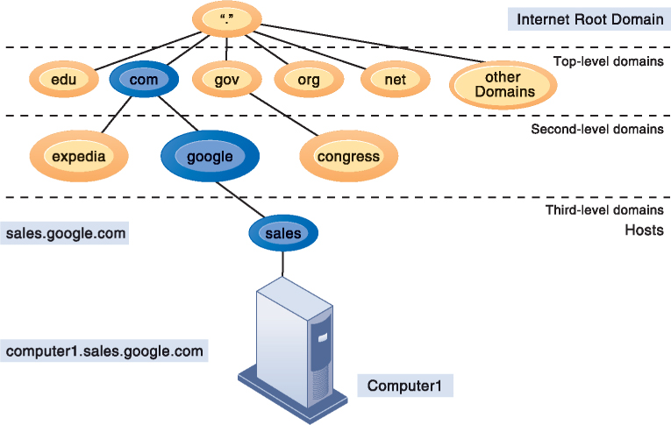
Figure 7.6: The Domain Name System
Notes:
Figure 7.6, Page 261.
Domain Name System is a hierarchical system with a root domain, top-level domains, second-level domains, and host computers at the third level.
This graphic describes how the domain name system works. Note that the “root” domain is the period that is used before the top-level domain, such as .edu or .com. Give students an example Internet address, such as myserver.myspace.com and ask them what the top-, second-, and third-level domains are.

Slide 22
Internet Architecture and Governance
Network service providers
  Own trunk lines (high-speed backbone networks)
Regional telephone and cable TV companies
  Provide regional and local access
Professional organizations and government bodies establish Internet standards
  IAB
  ICANN
  W3C

Slide 23
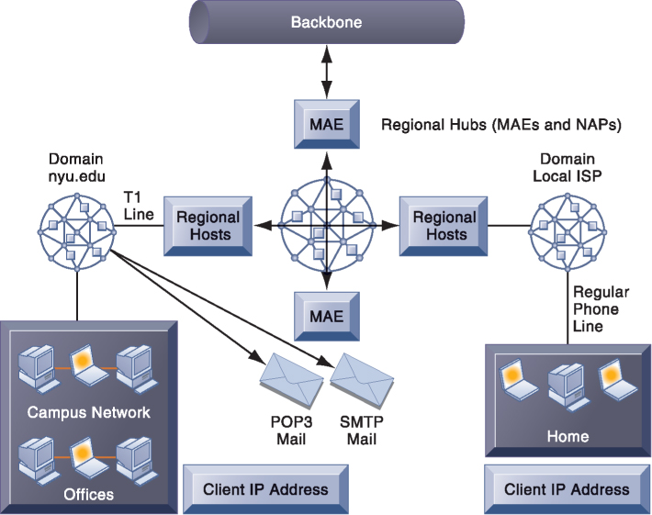
Figure 7.7: Internet Network Architecture
Notes:
Figure 7.7, Page 262.
The Internet backbone connects to regional networks, which in turn provide access to Internet service providers, large firms, and government institutions. Network access points (NAPs) and metropolitan area exchanges (MAEs) are hubs where the backbone intersects regional and local networks and where backbone owners connect with one another.
This graphic illustrates the architecture of the Internet. Note that MAEs (metropolitan area exchanges) are hubs where the backbone intersects regional and local networks and where backbone networks connect with one another.

Slide 24
Interactive Session: Organizations: The Global Battle Over Net Neutrality
Class discussion
  What is net neutrality? Why has the Internet operated under net neutrality up to this point?
  Who’s in favor of net neutrality? Who’s opposed? Why?
  What would be the impact on individual users, businesses, and government if Internet providers switched to a tiered service model for transmission over landlines as well as wireless?
  It has been said that net neutrality is the most important issue facing the Internet since the advent of the Internet. Discuss the implications of this statement.
  Are you in favor of legislation enforcing network neutrality? Why or why not?

Slide 25
The Future Internet: IPv6 and Internet 2
IPv6
  New addressing scheme for IP numbers
  Will provide more than a quadrillion new addresses
  Not compatible with current IPv5 addressing
Internet2
  Advanced networking consortium
    Universities, businesses, government agencies, other institutions
  Developed high-capacity 100 Gbps testing network
  Testing leading-edge new technologies for Internet

Slide 26
Internet Services and Communication Tools (1 of 2)
Internet services
  E-mail
  Chatting and instant messaging
  Newsgroups
  Telnet
  File Transfer Protocol (FTP)
  World Wide Web
Voice over IP (VoIP)
  Digital voice communication using IP, packet switching
Notes:
This slide continues the discussion about what the Internet is, here looking at the services, or applications, that the Internet supports. Notice that the Internet comprises many more services than just e-mail and the web. Ask students which of these services, beyond e-mail and the web have they used, and if they have, to describe how it works.

Slide 27
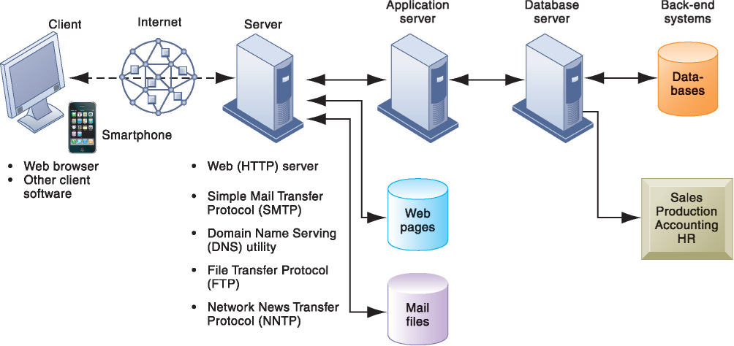
Figure 7.8: Client/Server Computing on the Internet
Notes:
Figure 7.8, Page 266.
Client computers running web browsers and other software can access an array of services on servers over the Internet. These services may all run on a single server or on multiple specialized servers.
This graphic looks at the services that an Internet server computer can offer: Websites (HTTP), e-mail (SMTP), file transfer (FTP), newsgroups (NNTP). It illustrates where on the path between client and backend systems these services lie.

Slide 28
Internet Services and Communication Tools (2 of 2)
Unified communications
  Communications systems that integrate voice, data, e-mail, conferencing
Virtual private network (VPN)
  Secure, encrypted, private network run over Internet
  PPTP
  Tunneling
Notes:
Students who have cable Internet telephones are using VoIP. Other popular technologies that use the Internet as a platform are VoIP, unified communications, and virtual private networks. Ask students what they think is the value to business is of each of these technologies.

Slide 29
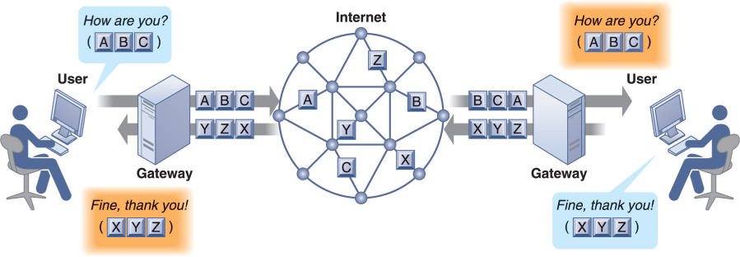
Figure 7.9: How Voice over IP Works
Notes:
Figure 7.9, Page 267.
A VoIP phone call digitizes and breaks up a voice message into data packets that may travel along different routes before being reassembled at the final destination. A processor nearest the call’s destination, called a gateway, arranges the packets in the proper order and directs them to the telephone number of the receiver or the IP address of the receiving computer.
This graphic shows how VoIP works. The voice messages are digitized and transported over the Internet in the same packet-switching method as traditional Internet data. Gateways are simply computers (network devices) that maintain the interface with the Internet in a firm.

Slide 30
Interactive Session: Management: Monitoring Employees on Networks: Unethical or Good Business?
Class discussion
  Should managers monitor employee e-mail and Internet usage? Why or why not?
  Describe an effective e-mail and web use policy for a company.
  Should managers inform employees that their web behavior is being monitored? Or should managers monitor secretly? Why or why not?

Slide 31
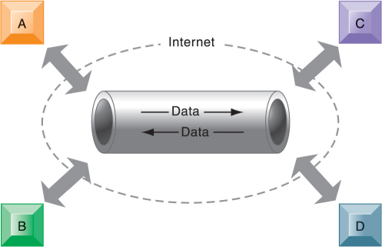
Figure 7.10: A Virtual Private Network Using the Internet
Notes:
Figure 7.10, Page 270.
This VPN is a private network of computers linked using a secure tunnel connection over the Internet. It protects data transmitted over the public Internet by encoding the data and wrapping them within the Internet protocol. By adding a wrapper around a network message to hide its content, organizations can create a private connection that travels through the public Internet.
This graphic illustrates how a virtual private network works. The rectangles A, B, C, and D represent different computers on the VPN. In a process
called tunneling, packets of data are encrypted and wrapped inside IP packets. By adding this wrapper around a network message to hide its content, business firms create a private connection that travels through the public Internet.

Slide 32
The Web
Hypertext
  Hypertext Markup Language (HTML)
  Hypertext Transfer Protocol (HTTP):
  Uniform resource locator (URL):
    http://www.megacorp.com/content/features/082602.html
Web servers
    Software for locating and managing web pages
Notes:
This slide looks at one of the most popular services on the Internet, the web, and the main protocols enabling the web. The web is an interlinked connection of websites, which are collections of web pages linked to a home page. These pages are created using a text markup language call HTML, and transmitted to user’s web browsers by HTTP. Web page addresses (URLs) are composed of the domain name of the website and the file location of the individual web page. Ask students if any have created web pages using HTML, and if so, to describe what this is like. How have they made the web pages visible to others on the web? There is a learning track available online that shows students how to create web pages using basic HTML.

Slide 33
Searching for Information on the Web (1 of 2)
Search engines
  Google’s PageRank System
Mobile search
Semantic search
Social search
Visual search and the visual web
  Tagging
  Pinterest
Notes:
This slide looks at how people find information of interest on the web. The primary method is through search engines, which today act as major portals to the web. Ask students where their initial points of entry are on the web, and how they find information they are interested in. Most will be Google users, but ask if they have looked at Bing, the Microsoft search engine that is showing some promise.
The text discusses how big the web is, in terms of pages. Google visited and indexed the content of more than an estimated 50 billion web pages in 2011, but this does not include the “deep web.” Other estimates point to “one trillion” web pages, but many of these are duplicates.

Slide 34
Searching for Information on the Web (2 of 2)
Intelligent agent shopping bots
Search engine marketing
Search engine optimization (SEO)
  Link farms
Search engine algorithms
Notes:
Ask students what the “deep web” is. Note that web pages available only to subscribers for a fee (“premium content”) do not allow crawlers to index the pages. Shopping bots are always fun to visit in class. Ask students what they might be interested in having you shop for, and then use one of the shop bots such as Shopzilla or Pricegrabber.

Slide 35
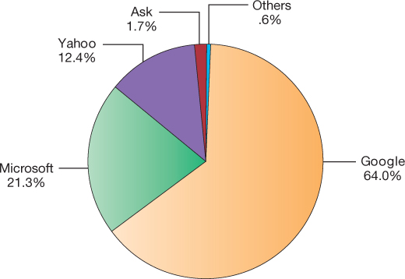
Figure 7.11: Top U.S. Web Search Engines
Notes:
Figure 7.11, Page 272.
Google is the most popular search engine, handling about 64 percent of web searches in the United States and about 90 percent in Europe. Sources: Based on data from comScore Inc., February 2016.
This graphic ranks the major search engines according to popularity, or percentage of total number of searches performed. Google is a clear favorite. Is this due to the superiority of their search engine results or does it involve other factors such as their clean interface, or their reach, which makes their ad platform more valuable to advertisers. Poll your class about the search engines they use.

Slide 36
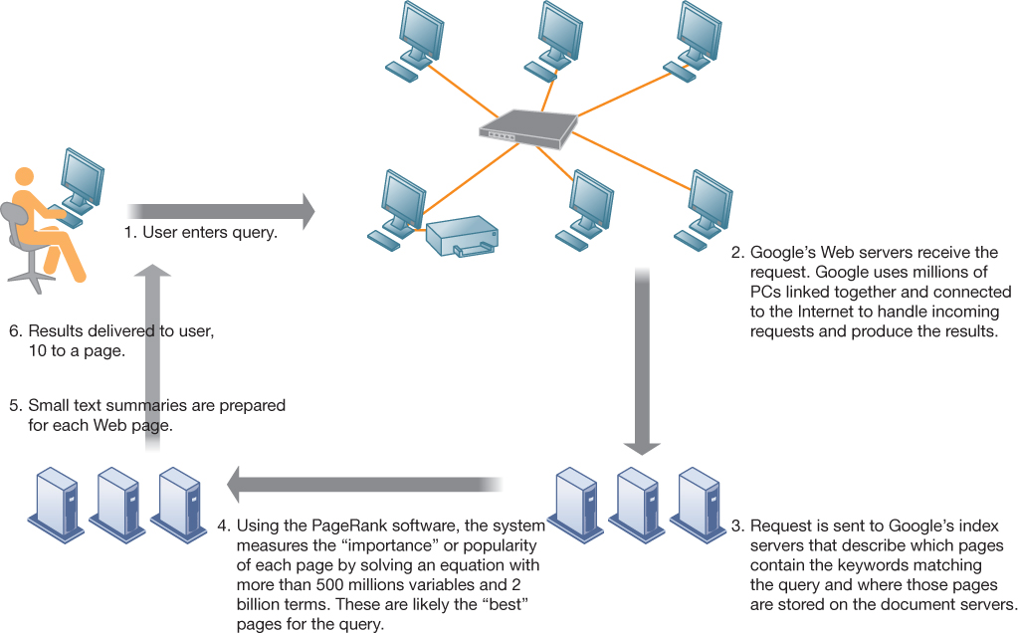
Figure 7.12: How Google Works
Notes:
Figure 7.12, Page 273.
The Google search engine is continuously crawling the web, indexing the content of each page, calculating its popularity, and storing the pages so that it can respond quickly to user requests to see a page. The entire process takes about half a second.
This graphic illustrates in a very high level diagram how Google works. At the foundation of Google’s search engine are two concepts—page ranking and the indexing of combinations of words. Ask students if they have a favorite search engine, and if so, why that search is their favorite. The reality of how Google actually works is the subject of many volumes, and is beyond the scope of this book.

Slide 37
Web 2.0 (1 of 2)
Second-generation services
Enabling collaboration, sharing information, and creating new services online
Features
  Interactivity
  Real-time user control
  Social participation (sharing)
  User-generated content
Notes:
This slide discusses the features of Web 2.0 services to answer the question, what makes a website “Web 2.0” rather than a traditional, or 1.0 site?

Slide 38
Web 2.0 (2 of 2)
Blogs: chronological, informal websites created by individuals
  RSS (Really Simple Syndication)
  Blogosphere
  Microblogging
Wikis: collaborative websites where visitors can add, delete, or modify content on the site
Social networking sites: enable users to build communities of friends and share information
Notes:
This slide describes examples of Web 2.0 services. Ask if students use a blog reader, such as Google Reader, to read their blogs. If they have, they have used RSS to pull in the content from their blogs to read them in one place. Note that wikis are used in business to share information. Note that Twitter is one form of microblogging. Another example is Tumblr.

Slide 39
Web 3.0 and the Future Web
More tools to make sense of trillions of pages on the Internet
Pervasive web
Internet of Things
Internet of People
App Internet
Increased cloud computing and SaaS
Ubiquitous mobile connectivity
Greater seamlessness of web as a whole
Notes:
The Internet of Things includes the idea that our cars, refrigerators, heaters and air conditioning units, along with all other appliances, and buildings, will be on the Internet.

Slide 40
Cellular Systems
Competing standards
  CDMA: United States only
  GSM: Rest of world, AT&T, T-Mobile
Third-generation (3G) networks
  144 Kbps
  Suitable for e-mail access, web browsing
Fourth-generation (4G) networks
  Up to 100 Mbps
  Suitable for Internet video
  LTE and WiMax
Notes:
This slide discusses the continuing revolution in wireless communication. Ask students what changes or improvements have happened in their cell phone service over the past two years. Have they purchased or upgraded a cell phone in that time, and if so, why? Most cell phone users today rely on 3G networks, a standard which first appeared in the early 2000s, and was improved upon over the last decade. 3G networks have mobile upload capacities of about 144 mbps, enough for email and some web browsing, but not videos. 4G networks started appearing in 2010 in the United States. They are also called LTE (Long Term Evolution) networks. 4G cell networks can be used for display of video on mobile devices with download speeds of about 100 mbps, and upload speeds of 50 mbps. How many students watch videos on their smartphones?

Slide 41
Wireless Computer Networks and Internet Access (1 of 2)
Bluetooth (802.15)
  Links up to 8 devices in 10-m area using low-power, radio-based communication
  Useful for personal networking (PANs)
Wi-Fi (802.11)
  Set of standards: 802.11
  Used for wireless LAN and wireless Internet access
  Use access points: device with radio receiver/transmitter for connecting wireless devices to a wired LAN
Notes:
This slide discusses the current standards in wireless networking. Ask students if they have any Bluetooth or wireless devices they use for computing, such as keyboards, earphones, or other. Note that in most Wi-Fi communications, wireless devices communicate with a wired LAN using an access point.

Slide 42
Wireless Computer Networks and Internet Access (2 of 2)
Wi-Fi (cont.)
  Hotspots: one or more access points in public place to provide maximum wireless coverage for a specific area
  Weak security features
WiMax (802.16)
  Wireless access range of 31 miles
  Require WiMax antennas
Notes:
This slide continues the discussion about wireless networking and Wi-Fi. Ask students if they have ever connected to the Internet through a hotspot at an airport, coffee shop, hotel, or other location. Was there any security?
Ask students what other drawbacks, beside security, there are to Wi-Fi (roaming difficulties, interference). Note that wireless networks based on the upcoming 802.11n specification will solve interference problems by using multiple wireless antennas in tandem to transmit and receive data and technology to coordinate multiple simultaneous radio signals. What is this technology called? (MIMO).

Slide 43
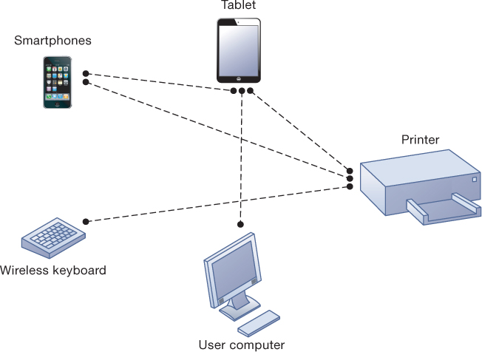
Figure 7.13: A Bluetooth Network (PAN)
Notes:
Figure 7.13, Page 279.
Bluetooth enables a variety of devices, including cell phones, smartphones, wireless keyboards and mice, PCs, and printers, to interact wirelessly with each other within a small, 30-foot (10-meter) area. In addition to the links shown, Bluetooth can be used to network similar devices to send data from one PC to another, for example.
This graphic illustrates the uses of Bluetooth for a PAN. Bluetooth connects wireless keyboards and mice to PCs or cell phones to earpieces without wires. Bluetooth has low-power requirements, making it appropriate for battery-powered handheld computers, and cell phones. Most cell phones today are Bluetooth enabled, allowing them to connect to other wireless devices (such as earphones) and PCs.

Slide 44
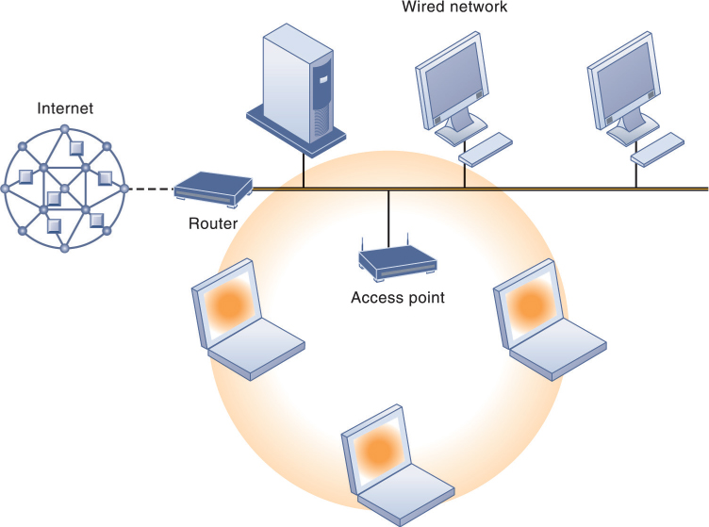
Figure 7.14: An 802.11 Wireless LAN
Notes:
Figure 7.14, Page 280.
Mobile laptop computers equipped with network interface cards link to the wired LAN by communicating with the access point. The access point uses radio waves to transmit network signals from the wired network to the client adapters, which convert them to data that the mobile device can understand. The client adapter then transmits the data from the mobile device back to the access point, which forwards the data to the wired network.
This graphic illustrates an 802.11 wireless LAN operating in infrastructure mode that connects a small number of mobile devices to a larger wired LAN. Most wireless devices are client machines. The servers that the mobile client stations need to use are on the wired LAN. The access point controls the wireless stations and acts as a bridge between the main wired LAN and the wireless LAN. (A bridge connects two LANs based on different technologies like your wireless network to your BluRay player so you can download Internet movies from Netflix and watch them on your TV). The access point also controls the wireless stations.

Slide 45
Radio Frequency Identification (RFID)
Use tiny tags with microchips containing data about an item and location
Tag antennas to transmit radio signals over short distances to special RFID readers
Common uses:
  Automated toll-collection
  Tracking goods in a supply chain
Reduction in cost of tags making RFID viable for many firms
Notes:
This slide introduces one of two wireless technologies having a major impact on business, radio frequency ID. Ask students for examples of where RFID is used today. The text provides the example of Walmart using RFID to manage inventory and supply chains. Ask students how this works.

Slide 46
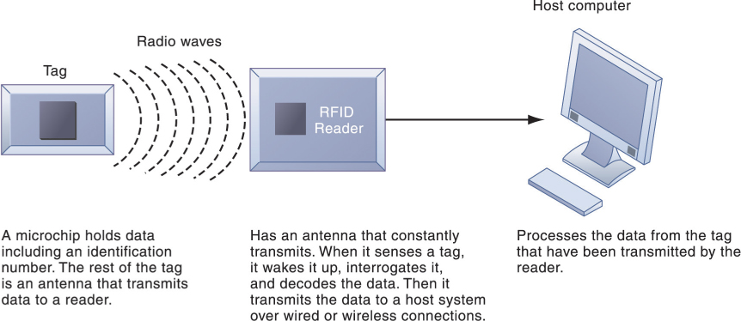
Figure 7.15: How RFID Works
Notes:
Figure 7.15, Page 282.
RFID uses low-powered radio transmitters to read data stored in a tag at distances ranging from 1 inch to 100 feet. The reader captures the data from the tag and sends them over a network to a host computer for processing.
This graphic illustrates how RFID works. Ask students if RFID potentially poses any ethical problems. For example, if your jeans have a built in RFID chip, it’s easy to track your movements. Likewise if your student ID card has an RFID chip.

Slide 47
Wireless Sensor Networks (WSNs)
Networks of hundreds or thousands of interconnected wireless devices
Used to monitor building security, detect hazardous substances in air, monitor environmental changes, traffic, or military activity
Devices have built-in processing, storage, and radio frequency sensors and antennas
Require low-power, long-lasting batteries and ability to endure in the field without maintenance
Major sources of “Big Data” and fueling “Internet of Things”
Notes:
This slide introduces a second wireless technology having a major impact on business, wireless sensor networks. Note that the wireless sensors are linked into an interconnected network that routes the data to a computer for analysis.

Slide 48
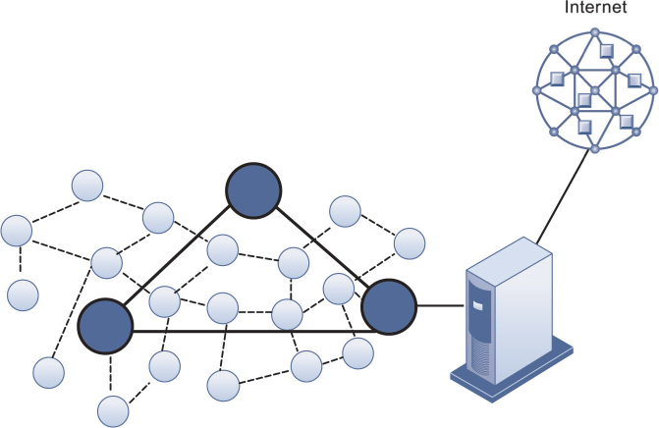
Figure 7.16: A Wireless Sensor Network
Notes:
Figure 7.16, Page 284
The small circles represent lower-level nodes, and the larger circles represent high-end nodes. Lower-level nodes forward data to each other or to higher-level nodes, which transmit data more rapidly and speed up network performance.
This graphic illustrates the lower level nodes and higher level nodes at work in a wireless sensor network. Note that the server that data from the sensors is sent to acts as a gateway to a network based on Internet technology.

