Slide 1
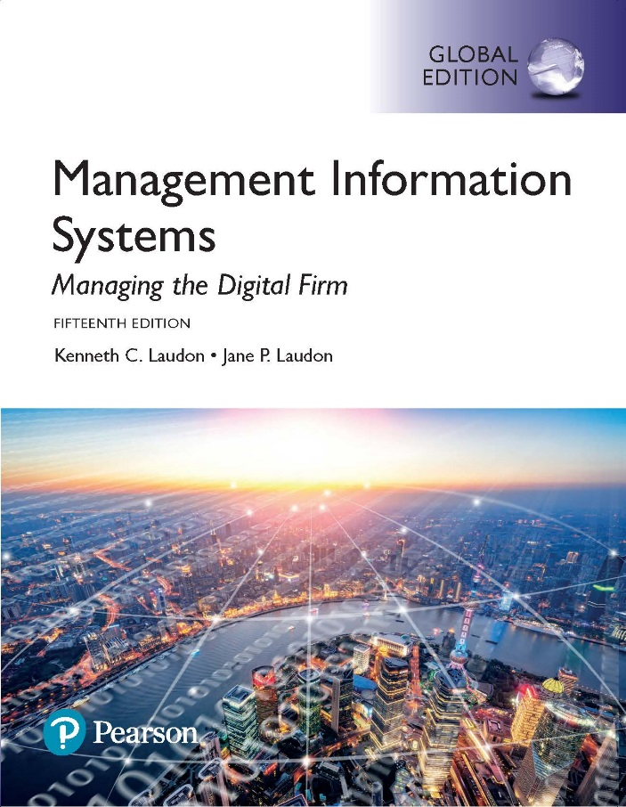
Management Information Systems: Managing the Digital Firm
Fifteenth edition
Chapter 4
Ethical and Social Issues in Information Systems

Slide 2
Learning Objectives
4-1 What ethical, social, and political issues are raised by information systems?
4-2 What specific principles for conduct can be used to guide ethical decisions?
4-3 Why do contemporary information systems technology and the Internet pose challenges to the protection of individual privacy and intellectual property?
4-4 How have information systems affected laws for establishing accountability, liability, and the quality of everyday life?
Notes:
This chapter examines the ethical, social, and political issues raised by information systems. It can be useful to ask students to help you put together a list of these issues categorized into ethical, social, and political columns.

Slide 3
Video Cases
Case 1: What Net Neutrality Means for You
Case 2: Facebook and Google Privacy: What Privacy?
Case 3: United States v. Terrorism: Data Mining for Terrorists and Innocents
Instructional Video: Viktor Mayer Scöhnberger on the Right to Be Forgotten

Slide 4
The Dark Side of Big Data (1 of 2)
Problem
  Opportunities from new technology
  Undeveloped legal environment
Solutions
  Develop big data strategy
  Develop privacy policies
  Develop big data predictive models
  Develop big data mining technology
  Develop big data analytics tools and predictive modeling systems

Slide 5
The Dark Side of Big Data (2 of 2)
Organizations like Progressive and Deloitte Consulting LLP use predictive modeling to identify individual customers that fit risk or vulnerability profiles
Demonstrates how technological innovations can be a double-edged sword
Illustrates the ability of IT systems to support decision making

Slide 6
What Ethical, Social, and Political Issues Are Raised by Information Systems? (1 of 2)
Recent cases of failed ethical judgment in business
  General Motors, Barclay’s Bank, GlaxoSmithKline, Takata Corporation
  In many, information systems used to bury decisions from public scrutiny
Ethics
  Principles of right and wrong that individuals, acting as free moral agents, use to make choices to guide their behaviors
Notes:
There are numerous examples of business ethical failures to ask students about. You could ask how information systems or their absence might have been related to the recent financial crisis in the United States, the investment banks that have suffered heavy losses, and individuals who were able to defraud investors of millions. What role did IS have in this crisis? The Madoff Ponzi scheme is instructive: systems were used for more than twenty years to fool investors, regulators, and investigators about the true nature of Madoff’s business.

Slide 7
What Ethical, Social, and Political Issues Are Raised by Information Systems? (2 of 2)
Information systems raise new ethical questions because they create opportunities for:
  Intense social change, threatening existing distributions of power, money, rights, and obligations
  New kinds of crime
Notes:
Ask students to describe some of the ethical dilemmas that are presented by information systems and new developments in technology. Privacy is an important issue—mention the opening case again and explain that the business models of Google, Facebook, and many other sites depend on getting users to give up their personal information so it can be used to market and sell them products.

Slide 8
A Model for Thinking about Ethical, Social, and Political Issues.
Society as a calm pond
IT as rock dropped in pond, creating ripples of new situations not covered by old rules
Social and political institutions cannot respond overnight to these ripples—it may take years to develop etiquette, expectations, laws
  Requires understanding of ethics to make choices in legally gray areas
Notes:
Can students provide any examples of how IT has challenged some area of ethics, social life, or legal arrangements?

Slide 9
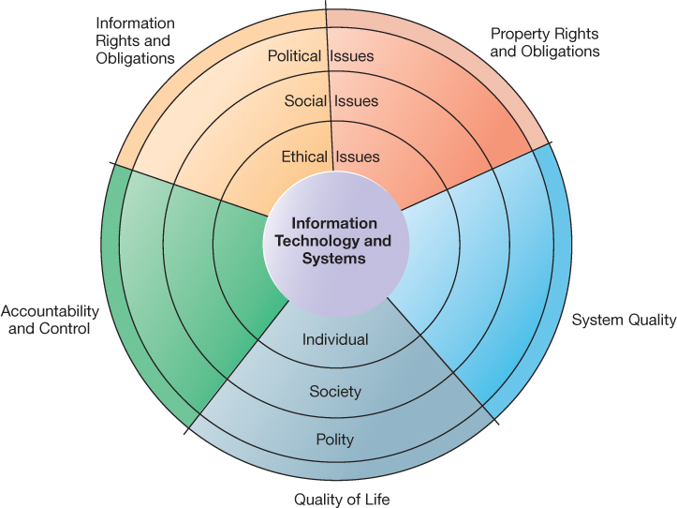
Figure 4.1: The Relationship Between Ethical, Social, and Political Issues in an Information Society
Notes:
Figure 4.1, Page 127.
The introduction of new information technology has a ripple effect, raising new ethical, social, and political issues that must be dealt with on the individual, social, and political levels. These issues have five moral dimensions: information rights and obligations, property rights and obligations, system quality, quality of life, and accountability and control.
Explain to students that the graphic displays the five moral dimensions listed in the caption. Consider online P2P bit torrent shared music as an example of how a new technology has ethical, social, and eventually political (legal) ramifications. If music can be ripped off, why pay any money for it? Why should anyone care about record labels or artist’s income?

Slide 10
Five Moral Dimensions of the
Information Age
Information rights and obligations
Property rights and obligations
Accountability and control
System quality
Quality of life
Notes:
Give examples of each of the five major issues. For example, an issue dealing with information rights might be, what rights do individuals possess with respect to themselves? What do they have a right to protect? An issue dealing with quality of life might be: what values should be preserved in an information- and knowledge-based society? An issue dealing with system quality might be: what standards of data and system quality should we demand to protect individual rights and the safety of society?

Slide 11
Key Technology Trends that Raise Ethical Issues
Computing power doubles every 18 months
Data storage costs rapidly decline
Data analysis advances
Networking advances
Mobile device growth impact
Notes:
Which of these trends do students believe might have the most adverse consequences? Why do they feel this way? Do the positives outweigh the negatives for all four issues? Why or why not?

Slide 12
Advances in Data Analysis Techniques
Profiling
  Combining data from multiple sources to create dossiers of detailed information on individuals
Nonobvious relationship awareness (NORA)
  Combining data from multiple sources to find obscure hidden connections that might help identify criminals or terrorists
Notes:
Online profiling is one of the most controversial computer-related ethical, social, and political issues today. Although it is used fairly extensively on the Internet, it is also used by insurance firms, health insurance firms, casinos, and of course national authorities around the globe for finding potential terrorists.

Slide 13
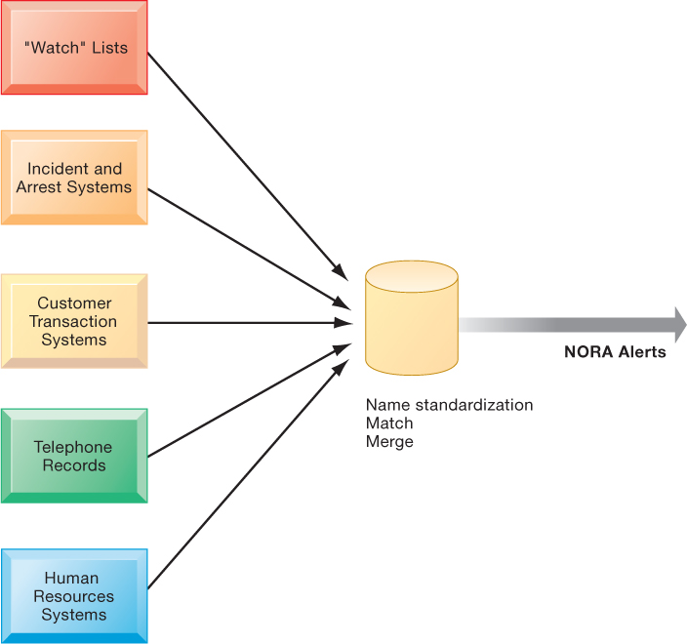
Figure 4.2: Nonobvious Relationship Awareness (NORA)
Notes:
Figure 4.2, Page 131
NORA technology can take information about people from disparate sources and find obscure, nonobvious relationships. It might discover, for example, that an applicant for a job at a casino shares a telephone number with a known criminal and issue an alert to the hiring manager.
Explain that NORA is used by both the government and the private sector for its profiling capabilities. Ask students to provide potential examples of NORA (other than the one mentioned in the caption) for both governmental and business purposes. One such example might be an airline identifying potential terrorists attempting to board a plane. Another might be government identifying potential terrorists by monitoring phone calls.

Slide 14
Basic Concepts: Responsibility, Accountability, and Liability
Responsibility
  Accepting the potential costs, duties, and obligations for decisions
Accountability
  Mechanisms for identifying responsible parties
Liability
  Permits individuals (and firms) to recover damages done to them
Due process
  Laws are well-known and understood, with an ability to appeal to higher authorities
Notes:
Explain that information systems do not exist in a vacuum and that these concepts are instrumental in understanding the impact of systems and measuring their success. Ask students why liability and due process are such important ethical concepts? (A rough answer would be that they provide recourse to individuals negatively effected by mismanagement of information systems, providing incentive to “play by the rules”.)

Slide 15
Ethical Analysis
Five-step process for ethical analysis
  Identify and clearly describe the facts.
  Define the conflict or dilemma and identify the higher-order values involved.
  Identify the stakeholders.
  Identify the options that you can reasonably take.
  Identify the potential consequences of your options.
Notes:
Do students believe that any aspect of ethical analysis is lacking from this process? If so, what? Can students offer a brief example of an ethical dilemma and how they would resolve it using this process? One class exercise is to work with students to identify an ethical situation they are aware of, or that may have been in the news. Then, go through the ethical analysis described in the slide to illustrate the process of analyzing an ethical situation.

Slide 16
Candidate Ethical Principles (1 of 2)
Golden Rule
  Do unto others as you would have them do unto you
Immanuel Kant’s Categorical Imperative
  If an action is not right for everyone to take, it is not right for anyone
Descartes’ Rule of Change
  If an action cannot be taken repeatedly, it is not right to take at all
Notes:
Ensure students understand the difference between the categorical imperative and the rule of change. Briefly, the difference is that the categorical imperative spans the entirety of the populace, whereas the rule of change applies to the decisions of one person over time. For example, the categorical imperative applies to an employee who tries to steal money from his employer. He shouldn’t do this, because if all employees attempted to do so, the company would fail. The rule of change applied to the same situation might run as follows: although the employee’s stealing one dollar from the company would not lead to any true problem, repeatedly stealing one dollar, or stealing a lot of dollars, would be unacceptable and ultimately lead to the destruction of the company.

Slide 17
Candidate Ethical Principles (2 of 2)
Utilitarian Principle
  Take the action that achieves the higher or greater value
Risk Aversion Principle
  Take the action that produces the least harm or potential cost
Ethical “No Free Lunch” Rule
  Assume that virtually all tangible and intangible objects are owned by someone unless there is a specific declaration otherwise
Notes:
How does the “no free lunch” rule relate to copyrights, patents, and trademarks? (These concepts are discussed in later slides.)
Explain that the appearance of unethical behavior is as harmful as actual unethical behavior at times, so adherence to these principles are critical. In an age of “open source software” how does the principle of “no free lunch” work out? Open source software is an example of an economic good which is licensed by the creator for distribution often without charge, or even attribution. In this case, there is a “free lunch.” But it occurs because the creators of the software consent to this arrangement.

Slide 18
Professional Codes of Conduct
Promulgated by associations of professionals
  American Medical Association (AMA)
  American Bar Association (ABA)
  Association for Computing Machinery (ACM)
Promises by professions to regulate themselves in the general interest of society

Slide 19
Real-world Ethical Dilemmas
One set of interests pitted against another
Examples
  Monitoring employees: Right of company to maximize productivity of workers versus workers right to use Internet for short personal tasks
  Facebook monitors users and sells information to advertisers and app developers
Notes:
Other ethical dilemmas include companies trying to use new systems to reduce the size of their workforce, such as telephone companies using automated systems to reduce the need for human operators. Emphasize that in cases like these, right and wrong are not clearly defined, but instead, contrasting values are at odds with one another (companies value productivity, employees value their work).

Slide 20
Information Rights: Privacy and Freedom in the Internet Age (1 of 3)
Privacy
  Claim of individuals to be left alone, free from surveillance or interference from other individuals, organizations, or state; claim to be able to control information about yourself
In the United States, privacy protected by:
  First Amendment (freedom of speech and association)
  Fourth Amendment (unreasonable search and seizure)
  Additional federal statues (e.g., Privacy Act of 1974)
Notes:
Do students believe that there are sufficient protections for privacy in law? If not, what are possible methods of developing appropriate privacy protections? Table 4-3 in the text lists a variety of other laws affecting both the government and private institutions, but few areas of the private sector are as well regulated with respect to privacy. Do an in-class poll and ask students who among them feel they can control the use of their personal information on the Internet. You should get no one raising their hand.

Slide 21
Information Rights: Privacy and Freedom in the Internet Age (2 of 3)
Fair information practices
  Set of principles governing the collection and use of information
    Basis of most U.S. and European privacy laws
  Used to drive changes in privacy legislation
    COPPA
    Gramm-Leach-Bliley Act
    HIPAA
    Do-Not-Track Online Act of 2011
Notes:
Explain what is meant by a “mutuality of interest between record holder and individual.” (Briefly, the individual wants to engage in a transaction, and the record holder needs information about the individual to support the transaction—both are interested parties in the transaction.)

Slide 22
Information Rights: Privacy and Freedom in the Internet Age (3 of 3)
FTC FIP principles
  Notice/awareness (core principle)
  Choice/consent (core principle)
  Access/participation
  Security
  Enforcement
Notes:
Do students believe that the websites they visit actually disclose their data collection and utilization practices? Is it difficult to find where?

Slide 23
European Directive on Data Protection:
Use of data requires informed consent of customer
EU member nations cannot transfer personal data to countries without similar privacy protection
Stricter enforcements under consideration:
  Right of access
  Right to be forgotten
Safe harbor framework
Edward Snowden
Notes:
EU protections of privacy are far more powerful than the United States because they require informed consent before a firm can do anything with personal information besides support the transaction at hand. In Europe, there is no junk postal mail for instance because advertising firms are prohibited from using personal information obtained from third parties, and without the consent of the individual.

Slide 24
Internet Challenges to Privacy (1 of 2)
Cookies
  Identify browser and track visits to site
  Super cookies (Flash cookies)
Web beacons (web bugs)
  Tiny graphics embedded in e-mails and web pages
  Monitor who is reading e-mail message or visiting site
Spyware
  Surreptitiously installed on user’s computer
  May transmit user’s keystrokes or display unwanted ads
Google services and behavioral targeting
Notes:
What are students attitudes toward these technologies? Emphasize that cookies can be useful at trusted sites, but perhaps invasive at others. Have students had any experience with spyware or web bugs on their own computers? How would they know they are being tracked?

Slide 25
Internet Challenges to Privacy (2 of 2)
The United States allows businesses to gather transaction information and use this for other marketing purposes.
Opt-out vs. opt-in model
Online industry promotes self-regulation over privacy legislation.
  Complex/ambiguous privacy statements
  Opt-out models selected over opt-in
  Online “seals” of privacy principles
Notes:
Do students believe that businesses should be pressed to provide more comprehensive privacy protections online? Explain that businesses prefer the looser regulation, but that individuals may not. Also emphasize that most individuals do not take the proper steps to ensure their own privacy in any case. Most people do not know how to protect their privacy online. Does that mean that privacy is unimportant or that people don’t care?

Slide 26
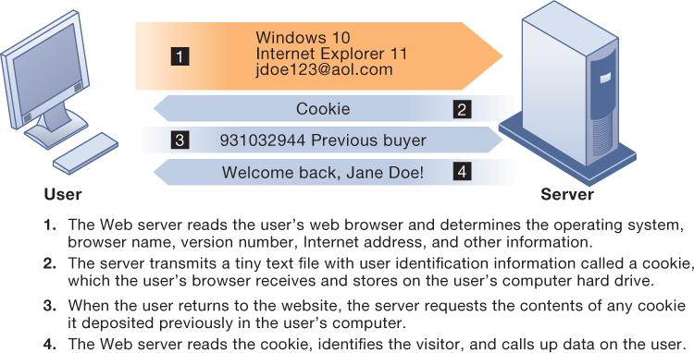
Figure 4.3: How Cookies Identify Web Visitors
Notes:
Figure 4.3, Page 138
Cookies are written by a website on a visitor’s hard drive. When the visitor returns to that website, the web server requests the ID number from the cookie and uses it to access the data stored by that server on that visitor. The website can then use these data to display personalized information.
Ask students to pinpoint where potential privacy invasions might occur in the process shown above. Students may suggest that no real privacy violation is occurring in the figure, which is a legitimate point of view. If so, ask them how they might feel about a website they did not trust engaging in the displayed process.

Slide 27
Technical Solutions
Solutions include:
  E-mail encryption
  Anonymity tools
  Anti-spyware tools
Overall, technical solutions have failed to protect users from being tracked from one site to another
  Browser features
    “Private” browsing
    “Do not track” options

Slide 28
Property Rights: Intellectual Property
Intellectual property
  Intangible property of any kind created by individuals or corporations
Three main ways that intellectual property is protected:
  Trade secret: intellectual work or product belonging to business, not in the public domain
  Copyright: statutory grant protecting intellectual property from being copied for the life of the author, plus 70 years
  Patents: grants creator of invention an exclusive monopoly on ideas behind invention for 20 years
Notes:
Do students believe that the property rights guaranteed by trade secrets, copyrights, and patents are strong enough to avoid the theft of intellectual property online? Give an example of a trade secret (the formula for Coke; a method of doing business or business process). Give an example of a copyright (which could include the copyright of a photo or newspaper article). And give an example of a patent (such as Amazon's One Click shopping as a business process patent, or Kodak‘s claim to have a patent on digital still cameras with digital displays for a viewfinder).

Slide 29
Challenges to Intellectual Property Rights
Digital media different from physical media
  Ease of replication
  Ease of transmission (networks, Internet)
  Ease of alteration
  Compactness
  Difficulties in establishing uniqueness
Digital Millennium Copyright Act (DMCA)
  Makes it illegal to circumvent technology-based protections of copyrighted materials
Notes:
Students may be unwilling to admit to infringing upon intellectual property rights themselves, but ask them whether they are familiar with the Internet and its ability to bypass intellectual property protections. Do they believe that legislation such as the DMCA is having any effect? How many have friends who download “free” music from P2P sights? Free videos?

Slide 30
Computer-Related Liability Problems
If software fails, who is responsible?
  If seen as part of a machine that injures or harms, software producer and operator may be liable.
  If seen as similar to book, difficult to hold author/publisher responsible.
  If seen as a service? Would this be similar to telephone systems not being liable for transmitted messages?
Notes:
Using the example from the text, who do students consider to be the liable party for the incident involving Bank of America customers whose paychecks were denied due to an operating error at the bank’s computer center? Is it the designers of the systems at the center? Is there no liability involved? Explain that it is difficult to ascribe liability to software developers for the same reason that it is difficult to ascribe a publisher liability for the effects of a book.

Slide 31
System Quality: Data Quality and System Errors
What is an acceptable, technologically feasible level of system quality?
  Flawless software is economically unfeasible
Three principal sources of poor system performance
  Software bugs, errors
  Hardware or facility failures
  Poor input data quality (most common source of business system failure)
Notes:
Do students have any opinion about when software is “good enough?” Does it depend on the particular product? For example, distinguish between software used by air traffic controllers and software used for word processing. Do students believe that there are different levels of acceptable quality for these products?

Slide 32
Quality of Life: Equity, Access, Boundaries (1 of 3)
Negative social consequences of systems
Balancing power: center versus periphery
Rapidity of change: reduced response time to competition
Maintaining boundaries: family, work, and leisure
Dependence and vulnerability
Computer crime and abuse
Notes:
Ask students whether they have witnessed any of these negative consequences first hand. It's likely that they know someone who has become dependent on their computer to some extent or have even experienced something similar first hand. Which of the above consequences do students feel is the most alarming?

Slide 33
Quality of Life: Equity, Access, Boundaries (2 of 3)
Computer crime and abuse
  Computer crime
  Computer abuse
  Spam
  CAN-SPAM Act of 2003
Employment
  Trickle-down technology
  Reengineering job loss
Notes:
Ask students what experience they have had with spam. A notable statistic is that spam accounts for more than 75% of all e-mail traffic and is relatively unlikely to decrease, because it is so difficult to regulate and so cheap to send.
Do students believe that the end result of continuing advances in information technology will be rising unemployment and a small number of elite corporate professionals? Students may enjoy debating this idea, which is somewhat far-fetched, but conceptually stimulating. There is some evidence that today’s manufacturing technology (including robots and computer controlled machines) is displacing factory jobs.

Slide 34
Quality of Life: Equity, Access, Boundaries (3 of 3)
Equity and access
  The digital divide
Health risks
  Repetitive stress injury (RSI)
  Carpal tunnel syndrome (CTS)
  Computer vision syndrome (CVS)
  Technostress
Notes:
Have students encountered any of these health risks, either from personal experience or from someone they know?

Slide 35
Interactive Session: Monitoring in The Workplace
Class discussion
  Which of the five moral dimensions of information systems identified in this text is involved in this case?
  What are the ethical, social, and political issues raised by this case?
  Which of the ethical principles described in the text are useful for decision making about monitoring employees in the workplace?

Slide 36
Interactive Session: Organizations: Are We Relying Too Much on Computers to Think for Us?
Class discussion
  Identify the problem described in this case study. In what sense is it an ethical dilemma?
  Should more tasks be automated? Why or why not? Explain your answer.
  Can the problem of automation reducing cognitive skills be solved? Explain your answer.

