Slide 1

Essentials of Management Information Systems
Thirteenth Edition
Chapter 12
Building Information Systems and Managing Projects
Copyright © 2019 Pearson Education Ltd.
Notes:
If this PowerPoint presentation contains mathematical equations, you may need to check that your computer has the following installed:
1) MathType Plugin
2) Math Player (free versions available)
3) NVDA Reader (free versions available)

Slide 2
Learning Objectives
12.1 What are the core problem-solving steps for developing new information systems?
12.2 What are the alternative methods for building information systems?
12.3 What are the principal methodologies for modeling and designing systems?
12.4 How should information systems projects be selected and managed?
12.5 How will M I S help my career?

Slide 3
Video Cases
Case 1: P S E G Leverages Big Data and Business Analytics Using G E’s Predix Platform
Case 2: I B M: B P M in a S a a S Environment
Case 3: I B M Helps the City of Madrid with Real-Time B P M Software
Instructional Video 1: What is P a a S?
Instructional Video 2: B P M: Business Process Management Customer Story

Slide 4
Eastspring: Targeted Enterprise System Building
Problem
  End-of-life technology and legacy systems
  Business needs of regional business units
Solutions
  Systems offering a breadth of services
  Using outside vendors for products and systems
  Changing business processes
Illustrates benefits of implementing a new system solution while changing business processes
Notes:
Even small, non-profit corporations can find solutions for business process challenges. Increasingly, firms and non-profits do not build their systems, but instead purchase solutions either off-the-shelf, or find online service providers who can deliver the functionality required.

Slide 5
Core Problem-Solving Steps for Developing New Information Systems
New information systems are built as solutions to problems
Four steps to building an information system
  Define and understand the problem
  Develop alternative solutions
  Choose a solution
  Implement the solution
The first three steps are called systems analysis
Notes:
It is important to emphasize that an information system is not technology for technology’s sake, it is a solution to a problem or set of problems the organization perceives it is facing— including the problem of an opportunity that requires the use of information systems in order to undertake. What problems with business processes have students encountered or witnessed in their work or educational career that could have been improved with the help of a new or improved information system?

Slide 6
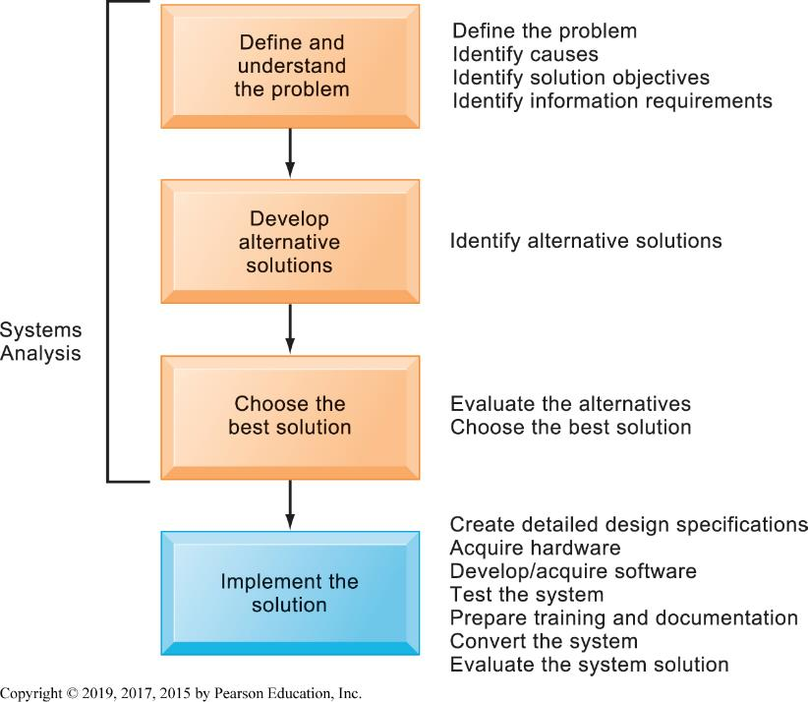
Figure 12.1 Developing an Information System Solution
Notes:
Figure 12.1, Page 438.
Developing an information system solution is based on the problem-solving process.
Emphasize the distinction between the orange boxes (systems analysis) and the blue box (implementation): why doesn’t implementation fall into the category of systems analysis? (Because the analysis has already been performed and a solution has been chosen; the final task is to actually create the planned solution.)

Slide 7
Defining and Understanding the Problem
Different people may have different ideas about the nature of the problem and its severity
  What caused the problem?
  Why does it persist?
  Why hasn’t it been solved?
  What are the objectives of a solution?
Information requirements
  Identifies who needs what information, when, where, and how
  Requirements analysis
Notes:
These are critical questions that businesses must ask as they begin to plan for the creation of a new information system. What would the result be if these questions were not thoroughly considered and answered prior to construction of the system?

Slide 8
Developing Alternative Solutions
Paths to a solution determined by systems analysis.
Some solutions do not require an information system.
Some solutions require modification of existing systems.
Some solutions require new systems.
Notes:
What types of solutions might not require an information system to fix? Sometimes, existing information systems are sufficient, but users may not be sufficiently trained to use them, for example.

Slide 9
Evaluating and Choosing Solutions
Feasibility study:
  Is solution feasible from financial, technical, and organizational standpoint?
Systems proposal report
  Describes, for each alternative solution
    Costs and benefits
    Advantages and disadvantages
Notes:
What does it mean that a solution is feasible from a financial standpoint? A technical standpoint? An organizational standpoint?

Slide 10
Implementing the Solution
Systems design
Completing implementation
  Hardware selection and acquisition
  Software development and programming
  Testing
  Training and documentation
  Conversion
  Production and maintenance
Managing the change
Notes:
Systems building is not a linear process that is finished once the system is built. Typically, additional changes and improvements will need to be made to the system or part of the system that will require additional analysis, design, programming, testing, conversion, and maintenance.

Slide 11
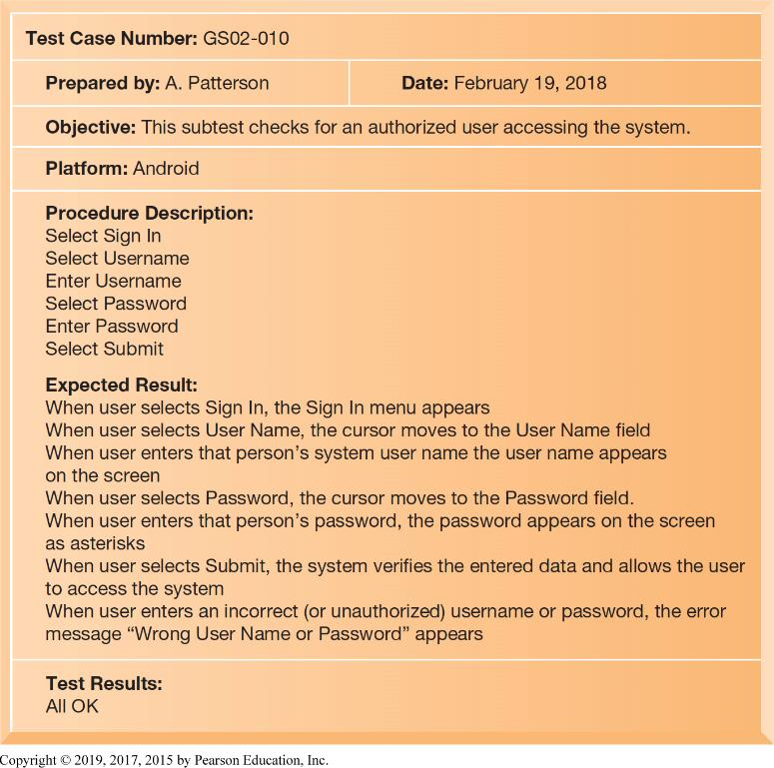
Figure 12.2 A Sample Test Plan for the Girl Scout Digital Cookie System
Notes:
Figure 12.2, Page 441.
When developing a test plan, it is imperative to include the various conditions to be tested, the requirements for each condition tested, and the expected results. Test plans require input from both end users and information systems specialists. Illustrated here is a test case for accessing the mobile Android app by an authorized Girl Scout user.
Explain that the above figure represents just a sample of a full test plan, which would consist of similar tests for all of the major functions of the information system.

Slide 12
Traditional Systems Development Lifecycle
S L D C: Oldest method for building information systems
Phased approach with formal stages
Waterfall approach
Formal division of labor
Used for building large, complex systems
Time consuming and expensive to use
Notes:
This slide describes the traditional systems lifecycle. Ask students what the effects of unanticipated user requirements are when using this type of building method. What is the role of end users in this method?

Slide 13
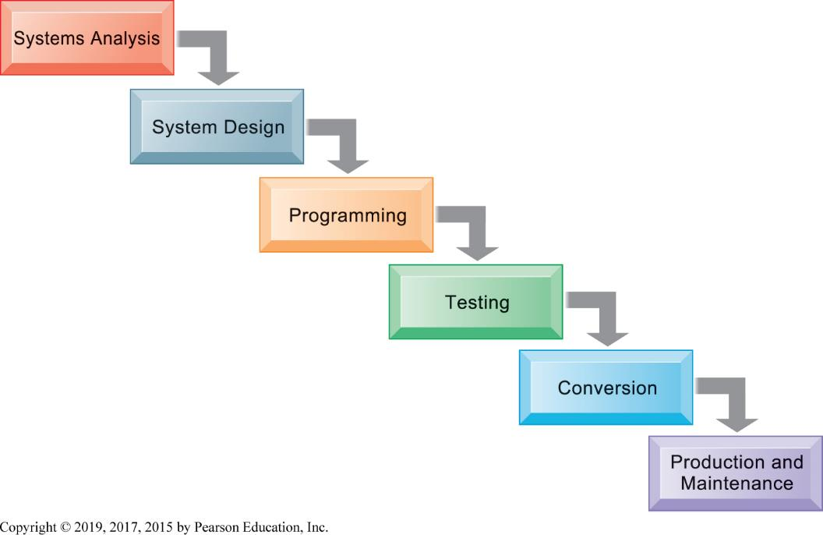
Figure 12.3 The Traditional Systems Development Life Cycle
Notes:
Figure 12.3, Page 443.
The systems development life cycle partitions systems development into formal stages, with each stage requiring completion before the next stage can begin.
What types of systems are well-suited to the traditional systems development lifecycle? One answer is larger, complex systems requiring rigorous and formal requirements analysis and tight controls. What types of systems are not well-suited? Smaller, more individualized desktop systems are not suited for a traditional design process.

Slide 14
Prototyping
Preliminary model built rapidly and inexpensively
Four-step process
  Identify the user’s basic requirements
  Develop an initial prototype
  Use the prototype
  Revise and enhance the prototype
Especially useful in designing a user interface
Notes:
Prototyping is an explicitly iterative process. The term iterative has been used several times; ask students to describe what this means (steps to build the system can be repeated over and over). What are the benefits of an iterative process?
Note that once no more iterations are needed, the prototype becomes the finished specifications for the final application, or may serve as the production version of the application.
Ask students to explain potential advantages and disadvantages of prototyping. For example, why is prototyping useful if there is uncertainty in requirements? What kinds of essential steps might be glossed over?

Slide 15
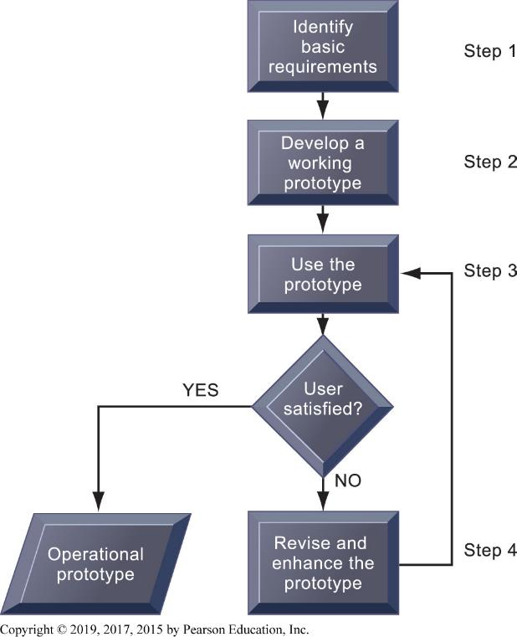
Figure 12.4 The Prototyping Process
Notes:
Figure 12.4, Page 444.
The process of developing a prototype consists of four steps. Because a prototype can be developed quickly and inexpensively, systems builders can go through several iterations, repeating steps 3 and 4, to refine and enhance the prototype before arriving at the final operational one.
This graphic illustrates the four steps (rectangles) of prototyping. The steps that are repeated are steps 3) Use the prototype and 4) Revise and enhance the prototype. Would this type of system development be appropriate for developing a large, enterprise management system?

Slide 16
End-User Development
End users create simple information systems with little or no assistance from specialists
Completed more rapidly than systems developed with conventional tools
Often leads to higher level of user involvement and satisfaction with systems
Cannot handle large numbers of transactions
Organizational risks
Notes:
What types of projects might end-user development be most suited for? How might this type of development result in a loss of control over data? Someone has to manage end-user development in order to develop company-wide standards and definitions.
Ask students if any have had experience working in a firm or agency where different employees created their own spreadsheets. What kinds of quality and management issues arise in this situation? What is the official version?

Slide 17
Application Software Packages, software Services, and Outsourcing
Request for Proposal (R F P)
Application software packages and cloud software packages
  Generalized systems for universal functions with standard processes
  Customization features
Outsourcing
  Domestic outsourcing
  Offshore outsourcing
Notes:
It is important to note that many functions are common to all business organizations—payroll, accounts receivable, or inventory control. Software packages will fulfill the need for many organizations for these types of functions. However, it is still important to perform systems analysis in order to determine your organization’s requirements for a system.
It is important to emphasize the amount of work involved in partnering and sharing work with a vendor. It may take anywhere from three months to a year to fully transfer work to a vendor. What other types of hidden costs can students identify?

Slide 18
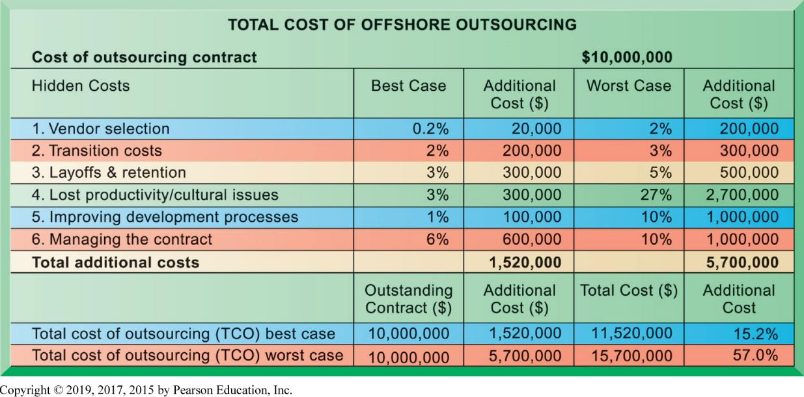
Figure 12.5 Total Cost of Offshore Outsourcing
Notes:
Figure 12.5, Page 446.
If a firm spends $10 million on offshore outsourcing contracts, that company will actually spend 15.2 percent in extra costs even in the best-case scenario. In the worst-case scenario, when there is a dramatic drop in productivity along with exceptionally high transition and layoff costs, a firm can expect to pay up to 57 percent in extra costs on top of the $10 million outlay for an offshore contract.
This graphic looks at the best and worst case scenarios regarding hidden costs in outsourcing. The best case column shows the lowest estimates for additional costs, and the worst case reflects the highest estimates for these costs. In the Additional Cost column at the lower right, you can see that hidden costs increase the total cost of an offshore outsourcing project by an extra 15 to 57 percent. However, it is important to note that even with these extra hidden costs, many firms will benefit from offshore outsourcing if they manage the work well.

Slide 19
Mobile Application Development
Mobile websites, web apps
Native apps
Different requirements for mobile devices than for P Cs
  Reduced size of screens
  Touch screens
  Saving resources: bandwidth, memory, processing, data entry
Responsive web design
Notes:
In 2017 mobile e-commerce grew to $153 billion, 22% of all B2C e-commerce ($693 billion).

Slide 20
Interactive Session – Technology: Developing Mobile Apps: What’s Different
Class discussion
  What people, organization, and technology issues need to be addressed when building mobile applications?
  How does user requirement definition for mobile applications differ from that in traditional systems analysis?
  Describe how Great-West’s invoice approval process changed after the mobile application was deployed.

Slide 21
Rapid Application Development
Need for agility, scalability, and fast-cycle techniques
Rapid application development (R A D)
  Creating workable systems in a very short period of time
Joint application design (J A D)
  End users and information systems specialists working together on design
Agile development
Dev Ops
Notes:
Rapid application development is one of several methods that emphasize providing fast solutions needed in an increasingly digital world.
What elements in RAD are similar to building methods already discussed—CASE tools, prototyping, and so on?

Slide 22
Structured Methodologies
Step by step techniques’
Top-down modeling
Separate data from process
Tools:
  Data flow diagram
  Process specifications
  Structure chart

Slide 23
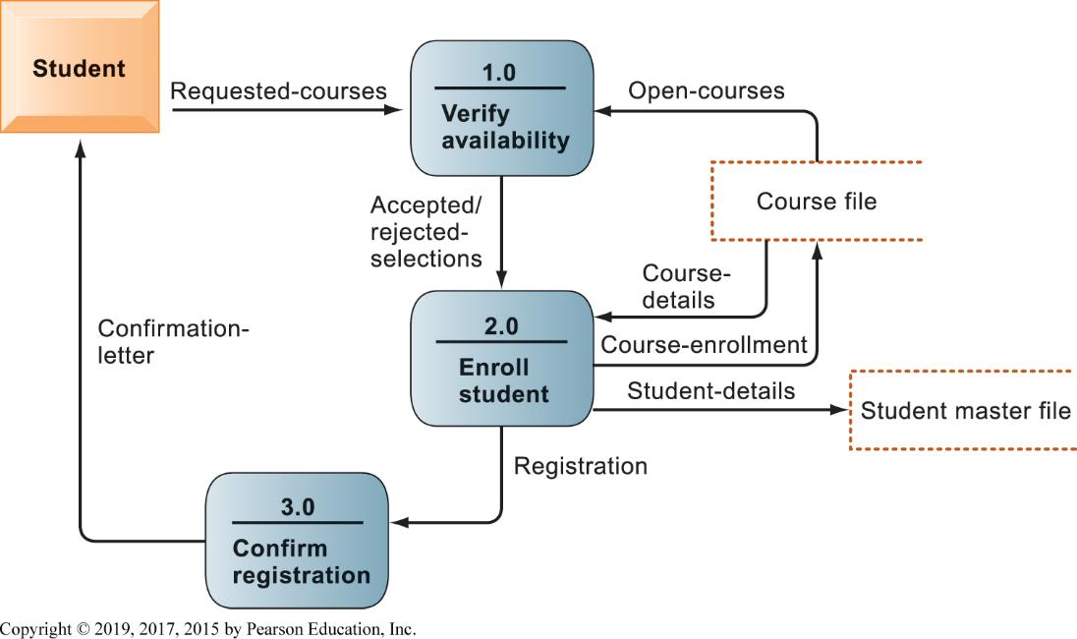
Figure 12.6 Data Flow Diagram for Mail-in University Registration System
Notes:
Figure 12.6, Page 450.
The system has three processes: Verify availability (1.0), Enroll student (2.0), and Confirm registration (3.0). The name and content of each of the data flows appear adjacent to each arrow. There is one external entity in this system: the student. There are two data stores: the student master file and the course file.
This graphic is a data flow diagram. Ask students what the rounded boxes represent (processes) and what the square box represents (an external entity). What about the open rectangle and the arrows? Where does the process begin? Ask a student to step through the process of registering a student for a course, noting what data is transferred at each step. It’s always fun to do data flow diagrams as a group because it illustrates how the same process is seen differently by different people.

Slide 24
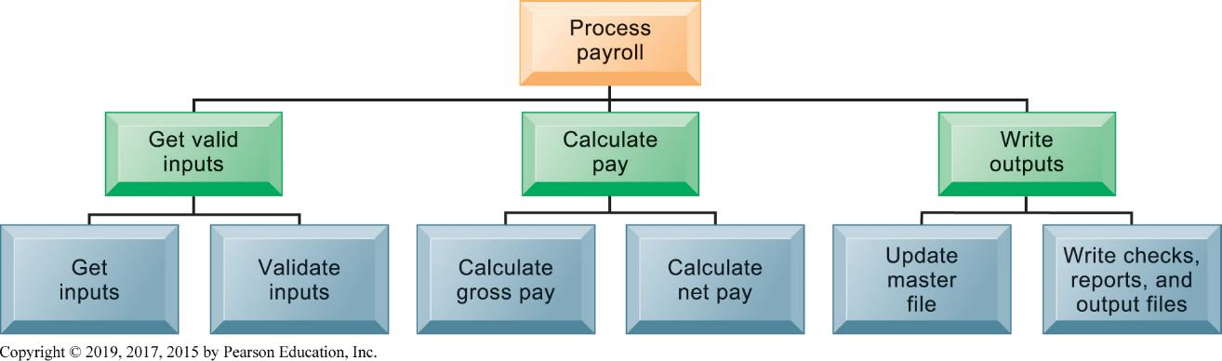
Figure 12.7 High-Level Structure Chart for a Payroll System
Notes:
Figure 12.7, Page 451.
This structure chart shows the highest or most abstract level of design for a payroll system, providing an overview of the entire system.

Slide 25
Object-Oriented Development
Uses the object as the basic unit of systems analysis and design
  Class
  Inheritance
More iterative and incremental than traditional structured development
Component-based development
  Groups of objects assembled into software components
  Used to create e-commerce applications
  Web services, cloud-based development
Notes:
Component-based development also speeds up system and software building. Web services describe Internet-standards based, reusable software components that can be combined to build more complex applications, such as checking a customer’s credit, procurement, or placing orders.

Slide 26
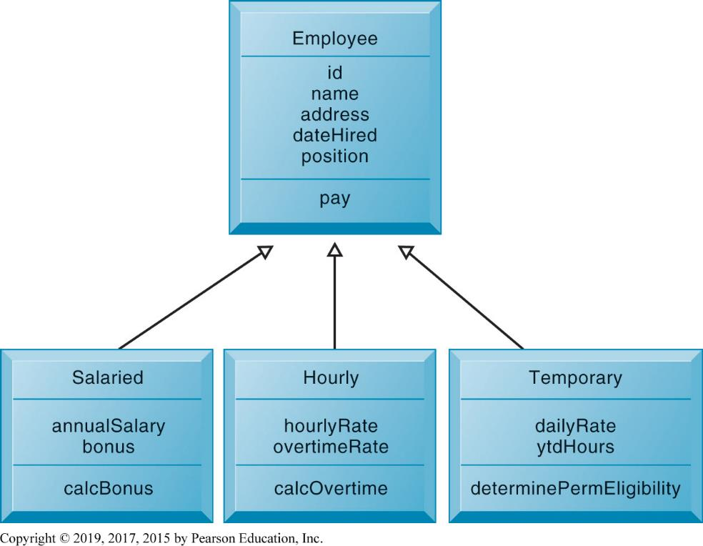
Figure 12.8 Class and Inheritance
Notes:
Figure 12.8, Page 452.
This figure illustrates how classes inherit the common features of their superclass.

Slide 27
Computer-Aided Software Engineering (CASE)
Provides software tools to automate the previously described methodologies
Reduces repetitive work in systems development
CASE tools facilitate
  Clear documentation
  Coordination of team development efforts
  Modest productivity benefits if tools are used correctly
Notes:
CASE tools are software tools to automate development tasks for either of the two methodologies just discussed (structured, object-oriented). What does it mean that organizational discipline must be used to be used effectively? What kinds of gains in productivity can be expected if CASE tools are used properly?

Slide 28
Project Management Objectives
Project management
  Application of knowledge, skills, tools, and techniques to achieve targets within specified budget and time constraints
Five major variables:
  Scope
  Time
  Cost
  Quality
  Risk
Notes:
Information systems offer powerful solutions, but only if they can be implemented in a timely and economic fashion. Project management is the art of bringing together the skills and talents of a business firm to achieve some well defined objectives. The main dimensions of project management are given in the slide above. Ask students what has been their experience working on projects, or perhaps as project managers.

Slide 29
Selecting Projects
Determining project costs and benefits
  Tangible benefits
  Intangible benefits
  Capital budgeting methods
Information systems plan
Portfolio analysis
Scoring model
Notes:
Projects are developed often for reasons that have nothing to do with the benefits to the firm. One of the more difficult tasks of management is to choose which of many projects should be developed, and how to rank order them in terms of positive impacts on the firm. Intangible benefits are often difficult to quantify, and yet may be the most important ultimately in terms of revenues and earnings.

Slide 30
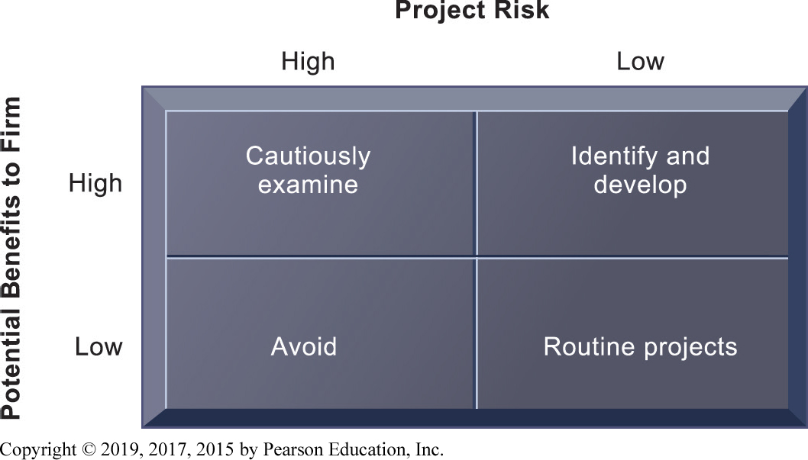
Figure 12.9 A System Portfolio
Notes:
Figure 12.9, Page 457.
Companies should examine their portfolio of projects in terms of potential benefits and likely risks. Certain kinds of projects should be avoided altogether and others developed rapidly. There is no ideal mix. Companies in different industries have different information systems needs.

Slide 31
Managing Project Risk and System-Related Change
Implementation and change management
  Implementation
  User-designer communications gap
Controlling risk factors
  Formal planning and tools
  Gantt chart, P E R T chart
  Project management software
Overcoming user resistance
  Ergonomics
  Organizational impact analysis
Notes:
Ask students if any have had experience with failed system projects, or worked with systems that were poorly designed. What factors do they think were involved?

Slide 32
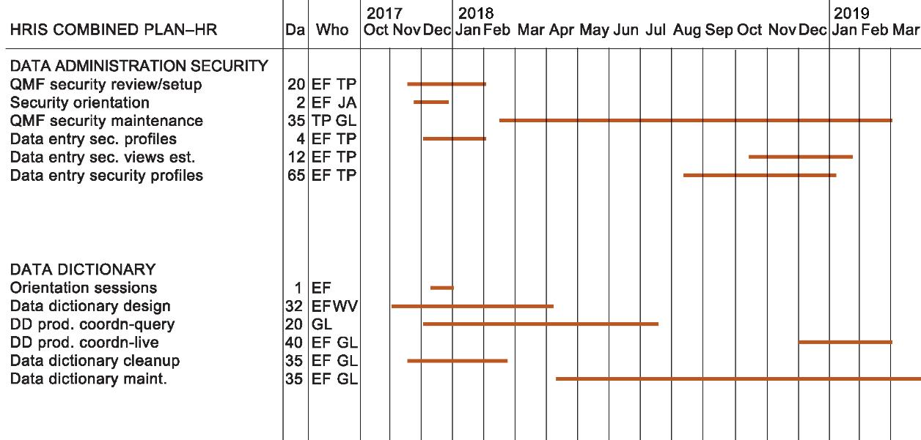
Figure 12.10 A Gannt Chart (1 of 3)
A:
Notes:
Figure 12.10, Page 460.
The Gantt chart in this figure shows the task, person-days, and initials of each responsible person as well as the start and finish dates for each task. The resource summary provides a good manager with the total person-days for each month and for each person working on the project to manage the project successfully. The project described here is a data administration project.

Slide 33
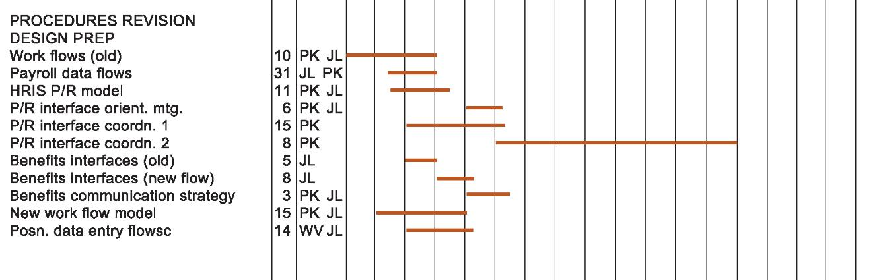
Figure 12.10 A Gannt Chart (2 of 3)
B:
Notes:
Figure 12.10, Page 460.
The Gantt chart in this figure shows the task, person-days, and initials of each responsible person as well as the start and finish dates for each task. The resource summary provides a good manager with the total person-days for each month and for each person working on the project to manage the project successfully. The project described here is a data administration project.

Slide 34
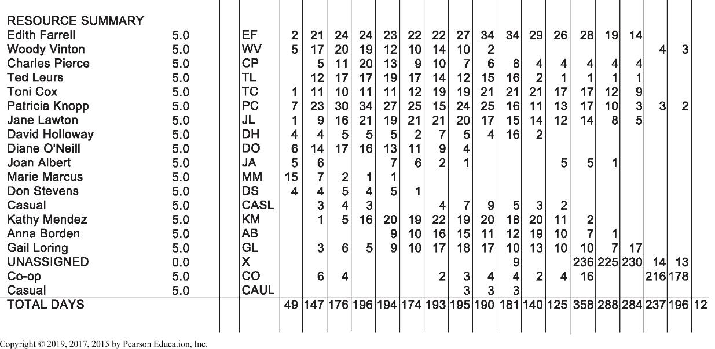
Figure 12.10 A Gannt Chart (3 of 3)
C:
Notes:
Figure 12.10, Page 460.
The Gantt chart in this figure shows the task, person-days, and initials of each responsible person as well as the start and finish dates for each task. The resource summary provides a good manager with the total person-days for each month and for each person working on the project to manage the project successfully. The project described here is a data administration project.

Slide 35
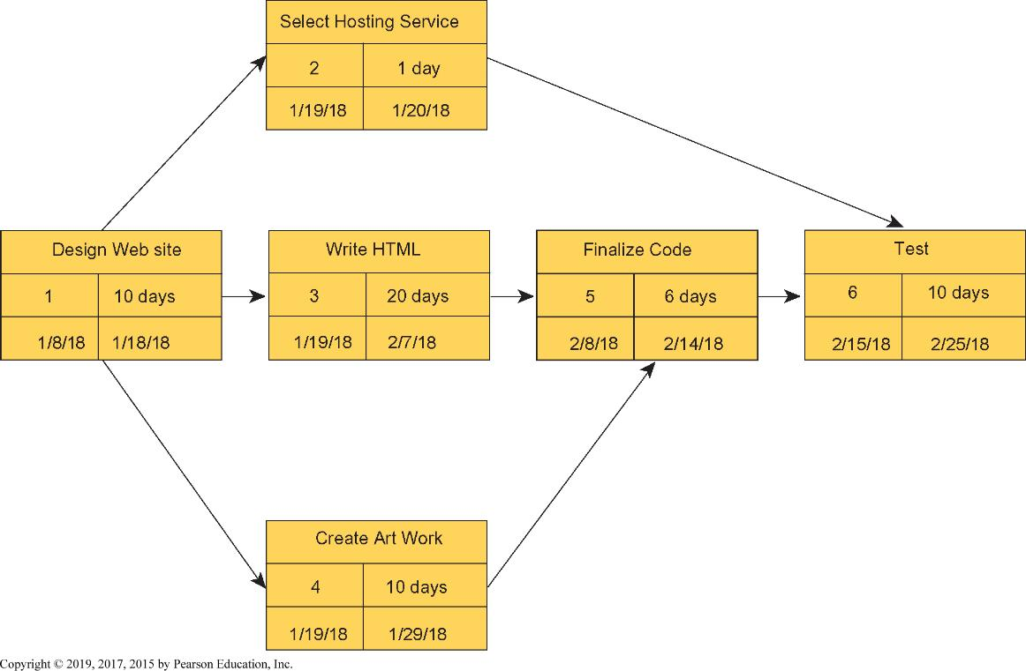
Figure 12.11 A P E R T Chart
Notes:
Figure 12.11, Page 461.
This is a simplified PERT chart for creating a small website. It shows the ordering of project tasks and the relationship of a task with preceding and succeeding tasks.

Slide 36
Interactive Session – Organizations: Fujitsu Selects a SaaS Solution to Simplify the Sales Process
Class discussion
  What were Fujitsu’s problems with its existing systems for the CPQ process? What was the business impact of these problems?
  List and describe the most important information requirements you would expect to see in Fujitsu’s RFP.
  Why was the FPX CPQ solution selected? Was it a good choice? Why or why not?
  Why would software as a service be an appropriate solution for Fujitsu? Should Fujitsu have built its own CPQ system in-house?
  How much did FPX CPQ change the way Fujitsu ran its business?

Slide 37
How Will M I S Help My Career?
The Business: Systems 100 Technology Consultants
Position Description
Job Requirements
Interview Questions
Notes:
A good opportunity for a class discussion of the new Section on careers. Would any in the class be interested in a job like this? What do they think are the most important skills the employer is looking for? How would they answer the interviewer questions?

