Slide 1

Essentials of Management Information Systems
Thirteenth Edition
Chapter 11
Improving Decision Making and Managing Knowledge
Copyright © 2019 Pearson Education Ltd.
Notes:
If this PowerPoint presentation contains mathematical equations, you may need to check that your computer has the following installed:
1) MathType Plugin
2) Math Player (free versions available)
3) NVDA Reader (free versions available)

Slide 2
Learning Objectives
11.1 What are the different types of decisions, and how does the decision-making process work?
11.2 How do business intelligence and business analytics support decision making?
11.3 What are the business benefits of using intelligent techniques in decision making and knowledge management?
11.4 What types of systems are used for enterprise-wide knowledge management, and how do they provide value for businesses?
11.5 How will M I S help my career?
Notes:
This chapter focuses on the information systems that support decision making in a firm and discusses the value of improved decision making in an organization. Ask the students to describe different types of decisions and whether some types of decisions are less valuable than others. What types of decisions, in a work framework, have students encountered in their own employment situations? Ask students to reveal what decisions they made on their last job.
This chapter is also about managing knowledge. This will seem a strange idea to many students. How can you possibly “manage knowledge?” You should point out that libraries are “repositories of knowledge” as is the Internet. It’s where you go when you want to know something. Those places you go are evidence of knowledge management that people encounter every day. Firms also are repositories of knowledge. Most public firms’ knowledge is worth as much or more than their book value (value of physical plant and equipment). Knowing how to do things right is an important asset for any firm. Firms that can create, store, disseminate, and renew their knowledge base are advantaged in the market place. Building systems to help firms manage knowledge is a major software niche market place.

Slide 3
Video Cases
Case 1: How I B M’s Watson Became a Jeopardy Champion
Case 2: Business Intelligence Helps the Cincinnati Zoo Work Smarter
Instructional Video 1: I B M Watson Demo Oncology Diagnosis and Treatment

Slide 4
Roche: Changing Medical Care with Mobile Technology and Big Data (1 of 2)
Problem
  Opportunities from new technology
  Aging population
Solutions
  Healthcare monitoring your body’s vital signs in real time
  Cloud servers
  Big Data software analytics
  Smartphone connections to patients

Slide 5
Roche: Changing Medical Care with Mobile Technology and Big Data (2 of 2)
The connected healthcare model collects data from smartphones and sends it to a health facility that monitors in real time.
Demonstrates IT’s role in providing information and business intelligence that help organizations improve services
Illustrates how information systems improve decision making

Slide 6
Business Value of Improved Decision Making
Possible to measure value of improved decision making
Decisions made at all levels of the firm
  Some are common, routine, and numerous
  Although value of improving any single decision may be small, improving hundreds of thousands of “small” decisions adds up to large annual value for the business
Notes:
Ask students what kinds of decisions they made on their previous or current jobs. Even if they are seemingly insignificant decisions, try to encourage students to express their decision making experience. You might also ask them to think about a McDonald’s restaurant. Have they ever watched the employees perform their jobs? They could observe that the success of McDonalds rests upon employees making a large number of seemingly minor decisions, small decisions, that add up to billions of dollars in firm revenue.

Slide 7
Table 11.1 Business Value of Enhanced Decision Making
Example Decision Value | Decision Maker | # of Annual Decisions | Estimated Value to Firm | Annual
Allocate support to most valuable customers | Accounts manager | 12 | $100,000 | $1,200,000
Predict call center daily demand | Call Center management | 4 | 150,000 | 600,000
Decide parts inventory level daily | Inventory manager | 365 | 5,000 | 1,825,000
Identify competitive bids from major suppliers | Senior management | 1 | 2,000,000 | 2,000,000
Schedule production to fill orders | Manufacturing manager | 150 | 10,000 | 1,500,000
Notes:
Table 11. 1, p. 396
Although there are “big” infrequent decisions of significant value, there are thousands of smaller decisions that add up to a large value. In other words, systems that make ordinary employees better decision makers can be as valuable or more valuable as systems that improve decision making of senior executives.

Slide 8
Types of Decisions
Unstructured
  Decision maker must provide judgment to solve problem
  Novel, important, nonroutine
  No well-understood or agreed-upon procedure for making them
Structured
  Repetitive and routine
  Involve definite procedure for handling them so do not have to be treated as new
Semi-structured
  Only part of problem has clear-cut answer provided by accepted procedure
Notes:
This slide discusses the importance of improved decision making and describes the three types of decisions that are made in an organization. It’s not just “big decisions” that can cost the firm a great deal, or reap big rewards. Smalls decision made hundreds of times a year can be just as valuable as a single decision made once a year. The different levels in an organization tend to make different types of decisions, and require different types of support to make these decisions. Ask students to provide examples of each type of decision. Give students examples of decisions and ask what category the decision fall into and why.

Slide 9
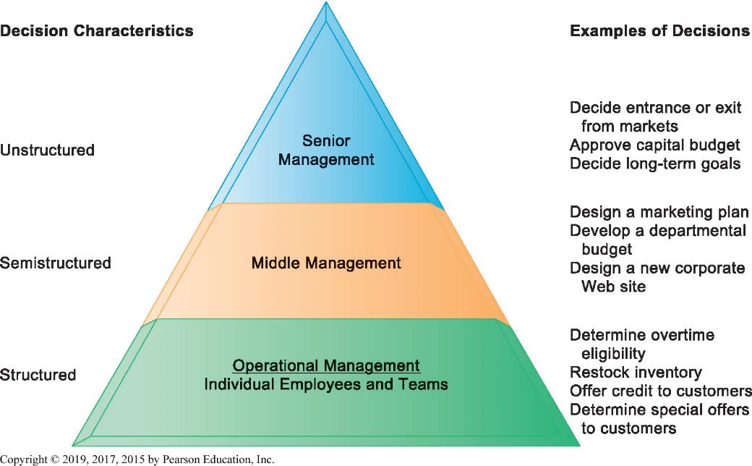
Figure 11.1 Information Requirements of Key Decision-Making Groups in a Firm
Notes:
Figure 11.1, Page 396.
Senior managers, middle managers, operational managers, and employees have different types of decisions and information requirements.
This graphic illustrates the three types of decision makers within an organization. Ask students to describe in their own words how to tell what category a decision falls into. If a structured decision is given separately to two employees, should they each come up with the same answer? What about semi-structured decisions? Unstructured decisions? Which of the types of decisions could most easily be handled by computer software?

Slide 10
The Decision-Making Process
Intelligence
  Discovering, identifying, and understanding the problems occurring in the organization
Design
  Identifying and exploring various solutions
Choice
  Choosing among solution alternatives
Implementation
  Making chosen alternative work and monitoring how well solution is working
Notes:
This slide describes the process of decision making as a series of four stages. It is important to note that if an implemented solution does not work, the decider can return to an earlier stage in the process and repeat as needed. Give the students an example decision, such as “what college should I apply to” and ask them to describe the actions taken at each of the four stages.

Slide 11
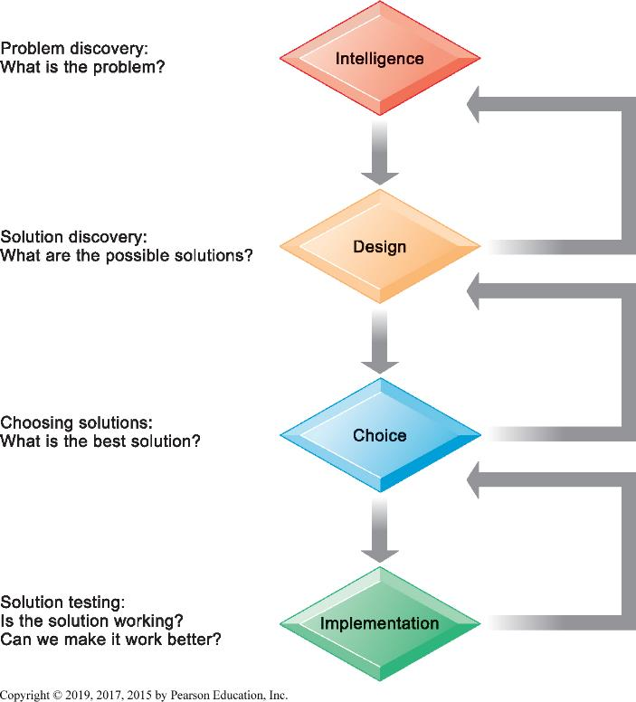
Figure 11.2 Stages in Decision Making
Notes:
Figure 11.2, Page 397.
The decision-making process can be broken down into four stages.
This graphic illustrates the four stages of decision making introduced in the previous slide, emphasizing that steps can be repeated as needed, depending on the outcome at each stage. You can ask students for a decision they have made in the past and then apply this framework. It could be a decision about which college to attend, which car to buy, or what computer to buy.

Slide 12
High-Velocity Automated Decision Making
Humans eliminated
Decision-making process capture by computer algorithms
Predefined range of acceptable solutions
Decisions made faster than managers can monitor and control
E.g. Trading programs at electronic stock exchanges
Notes:
Ask students if they can think of other high-velocity decision situations in which they participate such as Google search results, display ads that appear on their screens in milliseconds, or recommender systems such as Netflix and others that recommend media to them.

Slide 13
Quality of Decisions and Decision Making
Accuracy
Comprehensiveness
Fairness
Speed (efficiency)
Coherence
Due process
Notes:
There many dimensions of “good decision making.”

Slide 14
Business Intelligence
Infrastructure for managing data from business environment
  Warehousing
  Integrating
  Reporting
  Analyzing
Hadoop, O L A P, analytics
Products defined by technology vendors and consulting firms

Slide 15
The Business Intelligence Environment
Six elements in the B I environment
  Data from business environment
  Business intelligence infrastructure
  Business analytics toolset
  Managerial users and methods
  Delivery platform
    M S S, D S S, E S S
  User interface
Notes:
Business intelligence can be a very confusing phrase. There many elements that make up “business intelligence.” These are the six most important.

Slide 16
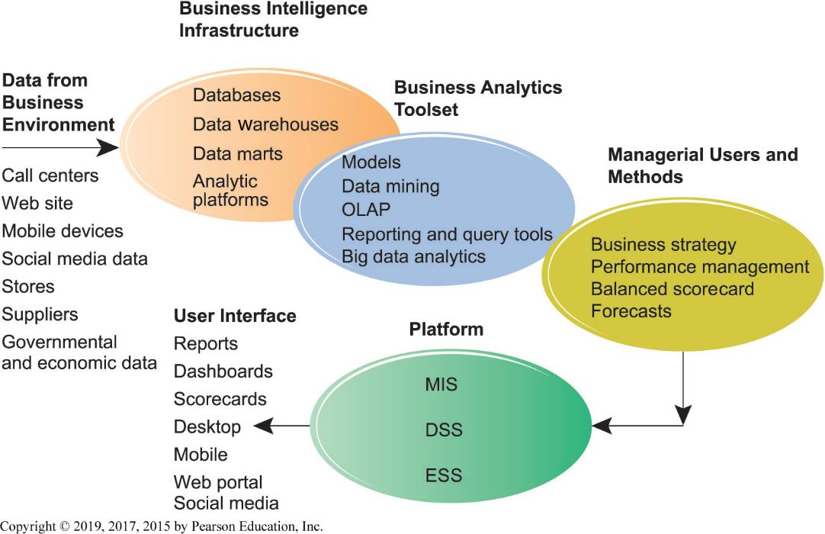
Figure 11.3 Business Intelligence and Analytics for Decision Support
Notes:
Figure 11.3, Page 400.
Business intelligence and analytics require a strong database foundation, a set of analytic tools, and an involved management team that can ask intelligent questions and analyze data.
This graphic is intended to illustrate in a single slide how all the elements of a business intelligence environment work together.

Slide 17
Business Intelligence and Analytics Capabilities
Production reports
Parameterized reports
Dashboards/scorecards
Ad-hoc query/search/report creation
Drill-down
Forecasts, scenarios, models
  Linear forecasting, what-if scenario analysis, data analysis
Notes:
These are the outputs of a fully enabled business intelligence capability.

Slide 18
Table 11.3 Examples of Predefined Business Intelligence Production Reports
Business Functional Area | Production Reports
Sales | Sales forecasts, sales team performance, cross selling, sales cycle times
Service/Call Center | Customer satisfaction, service cost, resolution rates, churn rates
Marketing | Campaign effectiveness, loyalty and attrition, market basket analysis
Procurement and Support | Direct and indirect spending, off-contract purchases, supplier performance
Supply Chain | Backlog, fulﬁllment status, order cycle time, bill of materials analysis
Financials | General ledger, accounts receivable and payable, cash ﬂow, proﬁtability
Human Resources | Employee productivity, compensation, workforce demographics, retention
Notes:
Table 11.3, p. 401

Slide 19
Predictive Analytics
Uses statistical analytics, data mining, historical data; assumptions of future conditions
Extracts information from data to predict future trends and behavior patterns
  Responses to direct marketing campaigns
  Best potential customers for credit cards
  At-risk customers
  Customer response to price changes and new services
Accuracies range from 65 to 90 percent

Slide 20
Big Data Analytics
Predictive analytics can use the big data generated from social media, consumer transactions, sensor and machine output, etc.
Combining with customer data
Big data analytics driving move toward “smart cities”
  Utility management
  Transportation operation
  Healthcare delivery
  Public safety
Notes:
Ask students if they have ideas about how the cities they live in, towns or villages, could use big data analytics to improve the lives of citizens.

Slide 21
Operational Intelligence and Analytics
Operational intelligence
  Day-to-day monitoring of business decisions and activity
Real-time monitoring
Schneider National truckload logistics services provider
  Data developed from sensors in trucks, trains, industrial systems
The Internet of Things (I o T) providing huge streams of data from connected sensors and devices

Slide 22
Location Analytics and G I S
Location analytics
  Big data analytics that uses location data from mobile phones, sensors, and maps
  E.g. Helping a utility company view customer costs as related to location
G I S – Geographic information systems
  Help decision makers visualize problems with mapping
  Tie location data about resources to map
Notes:
Many large corporations today are experiencing an explosion of customer information gathered from websites, social sites, blogs, and emails. Making sense out of this data is difficult. Graphical representation of data is one way to reduce the torrent of data into some simple messages that humans can understand in a glance.

Slide 23
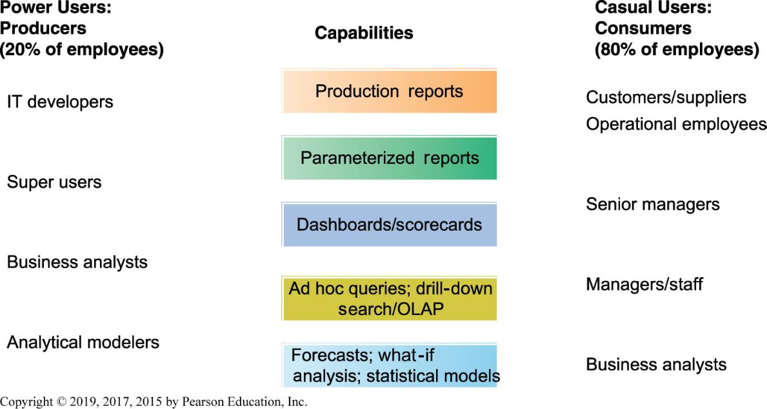
Figure 11.4 Business Intelligence Users
Notes:
Figure 11.4, Page 405.
Casual users are consumers of BI output, whereas intense power users are the producers of reports, new analyses, models, and forecasts.

Slide 24
Support for Semi-Structured Decisions
Decision-support systems (D S S)
  B I delivery platform for “super-users” who want to create own reports, use more sophisticated analytics and models
  What-if analysis
  Sensitivity analysis
  Backward sensitivity analysis
  Pivot tables: Spreadsheet function for multidimensional analysis
  Intensive modeling techniques

Slide 25
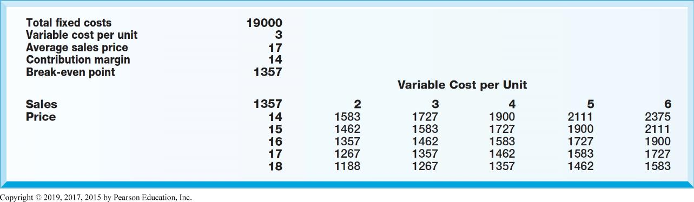
Figure 11.5 Sensitivity Analysis
Notes:
Figure 11.5, Page 405.
This table displays the results of a sensitivity analysis of the effect of changing the sales price of a necktie and the cost per unit on the product’s break-even point. It answers the question, “What happens to the break-even point if the sales price and the cost to make each unit increase or decrease?”

Slide 26
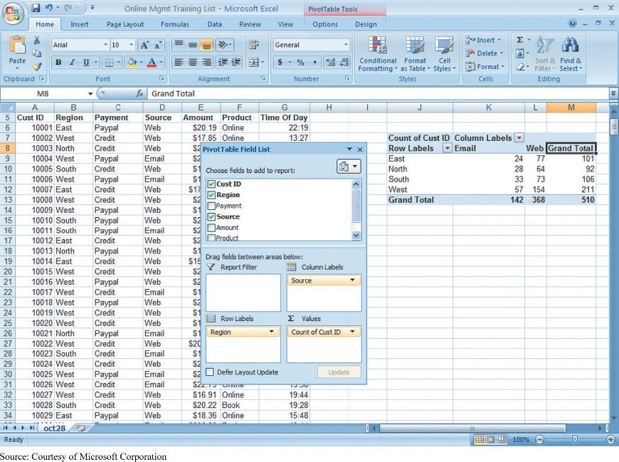
Figure 11.6 A Pivot Table That Examines Customer Regional Distribution and Advertising Source
Notes:
Figure 11.6, Page 406.
In this pivot table, we can examine where an online training company’s customers come from in terms of region and advertising source.

Slide 27
Decision Support for Senior Management (1 of 2)
Executive support systems
Balanced scorecard method
  Measures four dimensions of firm performance
    Financial
    Business process
    Customer
    Learning and growth
  Key performance indicators (K P I) used to measure each dimension

Slide 28
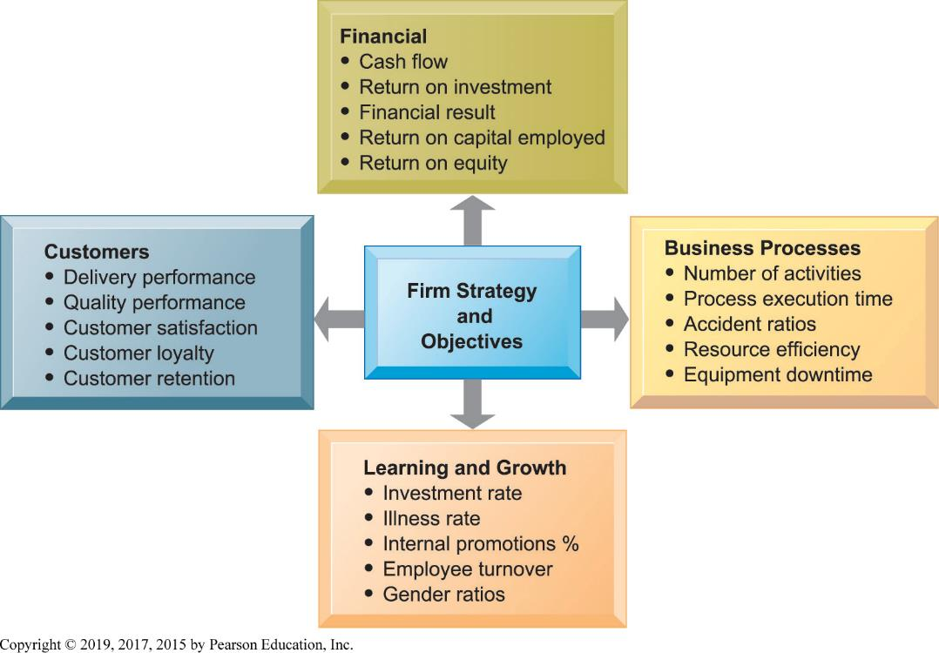
Figure 11.7 The Balanced Scorecard Framework
Notes:
Figure 11.7, Page 407.
In the balanced scorecard framework, the firm’s strategic objectives are operationalized along four dimensions: financial, business process, customer, and learning and growth. Each dimension is measured, using several KPIs. Ask where employees fit in this framework? What other measures of employees might be included in the Learning and Growth part of the framework?
The Balanced Scorecard Method is one of the most popular techniques for transforming a firms strategic objectives into operational targets.

Slide 29
Decision Support for Senior Management (2 of 2)
Business performance management (B P M)
  Management methodology based on firm’s strategies
  Translates strategies into operational targets
  Uses set of K P Is to measure progress toward targets
E S S combine internal data with external
  Financial data, news, etc.
Drill-down capabilities
Notes:
BPM is also a popular method of translating strategies into concrete, measured performance.

Slide 30
Group Decision-Support Systems (G D S S)
Facilitate solving of unstructured problems by set of decision makers
Software collects, ranks, stores ideas and decisions
Conference rooms or virtual collaboration
Support increased meeting sizes with increased productivity
Notes:
This slide discusses GDSS, a type of DSS system that supports group decision making. What types of problems might a group encounter when trying to make a decision as a group? What kinds of decisions might need to be made as a group?

Slide 31
Artificial Intelligent Techniques (1 of 4)
Artificial intelligence
Intelligent techniques
  Capture knowledge
  Discover patterns and behaviors in large amounts of data
  Perform some human-like action
  Generate solutions to problems to complex for humans to solve alone
  Used in decision making and knowledge management
Notes:
You should point out to students that artificial intelligence is not the same as human intelligence. While there are many tasks currently performed by humans that can be performed by machines, and sometimes much better (faster, more comprehensive, etc.) than humans, human intelligence is much more generalized, and powerful in many respects. Google’s search engine does something humans cannot do: search several billion websites in response to a query in just milliseconds. Humans, however, know what to search for. There are self-driving cars, but they don’t know where to drive unless directed by a human being. The human brain contains an estimated 100 billion neural cells, each with over 10,000 synapse connections to other cells. It operates on 7 watts of energy (the entire body uses 25 watts). Currently, scientists do not understand how the brain works at the microbiological or neural level. There are no computing systems in the foreseeable future that will come close to this level of computing power. IBM’s Watson AI system used 200,000 watts of electricity when playing Jeopardy.
So try to dispel the popular ideas about AI or robots taking over the world! All of these techniques are useful tools, but not replacements for human intelligence. They generally amplify human intelligence.

Slide 32
Artificial Intelligent Techniques (2 of 4)
Machine learning
  Computers improving performance by using algorithms to learn patterns from data and examples
Neural networks
  Find patterns and relationships in very large amounts of data
  Sensoring and processing nodes
Genetic algorithms
  Examine large number of solutions for a problem
  Based on machine learning techniques inspired by evolutionary biology

Slide 33
Interactive Session – Technology: Singapore Sports Institute Uses Analytics for SEA Games
Class discussion
  What technologies are used by SSI? What is their purpose?
  To what extent was technology responsible for Team Singapore’s success at the SEA games? Explain.
  Search the web for SimulCam and StroMotion. How can these tools be used for video analysis?
  Search the web for the role of big data in the German team’s 2014 World Cup victory and compare it with Team Singapore’s success at the SEA Games.

Slide 34
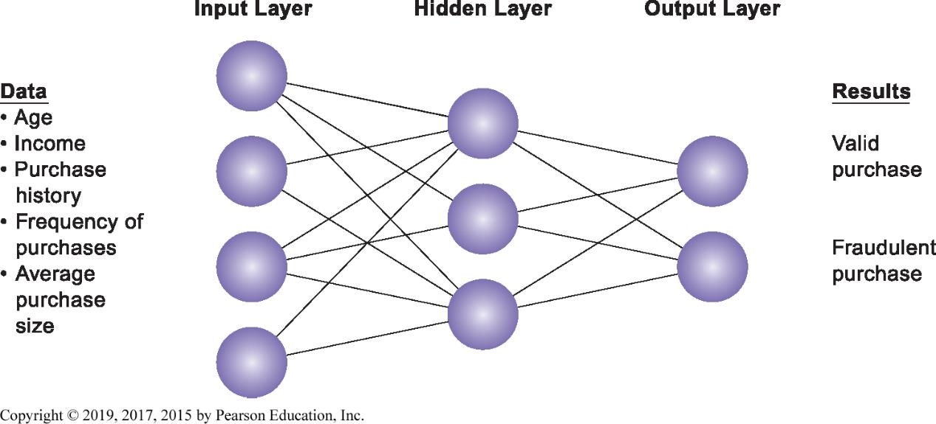
Figure 11.8 How a Neural Network Works
Notes:
Figure 11.8, Page 411.
A neural network uses rules it learns from patterns in data to construct a hidden layer of logic. The hidden layer then processes inputs, classifying them based on the experience of the model. In this example, the neural network has been trained to distinguish between valid and fraudulent credit card purchases.
This graphic illustrates how a neural network works—by using an internal, hidden layer of logic that examines existing data and assigning a classification to that set of data. For example, given one or more specific combinations of age, income, purchase history, frequency of purchases, and average purchase size, a neural network might determine that a new credit card purchase was likely to be fraudulent. What are the benefits and drawbacks of using this type of technique?

Slide 35
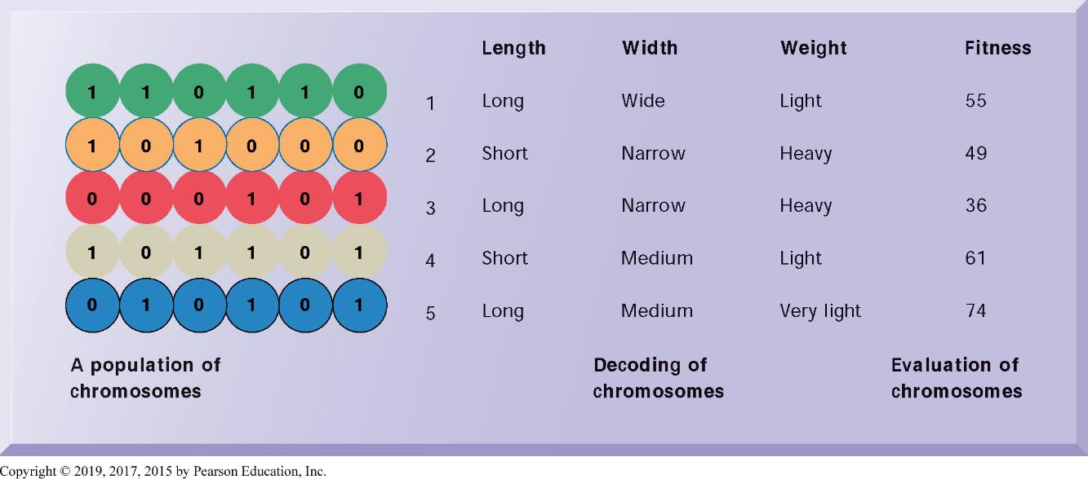
Figure 11.9 The Components of a Genetic Algorithm
Notes:
Figure 11.9, Page 412.
This example illustrates an initial population of chromosomes, each representing a different solution. The genetic algorithm uses an iterative process to refine the initial solutions so that the better ones, those with the higher fitness, are more likely to emerge as the best solution.
This graphic illustrates the components of a genetic algorithm—“chromosomes”, each with a variety of characteristics that can be compared for overall fitness in a given situation. Ask students what types of problems genetic algorithms are suited for.

Slide 36
Artificial Intelligent Techniques (3 of 4)
Intelligent agents
  Software programs that work in the background to carry out specific repetitive tasks
Natural language processing
  Software that can process voice or text commands using natural human language
Computer vision systems
  Emulate human visual system to view and extract information from real-world images

Slide 37
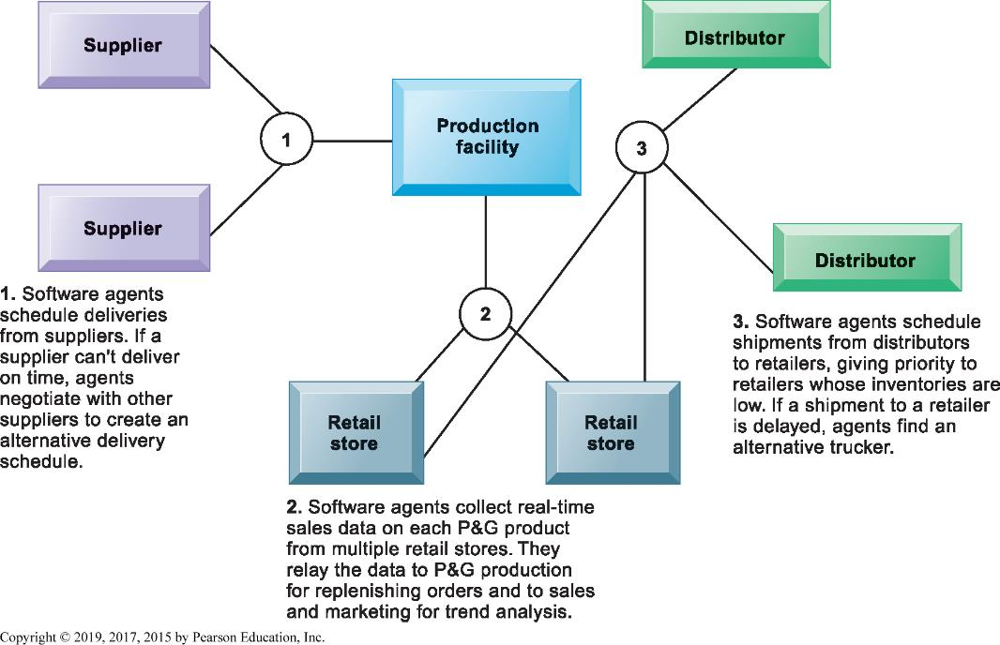
Figure 11.10 Intelligent Agents in P&G’s Supply Chain Network
Notes:
Figure 11.10, Page 413.
Intelligent agents are helping Procter & Gamble shorten the replenishment cycles for products such as a box of Tide.
This graphic illustrates Procter & Gamble’s use of intelligent agents in its supply chain network. Given that intelligent-agent modeling mimics the behavior of a number of “actors” in a given situation, what other types of situations might benefit from this type of analysis?

Slide 38
Artificial Intelligent Techniques (4 of 4)
Robotics
  Design and use of movable machines that can substitute for humans
Expert systems
  Capture human expertise in a limited domain of knowledge
  Express expertise as a set of rules in a software system
  Knowledge base
  Inference engine

Slide 39
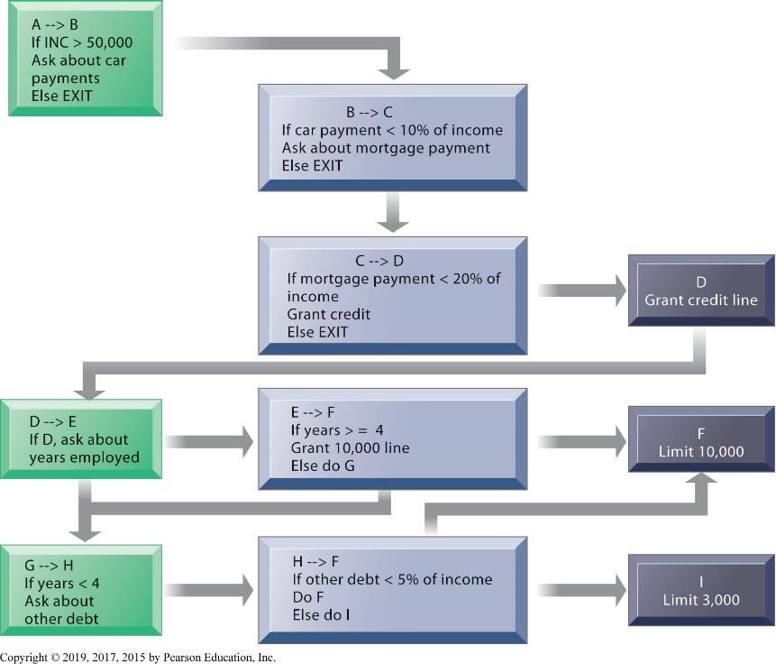
Figure 11.11 Rules in an Expert System
Notes:
Figure 11.11, Page 416.
An expert system contains a set of rules to be followed when used. The rules are interconnected, the number of outcomes is known in advance and is limited, there are multiple paths to the same outcome, and the system can consider multiple rules at a single time. The rules illustrated are for a simple credit-granting expert system.
This graphic illustrates the use of if/then rules in an expert system. Ask students to demonstrate an understanding of if/then rules, by analyzing a common decision as a series of if/then statements; for example, the decision to accept an invitation to socialize on a weeknight, or the decision of what to make for dinner.

Slide 40
Interactive Session – People: Will Robots Replace People in Manufacturing?
Class discussion
  Why have robots caught on in manufacturing? What knowledge do they require?
  Can robots replace human workers in manufacturing? Explain your answer.
  If you were considering introducing robots in your manufacturing plant, what people, organization, and technology issues would you need to address?

Slide 41
Knowledge Management
Business processes developed for creating, storing, transferring, and applying knowledge
Increases the ability of organization to learn from environment and to incorporate knowledge into business processes and decision making
Knowing how to do things effectively and efficiently in ways that other organizations cannot duplicate is major source of profit and competitive advantage
Notes:
This slide defines the term knowledge management and describes the process from acquiring knowledge to applying it as a value chain, and is followed by slides detailing each stage. Each stage of the chain adds more value to the raw data and information. Ask the students to differentiate between the stages, and how each stage could incorporate more value? For example, how does knowledge, once it is stored, incorporate more value than the previous stage knowledge that is being acquired?

Slide 42
Enterprise-wide Knowledge Management Systems
Three kinds of knowledge
  Structured
  Semi-structured
  Tacit knowledge (unstructured)
Enterprise-wide knowledge management systems
  Deal with all three types of knowledge
  General-purpose, firm-wide systems that collect, store, distribute, and apply digital content and knowledge
Notes:
Enterprise knowledge systems are generally very large databases that attempt to collect all the “valuable” information and knowledge of individuals and groups in the firm. This can include customer and vendor knowledge, case studies, PowerPoint slides, and internal reports.

Slide 43
Enterprise Content Management Systems
Capabilities for knowledge capture, storage
  Collecting and organizing semi-structured knowledge such as email
Repositories for documents and best practices
Classification schemes
  Key problem in managing knowledge
  Each knowledge object must be tagged for retrieval
Tools for locating and sharing expertise
  Search tools and directories of experts and profiles
Notes:
Enterprise content management systems can include or consist of capabilities for the creation and management of unstructured knowledge—knowledge-network systems. Ask the students to give examples of unstructured knowledge, given a type of industry or company: a law firm, an advertising firm, a school. What might be the difficulties in establishing a knowledge network system in a company? Contrast this network (crowd centered) approach to a top down structured knowledge management system.

Slide 44
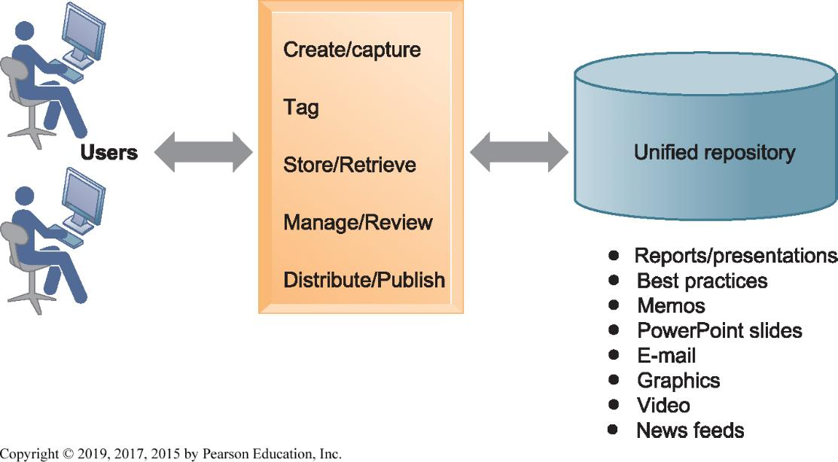
Figure 11.12 An Enterprise Content Management System
Notes:
Figure 11.12, Page 418.
An enterprise content management system has capabilities for classifying, organizing, and managing structured and semi-structured knowledge and making it available throughout the enterprise.
This graphic illustrates the functions of an enterprise content management system. Users interact with the system to both input knowledge, manage it, and distribute it. These management systems can house a wide variety of information types, from formal reports to graphics, as well as bring in external content resources such as news feeds. Ask students what types of documents would need to be stored by a hospital, bank, law firm, and so on.

Slide 45
Learning Management Systems
Provide tools for management, delivery, tracking, and assessment of employee learning and training
Multiple modes of learning
  Videos
  Web-based classes
  Live instruction
  Group learning in online forums
Massive open online courses (M O O Cs)
Notes:
This slide discusses learning management systems, which enable companies to track and manage employee learning. Ask students what are the benefits and drawbacks of using an LMS with centralized reporting.

Slide 46
Knowledge Work Systems
Specialized systems for knowledge workers
Requirements of knowledge work systems:
  Specialized tools
    Powerful graphics, analytical tools, and communications and document management
  Computing power to handle sophisticated graphics or complex calculations
  Access to external databases
  User-friendly interfaces
Notes:
This slide discusses the second main type of knowledge management system, the knowledge work system, and identifies the importance of knowledge workers to an organization and its knowledge creation. Ask the students why each of the three roles listed is important to an organization. Can all companies benefit from knowledge workers, or only design, science, and engineering firms?

Slide 47
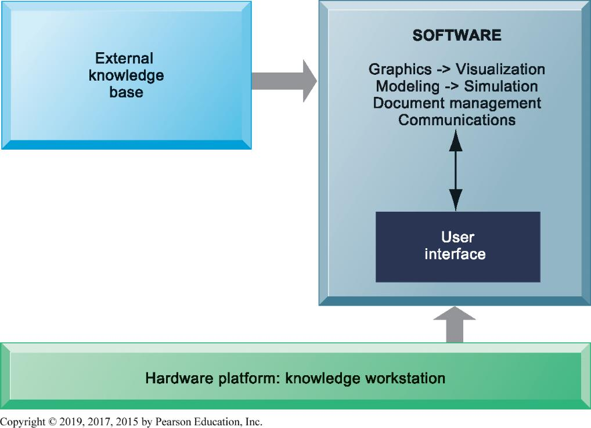
Figure 11.13 Requirements of Knowledge Work Systems
Notes:
Figure 11.13, Page 420.
Knowledge work systems require strong links to external knowledge bases in addition to specialized hardware and software.
This graphic illustrates the main components of a knowledge work station: having the need for both specialized software and hardware, access to external information, and an easy-to-use interface. What types of external knowledge might be valuable to an engineer, a financial analyst, a medical researcher?

Slide 48
Examples of Knowledge Work Systems
Computer-aided design (CAD) systems
Virtual reality (V R) systems
  Simulation and modeling
  Virtual Reality Modeling Language (V R M L)
Augmented reality (A R) systems
  Live view of physical world with elements augmented by computer-generated imagery
  E.g. image-guided surgery
Notes:
Ask if any of your students have worked with an engineering work station, or CNC (computer numerically controlled machine tool). Have any worked with a financial workstation that financial planners often use (really just a fast PC with software for financial planning)?

Slide 49
How Will M I S Help My Career?
The Business: Western Well Health
Position Description
Job Requirements
Interview Questions
Notes:
A good opportunity for a class discussion of the new Section on careers. Would any in the class be interested in a job like this? What do they think are the most important skills the employer is looking for? How would they answer the interviewer questions?

