Slide 1

Essentials of Management Information Systems
Thirteenth Edition
Chapter 6
Foundations of Business Intelligence: Databases and Information Management
Copyright © 2019 Pearson Education Ltd.
Notes:
If this PowerPoint presentation contains mathematical equations, you may need to check that your computer has the following installed:
1) MathType Plugin
2) Math Player (free versions available)
3) NVDA Reader (free versions available)

Slide 2
Learning Objectives
6.1 What is a database, and how does a relational database organize data?
6.2 What are the principles of a database management system?
6.3 What are the principal tools and technologies for accessing information from databases to improve business performance and decision making?
6.4 Why are information policy, data administration, and data quality assurance essential for managing the firm’s data resources?
6.5 How will M I S help my career?
Notes:
Ask students to make a list with you of all the databases they use or interact with in their lives. The idea here is to make students aware of the ubiquity and importance of record keeping systems (databases). Databases are at the very heart of the MIS profession.
Ask students if they have had any experience with errors in a database? A mistaken identity, a wrong address, an incorrect balance on a statement. Why are data errors important for a business? For individuals?

Slide 3
Video Cases
Case 1: Dubuque Uses Cloud Computing and Sensors to Build a Smarter City
Case 2: Brooks Brothers Closes in on Omnichannel Retail
Case 3: Maruti Suzuki Business Intelligence and Enterprise Databases

Slide 4
Data Management Helps the Charlotte Hornets Learn More About Their Fans
Problem
  Large volumes of data in isolated databases
  Outdated data management technology
Solutions
  S A P H A N A
  Data warehouse
  FanTracker
Illustrates the importance of data management for better decision making and customer analysis

Slide 5
What is a Database?
Database:
  Collection of related files containing records on people, places, or things
Entity:
  Generalized category representing person, place, thing
  E.g., SUPPLIER, PART
Attributes:
  Specific characteristics of each entity:
    SUPPLIER name, address
    PART description, unit price, supplier
Notes:
Ask students if databases are always digital? Can they think of a non-digital database? How about a telephone book. What are the entities? The attributes? Or, a library card catalog.

Slide 6
Relational Databases
Organize data into two-dimensional tables (relations) with columns and rows
One table for each entity:
  E.g., (CUSTOMER, SUPPLIER, PART, SALES)
  Fields (columns) store data representing an attribute
  Rows store data for separate records, or tuples
Key field: uniquely identifies each record
Primary key

Slide 7
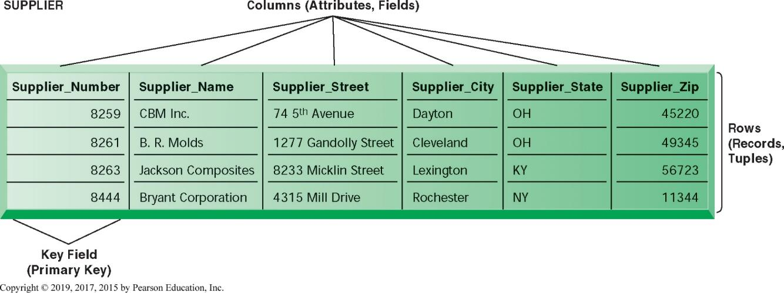
Figure 6.2 A Relational Database Table
Notes:
Figure 6.2, Page 199.
A relational database organizes data in the form of two-dimensional tables. Illustrated here is a table for the entity SUPPLIER showing how it represents the entity and its attributes. Supplier_Number is the key field.
The graphic on this slide and the next illustrates two tables in a relational DBMS. Ask students what the entity on this slide and the next are.
The key field in the Supplier table is the Supplier number. What is the purpose of the key field?

Slide 8
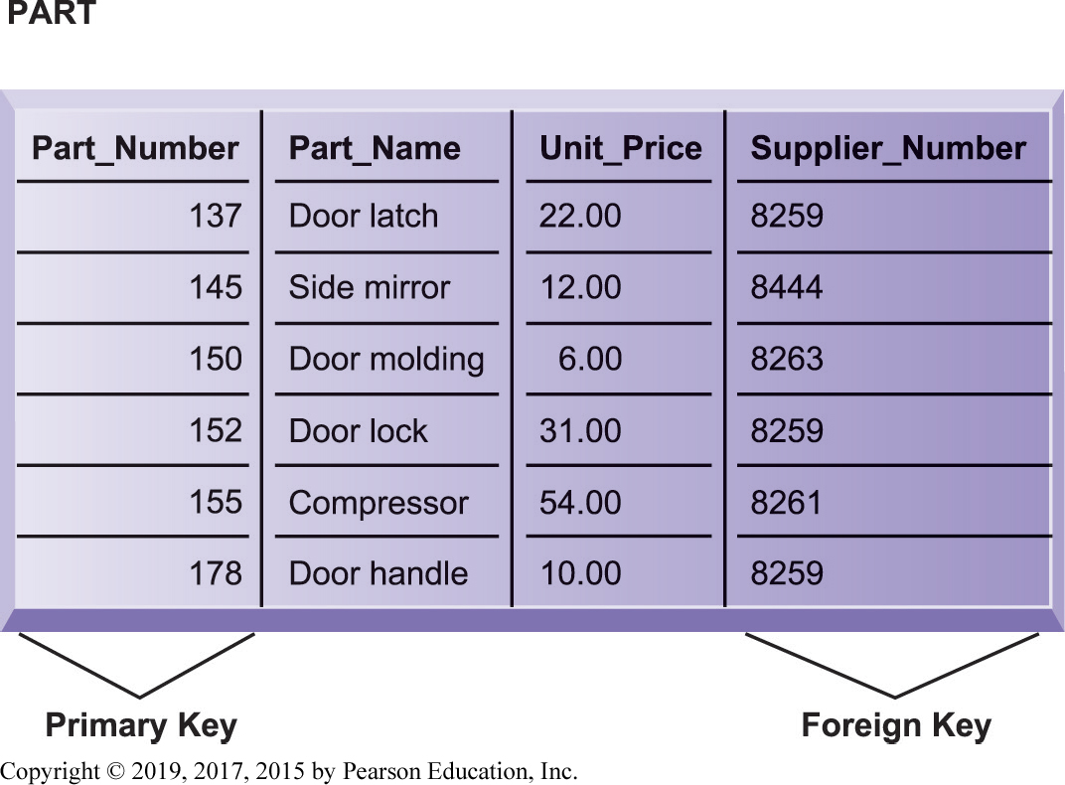
Figure 6.3 The PART Table
Notes:
Figure 6.3, Page 199.
Data for the entity PART have their own separate table. Part_Number is the primary key and Supplier_Number is the foreign key, enabling users to find related information from the SUPPLIER table about the supplier for each part.
This slide shows the second part of the graphic on the previous slide. Notice that the foreign key in this table is the primary key in the Suppliers table. What is the purpose of the foreign key. Can multiple records have the same foreign key?

Slide 9
Establishing Relationships (1 of 2)
Entity-relationship diagram
  Used to clarify table relationships in a relational database
Relational database tables may have:
  One-to-one relationship
  One-to-many relationship
  Many-to-many relationship
    Requires “join table” or intersection relation that links the two tables to join information

Slide 10

Figure 6.4 A Simple Entity-Relationship Diagram
Notes:
Figure 6.4, Page 200.
This diagram shows the relationship between the entities SUPPLIER and PART.

Slide 11
Establishing Relationships (2 of 2)
Normalization
  Streamlining complex groups of data
  Minimizes redundant data elements
  Minimizes awkward many-to-many relationships
  Increases stability and flexibility
Referential integrity rules
  Ensure that relationships between coupled tables remain consistent
Notes:
This slide describes activities involved in designing a database. To create an efficient database, you must know what the relationships are among the various data elements, the types of data that will be stored, and how the organization will need to manage the data. Note that the conceptual database design is concerned with how the data elements will be grouped, what data in what tables will make the most efficient organizations.

Slide 12
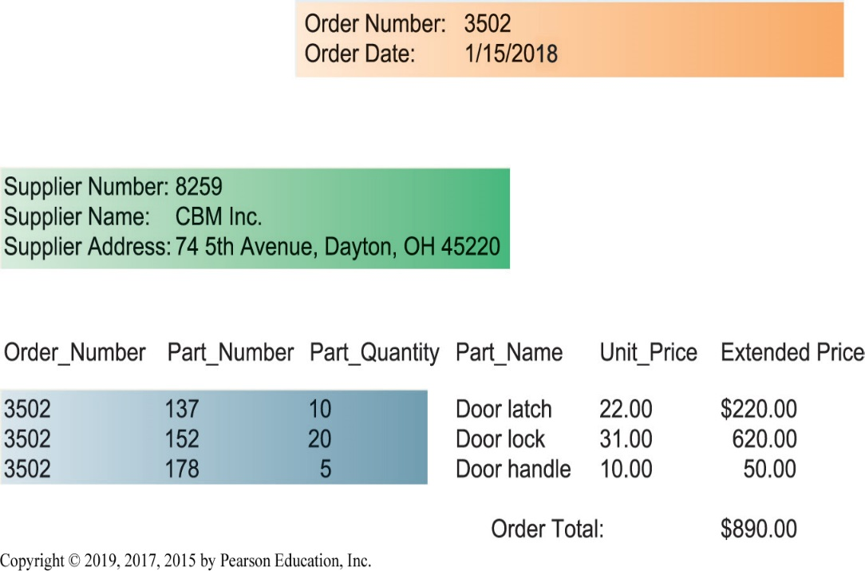
Figure 6.5 Sample Order Report
Notes:
Figure 6.5, Page 201.
The shaded areas show which data came from the ORDER, SUPPLIER, and LINE_ITEM tables. The database does not maintain data on extended price or order total because they can be derived from other data in the tables.

Slide 13
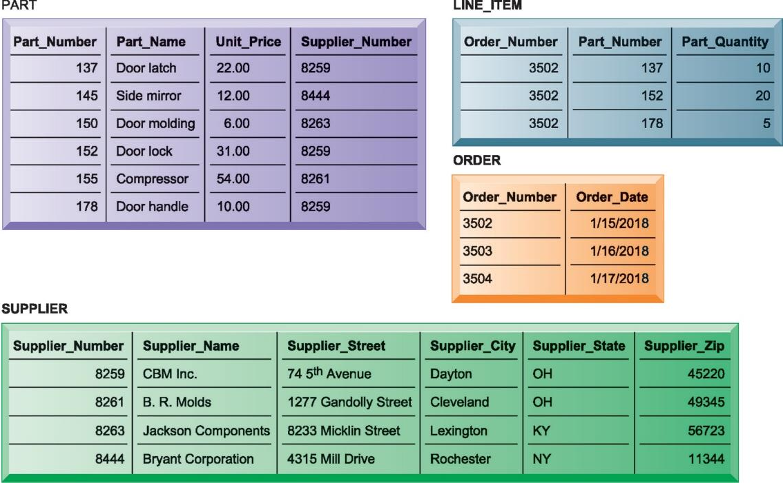
Figure 6.6 The Final Database Design with Sample Records
Notes:
Figure 6.6, Page 202.
The final design of the database for suppliers, parts, and orders has four tables. The LINE_ITEM table is a join table that eliminates the many-to-many relationship between ORDER and PART.

Slide 14

Figure 6.7 Entity-Relationship Diagram for the Database with Four Tables
Notes:
Figure 6.7, Page 203.
This diagram shows the relationship between the SUPPLIER, PART, LINE_ITEM, and ORDER entities.
This graphic shows an example of an entity relationship diagram. It shows that one ORDER can contain many LINE_ITEMs. (A PART can be ordered many times and appear many times as a line item in a single order.) Each LINE ITEM can contain only one PART. Each PART can have only one SUPPLIER, but many PARTs can be provided by the same SUPPLIER.

Slide 15
Database Management Systems (D B M S)
Software for creating, storing, organizing, and accessing data from a database
Separates the logical and physical views of the data
  Logical view: how end users view data
  Physical view: how data are actually structured and organized
Examples: Microsoft Access, D B 2, Oracle Database, Microsoft S Q L Server, My S Q L
Notes:
One of the most popular open source databases (purchased by SUN Computer but now owned by Oracle) is MySQL. Go to http://www.mysql.com/customers/ in class for some illustrations of companies that use MySQL. This database management system is not as sophisticated as high end enterprise database systems but still quite sufficient for many businesses.

Slide 16
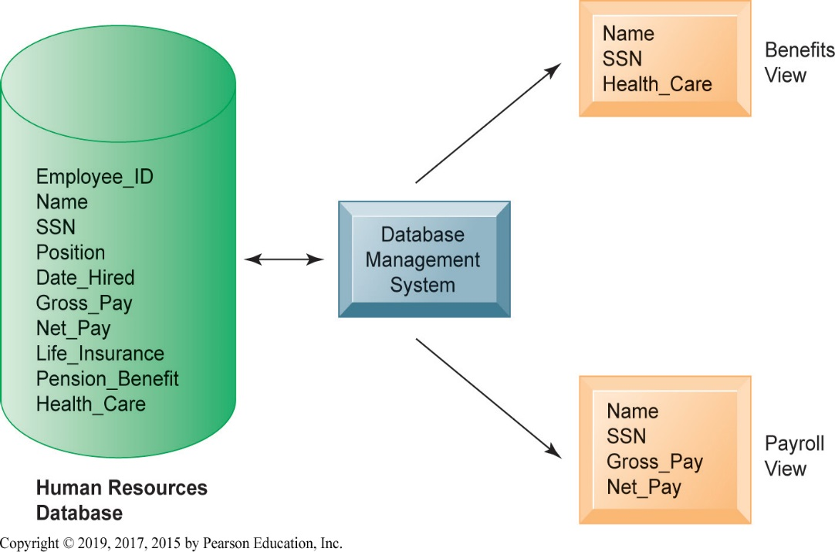
Figure 6.8 Human Resources Database with Multiple Views
Notes:
Figure 6.8, Page 204.
A single human resources database provides many views of data, depending on the information requirements of the user. Illustrated here are two possible views, one of interest to a benefits specialist and one of interest to a member of the company’s payroll department.
This graphic illustrates what is meant by providing different logical views of data. The orange rectangles represent two different views in an HR database, one for reviewing employee benefits, the other for accessing payroll records. The students can think of the green cylinder as the physical view, which shows how the data are actually organized and stored on the physical media. The physical data do not change, but a DBMS can create many different logical views to suit different needs of users.

Slide 17
Operations of a Relational D B M S
Select:
  Creates a subset of all records meeting stated criteria
Join:
  Combines relational tables to present the server with more information than is available from individual tables
Project:
  Creates a subset consisting of columns in a table
  Permits user to create new tables containing only desired information

Slide 18
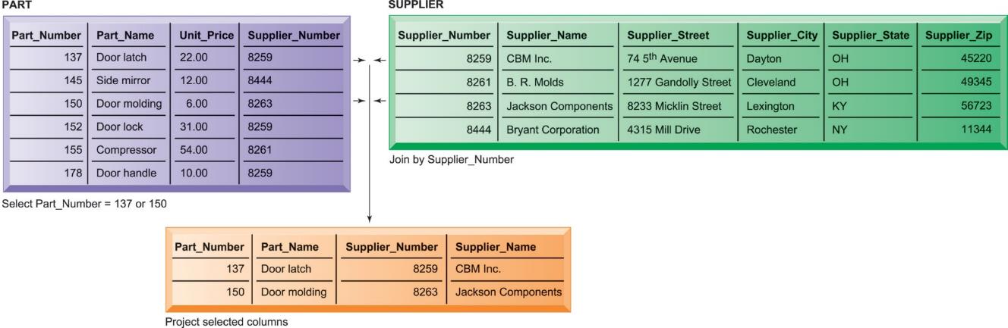
Figure 6.9 The Three Basic Operations of a Relational D B M S
Notes:
Figure 6.9, Page 205.
The select, join, and project operations enable data from two tables to be combined and only selected attributes to be displayed.
This graphic illustrates the result from combining the select, join, and project operations to create a subset of data. The SELECT operation retrieves just those parts in the PART table whose part number is 137 or 150. The JOIN operation uses the foreign key of the Supplier_Number provided by the PART table to locate supplier data from the Supplier Table for just those records selected in the SELECT operation. Finally, the PROJECT operation limits the columns to be shown to be simply the part number, part name, supplier number, and supplier name (orange rectangle).

Slide 19
Capabilities of Database Management Systems
Data definition capabilities:
  Specify structure of content of database
Data dictionary:
  Automated or manual file storing definitions of data elements and their characteristics
Querying and reporting:
  Data manipulation language
    Structured query language (S Q L)
    Microsoft Access query-building tools
  Report generation, e.g., Crystal Reports
Notes:
One important function of databases is to bring about common definitions of entities and attributes, like what is a fiscal year, how to express date of hire, and defining “business location.” In pre-database environments, and even in global companies, these definitions vary from one location to another.

Slide 20
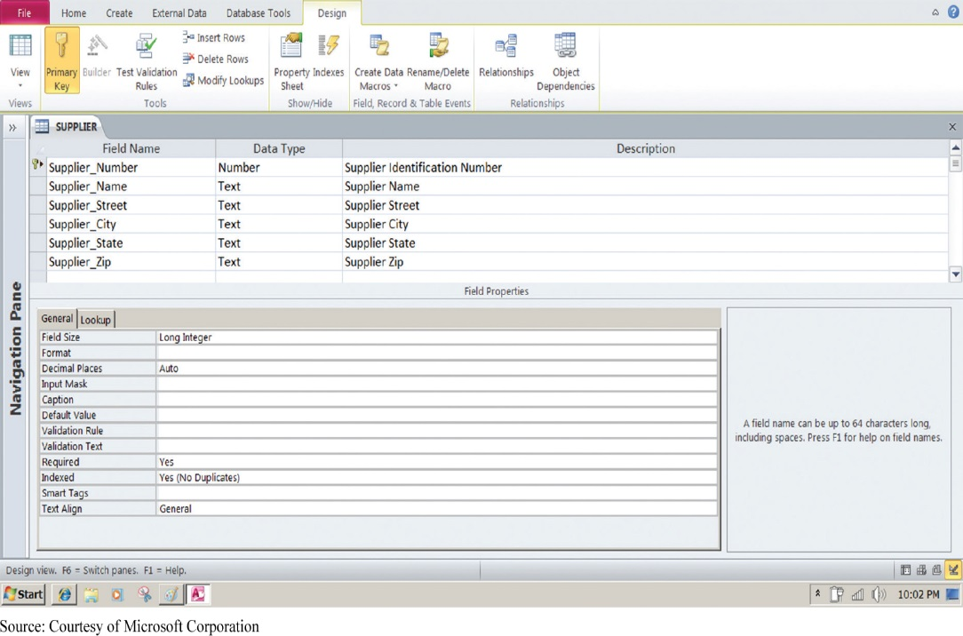
Figure 6.10 Access Data Dictionary Features
Notes:
Figure 6.10, Page 206.
Microsoft Access has a rudimentary data dictionary capability that displays information about the size, format, and other characteristics of each field in a database. Displayed here is the information maintained in the SUPPLIER table. The small key icon to the left of Supplier_Number indicates that it is a key field.
This graphic shows the data dictionary capability of Microsoft Access. For the field “Supplier Name” selected in the top pane, definitions can be configured in the General tab in the bottom pane. These General characteristics are Fields Size, Format, Input Mask, Caption, Default Value, Validation Rule, Validation Text, Required, Allow Zero Length, Indexed, Unicode Compression, IME mode, IME Sentence Mode, and Smart Tags.

Slide 21
Figure 6.11 Example of an S Q L Query
SELECT PART.Part_Number, PART.Part_Name, SUPPLIER.Supplier_Number,
SUPPLIER.Supplier_Name
FROM PART, SUPPLIER
WHERE PART.Suplier_Number = SUPPLIER.Supplier_Number AND
Part_Number = 137 OR Part_Number = 150;
Notes:
Figure 6.11, Page 206.
Illustrated here are the SQL statements for a query to select suppliers for parts 137 or 150. They produce a list with the same results as Figure 6.9.
This graphic shows an example SQL statement that would be used to retrieve data from a database. In this case, the SQL statement is retrieving records from the PART table illustrated on Slide 20 (Figure 6-8) whose Part Number is either 137 or 150.
Ask students to relate what each phrase of this statement is doing. (For example, the statement says to take the following columns: Part_Number, Part_Name, Supplier Number, Supplier Name, from the two tables Part and Supplier, when the following two conditions are true…)

Slide 22
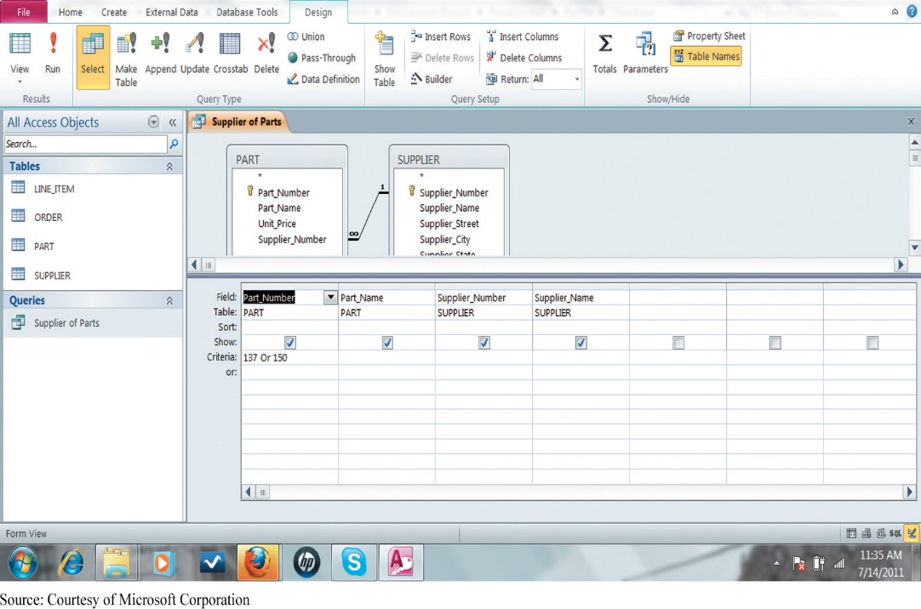
Figure 6.12 An Access Query
Notes:
Figure 6.12, Page 207.
Illustrated here is how the query in Figure 6.11 would be constructed using Microsoft Access query-building tools. It shows the tables, fields, and selection criteria used for the query.
This graphic illustrates a Microsoft Access query that performs the same operation as the SQL query in the last slide. The query pane at the bottom shows the fields that are requested (Fields), the relevant Tables (Table), the fields that will be displayed in the results (Show), and the criteria limiting the results to Part numbers 137 and 150 (Criteria).

Slide 23
Non-Relational Databases
“No S Q L”
Handle large data sets of data that are not easily organized into tables, columns, and rows
Use more flexible data model
  Don’t require extensive structuring
Can manage unstructured data, such as social media and graphics
E.g. Amazon’s Simple D B, MetLife’s Mongo D B

Slide 24
Cloud Databases and Distributed Databases
Relational database engines provided by cloud computing services
  Pricing based on usage
  Appeal to small or medium-sized businesses
Amazon Relational Database Service
  Offers My S Q L, Microsoft S Q L Server, Oracle Database engines
Distributed databases
  Stored in multiple physical locations
  Google’s Spanner cloud service

Slide 25
The Challenge of Big Data
Massive quantities of unstructured and semi-structured data from Internet and more
  3V s: Volume, variety, velocity
  Petabytes and exabytes
Big datasets offer more patterns and insights than smaller datasets, e.g.
  Customer behavior
  Weather patterns
Requires new technologies and tools

Slide 26
Business Intelligence Infrastructure
Array of tools for obtaining useful information from internal and external systems and big data
  Data warehouses
  Data marts
  Hadoop
  In-memory computing
  Analytical platforms
Notes:
Modern databases can store enormous amounts of information. Consider that PhotoBucket has 80 billion photos on tap! Yet making sense out of all this data is a challenge for managers. What’s needed are tools to organize the data, analyze, and describe what’s happening in the real world based on the data.

Slide 27
Data Warehouses
Data warehouse:
  Database that stores current and historical data that may be of interest to decision makers
  Consolidates and standardizes data from many systems, operational and transactional databases
  Data can be accessed but not altered
Data mart:
  Subset of data warehouses that is highly focused and isolated for a specific population of users
Notes:
Data warehouses and data marts are two tools that bring data together and move it offline to storage areas where it can be analyzed without interfering with the transaction processing systems that produce the data. Data analysis, business intelligence applications, would slow down transaction processing.

Slide 28
Hadoop
Open-source software framework for big data
Breaks data task into sub-problems and distributes the processing to many inexpensive computer processing nodes
Combines result into smaller data set that is easier to analyze
Key services
  Hadoop Distributed File System (H D F S)
  MapReduce

Slide 29
In-Memory Computing
Relies on computer’s main memory (RAM) for data storage
Eliminates bottlenecks in retrieving and reading data
Dramatically shortens query response times
Enabled by high-speed processors, multicore processing
Lowers processing costs

Slide 30
Analytic Platforms
Preconfigured hardware-software systems
Designed for query processing and analytics
Use both relational and non-relational technology to analyze large data sets
Include in-memory systems, No S Q L D B M S
E.g. I B M Pure Data System for Analytics
  Integrated database, server, storage components
Data lakes

Slide 31
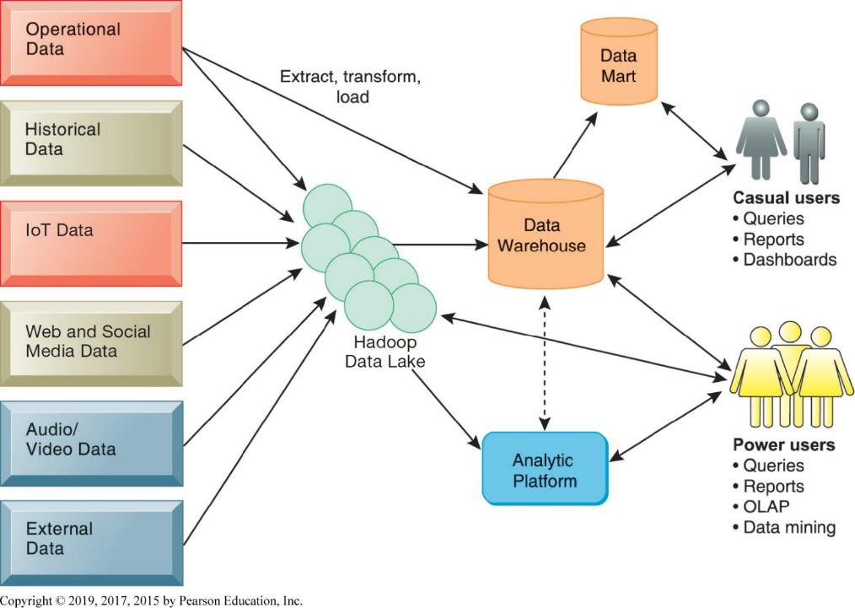
Figure 6.13 Business Intelligence Technology Infrastructure
Notes:
Figure 6.13, Page 213.
A contemporary business intelligence technology infrastructure features capabilities and tools to manage and analyze large quantities and different types of data from multiple sources. Easy-to-use query and reporting tools for casual business users and more sophisticated analytical toolsets for power users are included.

Slide 32
Interactive Session – Society: Societe Generale Builds an Intelligent System to Manage Information Flow
Class discussion
  Why did Societe Generale’s managers decide to develop an automated transaction processing system?
  Why did managers decide they needed an “intelligent system?” In what way was the new system “intelligent?”
  What is the role of human decision makers in the new system?
  Why did managers select the Infogix platform?

Slide 33
Analytical Tools: Relationships, Patterns, Trends
Once data is gathered, tools are required for consolidating, analyzing, to use insights to improve decision making
  Software for database querying and reporting
  Multidimensional data analysis (O L A P)
  Data mining

Slide 34
Online Analytical Processing (O L A P)
Supports multidimensional data analysis, enabling users to view the same data in different ways using multiple dimensions
  Each aspect of information—product, pricing, cost, region, or time period—represents a different dimension
  E.g., comparing sales in East in June versus May and July
Enables users to obtain online answers to ad hoc questions such as these in a fairly rapid amount of time

Slide 35
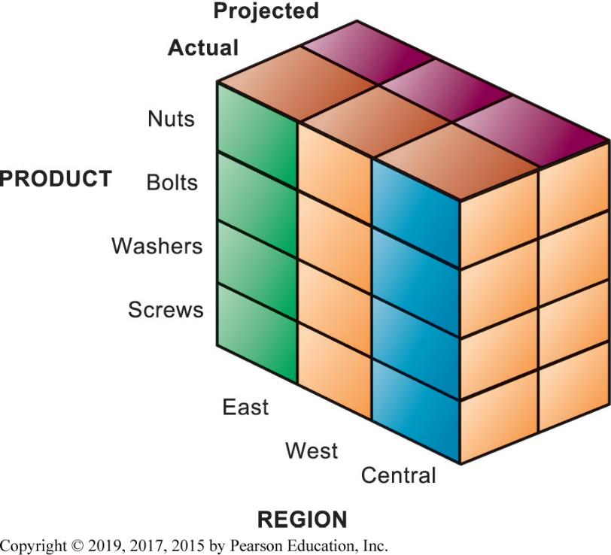
Figure 6.14 Multidimensional Data Model
Notes:
Figure 6.14, Page 214.
This view shows product versus region. If you rotate the cube 90 degrees, the face that will show is product versus actual and projected sales. If you rotate the cube 90 degrees again, you will see region versus actual and projected sales. Other views are possible.
This graphic illustrates a data cube composed of three dimensions: actual/projected sales, product, and region. Obviously, the point is to try and understand differences between actual and projected sales by looking at region and product. This is an ideal problem for pivot tables in Excel because two of the variables are categorical (product and region), one is interval.

Slide 36
Data Mining
Finds hidden patterns and relationships in large databases and infers rules from them to predict future behavior
Types of information obtainable from data mining
  Associations: occurrences linked to single event
  Sequences: events linked over time
  Classifications: patterns describing a group an item belongs to
  Clustering: discovering as yet unclassified groupings
  Forecasting: uses series of values to forecast future values
Notes:
With terrorism so much in the news, you might ask students how they imagine federal officials use data mining to identify potential or actual terrorists. For instance, if one was looking for terrorists, what kinds of associations, sequences, classifications, and clusters would you look for.

Slide 37
Text Mining
Unstructured data (mostly text files) accounts for 80 percent of an organization’s useful information.
Text mining allows businesses to extract key elements from, discover patterns in, and summarize large unstructured data sets.
Sentiment analysis
  Mines online text comments online or in email to measure customer sentiment

Slide 38
Web Mining
Discovery and analysis of useful patterns and information from the web
  E.g. to understand customer behavior, evaluate website, quantify success of marketing
Content mining – mines content of websites
Structure mining – mines website structural elements, such as links
Usage mining – mines user interaction data gathered by web servers

Slide 39
Databases and the Web
Firms use the web to make information from their internal databases available to customers and partners.
Middleware and other software make this possible
  Web server
  Application servers or C G I
  Database server
Web interfaces provide familiarity to users and savings over redesigning legacy systems.

Slide 40
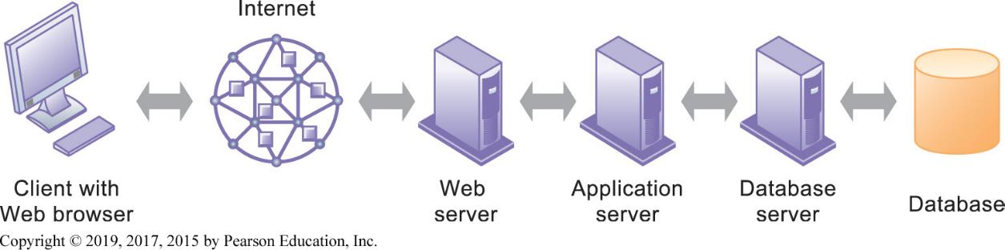
Figure 6.15 Linking Internal Databases to the Web
Notes:
Figure 6.15, Page 216.
Users access an organization’s internal database through the web, using their desktop PCs or mobile devices and web browser software.
This graphic illustrates the way data is passed from a database through to a user with a Web browser. Ask students to describe what types of data transformation occur between the various appliances; for example, what happens to data between the database and the database server?

Slide 41
Establishing an Information Policy
Information policy
  States organization’s rules for organizing, managing, storing, sharing information
Data administration
  Responsible for specific policies and procedures through which data can be managed as a resource
Database administration
  Database design and management group responsible for defining and organizing the structure and content of the database, and maintaining the database.
Notes:
Databases are much more than hardware and software. Indeed the most difficult parts involve organizational and people considerations. Sometimes the careers of people, and the fate of entire departments, are involved with the data they collect. When you install a DBMS you potentially are changing who collects what information about whom, where, when, and how.

Slide 42
Ensuring Data Quality
Poor data quality: major obstacle to successful customer relationship management
Data quality problems caused by:
  Redundant and inconsistent data produced by multiple systems
  Data input errors
Data quality audit
Data cleansing
Notes:
Databases are often collections of dirty data, data that is ambiguous, inaccurate, or incomplete. Before a modern DBMSD system is installed, one large budget item is usually cleaning up the old data in old systems. The size of data quality problems varies from one database to another, but credit record databases usually exhibit a 25 percent rate of quality problems, with 10 percent of the records actually being wrong. Ask students if they are aware of instances where a database was wrong about some person or entity.

Slide 43
Interactive Session – Organizations: Data-Driven Policing Goes Global
Class discussion
  What are the benefits of intelligence-driven prosecution for crime fighters and the general public?
  What problems does this approach to crime fighting pose?
  What management, organization, and technology issues should be considered when setting up information systems for intelligence-driven prosecution?

Slide 44
How Will M I S Help My Career?
The Business: Mega Midwest Power
Position Description
Job Requirements
Interview Questions
Notes:
A good opportunity for a class discussion of the new Section on careers. Would any in the class be interested in a job like this? What do they think are the most important skills the employer is looking for? How would they answer the interviewer questions?

