Slide 1
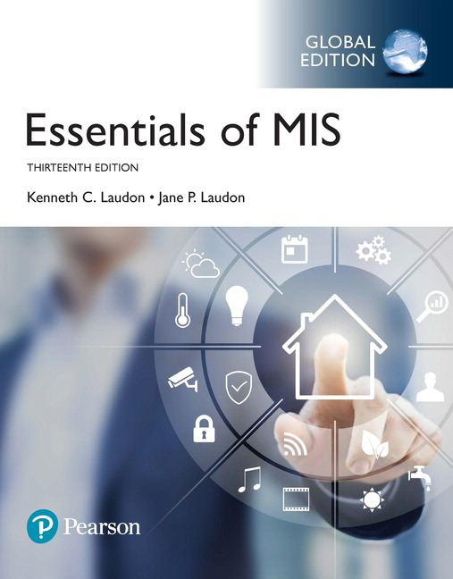
Essentials of Management Information Systems
Thirteenth Edition
Chapter 5
I T Infrastructure: Hardware and Software
Slides in this presentation contain hyperlinks. JAWS users should be able to get a list of links by using INSERT+F7
Copyright © 2019 Pearson Education Ltd.
Notes:
If this PowerPoint presentation contains mathematical equations, you may need to check that your computer has the following installed:
1) MathType Plugin
2) Math Player (free versions available)
3) NVDA Reader (free versions available)

Slide 2
Learning Objectives
5.1 What are the components of I T infrastructure?
5.2 What are the major computer hardware, data storage, input, and output technologies used in business and the major hardware trends?
5.3 What are the major types of computer software used in business and the major software trends?
5.4 What are the principal issues in managing hardware and software technology?
5.5 How will M I S help my career?
Notes:
Slide 2 is list of textbook LO numbers and statements

Slide 3
Video Cases
Case 1– Rockwell Automation Fuels the Oil and Gas Industry with the Internet of Things (I o T)
Case 2– E S P N.com: The Future of Sports Coverage in the Cloud
Case 3– Netflix: Building a Business in the Cloud

Slide 4
Grab Leverages Information Technology to
Enhance Its Services
Problem
  providing customers with timely service and drivers with enough fares
  matching demand with resources in an unpredictable sector
Solutions
  Managed cloud infrastructure
  On-demand, scalable services
Illustrates use of cloud computing to improve effectiveness and control costs

Slide 5
Infrastructure Components
I T infrastructure
  Platform for supporting all information systems in the business
Computer hardware
Computer software
Data management technology
Networking and telecommunications technology
Technology services
Notes:
It may be difficult for students to think of a business having “computer infrastructure.” A good parallel is the infrastructure of a building which would include the electrical and plumbing systems, along with a telephone network. Students are familiar with these types of infrastructure. Like these other kinds of infrastructure, IT infrastructure may not be visible to the casual employee, but it plays a vital role in the life of the business. Without it, there would be no business.

Slide 6
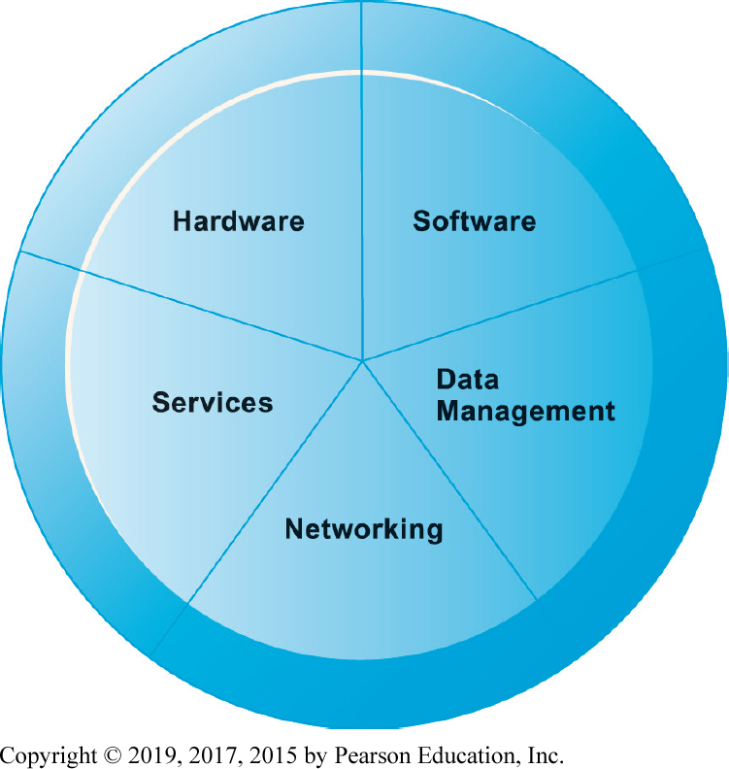
Figure 5.1 I T Infrastructure Components
Notes:
Figure 5.1, Page 158.
A firm’s IT infrastructure is composed of hardware, software, data management technology, networking technology, and technology services.

Slide 7
Types of Computers
Personal computers and mobile devices
Workstations
Servers
Mainframes
Supercomputers
Grid computing
Notes:
Most students do not think of their cell phones as computers. Yet cell phones have powerful, energy-efficient processor chips that use very little power, an operating system, and application software (including games). Of course smartphones like iPhone, Samsung, and others truly are computer systems that also are telephones and media devices. Today’s smartphones are far more powerful than the early PCs of the 1980s. The more appropriate term for smartphones is “media and entertainment devices” as Steve Jobs often referred to the iPhone and iPad.

Slide 8
Client/Server Computing
Form of distributed computing
Splits processing between “clients” and “servers”
Two-tiered client/server architecture
Multi-tiered client/server architecture (N-tier)
  Web servers
  Application servers
Notes:
You may want to spend some time explaining carefully client/server computing because it is the dominant model of computing and has been since the 1990s. The web is a very large example of client/server computing. The client/server model of computing is based on inexpensive PC microprocessors. Server architecture allows data centers to scale up as need by simply adding more servers (or increasing the processing power of existing servers by moving to dual and quad core processors). Clients are the interface between system and user.

Slide 9
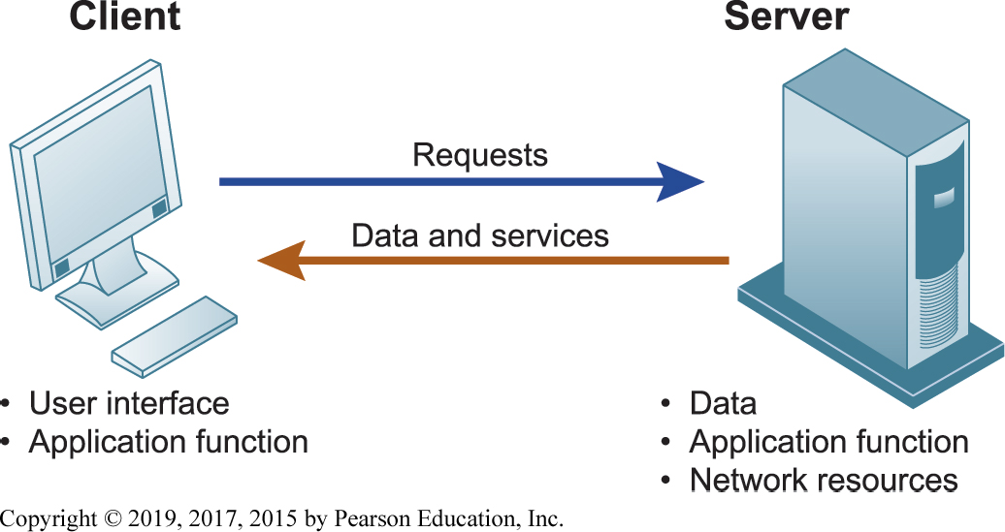
Figure 5.2 Client/Server Computing
Notes:
Figure 5.2, Page 160.
In client/server computing, computer processing is split between client machines and server machines linked by a network. Users interface with the client machines.
You might point out to students the confusion that results from the word “server.” A server is a physical computer. It’s also the software that runs on that computer which “serves” user requests. The intended meaning often comes from the context in which it is used. If someone says we had to “purchase a number of servers,” it usually means the purchase of computers. When people say “the server is down” they usually mean the computer is down. However, a web page server is also a piece of software that serves up content to users on request.

Slide 10
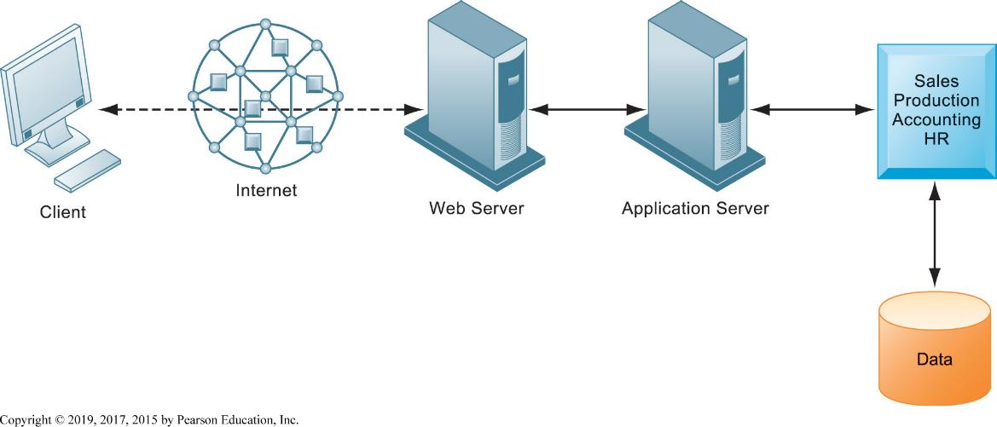
Figure 5.3 A Multitiered Client/Server Network (N-Tier)
Notes:
Figure 5.3, Page 161.
In a multitiered client/server network, client requests for service are handled by different levels of servers.
Corporations and even small firms usually separate the application processing (usually a database application) from the web page server function. Although not necessarily on different physical servers, often this separation does involve a separate physical server for applications.

Slide 11
Storage, Input, and Output Technology
Primary secondary storage technologies
  Magnetic disk
    S S Ds
  Optical disks
  Magnetic tape
  Storage networking: S A Ns
Input devices
  E.g. keyboard
Output devices
  E.g. monitor
Notes:
The cost of digital storage has fallen exponentially along with the cost of computing. Today, an 32 gigabyte USB “Flash Drive” costs about $12. You might ask students what impact they think this might have on the amount of digital information stored in corporations. Or ask students how many gigabytes of information they use to store photos, music, videos, podcasts, and other digital material. On average in 2015, Americans consumed an estimated 35 gigabytes of digital information a day. Ask students if they can imagine themselves consuming that much digital information. Ask them to help you make a list of the digital information sources they use in a day. Try to estimate how large are the files they routinely use for music, video, advertising, browsing the web and using search engines. The biggest digital files are video files.
Ask if students can think of other ways information gets into computers. How about cell phone cameras?

Slide 12
Contemporary Hardware Trends (1 of 3)
The mobile digital platform
  Tablet computers
  Netbooks
Consumerization of I T and B Y O D
Nanotechnology and quantum computing
Virtualization
  Software-defined storage (S D S)
Notes:
Talk to students about how they are using their cell phones. Are they listening to online radio stations, streaming music and videos, or mostly just texting? Do they shop, and do some buy? What do they buy– digital goods or retail goods like at Amazon? How use apps to purchase? Ask them to think about how this new mobile platform might influence how a business is run, or how it is managed.
Quantum physics, or quantum mechanics, studies the behavior of physical matter at microscopic scales, in which energy and matter behave as both waves and particles.
The term “virtualization” is so widely used that it can be confusing. Virtualization has an “as if” quality to it. There are virtual machines that are software “machines” that act as if they were a real physical computer (executes instructions like the physical machine it emulates). IBM’s mainframes run tens of thousands of separate instances of Windows or Linux on a single large mainframe computer, giving users the impression they have their own dedicated computer. Server computers can be virtualized to run multiple instances of an operating system also giving users the feeling they have their own computer. Virtualized computers are much more efficient than a typical non-virtualized computer because they can be executing multiple jobs nearly simultaneously. Virtual memory is memory which fools the processor into thinking it is hardware memory but in fact is memory located on a hard drive.

Slide 13
Interactive Session – Technology: Wearable Computers Change How We Work
Class discussion
  Wearables have the potential to change the way organizations and workers conduct business. Discuss the implications of this statement.
  How would a business process such as ordering a product for a customer in the field be changed if the salesperson was wearing a smartwatch equipped with Salesforce software?
  What people, organization, and technology issues would have to be addressed if a company was thinking of equipping its workers with a wearable computing device?
  What kinds of businesses are most likely to benefit from wearable computers? Select a business and describe how a wearable computing device could help that business improve operations or decision making.

Slide 14
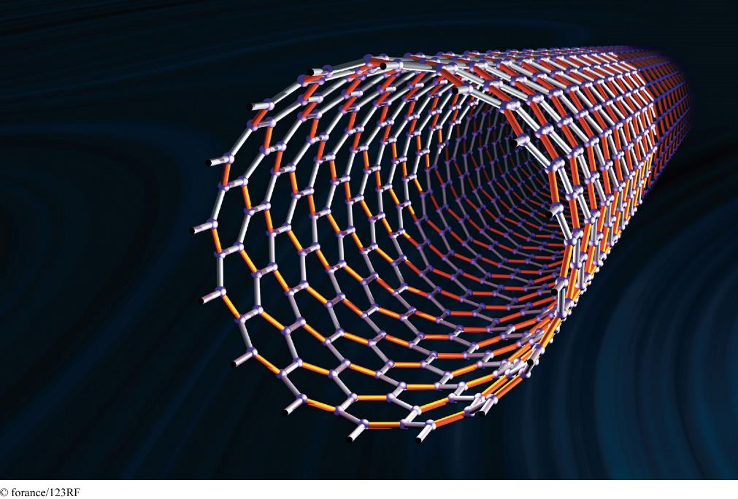
Examples of Nanotubes
© forance/123R F
Notes:
Examples of Nanotubes, Page 165.
Nanotubes are tiny tubes about 10,000 times thinner than a human hair. They consist of rolled-up sheets of carbon hexagons and have potential uses as minuscule wires or in ultrasmall electronic devices and are very powerful conductors of electrical current.
Nanotechnology is the study of the controlling of matter on an atomic and molecular scale. Generally, nanotechnology deals with structures of the size 100 nanometers or smaller. Nanotechnology is used to create transistors of the tiny size previously mentioned. Can students describe any other applications of this type of technology (for example, medical)?

Slide 15
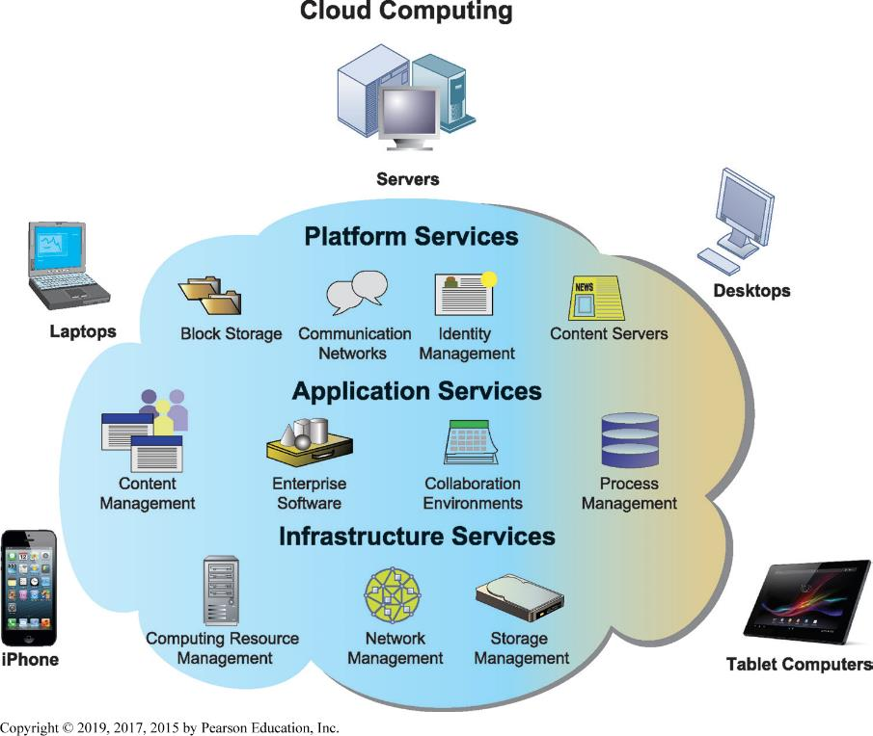
Figure 5.4 Cloud Computing Platform
Notes:
Figure 5.4, Page 166.
In cloud computing, hardware and software capabilities are a pool of virtualized resources provided over a network, often the Internet. Businesses and employees have access to applications and IT infrastructure anywhere and at any time.
The largest operators of cloud computing data centers are Amazon, IBM, Oracle, HP, Apple, and Google.

Slide 16
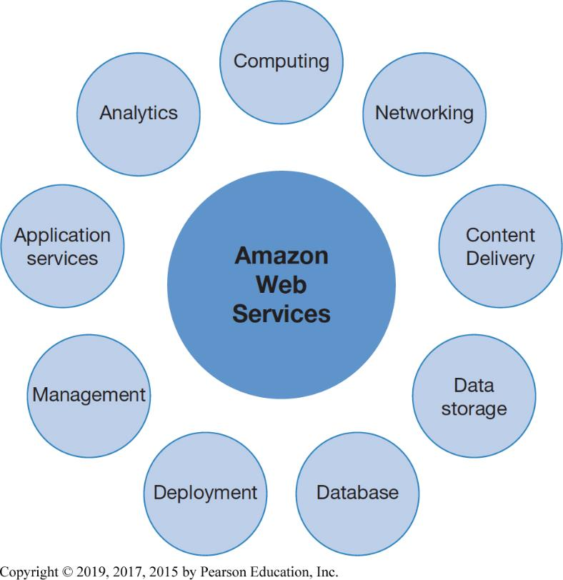
Figure 5.5 Major Amazon Web Services
Notes:
Figure 5.5, Page 167.
Amazon Web Services (AWS) is a collection of web services that Amazon provides to users of its cloud platform. AWS now offers over 90 services and is the largest provider of public cloud-based services.
The largest operators of cloud computing data centers are Amazon, IBM, Oracle, HP, Apple, and Google.

Slide 17
Contemporary Hardware Trends (2 of 3)
Cloud computing:
  Computing resources obtained over the Internet
    Infrastructure as a service (I a a S)
    Software as a service (S a a S)
    Platform as a service (P a a S)
  Public versus. private clouds
  Utility computing, on-demand computing
  Hybrid cloud
  Data storage security is in hands of provider
Notes:
Both grid computing and cloud computing allow organizations to optimize their use of resources in new ways. Grid computing allow corporations to take advantage of spare computing power in the form of networked virtual supercomputers, and cloud computing allows organizations to avoid the expenses of maintaining their own hardware and software, relying on public and private cloud computers. Refer students to the Cloud Computing Learning Track on the website.

Slide 18
Contemporary Hardware Trends (3 of 3)
Green computing
  Green I T
  Practices and technologies for minimizing impact on environment
High-performance and power-saving processors
  Multicore processors
  Reduced power consumption
Notes:
Chapter 1 Case 2 Google Data Center Efficiency provides a good introduction to this topic. Today’s chips are much more power efficient than in the past, but still require cooling fans in PCs and laptops. Smartphones do not have fans, but heat sinks to dissipate the processor heat to the frame of the phone. According to a study by the National Resources Defense Council (NRDC), all data centers in the US consume 91 billion kilowatt hours a year in 2014, about 34 power plants putting out 500 megawatts each. Large mega-sized cloud centers consume only 5% of this load, and are the most efficient forms of computing. The problem is the 95% of smaller data centers that are very inefficient.
Multicore processors are the major way computer manufacturers today can increase speed and power. When all processing is done by a single chip, power leakage and heat increase as processor speed is increased. These limitations are avoided by spreading the load across two or more processors operating at slower speeds but which together can get the job done faster than a single high speed chip.

Slide 19
Interactive Session – Organizations: Glory Finds Solutions in the Cloud
Class discussion
  Why did Glory choose a cloud solution as opposed to modernizing the systems it had?
  Why was it necessary to hire a systems integrator firm?
  What were the main organizational change requirements for implementing the new cloud platform?
  Why did management choose a regional rollout strategy? Why in the UK?

Slide 20
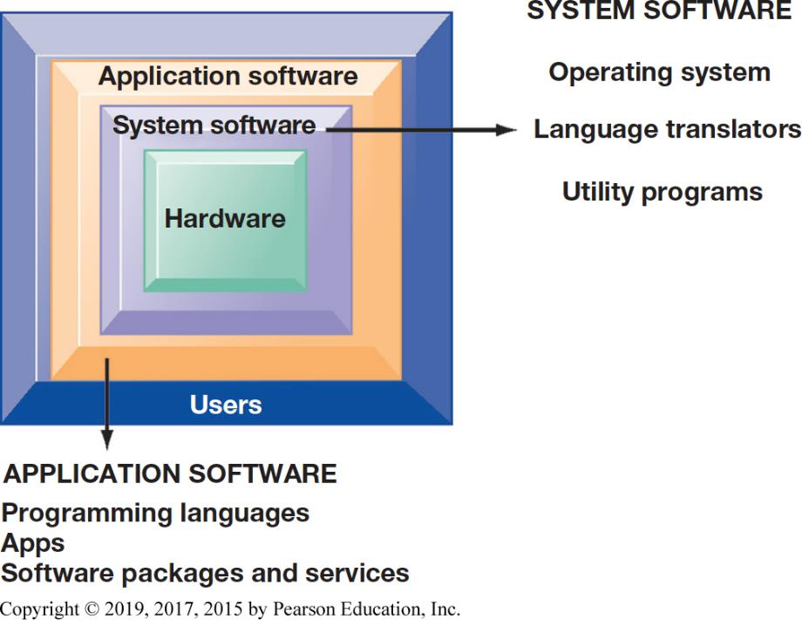
Figure 5.6 The Major Types of Software
Notes:
Figure 5.6, Page 172.
The relationship between the system software, application software, and users can be illustrated by a series of nested boxes. System software—consisting of operating systems, language translators, and utility programs—controls access to the hardware. Application software, including programming languages and software packages, must work through the system software to operate. The user interacts primarily with the application software.
You might ask students why a Microsoft application like Word cannot be installed on both PCs and Macintosh computer? Why is it that users are forced to buy different software application software for different devices? A part of the answer is the close interdependency of hardware, operating systems, and application software.

Slide 21
Operating System Software
Software that controls computer activities
G U I s
Multitouch
P C operating systems
  Windows, Mac
  UNIX
  Linux (open source)
Mobile operating systems
  Chrome, Android, i O S
Notes:
PC operating systems create the user interface, like Windows or Macintosh OS. This interface has evolved from a text command interface to a mouse-based graphical user interface to current touch screen interfaces found on some PCs and smartphones. Most students do not know their cell phone has an operating system. On the blackboard, make a list of the “resources” that a cell phone or smartphone has to manage. Managing these resources is one function of the operating system, along with creating the use interface.

Slide 22
Application Software and Desktop Productivity Tools (1 of 2)
Programming languages for business
  C
  C++ - newer, object-oriented version of C
  Visual Basic: Visual programming language for M S Windows applications
  Java: O S-independent object-oriented programming language
    Migrated to mobile applications, game machines, cable T V systems
    Java Virtual Machine
Notes:
Java, and the Java Virtual Machine, is ubiquitous across the web. It is useful because it allows developers to write an application once in Java, and then be assured it will work on any Java-enabled machine.
Ask if any students are computer programmers? What languages did they use? What kinds of applications did they develop?

Slide 23
Application Software and Desktop Productivity Tools (2 of 2)
Software packages and desktop productivity tools
  Word processing software
  Spreadsheet software
  Data management software
  Presentation graphics
  Software suites
  Web browsers
Notes:
Although Microsoft Office applications are found on more than 80 percent of the world’s billion computers, the news in this area is the growth of open source and free desktop applications. Although online on demand apps like Google Apps, and OpenOffice, are growing in market acceptance, most users continue to buy Microsoft software. Why do students think this is the case?

Slide 24
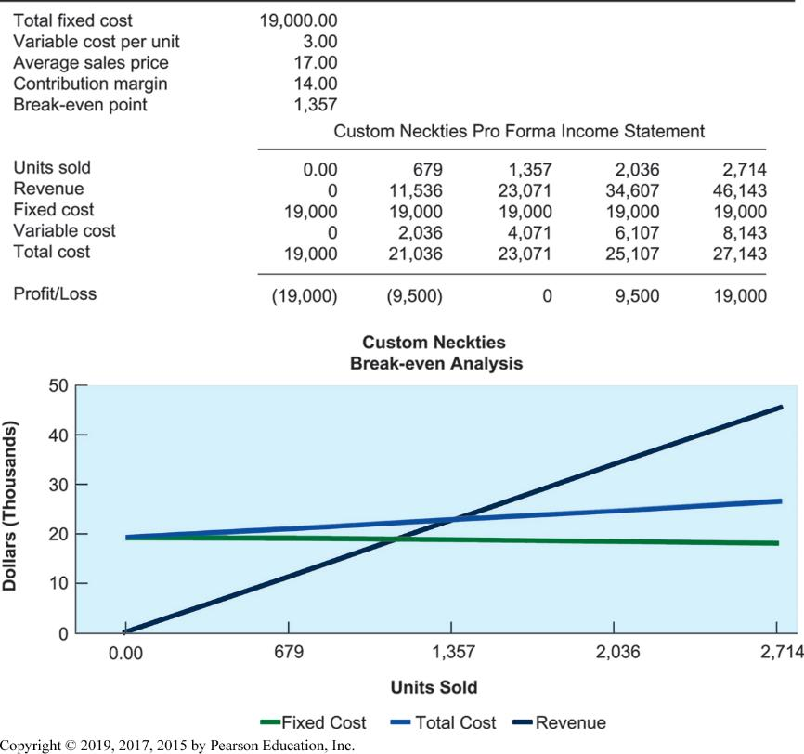
Figure 5.7 Spreadsheet Software
Notes:
Figure 5.7, Page 175.
Spreadsheet software organizes data into columns and rows for analysis and manipulation. Contemporary spreadsheet software provides graphing abilities for a clear, visual representation of the data in the spreadsheets. This sample breakeven analysis is represented as numbers in a spreadsheet as well as a line graph for easy interpretation.
Ask how many students use spreadsheets on a regular, daily basis? How many have never used spreadsheet software? Ask the users to describe how they use the software, what kinds of reports have they produced? What are the advantages of this software when compared to older methods—like calculating things by hand? What are the drawbacks of this software that they have personally witnessed?

Slide 25
H T M L and H T M L 5
Hypertext markup language (H T M L):
  Page description language for specifying how elements are placed on a web page and for creating links to other pages and objects
H T M L 5
  Next evolution of H T M L
  Enables multimedia embedding without 3rd party plugins like Flash
Notes:
Many students probably do not know that you can see the HTML code of any web page by the View/Page Source menu in Mozilla Firefox. You could demonstrate this during class.

Slide 26
Web Services
Software components that exchange information with one another using universal web communication standards and languages
X M L (eXtensible Markup Language)
  Foundation of web services
Service oriented architecture (S O A)
  Collection of services used to build an organization’s software systems
Notes:
Web services is an approach to building enterprise applications. Web services is a “messaging system” which allows diverse computing applications in a firm to communicate data with one another without extensive integration of the constituent applications (which tends to be very expensive). In a service-oriented architecture, various applications provide “services” (data) on request to other applications needing data. SOA is a major alternative to installing large scale enterprise systems.
Emphasize that SOA is a method of developing infrastructure using web services with an eye toward creating applications that draw data from several underlying (usually older programs). All programs are built or redesigned to provide certain information (services) to all other programs. With SOA, developers incorporate each individual service into an application that successfully meets the needs of the organization.

Slide 27
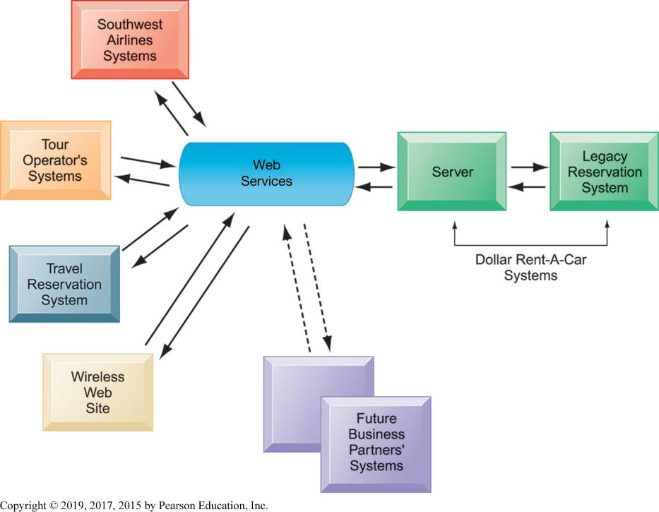
Figure 5.8 How Dollar Rent-A-Car Uses Web Services
Notes:
Figure 5.8, Page 178.
Dollar Rent-A-Car uses web services to provide a standard intermediate layer of software to talk to other companies’ information systems. Dollar Rent-A-Car can use this set of web services to link to other companies’ information systems without having to build a separate link to each firm’s systems.
Dollar Rent-a-Car is an excellent example of how computer applications, some owned by different firms, can work together to provide a single environment for customers and users.

Slide 28
Software Trends
Open source software
  Linux, Apache
Cloud-based software and tools
  S a a S (software as a service)
    Google Docs
  Mashups
    Zip Realty uses Google Maps and Zillow.com
  Apps
    Mobile apps
Notes:
Ask students to help you put together a list of really interesting software apps they have discovered or used in the last few months. Apple and Android have about 1.5 million apps each, a total of 3 million apps exist. How many apps do students have on their phones? The average is about 23 apps per phone. The top ten apps account for 90% of the usage. Facebook alone accounts for 50% of user smartphone time.

Slide 29
Capacity Planning and Scalability
Capacity planning
  Predicting when hardware system becomes saturated
  Ensuring computing power for current and future needs
  Factors include:
    Maximum number of users
    Impact of current, future software
    Performance measures
Scalability
  Ability of system to expand to serve large number of users without breaking down
Notes:
One of the problems that firms face is the holidays when user demand for online services explodes, but then recedes after the holidays to a normal background level. Firms are forced to buy additional infrastructure to handle peak loads, which then sits idle after the holiday is over. One solution is to use cloud-based services to handle the peak loads of your firm, essentially renting extra capacity as needed. This solves the peak load problem and a part of the scalability problem—with cloud computing services you expand as needed without huge financial outlays.

Slide 30
Total Cost of Ownership (T C O) model
Analyzing direct and indirect costs to determine the actual cost of owning a specific technology
  Direct costs: hardware, software purchase costs
  Indirect costs: ongoing administration costs, upgrades, maintenance, etc.
  Hidden costs: support staff, downtime, etc.
T C O can be reduced through increased centralization, standardization of hardware and software resources.
Notes:
Most students think of the “cost of computing” as the cost of the computer and the software. You could ask students to help you put together a list of all the additional costs that consumers face when purchasing a computer.

Slide 31
Using Technology Service Providers
Outsourcing
  Using external provider to run computer center and networks
  Web hosting service
  Offshore software outsourcing
  Service level agreements (S L A s)
Using cloud services
  Appealing to businesses with smaller I T budgets
  Pricing is per hour, per-use
  Switching costs
Notes:
One common answer to reducing the cost of computing hardware and software is to move the work off-shore to low wage countries like India and China. Thousands of U.S. and European firms outsource their programming work to low-wage countries. Even more firms outsource programming, systems analysis and design, and consulting work to onshore domestic firms. Nevertheless, computer and network jobs are abundant in the United States in part because more systems are being built than ever before (in part because building systems is less expensive than ever). As the costs of developing systems decline, the demand for systems grows stronger.
One way students can use cloud services is through Amazon Markets http://www.amazonservices.com/. Amazon provides cloud services to major business firms, and also to thousands of small merchants who want to use Amazon software to sell their goods and services. Take students to the Amazon site to demonstrate some of its capabilities.

Slide 32
Managing Mobile Platforms
Mobile devices provide productivity gains
Expenses of equipping employees with devices
Network configuration
Software
Device security
Stolen or compromised devices
Mobile device management (M D M) software

Slide 33
Managing Software Localization for Global Business
Software localization
  Local language interfaces
  Complex software interfaces
Differences in local cultures
Differences in business processes
These factors add to T C O of using technology service providers
Notes:
If you are operating in a global environment you can’t assume your employees will be able to understand English interfaces. An interesting niche business is software translation services. Do a search in class on “localization services” or go to http://www.ricintl.com. Ric International translation services to illustrate for students how firms are translating their systems and localizing them (which is more than just translation).

Slide 34
How Will M I S Help My Career?
The Business: A1 Tech I T Consulting
Position Description
Job Requirements
Interview Questions
Notes:
A good opportunity for a class discussion of the new Section on careers. Would any in the class be interested in a job like this? What do they think are the most important skills the employer is looking for? How would they answer the interviewer questions?

