Slide 1

Essentials of Management Information Systems
Thirteenth Edition
Chapter 3
Achieving Competitive Advantage with Information Systems
Copyright © 2019 Pearson Education Ltd.
Notes:
If this PowerPoint presentation contains mathematical equations, you may need to check that your computer has the following installed:
1) MathType Plugin
2) Math Player (free versions available)
3) NVDA Reader (free versions available)

Slide 2
Learning Objectives
3.1 How do Porter’s competitive forces model, the value chain model, synergies, core competencies, and network-based strategies help companies use information systems for competitive advantage?
3.2 How do information systems help businesses compete globally?
3.3 How do information systems help businesses compete using quality and design?
3.4 What is the role of business process management (B P M) in enhancing competitiveness?
3.5 How will M I S help my career?
Notes:
“Strategy” can be an abstract concept to undergraduates. It's helpful to start this conversation by asking students for some examples of “business strategy.” Or ask them what they think the strategy of well-known firms might be? How about Apple, Microsoft, Ford, AT&T Wireless, Coca Cola, Google, or any well-known public company? Ultimately strategy is about performing better than the other firms in your industry. How can firms do that?

Slide 3
Video Cases
Case 1: G E Becomes a Digital Firm: The Emerging Industrial Internet
Case 2: National Basketball Association: Competing on Global Delivery with Akamai O S Streaming

Slide 4
Tate & Lyle Devise a Global IT Strategy
Problem
  expand the specialty food segment
  face off stiff competition from giant global competitors
  reconcile financial accounting systems across four regions and thirty operating facilities
Solutions
  Account Reconciliation and Task Management system based on SAP’s ERP
Demonstrates that businesses must change their strategies over time
Notes:
You can ask students which company has the “better” strategy, and why? Will these firms attract them to switch their wireless provider, or to purchase some of their services?

Slide 5
Porter’s Competitive Forces Model
Five competitive forces shape fate of firm
  Traditional competitors
  New market entrants
  Substitute products and services
  Customers
  Suppliers
Notes:
Porter's model is the best known model of competitive advantage. Now more than thirty years old, it still provides a nice summary of the strategic situation of firms in a larger business environment. The model focuses on industry structure (or the environment of the firm) as the main determinant of management decisions about corporate strategies. Managers don't just make up strategies out of thin air. They look at the competitive situation in their industry, and then consider ways of coping and succeeding in that environment.

Slide 6
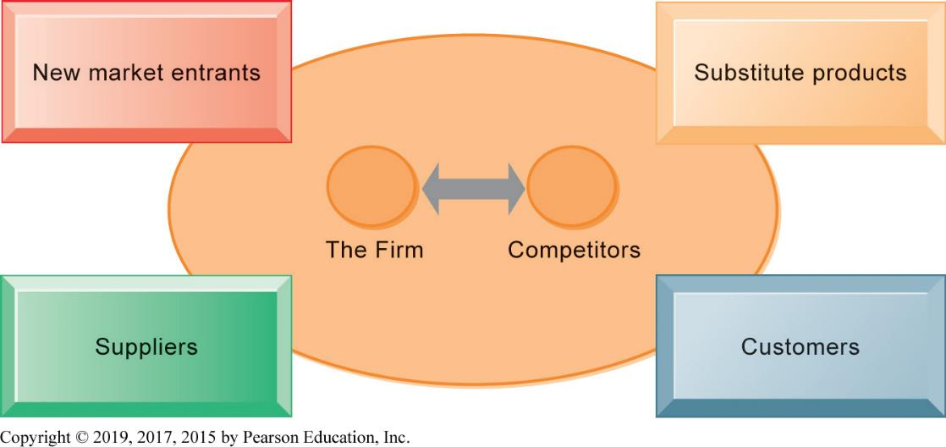
Figure 3.1 Porter’s Competitive Forces Model
Notes:
Figure 3.1, Page 81.
In Porter’s competitive forces model, the strategic position of the firm and its strategies are determined not only by competition with its traditional direct competitors but also by four forces in the industry’s environment: new market entrants, substitute products, customers, and suppliers.
A good way to teach this model is to take a specific industry and ask students to fill in the boxes in the model (starting with the environmental boxes). Any industry can be analyzed: automobiles, PC computers, smartphones, and so on.

Slide 7
Information System Strategies for Dealing with Competitive Forces (1 of 5)
Basic strategy: Align I T with business objectives
  Identify business goals and strategies
  Break strategic goals into concrete activities and processes
  Identify metrics for measuring progress
  Determine how I T can help achieve business goals
  Measure actual performance
Notes:
Information systems often play a critical role in defining and achieving strategic objectives of the firm. Sometimes, IS is tangential: Coca Cola for instance is not an intense technology user, and maintains its differentiated product through marketing and branding efforts. Other firms are intensely using IS to achieve competitive advantages, from Walmart to Facebook, Amazon, and Google.
The first step in using information systems to serve your firm is to make sure the IS objectives are lined up with the business objectives.

Slide 8
Information System Strategies for Dealing with Competitive Forces (2 of 5)
Low-cost leadership
  Use information systems to achieve the lowest operational costs and the lowest prices
  E.g. Walmart
    Inventory replenishment system sends orders to suppliers when purchase recorded at cash register
    Minimizes inventory at warehouses, operating costs
    Efficient customer response system
Notes:
In the physical retail industry, including groceries, the keys to success are efficiency in moving product through your pipeline, minimizing inventory and time delays between receipt of the goods, and the customer purchase. Large regional and national grocery chains like Krogers, Walmart, Shoprite, Safeway, and Publix, are competing directly with Amazon by offering online ordering and home delivery using their local stores as warehouses.

Slide 9
Information System Strategies for Dealing with Competitive Forces (3 of 5)
Product differentiation
  Use information systems to enable new products and services, or greatly change the customer convenience in using your existing products and services
  E.g., Google's continuous innovations, Apple's i Phone
  Use information systems to customize, personalize products to fit specifications of individual consumers
    E.g., Nike's NIKE i D program for customized sneakers
Notes:
Ask students to help you make a list of companies that have really unique products or services. It's fun to ask students for local firms on this list. There may be a really unique pizza store, theater, or restaurant in the neighborhood to help illustrate the point about product differentiation as a competitive strategy.

Slide 10
Information System Strategies for Dealing with Competitive Forces (4 of 5)
Focus on market niche
  Use information systems to enable specific market focus, and serve narrow target market better than competitors.
    Analyzes customer buying habits, preferences
    Advertising pitches to smaller and smaller target markets
  E.g., Hilton Hotel’s On Q System
    Analyzes data collected on guests to determine preferences and guest's profitability
Notes:
Ask students for web stores that appeal to a very small niche market, e.g., people with unique hobbies, special interests, or different political and cultural views. Etsy is a good example to visit in class.

Slide 11
Information System Strategies for Dealing with Competitive Forces (5 of 5)
Strengthen customer and supplier intimacy.
  Strong linkages to customers and suppliers increase switching costs and loyalty
  Toyota: uses I S to facilitate direct access from suppliers to production schedules
    Permits suppliers to decide how and when to ship supplies to plants, allowing more lead time in producing goods.
  Amazon: keeps track of user preferences for purchases, and recommends titles purchased by others
Notes:
Ask students to describe and discuss firms that they believe really “care about the customer” or offer great customer service. If this proves difficult, ask them to talk about companies with really poor customer service. Everybody knows a really poor customer service organization. In these discussions, ask students how IS could help improve the relationship with the customer.

Slide 12
The Internet’s Impact on Competitive Advantage
Enables new products and services
Encourages substitute products
Lowers barrier to entry
Changes balance of power of customers and suppliers
Transforms some industries
Creates new opportunities for creating new markets, building brands, and large customer bases
Smart products and the Internet of Things
Notes:
Ask students to help you put together a list of industries that have been greatly impacted by the Internet and the web. Then for each industry, ask them to describe how the Internet has changed the industry. How has the Internet changed that industry from a consumer perspective? Can students think of some industries that have been destroyed by the Internet? Or greatly changed? Record stores, video stores, and small local bookstores come to mind.

Slide 13
The Business Value Chain Model
Highlights specific activities in a business where competitive strategies can best be applied and where information systems are likely to have a strategic impact.
  Primary activities
  Support activities
  Benchmarking
  Best practices
Notes:
Porter's industry analysis is not the only competitive strategy model. In the business chain (really a business process model), firms achieve competitive advantages by being more efficient. This does not mean low-priced. The gains from efficiency may be retained by the firm as greater profits, depending on the competitive situation. For instance, Walmart adopts a business value chain model to achieve the lowest prices, but not so low as to report lower profits.

Slide 14
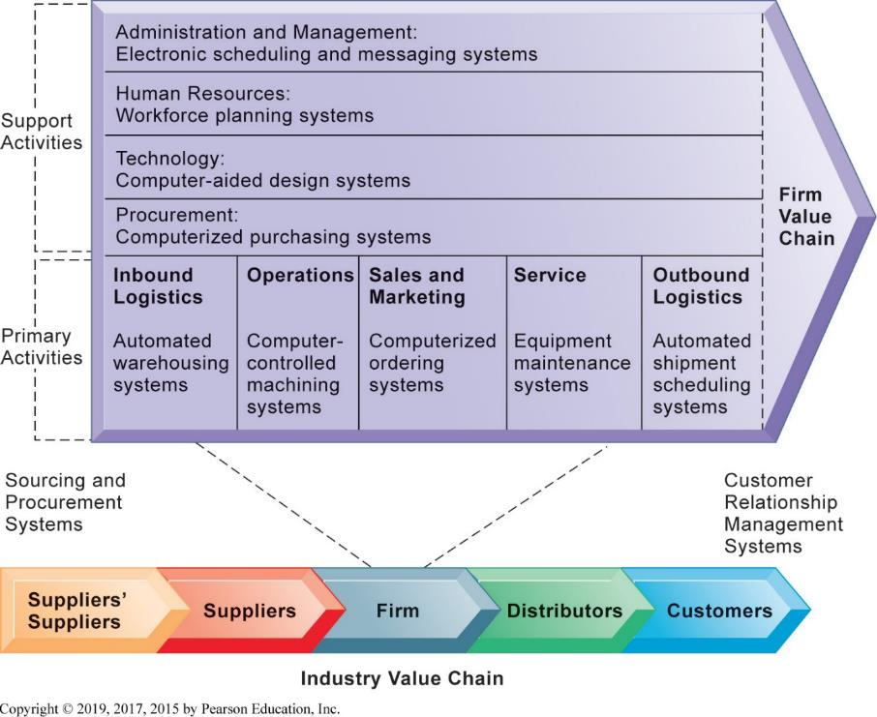
Figure 3.2 The Value Chain Model
Notes:
Figure 3.2, Page 89.
This figure provides examples of systems for both primary and support activities of a firm and of its value partners that would add a margin of value to a firm’s products or services.
You can ask a single student to describe the business value chain in a business where they now work, or did work. Then ask the student to talk about how information systems were used in each step of the value chain.

Slide 15
The Value Web
A firm’s value chain is linked to the value chains of its suppliers, distributors, and customers.
Value web
  Collection of independent firms that use information technology to coordinate their value chains to produce a product collectively.
  Value webs are flexible and adapt to changes in supply and demand.
Notes:
The phenomenon where several firms cooperate with one another in order to put together for the customer a single product or service goes by many names. At times it has been referred to as the extended firm, the virtual firm, the contract firm, and so on. To a large extent, business firms have always been dependent on their suppliers, logistics partners (trucking and railroads), and distributors including retailers. But in the Internet age, this kind of dependence and coordination takes place much more broadly and continuously. A small Internet company often works with a design firm thousands of miles away, a software firm on a different continent, and sells its products using Google's Ad Word program. The customer receives a single product or service which was co-produced by many firms working together closely.

Slide 16
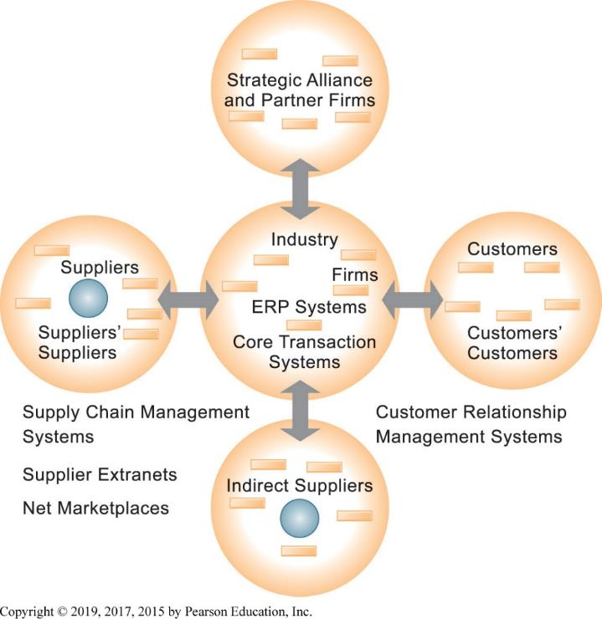
Figure 3.3 The Value Web
Notes:
Figure 3.3, Page 91.
The value web is a networked system that can synchronize the value chains of business partners within an industry to respond rapidly to changes in supply and demand.

Slide 17
Synergies, Core Competencies, and Network-Based Strategies
Large corporations comprised of business units
  Financial returns overall are tied to performance of business units
Information systems improve performance of business units by promoting
  Communication
  Synergies
  Core competencies

Slide 18
Synergies
When output of some units can be used as inputs to other units
When two firms can pool markets and expertise (e.g., recent bank mergers)
Lower costs and generate profits
Enabled by information systems that ties together disparate units so they act as whole
Notes:
Other competitive strategy models don't focus on business processes and value chains, but instead focus on the core competencies of a firm. Most times we don't think about what firms are really good at, but the idea is for the firm to focus on what it really does well, better than anyone else, and to succeed by being the most efficient producer of best quality products and services. At the very least, firms should not be involved in a host of businesses where they are at best mediocre players. The role of IT in these models of competition is usually as a tool for achieving best-in-class products and services. This can include using IT as a collaboration tool, coordinating tool, and knowledge aggregator or store for the firm so that knowledge can be widely shared.

Slide 19
Core Competency
Activities for which firm is world-class leader
  E.g., world’s best miniature parts designer, best package delivery service, etc
Relies on knowledge gained over years of experience as well as knowledge research
Any information system that encourages the sharing of knowledge across business units enhances competency
  E.g., Procter & Gamble uses intranet to help people working on similar problems share ideas and expertise.

Slide 20
Network-Based Strategies
Network economics
  Marginal costs of adding another participant are near zero, whereas marginal gain is much larger
  E.g., larger number of participants in Internet, greater value to all participants
Virtual company
  Uses networks to link people, resources, and ally with other companies to create and distribute products without traditional organizational boundaries or physical locations
Notes:
Network competitive strategies focus usually on Internet opportunities and companies. Here the emphasis is on products or services that can “go viral,” that is, take advantage of the fact that there are millions of people online, and if they generate positive messages about your product, in a few hours several million people will know about it. This explains why some services like Twitter, Facebook, and YouTube have grown with truly hockey-stick curves. Another different Internet (network) strategy is to use the Internet to find partners and collaborators who can magnify the power of your smaller firm.

Slide 21
Disruptive Technologies
Technologies with disruptive impact on industries and businesses, rendering existing products, services and business models obsolete
  Personal computers
  World Wide Web
  Internet music services
First movers versus fast followers
  First movers of disruptive technologies may fail to see potential, allowing second movers to reap rewards (fast followers)
Notes:
Most technologies throughout history have been “disruptive” in the sense that their use produces superior products and services at a fraction of the cost. Certainly automobiles were a disruptive technology a hundred years ago which rather completely eliminated the buggy industry. The Internet is no different in rendering certain industries obsolete and unable to compete. Ask students to make a list with your help on industries that have been disrupted by the Internet.

Slide 22
The Internet and Globalization
Prior to the Internet, competing globally was only an option for huge firms able to afford factories, warehouses, and distribution centers abroad.
The Internet drastically reduces costs of operating globally.
Globalization benefits
  Scale economies and resource cost reduction
  Higher utilization rates, fixed capital costs, and lower cost per unit of production
  Speeding time to market
Notes:
Certainly one of the more disruptive impacts of the Internet has been to spread jobs out across a world labor market, with industrial jobs moving to the lowest-wage countries. In the past, communication barriers were so severe that it would be impossible to coordinate product and service development in both the United States and China, or India. Today, with instant Internet communications from email, chat, and video cameras, the cost of operating globally has fallen, and even small firms work on a global basis today.

Slide 23
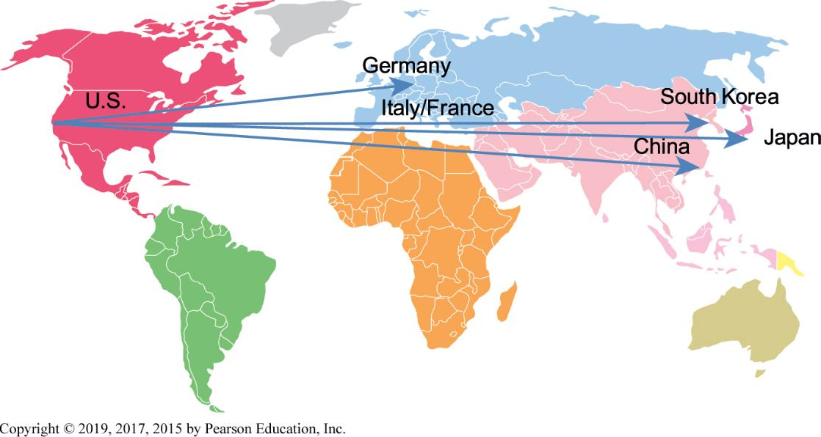
Figure 3.4 Apple i Phone’s Global Supply Chain
Notes:
Figure 3.4, Page 94.
Apple designs the iPhone in the United States and relies on suppliers in the United States, Germany, Italy, France, and South Korea for parts. Final assembly occurs in China.
Most of the electronic products we use today are “global” in the sense that their design, production, and distribution take place across nearly all continents. Even automobiles increasingly are global collections of parts and sub-assemblies.

Slide 24
Global Business and System Strategies
Domestic exporters
Multinationals
Franchisers
Transnationals
Notes:
There are a lot of ways to set up a global information system. Much depends on the type of company. Most companies today have large data centers spread around the world to handle their information needs on a regional basis. Some are more centralized than others. Generally, the trend was to allow regions considerable autonomy, but this strategy backfired as firms sought the efficiencies of a single global product, service, and database. Today the trend is towards centralized global systems for financial results, and supply chain coordination, and local/regional systems for customer-facing activities.

Slide 25
Global System Configuration
Centralized systems
Duplicated systems
Decentralized systems
Networked systems

Slide 26
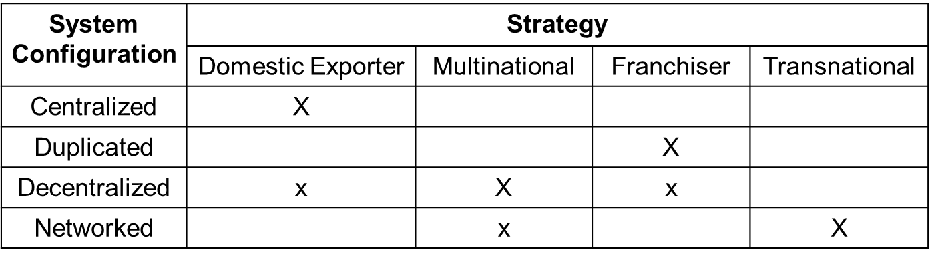
Figure 3.5 Global Business Organization Systems Configurations
Notes:
Figure 3.5, Page 96.
The large Xs show the dominant patterns, and the small Xs show the emerging patterns. For instance, domestic exporters rely predominantly on centralized systems, but there is continual pressure and some development of decentralized systems in local marketing regions.
Most of the electronic products we use today are “global” in the sense that their design, production, and distribution take place across nearly all continents. Even automobiles increasingly are global collections of parts and sub-assemblies.

Slide 27
What is Quality?
Producer perspective
  Conformance to specifications and absence of variation from specs
Customer perspective
  Physical quality (reliability), quality of service, psychological quality
Total quality management (T Q M)
  Quality control is end in itself
  All people, functions responsible for quality
Six sigma
  Measure of quality: 3.4 defects/million opportunities
Notes:
Surely one strategy is to produce the highest quality product or service, and charge accordingly. Information systems historically have placed a key role in the quality movement by enabling the measurement of quality, and helping managers model and optimize business processes. The overall customer experience is what firms are now concentrating on.

Slide 28
How Information Systems Improve Quality
Reduce cycle time and simplify production
Benchmark
Use customer demands to improve products and services
Improve design quality and precision
  Computer-aided design (C A D) systems
Improve production precision and tighten production tolerances
Notes:
This slide lists some of the more common ways IS has played a central role in the quality movement.

Slide 29
What is Business Process Management (B P M)?
Technology alone is often not enough to improve business
Organizational changes often necessary
  Minor changes in work habits
  Redesigning entire business processes
Aims to continuously improve processes
Uses variety of tools and methodologies to
  Understand existing processes
  Design and optimize new processes
Notes:
If your company has the most efficient, highest quality processes that result in few errors, you have a competitive advantage. However, this advantage can disappear pretty quickly as your competition catches up, and they will catch up. One answer is a continuous, incremental improvement process that is ongoing and results in your processes always being at the leading edge.
A major point of this book is to let students know that you can't just plug in computers and expect miracles. You need to think about your business processes and figure out how to improve, and then figure out how IT can help improve the processes even further.

Slide 30
Steps in B P M
Identify processes for change
Analyze existing processes
Design new process
Implement new process
Continuous measurement

Slide 31
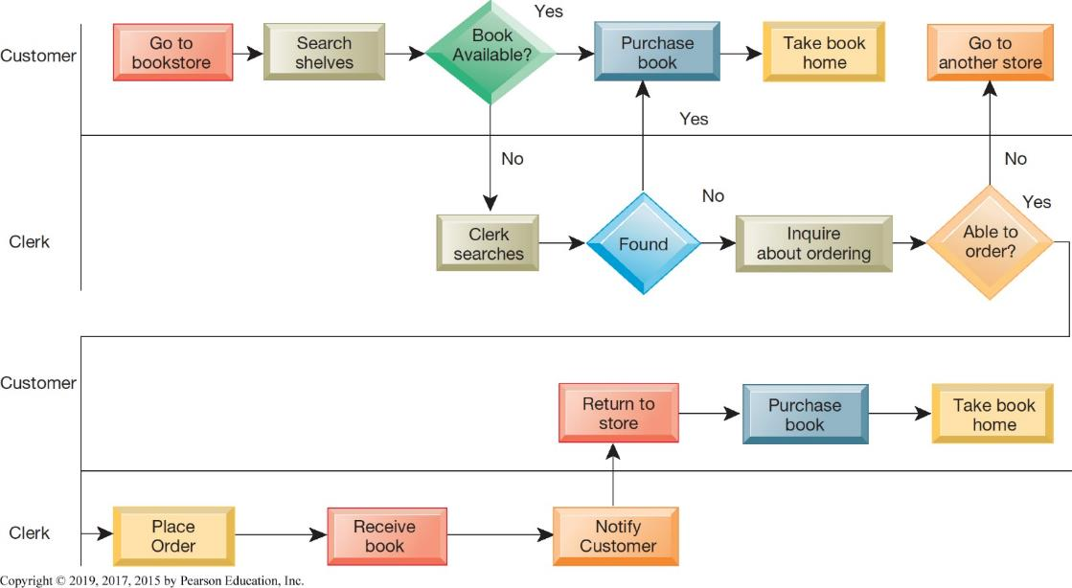
Figure 3.6 As-Is Business Process for Purchasing a Book from a Physical Bookstore
Notes:
Figure 3.6, Page 100.
Purchasing a book from a physical bookstore requires both the seller and the customer to perform many steps.

Slide 32
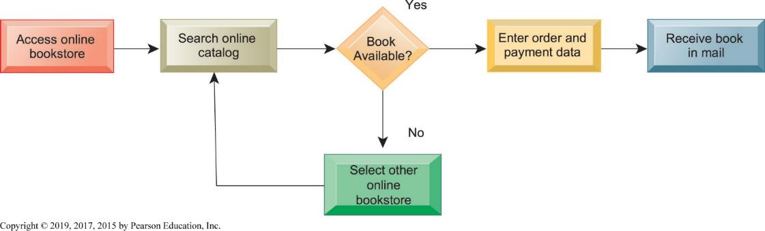
Figure 3.7 Redesigned Process for Purchasing a Book Online
Notes:
Figure 3.7, Page 101.
Using Internet technology makes it possible to redesign the process for purchasing a book so that it only has a few steps and consumes
fewer resources.
Competing on business processes almost always means simplifying the process, reducing the number of people involved, reducing the decision time, expanding the remaining employees' job responsibilities, and using information systems to speed the flow and quality of information.

Slide 33
Interactive Session: Organizations: Carter’s Redesigns Its Business Processes
Class discussion
  How did Carter’s previous business processes affect its business performance?
  What people, organization, and technology factors contributed to Carter’s problems with its business processes?
  Diagram Carter’s old and redesigned business process for paying an invoice.
  Describe the role of technology in Carter’s business process changes.
  How did Carter’s redesigned business processes change the way the company worked? What was the business impact? Explain.

Slide 34
Business Process Reengineering
A radical form of fast change
Not continuous improvement, but elimination of old processes, replacement with new processes, in a brief time period
Can produce dramatic gains in productivity
Can produce more organizational resistance to change
Notes:
“Reengineering” was at one point a highly regarded approach to high-speed dramatic change in business firms. It often resulted in profound simplification of antiquated business processes, resulting in severe disruptions to the work force which was decimated by layoffs. Most grand reengineering efforts did not produce the promised results, or produced results in very limited areas of the firm which had little impact on overall efficiency and productivity. Today industry and firm restructuring generally takes place through the impact of global markets on firms, and less by a planned form of social change.

Slide 35
How Will M I S Help My Career?
The Company: A+ Superior Data Quality
Position Description
Job Requirements
Interview Questions
Notes:
A good opportunity for a class discussion of the new Section on careers. Would any in the class be interested in a job like this? What do they think are the most important skills the employer is looking for? How would they answer the interviewer questions?

