Slide 1

Essentials of Management Information Systems
Thirteenth Edition
Chapter 2
Global E-business and Collaboration
Copyright © 2019 Pearson Education Ltd.
Notes:
If this PowerPoint presentation contains mathematical equations, you may need to check that your computer has the following installed:
1) MathType Plugin
2) Math Player (free versions available)
3) NVDA Reader (free versions available)

Slide 2
Learning Objectives
2.1 What major features of a business are important for understanding the role of information systems?
2.2 How do systems serve different management groups in a business, and how do systems that link the enterprise improve organizational performance?
2.3 Why are systems for collaboration and social business so important, and what technologies do they use?
2.4 What is the role of the information systems function in a business?
2.5 How will M I S help my career?
Notes:
Slide 2 is list of textbook LO numbers and statements

Slide 3
Video Cases
Case 1: Walmart’s Retail Link Supply Chain
Case 2: CEMEX – Becoming a Social Business
Instructional Video 1: U S Foodservice Grows Market with Oracle C R M on Demand

Slide 4
Enterprise Social Networking Helps Sanofi Pasteur Innovate and Improve Quality (1 of 2)
Problem
  Hierarchical top-down processes
  Large geographically dispersed workforce
Solutions
  Develop knowledge-sharing strategy and goals
  Redesign knowledge and collaboration processes
  Microsoft Yammer
  Enterprise social networking

Slide 5
Enterprise Social Networking Helps Sanofi Pasteur Innovate and Improve Quality (2 of 2)
Use of new technology to engage employees and enabled knowledge gathering and sharing
Demonstrates how outdated processes can affect knowledge sharing and innovation
Illustrates why organizations rely on information systems to improve performance and remain competitive
Notes:
Ask if any students have worked in an organization which they felt was very “top down,” hierarchical, and not very collaborative. Could they see that a Sanofi type enterprise wide system would have helped? What benefits did Sanofi receive from their investment in collaboration?

Slide 6
Organizing a Business: Basic Business Functions (1 of 2)
Business: formal organization that makes products or provides a service in order to make a profit
Four basic business functions
  Manufacturing and production
  Sales and marketing
  Finance and accounting
  Human resources
Notes:
Emphasize each element in the definition of “business”. What is meant by “formal organization”? Formal organizations get to be “formal” in part because they are chartered by the nation state (a country’s legal system). As a result, they have certain powers and obligations to perform. How might businesses differ depending on whether they make products or provide services? What role does profit play in business?

Slide 7
Organizing a Business: Basic Business Functions (2 of 2)
Five basic business entities
  Suppliers
  Customers
  Employees
  Invoices/payments
  Products and services
Notes:
You can describe any business in terms of these five elements. Ask a student who has work experience to describe the business entities as his/her current place of work.

Slide 8
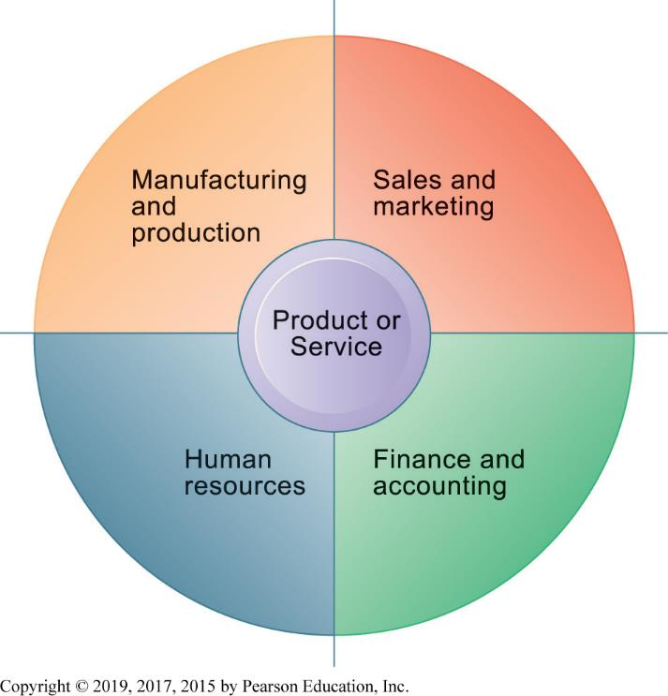
Figure 2.1 The Four Major Functions of a Business
Notes:
Figure 2.1, Page 44.
Every business, regardless of its size, must perform four functions to succeed. It must produce the product or service; market and sell the product or service; keep track of accounting and financial transactions; and perform basic human resources tasks such as hiring and retaining employees.
Emphasize that each function is critical to any business, and explain that the product or service is at the center of the diagram because it “governs” the way each business approaches the four major business functions.

Slide 9
Business Processes
Logically related set of tasks that define how specific business tasks are performed
  The tasks each employee performs, in what order, and on what schedule
  E.g., Steps in hiring an employee
Some processes tied to functional area
  Sales and marketing: identifying customers
Some processes are cross-functional
  Fulfilling customer order
Notes:
Emphasize each element in the definition of “business”. What is meant by “formal organization”? Formal organizations get to be “formal” in part because they are chartered by the nation state (a country’s legal system). As a result, they have certain powers and obligations to perform. How might businesses differ depending on whether they make products or provide services? What role does profit play in business?

Slide 10
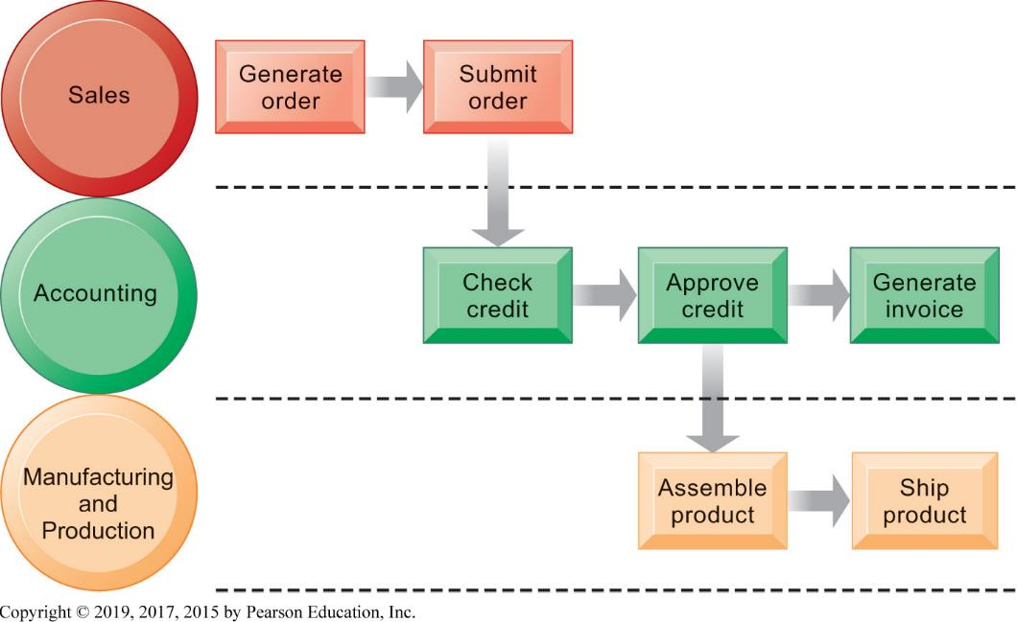
Figure 2.2 The Order Fulfillment Process
Notes:
Figure 2.2, Page 45.
Fulfilling a customer order involves a complex set of steps that requires the close coordination of the sales, accounting, and manufacturing functions.
Emphasize that each rectangle represents one part of the larger business process of order fulfillment. Notice that this business process spans more than one type mentioned on the previous slide.

Slide 11
How I T Enhances Business Processes
Automation of manual processes
Change the flow of information
Replace sequential processes with simultaneous activity
Transform how a business works
Drive new business models
Notes:
Ask students for examples for how IT is used in automation, changing information flow, replacing sequential processes, business transformation, and driving new business models.

Slide 12
Managing a Business and Firm Hierarchies
Firms coordinate work of employees by developing hierarchy in which authority is concentrated at top.
  Senior management
  Middle management
  Operational management
  Knowledge workers
  Data workers
  Production or service workers
Each group has different needs for information.
Notes:
Ask students what types of information are pertinent to each level of the hierarchy. Senior managers need summary information that can quickly inform them about the overall performance of the firm; middle managers need more specific information on the results of specific functional areas of the firm; and so on.

Slide 13
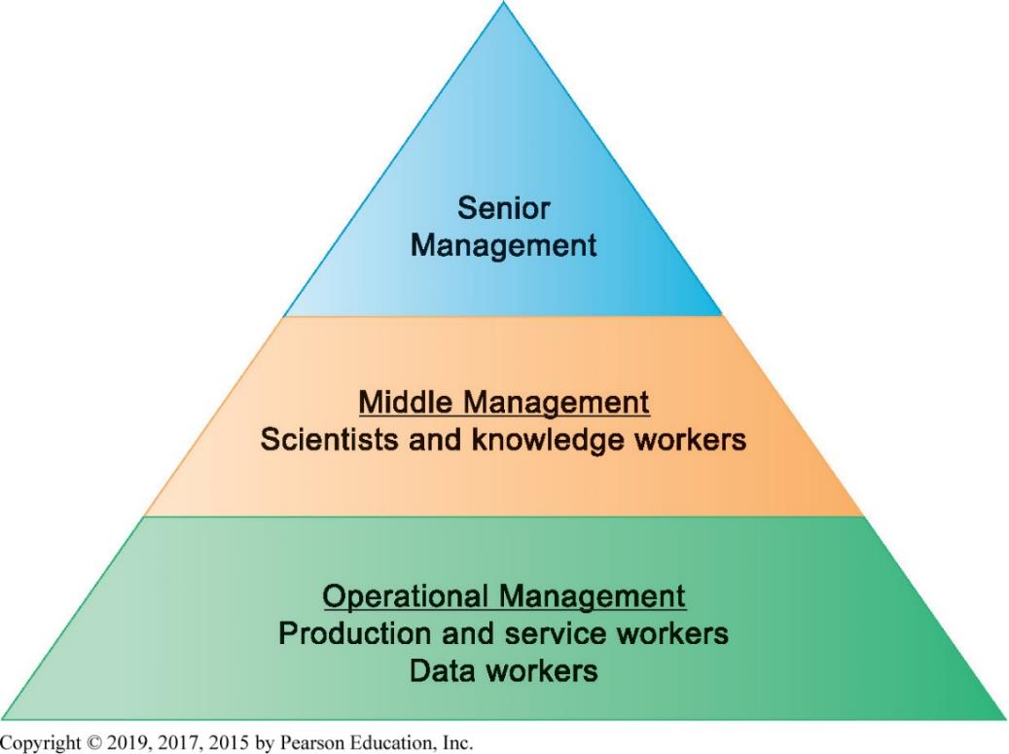
Figure 2.3 Levels in a Firm
Notes:
Figure 2.3, Page 46.
Business organizations are hierarchies consisting of three principal levels: senior management, middle management, and operational management. Information systems serve each of these levels. Scientists and knowledge workers often work with middle management.
Emphasize to students that different information systems are used by different levels of the pyramid.

Slide 14
The Business Environment
Businesses depend heavily on their environments for capital, labor, supplies, and more.
Global environment
  Technology and science, economy, politics, international change
Immediate environment
  Customers, suppliers, competitors, regulations, stockholders
Notes:
Ask students to give examples of how factors like politics and international change affect business based on their own experiences. One obvious example is political disruption in the Middle East and its impact on oil and gas prices around the world. Another example might be the fact that labor costs are so vastly different across countries and regions, and how this fact shapes decisions by firms to invest in one country as opposed to another.

Slide 15
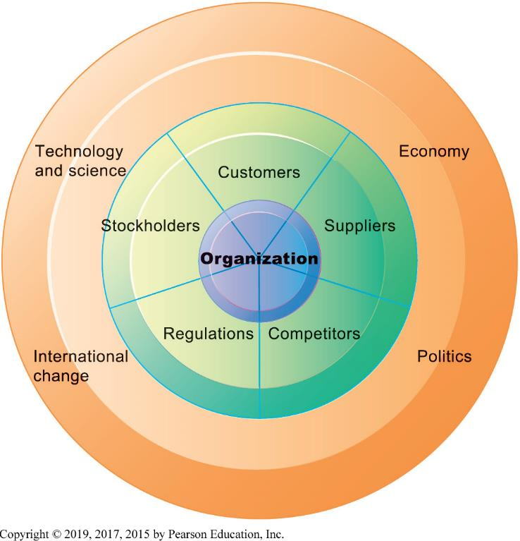
Figure 2.4 The Business Environment
Notes:
Figure 2.4, Page 47.
To be successful, an organization must constantly monitor and respond to—or even anticipate—developments in its environment. A firm’s environment includes specific groups with which the business must deal directly, such as customers, suppliers, and competitors, as well as the broader general environment, including socioeconomic trends, political conditions, technological innovations, and global events.
Emphasize to students that the outer ring consists of factors which are not a part of businesses and organizations, but nevertheless have a significant impact on the way a business is run and how well it performs. Obviously, the health of the larger economy effects businesses. How does development in technology and science impact business?

Slide 16
The Role of Information Systems in a Business
Firms invest in information systems in order to:
  Achieve operational excellence
  Develop new products and services
  Attain customer intimacy and service
  Improve decision making
  Promote competitive advantage
  Ensure survival
Notes:
To accomplish business objectives, businesses develop and use information systems.

Slide 17
Systems for Different Management Groups
Transaction processing systems (T P S)
  Keep track of basic activities and transactions of organization
Systems for business intelligence
  Address decision-making needs of all levels of management
    Management information systems (M I S)
    Decision support systems (D S S)
    Executive support systems (E S S)
Notes:
The constituency perspective emphasizes which groups in the firm are served by specific different systems.

Slide 18
Transaction Processing Systems
Serve operational managers
Principal purpose is to answer routine questions and to track the flow of transactions through the organization
  E.g., inventory questions, granting credit to customer
Monitor status of internal operations and firm’s relationship with external environment
Major producers of information for other systems
Highly central to business operations and functioning
Notes:
TPS systems are really the most basic kind of information system in a business, and they were among the first to be developed. A business is in large part a collection of transactions. Keeping track of all these transactions is the fundamental job of management. Without this, the business would soon collapse. Ask students for examples of a “transaction” in a business and make sure they understand the fundamental role of transactions.

Slide 19
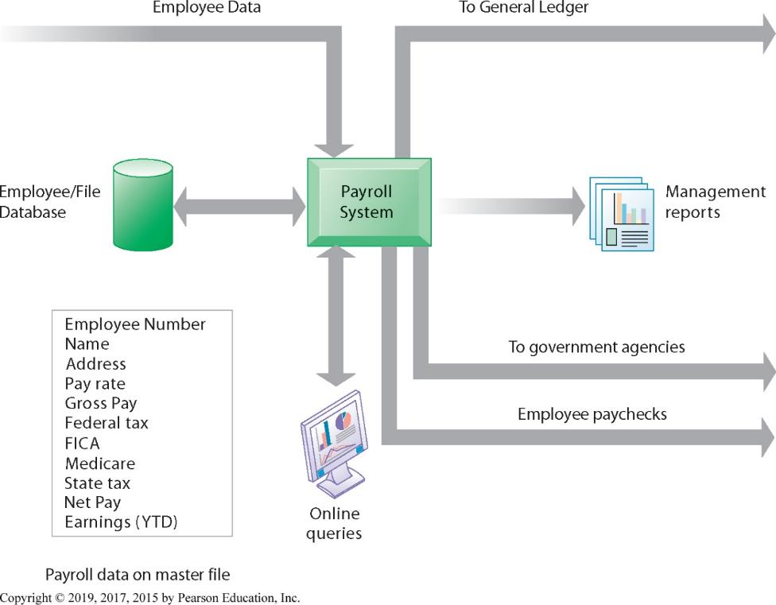
Figure 2.5 A Payroll T P S
Notes:
Figure 2.5, Page 49.
A TPS for payroll processing captures employee payment transaction data (such as a timecard). System outputs include online and hard copy reports for management and employee paychecks.
A payroll system involves a transaction between the firm and its employees. Without such a system, no paychecks are sent. That’s pretty basic!

Slide 20
Management Information Systems
Provide middle managers with reports on firm’s performance, to help monitor firm and predict future performance
Summarize and report on basic operations using data from T P S
Provide weekly, monthly, annual results, but may enable drilling down into daily or hourly data
Typically not very flexible systems with little analytic capability
Notes:
MIS—management information systems—are used by middle and general managers to summarize and keep track of all the important transactions in a business firm. In some sense, being a manager means keeping track of transactions.

Slide 21
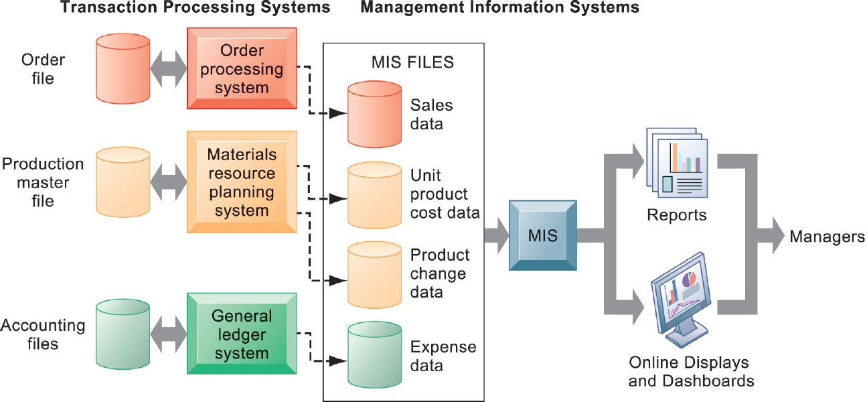
Figure 2.6 How M I S Obtain Their Data from the Organization’s T P S
Notes:
Figure 2.6, Page 50.
In the system illustrated by this diagram, three TPS supply summarized transaction data to the MIS reporting system at the end of the time period. Managers gain access to the organizational data through the MIS, which provides them with the appropriate reports.
In the system illustrated by this diagram, three TPS supply summarized transaction data to the MIS reporting system at the end of the time period. Managers gain access to the organizational data through the MIS, which provides them with the appropriate reports.

Slide 22
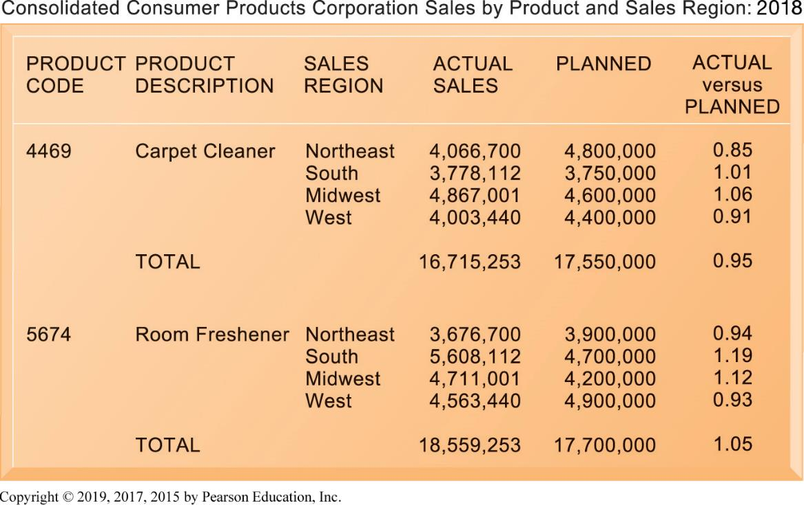
Figure 2.7 Sample M I S Report
Notes:
Figure 2.7, Page 51.
This report, showing summarized annual sales data, was produced by the MIS in Figure 2.6.
MIS reports are intended to summarize performance of the firm at a fairly concrete, product by product, region by region level. Typically, they report performance against planned objectives, e.g., planned sales of carpet cleaner $4.8 million in the quarter, actual sales were 4 million. This disparity should alert a manager to find out why the sales shortfall occurred.
Today, MIS reports to middle management are increasingly delivered not as paper reports but online summaries of operations. Increasingly, these internal reports are available on mobile platforms like smartphones.

Slide 23
Decision Support Systems
Serve middle managers
Support nonroutine decision making
  Example: What is impact on production schedule if December sales doubled?
Often use external information as well from T P S and M I S
Model driven D S S
  Voyage-estimating systems
Data driven D S S
  Intrawest’s marketing analysis systems

Slide 24
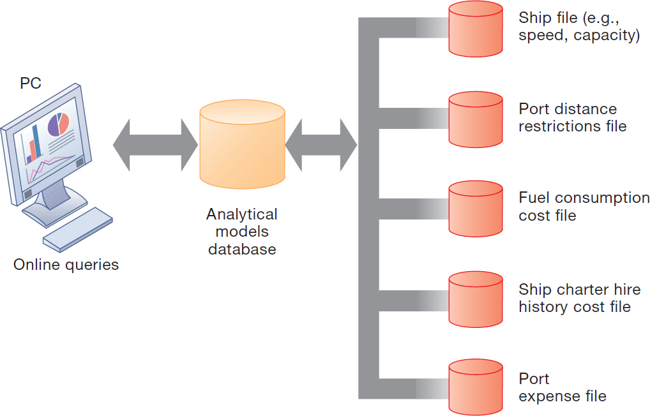
Figure 2.8 Voyage-Estimating Decision Support System
Notes:
Figure 2.8, Page 52.
This DSS operates on a powerful PC. Managers who must develop bids on shipping contracts use it daily.
DSS are usually aimed at solving a recurring, very specific problem, like in this illustration calculating the costs of ocean transportation for a firm based on a variety of factors.

Slide 25
Executive Support Systems
Serve senior managers
Address strategic issues and long-term trends
  E.g., what products should we make in five years?
Address nonroutine decision making
Provide generalized computing capacity that can be applied to changing array of problems
Draw summarized information from M I S, D S S, and data from external events
Typically use portal with Web interface, or digital dashboard, to present content
Notes:
ESS are high level systems aimed at senior managers that summarize the performance of the firm along key dimensions, e.g., sales by region, product sales, cost of goods used in production, and weekly summaries of financial data. Usually this data is presented in an attractive “digital dashboard” interface.

Slide 26
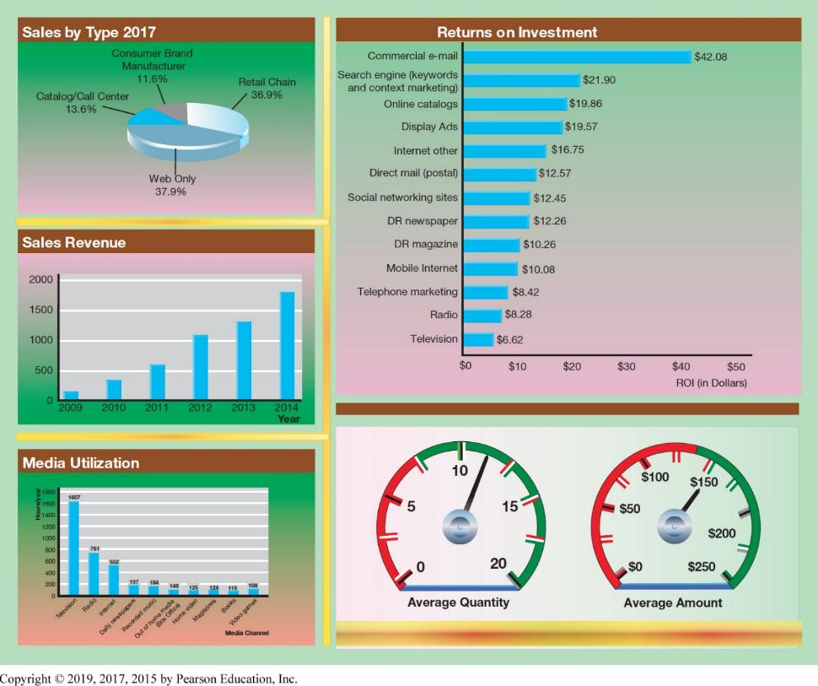
Figure Digital Dashboard
Notes:
Figure Page 53.
A digital dashboard delivers comprehensive and accurate information for decision making, often using a single screen. The graphical overview of key performance indicators helps managers quickly spot areas that need attention.
Why is it that digital dashboards are more effective than, say, spreadsheets with rows and columns of the same data? One answer is just the cognitive cost of looking for “information” in table of rows and columns is much greater than looking at a graphical representation of the same data.

Slide 27
Interactive Session – People: Data Changes How N F L Teams Play the Game and How Fans See it
Class discussion
  What kinds of systems are illustrated in this case study? Where do they obtain their data? What do they do with the data? Describe some of the inputs and outputs of these systems.
  What business functions do these systems support? Explain your answer.
  How do the data about teams and players captured by the N F L help N F L football teams and the N F L itself make better decisions? Give examples of two decisions that were improved by the systems described in this case.
  How did using data help the N F L and its teams improve the way they run their business?
Notes:
Ask students whether or not the smartphones that are changing business have had a similar effect on their own lives. Have iPhones dramatically changed they way they do things or created new possibilities? Or the ways they watch television?

Slide 28
Systems for Linking the Enterprise
Enterprise applications
  Systems that span functional areas, focus on executing business processes across the firm, and include all levels of management
Four major types
  Enterprise systems
  Supply chain management systems
  Customer relationship management systems
  Knowledge management systems
Notes:
ESS are high level systems aimed at senior managers that summarize the performance of the firm along key dimensions, e.g., sales by region, product sales, cost of goods used in production, and weekly summaries of financial data. Usually this data is presented in an attractive “digital dashboard” interface.

Slide 29
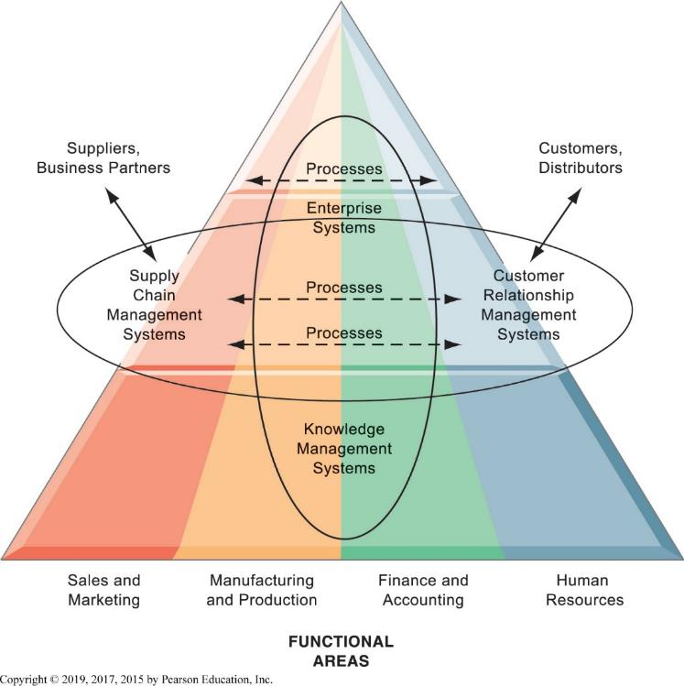
Figure 2.9 Enterprise Application Architecture
Notes:
Figure 2.9 Page 55.
Enterprise applications automate processes that span multiple business functions and organizational levels and may extend outside the organization.
Enterprise systems span functions, and span levels in the firm. This looks like a complicated diagram or concept, but the idea is simple: pull all the relevant information in a firm into a single database environment. Share it freely across all levels and specialties in the firm. In the past, where each silo of business had its own systems and databases, this was impossible. Whatever the marketing department “knew” was locked in marketing systems and databases which could not be access by managers in other departments.

Slide 30
Enterprise Systems
Also called enterprise resource planning (E R P) systems
Integrate data from key business processes into single system
Speed communication of information throughout firm
Enable greater flexibility in responding to customer requests, greater accuracy in order fulfillment
Enable managers to assemble overall view of operations
Notes:
The alternative to enterprise systems is departmental systems. What’s wrong with each department, say marketing and accounting, having their own systems to serve their needs?

Slide 31
Supply Chain Management (S C M) Systems
Manage relationships with suppliers, purchasing firms, distributors, and logistics companies
Manage shared information about orders, production, inventory levels, and so on
  Goal is to move correct amount of product from source to point of consumption as quickly as possible and at lowest cost
Type of interorganizational system
  Automating flow of information across organizational boundaries
Notes:
Do students have any examples of supply chains based on their work experience? What are some of the difficulties they encountered? Some likely candidates are slow delivery, mistakes in delivery, inability to supply because of lack of inventory, delivery to wrong location, and so forth.

Slide 32
Customer Relationship Management (C R M) Systems
Help manage relationship with customers.
Coordinate business processes that deal with customers in sales, marketing, and customer service
Goals:
  Optimize revenue
  Improve customer satisfaction
  Increase customer retention
  Identify and retain most profitable customers
  Increase sales
Notes:
Have students interacted with a CRM? Most have but don’t realize it. Most everyone has interacted with a call center over the phone. What has been the experience of your students dealing with call centers? Why do they think call centers are important to a business? What’s the worst experience they have had? Often it’s a cable company or other utility. Or a bad experience with a foreign-based call center where customer services reps could not be easily understood. Why can service at call centers be so poor?

Slide 33
Knowledge Management Systems
Manage processes for capturing and applying knowledge and expertise
Collect relevant knowledge and make it available wherever needed in the enterprise to improve business processes and management decisions
Link firm to external sources of knowledge
Notes:
Most students will never have heard of a “knowledge management system.” In one sense it’s just a corporate library that contains documents, even books, but also reports, PowerPoint slides, spreadsheets, in short, a collection of everything a firm (the people in it) knows about the business. Everyone knows (or did know) what a library is. Another way to think about knowledge management is to think about Google being a collection of part of what is known or thought to be in the world. A good knowledge management system would allow employees to search a corporate database just like searching Google.

Slide 34
Intranets and Extranets
Technology platforms that increase integration and expedite the flow of information
Intranets:
  Internal networks based on Internet standards
  Often are private access area in company’s website
Extranets:
  Company websites accessible only to authorized vendors and suppliers
  Facilitate collaboration
Notes:
The distinction between intranets and extranets is still common. Yet many companies simply talk about their “website” and the various areas of their website where access is confined to specific groups. Restricted areas of their websites are available only to employees (intranets). Other areas are open to outside suppliers, or customers (extranets). The important point is that no matter how you refer to the phenomenon, firms use their websites (many firms have multiple websites—some for strictly internal use, and some for use by outside parties) to deliver services and information to all the parties in their business value system, from suppliers to consumers.

Slide 35
E-Business, E-Commerce, and E-Government
E-business:
  Use of digital technology and Internet to drive major business processes
E-commerce:
  Subset of e-business
  Buying and selling goods and services through Internet
E-government:
  Using Internet technology to deliver information and services to citizens, employees, and businesses

Slide 36
What is Collaboration?
Growing importance of collaboration:
  Changing nature of work
  Growth of professional work
  Changing organization of the firm
  Changing scope of the firm
  Emphasis on innovation
  Changing culture of work and business
Notes:
A number of factors are leading to a growing emphasis on collaboration in the firm. Work is changing, requiring more cooperation and coordination. Professions play a larger role in firms than before, and this often requires more consultation among experts than before. Organizations are flatter, with many more decisions made far down in the hierarchy. Organizations are more far flung around the globe, in multiple locations. There’s an emphasis on finding and sharing ideas which requires collaboration. Finally, what it means to be a “good” employee these days is in part an ability to work with others, and collaborate effectively. The culture of work has changed.

Slide 37
What is Social Business?
Use of social networking platforms to engage employees, customers, suppliers
Conversations to strengthen bonds
Requires information transparency
Seen as way to drive operational efficiency, spur innovation, accelerate decision making
Notes:
Ask students if social platforms (Facebook, Twitter) have influenced their purchasing decisions. Have they ever had a conversation with a company employee about a product, and how did that influence their impressions of the company? How could social networks help a company spur innovation?

Slide 38
Business Benefits of Collaboration and Social Business
Investment in collaboration technology can return large rewards, especially in sales and marketing, research and development
Productivity: Sharing knowledge and resolving problems
Quality: Faster resolution of quality issues
Innovation: More ideas for products and services
Customer service: Complaints handled more rapidly
Financial performance: Generated by improvements in factors above
Notes:
Some of the benefits of collaboration and team work are greater productivity, faster reaction to market events, more innovation, and faster implementation times than previously without collaboration (command and control model). Ask students about their experience on the job with collaboration and team work. Have any worked in a more traditional “command and control” business?

Slide 39
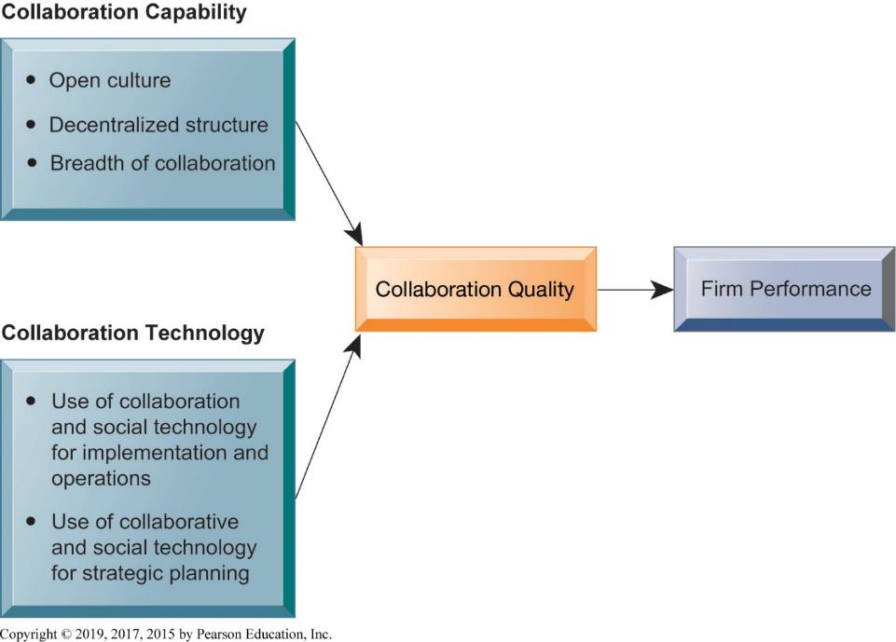
Figure 2.10 Requirements for Collaboration
Notes:
Figure 2.10 Page 60.
Successful collaboration requires an appropriate organizational structure and culture along with appropriate collaboration technology.
The gist of modern literature on the firm is that firms which support collaboration, and actually do it, tend to perform better. Do students find this believable? What are some possible drawbacks to collaboration?

Slide 40
Tools and Technologies for Collaboration and Teamwork
Email and instant messaging (I M)
Wikis
Virtual worlds
Collaboration and social business environments
  Virtual meeting systems (telepresence)
  Cloud collaboration services
    Google Drive, Dropbox
  Microsoft SharePoint and I B M Notes
  Enterprise social networking tools
Notes:
There’s been an explosion in collaboration tools and environments. Businesses are just now learning how to use them. Ask students how collaboration and teamwork are accomplished in their firms.

Slide 41
Interactive Session – Technology: Collaborating the Glasscubes Way
Class discussion
  Discuss the features of Glasscubes as a collaboration software.
  Why did the NSHCS require a tool for collaboration? Was Glasscubes a feasible option?
  Name some other areas where such software can be useful. Discuss at least one such area.
Notes:
Ask if any students have used a video conferencing tool in an organization. How many have used Face Time on their iPhones, or similar tools on Android phones? Have any used Skype collaboration tools for teleconferencing?

Slide 42
Evaluating and Selecting Collaboration Tools
What are your firm’s collaboration challenges?
What kinds of solutions are available?
Analyze available products’ cost and benefits.
Evaluate security risks.
Consult users for implementation and training issues.
Select candidate tools and evaluate vendors.
Notes:
The basic idea here is to identify the kind of problem you have and adopt those technologies that make sense. The key problems are time and location. Generally, no one has enough time and often key people are not in the right place. How to overcome these challenges in a cost effective manner is the difficult part.

Slide 43
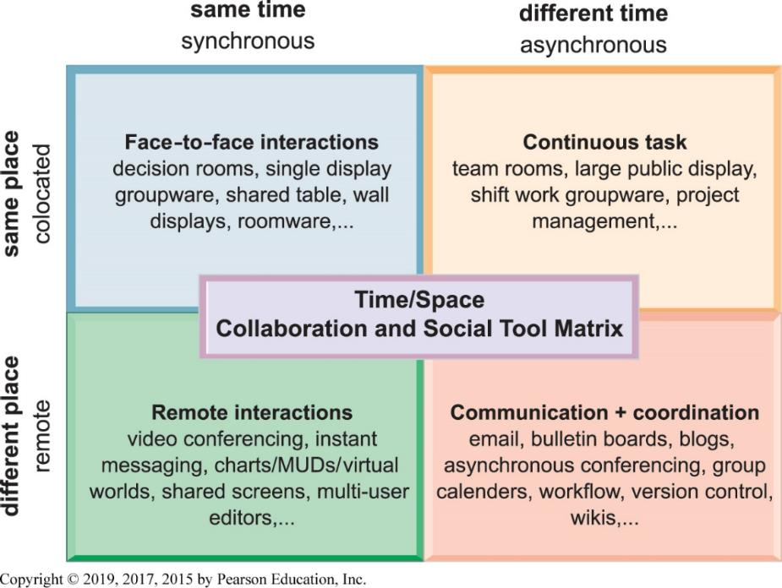
Figure 2.11 The Time/Space Collaboration and Social Tool Matrix
Notes:
Figure 2.11 Page 66.
Collaboration technologies can be classified in terms of whether they support interactions at the same or different time or place and whether these interactions are remote or colocated.
You can use this matrix to identify solutions to the time/location issues that face a firm, and to choose specific collaboration technologies.

Slide 44
The Information Systems Department
Programmers
Systems analysts
  Principle liaisons to rest of firm
Information systems managers
  Leaders of teams of programmers and analysts, project managers, physical facility managers, telecommunications managers, database specialists, managers of computer operations, and data entry staff
Senior managers: C I O, C P O, C S O, C K O, C D O
End users
Notes:
While in very small businesses the IS department is a single individual who does everything, as businesses get larger they generally develop a specialized unit, department, or division that handles all IS and IT areas in the firm. These IS units are composed of senior managers (CIO), middle managers, and technical employees like network administrators and computer programmers. End users are often represented on the governing bodies of these units as well, and consultants (external specialists) also can play a large role in IS departments by bringing in needed skills on an ad hoc basis.

Slide 45
Information Systems Services
Computing services
Telecommunications services
Data management services
Application software services
Physical facilities management services
I T management services
I T standards services
I T educational services
I T research and development services
Notes:
IS services departments deliver specialized services to most other units of the organization, as well as providing the overall computer infrastructure in a firm that serves everyone.

Slide 46
How Will M I S Help My Career?
The Company: Comprehensive Supplemental Insurance U S A
Position Description
Job Requirements
Interview Questions
Notes:
A good opportunity for a class discussion of the new Section on careers. Would any in the class be interested in a job like this? What do they think are the most important skills the employer is looking for? How would they answer the interviewer questions?

