Slide 1

Essentials of Management Information Systems
Thirteenth Edition
Chapter 1
Business Information Systems in Your Career
Copyright © 2019 Pearson Education Ltd.
Notes:
If this PowerPoint presentation contains mathematical equations, you may need to check that your computer has the following installed:
1) MathType Plugin
2) Math Player (free versions available)
3) NVDA Reader (free versions available)

Slide 2
Learning Objectives
1.1 Why are information systems so essential for running and managing a business today?
1.2 What exactly is an information system? How does it work? What are its people, organizational, and technology components?
1.3 How will a four-step method for business problem solving help you solve information system-related problems?
1.4 What information systems skills and knowledge are essential for business careers?
1.5 How will M I S help my career?

Slide 3
Video Cases
Case 1: Business in the Cloud: Facebook, Google, and eBay Data Centers
Case 2: U P S Global Operations with the D I A D and Worldport
Instructional Video: Tour I B M’s Raleigh Data Center

Slide 4
Premier League: The Power of IT Analytics (1 of 2)
Problem
  Improving revenue and player training through Big Data.
Solutions
  The Football Manager game simulation as a database
  A system of player-performance-enhancing IT analytics apps
Notes:
You could ask students to come up with suggestions for improving grocery store shopping using technology. How would they like to shop for groceries: at the store, or by ordering online?

Slide 5
Premier League: The Power of IT Analytics (2 of 2)
Use of networked sensors and powerful analytics to drive business operations and management decisions
Demonstrates how technology can be used to improve consumer experience
Illustrates why information systems are so essential today

Slide 6
How Information Systems are Transforming Business
In 2016, more than 142 million businesses had dot-com addresses registered.
273 million adult Americans online; 183 million purchased online
Internet advertising continues to grow at around 15 percent per year.
New laws require businesses to store more data for longer periods.
Changes in business result in changes in jobs and careers.
Notes:
Ask students for their impressions of how IS has changed the ways they shop, purchase, and consume media in particular. For comparison, how did they do these things in the past, and how did their parents do them.

Slide 7
What’s New in Management Information Systems?
New technologies
  Cloud computing, big data, Internet of Things
  Mobile digital platform
Management
  Managers use social networks, collaboration
  Business intelligence applications accelerate
  Virtual meetings proliferate
Organizations
  Social business
  Telework gains momentum
  Co-creation of value, collaboration across firms
Notes:
Ask students to explain why these items are examples of information systems transforming business. What industries are especially hard hit with disruptions and change due to IT?

Slide 8
Interactive Session – People: Can You Run the Company with Your i Phone?
Class discussion
  What kinds of applications are described here? What business functions do they support? How do they improve operational efficiency and decision making?
  Identify the problems that businesses in this case study solved by using mobile digital devices.
  What kinds of businesses are most likely to benefit from equipping their employees with mobile digital devices such as iPhones and i Pads?
  One company deploying i Phones has said, “The i Phone is not a game changer, it’s an industry changer. It changes the way that you can interact with your customers and with your suppliers.” Discuss the implications of this statement.
Notes:
Ask students whether or not the smartphones that are changing business have had a similar effect on their own lives. Have iPhones dramatically changed they way they do things or created new possibilities?

Slide 9
Globalization Challenges and Opportunities: A Flattened World
Internet and global communications have greatly reduced economic and cultural advantages of developed countries.
  Drastic reduction of costs of operating and transacting on global scale
  Competition for jobs, markets, resources, ideas
  Dependence on imports and exports
  Requires new understandings of skills, markets, opportunities
Notes:
You could ask students to name ways in which globalization affects their everyday lives. Ask them how they might react if they learned that a job opening they coveted was outsourced to another country, or on the other hand, what they would do if they were managers filling a job opening and workers from abroad could fill the spot for a fraction of the cost? Benefits of globalization: how would they feel about paying 50% more for their clothing that was made domestically in the U.S.?

Slide 10
Business Drivers of Information Systems
Businesses invest in I T to achieve six important business objectives.
  Operational excellence
  New products, services, and business models
  Customer and supplier intimacy
  Improved decision making
  Competitive advantage
  Survival
Notes:
Which objective do students consider to be most important? Ask students to describe their personal business experience as employers (or owners), and to describe which of the above objectives was most important in their firm or job.

Slide 11
Operational Excellence
Improved efficiency results in higher profits.
Information systems and technologies help improve efficiency and productivity.
Example: Walmart
  Power of combining information systems and best business practices to achieve operational efficiency—and over $473 billion in sales in 2014
  Most efficient retail store in world as result of digital links between suppliers and stores
Notes:
Describe to students why it is that digital links between suppliers and stores would improve efficiency (critical information travels faster, better control over inventory levels).
Walmart is the most efficient retailer in the industry and exemplifies operational excellence. You could ask students to name other businesses that they believe exhibit a high level of operational excellence. How about Amazon? Or iTunes. Or Netflix? Do customers perceive operational excellence? Does it make a difference for customer purchasing? What Web sites strike students as really excellent in terms of customer service? If you have a podium computer, you might want to visit the Walmart site and the Amazon site to compare them in terms of ease of use.

Slide 12
New Products, Services, and Business Models
Information systems and technologies enable firms to create new products, services, and business models.
Business model: how a company produces, delivers, and sells its products and services
Example: Apple
  Transformed old model of music distribution with i Tunes
  Constant innovations—i Pod, i Phone, i Pad, etc.
Notes:
You could ask students to name other new products or business models that they've encountered and how they might relate to new information systems or new technology. One way to encourage participation is ask students to help you list on the blackboard some really interesting recent digital product innovations. Discussing “green technologies” like wind, solar, and hybrid vehicles is always fun. The impact of smartphones and table computers is also a fun topic for students. In this context, what role will IT be playing in the development of these technologies?

Slide 13
Customer and Supplier Intimacy
Customers who are served well become repeat customers who purchase more.
  Mandarin Oriental hotel
    Uses I T to foster an intimate relationship with its customers, keeping track of preferences, and so on
Close relationships with suppliers result in lower costs.
  J C Penney
    I T to enhance relationship with supplier in Hong Kong
Notes:
You could ask students what types of companies might rely more on customer and supplier intimacy more than others and which companies they feel have served them exceptionally well. Ask the students to identify online sites that achieve a high degree of customer intimacy. Sites to visit would include Netflix, Amazon, and other sites which have recommender systems to suggest purchase ideas to consumers.

Slide 14
Improved Decision Making
If managers rely on forecasts, best guesses, and luck, they will misallocate employees, services, and inventory.
Real-time data improves ability of managers to make decisions.
Verizon: Web-based digital dashboard to update managers with real-time data on customer complaints, network performance, and line outages
Notes:
You could ask students if they have ever been recipients of exceptional service from a company made possible by improved decision making and whether or not information systems contributed to that level of service. For example, perhaps they had a power outage and it took a very short (or very long) time for the utility company to correct the error. Why do utility companies have such poor customer service in general?

Slide 15
Competitive Advantage
Often results from achieving previous business objectives
Advantages over competitors:
  Charging less for superior products, better performance, and better response to suppliers and customers
  Examples: Apple, Walmart, U P S are industry leaders because they know how to use information systems for this purpose
Notes:
Emphasize that achieving any of the previous four business objectives represents the achievement of a competitive advantage as well.

Slide 16
Survival
Businesses may need to invest in information systems out of necessity; simply the cost of doing business.
Keeping up with competitors
  Citibank’s introduction of A T Ms
Federal and state regulations and reporting requirements
  Toxic Substances Control Act and the Sarbanes-Oxley Act
Notes:
Ask students if they can name any examples of companies that failed to survive due to unwillingness or inability to update their information systems. While difficult at first, think about the firms where the products or service were really unacceptable, or where returns were poorly handled. The Sarbanes-Oxley Act requires that public firms keep all data, including e-mail, for five years. You could ask students if they appreciate why information systems would be useful toward meeting the standards imposed by this legislation. Indeed, why should all this information be retained?

Slide 17
What is an Information System? (1 of 2)
Information technology: the hardware and software a business uses to achieve objectives
Information system: interrelated components that manage information to:
  Support decision making and control
  Help with analysis, visualization, and product creation
Data: streams of raw facts
Information: data shaped into meaningful, useful form
Notes:
It's important to understand that information systems are not just technologies, but deeply involve people and organizations as well. Being a great programmer does not qualify you for being a great manager of information systems.
Ask students to think of a stream of raw facts (data), and then an organized body of data (information)? A stream of facts example is the ticker tape of a stock market (you can go to a Web site to display the streaming stock prices). Summary indices of stock movements and reports on stock groups (e.g. housing, transportation) or market indices like the S&P 500 constitute information.

Slide 18
What is an Information System? (2 of 2)
Activities in an information system that produce information:
  Input
  Processing
  Output
  Feedback
Sharp distinction between computer or computer program versus information system
Notes:
Use an example similar to the one given in the previous slide to illustrate the three activities involved in the function of an information system. Continuing with that example, the process of asking students their age would represent input, calculating the average age and determining the oldest and youngest age would represent processing, and writing that information on the board would represent output.

Slide 19
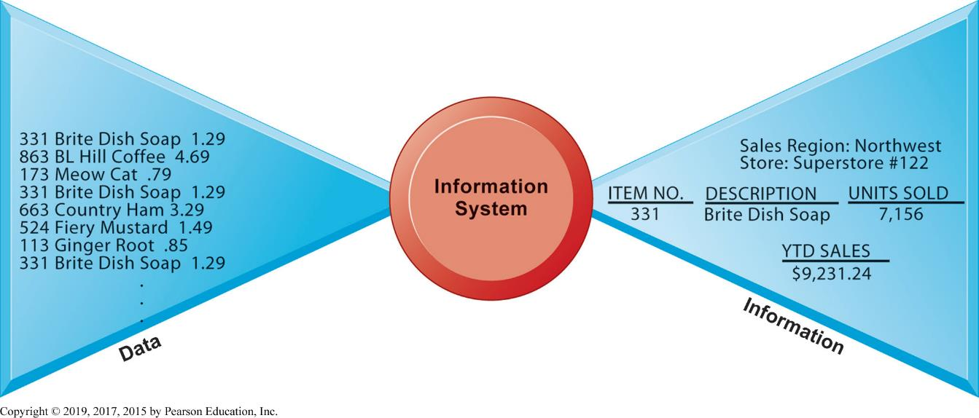
Figure 1.1 Data and Information
Notes:
Figure 1.1, Page 14.
Raw data from a supermarket checkout counter can be processed and organized to produce meaningful information, such as the total unit sales of dish detergent or the total sales revenue from dish detergent for a specific store or sales territory.
Emphasize the distinction between information and data. You could, for example, ask several students to list their ages and write the numbers on one side of the board—then you could calculate the average age of those students on the other side, oldest student, youngest student, and so forth, to illustrate the difference between raw data and meaningful information.

Slide 20
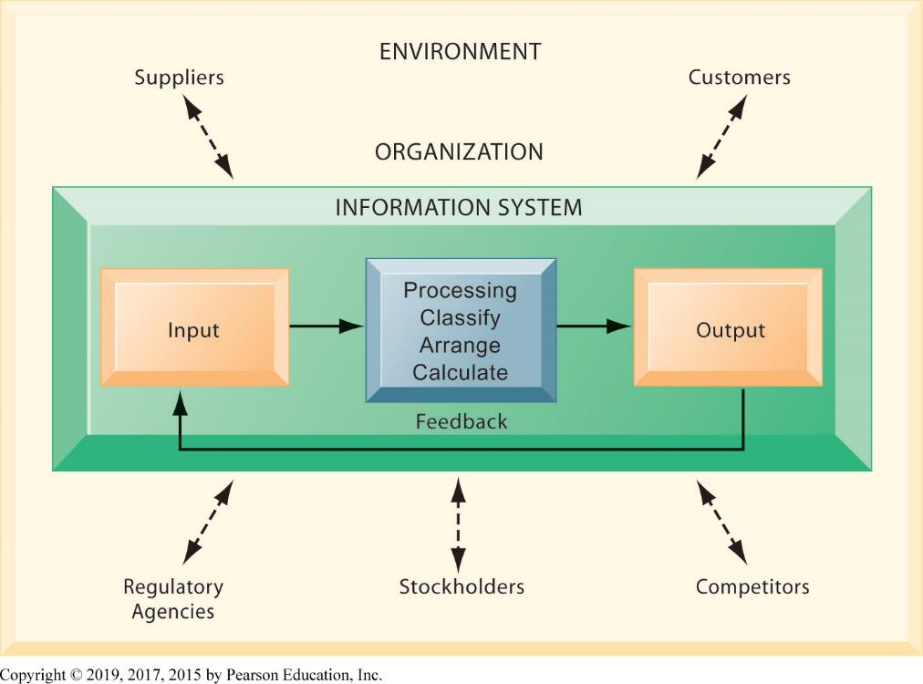
Figure 1.2 Functions of an Information System
Notes:
Figure 1.2, Page 15.
An information system contains information about an organization and its surrounding environment. Three basic activities—input, processing, and output—produce the information organizations need. Feedback is output returned to appropriate people or activities in the organization to evaluate and refine the input. Environmental actors, such as customers, suppliers, competitors, stockholders, and regulatory agencies, interact with the organization and its information systems.
The point of this diagram is first of all to highlight the three basic activities of information systems, so that students can understand what an information system is doing at its most fundamental level. But the diagram also puts information systems into the context of organizations (firms), and then puts the firm into its respective environment composed of shareholders, higher level authorities (government), competitors, suppliers, and customers. Suddenly, students should see that information systems play a central role mediating and interacting with all these players. Hence, systems play a key role in the operations and survival of the firm.
You could also explain this diagram by relating it back to the opening case, as the book does.

Slide 21
The Role of People and Organizations
Information systems literacy
  Includes behavioral and technical approach
Computer literacy
  Focuses mostly on knowledge of I T
Management information systems (M I S)
  Focuses on broader information systems literacy
  Issues surrounding development, use, impact of information systems used by managers and employees
Notes:
It takes many different skills to build and manage information systems.

Slide 22
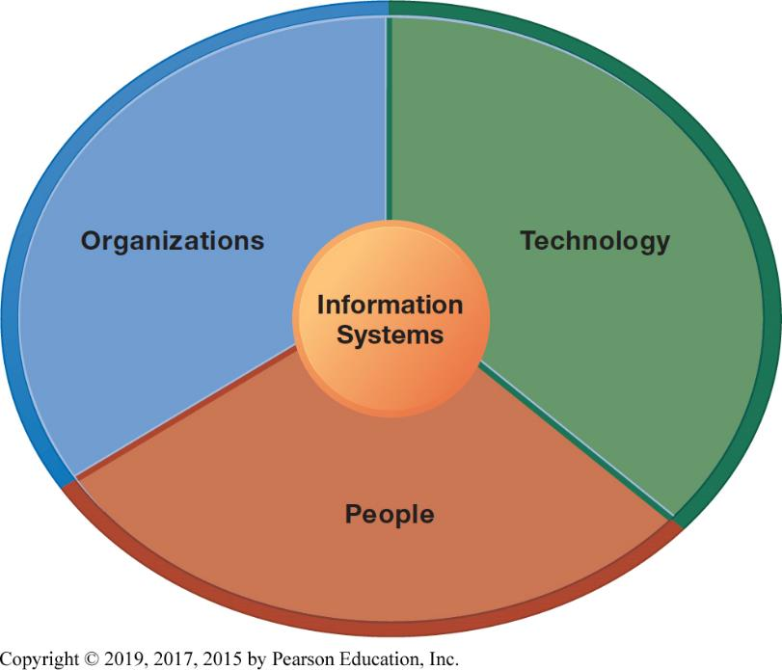
Figure 1.3 Information Systems are More Than Computers
Notes:
Figure 1.3, Page 16.
Using information systems effectively requires an understanding of the organization, people, and information technology shaping the systems. An information system provides a solution to important business problems or challenges facing the firm.
These three themes (people, organizations, and technology) will reappear throughout the book. Understanding the interaction between these factors and information systems is known as information system literacy. Knowing how to optimize the relationship between technology, organizations, and people is the purpose of this book and course.

Slide 23
Dimensions of Information Systems (1 of 3)
Organizations
  Coordinate work through structured hierarchy and business processes
  Business processes: related tasks and behaviors for accomplishing work
    Examples: fulfilling an order, hiring an employee
    May be informal or include formal rules
  Culture embedded in information systems
    Example: U P S’s concern with placing service to customer first
Notes:
What types of issues and problems would occur in a company whose information systems did not accurately reflect its culture, or whose hierarchy (chain of command) was overly complex or poorly conceived? In some cases, the culture of the firm is dysfunctional, and you would not want new information systems to reflect that culture.

Slide 24
Dimensions of Information Systems (2 of 3)
People
  Information systems require skilled people to build, maintain, and use them.
  Employee attitudes affect ability to use systems productively.
  Role of managers:
    Perceive business challenges
    Set organizational strategy
    Allocate human and financial resources
    Creative work: new products, services
Notes:
The “people” dimension of systems is often the most difficult to get right. Technologies change all the time, people do not change very rapidly. In order to use technologies effectively, people need training, and they need to think intelligently about how their business works. Managers are the employees who attempt to understand organizational issues and challenges, and then use technologies to solve the issues and meet the challenges.

Slide 25
Dimensions of Information Systems (3 of 3)
Technology
  I T Infrastructure: Foundation or platform that information systems are built on
    Computer hardware
    Computer software
    Data management technology
    Networking and telecommunications technology
      Internet and Web, extranets, intranets
      Voice, video communications
Notes:
Obviously, information systems are based on technologies—computer hardware and software, telecommunications equipment. These technologies are like the infrastructure of a building—the plumbing and electrical and mechanical features in a building. Technology is the platform that enables all the common systems applications from Apple iPhones to the Internet.

Slide 26
Interactive Session – Technology: Healthcare at Singapore’s JurongHealth Services
Class discussion
  What technologies are used by JurongHealth? What purpose do they serve?
  Search the web for RFID. Suggest an example of using RFID for locating and tracking people.
  What information systems are implemented by JurongHealth? Describe the input, processing, and output of any one such system.
  Why are information systems important for JurongHealth?
Notes:
Ask students if they have ever signed for a package using a device like the DIAD. How important are technologies like these to UPS's bottom line? There's an interesting video case study on the UPS DIAD in the Case Study package. You could show this video during class.

Slide 27
The Problem-Solving Approach
Few business problems are simple or straightforward.
Most business problems involve a number of major factors that can fall into three main categories:
  Organization
  Technology
  People
Notes:
Ask students to think about the jobs they have held in the past, and then describe some of the common business problems they faced, the factors involved, and what category these factors fall into.

Slide 28
A Model of the Problem-Solving Approach (1 of 7)
Problem solving: four-step process
Problem identification
Solution design
Choice
Implementation
Notes:
Ask students to think about the jobs they have held in the past, and then describe some of the common business problems they faced, the factors involved, and what category these factors fall into.

Slide 29
A Model of the Problem-Solving Approach (2 of 7)
Problem identification includes:
  Agreement that problem exists
  Definition of problem
  Causes of problem
  What can be done given resources of firm
Notes:
Ask students about their job experiences with problem identification. Usually, there are different points of view about what the problem actually is. There often is no agreement about what the problem really is.

Slide 30
A Model of the Problem-Solving Approach (3 of 7)
Typical organizational problems
  Outdated business processes
  Unsupportive culture and attitudes
  Political in-fighting
  Turbulent business environment, change
  Complexity of task
  Inadequate resources
Notes:
Ask students to describe if any of these typical business problems arose in their work experience.

Slide 31
A Model of the Problem-Solving Approach (4 of 7)
Typical technology problems
  Insufficient or aging hardware
  Outdated software
  Inadequate database capacity
  Insufficient telecommunications capacity
  Incompatibility of old systems with new technology
  Rapid technological change
Notes:
Once again, draw students out and ask them to speak about the technology problems they have experienced in their work.

Slide 32
A Model of the Problem-Solving Approach (5 of 7)
Typical people problems
  Lack of employee training
  Difficulties of evaluating performance
  Legal and regulatory compliance
  Work environment, ergonomics
  Poor or indecisive management
  Lack of employee support and participation
Notes:
There should be a flood of student comments about people problems they have experienced on jobs!

Slide 33
A Model of the Problem-Solving Approach (6 of 7)
Solution design
  Often many possible solutions
  Consider as many as possible to understand range of solutions
Solution Evaluation and Choice
  Factors include
    Cost
    Feasibility given resources and skills
    Length of time needed to implement solution
Notes:
Why are there so many solutions to a problem? How many solutions can be seriously examined and explored?
Why should implementation be considered in the problem solving process? One reason is that you want to avoid solutions that cannot be easily implemented.

Slide 34
A Model of the Problem-Solving Approach (7 of 7)
Implementation
  Building or purchasing solution
  Testing solution, employee training
  Change management
  Measurement of outcomes
  Feedback, evaluation of solution
Problem solving is a continuous process, not a single event
  Sometimes chosen solution doesn’t work or needs adjustment
Notes:
Why aren't problems solved once and for all? Some problems might be “solved” and forgotten, and lack of attention leads to the problems arising again.

Slide 35
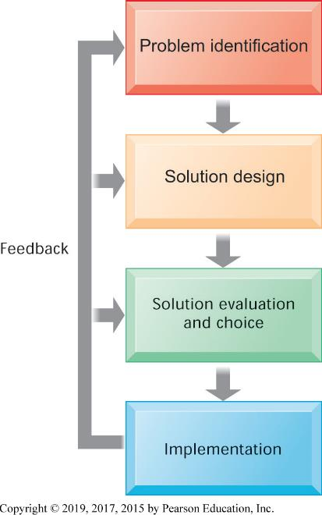
Figure 1.4 Problem Solving is a Continuous Four-Step Process
Notes:
Figure 1.4, Page 21.
During implementation and thereafter, the outcome must be continually measured, and the information about how well the solution is working is fed back to the problem solvers. In this way, the identification of the problem can change over time, solutions can be changed, and new choices can be made, all based on experience.
What makes problem solving continuous is that most solutions don't always work perfectly and need fine tuning. Some decisions result in actions that don't work at all, or work perfectly (at least for a period of time). In any case, you need continuous feedback from the environment to track how well solutions are working.

Slide 36
The Role of Critical Thinking in Problem Solving (1 of 2)
Without critical thinking, easy to jump to conclusions, misjudge a problem, and waste resources
Critical thinking:
  Sustained suspension of judgment with an awareness of multiple perspectives and alternatives
  Ability to collect and analyze data that might help understand the nature of the problem; a “data driven” approach
Notes:
Why aren't problems solved once and for all? Some problems might be “solved” and forgotten, and lack of attention leads to the problems arising again. Can students think of an example of where the wrong problem was solved? Or solutions adopted which had nothing to do with the problem?

Slide 37
The Role of Critical Thinking in Problem Solving (2 of 2)
Four elements of critical thinking:
  Maintaining doubt and suspending judgment
  Being aware of different perspectives
    Including technology, organization, and people perspectives
  Testing alternatives and letting experience guide
  Being aware of organizational and personal limitations
Notes:
Why should these elements of critical thinking be an issue at all? Why should it be hard to suspend judgment? Be aware of different perspectives? Test alternatives? Be aware of limitations?

Slide 38
The Connections Among Business Objectives, Problems, and Solutions
When firms cannot achieve business objectives these objectives become challenges.
Information systems often present solutions, partially or fully, to these challenges.
Notes:
If your objective is to increase sales of a new line of clothing, and then sales don't increase, at the very least a business has a challenge (if not an outright “problem” that needs solving).

Slide 39
How Information Systems Will Affect Business Careers (1 of 9)
Success in today’s job market requires a broad set of skills.
Job candidates must have problem-solving skills as well as technical skills so that they can complete specific tasks.
The service sector will account for 95 percent of the new jobs that are created or open up by 2022.
Notes:
Just having one set of skills is not a very wise idea when preparing for future labor markets. The more skills you have (say language skills plus information systems skills plus some finance skills) the greater your attractiveness to future employers who may see you as a multi-skilled person who could fit into a variety of jobs.

Slide 40
How Information Systems Will Affect Business Careers (2 of 9)
Accounting:
  Accountants increasingly rely on information systems to summarize transactions, create financial records, organize data, and perform financial analysis.
  Skills:
    Knowledge of databases and networks
    Online financial transactions and reporting systems
    How systems are used to achieve accounting functions

Slide 41
How Information Systems Will Affect Business Careers (3 of 9)
Finance:
  Relationship between information systems and financial management and services is so strong that many advise finance majors to co-major in information systems.
  Skills:
    Use systems for financial reporting, direct investment activities, implementation of cash management strategies
    Plan, organize, implement information systems strategies for the firm

Slide 42
How Information Systems Will Affect Business Careers (4 of 9)
Marketing:
  No field has undergone more technology-driven change in the past five years than marketing and advertising.
  Skills:
    Work with databases for tracking and reporting on customer behavior, product performance, customer feedback, product development
    Enterprise systems for product management, sales force management, customer relationship management

Slide 43
How Information Systems Will Affect Business Careers (5 of 9)
Operations management in services and manufacturing:
  Production managers, administrative service managers, and operations analysts
  Skills:
    Hardware and software platforms for operations management
    Use database and analytical software for coordinating and optimizing resources required for producing goods and services

Slide 44
How Information Systems Will Affect Business Careers (6 of 9)
Management:
  The job of management has been transformed by information systems.
  Impossible to manage business today without information systems
  Skills:
    Use of information systems for each function of job, from desktop productivity tools to applications coordinating the entire enterprise

Slide 45
How Information Systems Will Affect Business Careers (7 of 9)
Information systems:
  Fast changing and dynamic profession because information technologies are among most important tools for achieving business firms’ key objectives
  Domestic and offshore outsourcing
  Skills:
    Uses of new and emerging hardware and software to achieve six business objectives
    An ability to take a leadership role in the design and implementation of new information systems

Slide 46
How Information Systems Will Affect Business Careers (8 of 9)
Outsourcing and offshoring:
  Two types: outsourcing to domestic U.S. firms and outsourcing to low-wage countries such as India, China
  Production programming, system maintenance, call centers
  Benefits:
    Lower cost of building and maintaining systems within U.S.
    Increased need for managerial positions

Slide 47
How Information Systems Will Affect Business Careers (9 of 9)
Common requirements for all majors
  How I T helps achieve six business objectives
  Central role of databases
  Business analytics and intelligence systems
  Working with specialists and systems designers
  Ethical, social, legal environment and issues
    Use of I T to meet legal requirements
Notes:
All of the occupational areas discussed in this section require some level of information systems skills and knowledge. IS is a major lever of organizational change in the future, and very important for achieving new levels of productivity. The future will be very rich in digital information. Learning how to make sense out it will be a very valuable skill.

Slide 48
How Will M I S Help My Career?
The Company: Power Financial Analytics Data Services Inc.
Position Description
Job Requirements
Interview Questions
Notes:
A good opportunity for a class discussion of the new Section 1-5 on careers. Would any in the class be interested in a job like this? What do they think are the most important skills the employer is looking for? How would they answer the interviewer questions?

