Slide 1
Global Ecology, Ethics, and Social Responsibility
Part V. Managing IT, Business Processes, and
Social/Ecology Responsibility
Chapter 14
Course

Slide 2
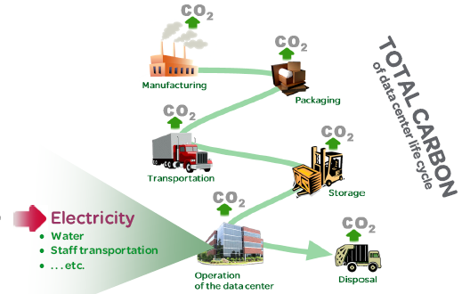

Chapter 14 Outline
14.1 IT’s Role in Reducing the Global Carbon Footprint
14.2 IT Ethical Issues and Responsibility
14.3 Connectivity Overload and Culture of Distraction
14.4 Future of IT in Business

Slide 3


Chapter 14 Learning Objectives
Understand how IT and users can reduce carbon emissions and global warming that harm the planet through green business practices and data center designs that conserve natural resources.
Understand the tradeoffs associated with conveniences and competitive advantages that IT offers.
Recognize the impacts of constant connectivity and distractions on quality of life, business, safety, and interpersonal relationships.
Understand the key trends and forecasts for IT.

Slide 4
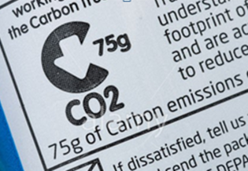
14.1 IT’s Role in Reducing the Global Carbon Footprint
The IT industry sector (called the information and communications technology, or ICT, in emission reports) has supported economic growth in developed and developing countries.
But what impact does our expanding IT dependence have on global warming?
And how can business processes be changed to use IT in order to reduce greenhouse gases (GHGs)?
Figure 14.4 Label showing the amount of CO₂ emissions produced in the making of a bag of Walkers crisps in the UK

Slide 5
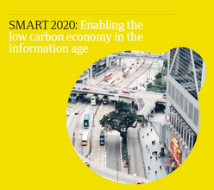
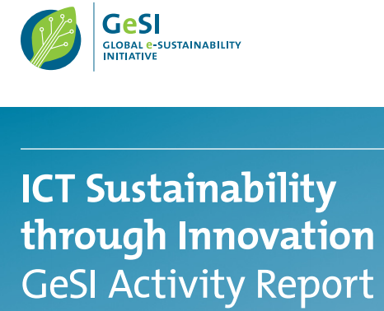
Global e-Sustainability Initiative and SMART 2020 Report
The Climate Group’s SMART 2020 Report is the world's 1st comprehensive global study of the IT sector's growing significance for the world's climate
The Climate Group on behalf of the Global e-Sustainability Initiative (GeSI) found that ICT is a key sector in the struggle to reduce climate warming

Slide 6
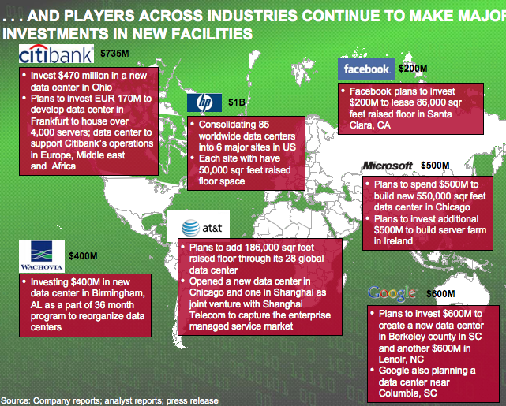
Toward a Low Carbon Economy in the Information Age
IT industry can reduce global GHG emissions by up to 30%
Many industries can use the latest IT for higher-efficiency & lower carbon
Better IT use to shift away from existing energy-intensive work habits and lifestyles will depend on government policy innovations, incentives for companies, and the active participation of consumers

Slide 7
Green IT & Mobile Solutions in Developed & Developing Nations
Sustainability—using things at a rate that does not deplete its availability in future generations
A process or industry is unsustainable when it uses up natural resources faster than they can be replenished
U.K. supermarket chain Asda deploys Isotrak's fleet management system
  Asda's fleet saved 29 million road kilometers, or 28 KtCO2e, and cut fuel costs by 23% over 3 years.
  Asda drivers have changed their behavior to improve fuel efficiency by 6.6% and the system is also enabling Asda to haul more waste and recyclable materials between stores and distribution centers, minimizing the number of trucks running without full loads.

Slide 8
GSMA Green Power for Mobile (GPM) program
GSMA GPM program advances the use of renewable energy sources by the mobile industry to power 118,000 new and existing off-grid base stations in developing countries by 2012. Achieving this target will:
  cut diesel fuel costs by $2.5 billion
  cut carbon emissions by up to 6.8 million tons per year
  connect 118 million people in developing countries to mobile networks using green power.
  GSMA Development Fund has delivered mobile green projects in Namibia, Africa and Vanuatu.

Slide 9
  Using Google Earth plugin http://earth.google.com/plugin/,
  you can view global mobile deployments in 3D at http://wirelessintelligence.com/green-power/

Slide 10
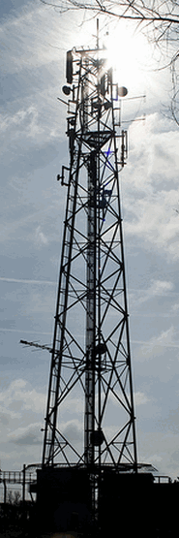
IT at Work 14.1
Soybean Biofuel Used to Run Mobile Base Stations
MTN Group in South Africa is the leading mobile telecom company, operating in Africa and the Middle East.
In Nigeria, MTN researched biofuel-powered generators. Three base stations in the Badagry region are running on biodiesel produced from locally grown soybeans. The use of soybean biofuel has increased local employment.

Slide 11
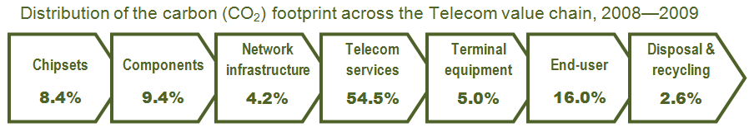
Each part of the telecom value chain, shown in Figure 14.6, is responsible for important CO2 emissions. Reductions are possible in each part of that value chain.
As the telecoms market grows so will its emissions, unless specific measures are implemented by all players in the carbon chain.
Figure 14.6 Telecom value chain’s carbon footprint

Slide 12
IT at Work 14.2
Three Myths about Green IT
Myth #1: The business case for green IT is clear
Myth #2: Green IT is an achievable outcome
Myth #3: Everyone cares about green IT

Slide 13

EPEAT and ENERGY STAR
Electronic Product Environmental Assessment Tool (EPEAT) is a searchable database of computer hardware that meets a strict set of environmental criteria.
ENERGY STAR is a joint program of the U.S. Environmental Protection Agency and Department of Energy helping save money and protect the environment through energy efficient products and practices.

Slide 14
14.2 IT Ethical Issues and Responsibility
Questions about data access and capture, tracking and monitoring, privacy and profiling are examples of IT capabilities that have ethical considerations.
In mid-2010, social media monitoring came under fire from the U.K. Daily Mail newspaper over revelations that a several large brands, including IT retailer BT, budget airline EasyJet, mobile phone retailer Carphone Warehouse, and Lloyds TSB bank, were using the specialized software to spy on customers.

Slide 15
Privacy Sensitivity
Because of privacy scandals in 2010 surrounding Facebook and Google, the public in general is extremely sensitive to privacy abuse.
Campaigns against social media monitoring that incite privacy concerns could have huge implications for both the tool and social media strategies.
There are competing interests and tradeoffs at work when the issue is privacy. But there’s no clear cut framework for deciding what is ethical and what’s not.

Slide 16
Free Speech Via Wikis and Social Networks
Free speech and privacy rights collide in a world populated by anonymous critics, vengeful people, those with personal agendas, and malcontents.
Companies victimized by online gossip and rumor have legal recourse, but against whom?
What if the identity of the sender or poster is not known?
Who is responsible for restricting troublesome content?
Furthermore, companies face legal actions if they are found to be negligent for not restricting harmful content.

Slide 17
14.3 Connectivity Overload and Culture of Distraction
Consider your daily sources of information and what you check on your mobile or the Internet.
Have you noticed the increase in the amount of information that you receive or check routinely?
Why are you receiving or checking info routinely?
Could you function without your mobile devices?
What distractions do mobile devices and constant connectivity create?

Slide 18
Information Quality—required by law
Information quality is critical to business operations and also mandated by several legislations.
The Data Quality Act of 2001 and Sarbanes-Oxley Act of 2002 impose strict information quality requirements on government agencies and companies.
  These Acts emphasize the importance of controlling and measuring data quality and information quality in business systems.
  Failure to comply can lead to huge fines and sanctions.

Slide 19
14.4 Future of IT in Business
The slideshow “Microsoft's Home of the Future: A Visual Tour” cio.com/article/597693/Microsoft_s_Home_of_the_Future_A_Visual_Tour shows a full-scale model home of the future.
The future of IT in the organization is bringing about exciting changes.
Escalating Trends:
  Cloud computing
  New faster and more robust Web
  Devices as doorways
  Fluid collaboration
  Conversation economy
  4G system development
  Data + decisions = differentiation

Slide 20
Chapter 14 Link Library
Internet World Stats internetworldstats.com/stats.htm
Green IT greenit.net/
Nicholas Institute for Environmental Policy Solutions at Duke University nicholas.duke.edu/institute/about.html
SMART 2020, low carbon economy in the information age smart2020.org/
Internet statistics, trends, and demographics isoc.org/internet/stats/
Green Student U greenstudentu.com/
National Research Council americasclimatechoices.org/
Green Power for Mobile (GPM) of the GSMA gsmworld.com/our-work/mobile_planet/green_power_for_mobile/index.htm
3D view of mobile Green Power deployments wirelessintelligence.com/green-power/
Google Earth plug-in earth.google.com/plugin/
ENERGY STAR ratings energystar.gov/
Information Commissioner’s Office, U.K. ico.gov.uk/
Stop Climate Change, European Free Alliance stopclimatechange.net/
U.S. Global Change Research Program globalchange.gov/

