Slide 1
IS Development and
Business Process Management
Part V. Managing IT, Business Processes, and
Social/Ecology Responsibility
Chapter 13
Course

Slide 2
Chapter 13 Outline
13.1 Business Process Management (BPM) and
Service-Oriented Architecture (SOA)
13.2 Software Architecture and IS Design
13.3 IT Project Management
13.4 Systems Development

Slide 3
Chapter 13 Learning Objectives
Understand business process management (BPM), BPM tools, and service-oriented architecture (SOA)—and their role in business agility and process optimization.
Understand the importance of software architecture design to the maintenance and agility of business processes.
Describe IT project identification, justification, and planning; and understand the triple constraints.
Describe the systems development lifecycle (SDLC).

Slide 4
13.1 Business Process Management (BPM) and Service-Oriented Architecture (SOA)
A business process accomplishes or produces something of value to the organization.
A business process consists of a collection of tasks that are executed according to certain rules to achieve certain goals.
  Tasks can be automated, semi-automated, or be performed manually.
A process has inputs and outputs that are measurable, and therefore can be managed.
Business processes integrate ISs and people.

Slide 5
Example of a process

Slide 6
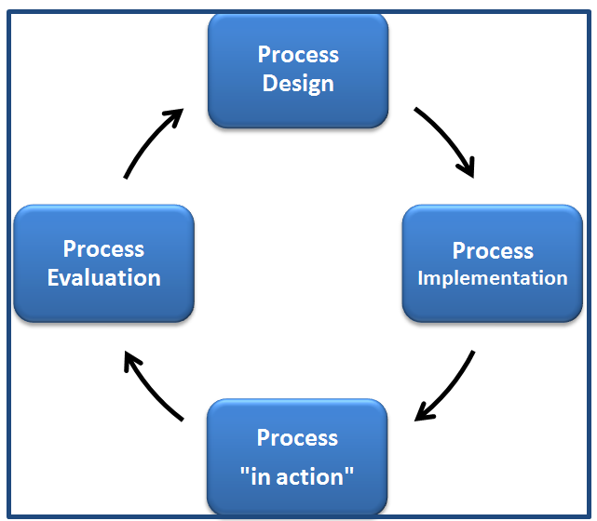
Figure 13.2 Business process life cycle

Slide 7
Business activity monitoring (BAM)
Many software vendors that are used to implement business processes, such as Oracle, Microsoft, Cordys, and IBM, include business activity monitoring (BAM) functionality.
For example, Oracle BAM is an integral part of the BPM suite oracle.com/appserver/business-activity-monitoring.html
  It is a message-based, event-driven platform links KPIs of the process being monitored in real-time and presents information about the processes on dashboards.

Slide 8
Business process management (BPM)
Methods and tools to support stages of the business process lifecycle.
In the short term, BPM helps companies improve profitability by reducing waste and costs
In the long run, BPM helps keep companies responsive to business changes.
To properly address process improvement, organizations must develop a carefully crafted BPM strategy.

Slide 9
BPM Strategy Considerations
A well-implemented BPM strategy enables an organization to:
  Gain greater visibility into processes
  Identify root causes of bottlenecks within processes
  Pinpoint hand-offs in processes
  Warning: If organizations focus exclusively on automation and cost savings, they can improve operational efficiencies, but lose their competitive edge and fall short of performance targets, as British Telecom (BT) and United Airlines did when they failed to link strategic goals with their BPM initiatives.

Slide 10
Service-Oriented Architecture (SOA)
SOA enables businesses to leverage existing IT investments by reusing existing apps
SOA can enable interoperability between different types of apps
SOA provides a level of flexibility that wasn't possible before

Slide 11
13.2 Software Architecture and IS Design
Long ago, business applications were written in COBOL
These apps were one large piece or tightly coupled programs that performed many functions
  Tightly coupled means that the programs, data, and reports they generated were hardwired
  Changes to these apps were tedious and time-consuming
The preferred software design is loosely coupled—and performs only a single function or very few functions
An organizations’ software architecture can also be designed for greater flexibility by using a tiered model

Slide 12
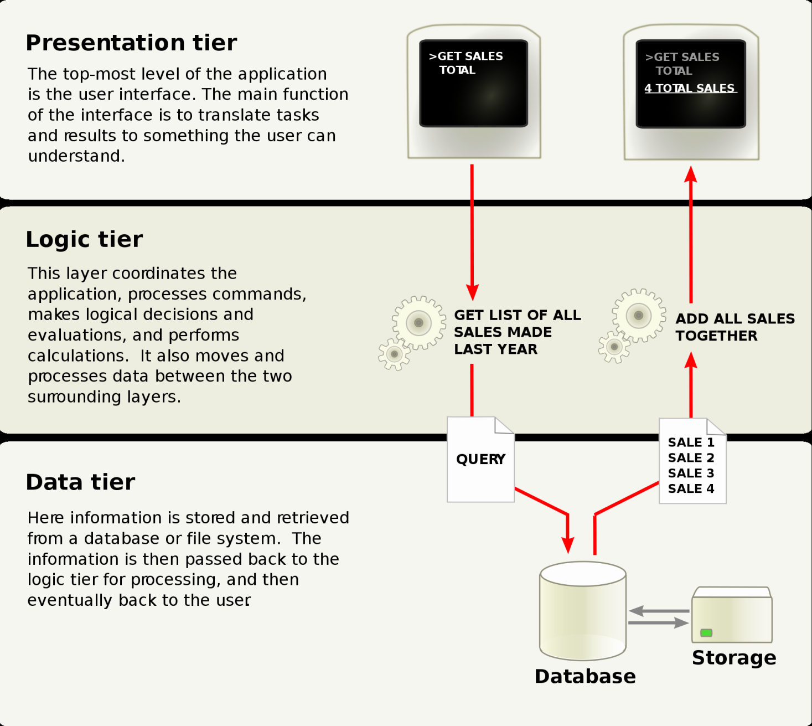

Slide 13
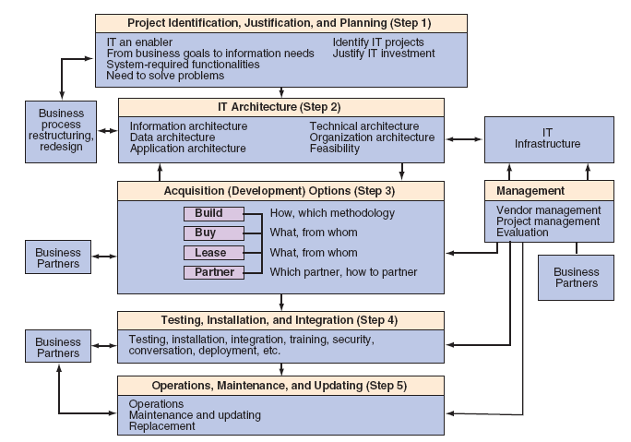
The IT Acquisition Process
Figure 13.4 The process of IT application acquisition

Slide 14

IT at Work 13.1
High-Tech Census Project Fails—An Analysis
The U.S. Census Bureau scrapped its $600 million project that was supposed to collect data using 500,000 handheld devices in 2010.
The Bureau had contracted to use handheld devices from Harris Corp., but mismanagement, cost overruns, and poor planning caused the plan to fail.
Poor management—not poor technology—caused the government to spend an additional $3 billion for the next census.

Slide 15
In-House Development: Insourcing
Although in-house development—insourcing—can be time consuming and costly, it may lead to IT apps that better fit an enterprise’s strategy and vision
  Options for In-House Development
  Build from scratch
  Build from components
  Integrating applications

Slide 16
In-House Development Methods
Systems development life cycle (SDLC). Large IT projects, especially ones that involve infrastructure, are developed according to the SDLC methodology using several tools.
Prototyping methodology. With a prototyping methodology, an initial list of basic system requirements is defined and used to build a prototype. The prototype is then improved in several iterations, based on users’ feedback.
    Web 2.0 or Application 2.0 methodology. This prototype approach involves close user involvement and the use of Web 2.0 tools.

Slide 17
13.3 IT Project Management
Projects are managed by managing the triple constraints, which are:
Scope: what the project is supposed to accomplish—its outcomes or deliverables.
Time: determined by task durations and task dependencies. Some tasks are dependent on other tasks being completed before they can begin. For example, in construction, a hole must be dug before the pouring of concrete can start. Task durations and task dependencies determine the time required to complete the project.
Budget: resources allocated to the project.

Slide 18
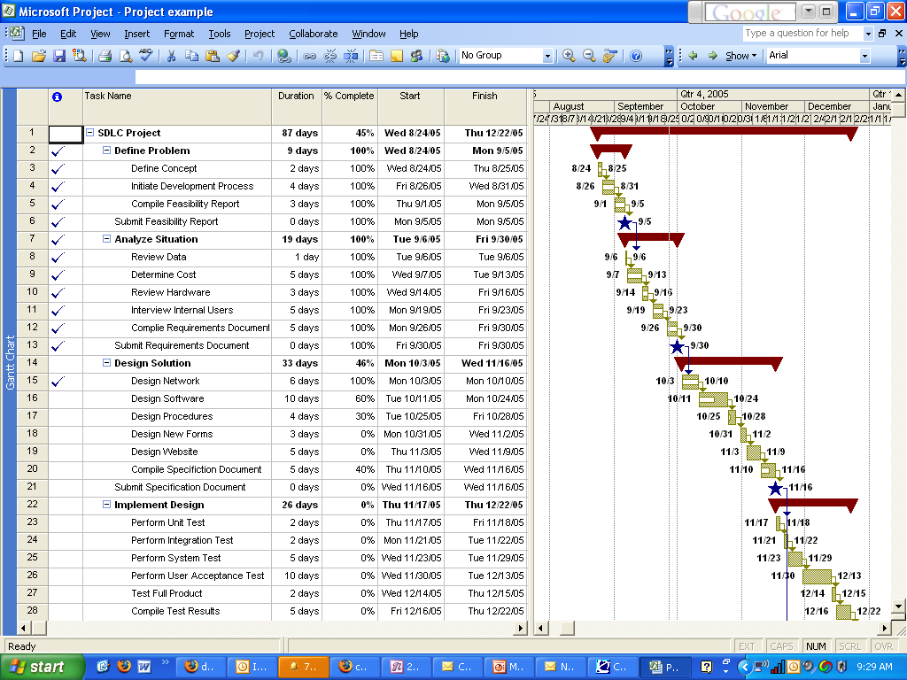
Figure 13.5 Project work breakdown schedule (WBS) and Gantt chart

Slide 19
What Do Project Managers Do?
Project management includes 3 basic operations:
Planning: Specifying the desired results, determining the schedules, and estimating the resources.
Organizing: Defining people’s roles and responsibilities.
Controlling: Tracking the planned performance and budget against the actual performance. Also managing people’s performances, addressing problems, putting out fires, and keeping priorities well-known.

Slide 20
Managing the Critical Path
Tasks must be completed in a specific order to get the job done.
Certain tasks make up what is called the critical path, which is an important principle of project management.
Project managers must manage the critical path.
The critical path is the length of the project. Each task on the critical path is a critical task.
Critical tasks must start and finish on schedule or else the project completion will be delayed--unless action is taken to expedite them.

Slide 21
13.4 Systems Development
The systems development life cycle (SDLC) is the traditional systems development method used by organizations for large IT projects, such as IT infrastructure.
The SDLC is a structured framework that consists of sequential processes by which information systems are developed.
Within the SDLC, there is an iterative feature. Iteration is the revising of the results of any development process when new information makes this revision the smart thing to do.

Slide 22
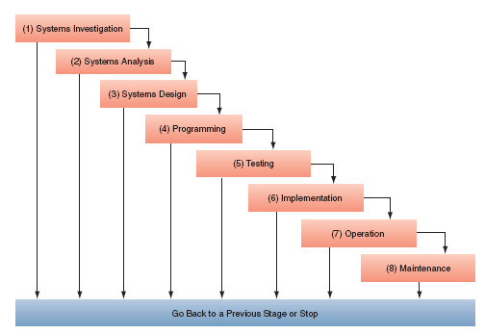
Figure 13.6 An eight-stage system development life cycle (SDLC)

Slide 23
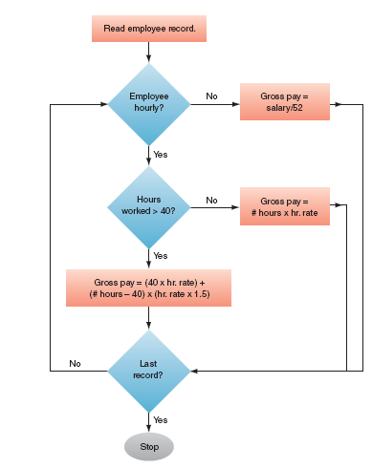
Figure 13.7 Flowchart of a payroll application.
Used during the programming stage (stage 4 )

Slide 24
Chapter 13 Link Library
ARIS Express, business process modeling software. ariscommunity.com/aris-express
Oracle BPM Suite 11g oracle.com/us/technologies/bpm/
Oracle SOA Suite 11g oracle.com/us/technologies/soa/
Project Management Institute pmi.org/
Fastforward BPM blog fastforwardblog.com/
Open source BPM and workflow processmaker.com/
BPM/SOA Community Insights blog.soa-consortium.org/
Adaptive Planning demo for budgeting, forecasting, reporting, analysis adaptiveplanning.com/
IBM BPM www-01.ibm.com/software/info/bpm/
IBM BPM Blueprint demo www-01.ibm.com/software/integration/bpm-blueprint/
IT Business Edge BPM itbusinessedge.com/topics/show.aspx?t=482
Oracle Business Activity Monitoring (BAM) oracle.com/appserver/business-activity-monitoring.html
InfoSys Research BPM, SOA, and enterprise architecture infosys.com/research/ and infosys.com/research/centers-of-excellence/

