Slide 1
IT Strategic Planning
Part V. Managing IT, Business Processes, and
Social/Ecology Responsibility
Chapter 12
Course

Slide 2
Chapter 12 Outline
12.1 IT Strategies
12.2 Corporate and IT Governance
12.3 Aligning IT with Business Strategy
12.4 IT Strategic Planning Process
12.5 IT Outsourcing Strategies

Slide 3
Chapter 12 Learning Objectives
Explain the value of aligning the IT and business strategies, and how this alignment can be achieved.
Recognize the importance, functions, and challenges of IT governance.
Describe the reasons and benefits of aligning IT strategy and business strategy.
Describe the IT strategic planning process.
Understand major types of outsourcing, reasons for outsourcing, and the risks and benefits.

Slide 4
IT Investments
Making IT investments on the basis of an immediate need or threat are sometimes necessary, but these reactive approaches won’t maximize ROI—and can result in incompatible, redundant, or failed systems.
Two of the biggest risks and concerns of top management are:
  failing to align IT to real business needs; and, as a result
  failing to deliver value to the business

Slide 5
12.1 IT Strategies
4 main points of IT strategic plans are:
To improve management’s understanding of IT opportunities and limitations
To assess current performance
To identify capacity and human resource requirements
To clarify the level of investment required

Slide 6
IT strategies can be divided into 2 categories:
  In-house development
  Outsource development, or outsourcing
    on-shore (domestic) sourcing
    offshoring
Organizations use combinations of these IT strategies—in-house, on-shore sourcing, offshoring, cloud computing, and SaaS.

Slide 7
Reasons why an IT project might be abandoned:
the business strategy changed
technology changed
the project was not going to be completed on time or budget
the project sponsors responsible did not work well together
the IT strategy was changed to cloud or SaaS.

Slide 8


A company can outsource the work, but not the responsibility for it
When an IT failure causes harm to people or the environment, then regulatory agencies—and the public--will hold the CEO accountable.
BP CEO Tony Hayward was held accountable for "The Role of BP in the Deepwater Horizon Explosion and Oil Spill,“ killed 11 workers and released 60,000+ barrels per day into the Gulf of Mexico. Hayward’s attempts to claim ignorance of the risks and use the SODDI defense (some other dude did it) didn’t work.
Figure 12.2 Activists Protest the BP Oil Spill at a BP Gas Station in Soho, New York by spilling "oil" on themselves. May 28, 2010

Slide 9
12.2 Corporate and IT Governance
IT governance is concerned with insuring that organizational investments in IT deliver full value.
IT performance management--being able to predict and anticipate failures before it’s too late-- is a big part of IT governance.
IT performance management functions include the following:
  verify that strategic IT objectives are being achieved
  review IT performance
  assess the contribution of IT to the business

Slide 10
What IT Governance Covers
Supports the strategy: Provides for strategic direction of IT.
Delivers value: Confirms maximum business value from IT.
Risk management: Confirms that risks have been adequately managed.
Resource management: Provides direction for sourcing and use of IT resources.
IT Performance management: (Refer also to the beginning of section 12.2) Verifies strategic compliance, or the achievement of strategic IT objectives.

Slide 11
12.3 Aligning IT with Business Strategy
IT–business alignment can be improved in several ways:
  1. Understanding IT and corporate planning
  2. CIO is a member of senior management
  3. Shared culture and good communication
  4. Commitment to IT planning by senior management
  5. Links between business and IT plans should be made at the strategic, tactical, and operational levels.

Slide 12
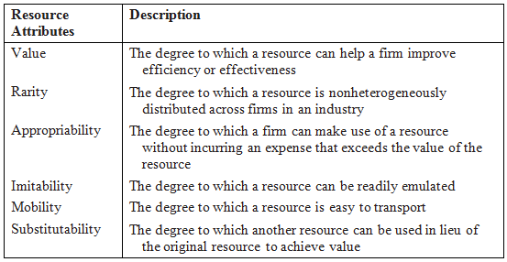
TABLE 12.3 Key Resource Attributes That Create Competitive Advantage

Slide 13
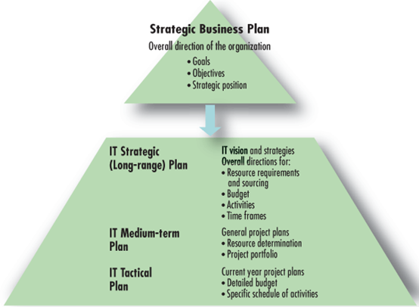
12.4 IT Strategic Planning Process
Figure 12.4. IT strategic planning process.

Slide 14
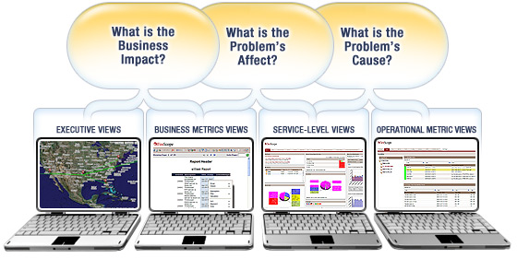
Tools and Methodologies of IT Strategic Planning
Business Service Management: links KPIs of IT to business goals to determine their impacts on the business
Figure 12.5 Business Service Management (from FireScope)

Slide 15
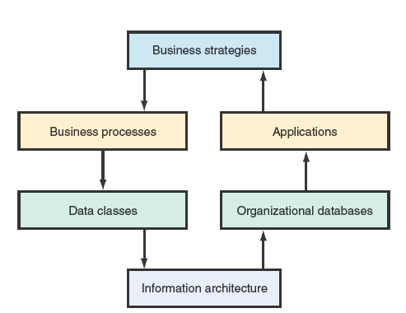
Tools and Methodologies of IT Strategic Planning
Business systems planning (BSP) developed by IBM.
From this architecture, planners define organizational databases and apps that support business strategies.
Figure 12.6 Business systems planning (BSP) approach

Slide 16
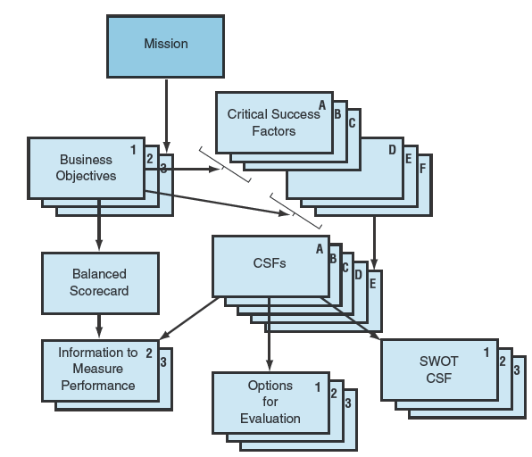
Other Tools and Methodologies of IT Strategic Planning
Balanced Scorecard
Critical Success Factors (CSF)
Scenario Planning
Resource Allocation
Figure 12.7

Slide 17
12.5 IT Outsourcing Strategies
Outsourcing can be done domestically or offshore, or via cloud computing or SaaS
SaaS provides an ability to easily extend internal processes outside the organizational boundary to support business processing outsourcing (BPO) arrangements
BPO:
  the process of hiring another company to handle business activities
  includes non-core functions, such as financial and administration processes, HR functions, call center and customer service activities, and accounting

Slide 18
Outsourcing
Outsourcing deals are multi-year contracts that can run into hundreds of millions of dollars.
Often, people performing the work internally for the client firm are transferred and become employees for the service provider.
Outsourcing service providers: IBM, Accenture, and Hewitt Associates in the U.S. and European and Asian companies Capgemini, Genpact, TCS, Wipro and Infosys.
Many of these BPO efforts involve offshoring, with India one of the most popular location for BPO activities.

Slide 19
IT at Work 12.3 eBay Challenging Transition to BPO
In 2005, eBay migrated all of its AP operations to Genpact, a BPO provider.
This migration to Genpact was not without challenges, but was ultimately a success.
Lessons learned:
Manage change by securing the commitment of senior leaders
Assess organizational readiness for a BPO transition and set realistic expectations
Anticipate risks and formulate a plan for mitigating them
Build project management infrastructure to manage the transition and the processes being transitioned
Create a governance mechanism that provides feedback and oversight
Properly define how success will be measured, qualitatively & quantitatively

Slide 20
Growth in Outsourcing as an IT Strategy
Since the late 1980s, many organizations have outsourced the majority of their IT functions, rather than only incidental parts.
The trend became classic in 1989 when Eastman Kodak transferred its data centers to IBM under a 10-year, $500 million contract.
  This example, at a prominent multibillion-dollar company, gave a clear signal that outsourcing was a legitimate IT strategy.
Trend is toward using multi-vendors to capture the services of best-of-breed vendors.
Organizations are leveraging existing global cloud infrastructures from Amazon, Google, Rackspace, and Windows Azure.

Slide 21

S3, one of Amazon’s Web services
S3 (Simple Storage Service) lets businesses store their data in the cloud, avoiding the need to operate their own servers. http://aws.amazon.com/s3/
S3 is part of the same online infrastructure that Amazon uses to run its own business.
Twitter uses S3, as does The New York Times to store and deliver articles from its historical archives.
Outsourcing companies have started to offer some interesting new business models and services around cloud computing.
These innovative new IT models have added to the number of options to be considered in IT strategic planning.

Slide 22
Outsourcing Risks and Hidden Costs
Shirking: Vendor underperforms while claiming full payment.
Poaching: Vendor develops a strategic app for a client and then uses it for other clients.
Opportunistic repricing: Vendor over-charges for unanticipated enhancements.
Inability to deliver
Loss of control over data

Slide 23
IT Offshoring, or IT offshore outsourcing
Offshoring software development has become a common practice due to global markets, lower costs, and increased access to skilled labor.
Duke University's Center for International Business Education and Research studied IT offshoring results at Fortune 500 companies.
  63% of the companies cut costs 30% per year
  14% of them achieved savings over 50%
According to a 2009 report by AMR Research on the state of IT outsourcing, 80% of enterprises planned to increase their amount of IT offshoring or keep it constant.

Slide 24
Types of work that are not readily offshored
Work that has not been routinized
Work that if offshored would result in the client company losing too much control over critical operations
Situations in which offshoring would place the client company at too great a risk to its data security, data privacy, or intellectual property.
Business activities that rely on an uncommon combination of specific application-domain knowledge and IT knowledge in order to do the work properly.

Slide 25
Outsourcing Life-Cycle
Strategy
Reassessment
Selection
Negotiation
Implementation
Oversight management
Build completion
Change
Exit

Slide 26
Chapter 12 Link Library
Balanced Scorecard Institute balancedscorecard.org/
Outsourcing Professionals’ best outsourcing service providers outsourcingprofessional.org/content/23/152/1197/
Visual Ark virtualark.com/
Windows Azure microsoft.com/windowsazure/
Rackspace Hosting rackspace.com/
CIO Insights and Strategy IBM.com/CIO/
Debate Over Offshore Outsourcing quality-web-solutions.com/offshore-outsourcing-debate.php
Outsource Blog theoutsourceblog.com/
Bloomberg Real-time Information Services bloomberg.com/
IT Governance Institute itgi.org/
Video on SaaS & Outsourcing Relationship Management janeeva.com/blog/

