Slide 1
Operational Planning and Control Systems
Part IV. Operational and Enterprise Systems and Processes
Chapter 9
Course

Slide 2
Chapter 9 Outline
9.1 Management Levels, Functions, and Operational Systems
9.2 Manufacturing and Production Systems
9.3 Sales and Marketing Systems
9.4 Accounting and Finance Systems
9.5 Human Resource Systems

Slide 3
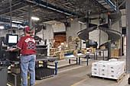
Chapter 9 Learning Objectives
Describe how functional systems support managers and workers at the operational level
Understand the support provided by manufacturing and production/operations systems
Understand the support provided by marketing and sales systems
Understand the support provided by accounting and finance systems
Understand the support provided by human resources systems
Figure 9.4. Preparing factory orders for shipping

Slide 4
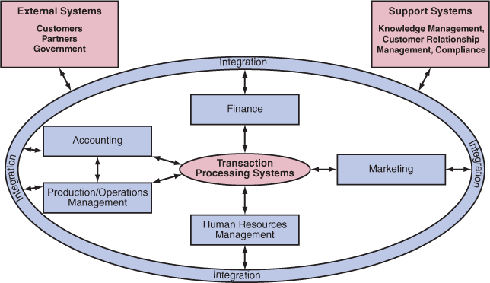
Figure 9.1 Functional areas, TPS, and integration connection.
Getting a complete view of what’s going on requires integrating the functional systems with the TPS.

Slide 5
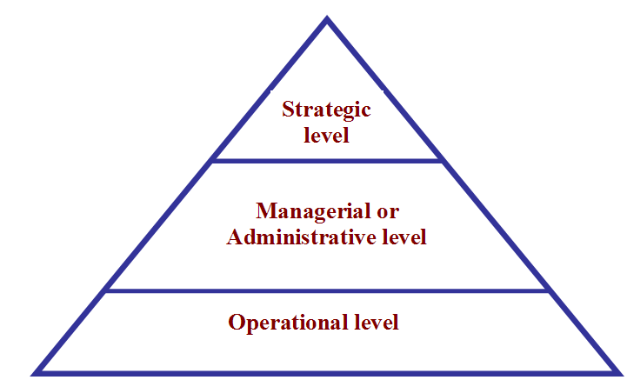
9.1 Management Levels, Functions, and Operational Systems
Each level of management has its own data needs, decision making responsibilities, and time horizons
Figure 9.3 Robert Anthony’s Model of organizational levels, decision making, planning and control

Slide 6
IT support of all levels
Strategic level. Decisions are visionary, future-oriented, and define the mission, objectives, and strategy. External data needed for SWOT (strengths, weaknesses, opportunities, threats) analysis.
Managerial or administrative level. Control is important at this level. Middle level managers set goals for their departments or business units. External and internal data are important.
Operational level. Lower-level managers, supervisors, and workers need detailed data, in real-time or near real-time, and the ability to respond to what they learn from functional ISs.

Slide 7
TABLE 9.1 Key Characteristics of a TPS
• Large volumes of data are processed.
• Data sources are mostly internal, and the output is intended mainly for internal users and trading partners.
• Processes data on a regular basis: hourly, daily, weekly, biweekly, and so on.
• High speed processing due to the high volume.
• Input and output data are structured.
• High level of detailed raw data.
• Low computation complexity.
• Accuracy, data integrity, and security are critical.
• High reliability is required.
• Quick search and query processing capacities are a must, often in real time.

Slide 8

Operational Sub-Systems
Manufacturing and production: purchasing, quality control, scheduling, shipping, receiving
Accounting: accounts receivable, accounts payable, general ledger, budgeting
Finance: cash management, asset management, credit management, reporting
Sales and marketing: order tracking, pricing, sales commissions, market research
HR: payroll, employee benefits, training, compensation, employee relations, staffing, performance appraisal
Figure 9.5 Server at a café uses a mobile scanner to process credit card payment

Slide 9
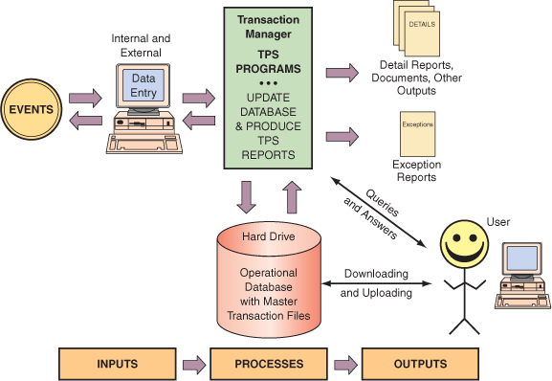
Figure 9.6 Flow of information in transaction processing

Slide 10
Processing
Batch: data is collected from transactions and stored. The system then prepares and processes the collected data periodically, such as at the end of the workday. E.g., payroll, billing
Online [online transaction processing (OLTP)]: data are processed as soon as the transaction occurs, in real time. Data can be accessed directly from the operational database.

Slide 11
IT at Work 9.2
Yahoo! Web Analytics helps First Choice Ski Triple Sales
firstchoice-ski.co.uk/
In the highly competitive tour operator industry, margins are tight. As a result, real-time reporting is key to maintaining a profitable business.
By using Yahoo! Web Analytics (web.analytics.yahoo.com/), First Choice Ski was able to gain insights into its customers to respond in near real-time to their online behaviors—by revamping its travel Web site.
The Internal Campaign Report is valuable because of the numerous travel promotions on First Choice Ski. They monitor the number of clicks and number of sales generated by the campaigns, and when a low ratio of sales to clicks is noticed, they adjust the campaign accordingly.

Slide 12
IT at Work 9.3
TIAA-CREF Reporting Failure
TIAA-CREF is a huge company serving the retirement, insurance, and other financial needs
In September 2005, thousands of TIAA-CREF members were unable to withdraw funds from their pensions. The company assured clients that this was just a small delay due to the IT platform upgrade. However, the problems continued for months and expanded to interfere with deposits as well.
The cause of the problem was the introduction of the powerful new IT platform, Open Plan Solutions.
The integrated platform did not synchronize the company’s Web-access software and the record-keeping system during the batch transaction processing. In other words, the new system was not in sync with the old one.

Slide 13
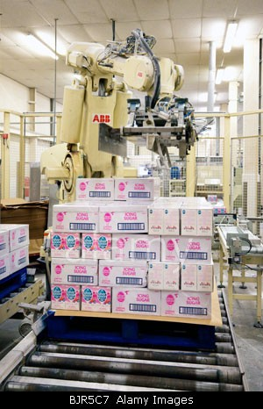
9.2 Manufacturing and Production Systems
Logistics management deals with ordering, purchasing, inbound logistics (receiving), and outbound logistics (shipping) activities. In-house logistics activities are processes that cross several functional departments.
Scanners, RFID, and voice technologies support inspection, and robots can perform distribution and materials handling.
Figure 9.8. Industrial robot handles boxes of sugar

Slide 14
Inventory control systems
inventory control minimizes the total cost of inventory
objective is to maintain optimal inventory levels by re-ordering the correct quantity at the right time
Inventory control systems minimize 3 categories of cost:
  cost of holding inventory: warehousing costs, security costs, insurance, losses due to theft or obsolescence, inventory financing costs based on the interest rate
  cost of ordering and shipping: employees’ time ordering and receiving, shipping fees
  cost of inventory shortage: production delays and forgone revenues because of stock outs

Slide 15
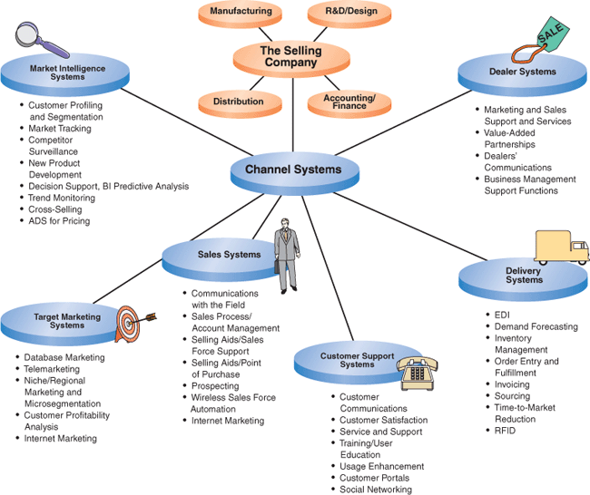
9.3 Sales and Marketing Systems
Figure 9.9 Marketing channel systems

Slide 16
Marketing management functions
Data-driven marketing
Distribution channels
Marketing management
  Pricing of products and services
  Salesperson productivity
Profitability analysis
New product analysis, market planning, and forecasting

Slide 17
9.4 Accounting and Finance Systems
Accounting and finance: control and manage cash flows, assets, liabilities, net income or profit; and issue financial statements to regulatory agencies
Critical responsibility: fraud prevention, detection, and investigation
Inaccurate cash flow projection: #1 reason why many small businesses go bankrupt
Inability to access credit led to the demise of the investment bank Lehman Brothers in September 2008.
Several software packages, many Web-based, support budget preparation and control. Budgeting modules from Oracle and Capterra.com facilitate communication among participants in budget preparation.
Software support for budgeting and forecasting is available from Prophix

Slide 18
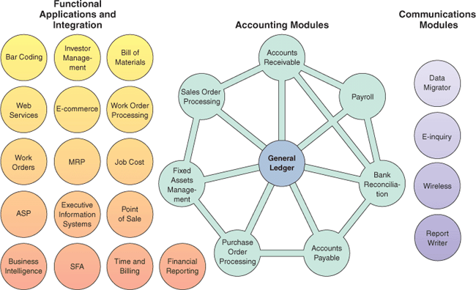
Figure 9.11 Integrated accounting/business software

Slide 19
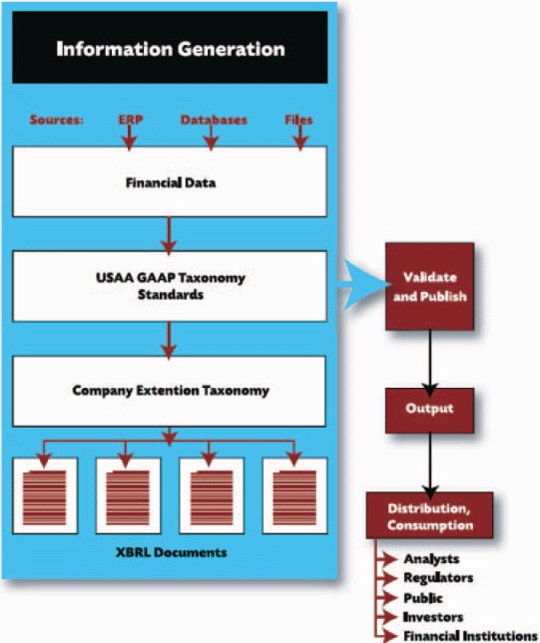
XBRL: eXtensible Business Reporting Language
XBRL is a programming language and an international standard for electronic transmission of business and financial information
Figure 9.12 How XBRL works

Slide 20
XBRL helps financial institutes:
Generate cleaner data, including written explanations and supporting notes.
Produce more accurate data with fewer errors that require follow-up by regulators.
Transmit data faster to regulators and meet deadlines.
Increase the number of cases and amount of information that staffers can handle.
Make information available faster to regulators and the public.

Slide 21
9.5 Human Resource Information Systems (HRIS)
Human Resources (HR) deals with policies, procedures, compliance requirements, and best practices.
HRISs have been moved to intranets and the cloud—where HR apps are leased in software as a service (SaaS) arrangements.
IT at Work 9.5
Using Intelligent Software and Social Networks to Improve Recruiting Processes
The challenge for companies is how to cost-effectively manage the online recruiting process because online ads are attracting large numbers of applicants. For example, Infosys receives over 1 million job applications each year to fill 9,000 positions.
Trovix offers a service based on its HR software, which uses embedded intelligence to help manage the recruitment process.

Slide 22
HR maintenance and development
Once recruited, employees become part of the corporate human resources pool, which needs to be maintained and developed. Some activities supported by IT are the following:
  Performance evaluation
  Training and development
  Labor negotiation
  Benefits administration
  Employee relationship management

Slide 23

Ethics
HRM applications are especially prone to ethical and legal considerations. E.g., training activities that are part of HRM may involve ethical issues in recruiting and selecting employees and in evaluating performance.
Likewise, TPS data processing and storage deal with private information about people, their performance, and so forth. Care should be taken to protect this information and the privacy of employees and customers.

Slide 24
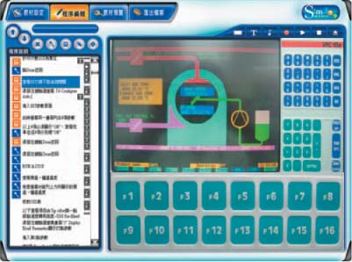
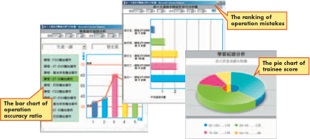
Examples of HR training software
(a) SimMagic training application in the pharmaceutical industry
(b) SimMagic presenting data of the training process
Figure 9.14. SimMagic training app and progress charts

Slide 25
Chapter 9 Link Library
Data sets, including profit margins data360.org
Web Analytics Association webanalyticsassociation.org
Piwik, open source Web analytics piwik.org/
Google Analytics google.com/analytics
Yahoo! Web Analytics web.analytics.yahoo.com/
Oracle oracle.com
EOQ Tutorial scm.ncsu.edu/public/inventory/6eoq.html
Project Management Institute (PMI) pmi.org
WebEx webex.com
Salesforce software salesforce.com

