Slide 1
Mobile Computing and Commerce
Part III. Web, Wireless, and Social Media Strategies
Chapter 7
Course

Slide 2
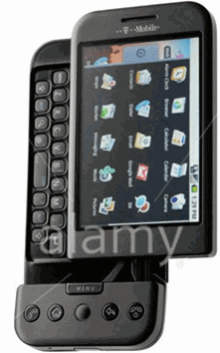
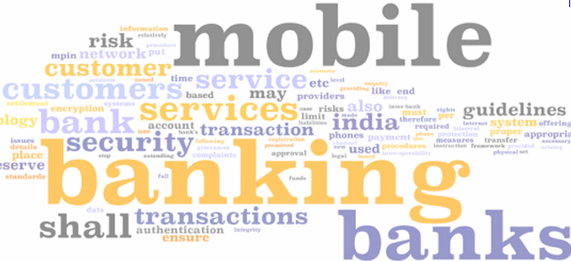
Chapter 7 Outline
7.1 Mobile Computing Technology
7.2 Mobile Financial Services (MFS)
7.3 Mobile Shopping, Entertainment and Advertising
7.4 Location-Based Services and Commerce
7.5 Mobile Enterprise Applications

Slide 3
Chapter 7 Learning Objectives
Understand mobile computing technologies
Describe the emergence of the mobile financial services industry
Understand the growing role of mobile computing in shopping, entertainment, gaming, hospitality & travel, and advertising
Describe the growth of location-based services & commerce
Identify the expansion of enterprise handhelds that make use of mobile computing technology

Slide 4
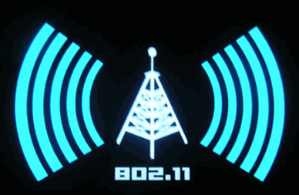
7.1 Mobile Computing Technology
The mobile computing landscape has evolved rapidly over the last two decades.
Wireless technology makes location irrelevant--making mobile computing and commerce a source of vast opportunities for businesses
As of 2010, there are over 4.6 billion cell phone users globally, which accounts for 60.6% of the world population.

Slide 5
Most popular mobile operating systems (OSs)
Blackberry OS (RIM) Dominant smartphone OS in U.S. and #2 globally
iOS (Apple) Used in Apple’s iPhone, iPod Touch and iPad products
Windows Mobile OS (MS) Losing ground globally to newer platforms
Windows Mobile OS (Google/Open Handset Alliance) Predicted to compete fiercely against Apple’s iOS
Palm OS (Palm) Enhanced for use in smartphones and PDAs
Linux OS (Linux) iOS, Android & Palm OSs are based on Linux Kernel
Symbian OS (Symbian Foundation) Globally it’s the dominant smartphone OS; runs mainly on Nokia phones

Slide 6
Figure 7.5 Smartphone OS Market Share in the U.S. , Q1 2010

Slide 7
Figure 7.6 Global Smartphone OS Market Share

Slide 8
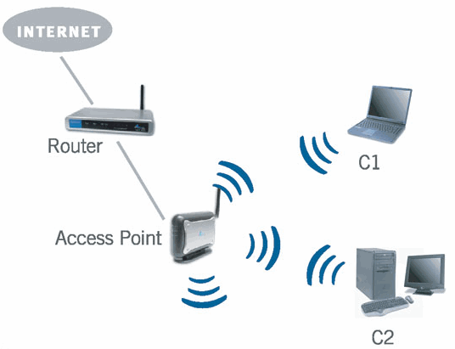
Network Access Point (AP)
Mobile devices must be able to connect
with high-speed broadband networks.
Mobile computing and commerce relies on 2 basic approaches to Internet connectivity:
  short range wireless technologies, such as Wi-Fi
  longer range telecommunications technologies,
  such as 3G and 4G networks, such as WiMAX

Slide 9
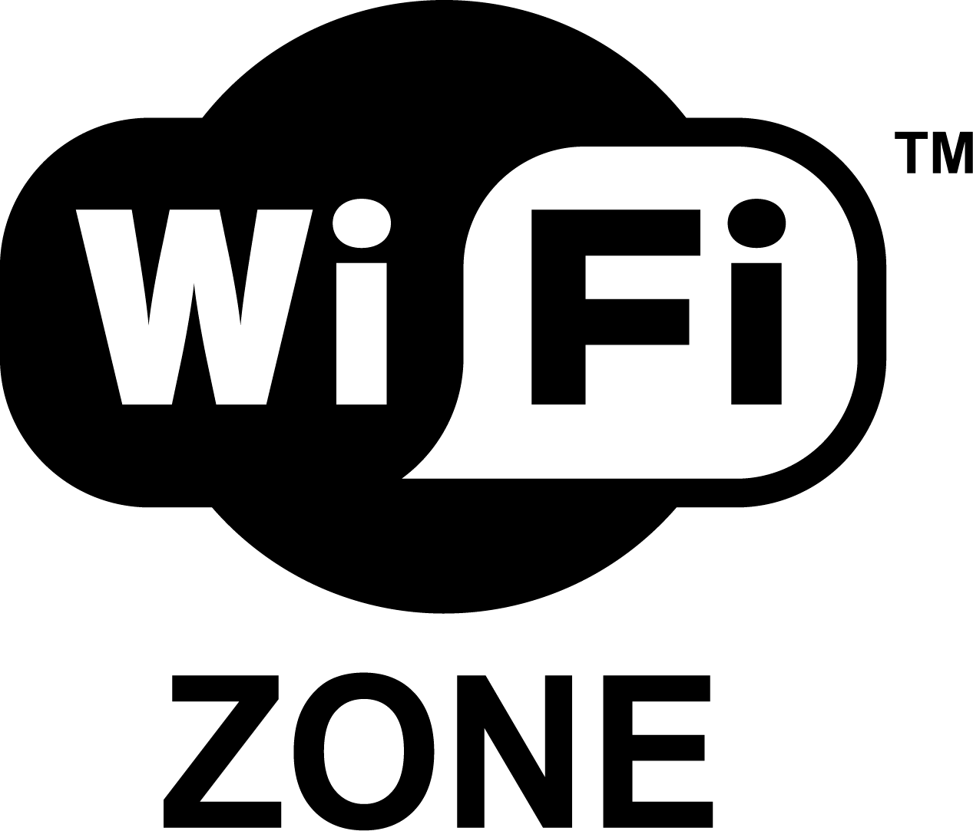
Wireless Local Area Networks (WLAN) & Wi-Fi
WLANs transmit/receive data over airwaves over a
short distance –Wi-Fi
Typical configuration: a transmitter with an antenna,
called a wireless access point (WAP) connects to a
wired LAN from a fixed location or to satellite dishes
that provide an Internet connection
Wi-Fi is used to support business & compliance requirements
  After the 2006 Sago mine disaster in W. Virginia, the U.S. Congress passed the Mine Improvement and New Emergency Response (MINER) Act
  MINER Act requires 2-way communications between underground and surface personnel; and an e-tracking system so surface personnel can determine the location of anyone trapped underground
  Solution: Wi-Fi to monitor underground conditions

Slide 10
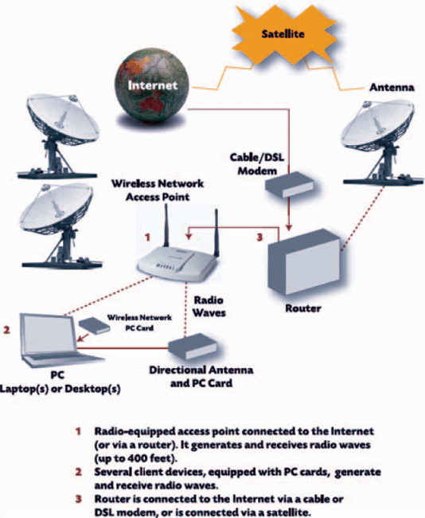
Figure 7.7 How Wi-Fi works

Slide 11
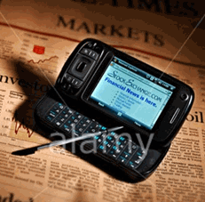
7.2 Mobile Financial Services (MFS)
Mobile banking is an extension of online banking
Financial service handhelds use short codes for sending SMS texts. Once a company has leased its short code, it can use it in promotions and interactivity with customers
  Voting on the TV show American Idol is done with short codes.
  Each contestant is assigned a short code; & viewers send text messages indicating which performer they liked best.
In Europe, U.S., & Asia, an increasing
percent of banks offer mobile access
to financial and account information

Slide 12
Mobile Banking Security Risks
Cloning – Duplicating the Electronic Serial Number (ESM) of one phone and using it in second phone, the clone
Phishing – Using a fraudulent communication, such as an email, to trick the receiver into revealing confidential information
Smishing – Similar to phishing, but the fraudulent communication comes is an SMS message
Vishing – Similar to phishing, but the fraudulent communication is voice or voicemail message
Lost or Stolen Phone – Lost or stolen cell phones can be used to conduct financial transactions without the owner’s permission

Slide 13
Mobile Electronic Payment Systems & examples
Innovative e-payment systems are needed that make transactions from smartphones and other mobile devices convenient and secure
  Charge to phone bill w/ SMS confirmation Boku.com
  Near Field Communication (NFC) Blingnation.com
  Credit card via phone # & SMS – Zong.com | Paypal.com
  Credit card + Web form
  Transfer funds from payment account using SMS obopay.com
  Mobile phone card reader square.com
  Using 2D tags Cimbal.com
  Bumping iPhones with Payment Applications bumptechnologies.com
  Phone displays barcode that retailers scan Facecash.com
  Mobile wallet
  Most payment systems described above are illustrated on Youtube.com

Slide 14
7.3 Mobile Shopping, Entertainment and Advertising
Mobile commerce B2C handhelds are expanding in retail, entertainment, gaming, travel, hospitality advertising, and digital content—music, news, videos, movies, or games via portals
Shopping from wireless devices
  Wireless shoppers are supported by services similar to those available for wired (wireline) shoppers
  Customers use smartphones to shop at sites like target.com, amazon.com, and buy.com
  Many national restaurant chains offer consumers the ability to search menus, order and pay for food via mobiles

Slide 15
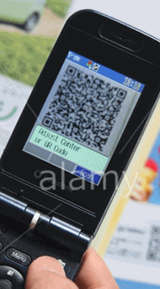
Mobiles, Codes, and Comparison Sites
Consumers increasingly use mobiles to get product
& price info while shopping in traditional stores
Pricegrabber.com, slifter.com, and froogle.com are a few of the price comparison sites to search for product information from mobile devices
Experts are now advising retailers that they need to take these savvy shoppers into consideration when developing their mobile strategy
Figure 7.9 QR codes linked to specific goods/services give mobile users access to product info

Slide 16

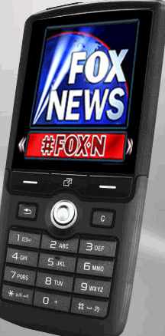
Mobile Entertainment
Sports enthusiasts enjoy a large number of apps and services on their mobile devices.
  ESPN’s Sport Center, in partnership with Sanyo, offers a cell phone dedicated to sports.
  Companies like theChanner.com and FLO TV offer television programming to mobiles
  Fox Mobile introduced a mobile app that will allow smartphone users to view TV content from its Web site Hulu.com
  iTunes Store continues to be a leader in making digital music, movies, & podcasts
  Food Network has a handheld with tips and recipes for fine dining and entertaining

Slide 17
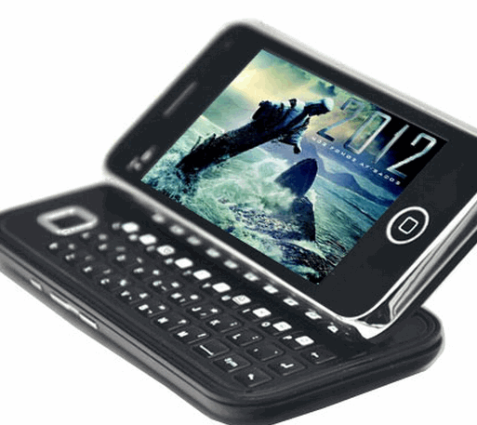
Mobile Game Market
>45% of smartphone users play games
With smartphones, the potential audience for
mobile games is substantially larger than the market
for other platforms, such as PlayStation or X-box
Mobile game market is growing rapidly as network speeds and the power of mobiles increase the richness of the gaming experience
Ericsson, Motorola, Nokia, and Siemens established the Open Mobile Alliance openmobilealliance.org to define a range of technical standards that make it possible to deploy mobile games across multi-game servers and wireless networks, and over different mobile devices

Slide 18
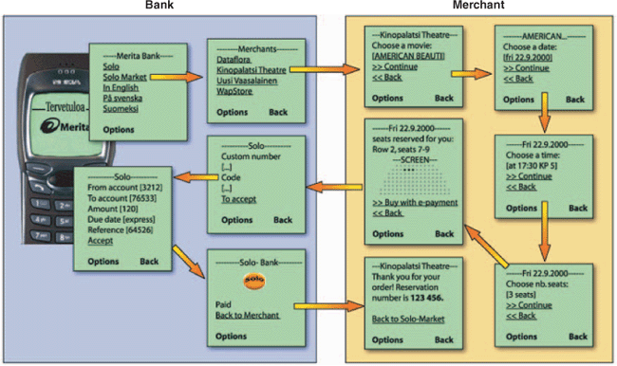
Figure 7.10 Purchasing movie tickets with WAP Solo
Overview of the data transfers when purchasing movie tickets via a mobile

Slide 19
7.4 Location-Based Services and Commerce
Location-based commerce (l-commerce)-- delivery of ads, products, or services to customers whose locations are known at a given time; also called location-based services (LBSs)
5 key concepts:
  1. Location. Determining the position
  2. Navigation. Plotting a route
  3. Tracking. Monitoring movement along a route
  4. Mapping. Creating digital maps
  5. Timing. Determining the precise time at a specific location

Slide 20
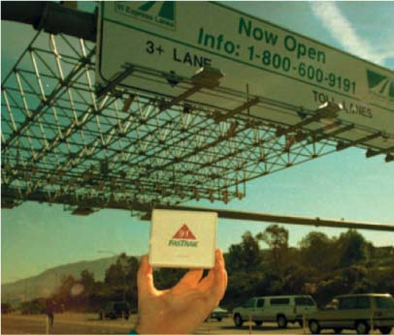
IT at Work 7.3 The Highway 91 Project
RFID sensors in the pavement let the tollway computer know that a car has entered. Only prepaid subscribers can drive on the 91.
Figure 7. 11
Highway 91 Project

Slide 21
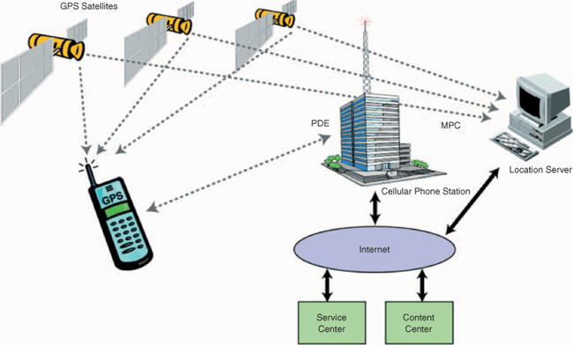
L-Commerce technologies
Figure 7.12 Smartphone with GPS in Location-based commerce

Slide 22
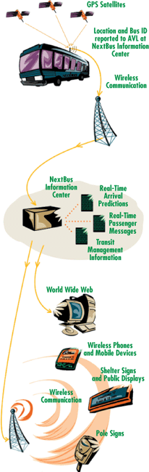
IT at Work 7.4 NextBus: Superb Customer Service
San Francisco bus riders carrying a mobile can quickly find out when a bus is likely to arrive at a bus stop.
The NextBus system tracks public transportation buses in real time.
Knowing where each bus is and factoring in traffic patterns and weather reports, NextBus dynamically calculates the ETA of the bus to each bus stop on the route.
Figure 7.13 NextBus
operational model

Slide 23
7.5 Mobile Enterprise Applications
Organizations are creating a full range of mobile apps—from back-office to consumer-centric apps
Leading organizations are building a marketing and sales strategy that ‘s built on connecting with their customers via mobiles
limitations due to 2-inch or 2-inch screens are being eliminated by the iPad and other mobile tablets—and expanding the possibilities of mobile computing and mobile enterprise applications.

Slide 24
Mobile apps
Supporting salespeople while they’re waiting on customers.
Supporting field employees doing repairs or maintenance on corporate premises or for clients
Supporting traveling or off-corporate-site executives, managers, or other employees
Supporting employees while they do work inside the enterprise, but where there is no easy access to desktop computers; e.g., in a warehouse, outdoor facilities, or large retail stores.

Slide 25
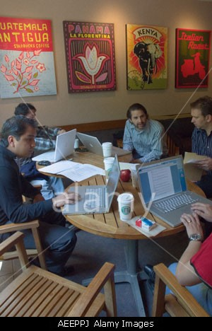

Mobile enterprise apps
Figure 7. 16 A Starbuck's branch in the Polanco district of Mexico City
Mobile POS (Point of Sale)
Inventory management
Customer service
Job dispatch
Customer support and mobile CRM
  sales force automation and field service
Mobile supply chain management (MSCM)
Figure 7.15 Starbucks Venti coffee

Slide 26
Chapter 7 Link Library
Ecommerce Times’ M-Commerce ecommercetimes.com/perl/section/m-commerce/
Mobile Commerce Daily mobilecommercedaily.com
Storefront Backtalk storefrontbacktalk.com/
Lo-So (Location-based social networking) Foursquare.com
Augmented Reality on Smartphones youtube.com/watch?v=b64_16K2e08
Mobile payments threaten retail banks and credit cards youtube.com/watch?v=vpw9KcqgVvE&feature=related
Wearable Computer by Motorola youtube.com/watch?v=zNYNZ03WH1E&feature=related
Innovative Mobile Payment System by Square youtube.com/watch?v=iBieYjxUj5Q
Mobile Inventory Management youtube.com/watch?v=6ekR-CUDD9o

