Slide 1
Network Management and Mobility
Part II. Data and Network Infrastructure
Chapter 4
Course

Slide 2
Chapter 4 Outline
4.1 Business Networks
4.2 Wireless Broadband Networks
4.3 Network Management and Portals
4.4 Collaboration
4.5 Green, Legal, and Ethical Issues

Slide 3
Chapter 4 Learning Objectives
Describe networks, standards, and mobility.
Discuss network and collaboration technologies.
Understand 4G and other mobile networks.
Describe group work technologies.
Evaluate green, social, and ethical issues related to the use and operations of networks.

Slide 4
4.1 Business Networks
Business networks support 4 basic functions:
  mobility
  collaboration
  relationships
  Search
  Common to all network functions are traffic and the circuits that transmit the traffic.

Slide 5
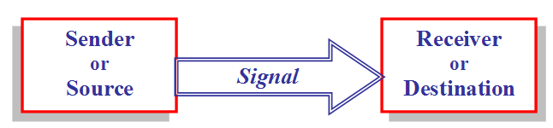
Network basics
Figure 4.2 A signal is transmitted from a sender/source to a receiver/destination via circuit or packet switching.

Slide 6
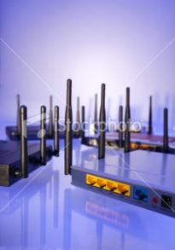
Switching: transmission of the signal
Circuit switching: Circuit switching is older technology that was used for telephone calls. Plain old telephone service (POTS) and most wired telephone calls are transmitted, at least in part, over a dedicated circuit.
Packet switching: The path of the signal is digital, and is neither dedicated nor exclusive. A file is broken into smaller blocks, called packets.
Figure 4.3 Wireless routers use antennae to transmit signals

Slide 7
Network Terminology
Bandwidth: Throughput capacity or speed of a network.
Protocol: Standards that govern how networked devices exchange information.
TCP/IP: Transmission control protocol/Internet Protocol) are a suite of Internet protocols.
Broadband: Short for broad bandwidth.
  Fixed-line broadband: Cable or DSL Internet connections.
  Mobile broadband: Wireless high-speed Internet access through a portable modem, phone, or other device.

Slide 8
3G and 4G networks
3G: Short for third generation of cellular telecommunications technology.
4G: Short for fourth generation. 4G mobile network standards enable faster data transfer rates.
Users can get 4G wireless connectivity through one of two standards:
  WiMAX
  LTE (Long-Term Evolution)

Slide 9
4.2 Wireless Broadband Networks
Enterprises are moving away from unsystematic adoption of mobile devices and infrastructure to a strategic build-out of mobile capabilities.
  But identifying strategic technologies and avoiding wasted investments is difficult.
Mobile infrastructure consists of technology, software, support, security measures, and devices to manage and deliver wireless communications.

Slide 10
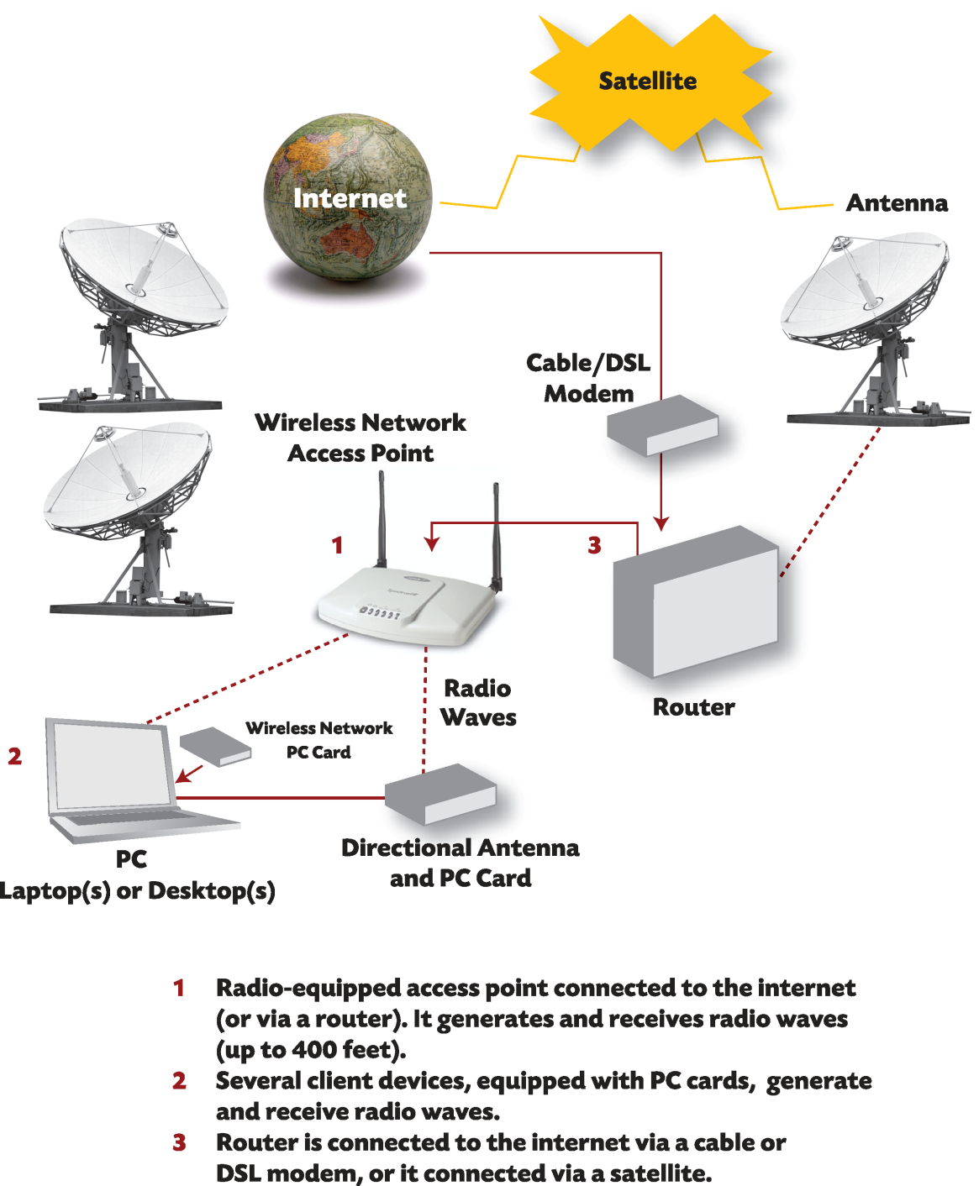
Figure 4.4
How Wi-Fi works
Wi-Fi allows computers to share a network wirelessly without connecting to a commercial network.

Slide 11
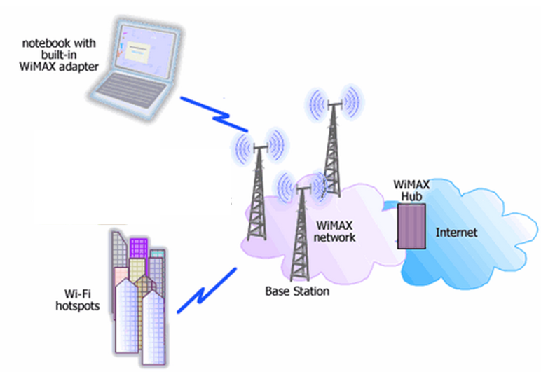
WiMAX: a broadband wireless metropolitan area network (MAN) access standard that can deliver voice and data at distances of 30 miles
Figure 4.5 WiMAX/Wi-Fi network architecture

Slide 12
4.3 Networks Management and Portals
When the network goes down or access is blocked, so does the ability to operate or function.
Damages when a company cannot operate or fulfill orders include:
  lost sales and productivity
  Inability to send and receive payments
  inability to process payroll and inventory
Network infrastructure alone does not improve business performance. It’s how network capabilities combine with other IT to support employees, connect remote locations, service customers, and coordinate with supply chain partners.

Slide 13
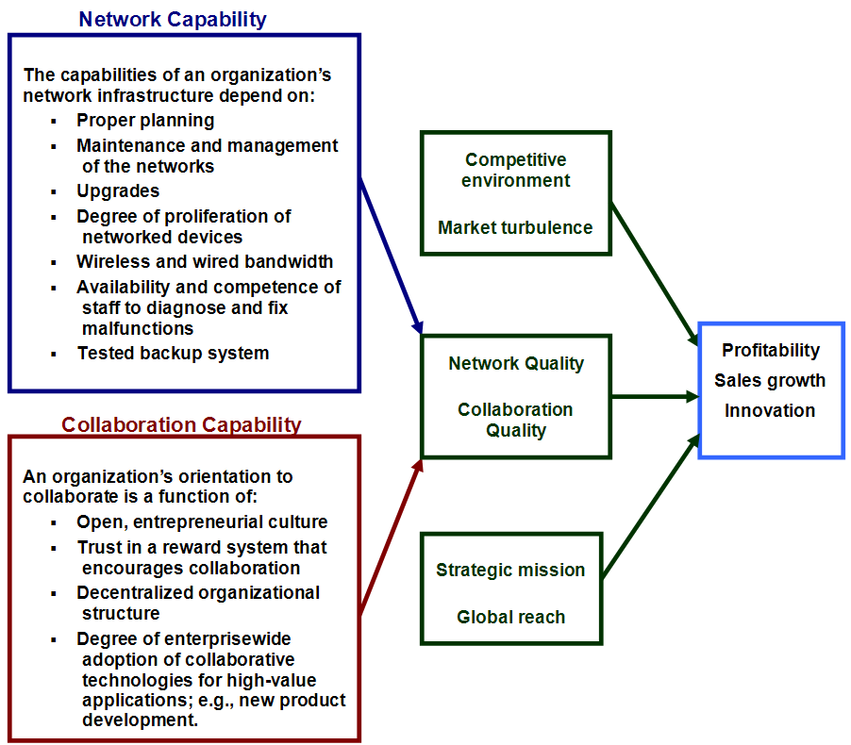
Figure 4.6 Model of Network, Collaboration, and Performance Relationship

Slide 14
TCP/IP Networks
The Internet protocol suite consists of the IP (Internet Protocol) and TCP (Transport Control Protocol), or TCP/IP.
In preparation for transmission, data are digitized into packets and sent via packet-switched networks, local area networks (LAN), or wide area networks (WAN).
Voice over IP (VoIP), or IP telephony, involves an analog-to-digital conversion. Voice and data transmissions travel over telephone wires in packets.

Slide 15
Internet Application Categories
Discovery or search. Discovery involves browsing, finding, and retrieving information.
Communication. Developments in Internet-based and wireless communication such as podcasting, RSS, and micro-blogging transform business communications, marketing channels, and supply chain management
Collaboration. Tools and technologies are available, ranging from online meetings with screen sharing to videoconferencing and group support systems.

Slide 16
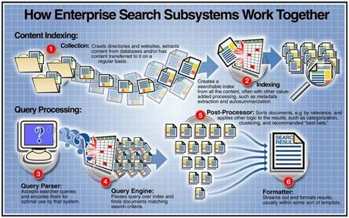
Figure 4.9 Overview of enterprise search.

Slide 17
Network Computing Infrastructures
Intranets: a network serving the internal informational needs of a company.
Extranets: private, company-owned network that uses IP technology to securely share part of a business’s information or operations with suppliers, vendors, partners, customers, or other businesses.
Extranets can use virtual private networks (VPNs). VPNs are created using specialized software and hardware to encrypt/send/decrypt transmissions over the Internet.

Slide 18
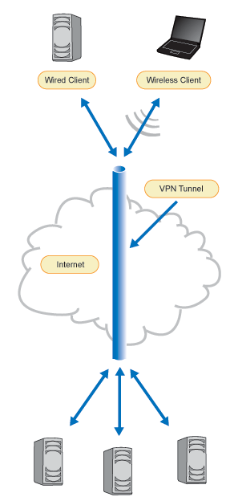
Figure 4.7 Virtual Private Network (VPN)

Slide 19
4.4 Collaboration
Messaging and collaboration tools include:
older communications media such as e-mail, videoconferencing, fax, and IM
newer media such as blogs, podcasts, RSS, wikis, VoIP, Web meetings, and torrents (for sharing very large files)

Slide 20
Group Decision Processes
Benefits of working in groups:
Groups tend to be better than individuals at understanding problems.
Group members have their egos embedded in the decision, and so they will be committed to the solution.
A group has more information (knowledge) than any one member. Groups can leverage this knowledge to create new knowledge.
Groups are better than individuals at catching errors.
Despite the benefits of collaborative work, groups are not always successful.

Slide 21
Collaboration Support Technologies
Portals, intranets, extranets, and shared workspaces are examples.
Web 2.0 or Enterprise 2.0 technologies such as wikis, blogs and microblogs, provide more options to promote and support enterprise collaboration.

Slide 22
4.5 Green, Legal, and Ethical Issues
Managers need to consider ethical and social issues, such as quality of working life.
Workers will experience both positive and negative impacts from being linked to a 24/7 workplace environment, working in computer-contrived virtual teams, and being connected to handhelds whose impact on health can be damaging.

Slide 23
Risks and Ethical Issues
Driving while distracted
Health
Personal time
RF emissions and SAR
  specific absorption rate, or SAR, is a way of measuring the quantity of radio frequency (RF) energy that is absorbed by the body.
  Life out of control

Slide 24
Chapter 4 Link Library
Google Wave http://wave.google.com/ video wave.google.com/about.html#video
Twitter network status http://status.twitter.com/
Azulstar http://azulstar.com/
Clear 4G WiMAX http://clear.com
International CTIA Wireless Tradeshows http://ctiawireless.com/
Cisco http://cisco.com
Microsoft SharePoint 2010 http://sharepoint.microsoft.com/Pages/Default.aspx
Cellular Telecommunications Industry Association http://ctia.org/
WiMAX Forum http://wimaxforum.org
Packet switching flash demo http://pbs.org/opb/nerds2.0.1/geek_glossary/packet_switching_flash.html
Cell phone radiation levels (SAR) http://reviews.cnet.com/2719-6602_7-291-2.html?tag=
Kaiser Permanente HealthConnect video http://youtube.com/kaiserpermanenteorg

