Slide 1
Data, Text, and
Document Management
Part II. Data and Network Infrastructure
Chapter 3
Course

Slide 2
Chapter 3 Outline
3.1 Data, Text, and Document Management
3.2 File Management Systems
3.3 Database Management Systems
3.4 Data Warehouses, Data Marts, and Data Centers
3.5 Enterprise Content Management

Slide 3
Chapter 3 Learning Objectives
Describe data, text, and document management, and their impacts on performance.
Understand file management systems.
Understand the functions of databases and database management systems.
Describe the tactical and strategic benefits of data warehouses, data marts, and data centers.

Slide 4
3.1 Data, Text, and Document Management
Data, text, and documents are strategic assets. Vast quantities are:
  created and collected
  then stored – often in 5 or more locations
Data, text, and document management helps companies improve productivity by insuring that people can find what they need without having to conduct a long and difficult search.

Slide 5
Data Management
Why does data management matter?
  No enterprise can be effective without high quality data that is accessible when needed.
  Data that’s incomplete or out of context cannot be trusted.
  Organizations with at least 1,000 knowledge workers lose ~ $5.7 million annually in time wasted by employees reformatting data as they move among applications.
What is the goal of data management?
  To provide the infrastructure and tools to transform raw data into usable information of the highest quality.

Slide 6
Data Management
Why is data management difficult and expensive?
  Volume of data is increasing exponentially.
  Data is scattered throughout the organization.
  Data is created and used offline without going through quality control checks.
  Data may be redundant and out-of-date, creating a huge maintenance problem.

Slide 7
Data Management
Current key issues
Master data management (MDM): Processes to integrate data from various sources and enterprise apps in order to create a unified view of the data.
Document management system (DMS): Hardware and software to manage, archive, and purge files and other electronic documents (e-documents).
Green computing: Efforts to conserve natural resources and reduce effects of computer usage on the environment.

Slide 8
IT at Work 3.1 – Healthcare Sector
Data Errors Cost Billions of Dollars and Put Lives at Risk
Every day, healthcare administrators and others throughout the healthcare supply chain waste 24% --30% of their time correcting data errors.
Each incorrect transaction costs $60 to $80 to correct.
About 60% of all invoices among supply chain partners have errors, and each invoice error costs $40 to $400 to reconcile.
Each year, billions of dollars are wasted in the healthcare supply chain because of supply chain data disconnects.

Slide 9
IT at Work 3.1 (continued)
Data Errors Cost Billions of Dollars and Put Lives at Risk
Benefits from data synchronization in the healthcare sector and supply chair:
  Easier and faster product sourcing because of accurate and consistent item information
  Significantly reduces the amount of fraud or unauthorized purchasing
  Reduces unnecessary inventories
  Lowers prices because purchase volumes became apparent
  Improves patient safety

Slide 10
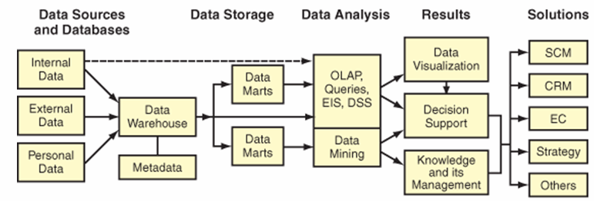
Data management is a structured approach for capturing, storing, processing, integrating, distributing, securing, and archiving data effectively throughout their life cycle.
Figure 3.2 Data life cycle

Slide 11
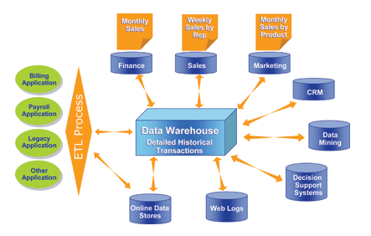
Data from various sources are extracted, transformed, & loaded (ETL) into a data warehouse; then used to support functions and apps throughout the enterprise.
Figure 3.4. Model of an Enterprise Data Warehouse

Slide 12
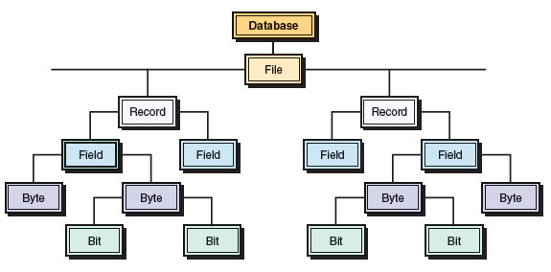
3.2 File Management Systems
Computer systems organize data into a hierarchy:
bits, bytes, fields, records, files, and databases
Figure 3.6 Hierarchy of data for a computer-based file.

Slide 13
Limitations of the File Environment
When organizations began using computers, they started with one application at a time, usually accounting, billing, and payroll. Each app was designed to be a stand-alone system, which led to data problems.
Data problems with a file environment:
  data redundancy
  data inconsistency
  data isolation
  data security

Slide 14
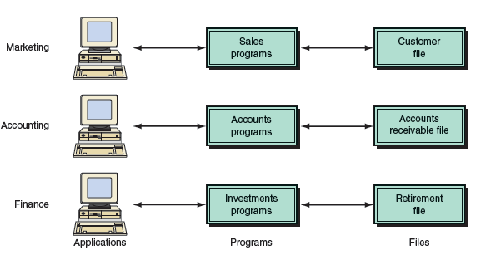
  Stand-alone systems result in data redundancy, inconsistency, and isolation.
  Database management systems helped solve the data problems of file-based systems.

Slide 15
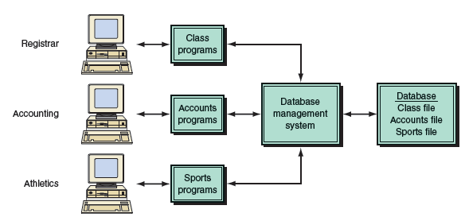
Figure 3.10 Database management system provides access to all data in the database.

Slide 16
3.3 Database Management Systems (DMBS)
Numerous data sources
  clickstream data from Web and e-commerce applications
  detailed data from POS terminals
  filtered data from CRM, supply chain, and enterprise resource planning applications
DBMS permits an organization to centralize data, manage them efficiently, and give application programs access to the stored data.

Slide 17
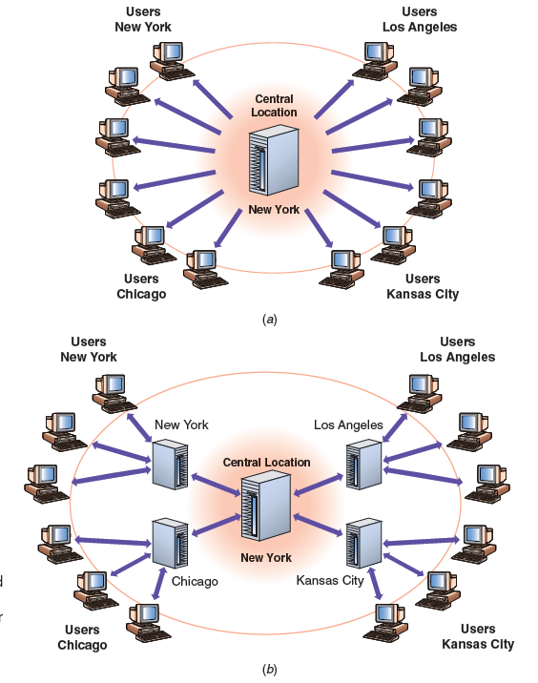
2 types of databases:
Centralized database
Distributed database with complete or partial copies of the central database in more than one location

Slide 18
Functions of a Database Management System (DBMS)
Data filtering and profiling: Inspecting the data for errors, inconsistencies, redundancies, and incomplete information.
Data quality: Correcting, standardizing, and verifying the integrity of the data.
Data synchronization: Integrating, matching, or linking data from disparate sources.
Data enrichment: Enhancing data using information from internal and external data sources.
Data maintenance: Checking and controlling data integrity over time.

Slide 19
3.4 Data Warehouses, Data Marts, and
Data Centers
Data warehouse: a repository in which data are organized so that they can be readily analyzed using methods such as data mining, decision support, querying, and other applications.
  enable managers and knowledge workers to leverage enterprise data to make the smartest decisions
  enable OLAP (online analytic processing)
Data marts: designed for a strategic business unit (SBU) or a single department.
Data centers: facilities containing mission-critical ISs
and components that deliver data and IT services to the enterprise.

Slide 20
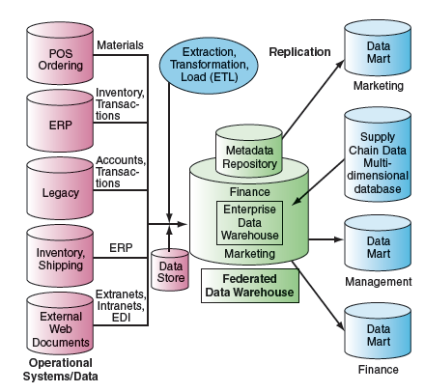
Figure 3.11 Data warehouse framework and views.

Slide 21
Building an Enterprise Data Warehouse (EDW)
A company that is considering building a DW first needs to address a series of basic questions to avoid a failure:
  Does top management support the DW?
  Do users want access to a broad range of data
  Do users want data access and analysis tools?
  Do users understand how to use the DW to solve business problems?
  Does the unit have one or more power users who can understand DW technologies?

Slide 22
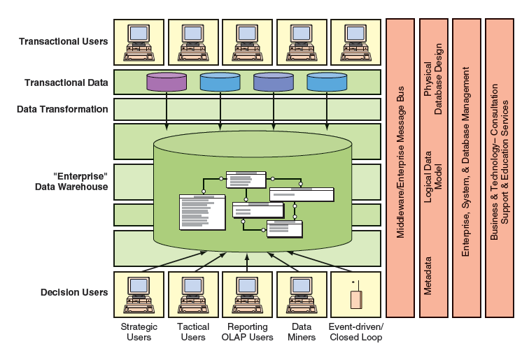
Figure 3.12 Teradata Corp.’s EDW

Slide 23
Suitability
Data warehousing is most appropriate for organizations that have some of the following characteristics:
End users need to access large amounts of data
Operational data are stored in different systems
The organization serves a large, diverse customer base
The same data are represented differently in different systems
Extensive end-user computing is performed

Slide 24
3.5 Enterprise Content Management
ECM includes:
electronic document management
Web content management
digital asset management, and
electronic records management (ERM)

Slide 25
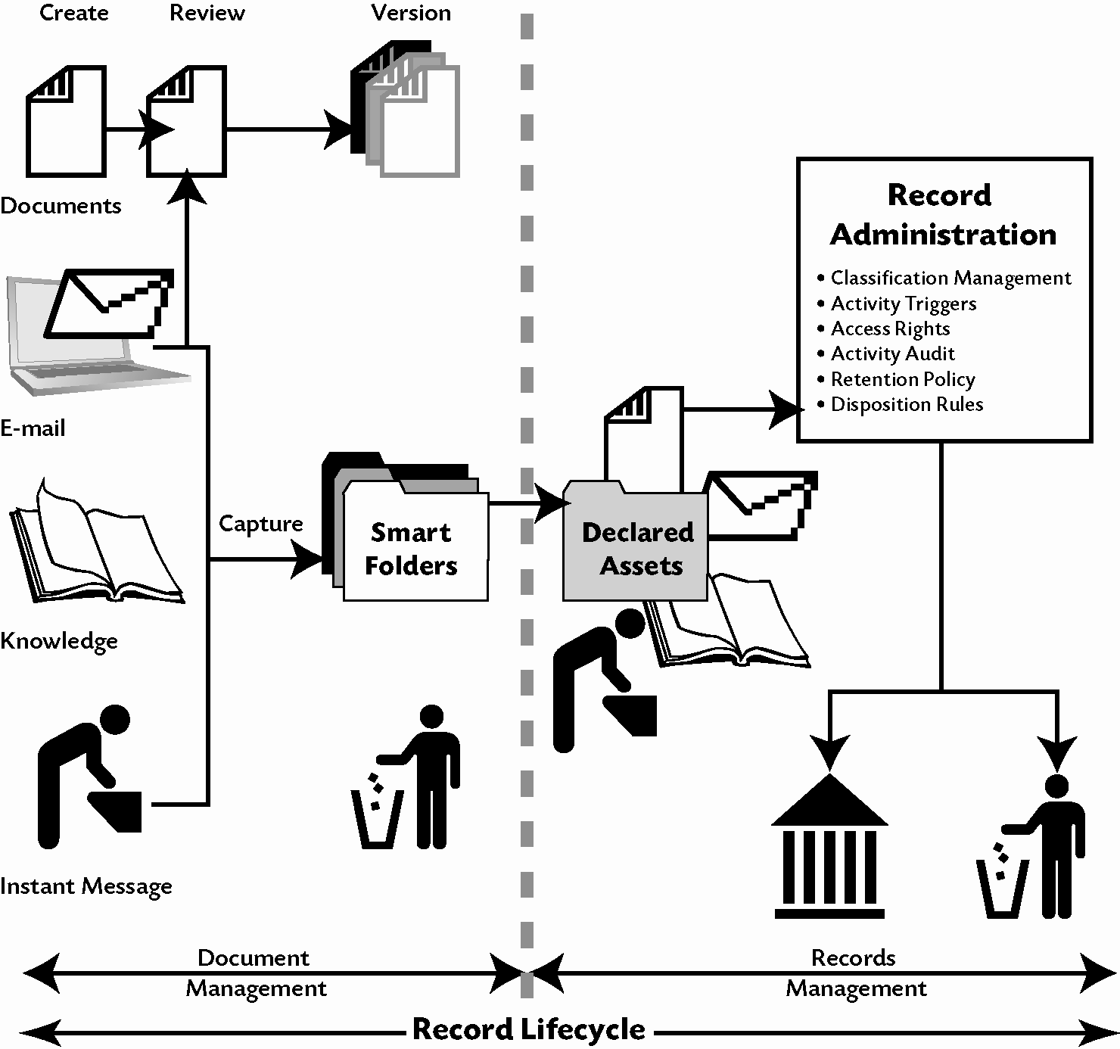
Figure 3.13 Electronic records management from creation
to retention or destruction

Slide 26
Unstructured business records
Businesses generate volumes of documents, messages, and memos that, by their nature, contain unstructured content that cannot be put into a database.
Many of these materials are business records that must be retained and made available when requested by auditors, investigators, the SEC, the IRS, or other authorities.
To be retrievable, business records must be organized and indexed.
Records are not needed for current operations or decisions, are archived—moved into longer-term storage.

Slide 27
Business Value of E-Records Management
Companies need to be prepared to respond to an audit, federal investigation, lawsuit, or other legal action against it.
  Examples of lawsuits: patent violations, fraud, product safety negligence, theft of intellectual property, breach of contract, wrongful termination, harassment, and discrimination
E-discovery is the process of gathering electronically stored information in preparation for trial, legal or regulatory investigation, or administrative action as required by law.
  When a company receives an e-discovery request, the company must produce what is requested—or face charges of obstructing justice or being in contempt of court.

Slide 28
Companies have incurred huge costs for not responding to e-discovery
Failure to save e-mails resulted in a $2.75 million fine for Phillip Morris.
Failure to respond to e-discovery requests cost Bank of America $10 million in fines.
Failure to produce backup tapes and deleted e-mails resulted in a $29.3 million jury verdict against UBS Warburg in the landmark case, Zubulake v. UBS Warburg.

Slide 29
Chapter 3 Link Library
Advizor Solutions, data analytics and visualization http://advizorsolutions.com/
Clarabridge: How Text Mining Works http://clarabridge.com/
SAS Text Miner http://sas.com/
Tableau data visualization software http://tableausoftware.com/data-visualization-software/
EMC Corp., enterprise content management http://emc.com
Oracle DBMS http://oracle.com/

