Slide 1
Bargaining and Power in Networks

Slide 2
Outline
12.1 Power in Social Networks
12.2 Experimental Studies of Power and Exchange
12.3 Results of Network Exchange Experiments
12.4 A Connection to Buyer-Seller Networks
12.5 Modeling Two-Person Interaction: The Nash Bargaining Solution
12.6 Modeling Two-Person Interaction: The Ultimatum Game
12.7 Modeling Network Exchange: Stable Outcomes
12.8 Modeling Network Exchange: Balanced Outcomes
12.9 Advanced Material: A Game-Theoretic Approach to Bargaining

Slide 3
Abstract
Formulate a perspective on power in networks that can help us further refine our predictions for the outcomes of different participants
  Division of the available surplus between players (e.g. favor buyers or sellers?)
To create a succinct mathematical framework enabling predictions. For arbitrary networks
  which nodes have power,
  how much power they have
Notes:
In this chapter, we formulate a perspective on power in networks that can help us further refine our predictions for the outcomes of different participants.
This perspective arises dominantly from research in sociology, and it addresses not just economic transactions, but also a range of social interactions more generally that are mediated by networks.

Slide 4
12.1 Power in Social Networks

Slide 5
The main idea of power
Power is not just as a property of agents in economic settings, or in legal or political setting, but in social interaction is more generally.
Power is not so much a property of an individual as a property of a relation between two individuals
Someone is particularly powerful because he/holds a pivotal position in underlying social structure
Notes:
The goal here is to understand power not just as a property of agents in economic settings,
or in legal or political settings, but in social interaction more generally | in the roles people
play in groups of friends, in communities, or in organizations. A particular focus is on the
way in which power is manifested between pairs of people linked by edges in a larger social
network. Indeed, as Richard Emerson has observed in his fundamental work on this subject, power is not so much a property of an individual as it is a property of a relation between two individuals | it makes more sense to study the conditions under which one person has power over another, rather than simply asserting that a particular person is powerful"

Slide 6
Exchange theory
The value may be divided equally or unequally between two parties in certain context of relationship (business alliance, friendship, etc.)
Social exchange：The way in which the value in the relationship is divided between the two parties
Network exchange theory：The ways in which social imbalances and power can be partly rooted in the structure of the social network has motivated the growth of a research area in sociology.

Slide 7
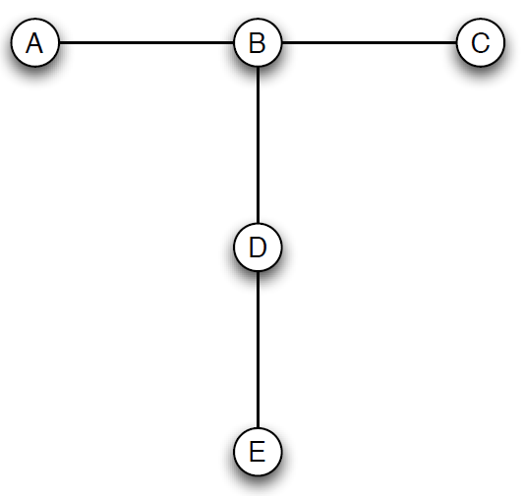
Example of a Powerful Network Position
A social network on five people, with node B occupying an intuitively powerful position
  Particularly, powerful relative to A and C

Slide 8
Why B is relative Powerful ?
Dependence: A and C are completely dependent on B as value source. But B has multiple sources
Exclusion: B as the ability to exclude A and C
Satiation: B will acquire value a greater rate than other members. B may be interested in maintaining these social relations only if she can receive an unequal share value
Betweenness: B is unique access point between multiple different pairs of nodes in the network
Notes:
with strong friendships indicated by the social network links. Intuitively, node B appears
to hold a powerful position in the network, and in particular to be powerful relative to two
of her three neighbors, A and C. What general principle or principles should lead us to
this conclusion? Here are several proposals, which we state informally here but make more
precise in what follows.
(i) Dependence. Recalling that social relations confer value, nodes A and C are completely
dependent on B as a source of such value; B on the other hand, has multiple sources.
(ii) Exclusion. Related to (i), B has the ability to exclude A and C. In particular, suppose
each person were to choose a \best friend" in the group; then B has the unilateral
power to choose one of A and C, excluding the other. (However, B does not have the
analogous power over D.)
(iii) Satiation. A somewhat dierent basis for B's power might be implicit in the psychological
principle of satiation: having diminishing rewards for increased amounts of
something. Again, viewing social relations as conferring value, B will acquire value
at a greater rate than the other members of the group; having thus become satiated,
B may be interested in maintaining these social relations only if she can receive an
unequal share of their value.
(iv) Betweenness. If we believe that the value generated in social relations ows not just
across single edges but more generally along paths, then we are led to consider notions
such as betweenness. Betweenness was considered extensively in Section 3.6; for our
342 CHAPTER 12. BARGAINING AND POWER IN NETWORKS
purposes here, it is enough to think informally of a node as having high betweenness if
it lies on paths (and particularly short paths) between many pairs of other nodes. In
our example, B has high betweenness because she is the unique access point between
multiple dierent pairs of nodes in the network, and this potentially confers power.
More generally, betweenness is one example of a centrality measure that tries to nd
the \central" points in a network. We saw in our discussion of structural holes in
Section 3.5 that evaluating a node's power in terms of its role as an access point
between dierent parts of the network makes sense in contexts where we are concerned
about issues like the ow of information. Here, however, where we are concerned about
power arising from the asymmetries in pairwise relations, we will see some concrete
cases where a simple application of ideas about centrality can in fact be misleading.

Slide 9
12.2 Experimental Studies of Power and Exchange

Slide 10
About the experiments
Basic idea:
  Take the notion of “social value” and represent it under laboratory conditions using a concrete economic framework
  Value represented : An amount of money that the participants in a relationship get to share
Object:
  Seek a theoretical framework that predicts the outcome of such negotiation on a given graph

Slide 11
Mechanics for the experiment
People are placed at the nodes of a small graph representing a social network .
A fixed sum of money is placed on each edge of a graph; and negotiate over how the money placed between them.
Each node can take part in a division with only one neighbor. (one exchange rule)
The experiment is run over multiple periods to allow for repeated interaction by the participants

Slide 12
12.3 Results of Network Exchange Experiments

Slide 13
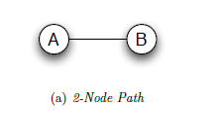
Four basic network-The 2-Node Path
The 2-node path is as simple as it gets：
Two people are given a fixed amount of time in
which to agree on a way to split $1
  Equal split

Slide 14
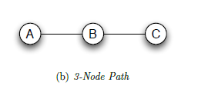
Four basic network-The 3-Node Path
On a 3-node path with nodes labeled A, B,
and C in order, node B intuitively has power
over both A and C
  B receive roughly 5/6

Slide 15

Four basic network-The 4-Node Path
The 4-node path is already significantly more subtle than the previous two examples.
  B get roughly between 7/12 and 2/3 of the money

Slide 16

Four basic network-The 5-Node Path
Paths of length 5 introduce a further subtlety: node C, which intuitively occupies the “central” position in the network.
  C does slightly better than A ,E but only slightly

Slide 17
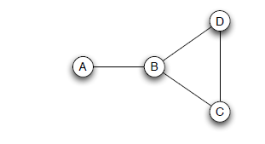
Other Networks
Many other networks have been studied experimentally. The outcomes can be understood by combining ideas from the four basic networks. Such as the picture below called “stem graph”.
  Node B is the stem graph makes slightly more money than node B in four-node path
An exchange network with a weak power advantage for node B.

Slide 18
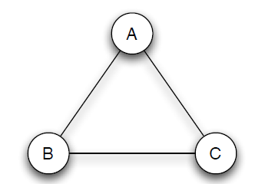
An Unstable Network
A common theme in all the networks we have discussed thus far is that the negotiations among participants tend to wrap up reliably by the time limit, with fairly consistent outcomes.
  An exchange network in which negotiations never stabilize

Slide 19
12.4 A Connection to Buyer-Seller Networks

Slide 20
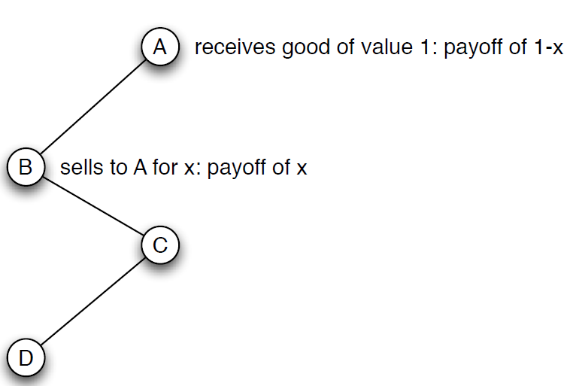
Buyer-Seller Networks
Suppose nodes A and C to be buyers, and nodes B and D to be sellers. We give one unit of a good to each of B and D, and one unit of money to each of A and C
An exchange network built from the 4-node path can also be viewed as a buyer-seller network with 2 sellers and 2 buyers

Slide 21
12.5 Modeling Two-Person Interaction: The Nash Bargaining Solution

Slide 22
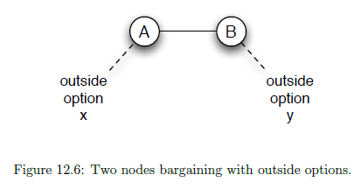
The Nash Bargaining Solution
When A and B negotiate over splitting a dollar, with an outside option of x for A and an outside option of y for B (such that x+y≤1)
  A requires at least x, and B requires at least y

Slide 23
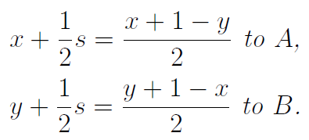
Outcome--Nash Bargaining Solution
Surplus s=1-x-y

Slide 24
Experiments on Status Effects
Experiment setting: Two people are asked to divide money in situations where they are led to believe that one is “higher-status” and the other is “lower-status.”
Differential status can lead to deviations from theoretical predictions in bargaining.
  Need to communicate information about their outside options
  People tented to inflate (reduce) outside options when their negotiating partner was of power of lower (high) status
  People believed or be of higher status by partner tend to received significantly better bargaining outcomes than theoretic prediction

Slide 25
12.6 Modeling Two-Person Interaction: The Ultimatum Game

Slide 26
Procedure of Ultimatum Game
Person A is given a dollar and told to propose a division of it to person B.
(ii) Person B is then given the option of approving or rejecting the proposed division.
(iii) If B approves, each person keeps the proposed amount. If B rejects, then each person gets nothing.
Notes:
(i) Person A is given a dollar and told to propose a division of it to person B. That is, A
should propose how much he keeps for himself, and how much he gives to B.
(ii) Person B is then given the option of approving or rejecting the proposed division.
(iii) If B approves, each person keeps the proposed amount. If B rejects, then each person
gets nothing.

Slide 27
The Results of Experiments on the Ultimatum Game
Game theoretic prediction
  A should propose 0.99 (1.00) for himself and 0.01(0.00) for B, knowing B will accept this offer
Experimental results - Guth, Schmittberger, and Schwarze (1982)
  The role of A tended to offer fairly balanced divisions of the money
  Very unbalanced offers were often rejected by the person playing the role of B (incur significant negative emotional payoff to being treated unfairly).
  Results are consistent in a number of different countries

Slide 28
12.7 Modeling Network Exchange: Stable Outcomes

Slide 29
An outcome of a network exchange consists of two things
A matching on the set of nodes, specifying who exchanges with whom.
A value attached to each node, indicating the node’s payoff from the exchange.

Slide 30
Outcomes
Stability: An outcome of network exchange is stable if and only if it contains no instabilities.
  No node X can propose an offer to some other node Y that makes both X and Y better off- thus “stealing” node Y away from an existing agreement
Instability: Given an outcome consisting of a matching and values for the nodes, an instability in this outcome is an edge not in the matching, joining two nodes X and Y , such that the sum of X’s value and Y ’s value is less than 1.

Slide 31
Stable or Unstable
An outcome of a network exchange is stable if it does not contain any instabilities.
An instability in an outcome, consisting of a matching and values for the nodes, is a non-matching edge joining nodes with values x and y such that x+y<1.

Slide 32
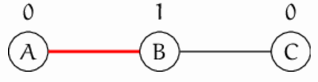
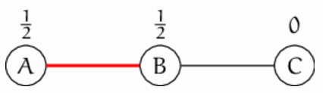
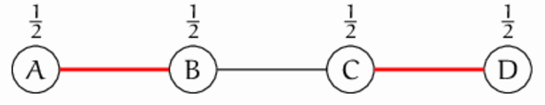
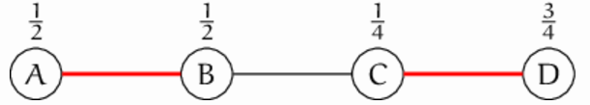
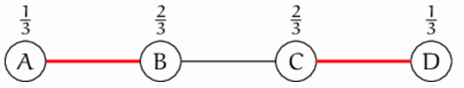
Stable or Unstable
Stable
Unstable
C can offer 2/3 to B to break edge A-B
C can offer x, ½<x<3/4 to B to break edge A-B

Slide 33
Applications of Stable Outcomes
Stable outcomes are good at approximately capturing what’s going on in situations with extreme power imbalances
In fact human subjects on 3-node path or 5-node paths will not push things all the way to 0-1 outcomes (in practice 1/6-5/6, which is close to 0-1)
There is no stable outcome for the triangle network

Slide 34
Limitations of Stable Outcomes
One source of limitations lies in the fact that it allows outcomes to go to extremes that people will not actually follow in real life.
A more fundamental difficulty with the notion of a stable outcome is that it is too ambiguous in situations where there is a weak power imbalance between individuals.

Slide 35
12.8 Modeling Network Exchange: Balanced Outcomes

Slide 36
Defining Balanced Outcomes
Balanced Outcome: An outcome (consisting of a matching and node values) is balanced if, for each edge in the matching, the split of the money represents the Nash bargaining outcome for the two nodes involved, given the best outside options for each node provided by the values in the rest of the network.

Slide 37
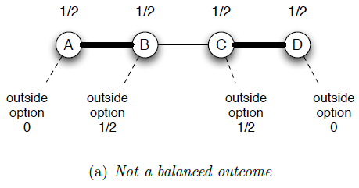
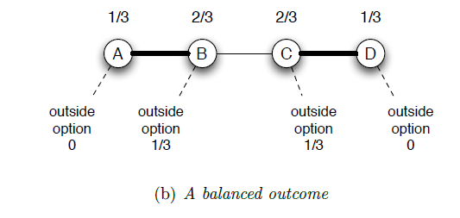
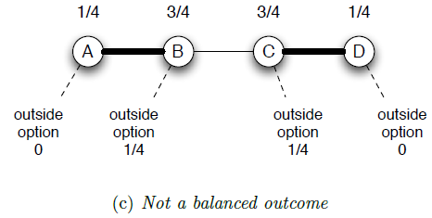
Balanced and unbalanced outcomes

Slide 38
Applications and Interpretations of Balanced Outcomes
An outcome is balanced if the values on its endpoints of each edge represent the Nash bargaining solution for those two nodes
Note that every balanced outcome is necessarily stable, as no two nodes have an incentive to disrupt the current outcome.

Slide 39
Cooperative game theory
Cooperative game theory: how a collection of players will divide up the value from a collective activities.
Stability: the core solution in cooperative game theory
Balance: kernel solution in cooperative game theory

Slide 40
12.9 Advanced Material: A Game-Theoretic Approach to Bargaining

Slide 41
Example of Formulating Bargaining as a Dynamic Game
A: I’ll give you 30% of the dollar
B: No, I want 40%.
A: How about 34%?
B: I’ll take 36%.
A: Agreed.

Slide 42
Define the Example
Stage 1: A proposes a split of the dollar in which he gets a1 and B gets b1.
Stage 2: B can accept A’s proposal or reject it. If accepts, the game ends Otherwise continue
Stage 3: B proposes a split of the dollar in which A gets a2 and B gets b2.
Stage 4: A can accept B’s proposal or reject it. If accepts, the game ends Otherwise continue
Continue like the following until the game ends

Slide 43
Analyzing the Game
1. An Overview
2. Analyzing a Two-Period Version of Bargaining
3. Back to the Infinite-Horizon Bargaining Game
4. A Stationary Equilibrium

Slide 44
An overview
Our main result is twofold. First, the bargaining game has a subgame perfect equilibrium with a simple structure in which A’s initial offer is accepted.
Second, for this equilibrium, we can work out the values in the initial split (a1, b1) that is proposed and accepted.
The Nash bargaining solution is a good approximate prediction for the outcome
  A’s outside offer is x and B’s outside offer is y

Slide 45
Analyzing a Two-Period Version of Bargaining
First, A will accept B’s proposal in period two provided a₂>=x . B’s proposal is period two is (x,1-x)
In period one, A prefers this split to the outcome in which negotiations end and B gets only y.
Assume there is a fixed probability p negotiation break down. Therefore, B’s expected payoff if she rejects the offer is py + (1 − p)(1 − x).
A will propose (1 − z, z) in the first round, and it will be immediately accepted.
  z= py + (1 − p)(1 − x) ; z=y when p->1, z=1-x when p->0
Notes:
• First, A will accept B’s proposal (a2, b2) in period two provided that a2 is at least
as large as A’s outside option x. (Since negotiations are guaranteed to end after th• Given this, there is no reason for B to offer A more than x, so B’s period-two proposal
will be (x, 1 − x). Since we have assumed x + y < 1, we have 1 − x > y, and so B
prefers this split to the outcome in which negotiations end and B gets only y.2
• Now, when B considers whether to accept or reject A’s offer in the first round, she
should compare it to the expected payoff she’d get by rejecting it and allowing the game
to continue. If she rejects the offer, then with probability p, negotiations break down
immediately and she gets y. Otherwise, the game continues to its second and final
round, where we’ve already concluded that B will get 1 − x. Therefore, B’s expected
payoff if she rejects the offer is
py + (1 − p)(1 − x).
Let’s call this quantity z; our conclusion is that in the first round, B will accept any
offer of at least z.
• Finally, we need to determine what A will propose in the first round. There is no point
in A’s offering to B anything more generous than (1 − z, z), since B will accept this,
so the question is simply whether A prefers this split to his outside option x. In fact,
he does: since y < 1 − x, and z is a weighted average of y and 1 − x, it follows that
z < 1 − x, and so 1 − z > x.

Slide 46
Back to the Infinite-Horizon Bargaining Game
Infinite-horizon game is fundamentally different:
  After a back-and-forth pair of offers by A and B, there is another copy of exactly the same infinite-horizon game left to be played.
  The structure and payoffs in the game don’t change over time.

Slide 47
Analyzing the Game: A Stationary Equilibrium
The split (a₁, b₁) that A will offer whenever he is scheduled to propose a split
The split (a₂, b₂) that B will offer whenever she is scheduled to propose a split; and
Reservation amounts a and b, constituting the minimum offers that A and B respectively will accept from the other.

Slide 48

Set the Equations
A will offer B the least he can in order to get B to accept his offer, so we set
B will offer the least she can in order to get A to accept her offer, so
A’s offer: for B to be indifferent between accepting and rejecting, we need b₁ = py + (1 − p)b₂
Similarly, B’s offer: we have a₂ = px + (1 − p)a₁

Slide 49
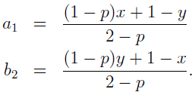
Solving equations
Since b₁ = 1− a₁ and a₂ = 1− b₂, this gives us two linear equation in two unknowns:
1 − a₁ = py + (1 − p)b₂
1 − b₂ = px + (1 − p)a₁
Solving these, we get

Slide 50

Payoff of A and B
A’s initial offer is accepted, so A gets a payoff of a₁, and B gets a payoff of

Slide 51
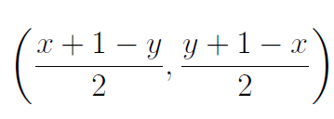
Payoffs– after converging
p converges to 0, so that the players can expect the negotiations to continue for a long time, the opening offer is still accepted in this stationary equilibrium, but the payoffs are converging to

