Slide 1
Matching Markets

Slide 2
Outline
10.1 Bipartite Graphs and Perfect Matchings
10.2 Valuations and Optimal Assignments
10.3 Prices and the Market-Clearing Property
10.4 Constructing a Set of Market-Clearing Prices
10.5 How Does this Relate to Single-Item Auctions?
10.6 Advanced Material: A Proof of the Matching Theorem

Slide 3
10.1 Bipartite Graphs and Perfect Matchings

Slide 4
Matching markets
Matching markets have a long history in economics, operations research
Basic principles
  the way in which people may have different preferences for different kinds of goods
  the way in which prices can decentralize the allocation of goods to people
  the way in which such prices can in fact lead to allocations that are socially optimal

Slide 5
Bipartite Graphs
An example of College dormitory
  Each room is designed for a single student
  Each student list several acceptable options
  Students can have different preference over rooms
  some people might want larger rooms, quieter rooms, sunnier rooms, and so forth

Slide 6
Perfect Matchings
There are an equal number of nodes on each side of a bipartite graph, a perfect matching is an assignment of nodes on the left to nodes on the right, in such a way that
  each node is connected by an edge to the node it is assigned to
  no two nodes on the left are assigned to the same node on the right

Slide 7
Perfect Matchings

Slide 8
Constricted Sets
On the right-hand side of nodes: S
On the left-hand side of nodes: neighbor of S
We define the neighbor set of S, denoted N(S)
Constricted Sets
  S contains strictly more nodes than N(S) does

Slide 9
Constricted Sets

Slide 10
Matching Theorem
If a bipartite graph (with equal numbers of nodes on the left and right) has no perfect matching, then it must contain a constricted set.
  Proposed independently by Denes Konig in 1931 and Phillip Hall in 1935

Slide 11
10.2 Valuations and Optimal Assignments

Slide 12
Valuation
Allow each individual to express how much they’d like each object, in numerical form

Slide 13
Valuation
We can evaluate the quality of an assignment of objects to individuals:
  The sum of each individual’s valuation for what they get
Quality of an assignment
=12 + 6 + 5 = 23

Slide 14
Optimal assignment
Maximizes the total happiness of everyone for what they get
It does not necessarily give everyone their favorite item
For example
  Room 1 is the best, but it can only go to one of them

Slide 15
Simple translation
The problem of bipartite matching is implicit in the broader problem of finding an optimal assignment

Slide 16
10.3 Prices and the Market-Clearing Property

Slide 17
Prices and Payoffs
Suppose that we have a collection of sellers, each with a house for sale, and an equal-sized collection of buyers
The valuation that a buyer j has for the house held by seller i will be denoted vij
Sellers offer house for a price pi ≥ 0
Payoff = vij - pi

Slide 18
Prices and Payoffs
If this quantity is maximized in a tie between several sellers, then the buyer can maximize her payoff by choosing any one of them
If her payoff vij − pi is negative for every choice of seller i, then the buyer would prefer not to buy any house

Slide 19
Prices and Payoffs
Payoff =12−5 = 7 if x buys from a,
Payoff = 4−2 = 2 if x buys from b,
Payoff = 2−0 = 2 if x buys from c

Slide 20
Market-Clearing Prices
Each of the three buyers value the house of seller a the highest; it is the high price of 5 that dissuades buyers y and z from pursuing this house
Market-Clearing Prices
  a set of prices that cause each house to get bought by a different buyer

Slide 21
Market-Clearing Prices
An example of prices that are not market-clearing
  Maximize self payoff
  Both x and z want a
  Contention unresolved

Slide 22
Market-Clearing Prices
This set of prices is market-clearing, even though a bit of coordination is required due to ties in the maximum payoffs.
X take a
Y take c
z take b

Slide 23
Market-Clearing Prices
A set of prices is market-clearing if the resulting preferred-seller graph has a perfect matching.
Existence of market-clearing prices
  For any set of buyer valuations, there exists a set of market-clearing prices

Slide 24
Market-Clearing Prices
Optimality of Market Clearing Prices
  For any set of market-clearing prices, a perfect matching in the preferred-seller graph has the maximum valuation of any assignment of sellers to buyers
Optimality of Market Clearing Prices
  A set of market clearing prices, and a perfect matching in the resulting preferred-seller graph, produces the maximum possible sum of payoffs to all sellers and buyers
Total payoff of M = Total Valuation of M –Sum of all prices

Slide 25
10.4 Constructing a Set of Market-Clearing Prices

Slide 26
Multiple auction (1/6)
At the start of each round, there is a current set of prices, with the smallest one equal to 0.
We construct the preferred-seller graph and check whether there is a perfect matching
If there is, we’re done: the current prices are market-clearing
If not, we find a constricted set of buyers S and their neighbors N(S)

Slide 27
Multiple auction (2/6)
If necessary, we reduce the prices — the same amount is subtracted from each price so that the smallest price becomes zero
We now begin the next round of the auction, using these new prices

Slide 28
Multiple auction (3/6)

Slide 29
Multiple auction (4/6)

Slide 30
Multiple auction (5/6)

Slide 31
Multiple auction (6/6)

Slide 32
Auction Must Come to an End
The auction starts with only a bounded supply of this potential energy at the beginning, it must eventually run out
Potential of a buyer
  maximum payoff she can get from any seller
Potential of a seller
  the current price he is charging

Slide 33
Auction Must Come to an End
All sellers begin with potential 0
Each buyer having a potential equal to her maximum valuation for any house (P0 ≥ 0)
The potential changes when the prices change
Buyers S has strictly more nodes than N(S) does
  The potential energy strictly decreases by at least one unit
  It can’t drop below 0, so the auction must come to an end

Slide 34
10.5 How Does this Relate to Single-Item Auctions?

Slide 35
Single-Item Auctions
We create n − 1 “fake” additional sellers
give buyer j a valuation of 0 for the item offered by each of these fake sellers

Slide 36
Single-Item Auctions
Ascending bid (English) auction: the buyer with highest valuation gets the item and pay the second-highest valuation

Slide 37
10.6 Advanced Material: A Proof of the Matching Theorem

Slide 38
The step
Claim
  If a bipartite graph has no perfect matching, then it must contain a constricted set
Maximum matching
  a matching that includes as many nodes as possible
Show that when enlarge fails, it produces a constricted set

Slide 39
Alternating and Augmenting Paths
alternating path
  a simple path(did not repeat) that alternates between non-matching and matching edges

Slide 40
Alternating and Augmenting Paths
In a bipartite graph with a matching, if there is an alternating path whose endpoints are unmatched nodes, then the matching can be enlarged

Slide 41
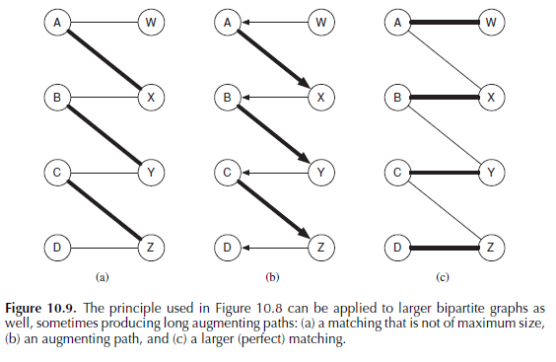
Alternating and Augmenting Paths
Augmenting Path
  an alternating path with unmatched endpoints, it gives us a way to augment the matching

Slide 42
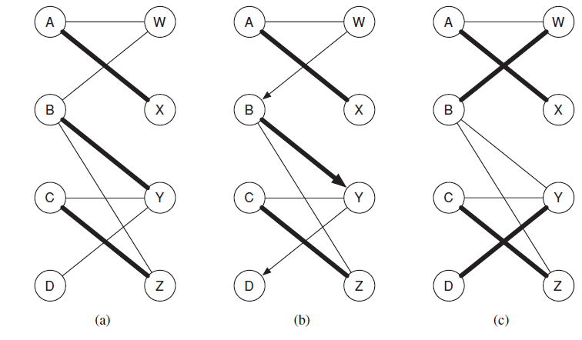
Alternating and Augmenting Paths

Slide 43
Searching for an Augmenting Path
Alternating BFS
  explore the rest of the graph layer by layer, adding new nodes to the next layer
  use non-matching edges from the left-hand side (for right nodes)
  use matching edges from the right-hand side (for left nodes)
  If a layer containing an unmatched node from the left-hand side of the graph, we have found an augmenting path

Slide 44
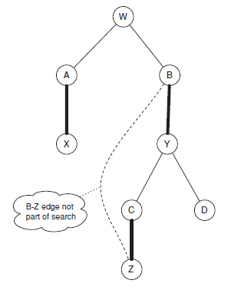
Searching for an Augmenting Path
Move down from W to D

Slide 45
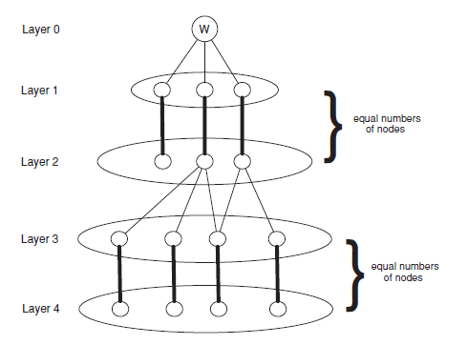
Augmenting Paths and Constricted Sets
BFS on a bipartite graph that is not perfect matching
The set of nodes in all even layers, at the end of a failed alternating BFS, forms a constricted set
Notes:
證明了沒perfect matching 一定有constricted set

Slide 46
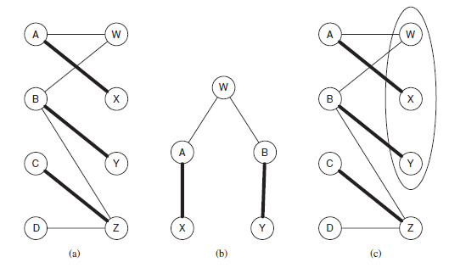
Augmenting Paths and Constricted Sets

Slide 47
Computing a Perfect Matching
We will progress through a sequence of matchings
Look at current matching and find an unmatched node W
Use alternating BFS to search for an augmenting path beginning at W
  If find one, use this augmenting path to enlarge the matching
  If don’t find one, stop with a constricted set that proves the graph has no perfect matching

Slide 48
Computing a Perfect Matching
When the procedure stops with a constricted set, it does not mean that we have a maximum matching

Slide 49
Computing a Perfect Matching
Search from w fail
Start from y will succeed

