Slide 1
Evolutionary Game Theory

Slide 2
Outline
7.1 Fitness as a Result of Interaction
7.2 Evolutionarily Stable Strategies
7.3 A General Description of Evolutionarily Stable Strategies
7.4 Relationship Between Evolutionary and Nash Equilibria
7.5 Evolutionarily Stable Mixed Strategies

Slide 3
Evolutionary game theory
The idea was ﬁrst articulated by John Maynard Smith and G. R. Price (1972)
Evolutionary biology is based on the idea that an organism’s genes largely determine its observable characteristics, and hence its ﬁtness in a given environment.
Fitter genes tend to win over time because they provide higher rates of reproduction. The success of any one of these organisms depends on how its behavior interacts with that of others

Slide 4
7.1 Fitness as a Result of Interaction
Interaction Among Organisms
  When two beetles compete for some food, we have the following possible outcomes
    When beetles of the same size compete, they get equal shares of the food
    When a large beetle competes with a small beetle, the large beetle gets the majority of the food
    In all cases, large beetles experience less of a fitness benefit from a given quantity of food, since some of it is diverted into maintaining their expensive metabolism

Slide 5
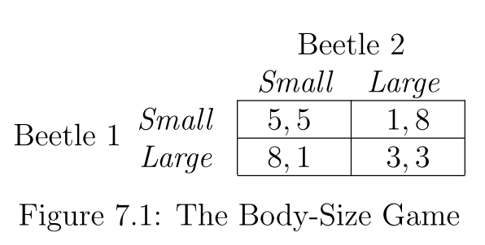
The payoffs to the beetles

Slide 6
7.2 Evolutionarily Stable Strategies
The basic definitions
  The ﬁtness of an organism in a population is the expected payoﬀ it receives from an interaction with a random member of the population
  A strategy T invades a strategy S at level x, for some small positive number x, if an x uses T and a 1 − x uses S
  S is evolutionarily stable if there is a (small) positive number y such that when any other strategy T invades S at any level x < y, the ﬁtness of an organism playing S is strictly greater than the ﬁtness of an organism playing T

Slide 7
First Example
a 1 − x fraction of the population uses Small and an x fraction of the population uses Large
  What is the expected payoff to a small beetle
    5(1 − x) + 1 · x = 5− 4x
  What is the expected payoff to a large beetle
    8(1 − x) + 3 · x = 8− 5x
    =>Small is not evolutionarily stable

Slide 8
First Example
a 1−x fraction of the population uses Large and an x fraction of the population uses Small
  What is the expected payoff to a large beetle
    3(1 − x) + 8 · x = 3 + 5x
  What is the expected payoff to a small beetle
    (1 − x) + 5 · x = 1 + 4x
    =>Large is evolutionarily stable

Slide 9
Interpreting the Evolutionarily Stable Strategy in our Example
Small beetles cannot drive out the large ones
  Small is not evolutionarily stable
Large beetles resists the invasion of small beetles
  Large is evolutionarily stable
Starting from a population of small (large) beetles, evolution by natural selection is causing the fitness of the organisms to decrease (increase) over time

Slide 10
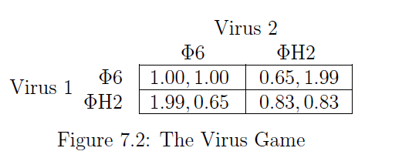
Empirical Evidence for Evolutionary Arms Races
The stronger takes advantage of the weaker
Example 1: the heights of trees can obey Prisoner’s-Dilemma
Example 2: the root systems of plants
Example 3: virus populations can also play an evolutionary version of the Prisoner’s Dilemma

Slide 11

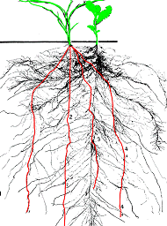

Slide 12
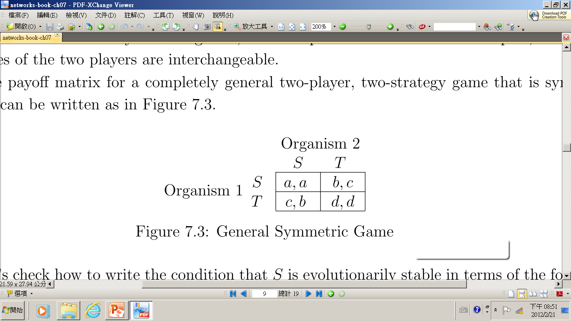
7.3 A General Description of Evolutionarily Stable Strategies
General Symmetric Game
  The expected payoff to S : a(1-x)+bx
  The expected payoff to T: c(1-x)+dx
  a(1-x)+bx > c(1-x)+dx
  In a two-player, two-strategy, symmetric game, S is evolutionarily stable precisely when either
  (i) a > c, or (ii) a = c and b > d

Slide 13
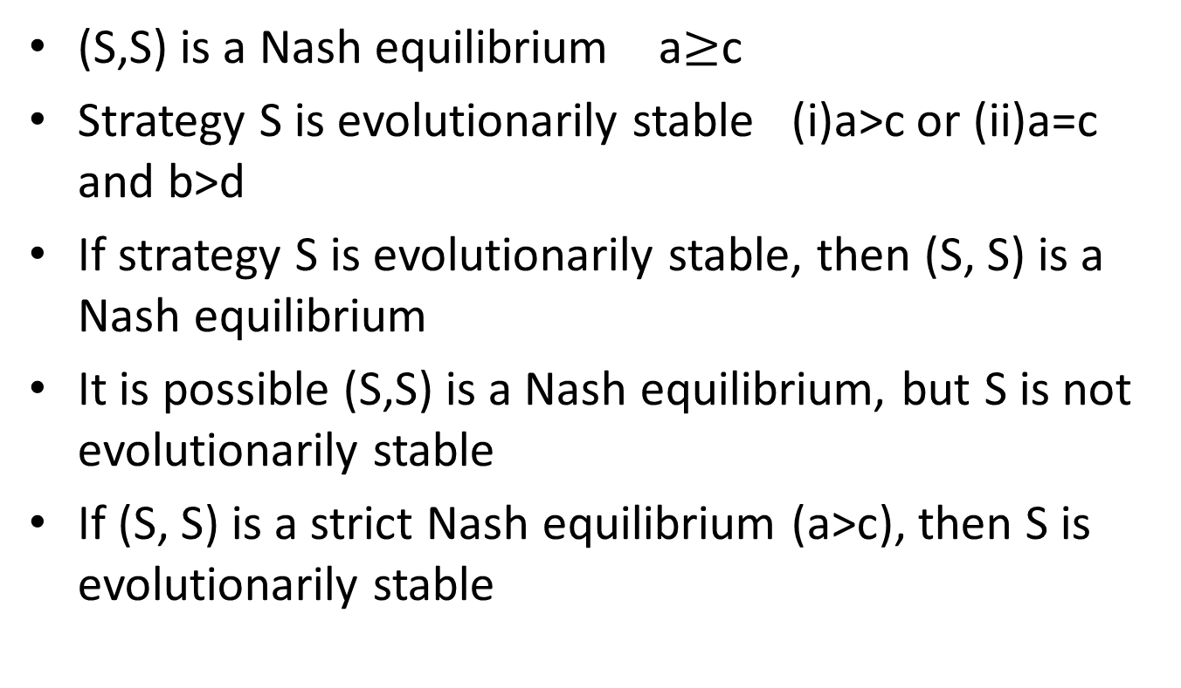
7.4 Relationship Between Evolutionary stability and Nash Equilibria
(S,S) is a Nash equilibrium a$≥$c
Strategy S is evolutionarily stable (i)a>c or (ii)a=c and b>d
If strategy S is evolutionarily stable, then (S, S) is a Nash equilibrium
It is possible (S,S) is a Nash equilibrium, but S is not evolutionarily stable
If (S, S) is a strict Nash equilibrium (a>c), then S is evolutionarily stable

Slide 14
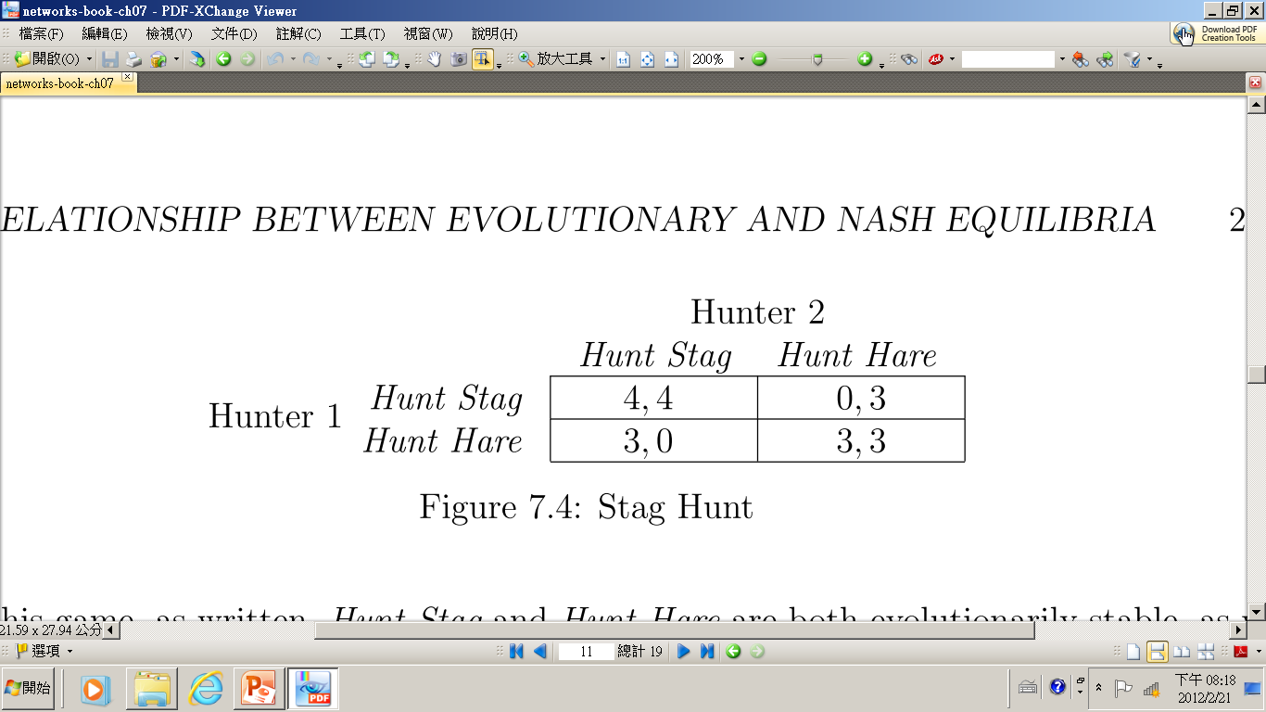
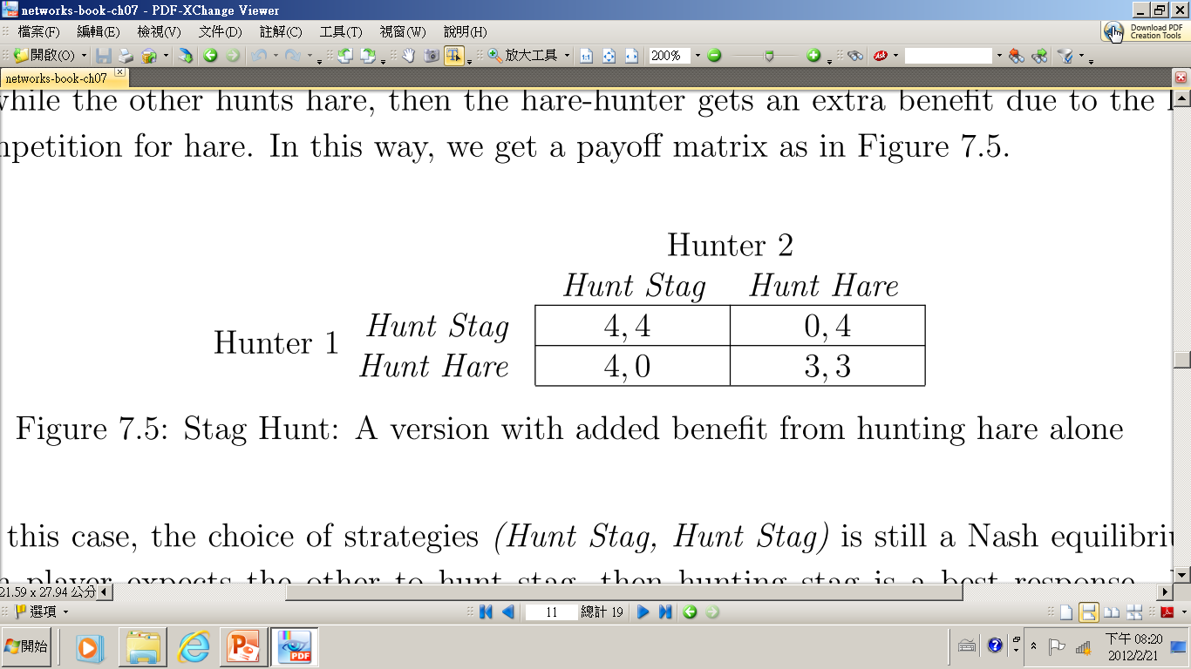
(stag, stag) is a Nash equilibrium and also evolutionarily stable
(stag, stag) is a Nash equilibrium but not evolutionarily stable

Slide 15
Evolutionary Stability vs Nash Equilibria
The set of evolutionarily stable strategies is a subset of the set of Nash Equilibrium strategies
In Nash Equilibrium, players choose mutual best responses to each other’s strategy and coordinate on strategies that are best response to each other’s strategy
In evolutionary stability, suppose no intelligence or coordination on the players. Strategies are viewed as being hard-wired into players (encoded in their genes) for more successful in producing offspring

Slide 16
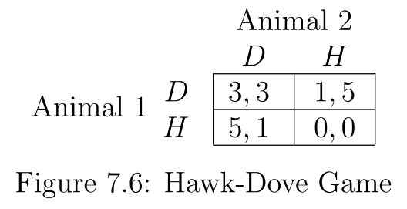
7.5 Evolutionarily Stable
Mixed Strategies
Hawk-Dove Game
  Two animals compete for a piece of food
  Hawk (H) behaves aggressively
  Dove (D) behaves passively

Slide 17
Hawk – Dove Evolutionary Game
Two pure Nash equilibria: (D, H) and (H, D).
Neither D nor H is a best response to itself, and neither is evolutionarily stable
  A hawk does very well in a population consisting of doves; but in a population of all hawks, a dove actually has an advantage by staying out of the way while the hawks fight with each other
  Evolutionary stability has been restricted to populations in which (almost) all members play the same pure strategy
Introducing concept of Evolutionarily Stable Mixed Strategies

Slide 18
Defining Mixed Strategies in
Evolutionary Game Theory
The expected payoﬀ for this ﬁrst player
  V (p, q) = pqa + p(1 − q)b + (1 − p)qc + (1 − p)(1 − q)d
q
1- q
p
1- p

Slide 19
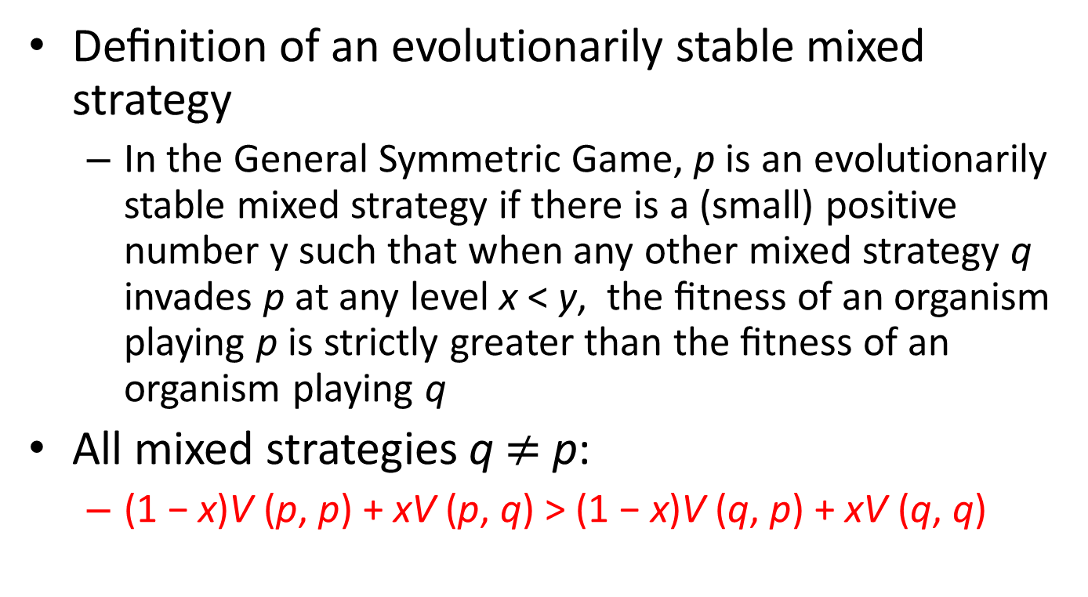
Defining Mixed Strategies in
Evolutionary Game Theory
Deﬁnition of an evolutionarily stable mixed strategy
  In the General Symmetric Game, p is an evolutionarily stable mixed strategy if there is a (small) positive number y such that when any other mixed strategy q invades p at any level x < y, the ﬁtness of an organism playing p is strictly greater than the ﬁtness of an organism playing q
All mixed strategies q $≠$ p:
  (1 − x)V (p, p) + xV (p, q) > (1 − x)V (q, p) + xV (q, q)

Slide 20
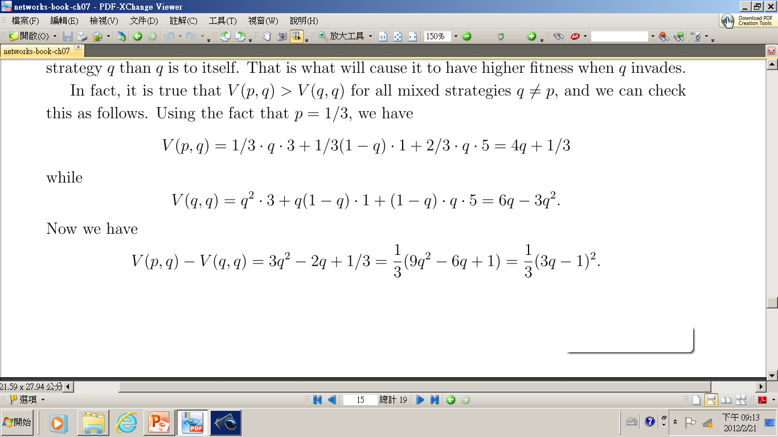
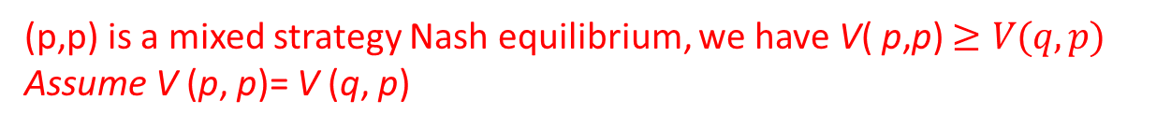
Evolutionarily Stable Mixed Strategies in the Hawk-Dove Game
(p,p) is a mixed strategy Nash equilibrium, we have V( p,p) $≥V(q,p)$
Assume V (p, p)= V (q, p)
p is indeed an evolutionarily stable mixed strategy

Slide 21
Interpretations of Evolutionarily Stable Mixed Strategies
Interpretation #1 (At individual level): All participants in the population may actually be mixing over the two possible pure strategies with the given probability
Interpretation #2 (At population level): it could be that 1/3 of the animals are hard-wired to always play D, and 2/3 are hard-wired to always play H

Slide 22
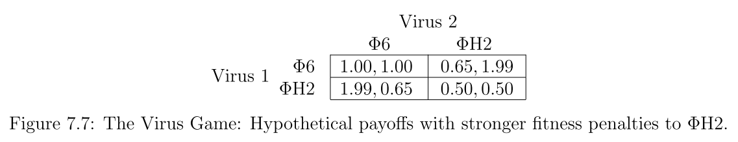
The Virus Game
Rather than having a Prisoner’s Dilemma type of payoﬀ structure, we’d have a Hawk-Dove payoﬀ structure
  Having both viruses play ΦH2 is suﬃciently bad that one of them needs to play the role of Φ6.
  Two pure equilibria : (Φ6,ΦH2) and (ΦH2,Φ6)
  Evolutionarily stable mixed strategy

Slide 23
Prisoner’s Dilemma vs Hawk-Dove
In both cases, a player can choose to be “helpful” to the other player or “selfish”
In Prison’s Dilemma, the playoff penalties from selfishness are mild and selfishness by both players is the unique equilibrium
In Hawk-Dove, selfishness is sufficiently harmful that at least one player should try to avoid it.

