Slide 1
Using artificial intelligence in craft education: crafting with text-to-image generative models
Vartiainen, H., & Tedre, M. (2023). Using Artificial Intelligence in Craft Education: Crafting Withtext-to-Image Generative Models. DIGITAL CREATIVITY, 34(1), 1–21.

Slide 2
Abstract
Artificial intelligence (AI) and the automation of creative work have received little attention in craft education.
Address this gap by exploring Finnish pre-service craft teachers’ and teacher educators’ insights into the potential benefits and challenges of AI, particularly text-to-image generative AI.
Implemented a hands-on workshop in order to stimulate discourses and capture imaginaries concerning generative AI.
The results revealed that making with AI inspired teachers to consider the unique nature of crafts as well as the tensions and tradeoffs of adopting generative AI in craft practices.
The teachers identified concerns in data-driven design, including algorithmic bias, copyright violations and black-boxing creativity, as well as in power relationships, hybrid influencing and behaviour engineering. The article concludes with a discussion of the complicated relationships the results uncovered between creative making and generative AI.

Slide 3
Introduction
Artificial intelligence (AI) is increasingly embedded in everyday life with new products, services and systems .
Generative machine-learning models are already used, for example, for creating digital art, composing music , free-hand sketching and drawing and creative writing. Generative models challenge artists' roles, but providing AI education can democratize creativity for innovative outcomes.
At this point, a considerable body of research has accrued on artificial intelligence and machine learning in the context of education. However, generative AI—in which the breakthrough applications are much more recent —has received little, if any, attention in craft education.

Slide 4
Introduction
As an early work on generative AI in craft education, the aim of this article is twofold, AI generates visuals from text
Provide new insights on AI's role in early-stage design discussions in craft, design, and tech education.
Aims to shed light on current and future Finnish craft educators’ (N = 15) insights into the potential and challenges of this still nascent technology.
Following the research-creation approach (Lupton and Watson Citation2022), we organized a hands-on workshop in teacher education, in which the participants collaborated to create visual images using generative AI, and then reflected on the role of AI and automation in the process of ideation and product design.

Slide 5
The role of visual materials and techniques in the craft design process
Craft education at its core emphasizes learning by designing and making digitally or materially embodied artefacts.
The goal of craft education has long been to mirror the expert practices and to cultivate designerly ways of thinking and practicing.
Ideation
Design
Making
Evaluation
complex and iterative problem solving process, where the designers work with open-ended and ill-defined design tasks

Slide 6
The role of visual materials and techniques in the craft design process
Design:
  Designers are not just gathering a collection of various kinds of reference material, but they use combinations and modifications of them to generate new ideas and thoughts
  Complexity in the overall design arises from such combinations and configurations among simple design elements that stand in a complex network of relationships from which novel ideas and design properties may emerge.
  Sketching and visualization play a key role in externalizing and further developing design ideas.
  The creation of various kinds of representations, such as sketches or prototypes, allows the designer to explore, develop and evaluate the form and function directly
  The mental ideas of the designer become visible and can be communicated to others for feedback

Slide 7
The role of visual materials and techniques in the craft design process
Making:
  design ideas are further transformed into material embodied forms and functional prototypes
  affects both the process and the outcomes of activity
  craft making relies heavily on material knowledge, such as knowledge of available materials, their technical properties, their sustainability and ways of manipulating and processing the required materials and tools
  The importance of skills in handling materials and tools has also been analyzed through concepts such as tacit knowledge and embodied thinking that characterize the practices and knowledge of expert designers and craftspersons
  computer-aided design (CAD) and 3D modelling：
    stimulate, facilitate, guide, externalize and otherwise mediate the process of design, thereby affecting the process of design as well as the kind of products designed

Slide 8
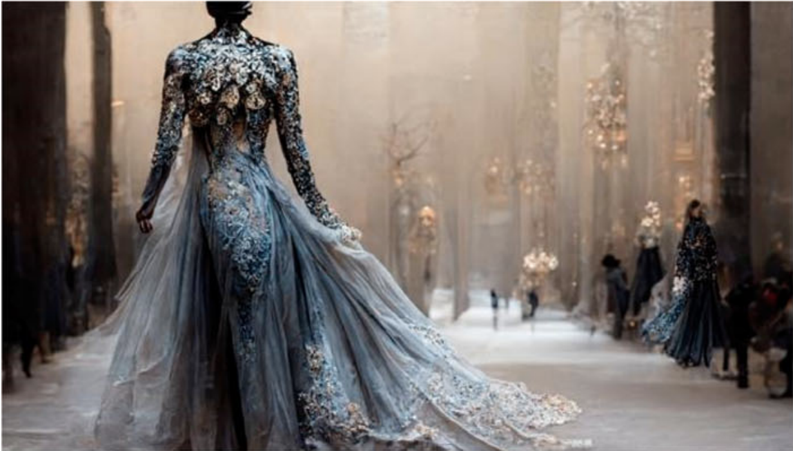
Generative models for producing photorealistic images
Generate highly aestheticimages from the user’s text prompts
eg. ‘Full shot of a haute couture dress walking at winter, sapphire, ice, ornate details, marchesa, tall shape,modelesque, costume design, fashion, beautiful back light, elegant mood, ethereal, muted coloursand neutrals, hyperrealistic, super detailed,—ar 16:9’
Created with Midjourney

Slide 9
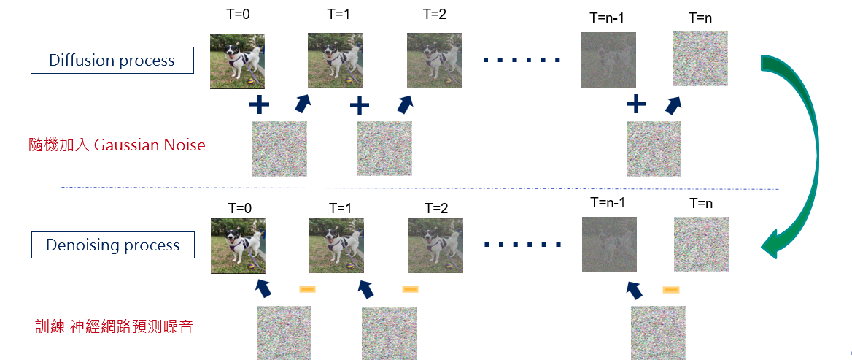
Generative models for producing photorealistic images
Diffusion models
  Can achieve photorealistic quality and generalize to images that have never previously appeared in the set of pictures used to train the model

Slide 10
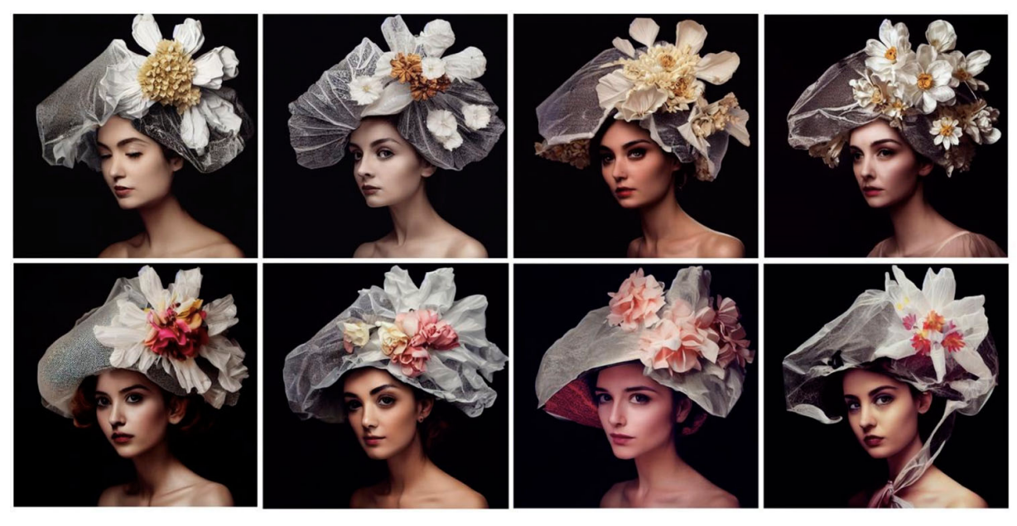
Generative models for producing photorealistic images
Human creativity in text-based generative art
  Creativity is not located in the end product, but emerges from the interaction between humans and the AI

Slide 11
Methodology
Context of the Study
  The empirical data for this study were collected during a workshop on craft teacher education
  The study explores the potential benefits and challenges of using AI in craft education, specifically focusing on text-to-image generative models
Participants
  pre-service craft teachers and teacher educators in craft science involved in the educational programme

Slide 12
Methodology
Workshop
  Pre-task:
    write down their preconceptions about AI and its relationship to the design process and the teaching of design
  Workshop:
    began with an introduction to AI and the mechanisms of text-to-image generative models
    provide insights into the ethical concerns related to AI
    show examples of how to use the Midjourney interface
    produce large number of various kinds of images with their ideas

Slide 13
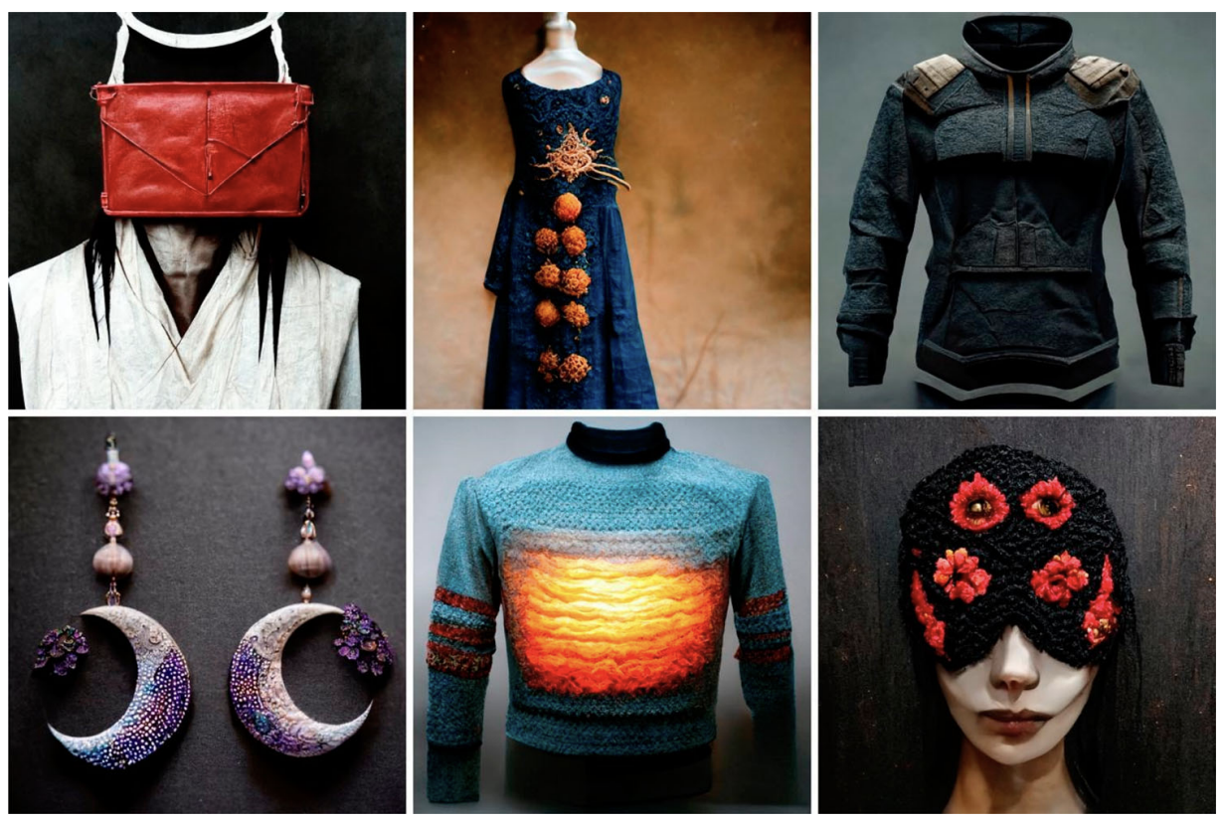
Methodology
Workshop
  Examples of participants’ design ideas. Created with Midjourney

Slide 14
Methodology
Data Collection
  Video & audio recordings, Observation , AI-generated images
Data analysis
  Data were transcribed and pseudonymized
  Thematic analysis
    Gain general sense of the nature of collaborative discourses
    Identify Meaningful Units
    Review Interpretations
    Compare and Contrast Coded units -> candidate themes
    Review potential themes: aggregated codes

Slide 15
Results - Tensions and tradeoffs in the process of design
Ideation
Externalization
Design constraints
Making
Assessment
Future skills
Notes:
設計過程中的緊張和權衡
構思。正面而言，參與者們認為在產品設計過程中有許多機會可以增強想法生成。
外化。可能為兒童以及教師提供的逐步提示製作方面的機會：
我會認為，如果AI能幫助孩子[反覆思考和發展想法]在設計方面：好吧，……夢想的庭院：我想在那裡建一個獨棟房子，一座紅色的房子，然後會有……不不，我想要那個更大的房子，好吧，現在就是這樣了，我想要它是用木頭建成的，一座大的紅色木屋。然後，它逐漸開始做，從而在某種程度上幫助了孩子。這很好；它開始看起來像那樣了。我還想在庭院裡有寶可夢（笑），所以類似這樣的東西。這樣一來，孩子和教師也會對它可能成為什麼有相當相似的想法。然後，它也可以同樣幫助教師和孩子。
設計限制。教職員工擔心，使用AI視覺化的想法可能不會受到設計約束的限制，例如材料限制、可用資源和實際技術技能以及學生的知識。從另一個角度來看，教師們也在思考利用AI生成的視覺化來分析情境設計限制的機會。
製作。許多參與者強調了製作的體現性質，這是數字設計所缺乏的。如果機器做了一切，那就像把你的大腦交給了外部來源。我不再需要是一個人；機器會為我做一切。但是，製作手工藝是一個緩慢的過程，它很慢，但是[AI]在幾分鐘內設計，而且使用你自己的大腦完全被這個系統所取代。
評估。使用AI驅動的設計工具引發了有關創意學習評估的一些問題，特別是關於評估中的設計技能。Vuokko說：“關於評估。如果學生使用文本轉圖像生成AI，我們在評估他或她的設計技能方面在評估什麼？我們在評估他或她是否發明了好的提示嗎？”
未來技能。與AI的探索促使教職員工思考自動化長期以來的恐懼及其與手工藝製作和教學的關係。Anita表示：“早在1980年代，我們就擔心當工業大量生產服裝時，手工藝作為一門學科將變得毫無意義，不再需要了。所以，當我們是學生時，這已經討論過了。但是，它並沒有消失，手工藝的愛好者增加了。”

Slide 16
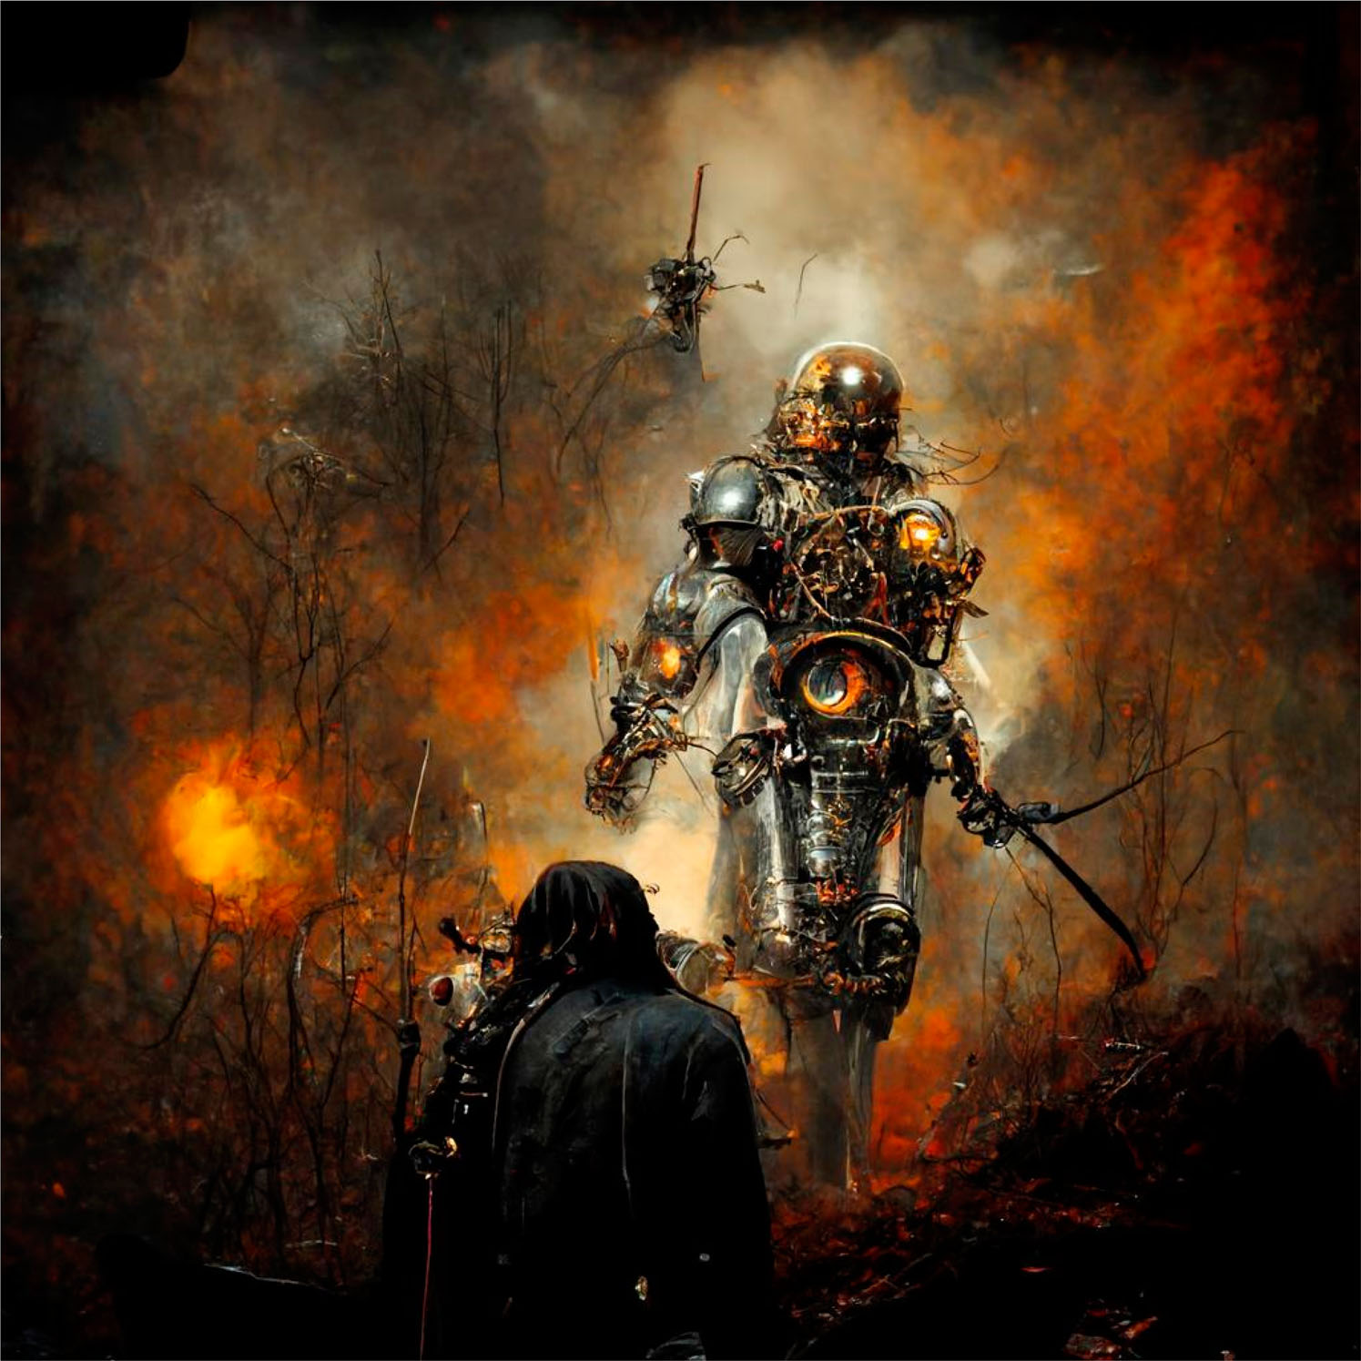
Results - Unforeseen tension and concerns
Biases
Copyright
Black-boxing creativity
Behaviour engineering
Notes:
未預見的緊張和擔憂
偏見。使用AI進行製作促使教師深入反思創造力。教職員工認識到AI一方面和人類設計師另一方面依賴於他們以前所見的某些相似之處。人們的設計思想很少是從空中冒出來的，而是反映了人們所見和經歷的事物。
教職員工和準服務教師都在思考是否過度依賴現有的想法和風格會導致不斷重複同樣的想法並加強現有偏見的惡性循環。
版權。AI生成的圖像也引發了對版權的許多討論。這是其他藝術家創作的藝術品，它使用這些來形成自己的圖像。因此，在某種程度上，它就像是在偷竊其他人的藝術品。而不是去問權限，比如，嘿，我現在正在使用這個。例如，就像你創建的那個蒸汽龐克圖片【圖5】… 它實際上可能只是佈局，它的角色排列方式，就像其他人的作品中一樣。
黑盒子化創造力。探索人工智能引發了教職員工對創造力定義的辯論。創造力並沒有一個固定的定義，你知道如何以新的方式製作或結合現有或舊的事物。這確實是這樣的。但是然後我想到了它是如何將事物聚合在一起的：讓它可見不是很好嗎？但我們看不到那些痕跡。我們只看到放在其中的文字。它得到了那些詞語和提示，通過結合它們，它創造了一個新的產品。但這是創造性的嗎？
行為工程。學生們也提出了關於算法權力的其他擔憂，這不僅影響了人們可以創造什麼以及這些系統如何使用，更深層次地影響了AI生成的個性化風格圖像如何被用於市場營銷和行為工程。
雖然教師們在批判性地反思AI生成的圖像和數據驅動設計的潛在風險和危害，但他們也意識到這些問題應該成為教學的一部分。
我們可能無法再將這些由人工智能生成的圖像和這個視覺世界放回瓶子裡了。我們再也無法回到那裡，但就在我們的教學中，一個非常重要的部分將是理解它可能存在偏見以及存在哪些偏見。

Slide 17
Discussion
The aim of this study was to shed light on Finnish pre-service craft teachers’ and teacher educators’ insights into the use of text-to-image generative models (images generated by AI to match users’ text prompts) in craft design and learning processes. Through creative making, this study aimed to stimulate discourses and engage workshop participants to develop new insights into the potential and limits of generative AI.
Notes:
本研究的目的是闡明芬蘭準服務手工藝教師和教師教育者對於使用文本生成圖像模型在手工藝設計和學習過程中的見解。
對於生成AI的反思高度地與芬蘭國家核心課程的整體手工藝過程密切相關。教師們談到了AI如何通過提供新的觀點和可視化可能和不可能的方式來協助構想過程。
與此同時，參與者還指出了生成AI在手工藝教育中的各種限制。在設計約束方面，他們懷疑使用生成AI會創造全新的技能差距，其中AI創建的可視化和學生可用的材料資源或實際技能和知識不匹配。參與者將觸摸和用手形成不同材料與兒童的大腦發展聯繫在一起，表明了一種不應自動化的觀點。同樣，AI在情感和具體互動方面的討論也被認為對人類學習、發展和幸福至關重要。事實上，使用生成AI進行創意製作促使教師加強了對手工藝的獨特性質和他們在教學中努力培養的技能的看法，以及這些抱負與在採用生成AI進行手工藝實踐時出現的緊張和取捨之間的關係。此外，與AI一起製作也促使教師思考評估和發展技能，尤其是在面向未來的教學方面。
分析還顯示，與生成AI共同製作刺激了關於手工藝教育背景下新主題的批判性話語。對於數據驅動設計的介紹和實際探索促使參與者思考許多在批判性媒體研究中顯示出的擔憂，例如新型權力關係、算法偏見、混合影響和行為工程。這些擔憂集中在制定設計決策和對數據驅動未來的感受上。
在與AI共同創造新設計並參與共享話語的過程中，教師們也一致認為，提出的許多問題和擔憂至少應在引入AI主題時加以考慮。創意製作可能是提高意識並產生替代或抵抗的想像力的重要途徑。然而，由於本文所涉及的緊張關係是基於手工藝教師與生成AI的首次接觸，因此還有待觀察這些技術和經驗上的緊張關係如何在教育實踐中實現。本研究還存在一定局限性，因為它僅專注於文本生成圖像AI，並未探討其他AI發展所帶來的利弊。雖然這項探索性研究的結果不能概括，但對教師的見解和經驗上的緊張關係的早期結果對手工藝、設計和技術教育研究的發展以及為未來的教師提供準備他們的學生在AI時代成為有創造力和批判性的製作者的能力至關重要。

