Slide 1
Is Writing Prompts Really Making Art?
Jon McCormack, Camilo Cruz Gambardella, et al. "Is Writing Prompts Really Making Art?"
EvoMUSART Conference (2023)

Slide 2
Abstract
A current wave of generative systems use text prompts to create complex imagery, video, even 3D datasets. The creators of these systems claim a revolution in bringing creativity and art to anyone who can type a prompt.
In this position paper, we question the basis for these claims, dividing our analysis into three areas:
  the limitations of linguistic descriptions
  implications of the dataset
  matters of materiality and embodiment.
We conclude with an analysis of the creative possibilities enabled by prompt-based systems, asking if they can be considered a new artistic medium.

Slide 3

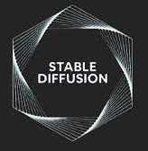

Introduction
Over the last decade a seemingly endless wave of innovations in generative machine learning models have allowed the generation of photo-realistic images of non-existent people, coherent paragraphs of text, conversion of text directly to runable computer code and, most recently from text descriptions to images, video, and even 3D models.
DALL-E 2
MidJourney
Stable Diffusion
Text-to-Image (TTI) systems

Slide 4
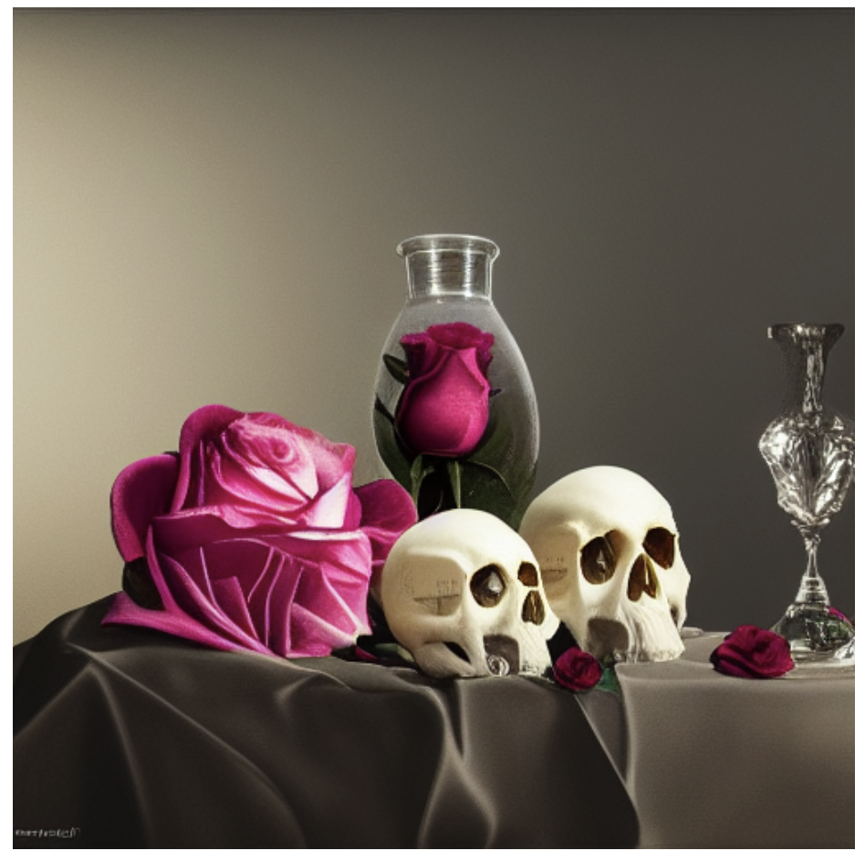
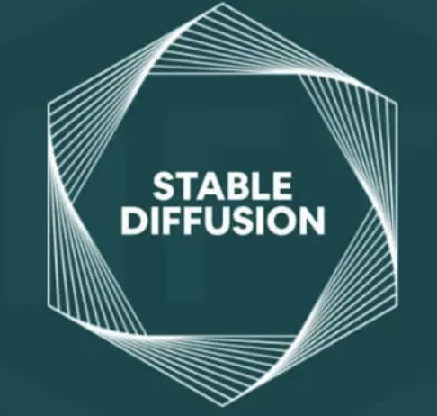
Introduction
still life with human skulls of different sizes, a rose, the most beautiful image ever seen, trending on art station, hyperrealistic, 8k, studio lighting, shallow focus, unreal engine

Slide 5
Introduction
“Ｗill empower billions of people to create stunning art within seconds.”
TTI systems are specially pitched as being artistic tools, i.e. their primary intended application is to create “art”.
Analyse the creative and artistic value , looking at the implications of Text-to-Image creativity and the underlying ethical considerations of such systems.
Unpack the drawbacks and the opportunities of TTI systems employed as artistic medium, offering an analysis of their potential for cultural contribution.

Slide 6
The Limitations of Linguistic Description
If you could say it in words, there would be no reason to paint.
- Edward Hopper
The “understanding” that TTI systems have of images is literal, as they are built upon millions of formal descriptions of visual material.
Consequently the images produced by these systems can only reflect the content of a prompt literally. Any further meaning, intention or encoded information assigned to a specific textual construct, be it metaphorical or culturally charged, will be lost in translation.

Slide 7
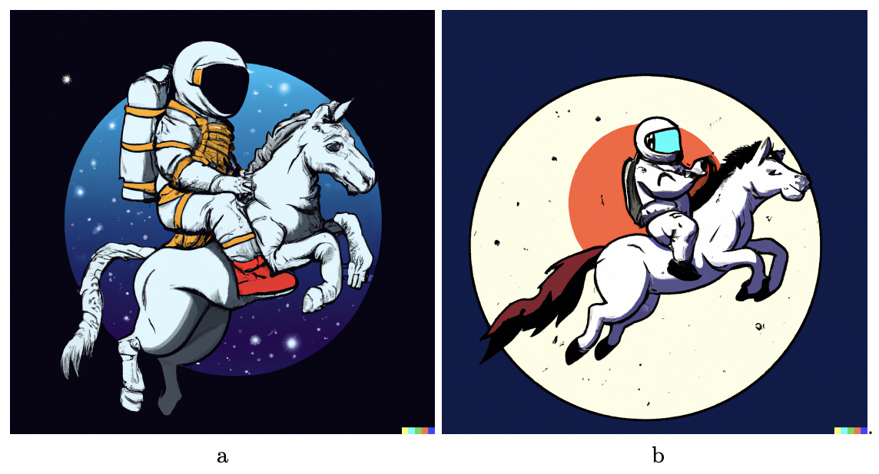
Levels of Control
Another issue with such high-level text descriptions is the level of control and malleability one has over image making via language only.
an astronaut riding a horse
a horse riding an astronaut

Slide 8
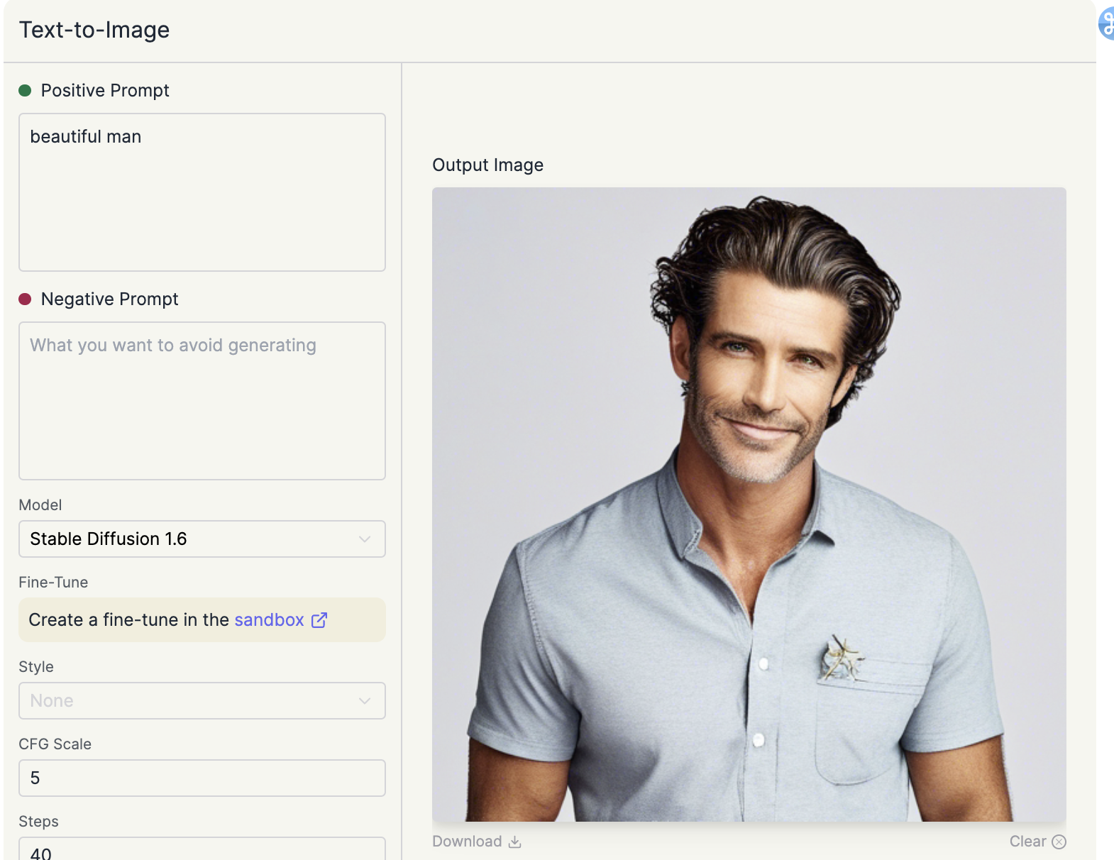
Levels of Control
prompt: beautiful man
the system returns an Internet stereotypical image of a man: white, heterosexual, youthful, professional, athletic.

Slide 9
Data Implications — AI as Parasite
AI models trained on vast datasets of human-created art, like TTI systems, act as parasites to human creativity. These models sustain themselves by drawing from human art, potentially overshadowing current human artistic endeavors.
TTI systems reinforce cultural norms and biases present in their training data, potentially marginalizing diverse artistic interpretations. While they can generate new images statistically, they lack the transformative creativity inherent in human artistry. As TTI systems become more integral to cultural production, they may diminish human creativity and sideline human artists, altering the artistic landscape.
Notes:
人工智慧作為寄生蟲
我們認為，訓練在大量人類創作藝術數據集上的深度學習模型——例如 TTI 系統——對人類藝術和創造力是寄生的，因為它們從人類藝術中獲取並維持自身，最終是以損害當前人類藝術為代價。TTI 模型直接依賴於人類藝術數據集的訓練，為了證明我們的寄生論主張，我們需要展示對人類藝術的負面影響。因此，如果 TTI 和類似系統削弱了人類藝術，則可以將其關係正當化為寄生的。
正如在第二部分討論的那樣，TTI 系統通過與其相關的語言和圖像的流行解釋來強化其訓練集的統計標準。雖然 TTI 系統可以生成“新”的圖像（在這個特定意義上，該圖像以前不存在），但它們都是預先存在圖像的統計組合。
如果 TTI 系統成為文化生產的一個日益重要的部分，人類藝術和創造力有可能因為上述原因而被削弱。此外，隨著這些系統取代人類插畫家，能夠勝任插畫工作的人類才可能會減少，因為與使用人工智慧相比，支付人類插畫家在商業上不太可行。

Slide 10
Data Implications — Parasitic Meaning
The concept of generative computer algorithms mimicking human art as "parasitic" isn't new and was proposed by philosopher Anthony O'Hear nearly 30 years ago. O'Hear emphasized that true appreciation of visual art extends beyond mere visual consumption, requiring a connection between art and its production history or intent. He argued that while computer-generated art may draw from existing works, its meaning is ultimately derived from human thought, making it "parasitically meaningful". We suggest that while TTI systems may convey human intentions, these intentions are predominantly borrowed from pre-existing human art, rendering any inferred meaning parasitic, according to O'Hear's understanding.
Notes:
寄生性的含義
這個模仿人類藝術的生成式計算機算法「寄生」的想法並不新鮮。哲學家安東尼·奧希爾（Anthony O'Hear）將這一觀點形成近30年前。奧希爾認為，藝術不僅僅是愉悅的視覺外觀或表面美學，它依賴於人類的意圖：意圖引起特定的體驗，傳達一個想法，或引發特定的情感反應。奧希爾承認，并非每一件藝術品都能實現這一點；然而，在奧希爾看來，這種意圖和真實性是被認為是「藝術」的必要條件。奧希爾具體考慮了從現有作品中獲得的的藝術品可能性，但這些作品不是任何完整作品的副本。
我們不是在說 TTI 系統無法傳達人類的意圖，而是大部分（或全部）的意圖都來自於現有的人類藝術，因此根據奧希爾對該術語的理解，推斷出的任何意義都是寄生的。引發圖像的提示的作者也可能有某種意圖，但這種意圖只能在圖像本身中表現得非常周邊，因為實際上是 TTI 系統而不是提示作者在創作圖像。

Slide 11
Data Implications — Data Laundering
The capability of TTI models heavily relies on access to massive datasets, often scraped from the internet, for training. This practice, known as "data laundering," raises ethical concerns as it often includes copyrighted material used without direct permission. Artists are concerned about their work being appropriated or imitated by such systems, and there are no easy ways for artists to opt-out of these datasets. Furthermore, the use of copyrighted images without proper compensation raises questions of plagiarism and circumvents traditional frameworks supporting artists.
Notes:
數據洗白
造成 TTI 模型能力的一個關鍵因素是它們能夠訪問用於訓練和驗證的大量數據集。實現它們能夠重現的視覺品質和多樣性需要大量的人造圖像語料庫，通常是從互聯網上收集的。在一種被稱為「數據洗白」的做法中，被收集的數據集——其中包括大量受版權保護的媒體——依賴於「學術用途」的特殊豁免來避免使用時遇到的法律障礙，或者避免版權所有者提出索賠。例如，Stability AI（Stable Diffusion 的「創造者」）資助了慕尼黑路德維希·馬克西米連大學的機器視覺與學習研究小組進行模型訓練，並由一個小型非營利組織創建了約 58.5 億張圖像的訓練數據集，其中許多是受版權保護的，一般而言，這些圖像是在未經圖像創作者直接許可的情況下為此目的而使用的。
藝術家已經對他們的作品被用於這類系統的道德和道德含義提出了擔憂。這些擔憂包括個別藝術家的「風格」被挪用、模仿，甚至是取代人類藝術家或插畫家。此外，從這些數據集中排除或刪除是沒有簡單的方法的。對於 TTI 系統引起的擔憂，出現了一些網站，讓任何人都可以搜索自己的作品是否作為訓練數據的一部分。一個相關的項目允許人們選擇是否將自己的數據納入其中。截至撰寫本文（2022年11月），大約有60％的受訪者選擇退出被納入任何訓練數據。
在數據集中使用受版權保護的圖像引發了另一個問題，引發了這樣一個問題：是否應將在受版權保護的數據上訓練模型視為抄襲。能夠輕松地以藝術家的風格生成圖像，而不必支付藝術家創作的費用（或支付任何版稅或許可費），使得使用這種技術的用戶可以繞過傳統的經濟、法律和道德框架，這些框架傳統上支持藝術家。立即生成可供商業使用的無版權圖像，而無需花費時間和費用從人類藝術家那里獲得版權，可能會成為一個有吸引力的建議，這引發了一個法律問題。

Slide 12
Materiality and Embodiment
Vast majority of visual art currently made by humans is made physically
TTI systems rely solely on language for the production of digital images
  excludes the phenomenological and embodied modalities
The artistic “practice” involves the iterative prompting and re-prompting of the TTI model
  not learned in any tacit, embodied, or individualised way
  confined to a screen

Slide 13
Embodiment in AI
Virtual environment that provides a (high-fidelity) simulation of a physical world can enable embodiment, provided the agents are structurally coupled with that environment
Systems like DALL-E, Midjourney and Stable Diffusion, and in general TTI systems, do not exist in a virtual environment that enables any kind of agent-environment interaction

Slide 14
Material Agency
The resistance of the medium to being moulded that leads to it’s true creative potential
TTI models we observe an attempt to conceal the qualities of the medium – to render it invisible
  by imitating more traditional materials like paint, photography, or with aesthetic conventions such as “cinematic lighting”

Slide 15
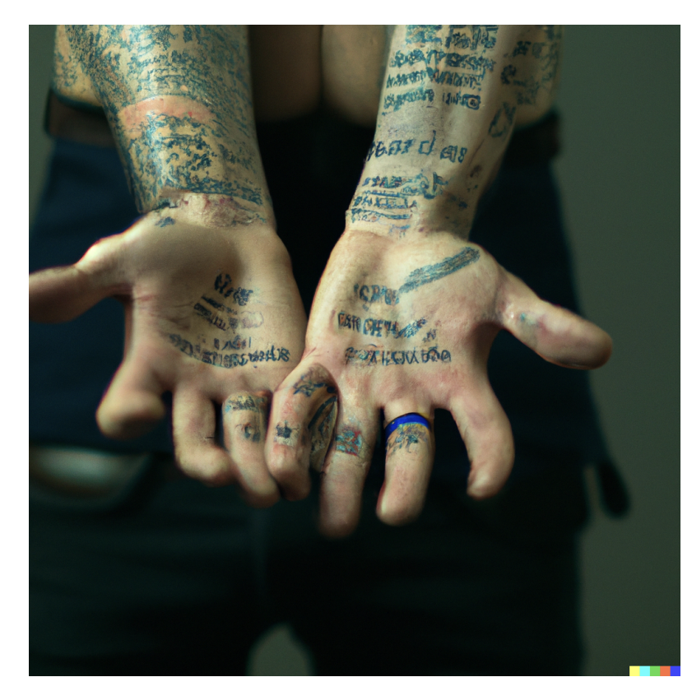
A New Medium?
AI artists to try and hide or fix errors generated by TTI systems
might lead to more interesting artistic possibilities
common deficiency with TTI systems – they are hopeless at generating meaningful text.

Slide 16
Conclusion
Is writing prompts really making art?
  it is difficult to see prompt writing as a significant art practice
  subvert their intended use
  embody the agency and interaction for these systems

