Slide 1
Genie: Generative Interactive Environments
Jake Bruce, Michael Dennis, Ashley Edwards, Jack Parker-Holder, Yuge Shi, Edward Hughes, Matthew Lai, Aditi Mavalankar, Richie Steigerwald, Chris Apps, Yusuf Aytar, Sarah Bechtle, Feryal Behbahani, Stephanie Chan, Nicolas Heess, Lucy Gonzalez, Simon Osindero, Sherjil Ozair, Scott Reed, Jingwei Zhang, Konrad Zolna, Jeff Clune, Nando de Freitas, Satinder Singh, Tim Rocktäschel

Slide 2
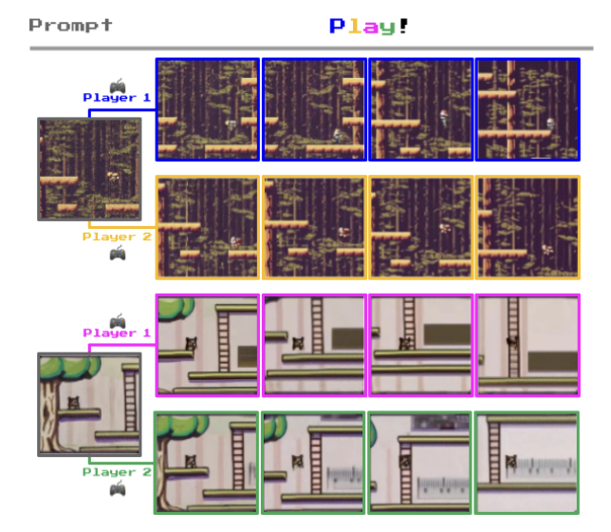
Introduction
Generative AI: language and image generation.
Genie: a generative interactive environment trained from unlabelled Internet videos.
Key features: text/image prompt-based generation, frame-by-frame controllability, and unsupervised learning of latent actions.

Slide 3
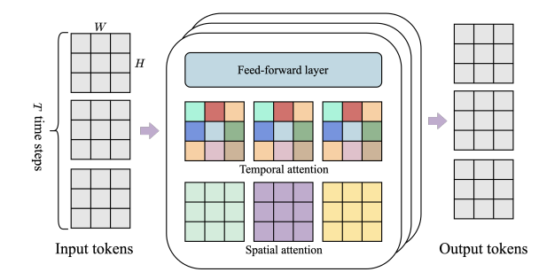
Methodology
Training from video-only data
Genie architecture
  based on the Vision Transformer (ViT)
Spatiotemporal transformer architecture for efficient video processing.
  ST-transformer

Slide 4
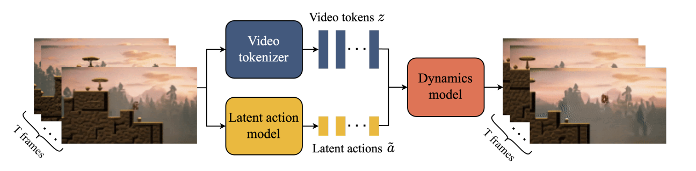
Model Components
Video tokenizer: compress videos into discrete tokens
Latent action model: Unsupervised learning of latent actions between frames
Dynamics model: decoder-only MaskGIT transformer

Slide 5
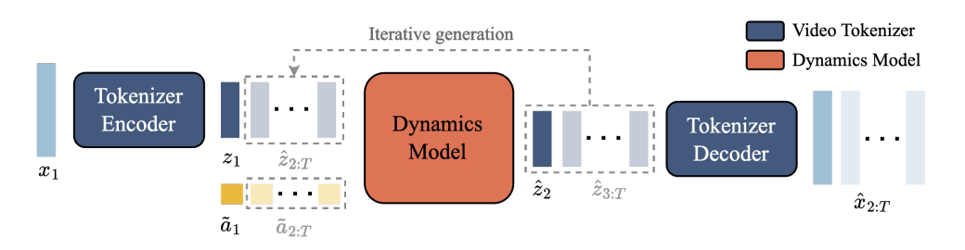
Inference: Action-Controllable Video Generation
Action-controllable video generation at inference time
Ability to prompt the model with images and control generation with latent actions
Potential for creating diverse interactive experiences

Slide 6
Experimental Results
Datasets:
  Collected from publicly available Internet videos of 2D Platformer games(Platformers).
  We construct the Platformers dataset by filtering publicly available videos for keywords relating to platformers, the final dataset contains 6.8M 16s video clips.
Metrics:
  Video Fidelity:
    Frechet Video Distance (FVD)
  Controllability:
    signal-to-noise ratio (Δ PSNR)

Slide 7
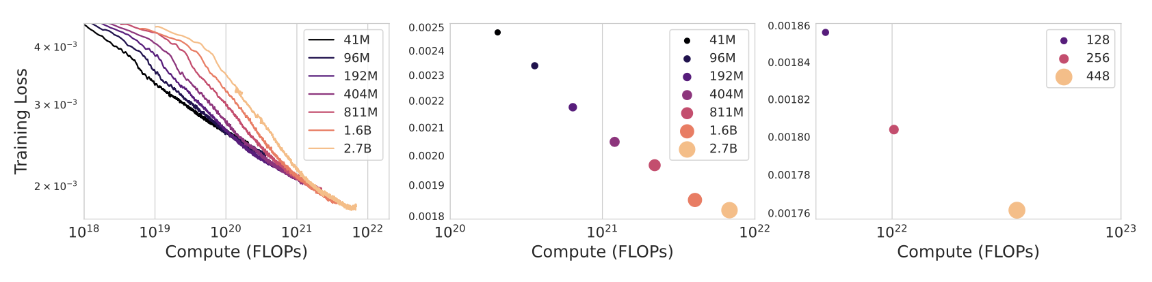
Scaling and Qualitative Results
Scaling Results:
  Investigating model scalability by varying model size and batch size.
  Increasing both parameters and batch size improves model performance.
  Final Genie model: 10.7B parameters trained on 942B tokens, enhancing overall quality.

Slide 8
Scaling and Qualitative Results
Qualitative Results:
  Genie model generates high-quality, controllable videos across diverse domains.
  Evaluation using out-of-distribution(OOD) image prompts demonstrates robustness.
  Capable of understanding 3D scenes and emulating parallax, showcasing versatility.
  Robotics-trained model learns distinct actions and interactions from video data without explicit labels.
Notes:
Notably, we qualitatively eval- uate our Platformers-trained model using only out-of-distribution (OOD) image prompts, includ- ing those generated from text-to-image models, hand-drawn sketches, and even realistic photos.

Slide 9
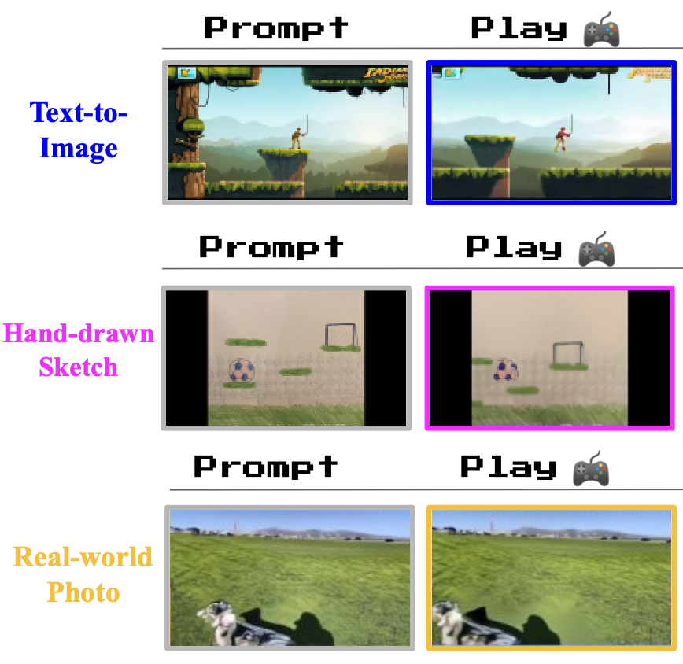
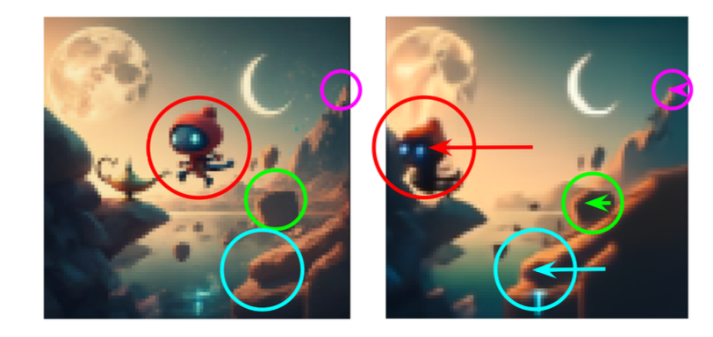
Scaling and Qualitative Results
OOD
Emulating parallax

Slide 10
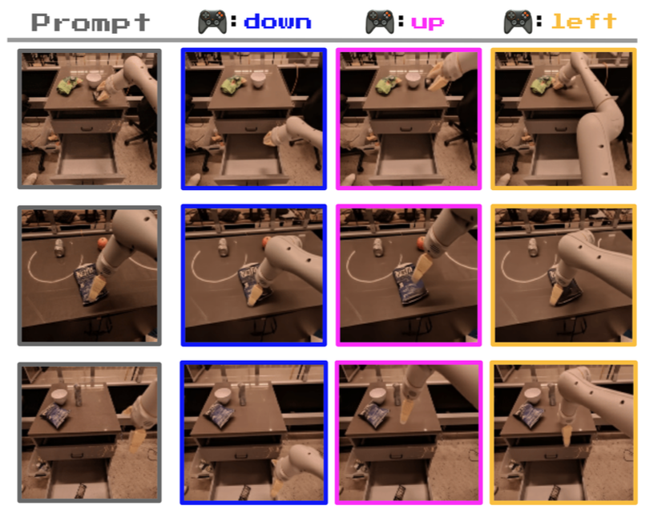
Scaling and Qualitative Results
Robotics-trained model

Slide 11
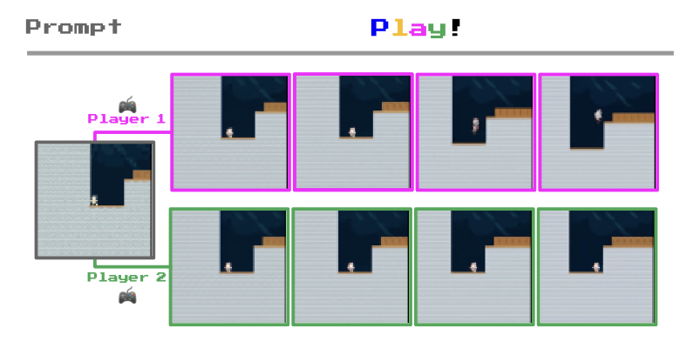
Training Agents
Genie could one day be used as a foundation world model for training generalist agents
Playing from RL environments

Slide 12
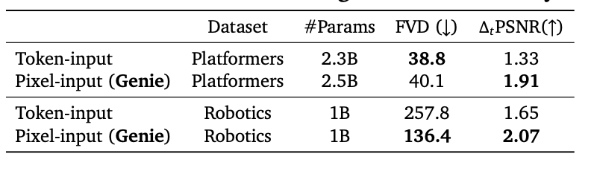
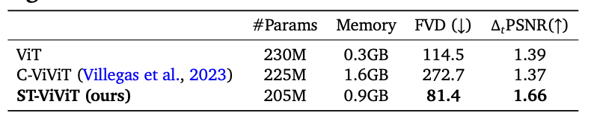
Ablation Studies
Latent Action Model Design:
  Evaluation of using original images versus tokenized images.
  Chose original images due to better controllability and performance across both Platformers and Robotics datasets.
  Token-input model exhibited lower controllability, suggesting loss of video dynamics during tokenization.
Tokenizer Architecture Ablations:
  Comparison of three tokenizers: ViT, ST-ViViT, and C-ViViT.
  ST-ViViT architecture demonstrated improved video generation and controllability compared to others.
  C-ViViT showed higher memory consumption without significant performance gain, indicating potential overfitting and requiring strong regularization.

Slide 13
Related Work
World models: Their work explores world models, focusing on next-frame prediction conditioned on action inputs, facilitating agent training without direct environment experience.
Video models: They delve into video models, which predict subsequent frames based on initial frames or text inputs, akin to recent transformer-based approaches.
Playable Video Generation: Their approach extends beyond playable video generation, incorporating latent actions to control world models learned from videos, allowing for interactive exploration.
Environment generation: They investigate environment generation, leveraging pixel-level learning to directly generate diverse levels from Internet video data.
Training agents with latent actions: Their research involves training agents using latent actions, drawing inspiration from prior works in imitation learning, planning, and pre-training reinforcement learning agents, aiming to infer policies for arbitrary environments from Internet videos.
Notes:
World models 的生成互動環境可以被視為一類世界模型，它們能夠實現在行動輸入條件下的下一幀預測。這樣的模型對於訓練代理人有可能是有用的，因為它們可以在代理人訓練時用於學習策略，而無需直接從環境中獲取經驗。
Video models 他們的工作與影片模型相關，這些模型通常會以初始幀（或文本）為條件，並預測影片中剩餘的幀。他們的方法最類似於最近基於變形器的模型，因為他們使用了MaskGIT和ST-Transformer在標記化圖像上。雖然影片模型越來越具有可控性，但他們追求更具有行動性的目標，並明確從數據中學習潛在的行動空間。
Playable Video Generation 與Genie相比，PVG考慮的是特定領域的靜態示例，而不是通過提示生成全新的環境。
Environment generation 他們的工作也與程序性內容生成（PCG）有關，在這方面，機器學習已被證明對生成遊戲關卡非常有效，最近通過直接編寫遊戲代碼的語言模型。語言模型本身也可以被視為是交互式環境。相比之下，在他們的設置中，關卡可以直接從像素中學習和生成，這使他們能夠利用互聯網影片數據的多樣性。
Training agents with latent actions 先前的工作已經使用潛在動作進行觀察的模仿、規劃和預訓練強化學習代理人。這些方法與他們的潛在動作模型具有類似的目標，但尚未大規模應用。VPT是一種最近的方法，它使用從人提供的帶標記動作的數據學習的逆動力學模型，將互聯網規模的影片標記為動作，然後可以用於訓練策略。

Slide 14
Conclusion and Future Work
Genie Capabilities:
  Despite being trained solely on video data, Genie can generate diverse and interactive environments upon prompt.
Model Limitations:
  Genie inherits weaknesses from autoregressive transformer models, leading to potential hallucinations of unrealistic futures.
  Spatial-temporal representation advancements are constrained by a 16-frame memory limit, hindering consistency over extended horizons.
  Currently, Genie operates at around 1FPS, necessitating future advancements for efficient interaction.
Future Research Potential:
  Despite limitations, Genie presents significant potential for future research, especially in training from a larger portion of internet videos to simulate diverse environments.
  Additionally, leveraging Genie for agent training could address the lack of rich and varied environments in reinforcement learning, potentially leading to more capable agents.
Notes:
他們提出了Genie，一種新型的生成式人工智慧，使得任何人，甚至是兒童，都能夢想、創建並進入生成的世界，就像他們能夠進入由人類設計的模擬環境一樣。
模型還有明顯的改進空間。Genie繼承了其他自回歸變形器模型的一些弱點，可能會出現不現實的未來情景。雖然他們在時空表示方面取得了進展，但他們仍然受限於16幀的記憶，這使得在長時間範圍內獲得一致的環境變得困難。最後，Genie目前的運行速度約為1FPS，需要未來的進步才能實現高效的幀速率以供交互使用。
然而，他們相信Genie為未來的研究開辟了廣闊的潛力。考慮到其通用性，該模型可以從更大比例的互聯網影片中進行訓練，以模擬多樣化、真實和想像的環境。

