Slide 1
Doodlebot: An Educational Robot for Creativity and AI Literacy
Williams, R., Ali, S., Alcantara, R., Burghleh, T., Alghowinem, S., & Breazeal, C.
ACM/IEEE International Conference on Human-Robot Interaction (2024)

Slide 2
Abstract
Traditional robotic toolkits used in education often lack suitability for young or non-programming proficient learners.
Doodlebot is introduced as a mobile social robot designed specifically for hands-on AI education.
Doodlebot effectively engages grade school students in exploring various AI concepts, including perception, representation, reasoning, and generation.
Preliminary user studies with elementary school students suggest that Doodlebot is effective and user-friendly, offering valuable insights for future educational robotics and AI curricula.

Slide 3
Introduction
Due to limited understanding among non-AI experts, educating all students about AI and its functions has become crucial, leading to a surge in AI literacy initiatives, especially in K-12 classrooms.
Although some robotic platforms for AI education exist, in our review, few are suitable for sustained use in K-12 classrooms and many are inaccessible to younger learners, inexperienced programmers, or resource-constrained classrooms.
To fll this gap in educational robotics, they designed Doodlebot,a social, mobile robot built for long-term use in K-12 classrooms:
  Three claims:
    Suitable for classroom use as a programmable and interactiveeducational robot
    Versatile and useful for teaching a range of AI concepts
    Efective and engaging for K-12 learners

Slide 4
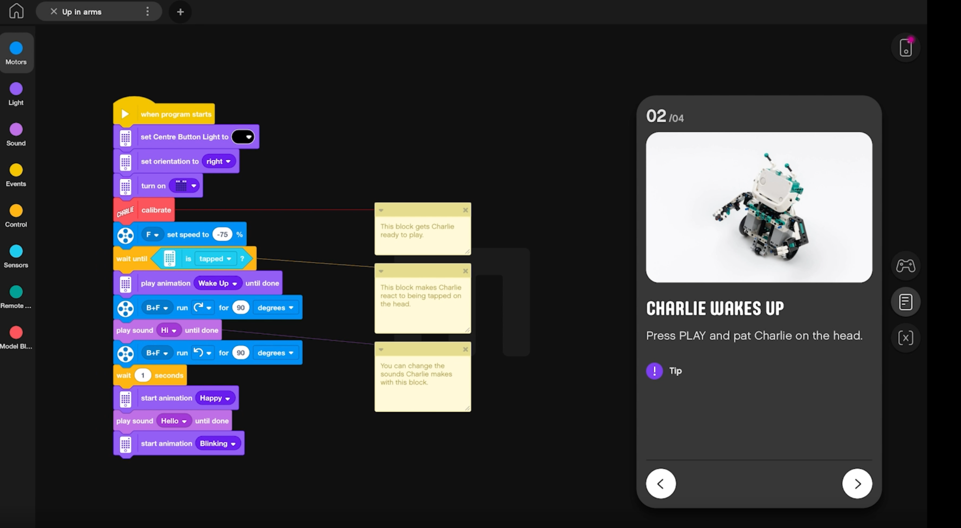
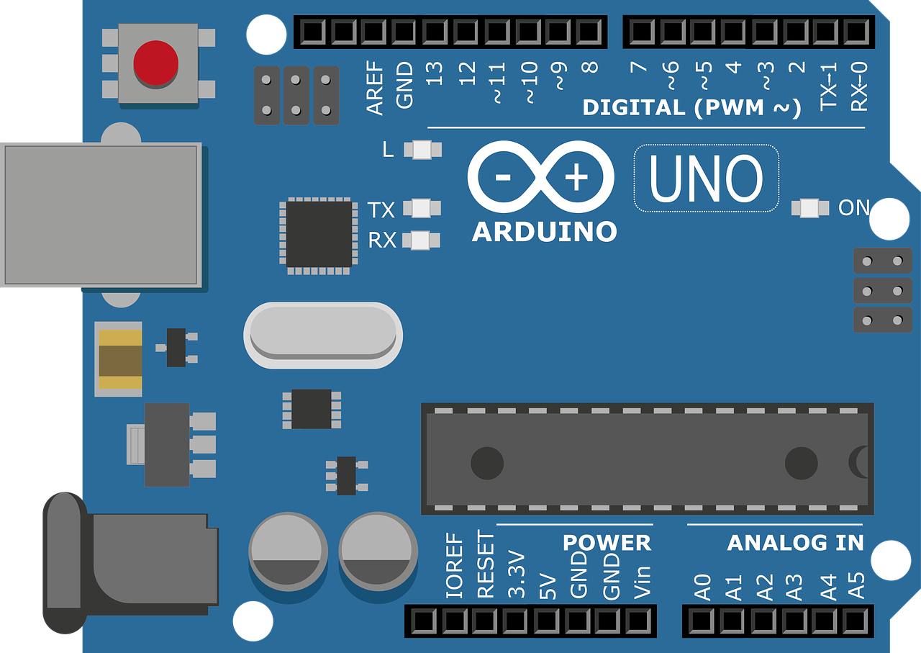
Background and Related work
Robots serve three primary roles in educational settings:
  surrogates for remote learners, programmable artifacts, and interactive learning companions
  LEGO Mindstorms
In K-12 AI education, platforms provide access to machine learning, conversational agents, and autonomous driving, but their limited variety and high costs hinder widespread adoption. Some tools blur the line between programmable artifacts and learning companions, showing potential for dual-function educational robots. Overall, there's a need for more affordable and diverse platforms tailored for young learners in AI education.

Slide 5
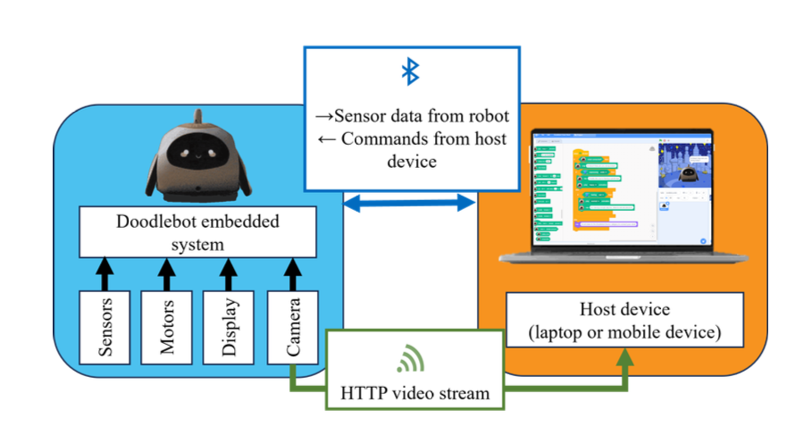
DOODLEBOT: DESIGN PROCESS

Slide 6
Robot Features and Components
LCD screen for display and animations.
Two stepper motors for precise movement.
Retractable pen for drawing.
Environmental sensors and onboard camera for interaction.

Slide 7
Robot Design Goals
Reliability: Durable components, long battery life
User-Friendliness: Easy setup, maintenance, and use
Versatility: Supports multiple use cases and AI topics

Slide 8
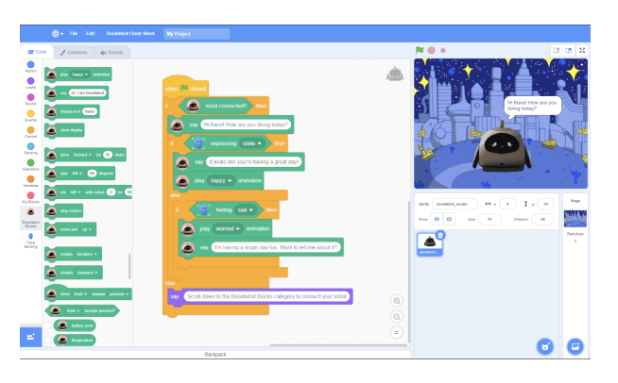
Programming socially assistive robots
AI Playground integration for block-based programming.
Teaching natural interaction and AI's societal impact.
Explore machine perception, reasoning and planning, machine learning, and social robotics

Slide 9
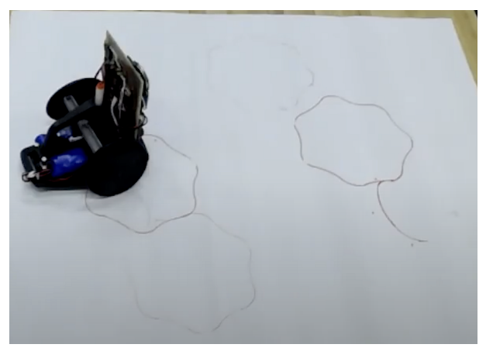
Collaborative Generative Drawing
Human-robot collaboration in creative tasks
Utilizing Sketch-RNN for generative drawing

Slide 10
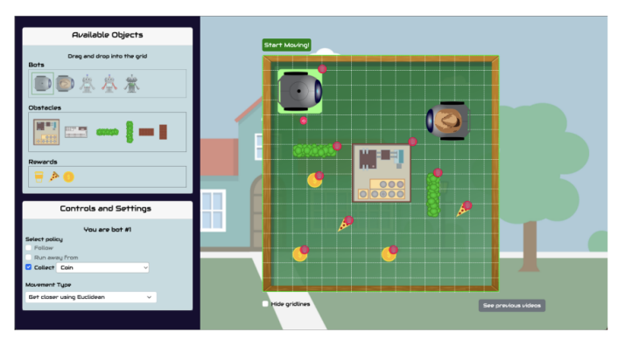
Frientelligent: Exploring multi-agent autonomous navigation
Game-based interface for exploring representation and reasoning.
Virtual and physical modes for different learning experiences.

Slide 11
User Study: Autonomous Navigation Curriculum
Research Questions:
How effective was the Autonomous Navigation Curriculum in teaching students about autonomous navigation?
How does the Physical Doodlebot interface compare to the Virtual one?
Participants:
Eight (7 female, 1 male) children between the ages of 9 and 11 (avg. 9.6-years-old) to participate in the study.
Each study session lasted approximately 60 minutes, with students working in pairs at each session.
Notes:
使用者研究：自主導航課程
我們設計了針對小學和初中青少年（6至14歲）的自主導航課程。我們設計了一項使用者研究，旨在回答兩個研究問題：（1）自主導航課程在教授學生自主導航方面的效果如何，以及（2）物理Doodlebot界面與虛擬界面相比如何？我們採用了混合方法進行數據收集和分析，以幫助我們回答這兩個問題。
參與者
我們招募了八名（7名女性，1名男性）年齡在9至11歲之間的孩子（平均9.6歲）參加研究。

Slide 12
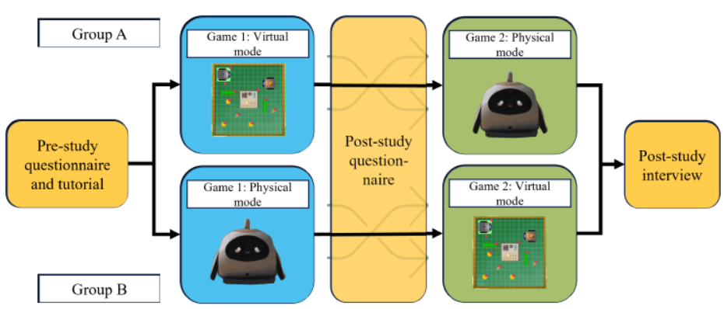
Procedure
Notes:
如圖7所示，參與者首先填寫了一份預問卷，然後完成了Frientelligent界面的教程。我們將參與者分為兩個條件，A組參與者先完成遊戲的虛擬版本，然後是實物版本，而B組參與者則從實物版本開始。每個人都試玩了兩個版本的遊戲，但交叉研究設計使我們能夠比較不同模式對他們的學習量和對Doodlebot的感知的影響。首先，參與者完成了前期研究問卷並完成了Frientelligent系統的視頻教程。然後，他們開始使用實物或虛擬界面玩多智能體遊戲。在參與者完成第一個版本的遊戲後，我們讓他們填寫一份後期研究問卷，然後參與者再次使用尚未玩過的遊戲模式進行遊戲。第二個遊戲結束後，學生對他們的經歷進行了後期訪談討論。
5.2.1 前後期研究問卷：前後期研究問卷包括與該研究介紹的課程相關的知識問題。問卷完全相同，以便我們可以衡量參與者在與第一遊戲模式互動後學到多少知識。
5.2.2 後期研究小組訪談：在會議結束時，我們與兩個參與者進行了一次簡短的非正式訪談，以獲取他們的反饋。我們分別詢問了虛擬和實體模式，收集了他們喜歡或不喜歡的事物，他們發現容易和困難的事物，以及他們希望在未來改進研究方式方面做出的改變。

Slide 13
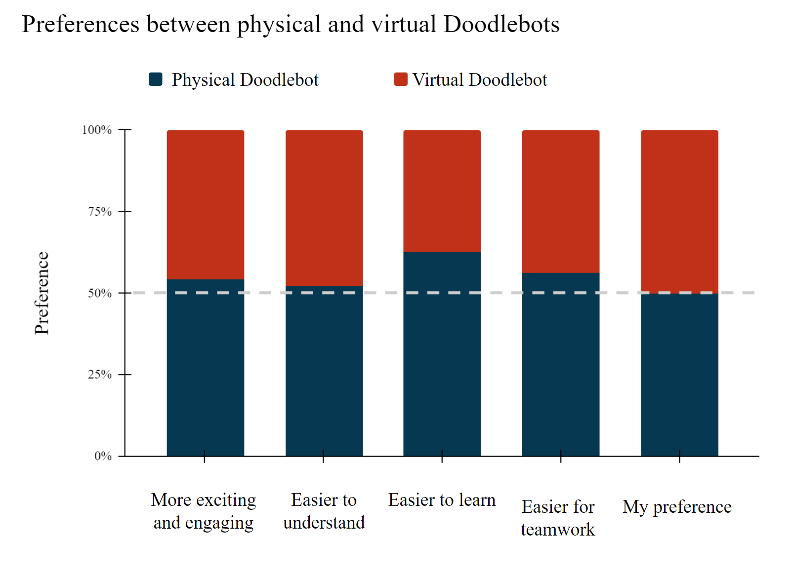
Data Analysis and Results
Virtual Doodlebot user interface
Physical Doodlebot
Virtual vs. physical modes
Learning outcomes
  Overall, the different game modes did not seem to have a signifcant impact on learning outcomes.
Notes:
資料分析與結果
5.3.1 虛擬Doodlebot使用者界面：在後期研究問卷中關於虛擬Doodlebot界面的可用性問題上，大多數學生表示他們認為該界面靈活、有趣且令人興奮。
5.3.2 實體Doodlebot：參與者對實體Doodlebot的可用性給予了高度評價。
5.3.3 虛擬與實體模式：在兩個條件組中，我們觀察到參與者在整個會話中的興奮、參與度和創造力。參與者傾向於對他們互動的第二種模式表現出輕微偏好，無論是虛擬還是實體模式。在我們直接比較兩個版本時，我們只觀察到對實體模式輕微的偏好（見圖9）。在虛擬模式下，觀察者注意到學生花更多時間設計地圖，而在與實體Doodlebot合作時，他們只花了幾分鐘來安排地圖。在實體遊戲模式下，學生更感興趣快速開始遊戲，以便能看到機器人移動。
5.3.4 學習成果：總的來說，不同的遊戲模式似乎對學習成果沒有顯著影響。學生在前測中表現良好，平均獲得10個問題中的7.6個正確答案。這在後測中留下了很少的提升空間（平均=7.8）。這一發現指向使用更適合學習材料的評估方法。我們要求學生自我評估他們在課程中討論的關鍵詞和技能的熟悉程度。在表2中顯示的結果顯示，學生對AI、自主導航、機器人政策和路徑規劃算法等關鍵詞的自我宣稱熟悉程度略有增加，但不顯著增加，以及規劃最佳路徑、設計地圖和使用AI產生積極影響等技能。我們得出結論，完全虛擬和實體界面都能有效地向兒童傳遞信息。通過引人入勝的基於Web的界面，參與者有更多的靈活性來設計他們的地圖。

Slide 14
Discussion & Conclusion
With the expansion of AI literacy courses beyond university computer science classrooms, education robots like Doodlebot are increasingly utilized to support students in learning AI.
Through collaboration with educators, low-cost and classroom-appropriate education robots have been successfully designed.
Examples from three courses illustrate Doodlebot's teaching approaches, including constructivist learning, collaborative drawing sessions, and game-based learning.
Doodlebot serves as an intelligent learning companion, supporting activities and personalized guidance.
Further research aims to validate the rationale behind the physical version of Doodlebot, expecting tangible expressions of technical concepts to deepen student engagement.
Notes:
隨著AI素養課程從大學計算機科學教室擴展到校園外，像Doodlebot這樣的教育機器人將越來越多地被用於支持學生學習AI。經過與教育工作者的合作，成功設計了低成本、適合課堂的教育機器人。Doodlebot通過運行使用者研究，根據教育工作者的反饋，價格定在100美元以下，並選擇了符合低成本的元件，同時不牺牲重要功能。為了提高可用性，開發了基於瀏覽器的工具，並提供了可觸及的對象進行互動。Doodlebot被設計為一個多用途的工具，涵蓋了多種AI主題，並實現了不同的教學方法。三個課程的示例展示了Doodlebot的教學方法，包括利用構造主義、通過設計學習的方法，合作繪圖課程以及基於遊戲的學習。此外，Doodlebot還可以作為智能學習伴侶，支持活動和個性化輔導。儘管使用者研究樣本量有限，但結果顯示Doodlebot在實體和虛擬版本中都同樣易於使用，並且實體版本未顯示出更引人入勝。然而，隨著對平台的進一步研究，將繼續尋找對實體Doodlebot版本的合理性的證明。期待實體Doodlebot在學生的物理空間中對技術思想的有形表現，從而促使學生與材料形成更深層次的聯繫。

