Slide 1
Generative AI for NFTs using GANs
Himanshu Tiwari, Ayush Raj, Ujjwal Kr. Singh, Hoor Fatima
2024 11th International Conference on Computing for Sustainable Global Development (INDIACom)

Slide 2
Introduction

Slide 3
Introduction
NFTs are digital assets, first developed on the Ethereum network and are now being adopted by Solana and a few other blockchains. The non-fungible characteristic of NFTs distinguishes them from their fungible cousins, such as cryptocurrencies like Bitcoin. Every NFT is a distinct digital asset that gives its owner clear ownership rights. Digital art based on Neural Field Theory (NFT) has the potential to become a fundamental element of immersive metaverse experiences as we explore the expanding metaverse, a virtual environment that obfuscates the boundaries between virtual and physical worlds.
Notes:
縱觀Zòng guān人類歷史，藝yi術一直是生活的基本面，是表達思想、情感和記憶的通用媒介。 但隨著數位革gé命後智慧型手機的興起和網路的便利使用，現在,人們重新需要在社群媒體和數位領域進行創意表達。 在社群媒體無所不在、數位環境不斷發展的現代數位時代，對電腦合成藝術的需求達到了頂峰Dǐngfēng。 然而，數位革命帶來的一個重大障礙Zhàng'ài是版權bǎnquán和所有權。 與實體藝術品相比，數位藝術品更容易複製和流通，因此失去了價值。 最近，針對這個問題出現了突破túpò性的解決方案就是（NFTs）。 NFTs 是一種數位資產，最初在以太坊網路上開發，現在被 Solana 和其他一些區塊鏈所採用。 每個 NFT 都是一種獨特的數位資產，其所有者擁有明確的所有權。 當我們探索tànsuǒ不斷擴kuo大的元宇宙 yǔzhòu 時，基於神經場理論（NFT）的數位藝術有可能成為身 lín qí jìng臨其境的元宇宙體驗的基本要素。

Slide 4
Introduction
The idea of creating digital art automatically has grown more appealing as a reaction to this problem. A novel strategy known as Generative Adversarial Networks, or GANs, holds the key to the solution. Generators and discriminators are the two models based on neural networks that make up GANs, or deep learning architectures. GANs have demonstrated state-of-the-art performance in a number of domains, such as picture and text generation, but their full potential for creating NFT art has not yet been reached. This work showcases an innovative convergence of generative artificial intelligence and blockchain technology, introducing a novel application for making NFT art using GANs.
Notes:
數位藝術的創作和銷售xiāoshòu zhúnián逐年增加。 然而，Zhìzuò製作數位藝術品是一個耗hào時的過程，需要對電腦程式碼和相關技術有深刻的理解。 為了解決這個問題，自動創作數位藝術作品的想法越來越xīyǐn吸引人。 一種被稱為 "生成對抗網路"（GANs）的新策略應運而生。 生成對抗網路指的是一種利用先進的人工智慧技術創造獨一無二的數位藝術品的方法，這些藝術品隨後可以作為 NFT 出售。
在這種情況下，人工智慧製作藝術品和改變人們對藝術的看法的能力比以往任何時候都更加明顯。 神經網路可以透過biànshì bǐchù辨識筆觸、色彩和陰影的模式，快速、可靠地將創作風格從一件作品轉移zhuǎnyí到另一件作品。 人工智慧藝術創作的這些發展提出了有關美學、創造力以及人工智慧在現代藝術中的地位等複雜問題。
The creation and selling of digital art have increased year by year. However, producing digital artwork is a time-consuming process that necessitates a profound comprehension of computer code and associated technology. The idea of creating digital art automatically has grown more appealing as a reaction to this problem. A novel strategy known as Generative Adversarial Networks (GANs). Generative Adversarial Networks refers to a method of creating unique, digital artwork using advanced AI techniques, which can then be sold as NFTs.
AI's ability to produce art and change how art is seen is more evident than ever in this situation. Neural networks can quickly and reliably transfer creative styles from one piece to another by recognizing patterns in strokes, colors, and shading. These developments in AI art production raise complex issues about aesthetic beauty, creativity, and AI's place in modern art.

Slide 5
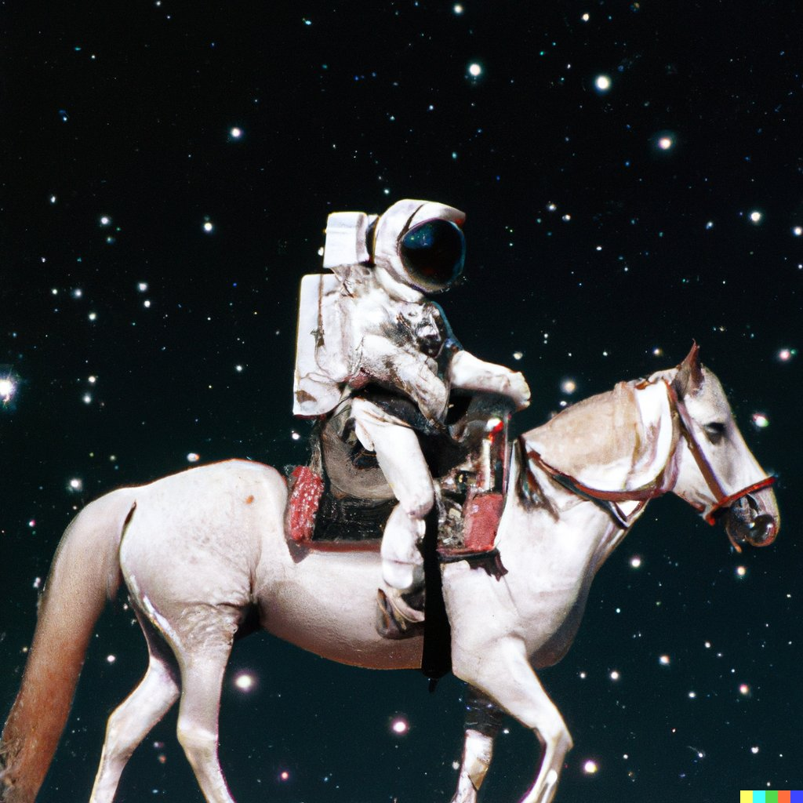
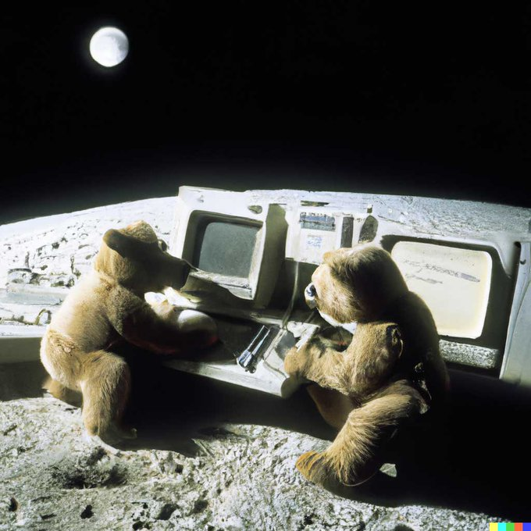

Instances of AI-generated content
Figure 1
Figure 2
Instruction 1:
An astronaut riding a horse in a photorealistic style.
Instruction 2:
teddy bear working on new AI research on the moon in the 1980s
OpenAI DALL-E 2
This is one example of the photographs that can be created swiftly using DALL E 2, an advanced model developed by Open AI.
Notes:
那現在我們來看一個AI 做image的例子。最近OpenAI 有develop一個模型叫DALL-E2。你可以輸入你一句話解釋你想要的圖片是怎樣。比如説在張圖裏面，ASTRONOUT riding 啊horse。那DALL-E2 會generated 跟著你輸入的那一句話。結果會長像figure 1。
本研究論文旨在探索人工智慧、區塊鏈和 NFT 的交叉點，深入研究人工智慧產生 NFT 藝術的新領域。 透過利用生成對抗網路（GANs）的功能，我們深入探討了人工智慧自主創造獨特而有價值的數位藝術品的潛qián力，這些藝術品不可分割ge，其所有權可在區塊鏈上驗證。
總之，將生成式人工智慧、區塊鏈和 NFTs 綜合在一起，將在當代藝術世界的最qiányán chéngxiàn 前沿呈現出一幅fu迷人的圖景。 本研究致zhi力於揭jiē開人工智慧生成的 NFT 藝術的神秘 面紗sha，chǎnmíng闡明其變革ge qianli潛力，並為其未來的發展指明方向。
This research paper aims to explore the intersection of AI, blockchain, and NFTs, delving into the novel realm of AIgenerated NFT art. By harnessing the capabilities of Generative Adversarial Networks (GANs), we delve into the potential for AI to autonomously create unique and valuable digital artworks that are indivisible, ownership of which is verifiable on the blockchain.
In summary, synthesizing generative AI, blockchain, and NFTs presents a captivating landscape at the forefront of the contemporary art world. This research endeavors to unravel the intricacies of AI-generated NFT art, shedding light on its transformative potential and charting the course for its future evolution.

Slide 6
2. The Generative AI History

Slide 7
History
Initially developed in the 1950s were primarily used to create sequential data, such as voice, and time series.
From N-gram models to recurrent neural networks like RNNs and LSTM, improving memory control and enabling systems to handle longer inputs.
Generative models in computer vision underwent a shift in 2014 with the
advent of Generative Adversarial Networks (GANs).
With the introduction of transformer architecture, Prominent big language models in NLP, such as BERT and GPT, have surpassed earlier designs like LSTM and GRU by using the transformer architecture as their primary building element.
Notes:
生成式AI一開始在1950年代被開發 使用像是Hidden Markov Models和高斯 Mixture Models，當時是被用來生成序列資料像是聲音和時間序列。
但是這些模型的能力和效果是有限的，直到深度學習出來才逐漸有進展。原本語句生成是利用n-gram language model，但這個model沒辦法準確分析文法，為了突破這個瓶頸，RNN和LSTM接連的被開發出來，特別是LSTM有著gating mechanisms 門控機制，裡面的Gated Recurrent Units (GRU)能有效提高記憶量，處理更多的輸入。
除此之外Learning-based的電腦視覺技術也從原本傳統的texture mapping演化到更先進的generative model，例如生成對抗網路、擴散生成模型和variational autoencoders (VAEs)，能夠穩定的生成更多樣、品質更高的圖像
接著在2017年一個重要的模型架構，transformer架構被發表了，許多著名的大型語言模型像是BERT、GPT開始出現，運算能力已經超越了先前的LSTM和GRU。這些模型主要使用transformer-based的技術像是Vision Transformer 和 Swim Transformer, 這些模型使的不同領域的模型開始能夠結合，去處理multimodal activities

Slide 8
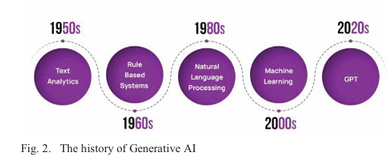
History
CLIP is a multimodal model that combines visual and linguistic information, enabling better task performance
Researchers are exploring transformer-based models like few-shot prompting and self-supervised contrasting learning for improving representations of modality-specific model.
Notes:
其中一種著名的multimodal 模型是CLIP，clip是一種圖形和語言的混合模型，它使用大量文本和照片訓練而成，能夠將文字和圖像匹配起來給出預測。
回到現在，近年來許多技術人員在transformer-based model上開發出了許多不同的架構，像是few-shot prompting model，透過提示來訓練的模型。還有像是研究自監督式學習來提高模型產生預測時的可信度

Slide 9
3. Methods
Notes:
接著我要介紹的是會使用到的技術，包含準備階段、模型的網路劫結構、和評估的方法

Slide 10
Step 1: Dataset and Pre-processing
The dataset includes NFT arts in gif, picture, and video files. Only the image files were used for this work. The art images reflect a wide variety of NFT arts and are not assigned to any one genre.
All the photos were downsized to 512 by 512 pixels, which is GAN architecture compatible.
Non-RGB color format photographs were eliminated.
Here were approx. sixty-five thousand photos left in the final dataset to be trained after this stage.
Notes:
第一點，這篇研究的資料及來自kaggle的資料集，這個資料集裏面包含了NFT的GIF檔、圖片和影像。那這篇研究只用到裡面的image file，這個file裡面包含了許多不同種類的NFT藝術品，並且沒有用標籤標記。
第二點，所有照片被處理成512x512像素大小，去符合GAN模型結構需求。
第三點，刪除所有非rgb色彩格式的照片
最後一點，最後大約有6萬5千筆照片做為資料來進行後續的訓練

Slide 11
Step 2: GAN Architecture and Setup
In this proposed application for generating NFT artworks, we utilized a model called Style GAN. Unlike models Style GAN has two methods that enable it to generate high definition face images; adaptive instance normalization (which adds an image style to each layer) and progressive growth (which produces high resolution images)

Slide 12
4. Result and Discussions

Slide 13
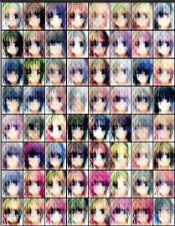
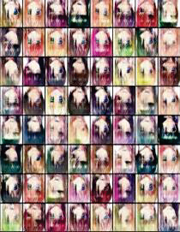
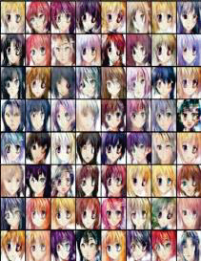
Result and Discussions

Slide 14
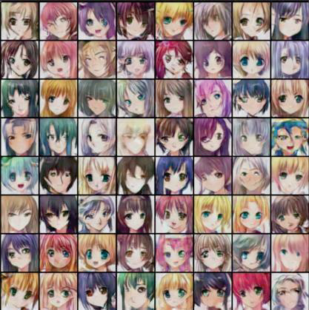
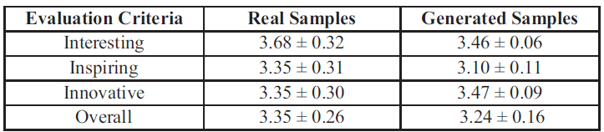
Result and Discussions

Slide 15
5. Conclusion

Slide 16
Conclusion
This study presented a GAN-based model application for creating NFT art.
NFT art dataset were used to train styleGAN2 model.
The result artwork exhibited quality and performed well according to FID and KID metrics.
The created artworks received a score of 3.24 out of 5, which is slightly lower than the score of 3.35 out of 5 for the original samples.
To enhance the quality of the generated art, it could be beneficial to explore conditional art generation techniques that focus on art styles or subjects.

