Slide 1
Comparative analysis of adversarial AI injection
attacks: A preliminary study
Masike Malatji
2024 International Conference on Artificial Intelligence, Computer, Data Sciences and Applications (ACDSA)

Slide 2
Abstract
This paper examines adversarial AI injection attacks in cybersecurity, such as adversarial example crafting, model evasion, and data poisoning. It explores their complexity, the vulnerabilities they exploit in AI systems, and the challenges in detection and tracing. The study highlights the evolving nature of these threats and their impact on AI security, emphasizing the need for better algorithmic resilience and detection methods. It concludes with recommendations for improved security protocols, continuous monitoring, and regulatory frameworks to combat these sophisticated threats.
Notes:
This paper examines adversarial AI injection attacks in cybersecurity, such as adversarial example crafting, model evasion, and data poisoning. It explores their complexity, the vulnerabilities they exploit in AI systems, and the challenges in detection and tracing. The study highlights the evolving nature of these threats and their impact on AI security, emphasizing the need for better algorithmic resilience and detection methods. It concludes with recommendations for improved security protocols, continuous monitoring, and regulatory frameworks to combat these sophisticated threats.
這篇論文探討了在網絡安全中的對抗性AI注入攻擊，例如對抗性示例的製作、模型規避和數據污染wuran。它探討了這些攻擊的複雜性、它們在AI系統中所利用的漏洞，以及檢測和追踪zhuīzōng的挑戰。這篇論文也強調了這些威脅的演變性及其對AI安全的影響，也還有強調需要更好的算法韌性rènxìng和檢測方法。論文以建議改進安全協議xiéyì、chíxù jiānkòng持續監控和監管框架jiānguǎn kuàngjià來對抗這些複雜的威脅作為結論。

Slide 3
Introduction

Slide 4
Introduction
Adversarial artificial intelligence injection attacks are a rapidly evolving threat in the cybersecurity landscape. These attacks exploit the vulnerabilities of machine learning models to manipulate or deceive them, leading to altered model behaviors that benefit the attacker. Unlike traditional injection attacks targeting software vulnerabilities, adversarial AI injection attacks exploit AI systems' underlying algorithms and data processing mechanisms. This new generation of attacks encompasses a range of techniques, including data poisoning, model evasion, and adversarial.
Notes:
在網路安全領域，對抗性人工智慧（AI）注入攻擊是一種快速發展的威脅。 這些攻擊利用機器學習（ML）模型的漏洞來操縱Cāozòng或欺騙它們，從而改變模型行為，（baca habis）使攻擊者受益Shòuyì。 與針zhen對軟體漏洞的傳統注入攻擊不同，對抗性人工智慧注入攻擊利用的是人工智慧系統的底層演算法和資料處理機制。 新一代攻擊包含一系列技術，包括資料中毒、模型規避和對抗性範例製作，每種技術都對人工智慧驅動系統的完整性和可靠性提出了獨特的挑戰。

Slide 5
2. Literature Review
Notes:
Wénxiàn zòngshù

Slide 6
Evolution of Injection
The rise of AI in cybersecurity has transformed traditional injection attacks into a new form known as adversarial AI injection attacks. Unlike conventional attacks like SQL and command injections that exploit software vulnerabilities, adversarial AI attacks target the algorithms and datasets of AI systems. These attacks manipulate AI to degrade performance or produce incorrect outputs, marking a significant shift in cybersecurity threats. This evolution demands a reassessment of security measures and the development of new defense mechanisms to protect AI-driven systems.
Notes:
The advent of AI in cybersecurity has brought about a significant evolution in the phenomenon of injection attacks. Traditionally, injection attacks primarily focused on exploiting vulnerabilities in software systems, such as structured query language (SQL) injection and command injection attacks, which manipulate input data to gain unauthorised control or access to information from a system. However, with the rise of AI/ML technologies, a new frontier for these attacks, known as adversarial AI injection attacks, has emerged. These attacks target the algorithms and datasets used in AI systems, manipulating them to degrade the system's performance or produce incorrect outputs. This shift from conventional software-based injection attacks to AI-centric attacks marks a significant transformation in the landscape of cybersecurity threats, demanding a reassessment of security measures and the development of novel defence mechanisms to safeguard AI driven systems
人工智慧在網路安全領域的興起將傳統的注入式攻擊轉變為一種新的形式，即對抗性人工智慧注入式攻擊。 與利用軟體漏洞的 SQL 和命令注入等傳統攻擊不同，對抗性人工智慧攻擊的目標是人工智慧系統的演算法和資料集。 這些攻擊操縱cāozòng人工智慧以降低jiàngdī效能或產生不正確的輸出，標誌著網路安全威脅的重大轉變。 這種演變要求對安全措施cuòshī進行重新評估，並開發新的防禦fangyu機制來保護人工智慧驅動的系統。

Slide 7
B. Type of Injection Attacks
There are three types of injection attacks:
Data Poisoning Attacks: Poisoned data can significantly impact the model's learning process, leading to compromised model integrity and biased or incorrect outputs.
Model Evasion Attacks:
  Small Perturbations: These attacks involve subtle changes to the prompt text that can significantly impact the output.
  Large Scale: These attacks involve crafting much longer and more complex prompts than the original prompt
Adversarial example crafting: Adversarial example crafting is a more specific model evasion attack involving creating carefully crafted input data to fool an ML model.
Notes:
Data poisoning attacks involve strategically injecting malicious data into the training dataset of an ML model. This poisoned data can significantly impact the model's learning process, leading to compromised model integrity and biased or incorrect outputs [8]. Identifying and mitigating data poisoning attacks is crucial for ensuring the robustness and trustworthiness of AI systems.
資料中毒攻擊是指有策略地將惡意資料注入 ML 模型的訓練資料集。 這種中毒數據會嚴重影響模型的學習過程，導致模型完整性受損sun，輸出結果有偏pian差或不正確。 識別和緩huan解資料中毒攻擊對於確保人工智慧系統的穩健性和可信度至關重要。
model evasion attacks are carefully crafted input data used to deliberately mislead AI models, causing them to misclassify or misinterpret the data. Unlike data poisoning attacks, model evasion attacks do not require any modifications to the model itself. Prompt injection attacks are model evasion attacks that involve crafting specially designed prompts to fool language models into generating text inconsistent with the prompt or even harmful. Prompt injection attacks can be categorised into two main types
逃避攻擊Evasion attack是網絡攻擊者用來繞rao過安全系統檢測的技術，使他們能夠在不被注意的情況下進行惡意活動。這種攻擊在機器學習（ML）和人工智能（AI）安全系統的背景下尤為相關。逃避攻擊的目標不僅僅是避免被檢測，還要盡可能長時間地保持對目標系統的訪問，從而促cu使提取敏感信息、傳播惡意軟體或進行其他惡意活動。那逃避攻擊與資料中毒攻擊是不一樣，模型規避攻擊不需要對模型本身進行任何修改。 提示注入攻擊是一種模型規gui避攻擊，它透過製作專門設計的提示來欺騙qipian語言模型，使其產生與提示不一致甚至有害的文字。 提示注入攻擊可以分為兩大類
小擾動： 這些攻擊涉she及對提示文字的細xi微改動，但會對輸出產生重大影響。 例如，攻擊者可能會更改提示文字中的一個單詞，導致模型產生不同的、可能有害的文字。
大規模： 這類攻擊涉及製作比原始提示更長、更複雜的提示。 這些提示可以控制模型的決策過程，迫po使其產生與攻擊者目標一致的文字。
Lastly, adversarial example crafting is a more specific model evasion attack involving creating carefully crafted input data to fool an ML model. Adversarial examples are often made using specialised algorithms that can exploit the particular characteristics of the target model. Detecting and preventing adversarial examples is challenging due to their ability to evade human detection.
最後，對抗性範例製作是一種更具體的模型規避攻擊，涉及創建精心製作的輸入資料來欺騙 ML 模型。 對抗性範例通常使用專門的演算法製作，這些演算法可以利用目標模型的特定特徵。 由於對抗性範例能夠躲duo避人工檢測，因此檢測和預防對抗性範例具有挑戰性。

Slide 8
3. Methods

Slide 9
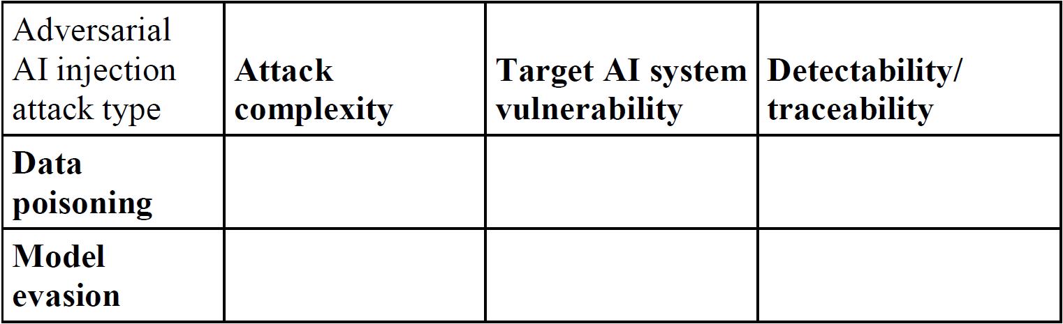
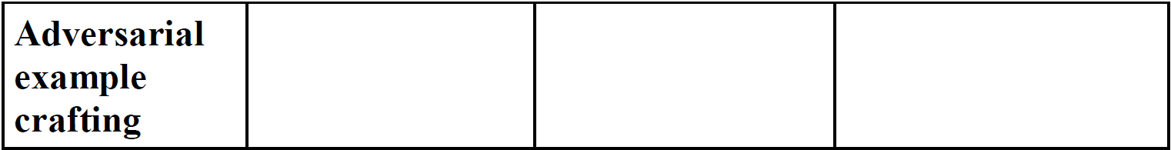
Theoretical Framework for Comparison

Slide 10
Data Source
The primary sources of information is come from Academic Papers. This papers aim to:
to address the shortcomings of current SQL injection detection techniques
to investigate the potential security issues related to the use of ML algorithms and to explore defensive techniques to protect ML algorithms against adversarial attacks
to address the advanced false data injection attacks in cyberphysical systems and propose detection methods for such attacks

Slide 11
4. Results and Discussions

Slide 12
Results
No. | Attack type | Attack complexity | Target AI system vulnerability | Detectability / traceability
4 | Adversarial example crafting | Proposed black-box attack method using RL | Differences in parsing logic between libinjection and actual database products | Detection and escape rates used to evaluate attack model performance
14 | Data poisoning attacks | Advanced false data injection (AFDI) attack | Vulnerability in cyber physical systems | Existing detectors have limitations in detecting AFDI attacks
15 | Model evasion attacks | The subtle adversarial noise can easily fool deep learning based AI systems. | The subtle adversarial noise can easily fool deep learning based AI systems. | Adversarial attacks can fool deep learning AI systems.
Notes:
接著我要介紹作者蒐集完paper後的比較結果，首先看到第一個參考編號4的paper，和SQL的injection attack檢測技術有關，這篇論文使用的攻擊方法是Adversarial example crafting對抗式樣本生成，這種攻擊的目的是製造能夠誤導模型的特定輸入，這些特例被設計成在人眼看來與正常輸入相似，卻使模型產生錯誤的預測。
攻擊的複雜度的話剛有提到跟技術有關，這個攻擊算是一種黑箱式的攻擊，著重於對輸入資料的修改，同時需要對欲攻擊的模型有一定的了解，並利用梯度優化、最佳化技術等方法來生成對抗性案例。
脆弱程度的話，這邊提到libinjection和actutal database的差別，libinjection主要用於檢測和防止SQL注入攻擊，通常使用正則表達式來識別SQL語句中的特定模式，如單引號、分號等，並通過比對這些模式來判斷是否存在注入攻擊的風險；實際的資料庫也有內置的防護機制來防止SQL注入攻擊，但它們的主要目標是實現有效的SQL解析和執行。因此如何在有效執行SQL的同時又能確保安全性就決定了模型的脆弱程度。
最後是這個攻擊是否容易偵測，這根要攻擊的model的detectopn和escape rate有關。
第二個攻擊的類別屬於Data poisoning attacks，中文叫做資料汙染攻擊，他來自一篇對Cyber-Physical System虛實整合系統對注入攻擊防禦的論文，是一種針對機器學習模型的攻擊技術，透過在通過修改訓練數據集或者注入有意義的惡意數據來影響模型的性能和預測結果，這種攻擊利用了機器學習模型對於訓練數據的敏感性，以改變模型的行為或降低其準確性。
模型的複雜度，這個攻擊使用的技術是叫做Advanced false data injection (AFDI) attack，也是一種針對機器學習的偽造數據攻擊，但與傳統的資料污染攻擊不同，它更加精細和專業化，攻擊者可能通過各種手段來製造與真實數據非常相似但對模型產生錯誤影響的偽造數據。這些偽造數據可能包括對於特定模型具有迷惑性的特徵模式、隱藏的輸入噪音、故意引導模型錯誤的樣本等等。
目標AI系統的脆弱性在這邊提到的是和虛實整合系統本身是否具備良好的防禦機制有關。
然後在可檢測性方面提到目前的偵測技術能以避免來自AFDI的威脅
第三篇論文在探討深度學習AI其實很容易被細微的對抗式噪音影響，這裡的攻擊類別屬於Model evasion attacks，目标是通过误导模型来使其产生错误的输出或不准确的预测，攻击者主要关注模型的预测结果是否可以被欺骗。
複雜度的部分，因為模型容易就被對抗式噪音影響所以攻擊的複雜度並不高，同時也代表模型的脆弱性根據其結構決定。
最後是這個攻擊的可偵測性，提到說可以騙過深度學習的AI，所以要被偵測有一定的難度存在

Slide 13
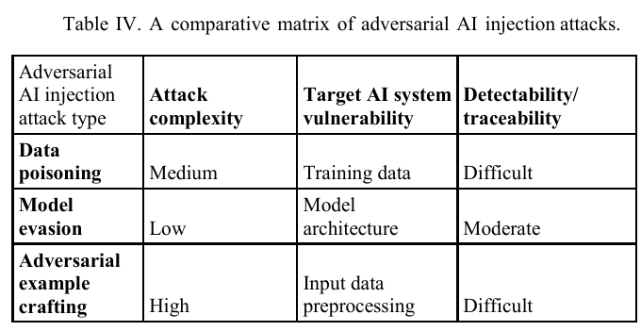
Findings
Notes:
接著這邊是根據作者整理出來的paper，所得到的發現、統整：
對對抗式AI注入攻擊的分析進行共通和差異的檢查後，可以發現一個潛在的現象，即AI系統中的漏洞容易被利用，並且存在著重大的檢測性和可追蹤性障礙。這些攻擊的共通就是都很複雜。然而，它们在特定目標和方法上存在差異：對抗式樣本生成攻擊主要操粽输入數據來欺騙模型，Model evasion attacks利用演算法中的固有的弱点進行攻擊，而資料汙染攻擊則策略性地改變訓練數據以破壞模型的學習過程。此外，这些攻击类型的复杂程度和可偵测性各不相同，这突顯了它们在威胁程度上的差异，以及在开发有效的應對措施方面所面临的挑战。

Slide 14
Conclusion
Concluding remarks
Recommendations
Limitations and future research
Notes:
首先是Concluding remarks，這篇研究顯示了對抗式AI注入攻击的复杂性和多樣性，要求各方共同努力，包括先进的技术解决方案、合作研究计划、政策制定和道德考量，以有效打擊這個近年不斷增加的威胁。
第二個是有關建議的部分，我們應該透過全面的方法來壓制injection attack，像是針對不同AI強化其安全協議來改善模型的演算法，可以透過對抗式訓練和開發複雜的偵測工具來實現。為參與人工智慧開發的相關人員提供完善的訓練計劃也同樣重要。對ai系统進行持续監控和更新，同时關注新出现的威脅，將有助於主動防禦，同时應制定有效的的事件應對計畫，以有效管理和缓解攻击。最后，促进公私合作關係可以充分利用各种资源和專業知識，從而为應對此類複雜的網絡威脅提供更全面的解决方案。
最後是有關限制和未來發展，這篇paper介绍的研究结果是正在进行的更廣闊研究的一部分。目前的分析僅限於這幾篇論文，因此有必要進一步探討更廣泛的論文和比較分析因素。

