Slide 1
Adversarial Attacks and Defenses for
Deployed AI Models
Kishor Datta Gupta, Dipankar Dasgupta
2022 IEEE 34th International Conference on Tools with Artificial Intelligence (ICTAI)
Notes:
今天我們要報是已部署 AI 模型的對抗性攻擊和防禦yu

Slide 2
Introduction
With the surge in the adoption of AI/ML techniques in industry, adversarial challenges are also on the rise and defense strategies. It is crucial to formulate new attack methods and devise novel defense strategies for coverage and robustness. In particular, which components of the learning system are vulnerable to what type of adversarial attacks, and the expertise needed to realize the severity of such adversarial attacks. Also, how to evaluate and address the adversarial challenges to recommend defense strategies for different applications. So, in this paper it will discuss on the skill set needed to examine and implement various defenses for emerging adversarial attacks
Notes:
隨著AI/ML技術在產業的guǎngfàn cǎiyòng廣泛採用，對抗性挑戰亦yì隨之增加，防禦yu策略變得重要。制定新的攻擊方法和構思gòusī創新的防禦策略對於Fùgài覆蓋範圍和wěnjiàn穩健性至關重要。特別是需要識別學習系統的哪些組件對於何種類型的對抗性攻擊是脆弱的，以及實現對這些對抗性攻擊嚴重性認識所需的專業知識。此外，tàntǎo探討如何評估和解決對抗性挑戰，以推薦適用於不同應用的防禦策略也是必要的。因此，本文將討論檢查和Shíshī實施zhēnduì針對新興對抗性攻擊的各種防禦所需的技能集。

Slide 3
Adversarial Attacks(AAs) and Their Strange Nature
Adversarial attacks are a type of cyber threat targeting machine learning (ML) models, where attackers craft inputs specifically designed to cause the model to make a mistake. The goal of AAs is to manipulated data in various malicious way, leading to incorrect outputs or decisions. The concept highlights potential vulnerabilities in AI and ML systems, particularly in applications where security a
nd reliability are critical, such as autonomous vehicles, facial recognition, and spam detection.
Notes:
對抗性攻擊是一種針對機器學習（ML）模型的網絡wēixié,威脅，攻擊者特別設計輸入，以導致模型出錯。對抗性攻擊（AAs）的目標是以各種 èyì惡意方式cāozòng 操縱數據，導致不正確的輸出或決策。這一概念突出了AI和ML系統的qián潛在脆弱性，特別是在安全和可靠性至關重要的應用中，比如自動jiàshǐ駕駛車輛、面部識別和垃圾郵件jiǎncè檢測。

Slide 4
Adversarial Attacks(AAs) and Their Strange Nature
AAs can be defined into three basic types as follows,
Poisoning Attack: Such attacks change ML training data and occur during the training time.
Evasion Attack: Inputs change in a way resulting in misclassifying a sample to another random or targeted class. Such an attack happens in production.
Trojan AI Attack: intend to change model’s architecture or internal parameters in a way, it misclassified the input. It can happen during the ML model setup or updating delivered systems as drive-by downloads.
Notes:
對抗性攻擊有三種basic types就是，
1. Dúhuà毒化攻擊poisoning attack 那個是一種針對機器學習（ML）系統的網絡攻擊，旨在損害zhǐ zài sǔnhài其完整性或性能。其mudi目的是通過將eyi惡意數據引入到訓練數據集中，從而破壞模型的學習過程，影響其未來的預測或分類。
逃避攻擊Evasion attack是網絡攻擊者用來繞過安全系統檢測的技術，使他們能夠在不被注意的情況下進行惡意活動。這種攻擊在機器學習（ML）和人工智能（AI）安全系統的背景下尤為相關。逃避攻擊的目標不僅僅是避免被檢測，還要盡可能長時間地保持對目標系統的訪問，從而促cu使提取敏感信息、傳播惡意軟體或進行其他惡意活動。
特洛伊yi AI攻擊Trojan AI Attack，也被稱為AI後門攻擊，shèjí涉及在機器學習（ML）模型中qiànrù嵌入一個yǐncáng隱藏的惡意功能，攻擊者可以在特定條件下Jīhuó激活。
A poisoning attack is a type of cyber attack that targets machine learning (ML) systems with the intent to compromise their integrity or performance. The goal is to corrupt the model's learning process by introducing malicious data into its training dataset, thereby affecting its future predictions or classifications.
An evasion attack is a technique used by cyber attackers to bypass detection by security systems, enabling them to carry out malicious activities without being noticed. This kind of attack is particularly relevant in the context of machine learning (ML) and artificial intelligence (AI) security systems. The goal of an evasion attack is not just to avoid detection but also to maintain access to the targeted system for as long as possible, facilitating the extraction of sensitive information, the delivery of malware, or other nefarious activities.
A Trojan AI attack, also known as an AI backdoor attack, involves embedding a hidden malicious functionality within a machine learning (ML) model that an attacker can activate under specific conditions.

Slide 5
Limitations of ADs
Adversarial training diminishes the ML model’s accuracy
Need to retrain the model whenever new attack samples are discovered
The processing techniques are static, they do not evolve alongside the attack.
Strong transfer potential of adversarial samples across neural network models can expose the system to attacks.

Slide 6
Should we care about AAS?
Difficult to formulate, environmental factors, standard filters, adversarial detection
Do we need to care about AAs?

Slide 7
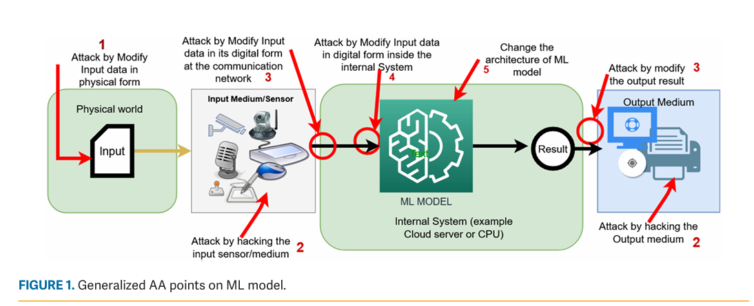
Should we care about AAS?

Slide 8
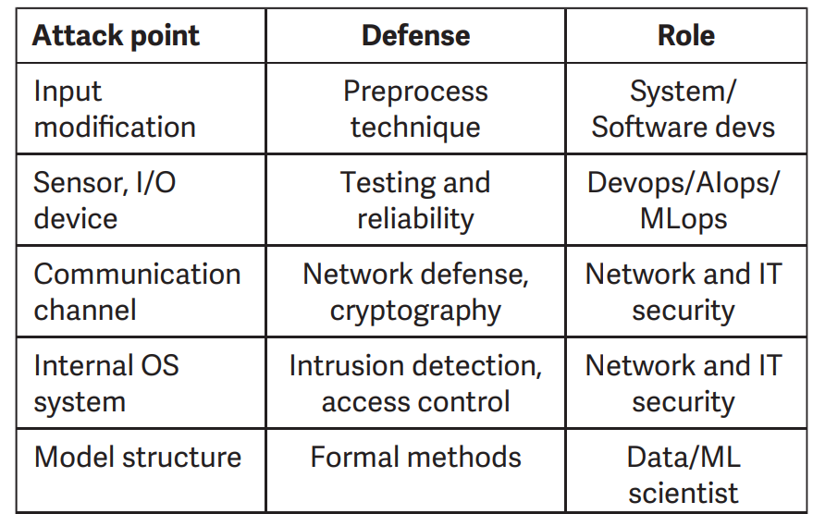
Who will Enforce The Defence?
Attack points and relevant responsible professional.

Slide 9
Conclusion
ADs are interconnected with other cyber- and network-infrastructure security domains
There is very limited of research for ADs in deployed AI/ML-based systems, which need higher priorities before releasing AI-based products to market.
Adaptive attacks and TrojAI attacks are the most challenging, which will require end-to-end protection to defend AI/ML-based systems.
Defense against AAs needs a collaborative approach between network, data, firmware, hardware, OS, cloud security.

