Slide 1
Deep Learning-driven Explainable AI using Generative Adversarial Network (GAN)
Jitendra Maan
IEEE 19th India Council International Conference (INDICON) 2023

Slide 2
Abstract
Human decisions are influenced by machine driven AI systems and it is essential to trust the outcome of such systems to justify the decisions.
Bias in AI Systems erode trust between humans & machines that learn together.
Transparency and fairness in the predictions of such models is of a major concern across various business domains.

Slide 3
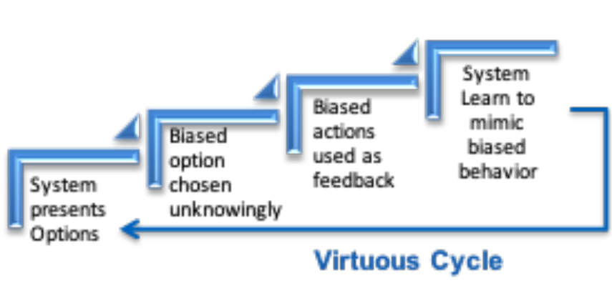
Introduction
Model fairness and explainability has become a major challenge associated with machine learning models which are developed and trained with biased datasets along with sensitive attributes like race, caste, geographical location, sex etc.
Biases in AI Systems not only erode the trust between human & machines.

Slide 4
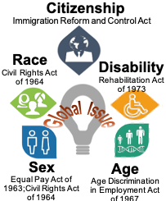
Background Work and Related Study
Nearly 9 out of 10 Organizations across industries have encountered ethical issues.
Several global issues arising due to antidiscrimination laws on Citizenship, Race, Disability, Sex, Age and so on.
Examples for unfair and opaque models:
Disparate treatment
Disparate impact

Slide 5
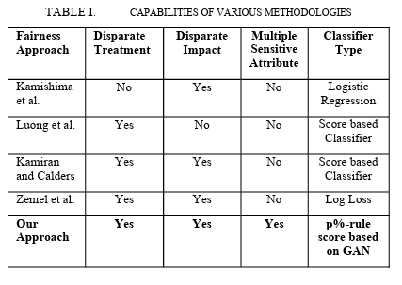
Background Work and Related Study
This paper mentions five ways to address Disparate treatment and Disparate impact generated by the model:

Slide 6
Key Challenges
1. Biases in AI Systems erode trust between humans & machines that learn together.
2. Machine learning models and algorithms are subject to few regulations, amplify human biases, leading to unfair outcomes.
3. Biased data used to train Machine learning model contains implicit racial, gender or ideological biases
4. Scores of ML Algorithms considered “Black Boxes” giving no insights on their decisions.

Slide 7
Modeling Technique and Methodology
The steps of modeling technique：
Classifier accuracy and P%-rule value is calculated based on the regular neural network.
Created a 3 layer Neural Network (with Dropout and activation layer as : ReLU).
Compile the classifier Neural Network.
Compile classifier with adversarial network.
Compile adversarial Network with loss function as binary cross-entropy and optimizer='adam'

Slide 8
Modeling Technique and Methodology
6. Compute class weights of the training set
7. Compute class weights of the target set
8. Pretrain Classifier and adversarial network on initial data set
9. Leveraged Adversarial Neural Network to increase the p%-rule to make the model more fair. If the regular neural network does not satisfy the p-rule value, we use Adversarial Neural Network and then check for the accuracy and the new p-rule value.
10. Train and test the accuracy and fairness of the model against sensitive attributes

Slide 9
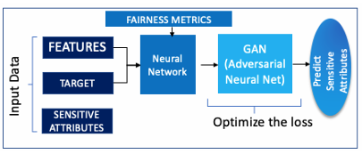
Neural Network Based Solution Architecture
A. Proposed Architecture based on Neural network

Slide 10

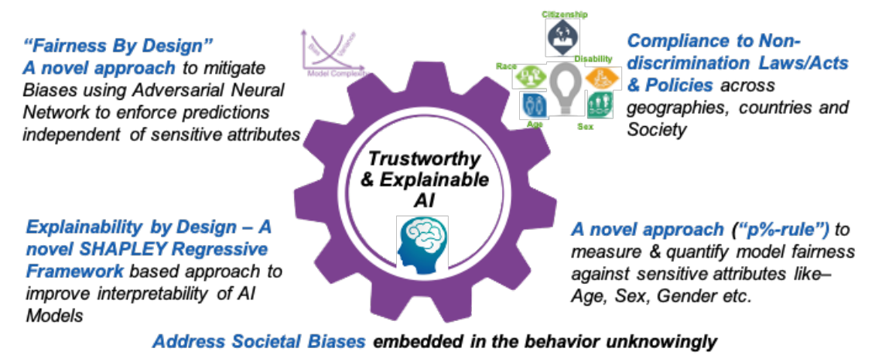

B. Salient features of the solution
Notes:
The diagram below depicts the most salient features of proposed solution to mitigate biases to make fair and transparent decision by machine learning models. “Fairness By Design” and “Explainability by Design” are some of the tenets that serve as a foundation of proposed methodology.
Fairness by design is a novel approach to mitigate biases using ANN to enforce predictions independent of sensitive attributes
Explainability by design. A novel shapley regressive framework based approach to improve interpretability of AI models
上圖描述了建議解決方案的最顯xian3著zhu\特點，即透過機器學習模型減少偏見，從而做出公平透明的決策。 "公平性設計 "和 "可解釋性設計 "是作為建議方法基礎的一些原則。
公平性設計是一種新穎ying3的方法，可利用 ANN 減少偏 -差 -，從而執zhi/行獨立於敏感屬性的預測。
可解釋性設計。 基於 Shapley 迴歸框kuang\架的新方法可提高人工智慧模型的可解釋性

Slide 11
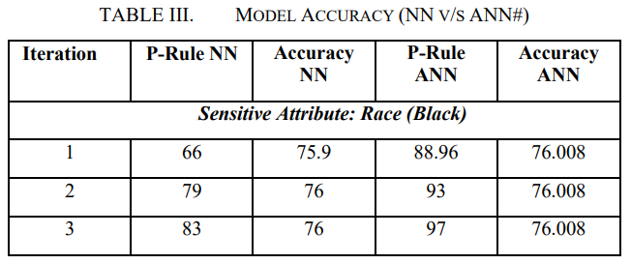
Experimental Result
Notes:
In above table, predictive accuracy of unfair classifier is 75.9%. Here, the results reflect the value of p%-rule for NN Classifier is just 66 while keeping the threshold at 95. We executed the adversarial neural network in iterations to check the result. After running the adversarial neural network, we got an accuracy of 76.008. It clearly signifies, accuracy of the target model is maintained. The P-rule is 88.96 which is again not satisfying our threshold value (i.e. 95%) but still it is giving us much better value.
In all experiments, this paper method to develop model using adversarial neural network is comparatively much fairer and unbiased than the regular neural network without compromising much on predictive accuracy of the neural network.
下頁是實驗結果，
在這邊這論文有比對 Neural net 跟 adversarial Neural net 的outcomes。那我們可以看上述shu表格中，我們會看如果使用NN模型，他的accuracy只能拿到75.9% 但如果使用 adversarial neural net 他的outcome 比neural net 好,就是76.008%。雖然不是差很多，但仍然提供了更好的value。
那從這實驗我們可以做一個結論就是對抗性神經網絡開發模型的方法相對於常規神經網絡來說就是可以更加公平和無偏。
不公平分類器的預測準確度為75.9%。在這裡，結果顯示了保持閾值為95%的NN分類器的p%-rule僅為66。我們對對抗性神經網絡進行了多次迭代以檢查結果。在運行對抗性神經網絡後，我們得到了76.008的準確度。這清楚地表明了目標模型的準確性得以保持。P-rule為88.96，這再次未達到我們的閾值值（即95%），但仍然提供了更好的值。
在所有實驗中，本文利用對抗性神經網絡開發模型的方法相對於常規神經網絡來說更加公平和無偏，而且並沒有在神經網絡的預測準確度上做出太多妥協。

Slide 12
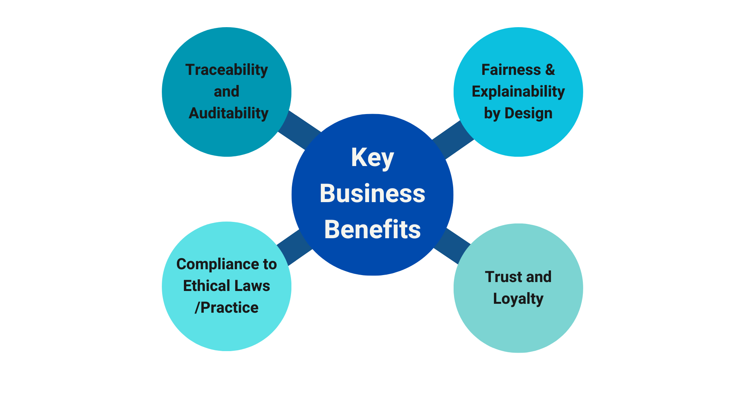
Business benefits
Facilitate traceability and Auditability of AI systems against legal, regulatory and GDPR requirements
Responsible AI toolkit for practitioners to monitor & evaluate fairness of machine learning model and explain Model Outcome
Responsible AI adhere to ethical principles - Fairness, Non-discrimination and racial disparities
Ethical AI interactions to drive positive experience, trust and loyalty
Notes:
下頁是商業效益
將道德考量納na入ruAI系統不僅確保公平性，還對組織的成功和聲譽yu產生積極影響。通過優先考慮4個keys就是 traceability, fairness, compliance, 和 trust，這樣的話業務可以建立持chi續和負責任的AI解決方案。
1. Traceability and Auditability。通過traceability，organizations能夠洞dong\察AI模型決策過程。所以呢業務會了解預測是如何做出的，從而更好地負責。再加上traceability有幫助管理與模型行為相關的風險。
2. Fairness and Explainability by Design 這個key是確保人工智能模型的Fairness 和 transparency，所以fair model能夠與客戶建立信任和透明度防止歧qi/視shi性做法。
3. Compliance to Ethical Laws/Practices，那業務可以避免法律處罰fa/、聲-譽損sun3害，並促進負責任的人工智能採用。
4Trust and loyalty, 當客戶認為AI系統透明 和 ethical他們會信任我們的業務。那這樣的話會影響業務，因爲我們可以拿到客戶的loyality。是因爲有信任，信任導致忠實的客戶，他們會信任組織的價值觀。

Slide 13
Conclusion & Future Work
Conclusion: Proposed an adversarial Neural Network based machine learning method which not only evaluate the fairness of the model against sensitive attributes (age, race, gender, sex and so on) to help mitigate the biases without losing much accuracy but improve transparency through interpretability of the model which clearly explain how a particular model arrive to a certain decision.
The future work: To refine Adversarial Neural Network performance and also develop a full-fledged Responsible AI toolkit to make unbiased, fair and trustworthy decisions with model explainability to build trust on model outcome from different stakeholders
Notes:
Due to pervasiveness of machine learning based insights across industry sections, organizations are more relying on everyday decision-making using AI systems, there is a paramount importance to accurately predict fairness in the model outcome. Proposed regenerative network method can help in detecting, understanding and mitigating discrimination and biases in datasets.
The proposed solution also provides some metrics to check for unwanted and unnoticed bias in datasets and machine learning models, and state-of-the-art algorithms to mitigate such bias. Next step is train and test ANN models with varying nature of contextual dataset and improved quantitative measures.
The future work is to refine Adversarial Neural Network performance and also develop a full-fledged Responsible AI toolkit to make unbiased, fair and trustworthy decisions with model explainability to build trust on model outcome from different stakeholders.
結論：在當今的數字化世界中，人們對機器驅動人工智慧系統的結果必須保持信任，以合理化他們的決策。然而，使用偏見數據集和敏感屬性訓練的機器學習模型存在公平性和可解釋性，這是其中的主要風險之一。提出的解決方案是基於對抗性神經網絡的機器學習方法，不僅評估模型對敏感屬性的公平性，幫助減輕偏見，而且通過模型的可解釋性改善shan\了透明度，清楚解釋了模型如何做出決策。
未來的工作是優化對抗性神經網絡的性能，並開發一個完整負責任的人工智能工具包，以做出無偏見、公平和值得信賴的決策，並提供模型可解釋性，以建立來自不同利益yi相關者對模型結果的信任。

